Slide 1
Comparison between mechanical configurations for C-ions gantry
A first proposal
E. Felcini
20/09/2021

Slide 2
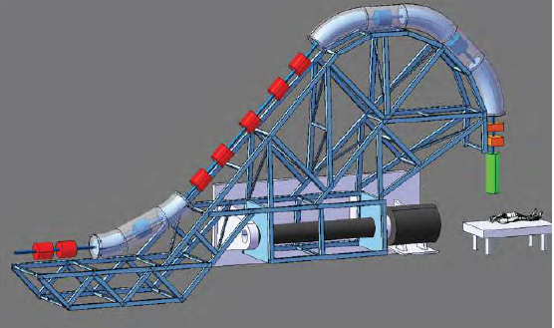
SIGRUM mechanics
The mechanics of the SIGRUM gantry, presented in the last year report [1], is based on a rotating structure attached to the wall that allows a rotation in the order of 180-220 degrees around the patient.
This solutions promises a strong reduction of gantry weigh, footprint (in combination with SC magnets) and costs.
[1] U. Amaldi et al., SIGRUM, A Superconducting Ion Gantry with Riboni’s Unconventional Mechanics, TERA-CERN, 11/2020

Slide 3
Clinical requirements
Three main requests emerged during the discussion with CNAO and MedAustron clinicians:
360° rotation is requested. A rotation reduced down to 220° rotation could be accepted. Less than 220° is basically not an option.
Volumetric imaging at the isocenter is requested.
→ Around the patient or mounted on the gantry, we should foreseen an imaging system.
Large scanning field is requested. 30 cm (along the axis of rotation) x 20 cm (transverse to the axis of rotation) is considered a good value. 40 cm x 40 cm would be ideal.
→ complexity and positioning of scanning magnets could affect the overall size of the gantry
These requests must be evaluated in terms of cost and benefits and used as guidelines for the design.

Slide 4
Comparison criteria
Different configurations (e.g. 220 vs 360 deg.) must be evaluated with common criteria.
The cost estimation would provide a solid and easy parameter for the comparison*
The same work is ongoing for all the main aspects, i.e. mechanics, magnet design,
beam optics solutions, building costs, etc.
*(so that we can compare apples with apples)

Slide 5
Comparison criteria
Different configurations (e.g. 220 vs 360 deg.) must be evaluated with common criteria.
The cost estimation would provide a solid and easy parameter for the comparison*
We propose to use the following parameters:
Footprint and weight
Estimated cost of the structure
Required R&D: cost and time
Design feasibility in 3 years
(estimated probability of success)
These can be considered as the main cost parameters related to the mechanical structure and should include building and operational costs.
*(so that we can compare apples with apples)

Slide 6
Comparison criteria
Different configurations (e.g. 220 vs 360 deg.) must be evaluated with common criteria.
The cost estimation would provide a solid and easy parameter for the comparison*
We propose to use the following parameters:
Footprint and weight
Estimated cost of the structure
Required R&D: cost and time
Design feasibility in 3 years
(estimated probability of success)
Size (length and height) and weight are usually used as comparison parameters between gantries.
Beyond the relation with the structure costs, the concept of a compact and light gantry can attract more funds (and interest from future possible buyer)
*(so that we can compare apples with apples)

Slide 7
Comparison criteria
Different configurations (e.g. 220 vs 360 deg.) must be evaluated with common criteria.
The cost estimation would provide a solid and easy parameter for the comparison*
We propose to use the following parameters:
Footprint and weight
Estimated cost of the structure
Required R&D: cost and time
Design feasibility in 3 years
(estimated probability of success)
A too ambitious and aggressive design could be a major threat for the project
*(so that we can compare apples with apples)

Slide 8
Comparison criteria
Different configurations (e.g. 220 vs 360 deg.) must be evaluated with common criteria.
The cost estimation would provide a solid and easy parameter for the comparison*
We propose to use the following parameters:
Footprint and weight
Estimated cost of the structure
Required R&D: cost and time
Design feasibility in 3 years
(estimated probability of success)
This is just a first proposal for the comparison parameters and the goal of this meeting is to define with you (the experts!) the best and most effective choice.

Slide 9
Comparison criteria
After the discussion with CERN we agreed on the following parameters (red text was added after the discussion):
Footprint and weight
Tolerances and precision
Estimated cost of the structure
Required R&D: cost and time
Design feasibility in 3 years
(estimated probability of success)

