Slide 1
Review of Protection Dumps in 2010
Analysis of suspicious events, are there potential holes ?
Are tools and procedures adequate?
Envisaged changes for 2011 run

Slide 2
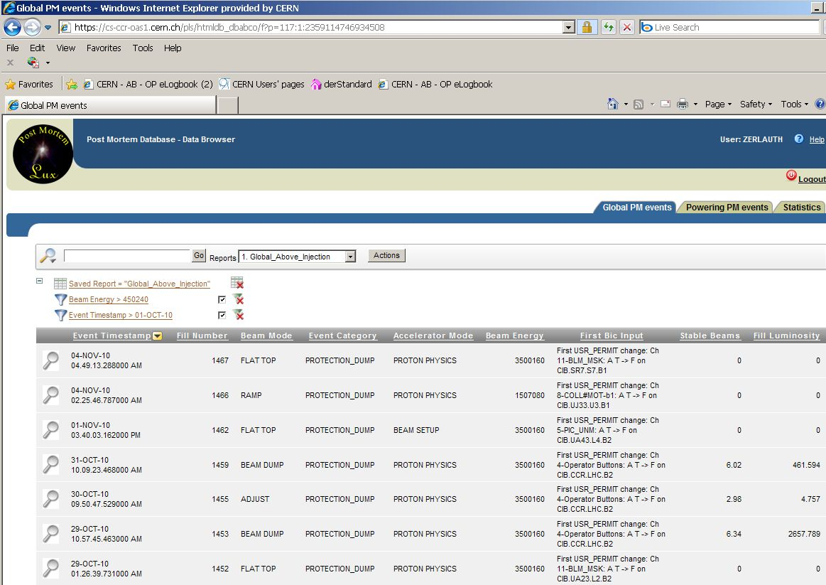
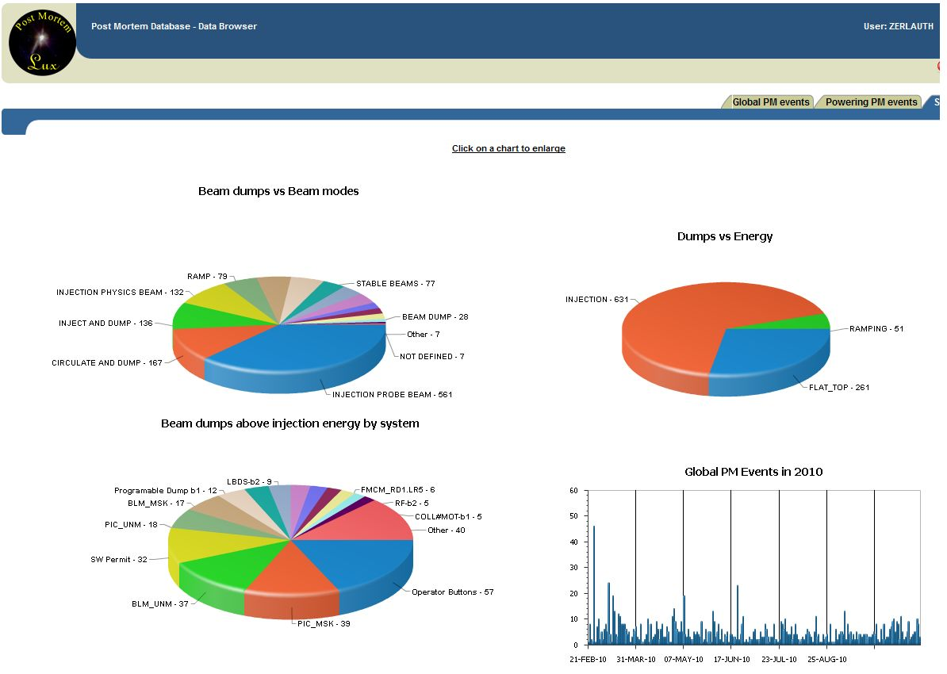
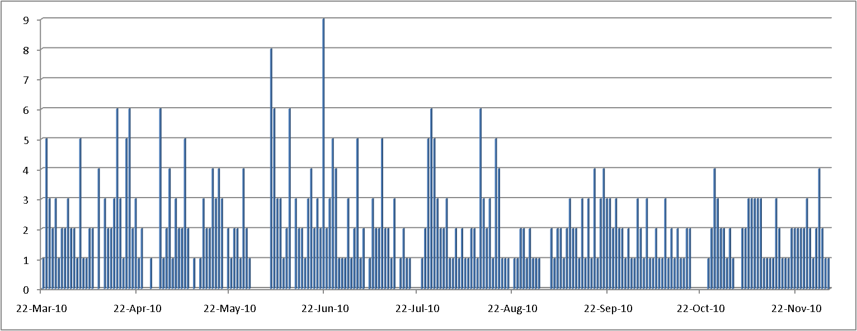
Review of Protection dumps
During 2010 run we counted
  1280 breaking of beam permit loops
  640 with beam in the machine
  370 where the energy ramp had started
Each dump is exercising parts of the machine protection infrastructure and used to assess the correctness of its response
  Dump summary is stored in database (time, cause, intensities, energy, operator comments, classifications, fill duration/integrated luminosity…) - https://cs-ccr-oas1.cern.ch/pls/htmldb_dbabco/f?p=pmdatabase
Breaking of BPLs in 2010
Breaking of BPLs above injection current
[11]
2

Slide 3
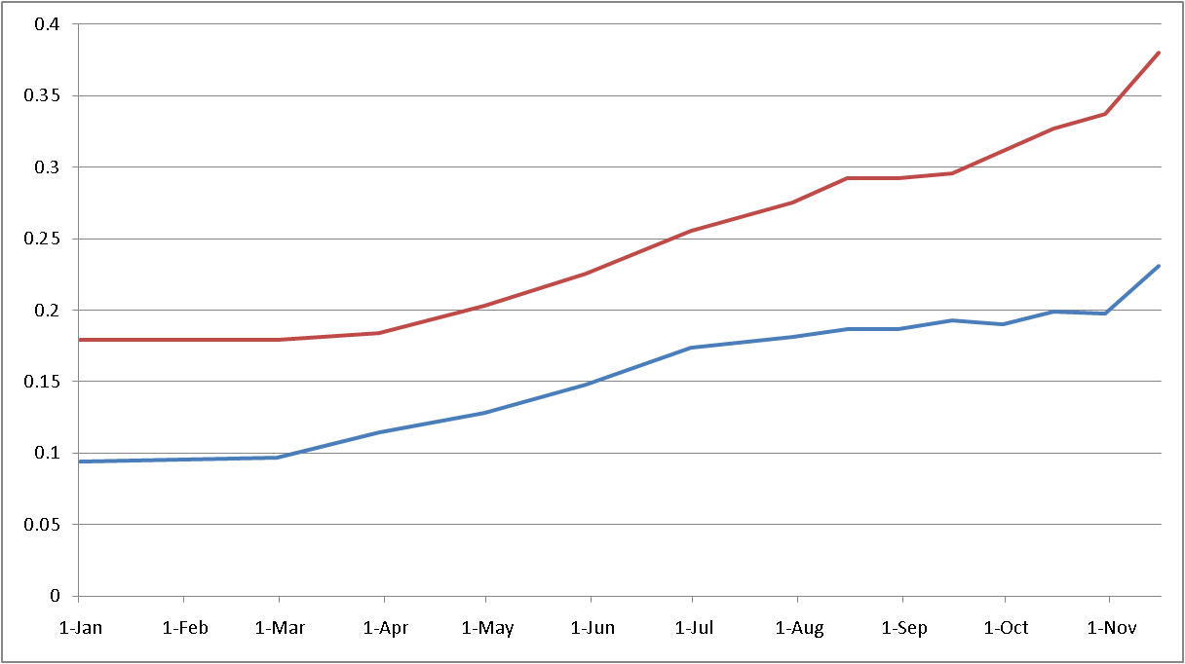
Machine ‘availability’ seen from PM
(Indirect) measure of machine availability: fraction of fills terminated with a programmed dump (counted from a given date until the end of the 2010 run)
    Yearly average: 8% of all fills, 17% of ramped fills
    During Ion run: 23% of all fills, 38% of ramped fills
Confirms steep learning curve in addition to intensity increase of factor >10⁴
Fills where ramp has started
All fills

Slide 4
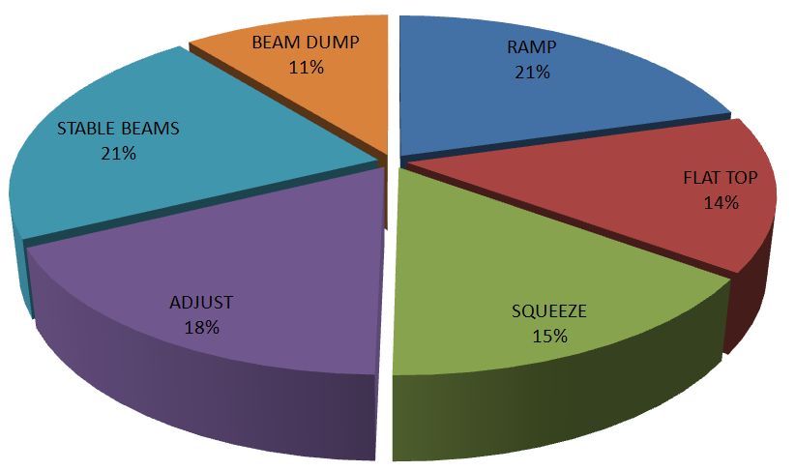
Main challenges during 2010 run (> injection)
Beam dumps as a function of beam mode for fills where energy ramp started and main causes of loosing the beams…
SIS (TCDQ Position, missing energy)
Magnet Powering (Orbit Feedback, etc..)
Collimator interlocks during ramp
>> Fast Losses (UFOs)
Magnet Powering (QPS, CRYO, PC,.. )
SW Permit (Orbit, BLM lost in IR7…)
Electrical Perturbations
Magnet Powering (OFB/QFB, QPS sector trip, ..)
Loss Maps, Collimator setup, Fast losses
ATLAS
Loss maps, wire scanner tests, collimators moving…
SW Permits (TCDQ position,…)
Magnet Powering (Mostly PC issues, …)
Magnet Powering (Mostly PC issues + FB, CRYO,..)
Fast losses, loss maps,…
SW Permits (TCDQ position, trip of DOCs)

Slide 5
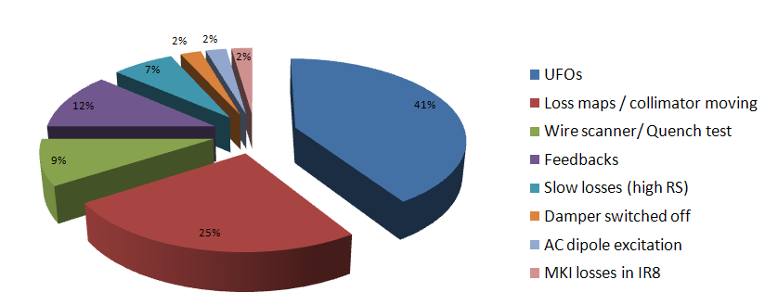
BLMs as ‘ultimate’ protection?
During 2010 run, 47 dumps out of 370 Protection Dumps (above injection energy) triggered by BLMs, i.e. ~ 13%
Most of dumps prior to increase of BLM thresholds on various cold/warm elements (i.e. with very conservative thresholds)
UFOs predominant, remaining triggers mostly during MPS tests /setup such as loss maps, wire scanner / quench tests, etc… at moderate intensities
All failures (including few ‘real’ equipment failures) nicely captured by BLMs before quenching any magnet (QPS providing ‘ultimate’ redundancy)

Slide 6
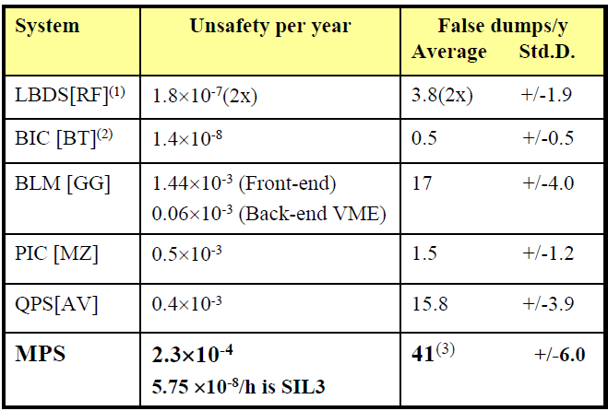
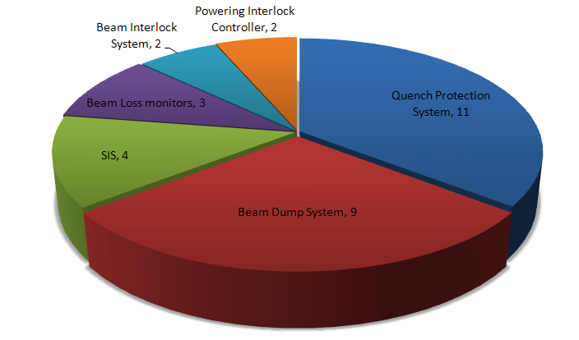
Dependability of MPS during 2010 run
Dependability / Availability of the machine protection systems has been a major design criteria and subject to extensive studies and Failure mode, effects and criticality analysis (FMECA) - https://lhc-mpwg-reliability.web.cern.ch/lhc-mpwg-reliability/
After ~ 10 months of operation
Dependability studies for MPS systems seems to be confirmed (or be better)
Nota bene: Only counting fills > injection

Slide 7
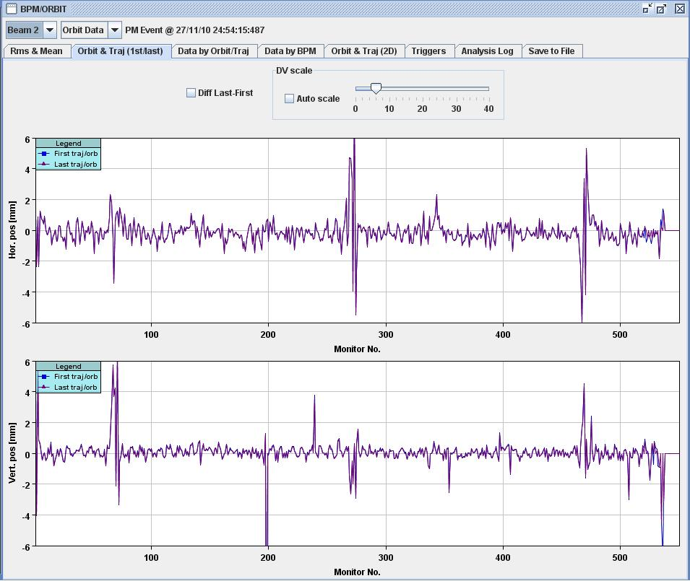
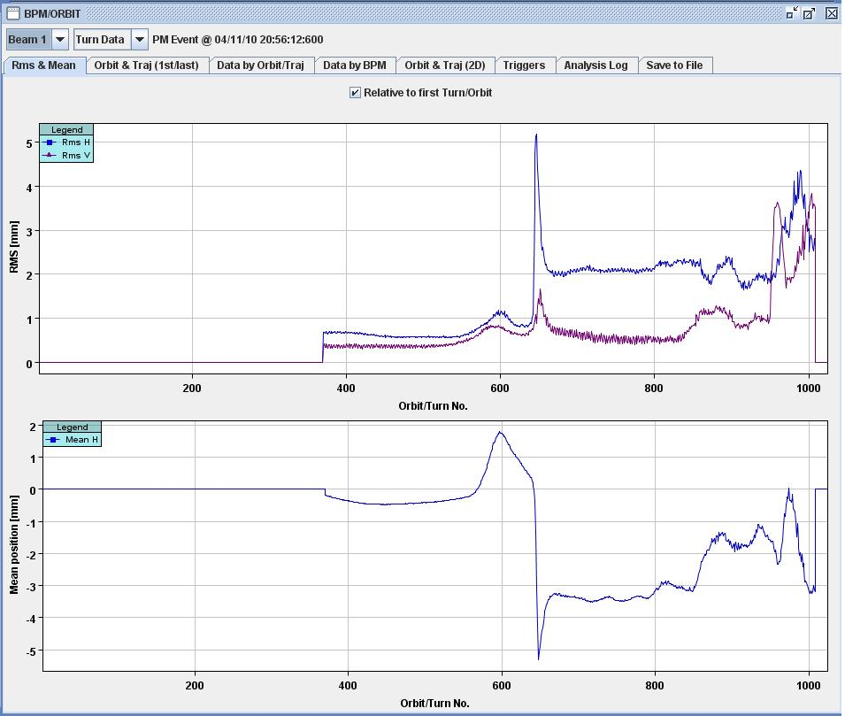
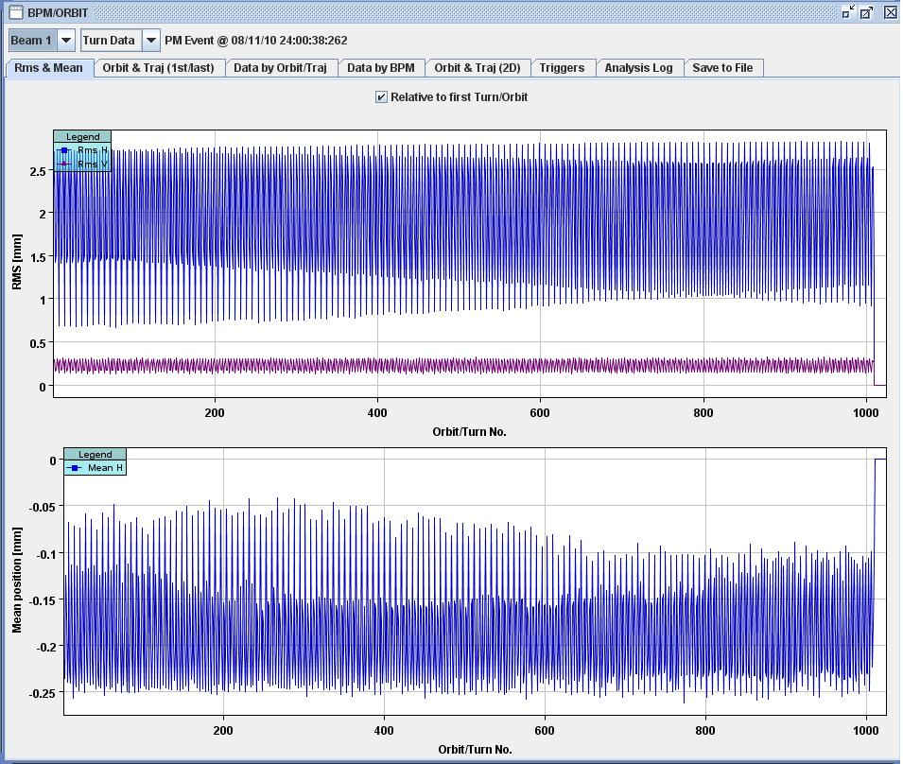
Are there any ‘suspicious events’, where are potential holes ?
Dumps above 450 GeV are systematically analyzed by MPS experts
At injection however little rigor is currently applied to fully understand the cause of event
  Losing beam during/just after injection because of beam instabilities or fast kicks
  Main causes are often wrong chromaticity, tune trims, quads at wrong current, low intensity on BPMs in IR6, injection losses, wrong timing tables,..…)
5mm
12mm
2mm

Slide 8
Are there any ‘suspicious events’, where are potential holes ?
While all dumps were correctly captured by the MPS, few occasions highlighted protection layers being bypassed (redundancy being lost), especially early on, during MDs…
  Masking (forgetting to unmask) SIS channels
  Software and human errors (not correctly controlling equipment, settings generations, thresholds,..) -> See talk of Alick
  Controlling equipment from outside the CCC (RBAC not yet fully enforced)
  Acknowledging of automatic checks vs procedures (IQC,XPOC, PM,…)
  ….many more…
For analysis of events the available tools (IQC, XPOC and Post Mortem) are generally well suited to analyze performance of the Machine Protection Systems
  Work reliably for identifying potential problems, long term degradation, etc…
  More rigor in acknowledging/following-up failures is needed in all systems, especially in PM more automated checks should be done (partially still relying on procedures /experts to assure offline follow-up)
  Similar rigor for re-commissioning of MPS changes after Technical Stops

Slide 9
Envisaged improvements for 2011
Post Mortem System evolving towards an expert system, further enhancing automatic checks rather than relying on procedures
  Split SIS input into maskable + a new unmaskable channel (vital machine protection features such as redundancy of user inputs, etc.. needing expert acknowledge)
  Possibility for analysis modules to propose “Advised Action” (to avoid e.g. repetitive trials to inject beam)
  Systematic check of TCDQ/TCT, TCP/Beam Dump Losses
  Automatic identification of beam loss shapes (UFO, dump losses, collimation, wire scanner, quench,…)
  Insufficient granularity in check-List / categories in PM: useful but needs to be more dynamic
Additional changes of related HW, diagnostics and procedures
  Direct use of telegrams from Timing Card rather than Network by SIS
  Enforcing intermediate injection: If less than 10¹² particles in LHC the SPS intensity will be verified by SIS to inhibit too big injections
  Verification of injection oscillations: SIS will block high intensity injection in case large oscillations observed during previous injection
  SMP Version 3 will be installed, providing full redundancy, energy read-back + new Beam Presence Flag
  No disabling of PM if above injection energy (enforced in sequencer + timing)

Slide 10
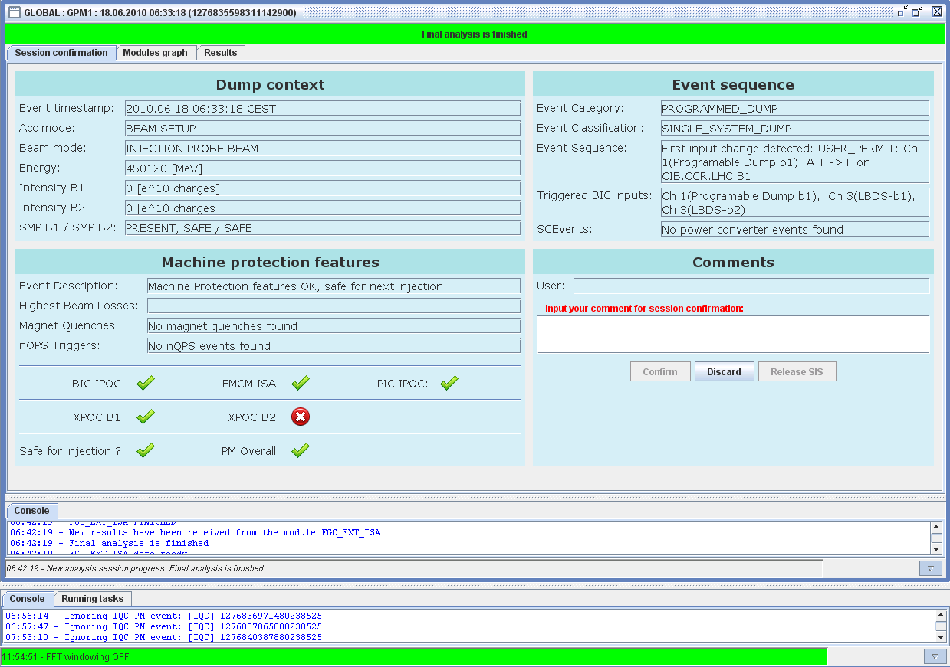
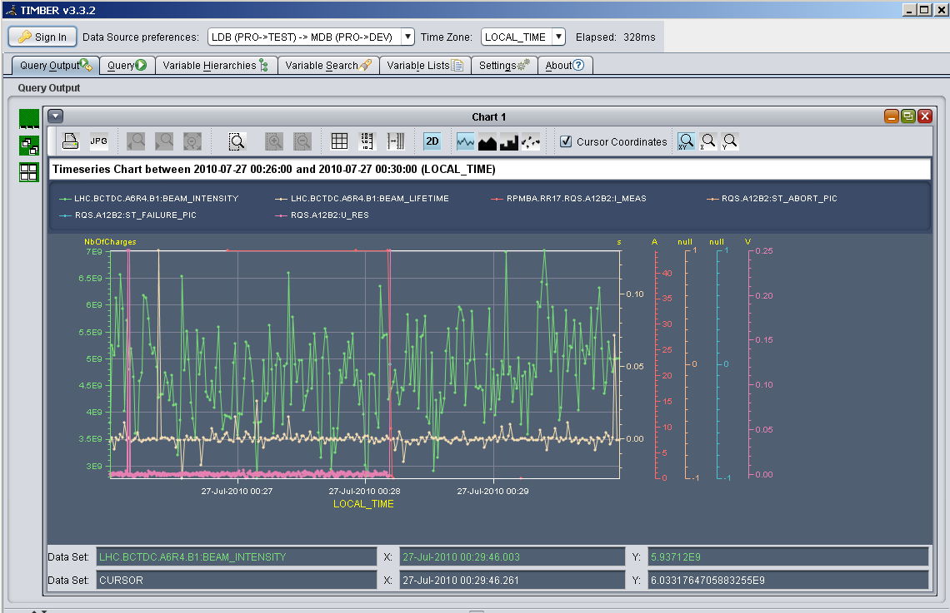
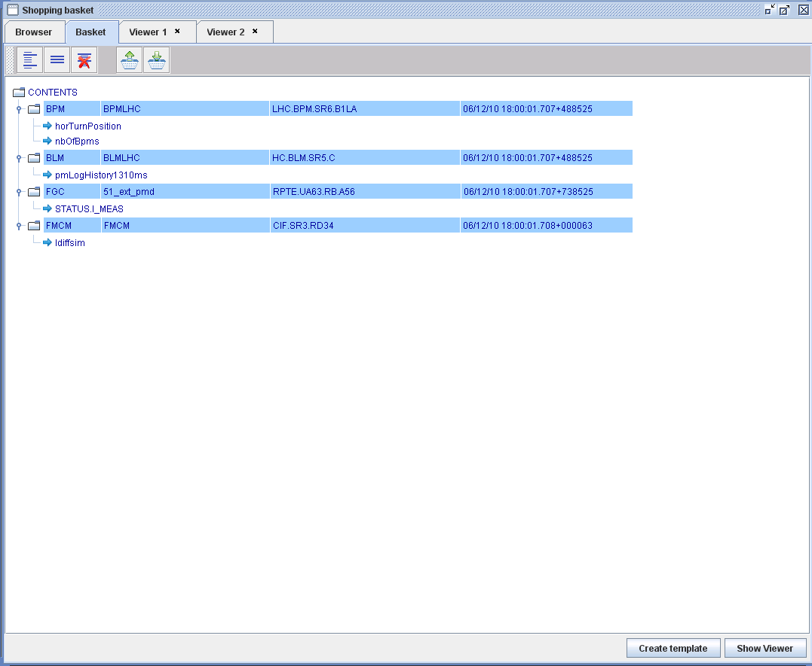
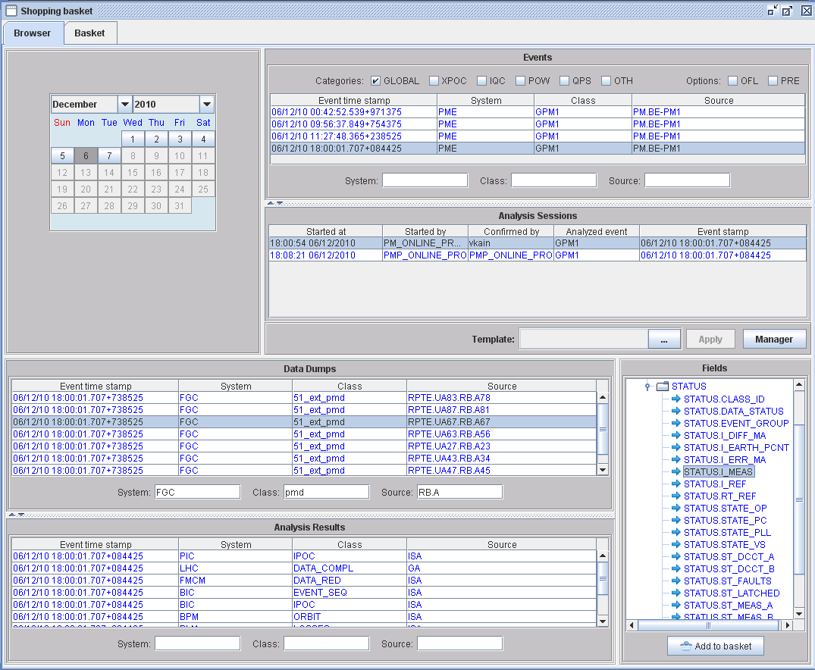

Envisaged improvements for 2011 – ctd..
Extend possibilities to view and correlate data for more efficient analysis
  PM data will be sent from interlocked BPMs in IR6
  New analysis modules for Tune, BLM and Collimators
  If possible adding vacuum info in PM to correlate with e.g. BLM data (e-cloud)
  BLM data has vital importance for understanding of events, not only around dump but over whole fills (UFO search, etc…)
    Play-back of BLM signals as a function of time (new application by Fabio)
    (Very) time-consuming data extraction from Logging DB -> Alternative data structures / extraction possibilities to be studied?
  Introduce ‘alternative’ x-scales for PM data, i.e. translate e.g. turn by turn data into time series data to correlate beam data against power converters, etc...
  Ultimate goal to correlate PM data with Logging Data (needs common data formats,…)

Slide 11
Summary
LHC Machine Protection Systems have been working extremely well during 2010 run thanks to a lot of commitment and rigor of operation crews and MPS experts
Most failures are captured before effects on beam are seen, still no quenches with circulating beam (with ~ 30MJ per beam and 10mJ for quenching a magnet)
Beam dumps above injection are rigorously analyzed, we can do better at injection (avoiding repetitive tries without identifying the cause)
Still a lot of room for improving tools for more efficient and automated analysis
No evidence of major loopholes or uncovered risks, but bypassing of protection layers was/is still possible -> Follow-up of MPS Review recommendations
Still we have to remain vigilant to maintain current level of dependability of MPS systems, especially when entering longer periods of ‘stable running’

Slide 12
Thanks a lot for your attention
12

