Slide 1
CAN WE IMPROVE THE MAGNETIC CYCLE/MODEL AND THEIR EFFECTS?
Evian, 8th December 2010
Workshop on commissioning
E. Todesco
For the FiDeL team:
C. Alabau Pons, L. Bottura, M. Buzio, L. Deniau, L. Fiscarelli, J. Garcia Perez,
M. Giovannozzi, P. Hagen, M. Lamont, G. Montenero, V. Remondino,
S. Redaelli, F. Schmidt, R. Steinhagen, M. Strzelczyk, R. Tomas, E. Todesco,
W. Venturini Delsolaro, J. Wenninger, L. Walckiers

Slide 2
contents
Precycle
  How many types we had?
  Has it been followed? Can we made it shorter ?
Chromaticity
  Decay at injection – how to include ?
  During ramp – can be improved ?
Tune
    Decay at injection
Hysteresis issue

Slide 3
HOW DID WE PRECYCLE THE LHC ?
Four combinations of precycle and cycle ramp rates and currents
  We started rather far from nominal
  No experience on decay and snapback in this regime
  2 A/s never explored in SM18
Since September 3 we are at 10 A/s
  With same parameters for physics cycle and precycle
What still missing w.r.t. nominal
  The energy ... still at 6 kA
  This should give smaller decay and snapback (about ½)
2 A/s
2 A/s
10 A/s
2 A/s
10 A/s
Combination of ramp and precycles in 2010 [N. Aquilina]

Slide 4
HOW DID WE PRECYCLE THE LHC ?
The LHC from the first day of operations uses the previous physics run as a precycle!
  If the physics run terminates abnormally one has to precycle
  Procedure followed at 97% in 2010 ☺☺
Precycle type in 2010 for all ramps [N. Aquilina]

Slide 5
HOW DID WE PRECYCLE THE LHC ?
The LHC from the first day of operations uses the previous physics run as a precycle!
  54% of the ramps used previous physics cycle ☺☺
  Precycle takes 90 minutes
    In average 45 minutes/ramp spent to precycle
  At this stage of operation is not dominant in the turn around time
  Anyway, it could be improved
    Dominated by the MQM MQY – one could study possibilities to make it shorter
  Other comments
    Special ramp-down when an access will be given (to avoid ramping up dipoles
    If a circuit trips, can we ignore it? General receipt is in CERN-ATS-2010-174 http://cdsweb.cern.ch/record/1283477/files/CERN-ATS-2010-174.pdf

Slide 6
contents
Precycle
  How many types we had?
  Has it been followed? Can we made it shorter ?
Chromaticity
  Decay at injection – how to include ?
  During ramp – can be improved ?
Tune
    Decay at injection
Hysteresis issue

Slide 7
CHROMATICITY DECAY AT INJECTION
How long we usually stay at injection?
  At least 30 minutes, in general 1-2 h, in average 5 h
  Measurements at SM18 showed that after 30 minutes most of the b₃ decay is ended (at 50 A/s ramp rate)
  Therefore we decided to correct the full decay via static trims thinking that in 2010 we always inject when decay is ended
  The option has been anyway coded and is available [M. Strzelczyk]
Time at injection for all ramps in 2010 [N. Aquilina]
Decay of b3 over 10000 s in 20 cases [N. Aquilina, L. Deniau, N. Sammut]

Slide 8
CHROMATICITY DECAY AT INJECTION
Beam measurements show decay on longer times
  The size of decay is in agreement with FiDeL (~0.5 units b₃, i.e., 20-25 units of chromaticity – but in the LHC is much slower!
  In 2010 variability in injection time changes chromaticity of 10-15
  Since trims of the previous injection are kept, one can inject on negative chromaticity and lose the beam
Chromaticity versus time at injection, beam1 (blue), beam2 (red) [W. Venturini Delsolaro]

Slide 9
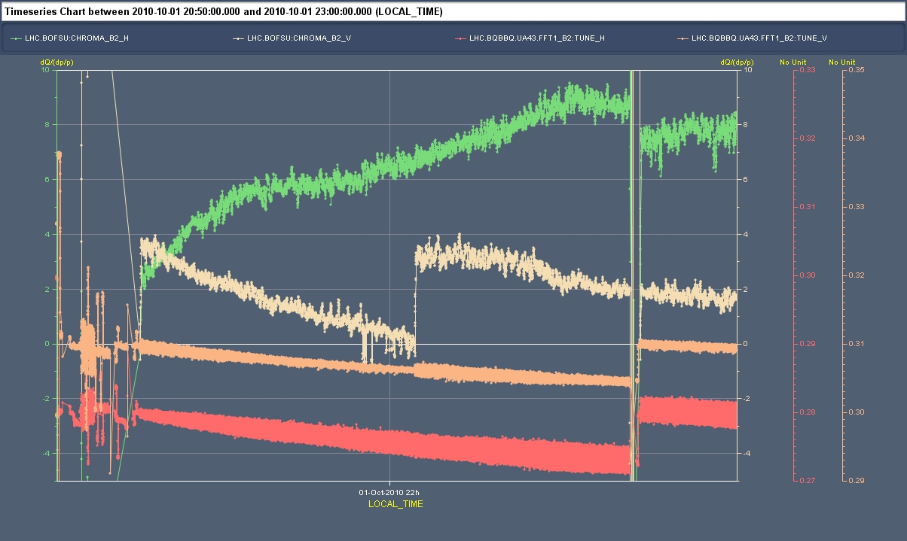
BEAM MEASUREMENTS
Measurements from M. Pojer
  Continuous measurements of chromaticity during injection (1 h)
  About 4 units in 1 h – this after 1 h at injection
  Compatible with previous measurements
Here chromaticity has been trimmed up by 4 units
Chromaticity versus time at injection, horizontal (green), vertical (beige) [M. Pojer]

Slide 10
CHROMATICITY DECAY AT INJECTION
How the EIC cope with this?
  Manual trim based on experience – no general strategy
  The trim is on the lattice sextupoles (MSF/D) whereas it should go on the MCS
Solution for 2011
  Use the process to correct decay at injection through MCS already prepared [M. Strzelczyk]
  But change the FiDeL time constant according to beam measurements and
    Measure periodically decay at injection in 2011
    Measure decay in dipoles with 10 A/s and 6 kA for 10 h? But on one dipole probably this is not enough

Slide 11
CHROMATICITY DURING RAMP
  We have ∼6 measurements of chromaticity during ramp [R. Steinhagen]
  FiDeL error during snapback: ±7 units – chromaticity is negative ☹
  FiDeL error after snapback during ramp: ±3 units – difficult to do better
  Decay at 3.5 TeV: 7 units
Tracking precision is sufficient for operation – but it could be improved in the snapback part
Static model
Decay
at 3.5 TeV
Chromaticity during the 10 A/s ramps , 6 cases blue: horizontal - red: vertical [R. Steinhagen]

Slide 12

CHROMATICITY DURING RAMP
  Error during snapback (the pyramid): two possible causes
  Trim at injection decreases linearly with time up to 120 s
  If this trim vanishes too rapidly this can create the pyramid
Static model
Decay
at 3.5 TeV

Slide 13
CHROMATICITY DURING RAMP
  Error during snapback (the pyramid): two possible causes
  If the snapback time constant is wrong one also gets a pyramid
  But it should be much, much longer … (factor 5-10)
Static model
Decay
at 3.5 TeV

Slide 14
contents
Precycle
  How many types we had?
  Has it been followed? Can we made it shorter ?
Chromaticity
  Decay at injection – how to include ?
  During ramp – can be improved ?
Tune
    Decay at injection
Hysteresis issue

Slide 15
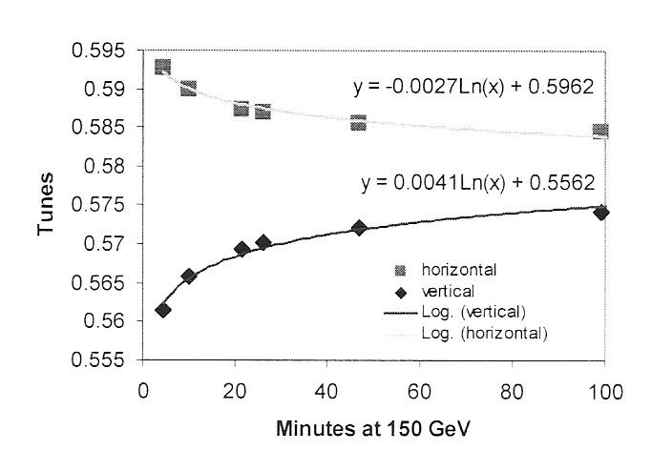
TUNE DECAY
  There is evidence of tune decay at injection
  About 0.005 over 1 h soon after precycle
    As far as I understand not an issue
    But it could be included
  Origin: could be decay in the quadrupoles
    0.005/60= 1.2 unit – compatible with meas.
Decay of tune at injection on 1st Oct 2010 [M. Pojer]
Decay of tune at injection in Tevatron [G. Annala, et al.]
Decay of MQ transfer function[L. Deniau]

Slide 16
contents
Precycle
  How many types we had?
  Has it been followed? Can we made it shorter ?
Chromaticity
  Decay at injection – how to include ?
  During ramp – can be improved ?
Tune
    Decay at injection
Hysteresis issue

Slide 17

HYSTERESIS
Hysteresis is a ghost which is periodically hunting
our nights … since years
  Two issues:
    IR quads during squeeze,
    having current ramping
    down
    Correctors, which are
    trimmed down and up
    by EiC and feedback
Implemented strategy
  When the dI/dt < 0 the model automatically changes hysteresis branch [M. Strzelczyk]
    With smoothing needed for not tripping the power converters and QPS
Psycho, 50 years celebration
[A. Hitchcock]
Measured transfer function during squeeze [W. Venturini Delsolaro]

Slide 18
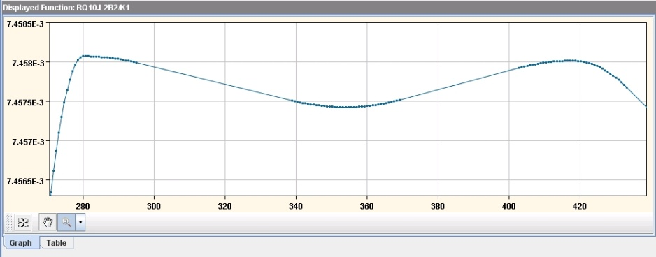
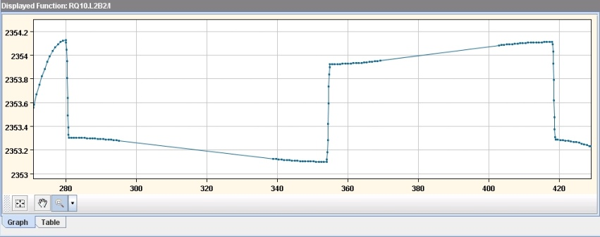
HYSTERESIS
Problems - 1
  For small changes of currents,
  one has jumps whereas the
  magnet in reality stays on the
  same branch
  Not nice, not necessary, and
  can induce beam losses [X. Buffat]
Required gradient during squeeze [M. Strzelczyk]
Corresponding current in PC [M. Strzelczyk]
Measured transfer function during squeeze [W. Venturini Delsolaro]

Slide 19
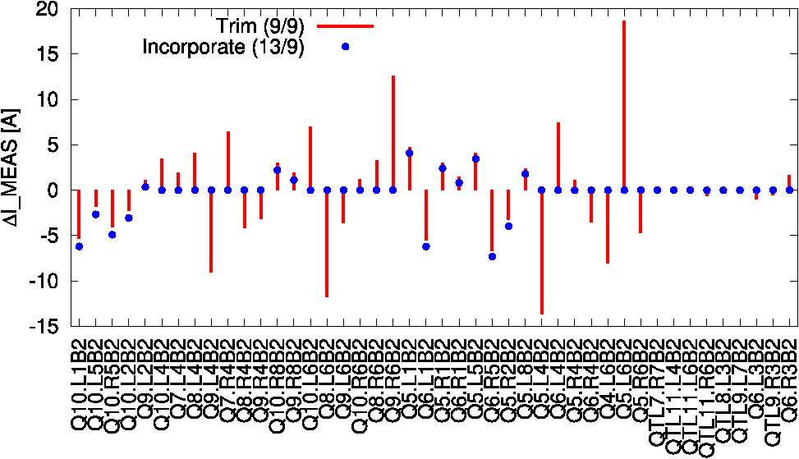
HYSTERESIS
Problems - 2
  When trims are first tried on actual settings and then incorporated, the branching causes a small difference – seen for beta beating correction
  This gives negligible effects on beta beating, but it is not nice
Difference between trims at 3.5 TeV and incorporated trims [R. Tomas]

Slide 20
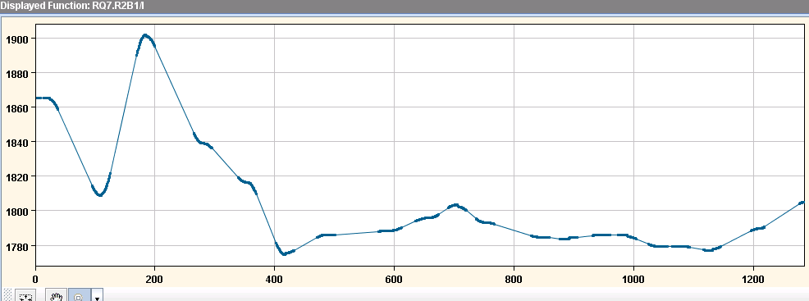
HYSTERESIS
Estimates show that in squeeze the impact of hysteresis is small
  Going to 1.1 m becomes important (10-50 units) in a few cases which are well known a priori (mainly MQM) – if neglected this gives 10% beta beating
No evidence of problems related to hysteresis, neither in correctors nor during squeeze
  We propose to remove it – we will include as trim for the few magnets that need it, and for β* that needs it
2.5
2.6
2.7
2.7
2.8
2.8
Error in units due to neglecting hysteresis during squeeze [P. Hagen]

Slide 21
CONCLUSIONS
Precycling
  Is correctly followed – 50% of times previous physics cycle is used
Decay of chromaticity
  ~20 units of decay, as expected by FiDeL, but on much longer times
  It is an issue for operation – should now be included
  It will be in 2011, parameters based on beam measurements
Chromaticity during ramp
  Tracked within ±7 units – we can improve the initial part

Slide 22
CONCLUSIONS
Tune decay
  About 0.005 units, possibly due to MQ – could be automatically tracked
Hysteresis
  No evidence of problems related to hysteresis, neither in correctors nor during squeeze
  Some side effects due to its implementation
  We propose to remove it – we will include it only if really needed

Slide 23
ACKNOWLEDGEMENTS
Thanks for discussions and comments
  EIC: R. Alemany Fernandez, A. Macpherson, V. Kain, G. Papotti, M. Pojer, L. Ponce, S. Redaelli, W. Venturini Delsolaro
  R. Steinhagen: feedback chromaticity and tune
  M. Lamont, M. Strzelczyk: controls and strategies

Slide 24

WE’RE GETTING FAMOUS!
LHC magnetic model – Evian December 2010 - 24

