Slide 1
The North Area Consolidation Project
The NA-CONS Team

Slide 2
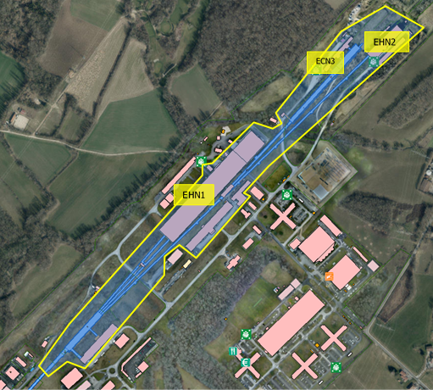
North Area Consolidation:
Renovation of the Fixed Target Experimetal Area at the CERN Prevessin site, after 45 years of wear-and-tear + fantastic physics
In view to:
Recover the availability and reliability of the beam- facility
Correct safety concerns and non-conformities
Be prepared for new projects and test beams in next decades

Slide 3
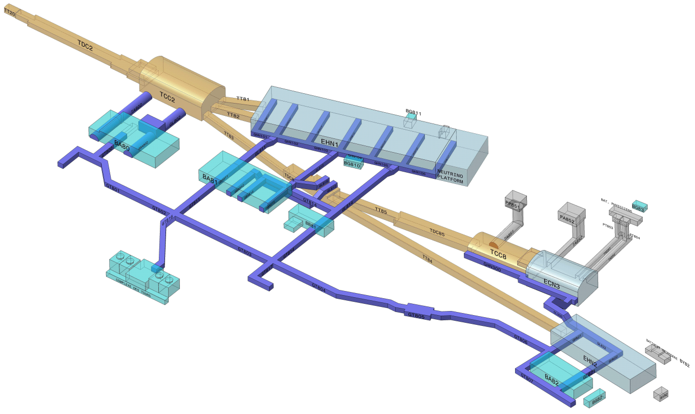
Schematic view of the North Area
A few numbers:
Overall surface 60000 m²:
underground 16600m²,
experimental halls 31000 m²,
service buildings: 12000 m²
6 beam lines, ~ 6.3 km cumulated
~ 1500 visitors / year
300 m
Secondary beam area
1250 m
Primary beam area
Underground
beam tunnels,
caverns
Underground
Technical galleries
Service
buildings
Exp. Halls

Slide 4
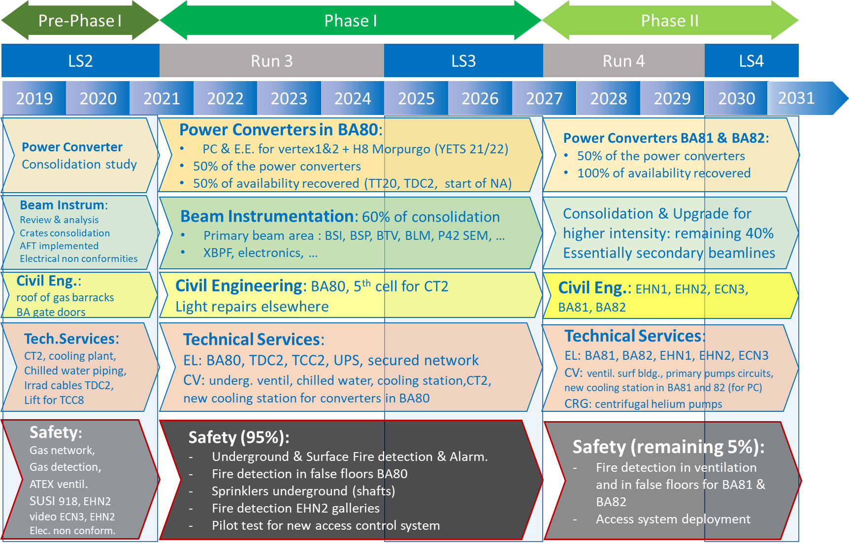
Project Timeline/Roadmap

Slide 5
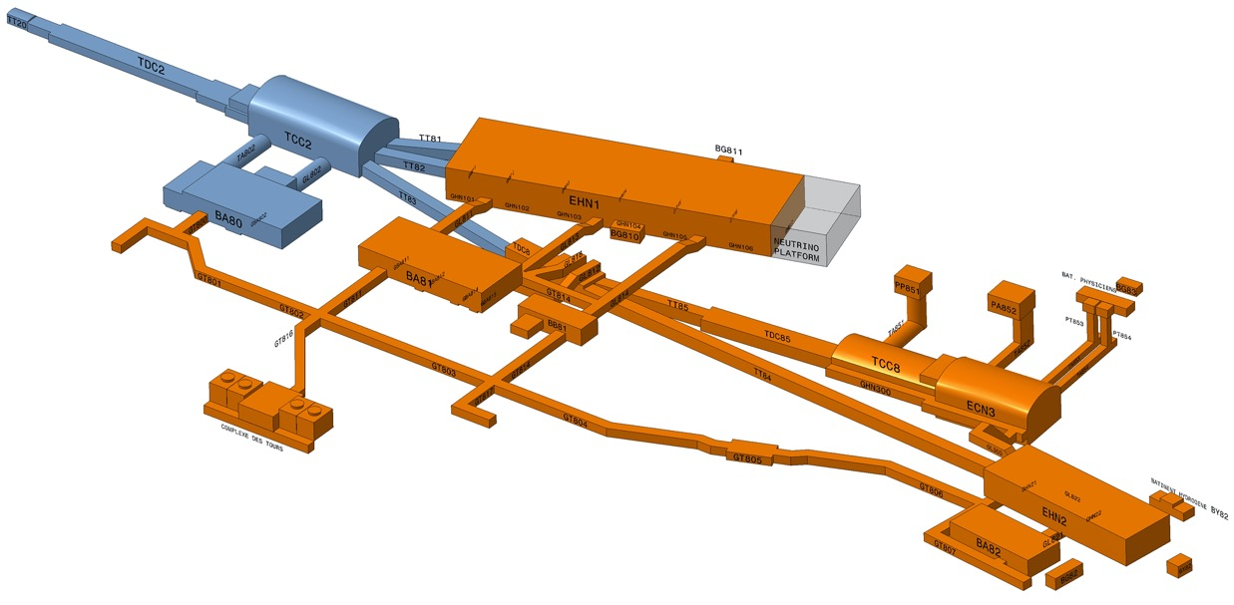
NA-CONS: Phase 1 & Phase 2
Phase 1: 2019 -2026 => priority to TT20 & NA Transfer Tunnels
Phase 2: 2027 -2030 => H2, H4, H6, H8, M2 & K12 beam lines

Slide 6
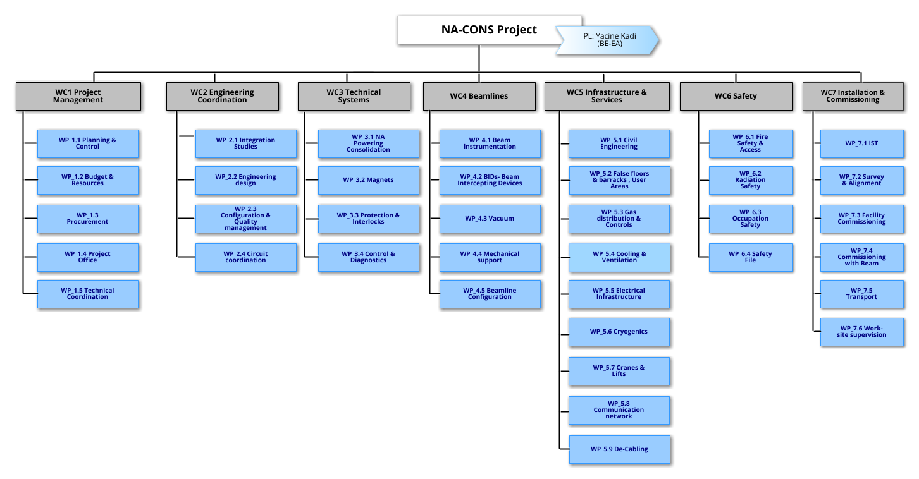
Project Organization
Level 1 : 7 Work Categories
Level 2 : 37 Work Packages
Level 3 : 120 Work units

Slide 7
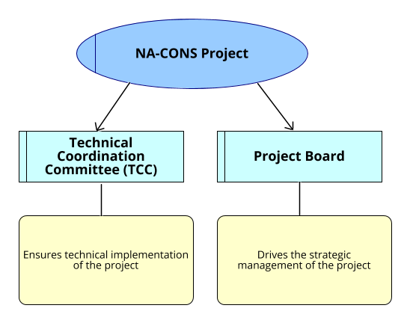
Project Organization
Project articulated around 2 main bodies

Slide 8

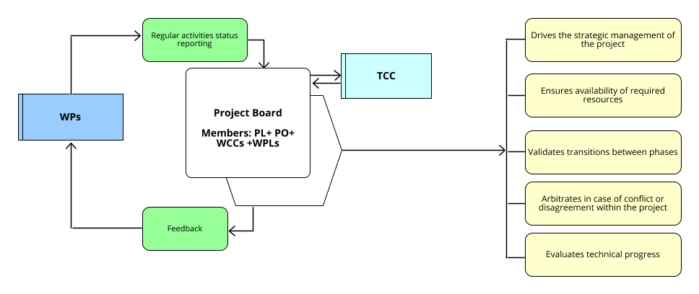
Project Board
PBM : Project Board Meetings
Frequency : Monthly
Duration : 2 Hours
https://indico.cern.ch/category/14292/
https://edms.cern.ch/ui/#!master/navigator/project?P:100708504:100708504:subDocs

Slide 9
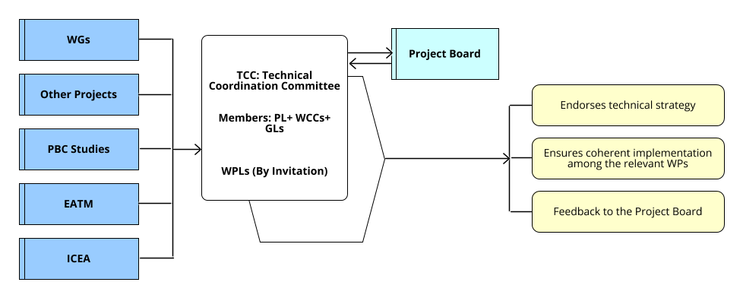
Technical Coordination Committee
TCM : Technical Coordination Meetings Frequency : Quarterly
Organized by topical subjects
WGs:
EABI WG
NA-Decabling WG
SLAWG
Reliability WG
NA Commissioning WG
Projects:
TG-CONS
EL-CONS
*ICEA: Integration Committee for Experimental Areas

Slide 10
Cumulated budget*
* Without EL-CONS (~ 20 MCHF)

Slide 11
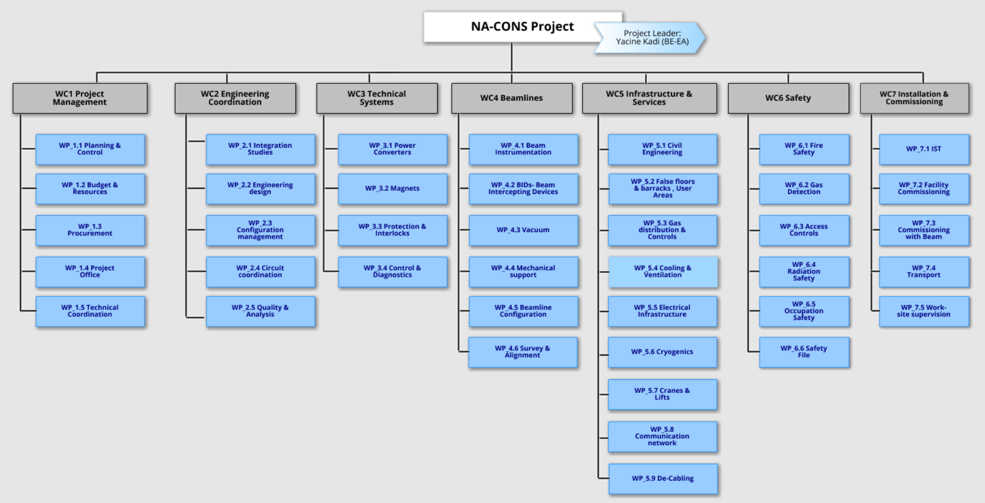
Main items
Objects for procurement in the PBS
Power
Converters

Slide 12
Main items
Objects for procurement in the PBS
Magnets and
magnet components

Slide 13
Main items
Objects for procurement in the PBS
Beam intercepting
devices + components
Vacuum
components

Slide 14
Main items
WBS – Objects for procurement
Building- and
tunnel renovation
Cooling and
Ventilation installations

Slide 15
Main items
Objects for procurement in the PBS
Electrical installation
and power supply
renovation

Slide 16
Main items
Objects for procurement in the PBS
Fire Safety installations
Fire- and gas detection
systems
Access control systems

Slide 17
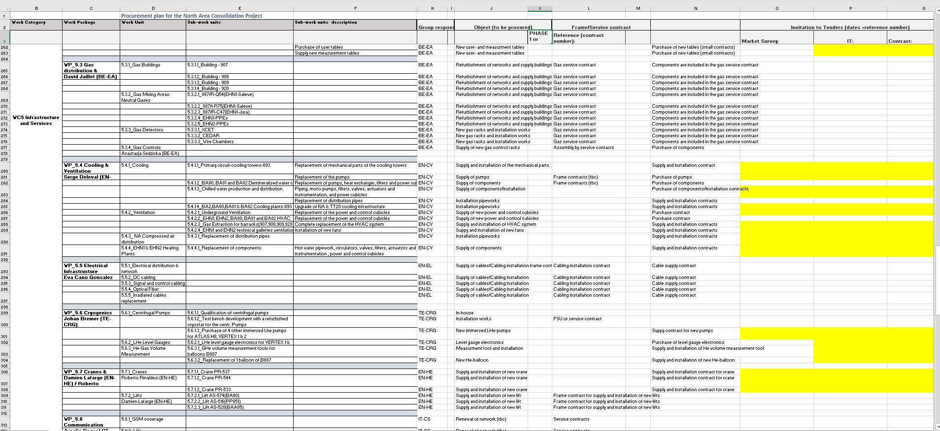
Experimental Magnets
85 kCHF
525 kCHF
+
155 kCHF
2’490 kCHF

Slide 18
Status consolidation of power converters for ATLAS/Morpurgo and VERTEX1&2
Xavier Genillon & Yves Gaillard SY/EPC

Slide 19
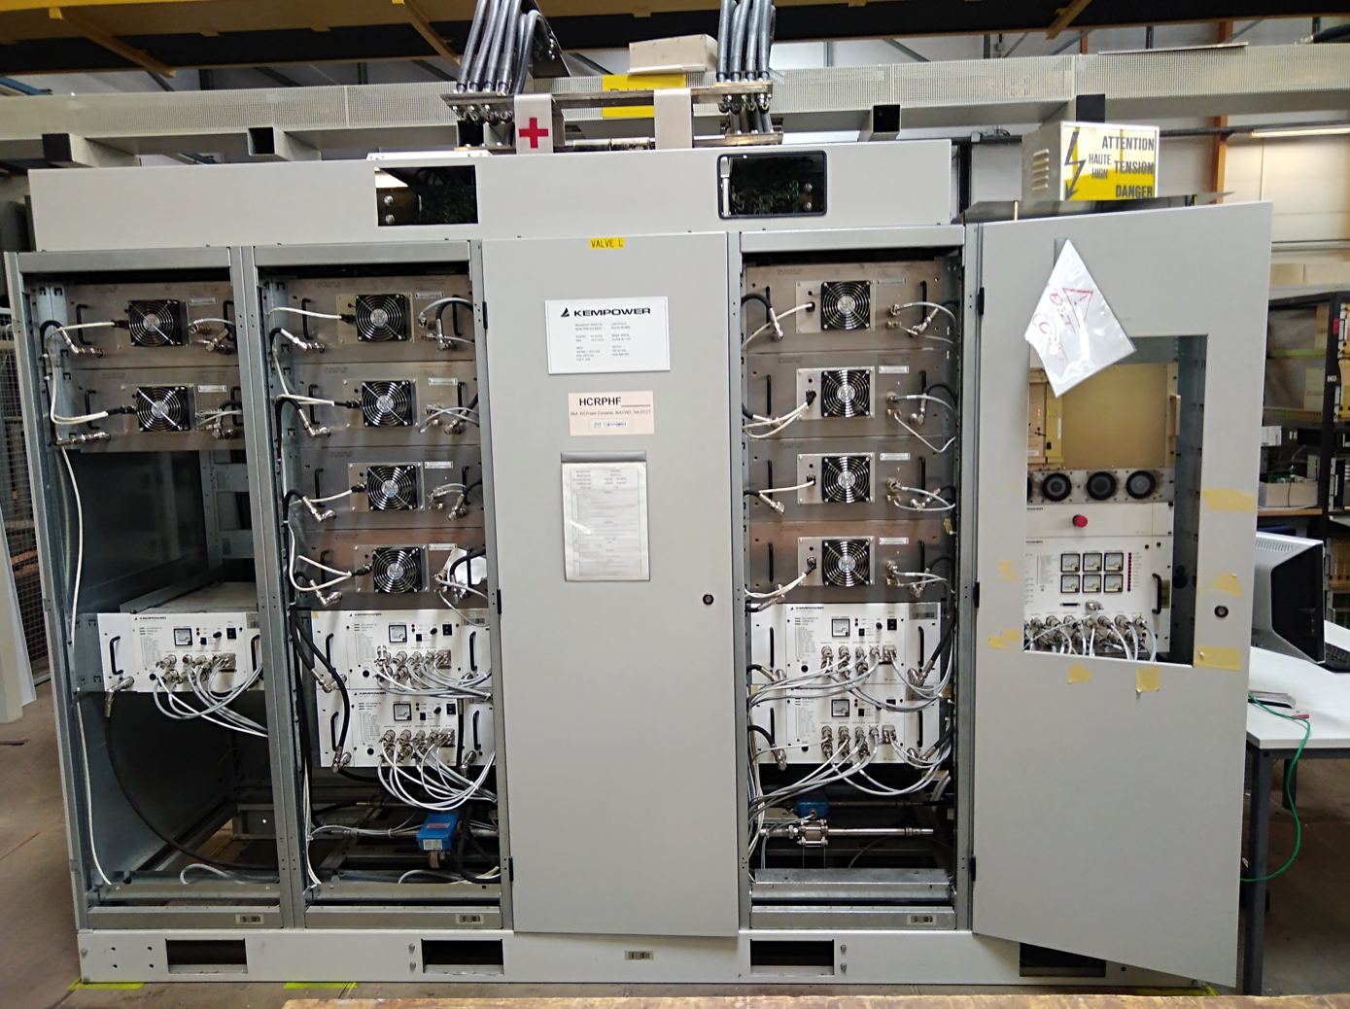
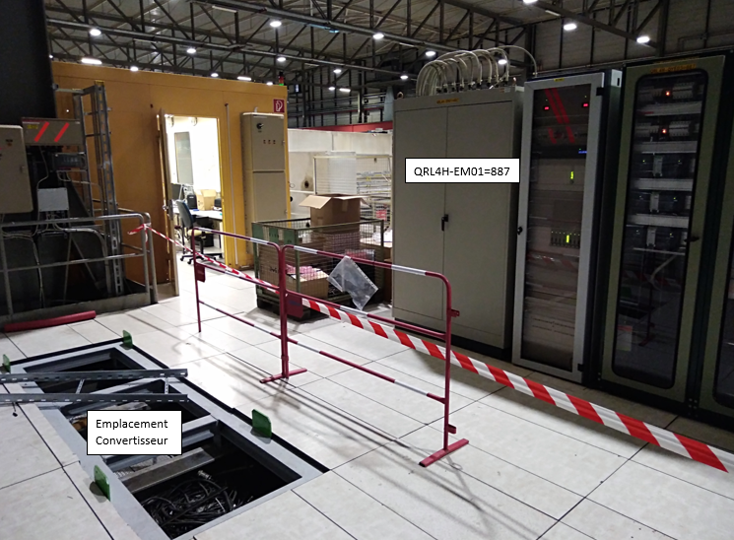
ATLAS/MORPUGO:
The power converter is ready and First powering tests in A7 building is ongoing
All Power and Control DIC are done and taken into account
(Final integration for DC cable to be validate by BE-EA)
Installation will start at the end of the 2021 Run (15th of November)
End of November: Power converter installation
December 2021: EN-EL and EN-CV installation
First Powering test (Short circuit) will start in beginning of February 2022
Commissionning with the Discharge system will start in middle of February

Slide 20
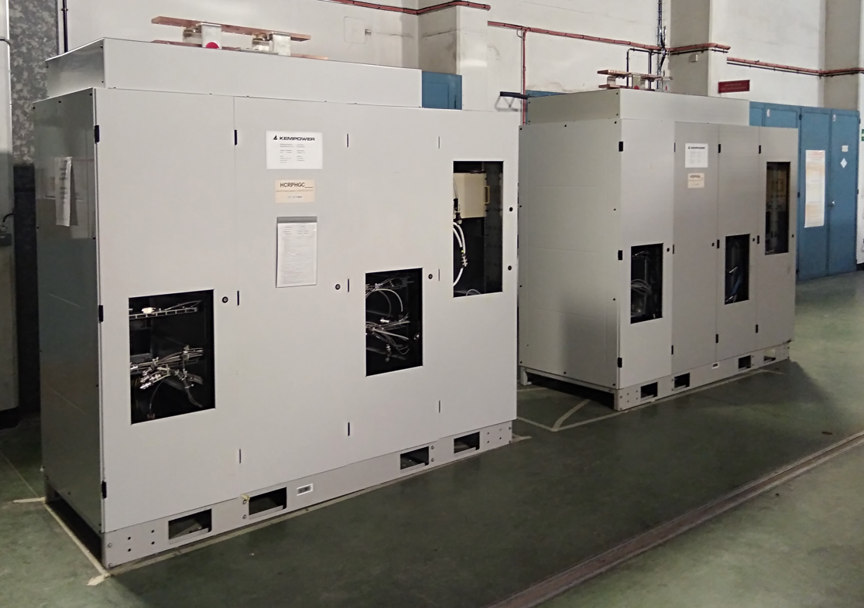
VERTEX1/VERTEX2:
The power converters are ready for the tests in A7 building
All Power and Control DIC are done and taken into account
Dismantling of the Vertex area will start at the end of the 2021 Run (15th of November)
Installation will start in January 2022.
The commissionning will be done during March/April 2022.

Slide 21
Status
Circuit topology study and optimization concluded
Choice of the most appropriate breaker made
DC circuit breakers chosen
Market Survey and Invitation to Tender for the breakers:
MS-4680/TE/NA completed in June
IT-4680/TE/NA completed end of July
Opening of the bids in August
Firms screening ongoing
Contract signature by end of September
Resistors bought and integration started
Budget envelope as indicated in DR should be respected
Working closely with EPC
On schedule !

Slide 23
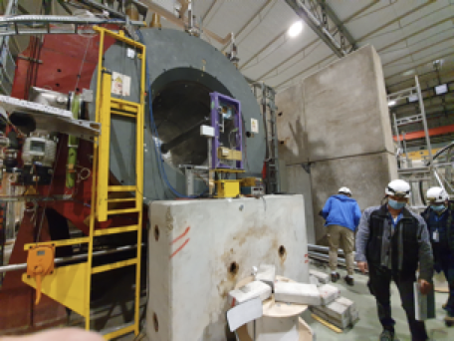
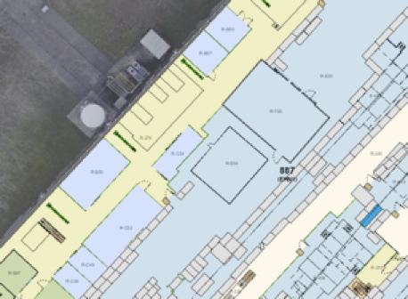

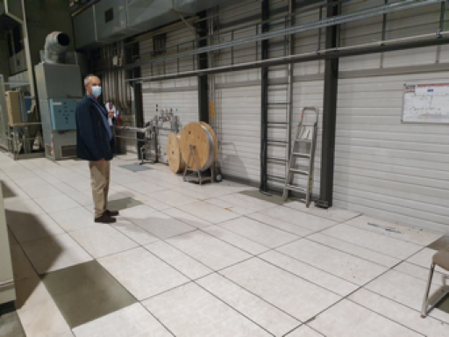
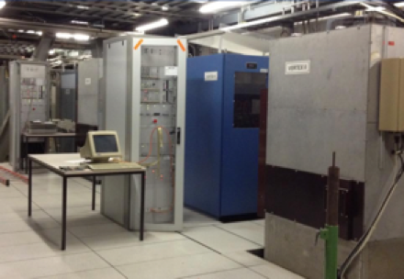
The 3 circuits
ATLAS/Morpurgo magnet
ATLAS
I_{nom} = 5000 A
At I_{nom}, U = 3.45 V
For 2A/s, U = 5.64 V
VERTEX 1
I_{nom} = 5013 A
L = 1.68 H
I = 3820 A, U = 1.17 V
I = 5013 A, U = 1.71 V
For 3 A/s, U = 4.3 V
VERTEX 2
I_{nom} = 3820 A
L = 1.68 H
I = 500 A, U = 0.19 V
I = 3820 A, U = 1.37 V
VERTEX 1 and VERTEX 2
New PC/EE location (keep the old system as a back-up)
VERTEX1&2: remove the old equipment and install the new ones
Almost identical parameters for the three circuits

