Slide 1
General news items, and news on the CDR
Lucie Linssen
Sept 27th 2010

Slide 2
CDR status
Status of CDR preparation following dedicated meetings for each of the chapters

Slide 3
CDR planning
The 3 CDR volumes:
1 Executive summary (~50 pages)
2 The CLIC accelerator and site facilities (>800 pages)
Physics and detectors at CLIC (~150 pages)
The current official CDR deadline is April 2011
(Based on presentation of CDR to SPC in May 2011 and to Council in June 2011.)
New elements:
-- Delay in CTF3 tests (e.g. acceleration tests) due to March 2010 fire in klystron gallery
-- European strategy session of CERN council will be held in 2012
It seems more appropriate to present the CDR to SPC in September 2011 and to Council in 2011.
We are trying to get a decision on a new CDR deadline date very soon

Slide 4
CDR detector geometry definition
Where do we stand with geometry definition?
Will be the subject of formal decision meetings.
Just at a glance…
Item |  | Status
HCAL absorber barrel | Tungsten, 7.5 Λ | Decided
HCAL absorber end-cap | Steel, 7.5 Λ | Decided
Yoke end-cal plug |  | Geometry decided
Muon system geometry |  | Model implemented. Use of # of active layers, to be decided later.
Forward region |  | Model similar to CLIC_ILD now being implemented in CLIC_SiD
Vertex detector + FTD (CLIC_ILD) |  | In simulation model. Final decision pending more full-simulation results
Vertex detector + FTD (CLIC_SiD) |  | Following discussion with SiD, new model being implemented

Slide 5
“Conference coordinator”
Michael Hauschild was nominated "conference coordinator" for the CLIC Detector studies.
In this role, Michael will collect and nominate abstracts/speakers representing the "CLIC Detector study" at workshops and conferences, taking into account the various contributions of individuals and institutes to the CLIC Detector study. He will also maintain a list of "past conference talks" in order to maintain a good level of fair sharing between potential presenters. His role will principally focus on "CLIC-specific studies", as currently carried out in view of the CLIC CDR.
We propose that groups working on individual technology developments with possible CLIC applications normally contact the conference organisers directly (so without Michael's intervention).
Where applicable, Michael will liaise with bodies with similar roles within the various existing collaborations (e.g. CALICE, LC-TPC).

Slide 6
Abstracts for IWLC2010
(Status of 26-Sep-2010)
19 abstracts submitted so far
    17 abstracts sent directly to IWLC2010 convenors
    2 abstracts sent via CALICE (subject to CALICE speakers board approval)
  Proposed sessions
    3 Tracking + Vertexing, 5 Calorimetry + Muons, 7 Detector Performance + Software Tools, 4 Higgs + Supersymmetry
  Proposed speakers
    10 CERN, 5 from outside institutes, 4 both from outside institute + CERN
Expect ~9-10 more abstracts
    2 Tracking, 1 Calorimetry, 1 Forward, 1 MDI/Engineering, 1 Polarization, 2 Particle Flow, 1 Performance Studies
    proposed speakers: 3 CERN, 5 from outside institutes, 1 both outside + CERN
  requests for abstracts sent ~2 weeks ago, need reminders now...
Should have eventually ~30 abstracts in total with speakers from CERN / outside institutes about equally distributed

Slide 7
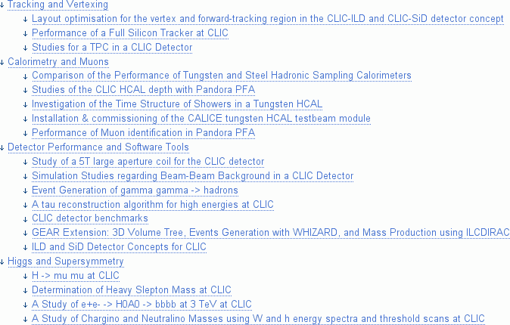
Summary of Submitted Abstracts
New TWiki created:
  https://twiki.cern.ch/twiki/bin/view/CLIC/IWLC2010

Slide 8
Upcoming workshops
High precision measurements of luminosity at future linear colliders
and polarization of lepton beams (FCAL context), Tel Aviv
October 3-5
http://alzt.tau.ac.il/~fcal/
ECFA linear collider workshop, IWLC, Geneva
October 18-22
https://espace.cern.ch/LC2010/default.aspx
See more details on next slide
Next SiD workshop, Eugene Oregon
November 15-17
http://physics.uoregon.edu/~lc/SiD/Oregon_2010/

Slide 9
About benchmarks and annual luminosity
List of CLIC benchmark processes can be found on LCD web (thanks to Angela):
http://lcd.web.cern.ch/LCD/Documents/PhysicsRequirements.html
"At a 3 TeV CLIC machine the spectrum has a peak near 3 TeV, accompanied by a long tail towards lower energies. For a total peak luminosity of 5.9*10³⁴ cm⁻²sec⁻¹ the luminosity in the most energetic 1% part of the spectrum amounts to 2.0*10³⁴ cm⁻¹sec⁻¹. For most physics analyses the full luminosity spectrum will be used. For estimates of data statistics we presume that an average year of operation of the fully commissioned machine corresponds to 200 days with an effective on-time of 50%. Hence, throughout the document the integrated luminosity per year of running at 3 TeV is assumed to amount to 500 fb⁻¹."

