Slide 1
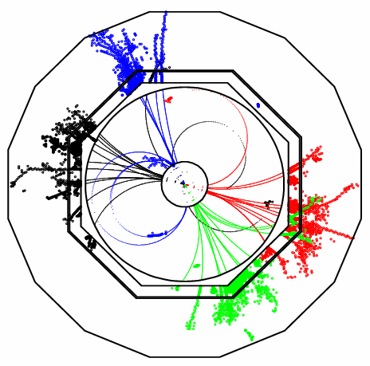
Pandora PFA Status and Plans
John Marshall,
University of Cambridge
LCD Software Meeting, September 27 2010

Slide 2
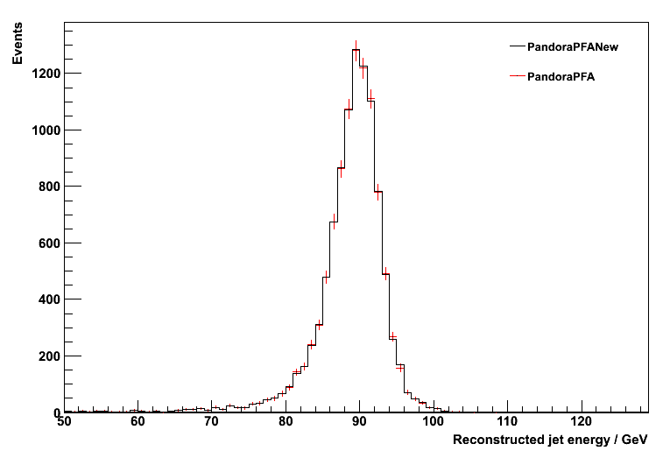
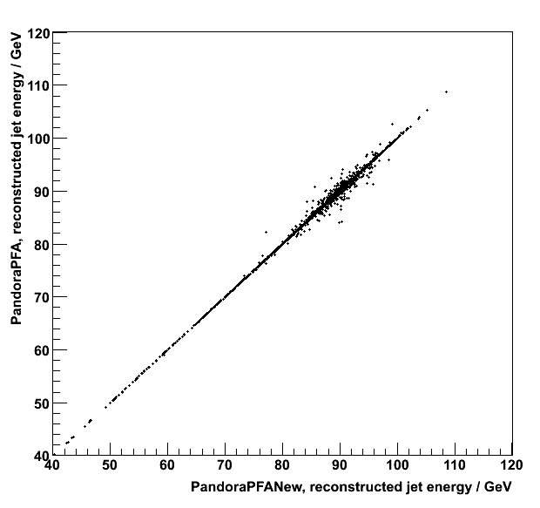
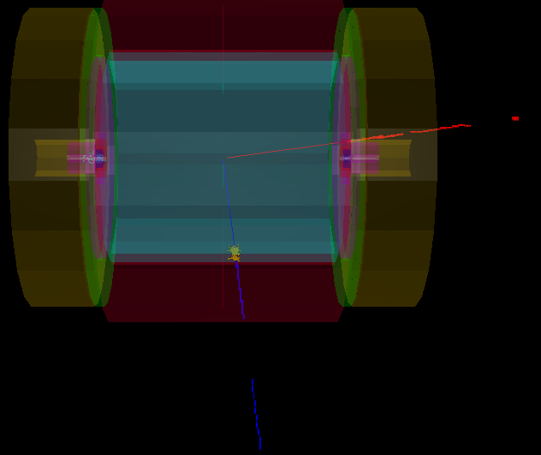
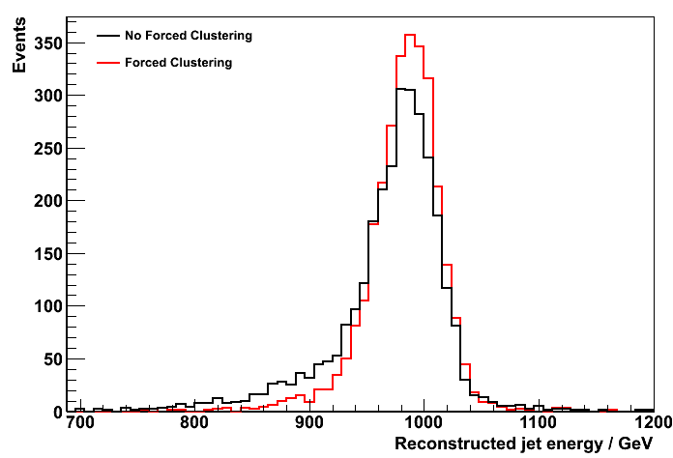
Past 12 Months
1. Redesign and rewrite
2. Reproduce old Pandora performance
Client Application:
Pandora Framework, treat as “black box”:
Pandora Algorithms:
Create Calo Hits
Specify Geometry
Create Tracks
Register User Content
Create MC Particles
Clustering Algorithm
Topological Association Algorithms
Statistical Reclustering Algorithm
Fragment Removal Algorithms
PFO Construction Algorithm
Photon Recovery
Algorithm
Track-cluster Association Algorithms
E_{j} = 45GeV
PFO energy sum, old vs. new
Pandora
Alg
Manager
Calo Hit Manager
Cluster Manager
Geometry Helper
Pandora Settings
Track Manager
Particle Flow Object Manager
MC Manager
Pandora API
Pandora Content API
Get Particle Flow Objects
3. Improve particle id and reclustering
4. Recent changes...
Mu+
In this talk, will discuss recent improvements to the reconstruction of high energy electrons.
Will take a first look at the impact of “split tracks” on particle flow performance.
Will discuss upcoming development plans.
Photon
Mu-

Slide 3
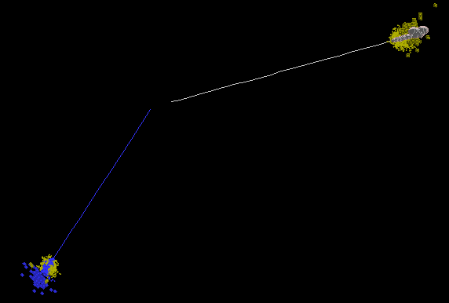
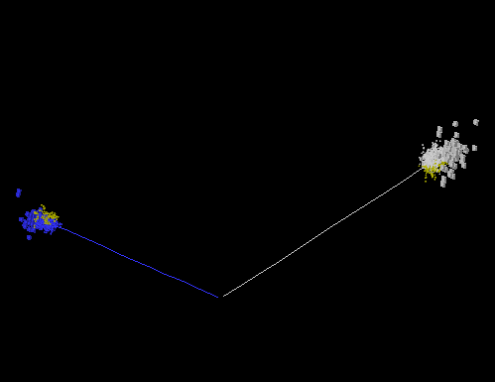
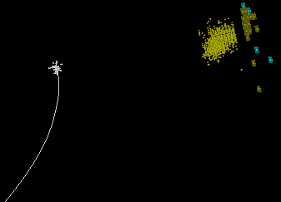
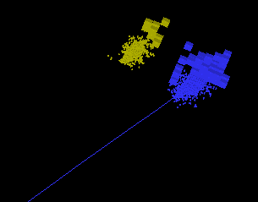
High energy electrons
For high energy electron events, the most common problem is Bremsstrahlung, which leads to a reconstructed track (of energy lower than the original electron) pointing directly at a large shower:
Photon
Positron
Positron
Photon
Electron
Photon
Photon
Electron
The situation is perhaps illustrated most clearly by events in which the photon and electron are not collinear. These tend to be well reconstructed, but in cases where the photon and electron are superposed, the reconstruction is very difficult.
Photon
Positron
Photon
Electron

Slide 4
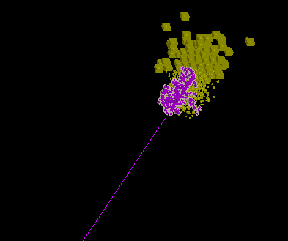
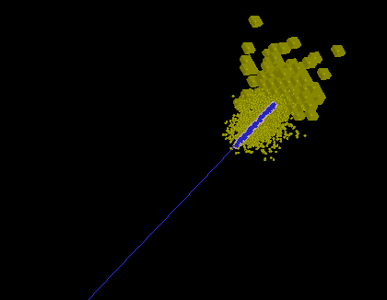
Fragment Removal
The poor agreement between the low-energy track and high-energy cluster tends to leave the Pandora forced reclustering to “dig out” sufficient hits from the cluster to match the track energy.
However, the creation of this “forced” cluster tends to leave the remaining shower shattered into many fragments. These fragments are typically identified as photons or neutrons.
In the FragmentRemoval algorithm, a number of the fragments are typically joined to the "forced" cluster, creating a final (odd-looking) cluster, that is unlikely to be identified as an electron.
Note inclusion of many fragments
Forced cluster
Typically many photons
Reconstruct
as Pi-
Reconstruct
as electron
LCD_WG2_Validation_2
LCD_WG2_Validation_3
In the new tag of PandoraPFANew, the FragmentRemoval algorithm no longer considers any clusters (with associated tracks) that look electron-like. This just leaves the track and forced cluster, which will be identified as an electron with high efficiency (see later).

Slide 5
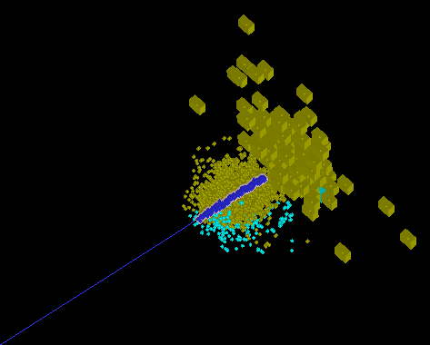
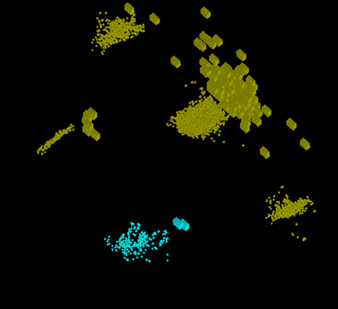
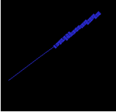
Photon Fragment Removal
After the successful identification of the track and forced cluster as an electron, the reconstruction must deal with the many neutral fragments left from the splintering of the original shower:
2
3
=
+
1
4
Electron
5
Neutral fragments
The remaining “photon-like” fragments are mopped-up in a new PhotonFragmentRemoval algorithm. Like the other fragment removal algorithms, this algorithm looks for evidence of contact between pairs of clusters.
For each pair of photon-like clusters, the algorithm considers:
  The fraction of the cluster layers that are in close contact,
  The fraction of hits in one cluster that lie within a specified cone around the second cluster,
  The fraction of hits in one cluster that lie within specified distances from hits in the second cluster.
The algorithm errs on the side of caution to avoid damaging jet energy reconstruction, but greatly reduces the number of neutral fragments and improves the cosmetic appearance of events.

Slide 6
Performance
The new LCD_WG2_Validation_3 tag offers improved reconstruction of high energy electrons, whilst avoiding too much “tension” between the electron/muon/photon identification and the jet energy reconstruction.
Examining a sample of 100 selectron events (200 high energy electrons), the following failures were identified:
  2 failures due to missing tracks (in θ=90° crack and in very forward region),
  3 failures due to dropped tracks (fail MarlinPandora quality cut on σ_{p}/p),
  2 failures due to cluster failing topological cuts (1 cluster very large, 1 with poorly reconstructed shape),
  4 events with excess electrons reconstructed due to track splitting (see later discussion).
Examining a sample of 100 smuon events (200 high energy muons), the following failures were identified:
  4 failures related to HCal gaps (insufficient information for gap recovery, although note new configurable gap ‘tolerance’ can help recover some of these),
  1 failure due to large overlapping photon cluster; muon is now called an electron,
  2 failures due to shower-like muon clusters that fail energy deposition cuts.
  1 failure due to missing track in very forward region.
Jet energy resolutions:
E_{j} | 45GeV | 100GeV | 250GeV | 500GeV
PandoraPFANew tag LCD_WG2_Validation_3, Ilcsoft v01-09-02, rms₉₀(E_{j}) / E_{j} | 3.58 ± 0.11 | 2.95 ± 0.08 | 2.87 ± 0.07 | 3.03 ± 0.07
Performance is quoted in terms of rms₉₀, the rms in the smallest range of reconstructed energy containing 90% of the events. The total energy is reconstructed and the jet energy resolution obtained by dividing the total energy resolution by √2. A cut on the polar angle is applied to avoid the barrel/endcap overlap region: |cos θ| < 0.7

Slide 7
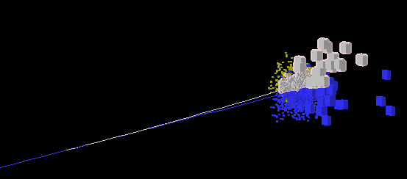
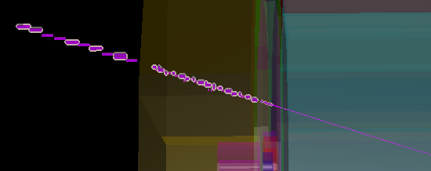
Split Tracks
A problem affecting both particle identification and jet energy reconstruction is that of “split tracks”.
These occur when the path of a single particle is reconstructed as two or more separate tracks, sometimes because of incorrect matching of track segments in the different tracking detectors.
The result is an excess of tracks in an event. Often the split tracks have near-identical reconstructed properties (helix fits and projected states at the ECal surface), all of which serves only to confuse the reconstruction.
Split segment 1
Split segment 2
Track splits lead to division of hits between two PFOs
In the Pandora reconstruction, a cluster must only have one associated track at the point of PFO construction. If this fails to be the case, the cluster is divided between the N associated tracks, based on distance to the track projection. This can clearly damage particle identification.
Excess tracks can often be declared as suitable for PFO formation, so the track energy will make an artificial contribution to the final reconstructed energy. This causes problems, although the excess tracks often become associated with neutral clusters, removing the cluster energy from the event and compensating for the initial bias.

Slide 8
Split Tracks
In order to address the issue of split tracks, changes need to be made to the FullLDCTracking processor. Some changes have already been made available in the FullLDCTrackingCLIC processor.
Last month, Mark took another look at the problem, creating a new FullLDCTrackingSPLIT processor. This processor uses new logic to combine TPC segments and it also checks all potential merges by applying a Kalman filter and examining the goodness of fit.
Examining reconstructed Z→uds events, we see that FullLDCTrackingCLIC processor makes little difference to the energy resolutions for jet energies in the range 45-500GeV.
However, the new FullLDCTrackingSPLIT processor makes a difference at higher energies. Improvements of this size are important and are quite difficult to come-by with simple changes.
Jet energy resolutions with default split-track correction (via Kinkfinder and Pandora track associations):
E_{j} | 45GeV | 100GeV | 250GeV | 500GeV
FullLDCTracking processor, rms₉₀(E_{j}) / E_{j} | 3.58 ± 0.11 | 2.95 ± 0.08 | 2.87 ± 0.07 | 3.03 ± 0.07
FullLDCTrackingCLIC processor, rms₉₀(E_{j}) / E_{j} | 3.61 ± 0.11 | 2.93 ± 0.08 | 2.89 ± 0.07 | 3.03 ± 0.07
FullLDCTrackingSPLIT processor, rms₉₀(E_{j}) / E_{j} | 3.60 ± 0.11 | 2.93 ± 0.08 | 2.84 ± 0.07 | 3.00 ± 0.07
Performance is quoted in terms of rms₉₀, the rms in the smallest range of reconstructed energy containing 90% of the events. The total energy is reconstructed and the jet energy resolution obtained by dividing the total energy resolution by √2. A cut on the polar angle is applied to avoid the barrel/endcap overlap region: |cos θ| < 0.7

Slide 9
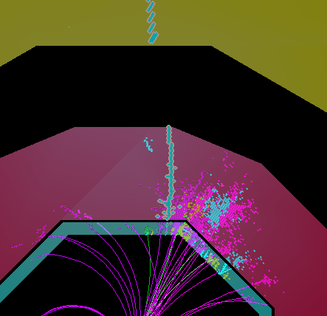
Current Plans
One of the difficulties with implementing new code to improve particle identification, is that it must not harm the standard Pandora jet energy reconstruction.
This tension between particle id and jet energy reconstruction is reduced if we can quickly identify specific particles in events and then remove them from the bulk of the reconstruction.
Amongst our plans for the next few months are ideas to identify and remove muons and photons at an early stage. We are starting to work with Erik on a new muon clustering idea:
1
Identify muon cluster
Identify tpc track associated with muon
Use standard clustering to create finely divided cluster fragments in ECal/HCal (no topological associations)
Identify relevant ECal/HCal cluster fragments
Tag PFO as muon and remove from reconstruction
3, 4
2
We have also experimented with the GARLIC photon id package. Used new ExternalClusteringAlgorithm in MarlinPandora to reconstruct GARLIC photon clusters within Pandora and remove calo hits from reconstruction.
Works very well at 500GeV (rms₉₀(E_{j}) / E_{j} 2.87→2.80), but harms reconstruction at low energies (91-200GeV) and has little impact at 1TeV. In long term, will return to this idea to fully understand behaviour.

Slide 10
Current Plans
Other development plans of note:
  Continued improvement of standard particle id, in particular ensuring minimisation of “false positives”.
  Examination of any events with poor energy reconstruction; identify and fix any problems.
  Addition of a new, suitably different, clustering algorithm to provide new approaches in the reclustering phase. Previous work with forced reclustering indicates that this could prove important.
To conclude:
  Recent changes have helped address problems with high energy electron reconstruction.
  Promising work has been carried out to tackle the causes of split tracks.
  Plans are proceeding for new approaches to muon and photon id, removing these particles early in the reconstruction and thereby reducing the tension between particle id and jet energy reconstruction.
  Many other technical and cosmetic changes have also been made in the past few months, meaning that the Pandora code is cleaner and more efficient than ever before:
  Pandora is currently ready for large scale processing,
  but improvements will continue to be made.

