Slide 1

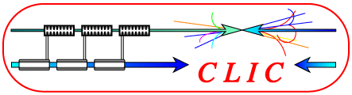

(First glimse on) Tracking Performance of CLIC_SiD_CDR
September 27, 2010
Christian Grefe
CERN, Bonn University
Notes:
1

Slide 2
Samples available for Study
Single e- und mu- samples (10000 each)
  Fixed energies (1, 2, 5, 10, 100), angles: 4 pi
  Fixed angles (Theta=10, 20, 30, 40, 50, 60, 70, 80, 90), energy: 0.1-100 GeV
e+ e- -> Hnunu (10000 each)
  H -> bb
  H -> cc
  H -> mumu
e+ e- -> Z -> uds (10000 each)
  91, 250, 500, 1000, 2000 GeV
e+ e- -> tt, 3TeV ( ~ 13000)
gg -> hadrons
Incoherent pairs (full bunch train)

Slide 3
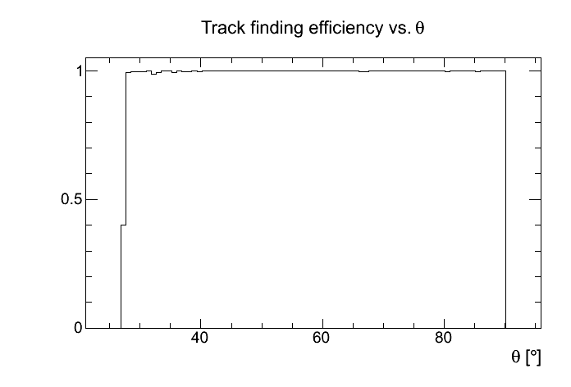
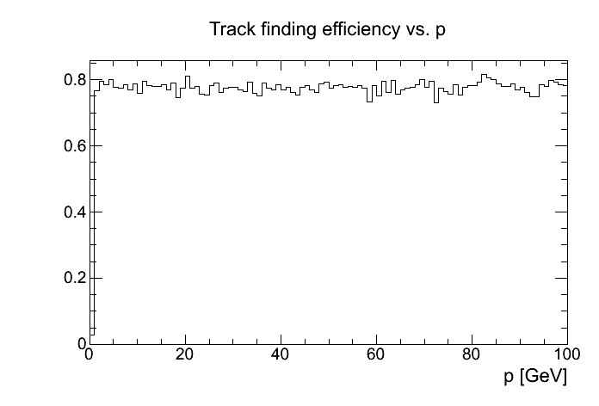
Muons
100 % finding of single muons within the acceptance (the known bug reduces acceptance from 8° to around 25°)
Missing efficiency vs. p due to limited acceptance

Slide 4
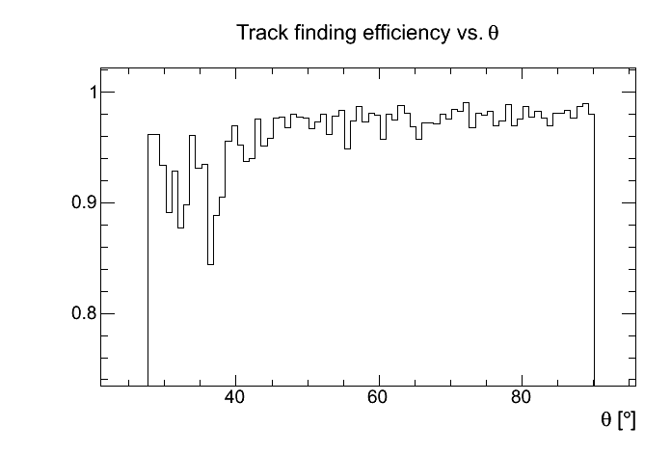
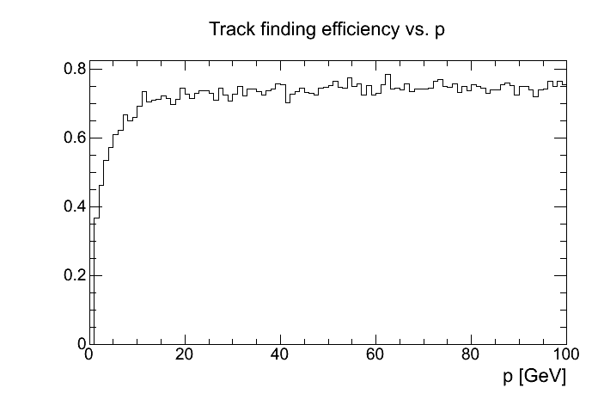
Electrons
Around 95% efficiency within anglular acceptance
Problems for p < 20 GeV

Slide 5
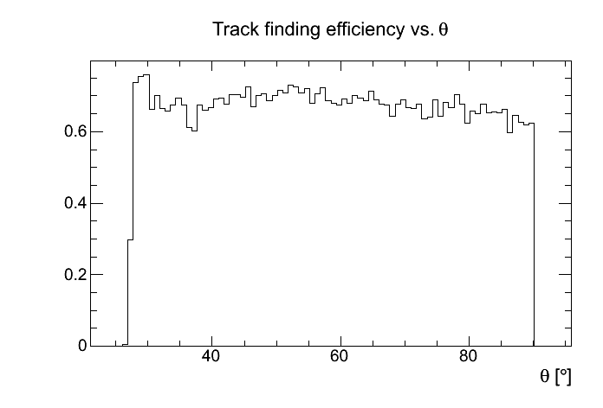
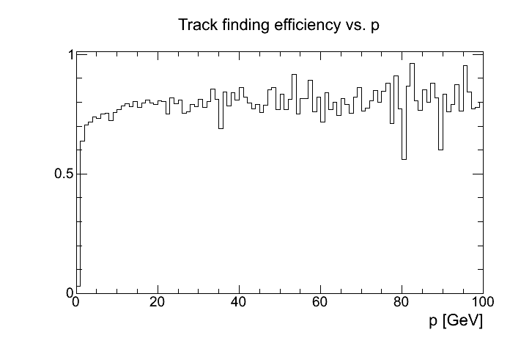
Z -> uds @ 1TeV
Need to work on low pt tracks in the barrel

Slide 6
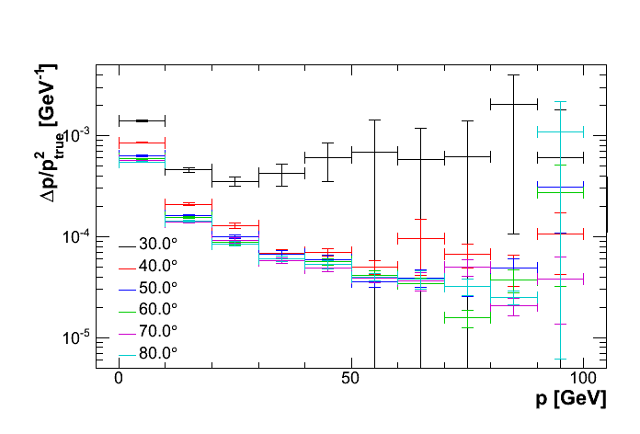
Momentum Resolution
Compatible with 5*10⁻⁵ (1/GeV) for theta > 30°

Slide 7
Outlook
Need to tune strategies further
Include backgrounds
  All samples at hand
  1BX of incoherent pairs is ~150MB (only tracker hit collections) -> possible to overlay a few BX
Fix forward track finding bug in CircleFitter

