Slide 1
PS Coupled-Bunch Feedback
Jan Paszkiewicz, Alexandre Lasheen, Ben Woolley, Heiko Damerau
15/09/2021

Slide 2
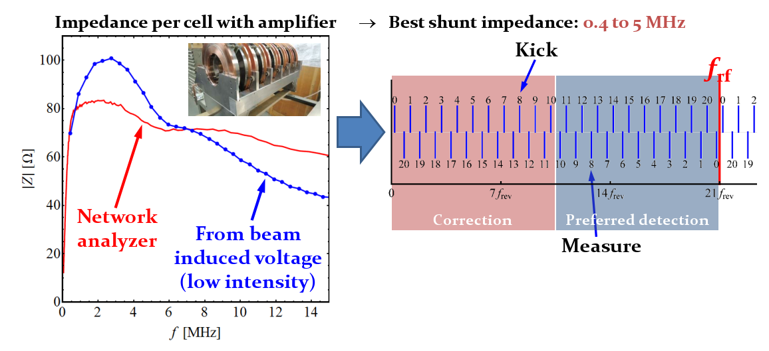
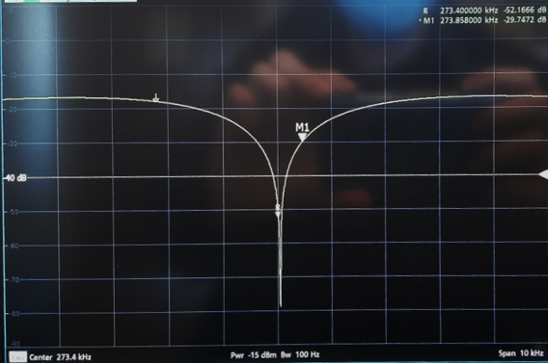
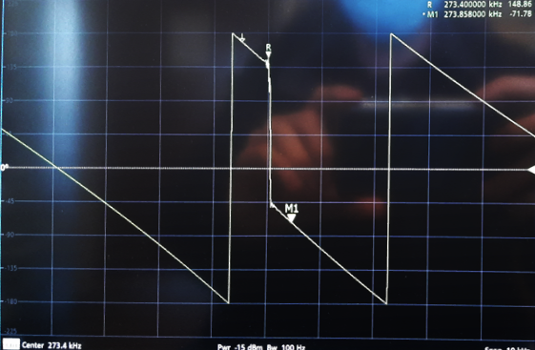
Summary of PS Coupled-Bunch Feedback
Frequency-domain coupled-bunch feedback system
Mirroring of spectrum: USB of h20 → LSB of h1, etc.
  Optimise frequency response of wideband longitudinal kicker cavity.
Central notch filter to remove frev harmonic.
10 signal processing channels spread over 3 1TFB boards.
Control of feedback gains and excitation parameters with programmable functions.
Acquisition of baseband signals at 10 kHz sample rate.
Magnitude response around f_{rev} harmonic:
Phase response:
180° step at centre.

Slide 3
DSP Channel Block Diagram
sample rates: 30 MHz 7.5 MHz 468 kHz 10 kHz
Cavity feedback enable flag
Complex gain
Bit shift register
Cavity return
IQ conv.
1st order IIR LPF
CIC
↓4
Complex multiply
CIC
↑4
50 MHz clock domain
h_{out} register
CIC
↓50
Acq
SRAM
Σ
IQ conv.
Out
h_{out} register
IQ conv.
1st order IIR HPF
CIC
↓64
Complex multiply
Σ
CIC
↑64
Beam
h_{in} register
Complex gain
DDS sin & cos
Excitation and CBFB enable flags
Sideband swap register
Bit shift register

Slide 4
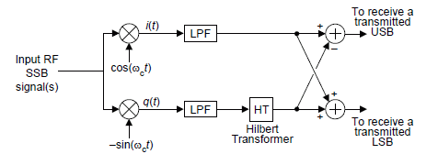
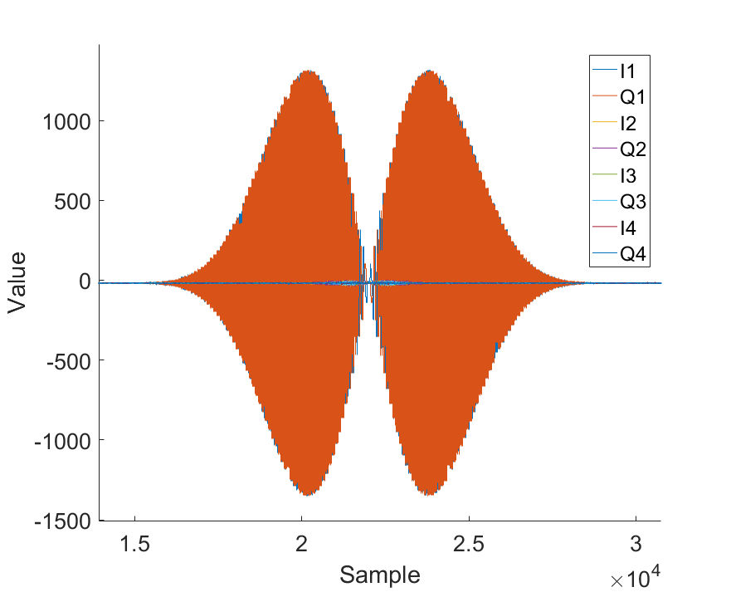
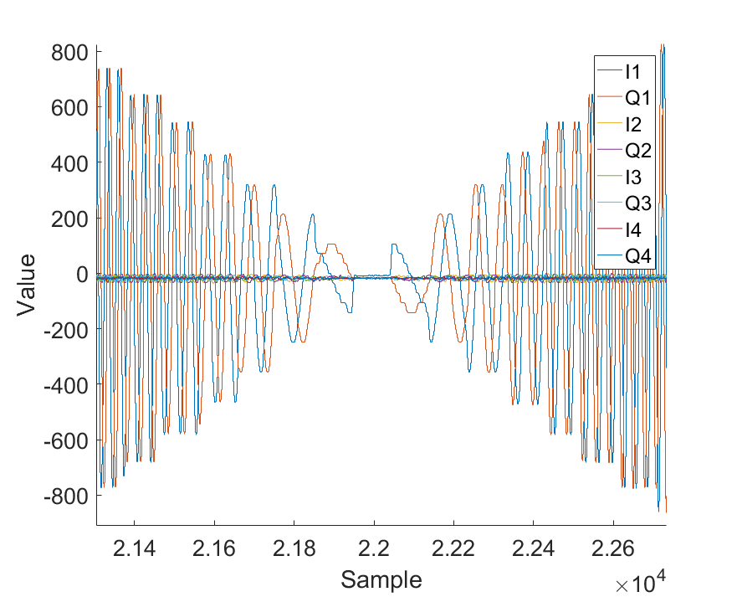
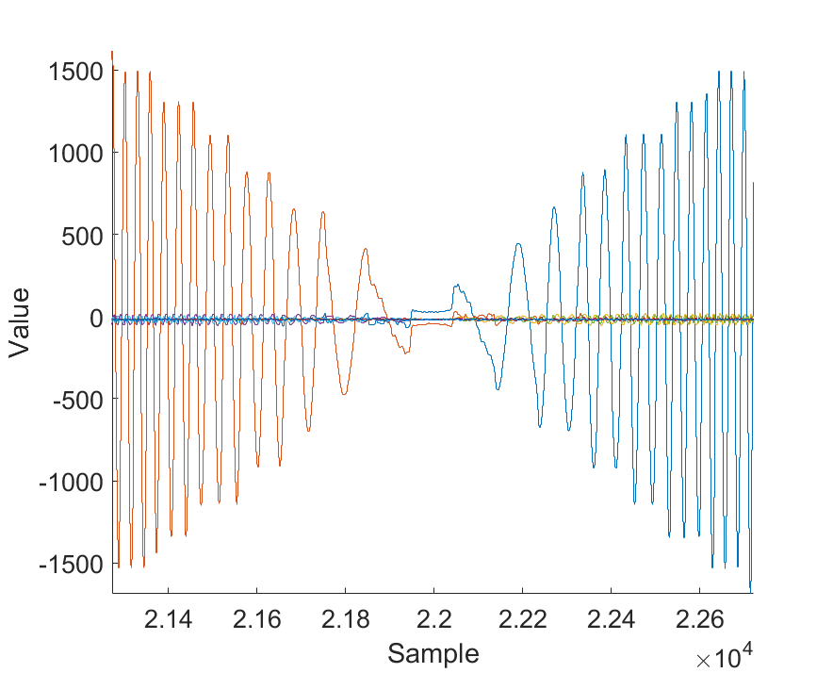
Acquired Data Examples and Processing
Data sampled after high-pass filter to remove f_{rev} harmonic.
Single-sideband demodulation done in post-processing.
Frequency sweep from VNA:
Zoomed in, raw IQ data:
With SSB demodulation:
LSB USB

Slide 5
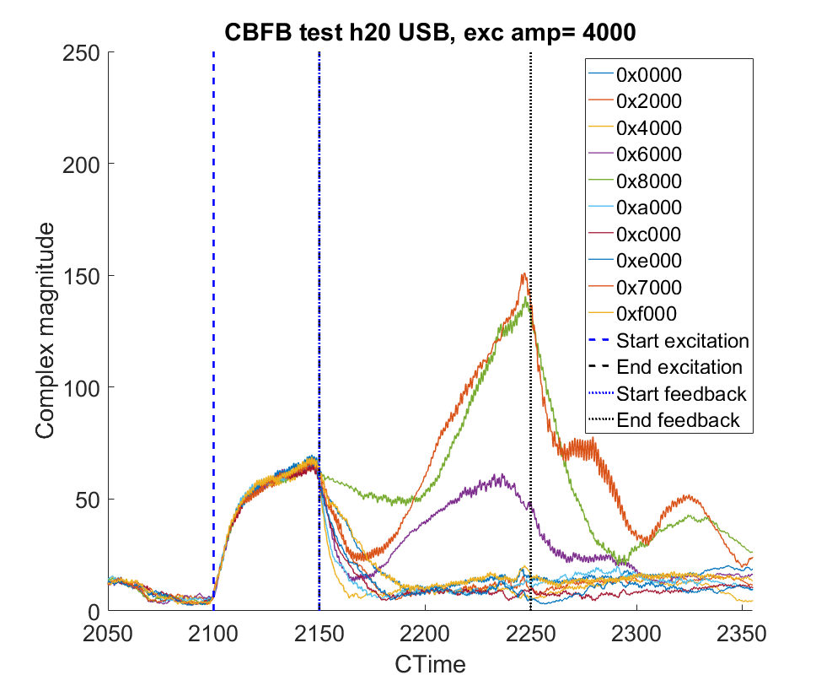
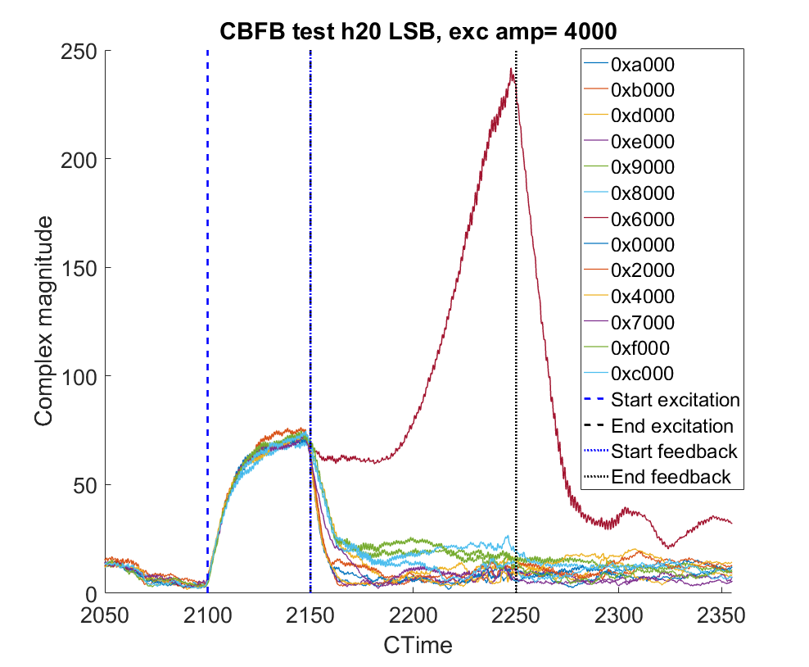
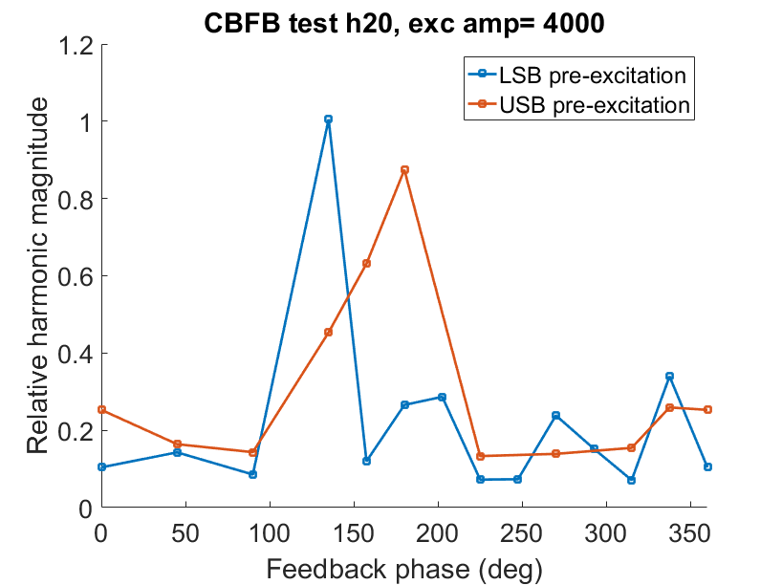
Tuning: Phase Scan Methodology
Excite coupled-bunch oscillations using the DDS between 2100 and 2150 ms (Left: excitation on USB, middle: excitation on LSB. Plots show total baseband magnitude vs time for various feedback phase values).
Activate feedback between 2150 and 2250 ms.
Calculate ratio of baseband magnitude during feedback to baseband magnitude during excitation for different phase values. Lower values indicate stronger damping.
Final feedback phase chosen in the middle of the stable range for each channel.
Chosen phase

Slide 6
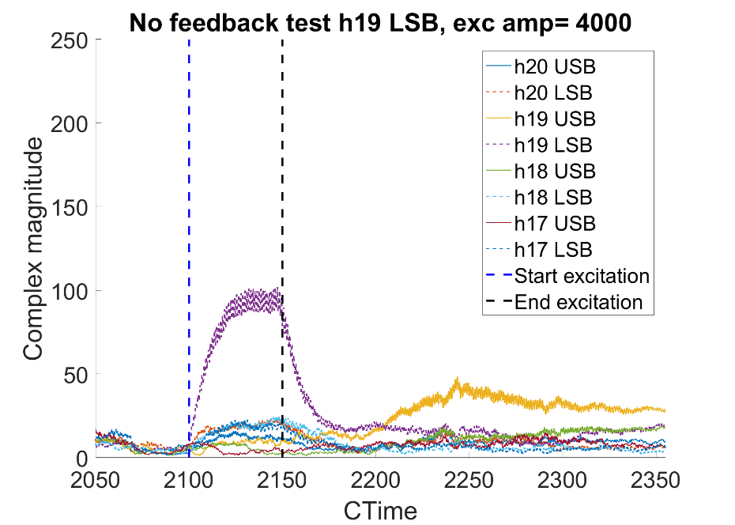
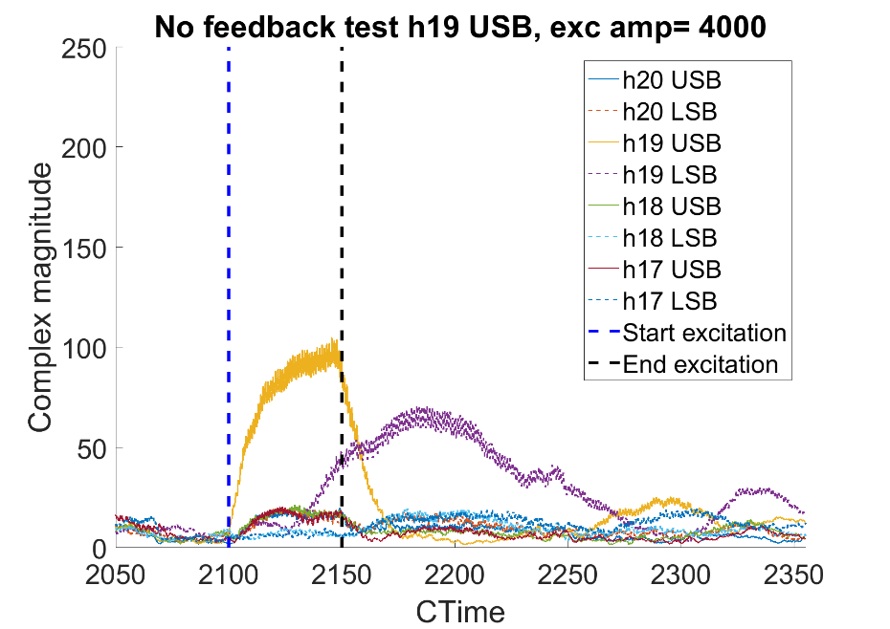
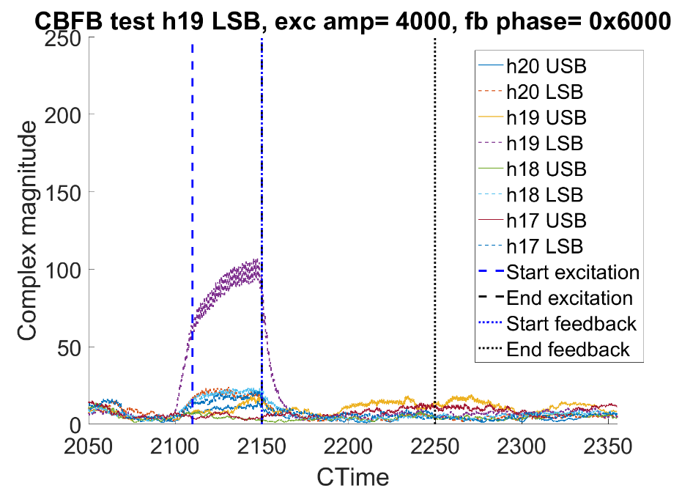
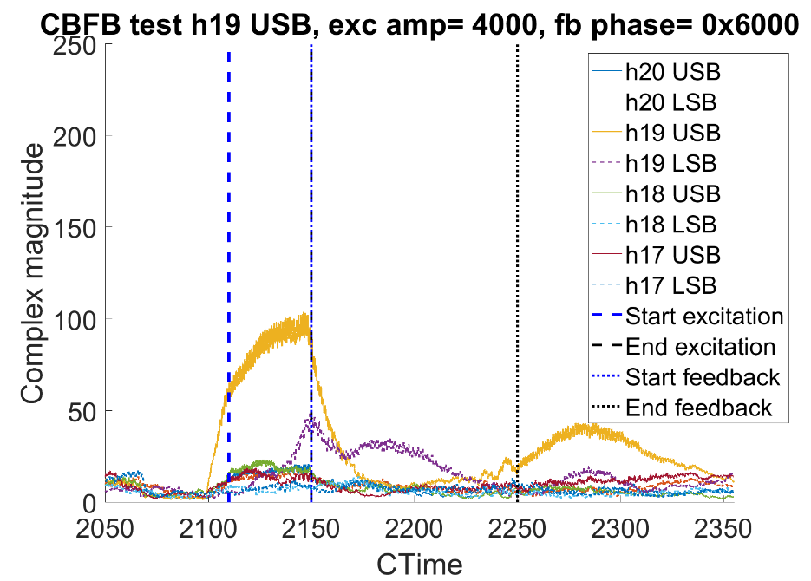
H19:
Phase: 0x6000
Bit shift: 10.
Excitation on LSB:
Excitation on USB:
Excitation with no feedback:
Excitation followed by feedback:

Slide 7
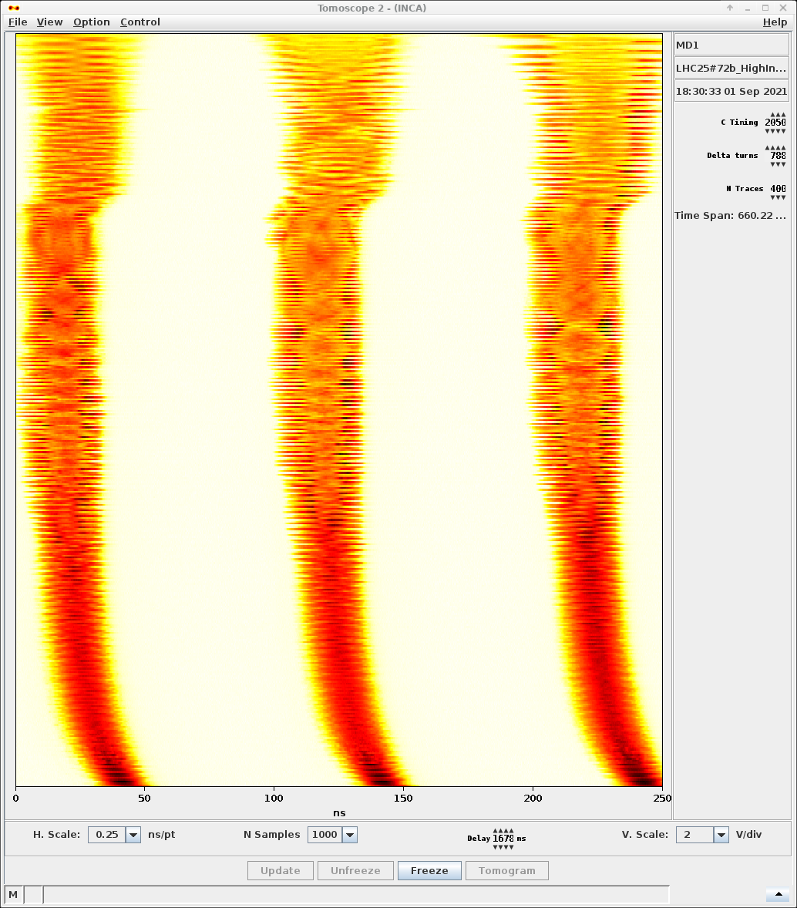
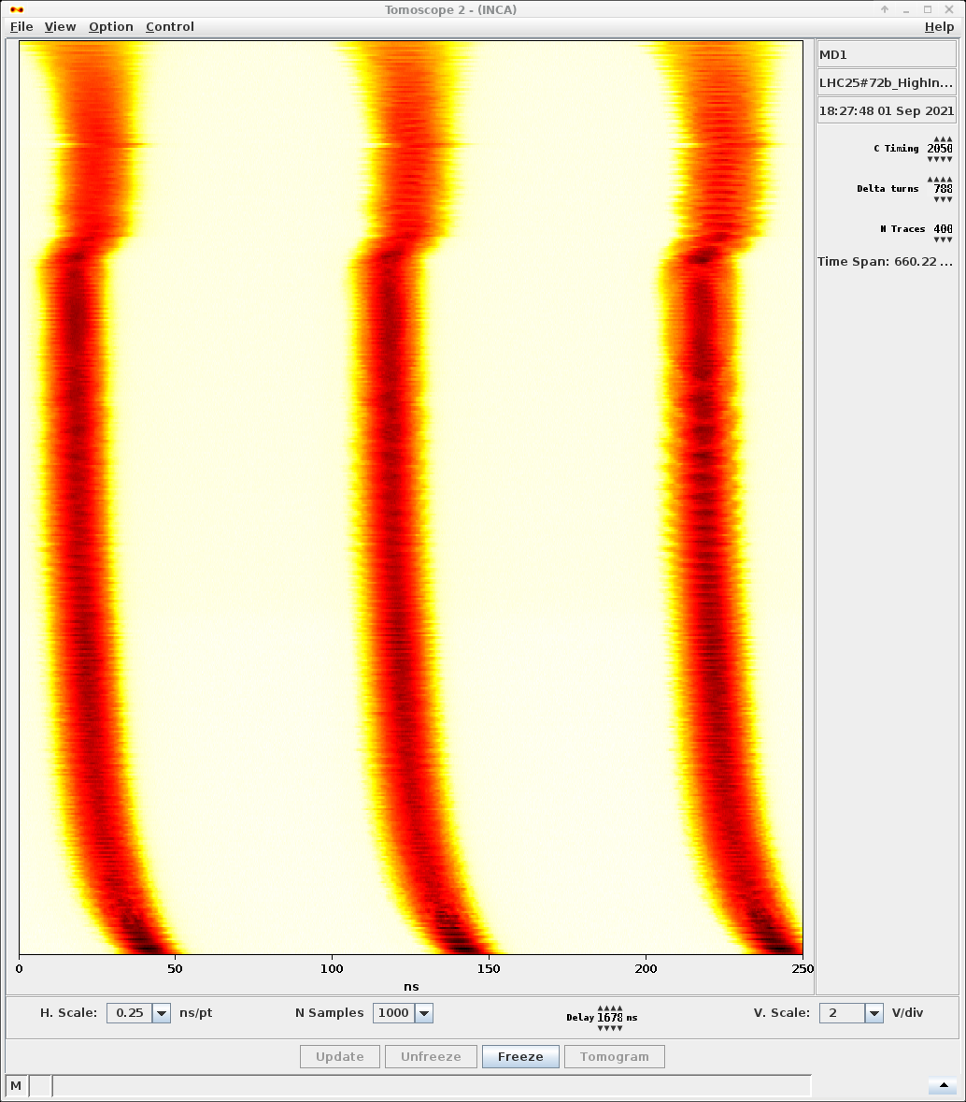
Use in Operations
Significant improvement in beam quality at high intensities.
Residual quadrupolar oscillations.
Without feedback:
With feedback:

Slide 8
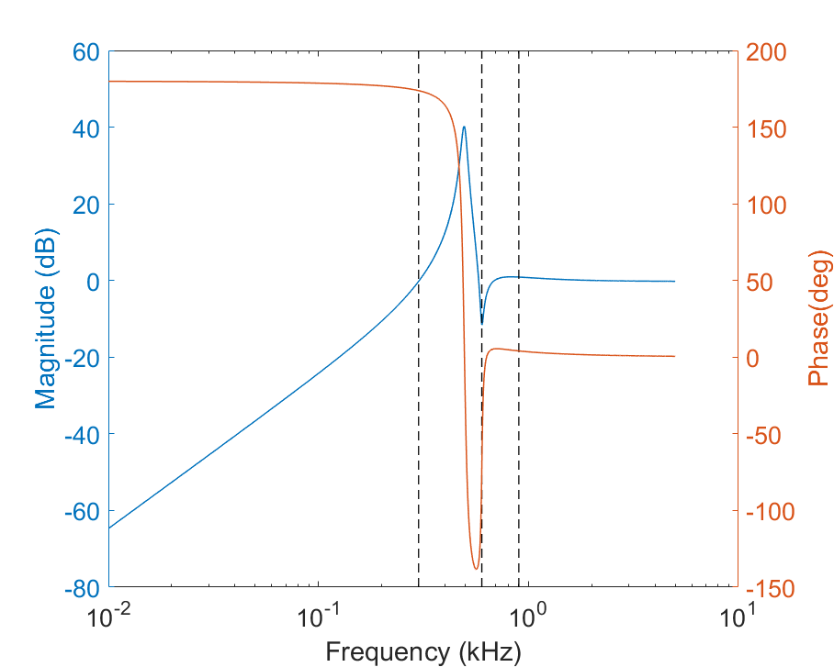
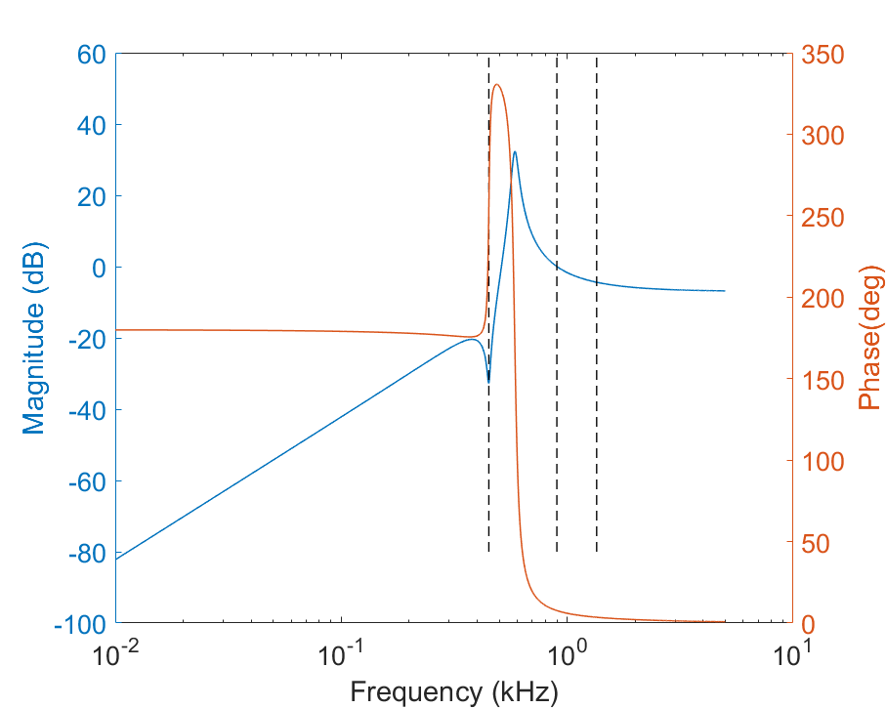
Quadrupole Mode Tracking Filters
IIR filters to separate dipole and quadrpole modes.
  Put poles in between synchrotron harmonics.
  High Q: ‘compresses’ phase response so group delay is high over a small range of frequencies, but low otherwise.
  Produces peak in magnitude response, but no signal expected there.
  Filter needs to track synchrotron frequency during ramping.
Specification for dipole mode filter:
Specification for quadrupole mode filter:

Slide 9
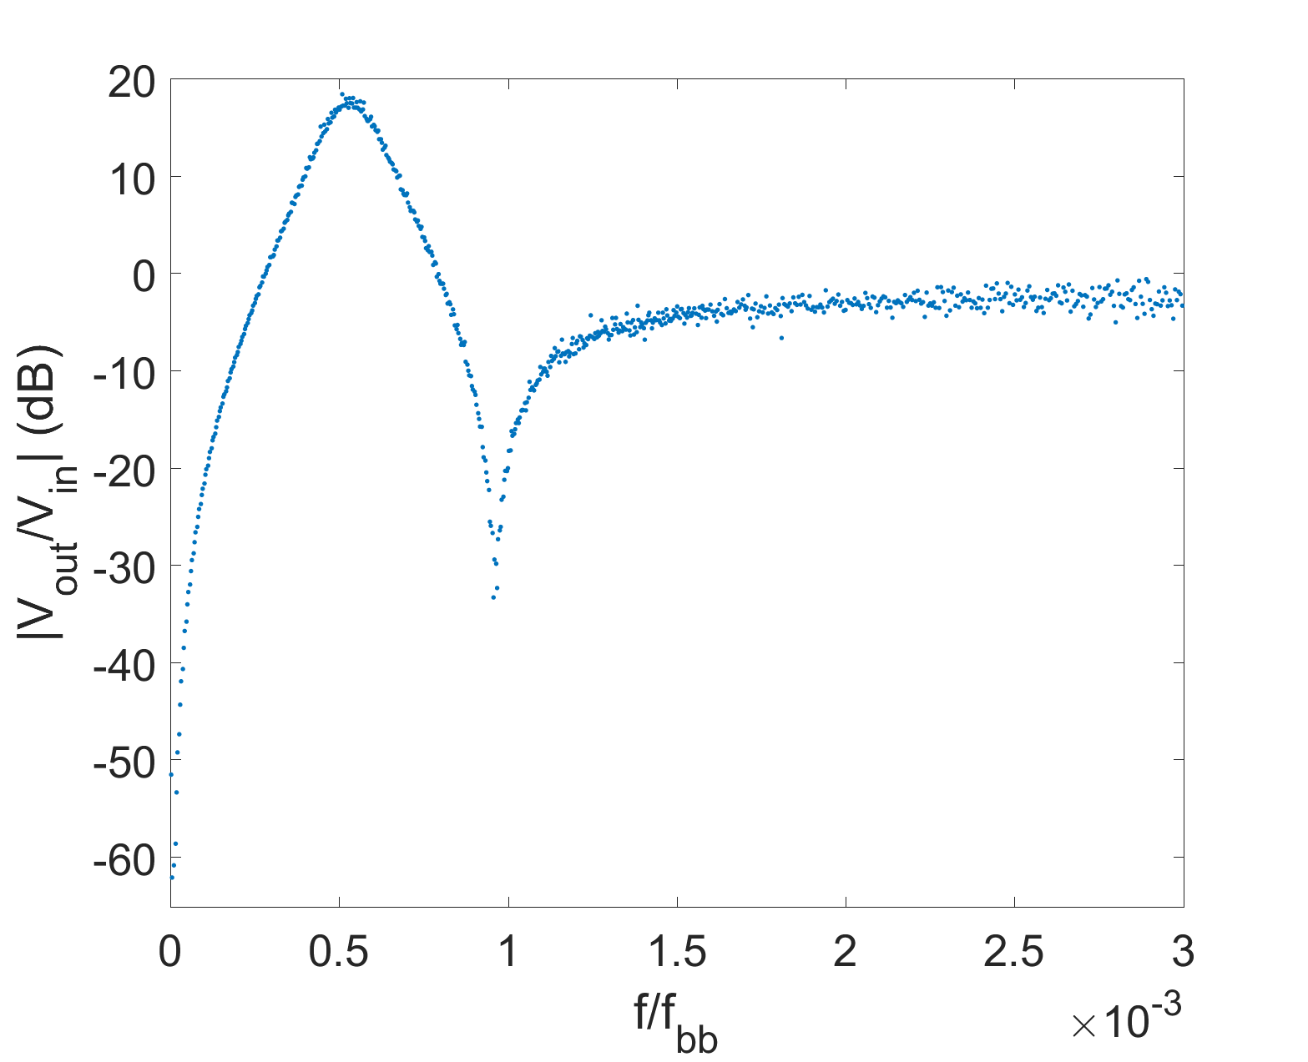
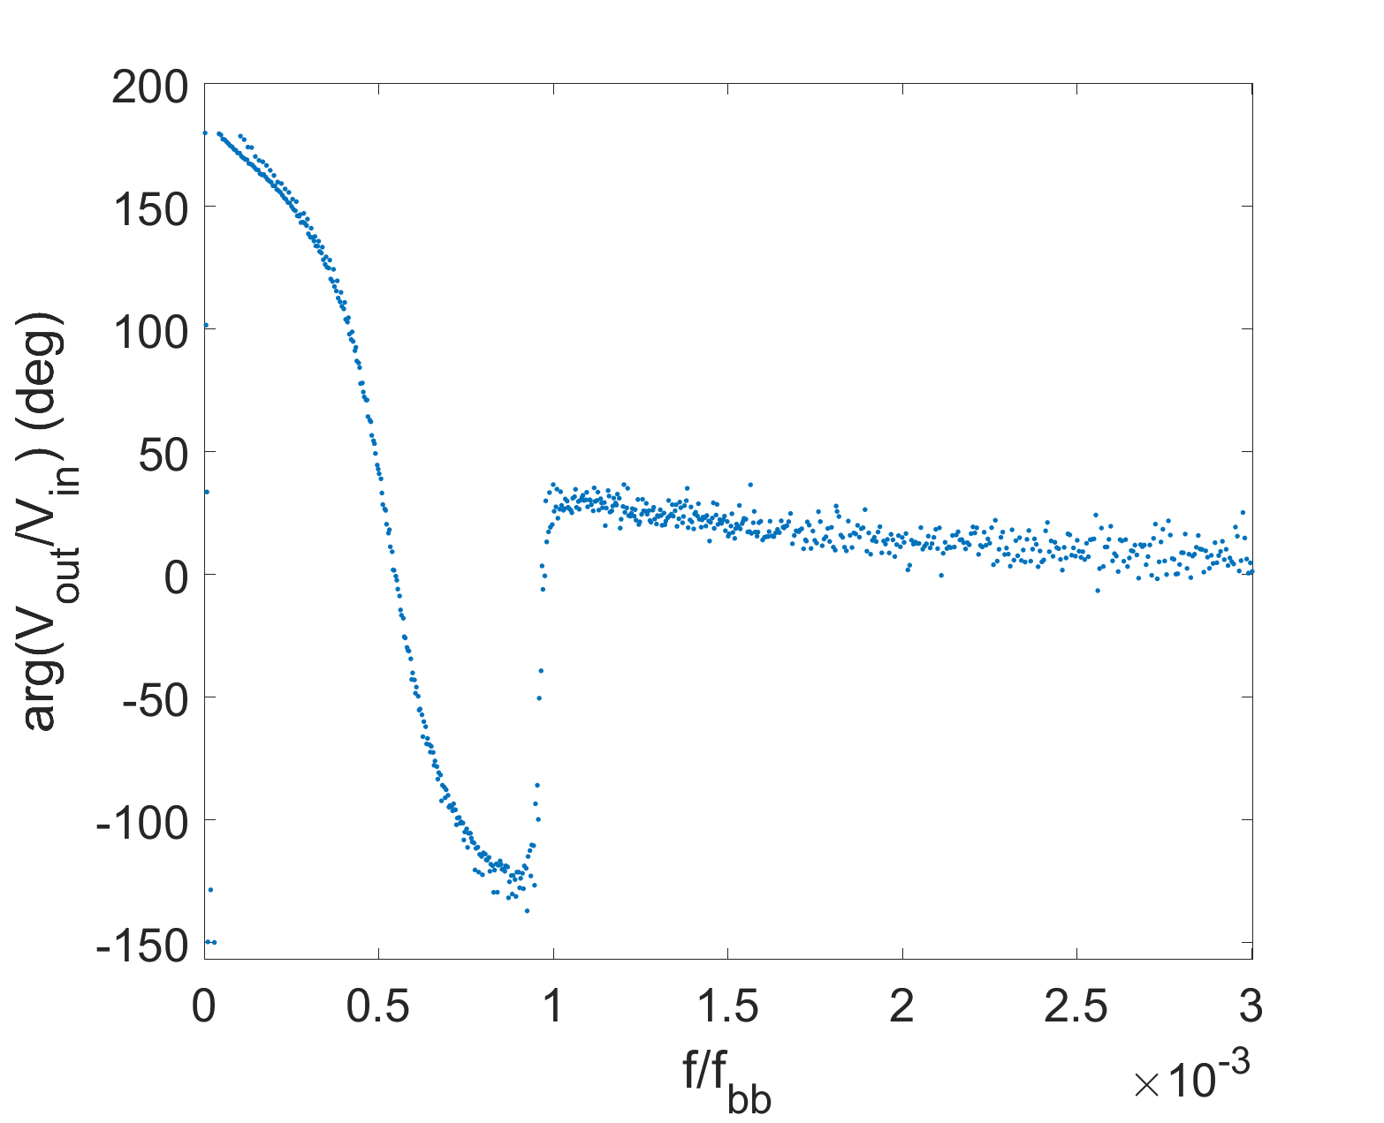
Quadrupole Mode IIR Filters
ModelSim simulation of quadrupole filter:
As in previous talk: put poles in between synchrotron harmonics.
  High Q: ‘compresses’ phase response so group delay is high over a small range of frequencies, but low otherwise.
  Produces peak in magnitude response, but no signal expected there.
  Filter needs to track synchrotron frequency during ramping.
Plan to implement using a sequential DSP core.
  2-stage biquad filter: ~40 multiply-accumulate operations per sample per harmonic.
  Performs well in RTL simulation.
  Details of coefficient sweep still under evaluation.
Notch at dipole frequency
Low delay at quadrupole frequency

Slide 10
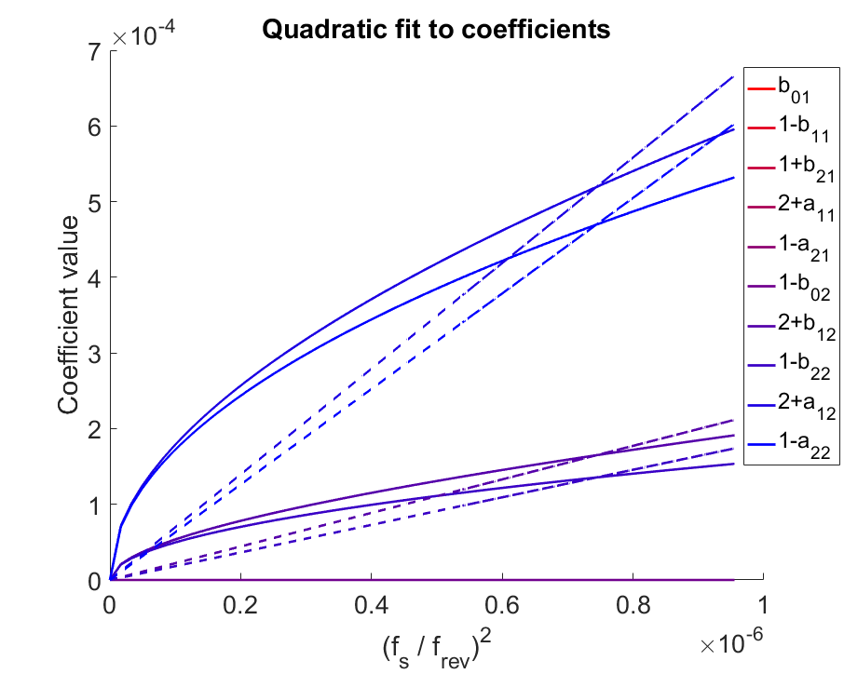
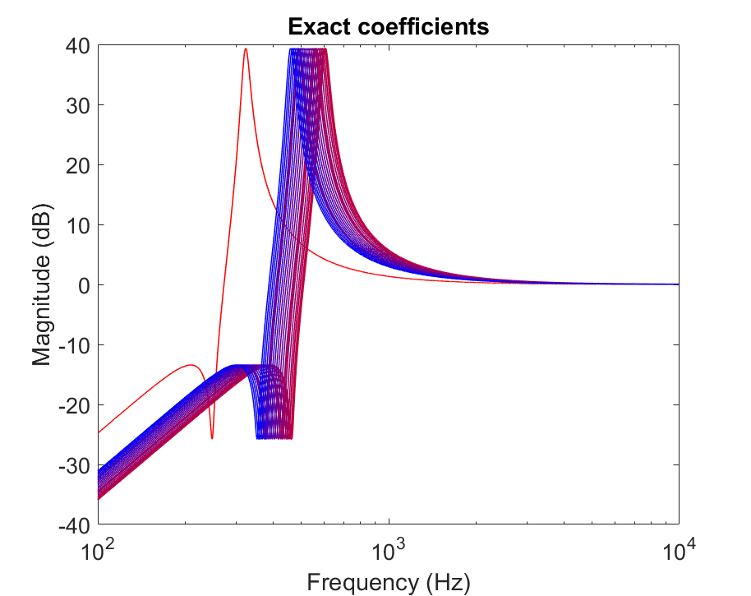
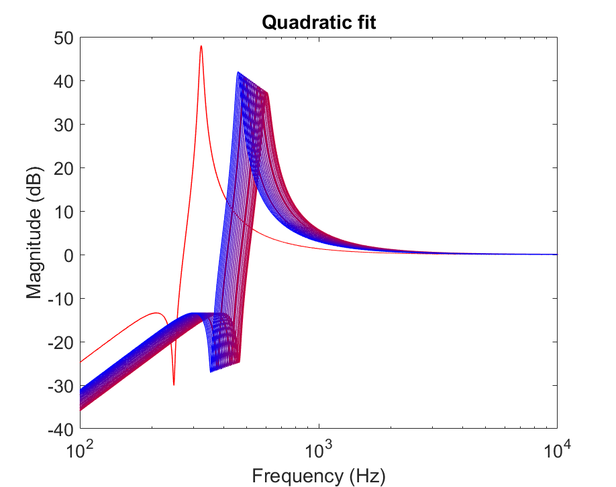
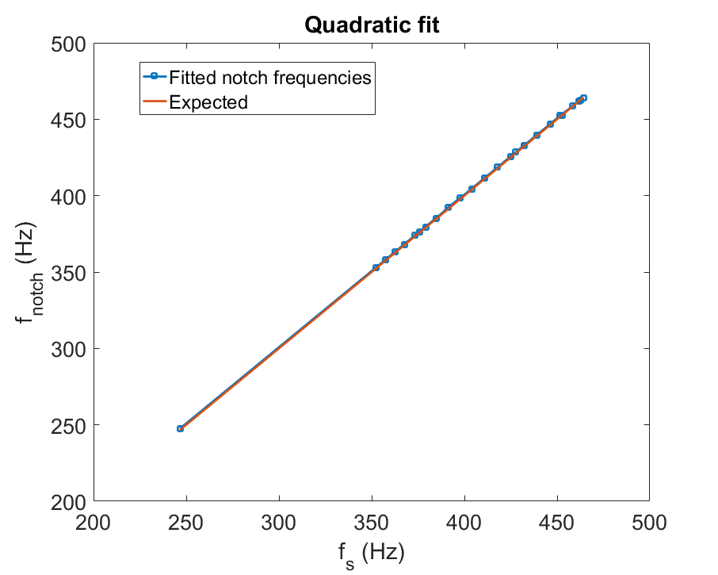
IIR Filter Coefficient Sweeping
Coefficient values from MATLAB vary with synchrotron frequency in a complex way.
  Not enough FPGA resources to implement a separate function for each coefficient.
  Use one function from FGC, then apply linear offset and scaling to obtain each coefficient.
  Using (f_{s} / f_{rev})² as the FGC function reproduces the notch frequencies exactly.

Slide 11
Questions for J-PARC Group
What are your experiences with your CBFB architecture?
  Tolerance to programmed synchrotron frequency function?
  How easy is the system to tune, and how often does this need to be done?
Do you have any insights to help us choose a baseband filter?
  IIR filter proposed in this presentation vs. tracking CIC filter
  eg. : group delay, rejection of unwanted coupled-bunch modes

