Slide 1
How to port your code from CUDA to SYCL, targeting Nvidia GPUs and more
Joe Todd – Senior Software Engineer
Notes:
Abstract:
Codeplay's contributions are helping developers target Nvidia GPUs using SYCL and oneAPI, and researchers using the pre-exascale supercomputer Perlmutter are developing software using SYCL and oneAPI.
By using SYCL and oneAPI developers can widen their targets, with Nvidia GPUs, Intel GPUs and AMD GPUs supported by the DPC++ compiler project.
This session will help you to understand how you can port your CUDA code to SYCL and continue to target Nvidia GPUs and retain a good level of performance. Using nbody simulation project code written in CUDA we will show how the code is automatically translated to SYCL and then compiled using the DPC++ compiler. Furthermore we will present some performance tips and tricks to ensure you can get the best performance from your SYCL code on Nvidia GPUs.

Slide 2

Nvidia is a registered trademark of NVIDIA Corporation
Intel is a registered trademark of Intel Corporation
SYCL, SPIR are trademarks of the Khronos Group Inc. OpenCL and the OpenCL logo are trademarks of Apple Inc. used by permission by Khronos

Slide 3
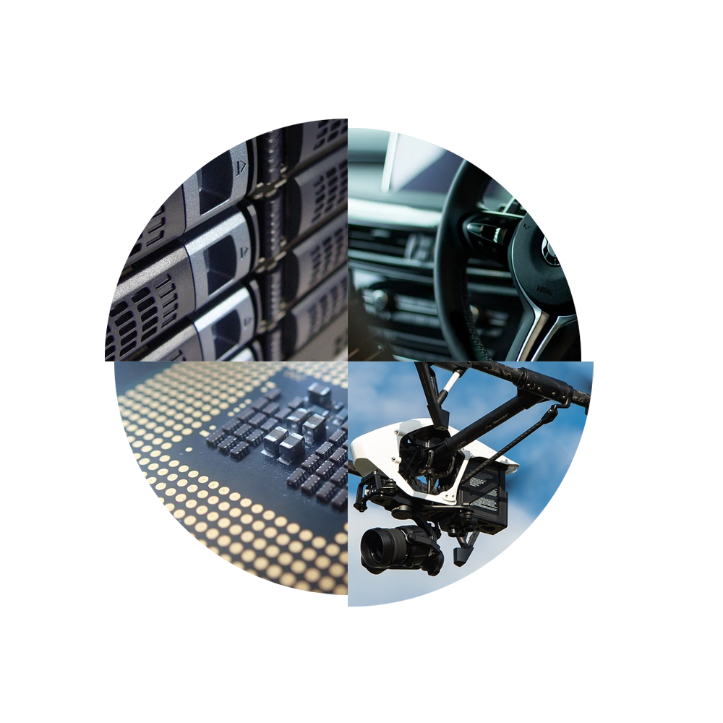











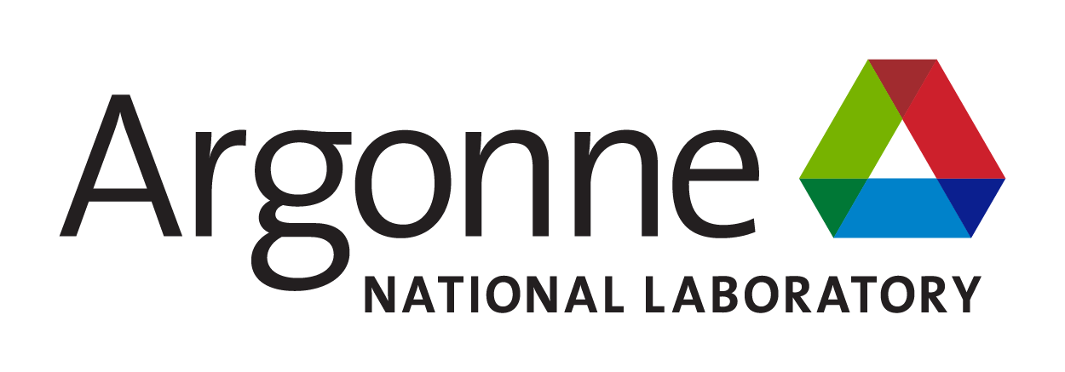



Company
Partners
Leaders in enabling high-performance software solutions for new AI processing systems
Enabling the toughest processors with tools and middleware based on open standards
Established 2002 in Scotland with ~80 employees
Enabling AI & HPC to be Open, Safe & Accessible to All
And many more!
Products
Markets
High Performance Compute (HPC)
Automotive ADAS, IoT, Cloud Compute
Smartphones & Tablets
Medical & Industrial
Technologies: Artificial Intelligence
Vision Processing
Machine Learning
Big Data Compute
Integrates all the industry standard technologies needed to support a very wide range of AI and HPC
The heart of Codeplay's compute technology enabling OpenCL™, SPIR-V™, HSA™ and Vulkan™
C++ platform via the SYCL™ open standard, enabling vision & machine learning e.g. TensorFlow™
Notes:
Codeplay is based in Edinburgh, Scotland with around 80 staff, mostly engineers working on open standards projects.
We contribute to multiple open standards bodies and specifications including OpenCL and SYCL.
We work with customers worldwide, in particular we have recently been working with key National Laboratories in the US to enable SYCL for some of the fastest supercomputers in the world according to top500.
We also have teams developing support for new processor architectures including those from Renesas R-Car and we are also working with organizations implementing processors using the RISC-V Vector Extension.

Slide 4
Migrating from CUDA to SYCL
Why migrate from CUDA to SYCL?
How to convert CUDA code to SYCL?
How does the code compare?
How to achieve performance using SYCL?

Slide 5
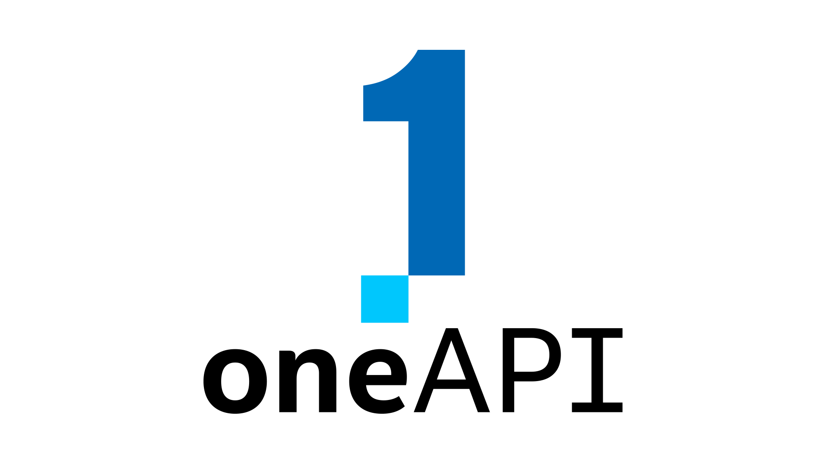
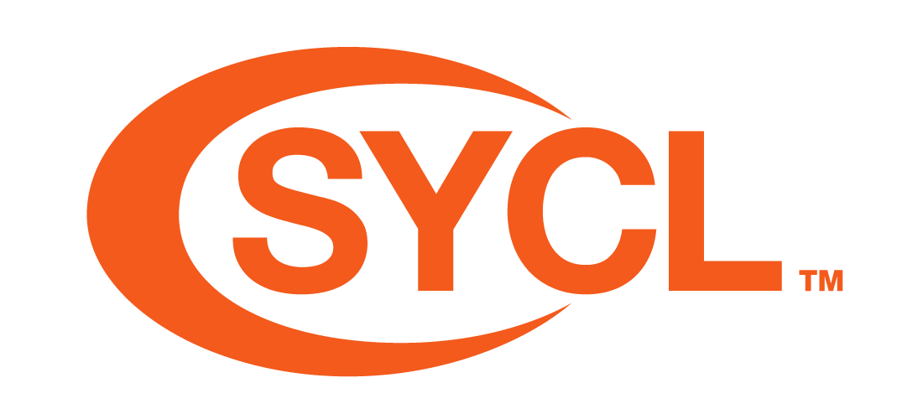
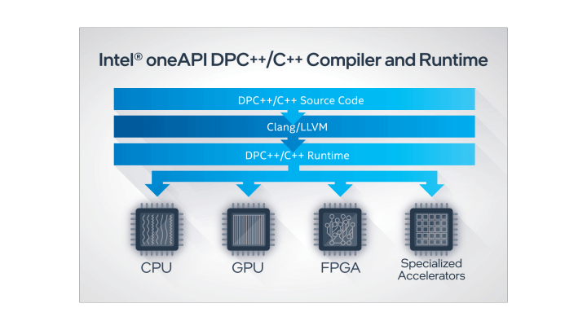
oneAPI and SYCL
SYCL sits at the heart of oneAPI
Provides an open standard interface for developers
Defined by the industry
SYCL source code
Notes:
oneAPI and SYCL are working together to bring developers an open standard environment for developers. oneAPI provides developers with a platform to build accelerated software, and SYCL sits at the heart of oneAPI, providing a mature, open standard interface for developers. When you write code using the oneAPI platform, you will be using the SYCL interface to interact with the low level hardware on your machine, whether that is targeting Intel GPUs, Nvidia GPUs or AMD GPUs. The DPC++ compiler is an implementation of the SYCL standard, and makes targeting massively parallel hardware architectures simple, and provides you with portability across different targets. The SYCL standard is defined by the whole industry, with myself as the chair, members from many major processor vendors, national laboratories and research groups ensuring that the standard continues to meet the needs of companies making processors and the software developers who want to easily target these processors.

Slide 6
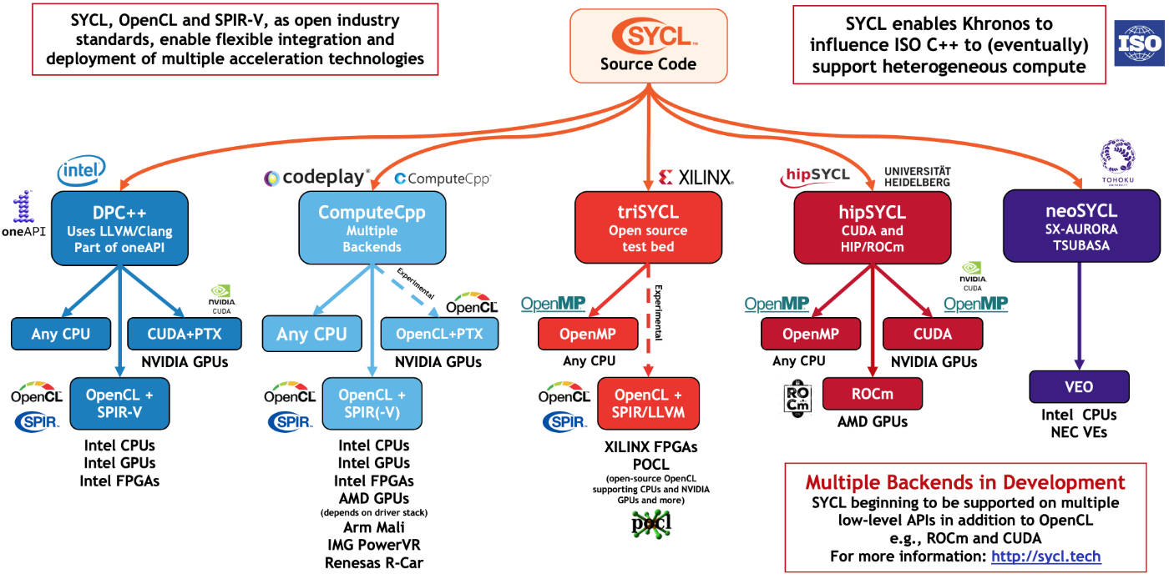
Why Migrate from CUDA to SYCL?
CUDA is a proprietary interface
Can only be used to target Nvidia GPUs
SYCL is an open standard interface
SYCL can be used to target Nvidia, Intel and AMD processors

Slide 7
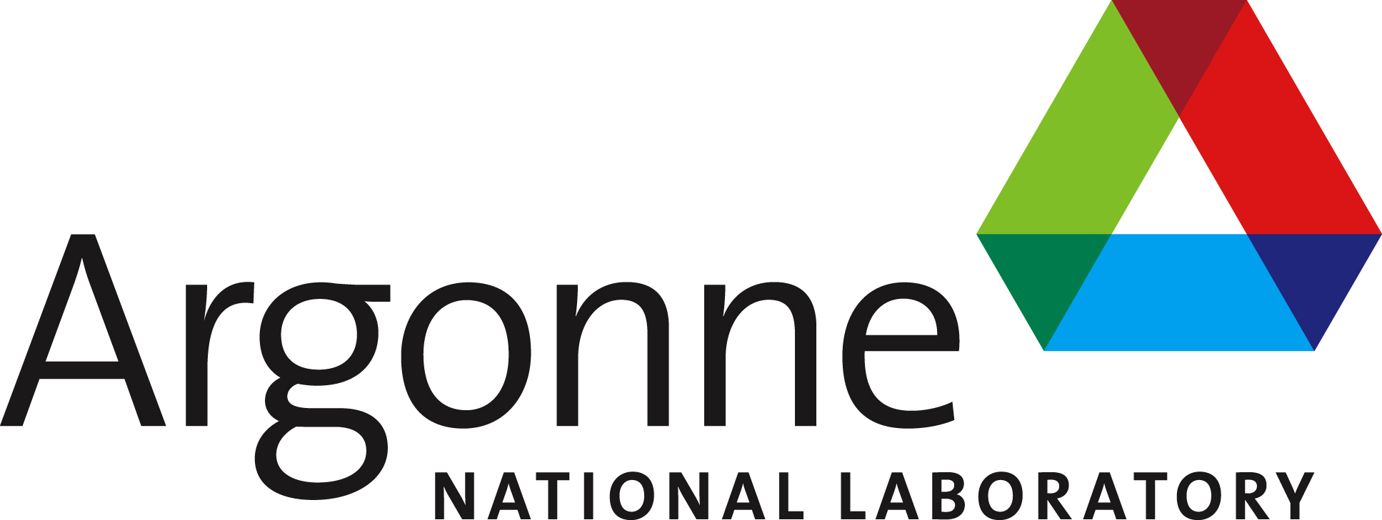
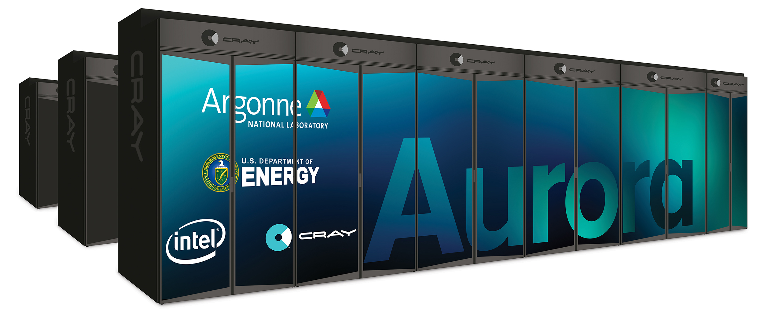

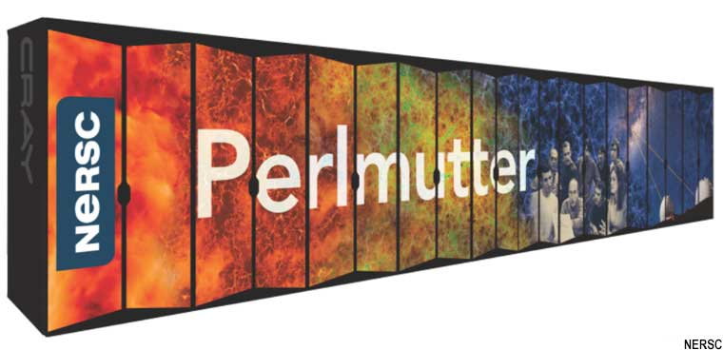

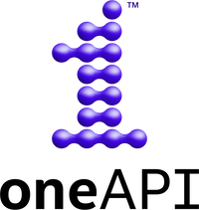

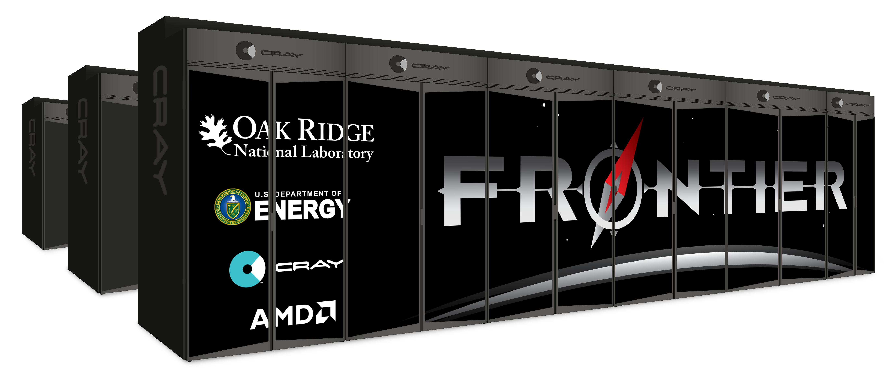
SYCL on the Fastest Supercomputers
SYCL is deployed on some of the fastest supercomputers
Codeplay develops and maintains SYCL for Perlmutter and Frontier
Intel GPUs
NVIDIA GPUs
AMD GPUs

Slide 8
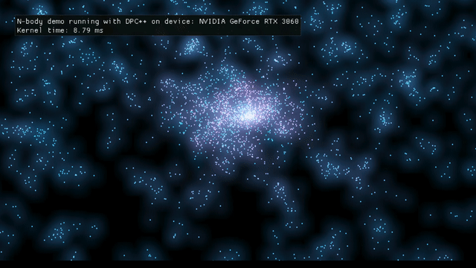
Overview
Simple case study using the Intel DPC++ Compatibility Tool to convert a small CUDA project to SYCL, will cover:
N-Body Simulation
Using the DPCT conversion tool
Quick look at DPCT output
Performance
Caveats

Slide 9
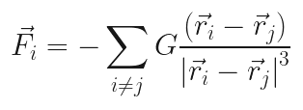
N-Body
Simulates gravitational interaction in a fictional galaxy
Intentionally simple kernel
  No use of shared memory
  O(N²) computation
OpenGL for graphics (in separate TUs)
Notes:
Simulation details, simplicity, blah

Slide 10
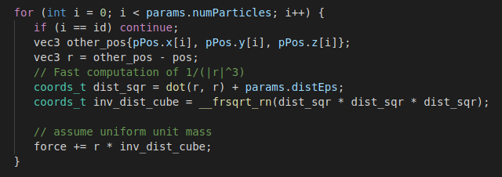
N-Body

Slide 11
N-Body
Designed to be accessible – please try it out!
  https://github.com/codeplaysoftware/cuda-to-sycl-nbody
Single .cu file (simulator.cu)
Lots of scripts provided to:
  Convert with DPCT
  Build the CUDA & SYCL demos
  Run them (even without X graphical output)

Slide 12
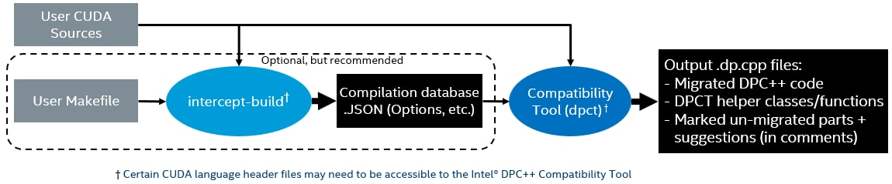
Intel DPC++ Compatibility Tool (DPCT)
Converts CUDA code to SYCL
Operates on individual .cu files
  But can `intercept-build make` to generate list of DPCT conversions
Promises ~90% code conversion
  Managed 100% for N-Body!
Verbose warnings in SYCL output

Slide 13
DPCT output

Slide 14
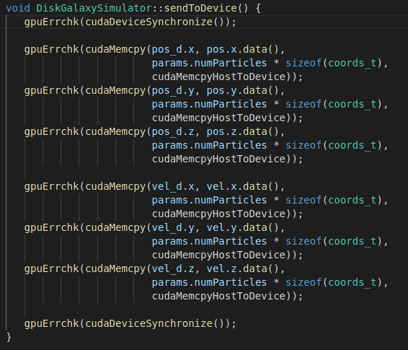
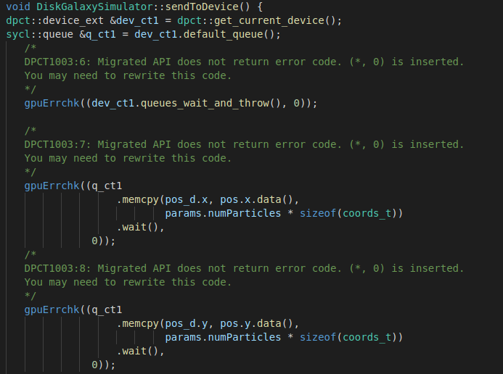
DPCT output: Error Handling
Notes:
1 – get_current_device, default_queue - these are needed because, while the CUDA API can take no arguments & assume a default device/stream, SYCL needs a queue to operate on.

Slide 15
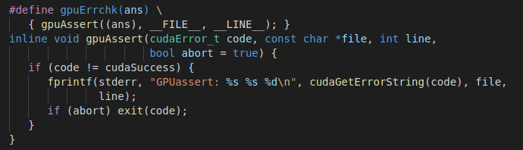

Error codes vs Exceptions

Slide 16
DPCT output
Relies on helper headers for migration
Verbose comments
No-op error handling macros

Slide 17
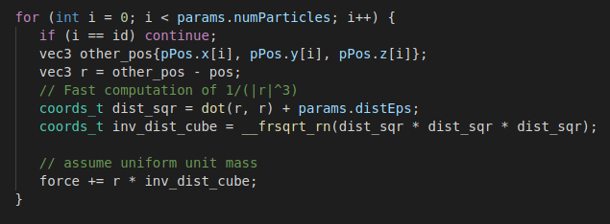
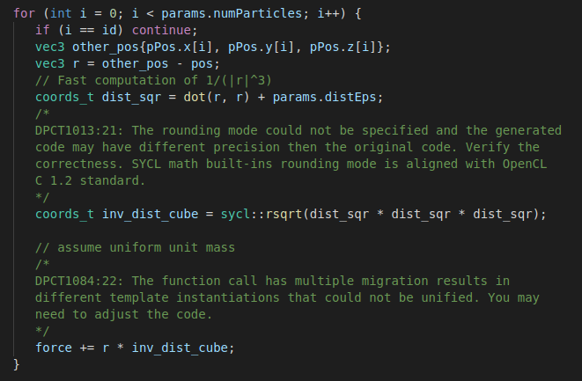
Informative, slightly pedantic warnings
Occasionally spurious warnings

Slide 18
DPCT output
Relies on helper headers for migration
Verbose comments
No-op error handling macros
Informative, slightly pedantic warnings
Occasionally spurious warnings

Slide 19
Helper Headers
Variety of helper functions:
  Device info
  Software atomics (compare and swap)
  Memory transfer & info
  etc...
All headers generated by default
  Possibly unneeded, lots of 'dead' code
  Consider what you need/don't need
Good for initial rapid porting but advise to remove dependencies later
  Produce portable code for all SYCL compilers

Slide 20
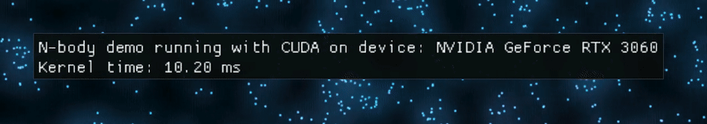
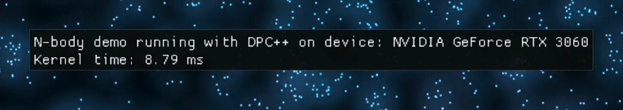
Performance
Should match performance on given Nvidia platform

Slide 21
Performance
Should match performance on given Nvidia platform
N-body is actually faster!
You can test this yourself
What if your code isn't as fast...

Slide 22
Performance Tips
Profile with Nvidia tools (Nsight Systems/Compute)
Avoid shared USM when possible
Experiment with work group size
Ensure you're inlining as much as possible:
  -fgpu-inline-threshold=100000
Ensure you're using hardware atomics if needed:
  -DSYCL_USE_NATIVE_FP_ATOMICS

Slide 23
DPCT caveats
Doesn't quite track latest CUDA version
Only ~90% code translation
Can't quite handle e.g. cuRAND on device
Relies on 'helper' headers
Struggles with kernel range dimensions (1D, 3D?)
But:
Rapid initial porting to get working code
Clear comments on required manual coding
Possible to remove need for helper headers later

Slide 24
SYCLomatic
Open-source version of DPC++ Compatibility Tool
May be slightly different – difficult to say
Now we can:
  Submit issues
  Propose solutions
  Submit PRs
https://github.com/oneapi-src/SYCLomatic

Slide 25
Summary
DPCT converted our simple n-body code entirely automatically
Performance is better than CUDA!
The tool is very helpful to rapidly get working code, but...
  It leaves muddy footprints
  It doesn't really touch the architecture
  Result relies on DPCT helper headers

