Slide 1


Progress of Greek ILO activities
24th CERN-GREEK WG, CERN 27.09.2021
N. Manthos, Greek ILO

Slide 2
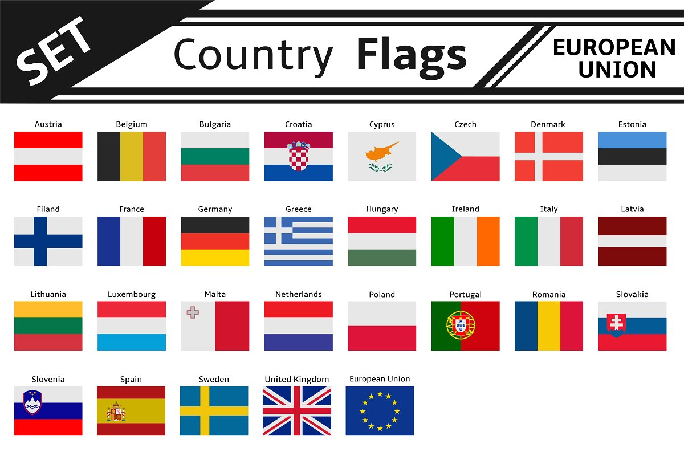
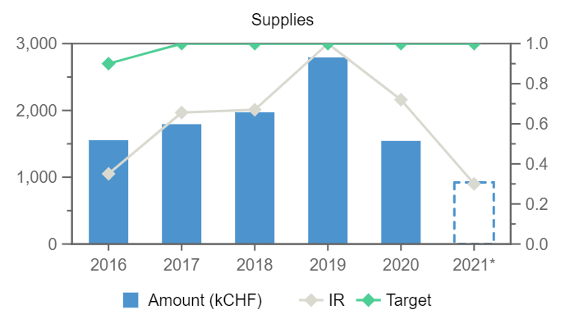
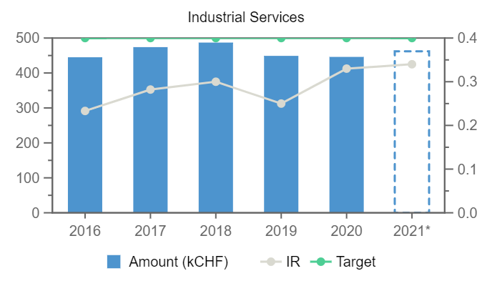
Industrial Return to Greece (CHF). YTQ3 FOR 2021.
IRC=(III/II)/I= 2019: (2793/261610)*100/(1.06)=1
Poorly : 0.3<IRC<1
Very poorly: IRC<0.3
Greece: poorly balanced (until 2022)
Contributions (CHF)
Expenditures (supplies, Services)
(All countries totals, CHF)
Expenditures
(Greece, CHF)
I
II
III
2021 YTQ3 : 1 199 321 000, 12 233 000 (1.02%) 302 391 000, 132 149 000 923 000, 462 000 IRC 0.3 (1), 0.23(0.4)
2020 YTQ3: 1 538 000, 420 000 IRC 0.62 (1), 0.29(0.4)
2020 : 1 168 922 250, 12 308 750 (1.05%) 207 407 000, 131 217 000 1 544 000, 446 000 IRC 0.72 (1), 0.33(0.4)
5y: 0.77, 0.29
2019 : 1 171 420 100, 12 453 650 (1.06%) 261 610 000, 167 528 000 2 793 000, 449 000 IRC 1 (1), 0.25(0.4)
2018 : 1 148 237 250, 12 567 300 (1.09%) 267 860 000, 146 760 000 1 973 013, 487 000 IRC 0.67 (1), 0.30 (0.4)
Services Sypplies Teams
2021 YTQ3: 462 000 + 923 000 + --------- = 1 385 000/ 12 233 000 = ~ 11%
Greek Top suppliers 2021
Kampakas
Morfi molds
Eurotrade
Rentron
2020: 446 000 + 1 544 000 + 56 000 = 2 046 000/ 12 308 750 = ~ 17%
2019: 449 000 + 2 793 000 + 161 000 = 3 403 000/ 12 453 650 = ~ 27%
2018: 486 809 + 1 973 012 + 206 011 = 2 665 832/ 12 567 300 = ~ 21%
Fair enough
target ~35%
i.e. ~ 4 MCHF
2020 YTQ3: 420 000 + 1 538 000 + 56 000 = 2 014 000/ 12 308 750 = ~ 16%

Slide 3
Actions to increase the return
Invitation of potential Greek firms to enrich the firm database.
Contact more Greek firms during the market surveys.
Workshop “Doing business with CERN”, 16 or 18 Nov 2021 (exact day is pending, duration 2.5 h), with potential Greek firms, organized by GSRI (Ministry of Development and Investment) in Greece to advertise the CERN “market”. Talks by CERN procurement service experts and B2B. Invitation of ~100 firms.
It would be followed by a national industry event at CERN (Greece@CERN), 7-8 Feb2022 (reserved). Participation target: ~30 firms. Expression of interest after the Workshop “Doing business with CERN”, Nov 2021.
Concerns for the proposal of replacing the national industry events at CERN by thematic industrial events although the justification is obvious.
I propose to keep both possibilities active, targeting the national industry events (2-3 per year) to poorly and very poorly
balanced countries.

Slide 4
Tentative agenda of the “Doing business with CERN”, 16 or 18.11.2021
Zoom link:…
09:30-9:45 Welcome (the importance of the CERN yearly return.) A.Kyriazis, GS for R&I
09:45-10:00 Role of CERN in basic research and technology, Emmanuel Tsesmelis – CERN International Relations
10:00-10:15 Yearly update on the Greece participation at CERN, C. Fountas, Delegate of Greece to the CERN council
10:15-11:00 How to do business with CERN – Procurement rules and practical advice, Anders Unnervik et al, CERN.
11:00-11:10 Greek firms and CERN, N. Manthos, Greek ILO at CERN.
11:10-11:20 Successful cases concerning business of Greek firms with CERN, Petros Soukoulias, PRIΒ EMTH (ΠΣΕΚ ΑΜΘ)
11:20-12:00 Questions, discussions and B2B meetings of Greek firms with CERN Representatives and participants

