Slide 1
Procurement Overview
for Greece(Member State)

Slide 2
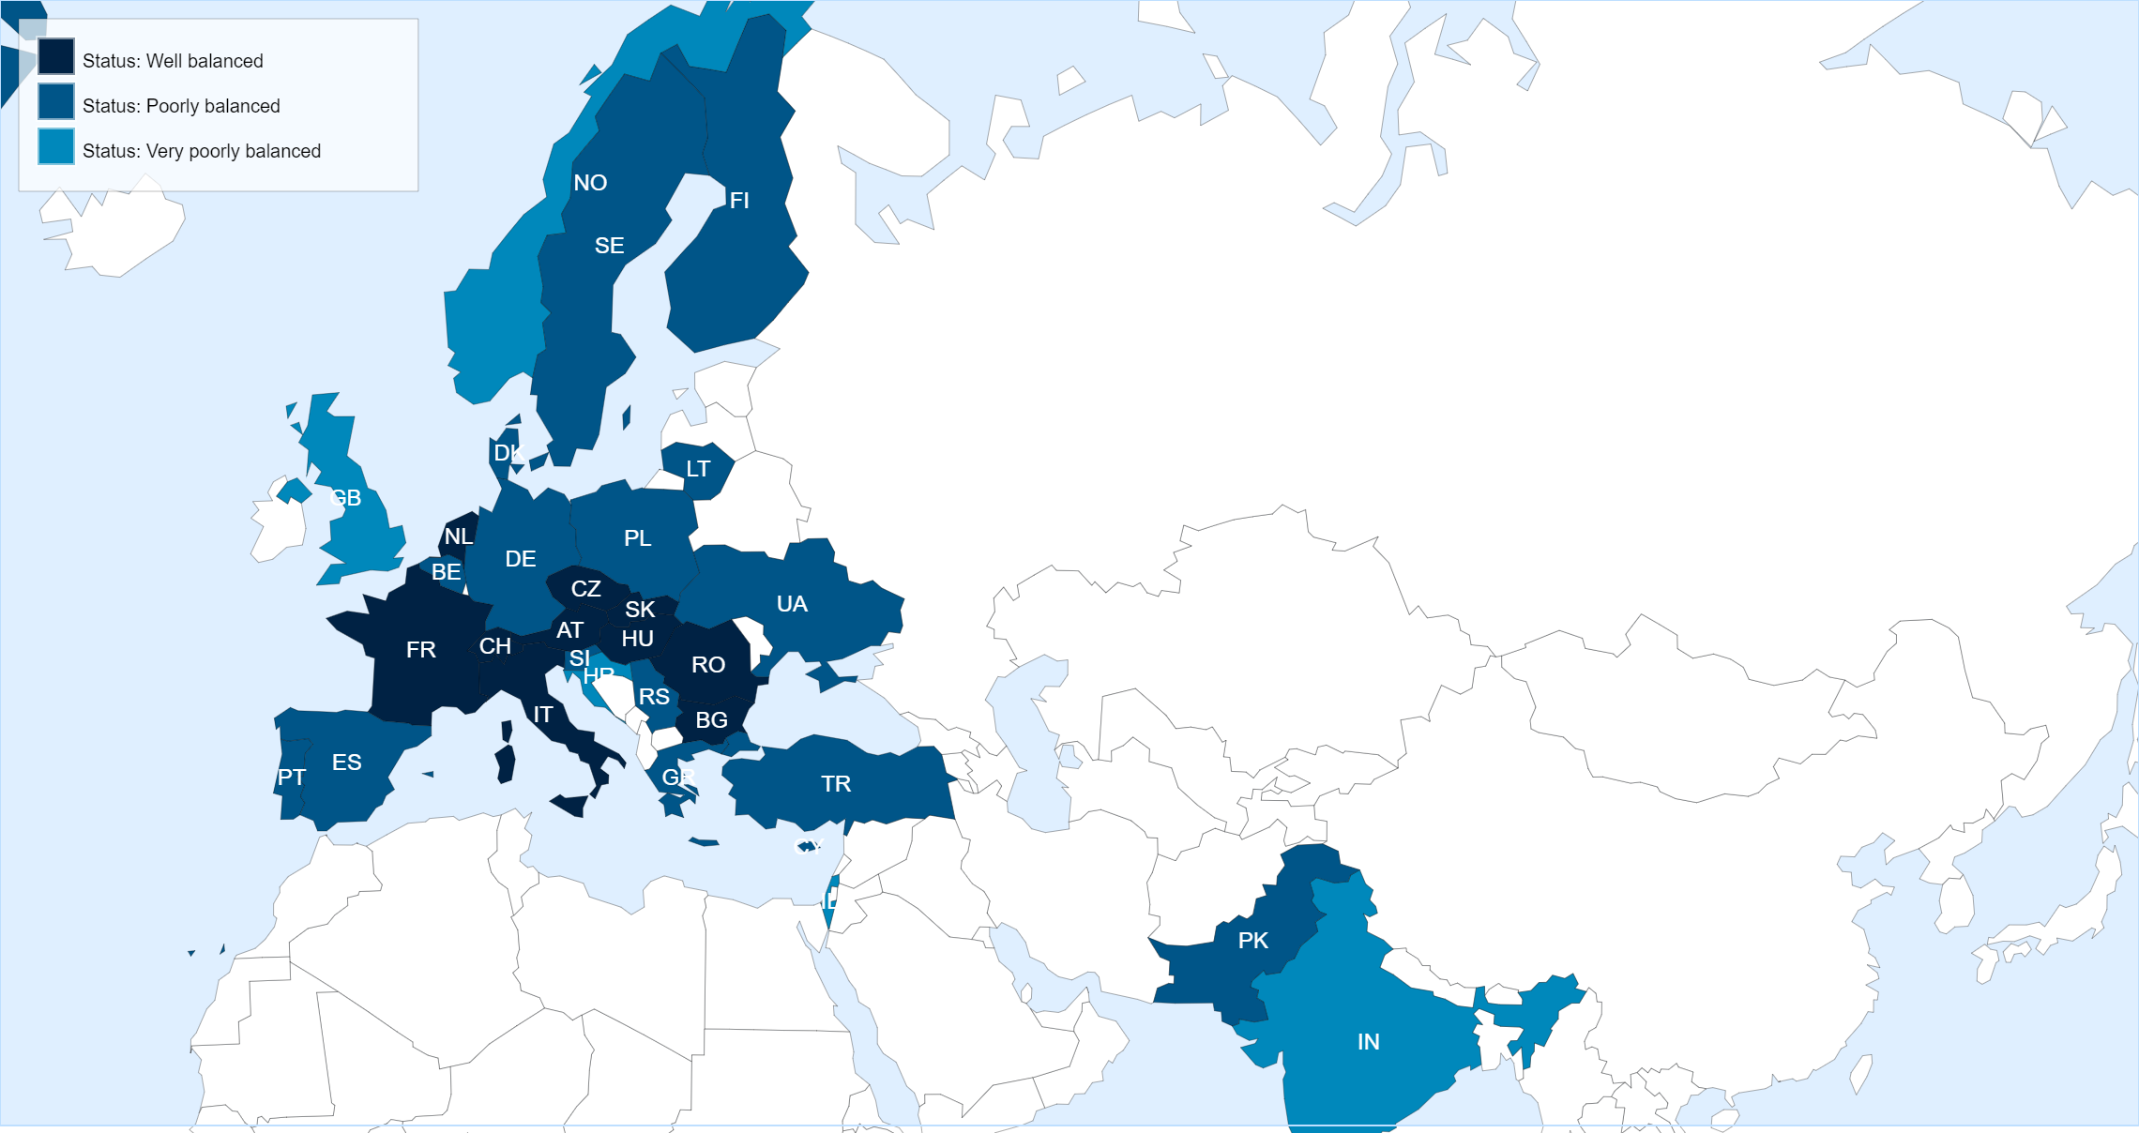
Status of Member States (For Supply contracts from 01.03.2021 until end of February 2022)
Key Figures for Greece
* Data not available in the DWH yet.
No. of suppliers registered on eProcurement
70
No. of contracts active in 2020
33
No. of contracts awarded in 2020
3
No. of firms contacted for MS dispatched in 2020
31
No. of firms contacted for IT dispatched in 2020
6
No. of firms contacted for PE dispatched in 2020
16

Slide 3
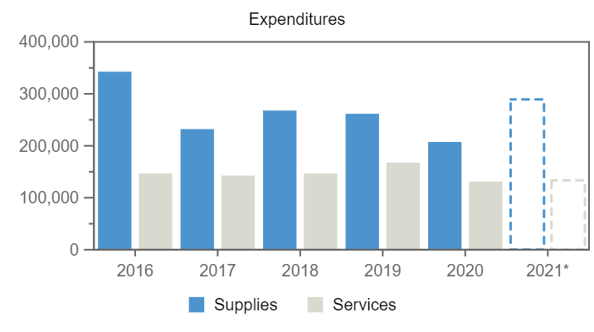
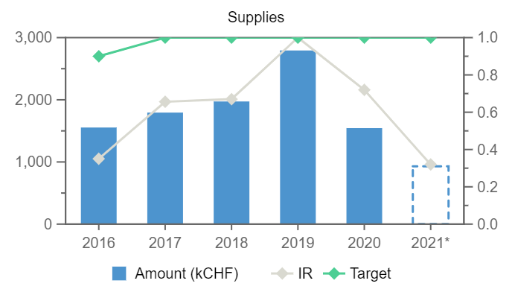
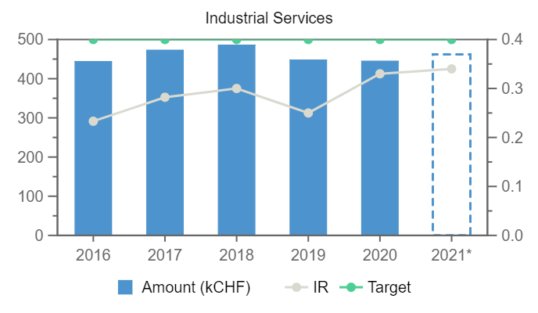
Expenditures (Greece, kCHF)
Year
Remaining
Procurement**
Personnel
No data available in table
Annual contributions and industrial returns for Greece
Contributions (kCHF)
Expenditures (All countries totals, kCHF)
Expenditures (Greece, kCHF)
Year
Country Contribution
All Countries
%
Year
Supplies
Services
Year
Supplies
Services
2016
14 612
1 127 444
1.3
2016
342 577
146 851
2016
1 554
445
2017
13 454
1 142 179
1.18
2017
232 087
142 732
2017
1 794
474
2018
12 567
1 148 237
1.09
2018
267 860
146 760
2018
1 973
487
2019
12 454
1 171 420
1.06
2019
261 610
167 528
2019
2 793
449
2020
12 309
1 196 893
1.03
2020
207 407
131 216
2020
1 544
446
2021
12 233
1 199 321
1.02
2021*
289 224
133 370
2021*
930
462
Industrial Return
Annual Industrial Return
Supplies
Services
Year
Ratio
Target
Ratio
Target
2016
0.35
0.9
0.23
0.4
2017
0.66
1
0.28
0.4
2018
0.67
1
0.3
0.4
2019
1
1
0.25
0.4
2020
0.72
1
0.33
0.4
2021*
0.32
1
0.34
0.4
*Provisional figure

Slide 4
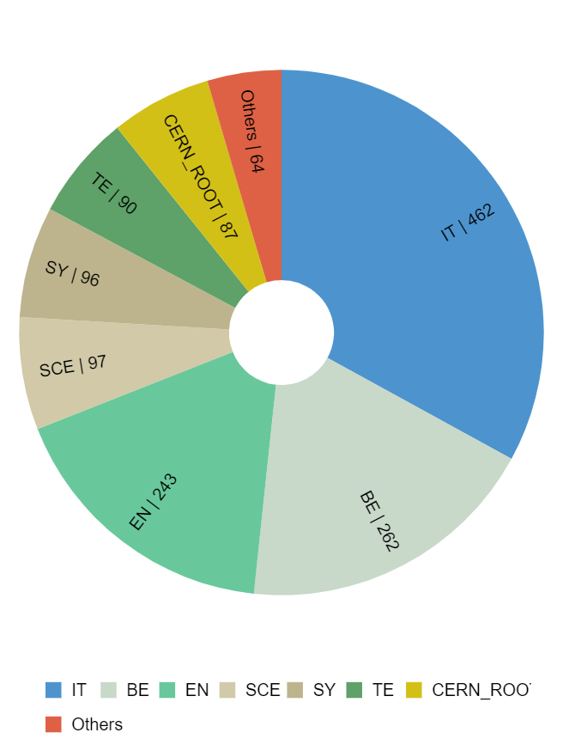
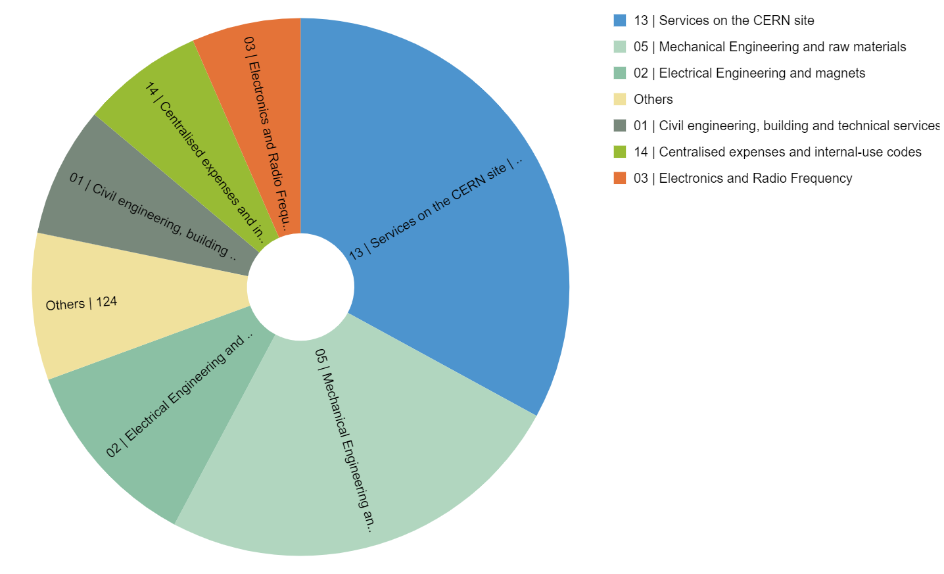
Expenditure by department and procurement codes for Greece
Expenditure by Department (kCHF)
Expenditure by (Activity|Procurement) Code (kCHF)

Slide 5
Top Suppliers in Greece
By Country of Supplier
By Country of Origin
Supplier Name
Town
No. Orders
CERN Budget (CHF)
Teams Budget (CHF)
Supplier Name
Supplier Country
No. Orders
% GR
CERN (CHF)
Teams (CHF)
ELEKTROMECH
Athens
20
120 409
–
DCS DATA CONVERSION SERVICE (CH) - INTRACOM TELECOM (GR)
CH
2
40
461 600
–
SPYRIDON ALEXOPOULOS (ALEXMOLDS)
Perama
30
112 524
–
ELEKTROMECH
GR
20
100
120 409
–
KAMPAKAS SA
Athens
3
103 893
–
SPYRIDON ALEXOPOULOS (ALEXMOLDS)
GR
30
100
112 524
–
EUROTRADE (EVROEMPORIKI)
Athens
3
68 604
28 817
RENTRON SA
Athens Palaio Faliro
15
78 080
–
KAMPAKAS SA
GR
3
100
103 893
–
EUROTRADE (EVROEMPORIKI)
GR
3
100
68 604
28 817
RENTRON SA
GR
15
100
78 080
–
MORFI MOLDS
Markopoulo Attiki
1
71 769
–
MORFI MOLDS
GR
1
100
71 769
–
BROS N AXAKALIS AND CO
GR
16
100
61 448
–
BROS N AXAKALIS AND CO
Neo Ikonio Perama
16
61 631
–
SAFEDOOR
GR
4
100
49 479
–
ARISTOTLE UNIVERSITY OF THESSALONIKI
GR
6
100
48 224
–
SAFEDOOR
Kalivia Thorikou
4
49 479
–
ARISTOTLE UNIVERSITY OF THESSALONIKI
Thessaloniki
6
48 224
–
PRISMA ELECTRONICS SA
Alexandroupolis
8
5 293
42 385

Slide 6
List of contract/orders with the highest turnover in 2021 for Greece
Contract/Order
Description
Supplier
Amount (CHF)
S220
COMPUTER CENTRE OPERATIONS
DCS DATA CONVERSION SERVICE (CH) - INTRACOM TELECOM (GR)
461 600
B1583
CAST IRON BLOCKS - SHIELDING
KAMPAKAS SA
103 893
CA8563371
J3067665, J3067666, SUPPORT LIGNE *N*
MORFI MOLDS
71 769
CA8667985
NEW CONTROL ROOMS T09-T10&T11 EXP. AREAS
EUROTRADE (EVROEMPORIKI)
64 402
BQ52
RACK FOR IT SERVER
RENTRON SA
56 701
CA8700834
SPS FIRE RETARDANT PARTITIONS
SAFEDOOR
41 427
CA8459246
INSTALLATION ASCENSEUR PMR BATIMENT 501
TECHLIFT
40 600
CA8295479
FCC PUBLIC DRUPAL WEBSITE DEVELOPMENT
G LAOUNAROS AND CO
28 619
CA8860926
J3071846 TEST STAND SC LINK PATCH PANELS
SPYRIDON ALEXOPOULOS (ALEXMOLDS)
27 772
KE4499
BE CO DS DEVELOPMENT / PJAS
ARISTOTLE UNIVERSITY OF THESSALONIKI
23 990

Slide 7
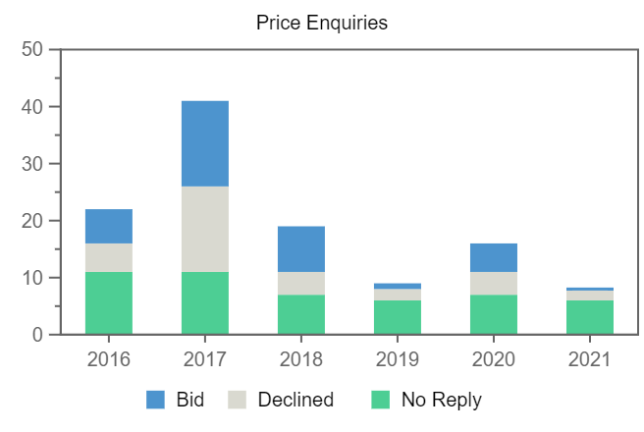
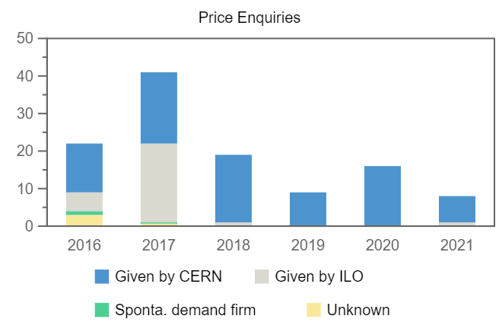
Price Enquiries above 50k CHF for Greece
Number of firms contacted
Origin of firms contacted
Year
Firms Contacted
RANK (1)
RANK (2)
RANK (3)
2016
22
1
1
1
2017
41
1
2
–
2018
19
4
–
–
2019
9
1
–
–
2020
16
1
–
–
2021
8
–
–
–

Slide 8
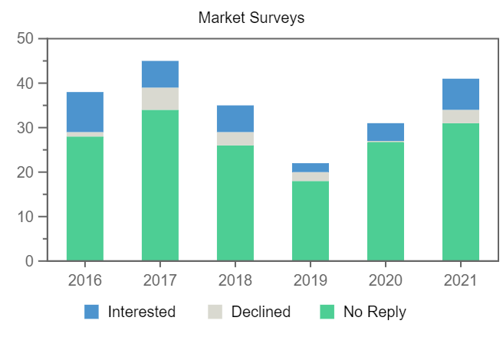
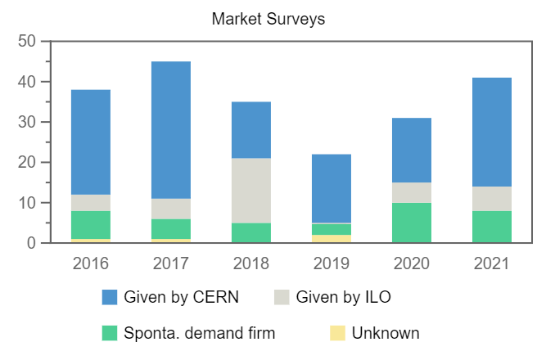
Market Surveys for Greece
Number of firms contacted
Origin of firms contacted
Year
Firms Contacted
Interested
Declined
No Reply
Selected
2016
38
9
1
28
2
2017
45
6
5
34
3
2018
35
6
3
26
1
2019
22
2
2
18
–
2020
31
4
–
27
2
2021
41
7
3
31
–

Slide 9
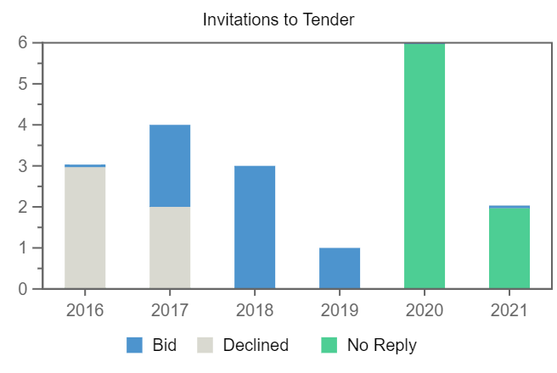
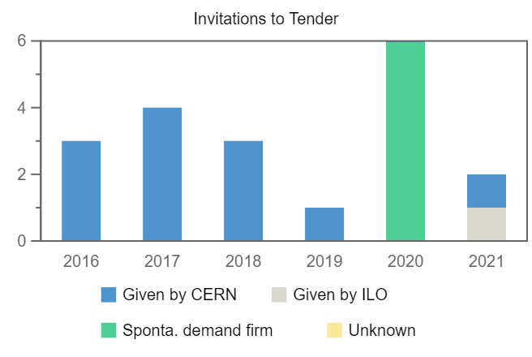
Invitations to Tender for Greece
Number of firms contacted
Origin of firms contacted
Year
Firms Contacted
RANK (1)
RANK (2)
RANK (3)
2016
3
–
–
–
2017
4
–
–
–
2018
3
1
–
–
2019
1
1
–
–
2020
6
–
–
–
2021
2
–
–
–

