Slide 1
ATEX Ventilation status
NA gas barracks consolidation
132nd EATM Meeting - Dany Gain – EN-CV
2021-09-14
https://indico.cern.ch/e/1074326

Slide 2
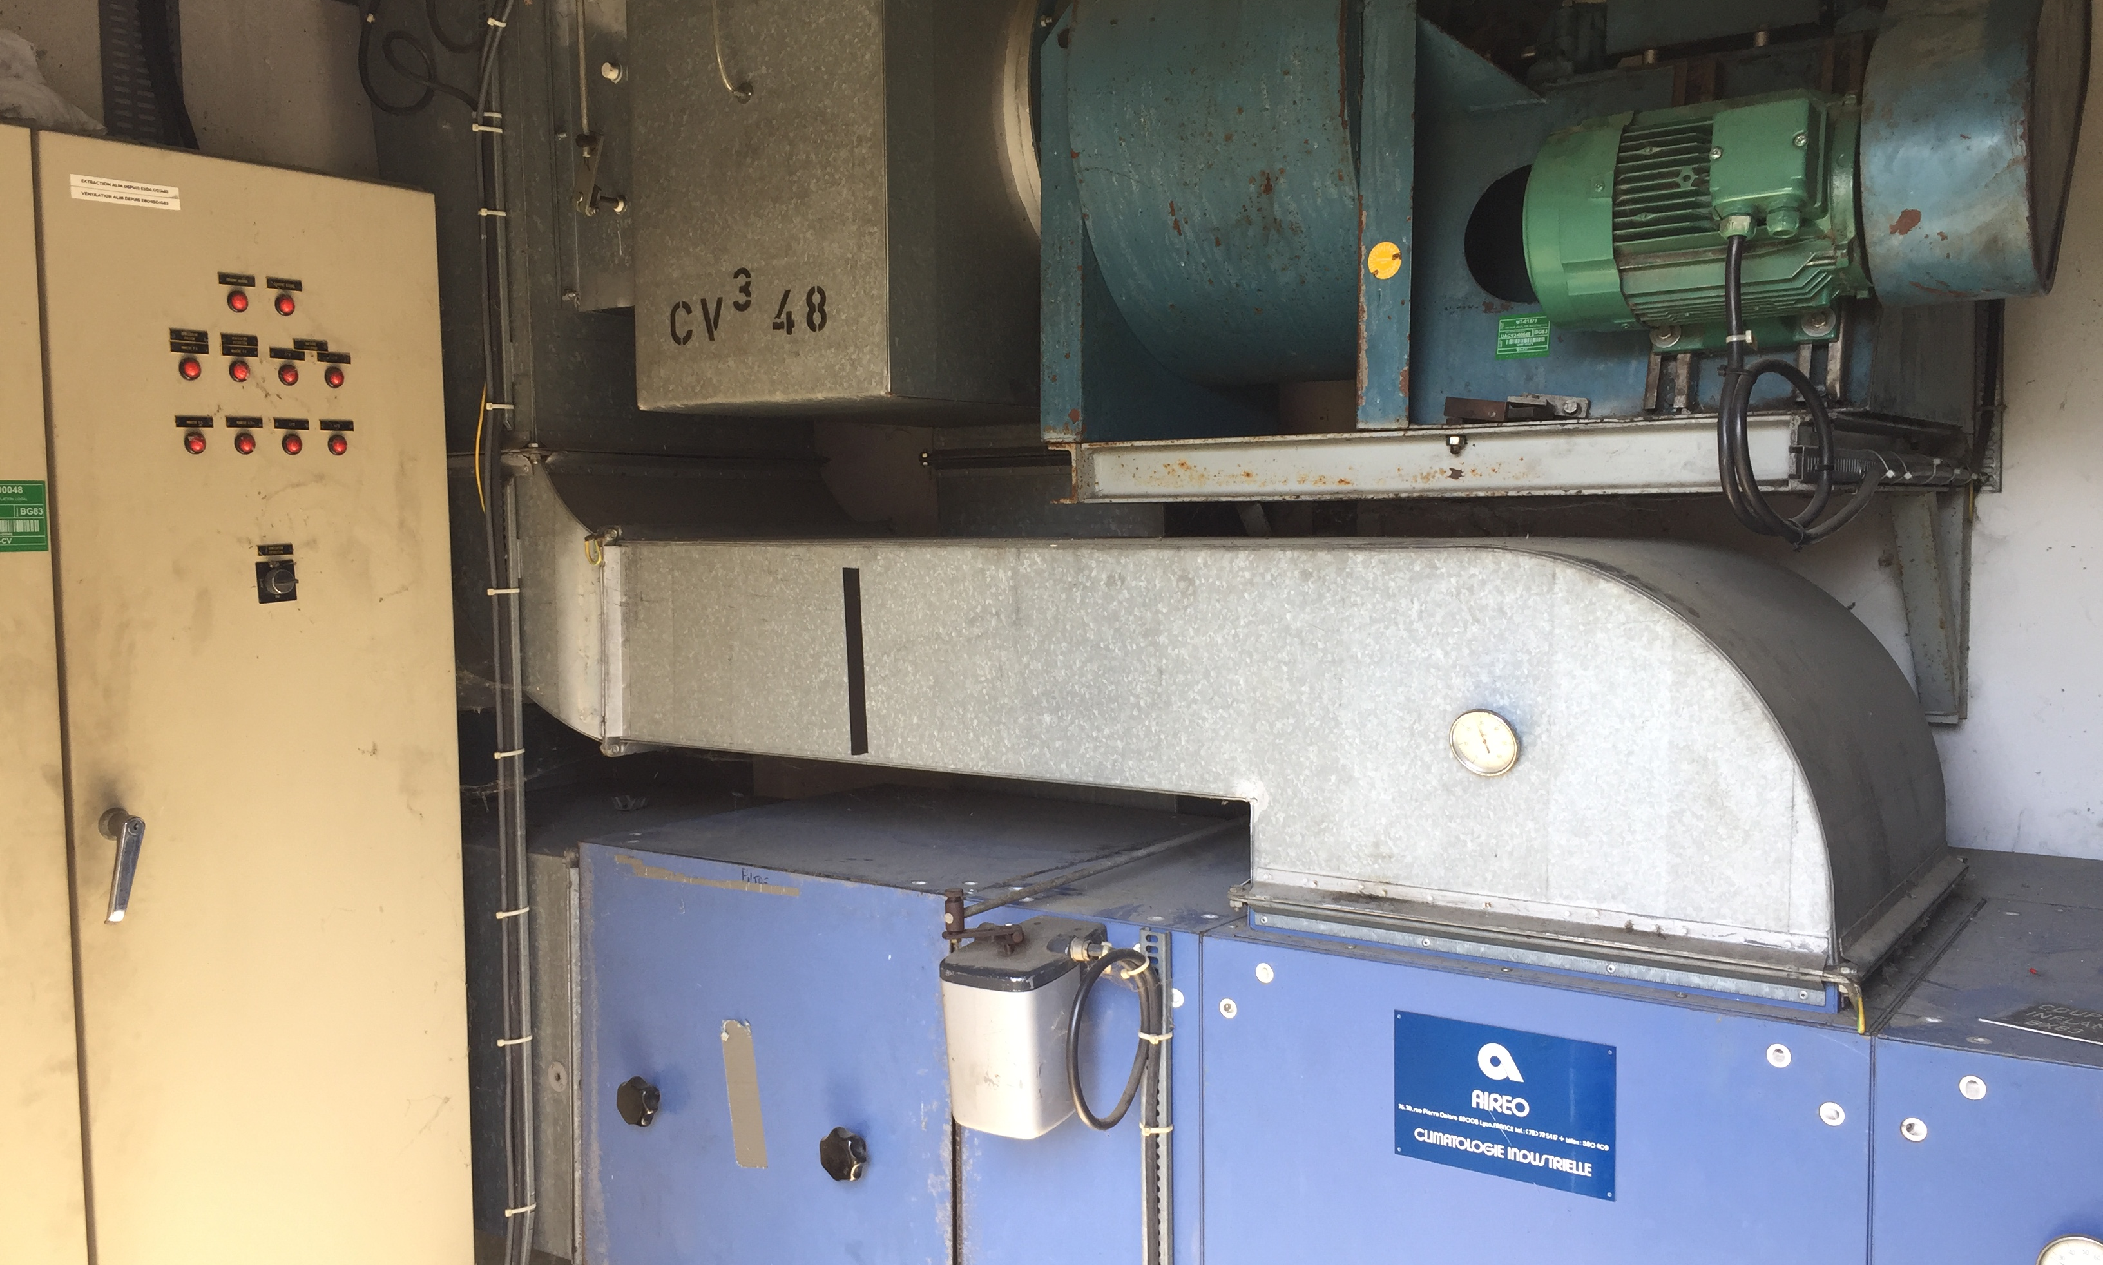
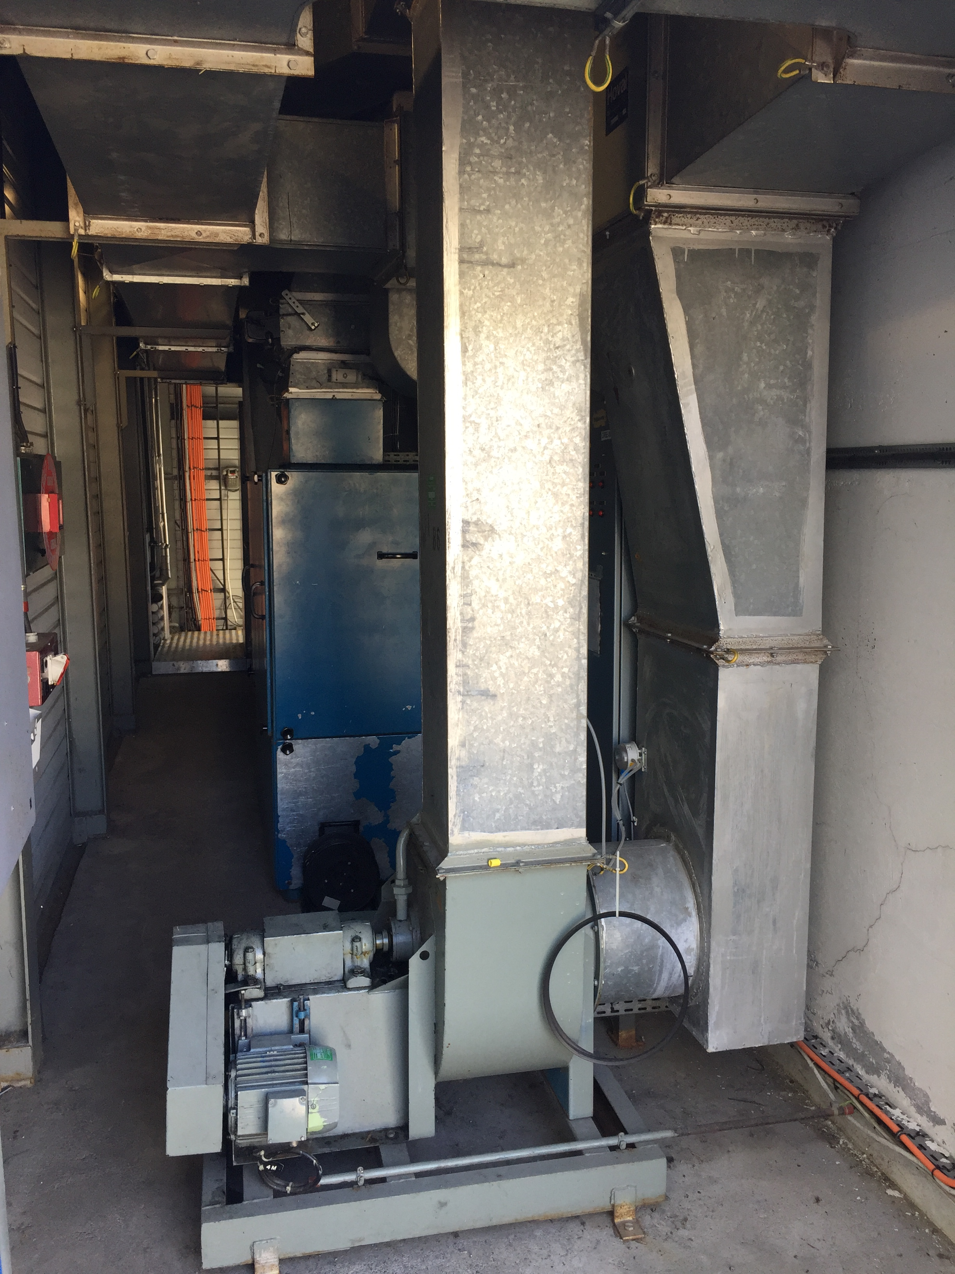
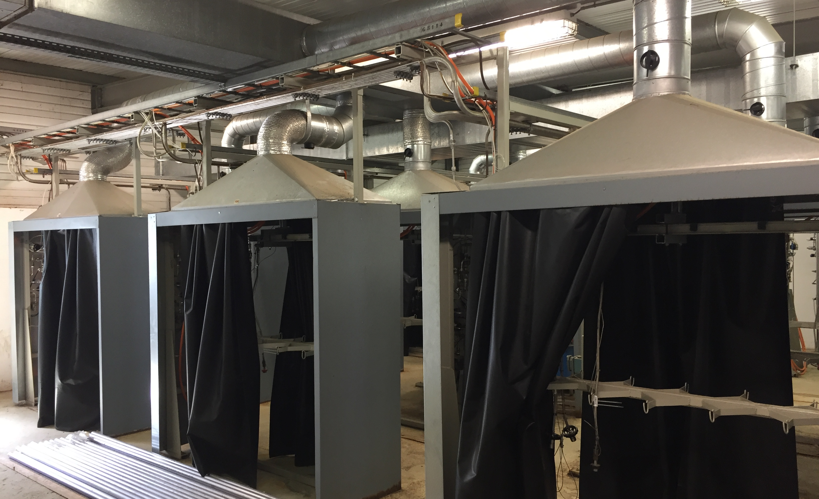
What was the issue before
Old EN-CV installations (installed since 1980)
Need to recover reliability, durability and operability
Gas distribution infrastructure modified (new bottle gas racks)
Need to apply current CERN directives and standards on ATEX extractions

Slide 3
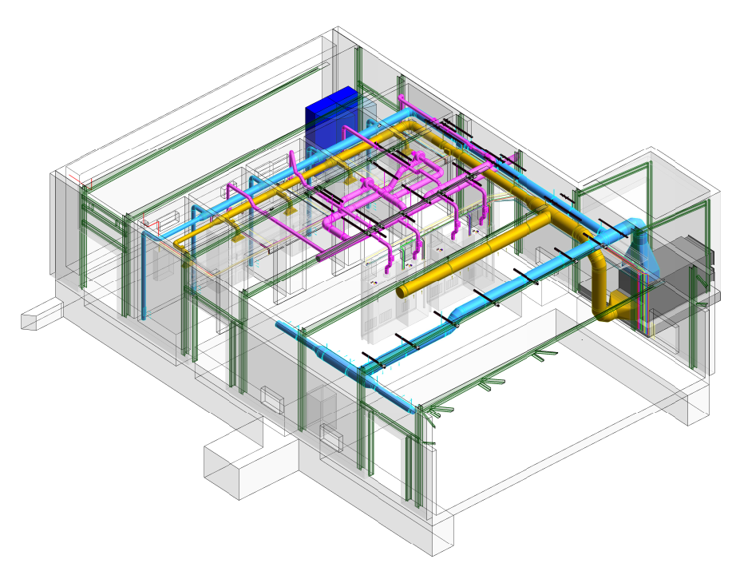
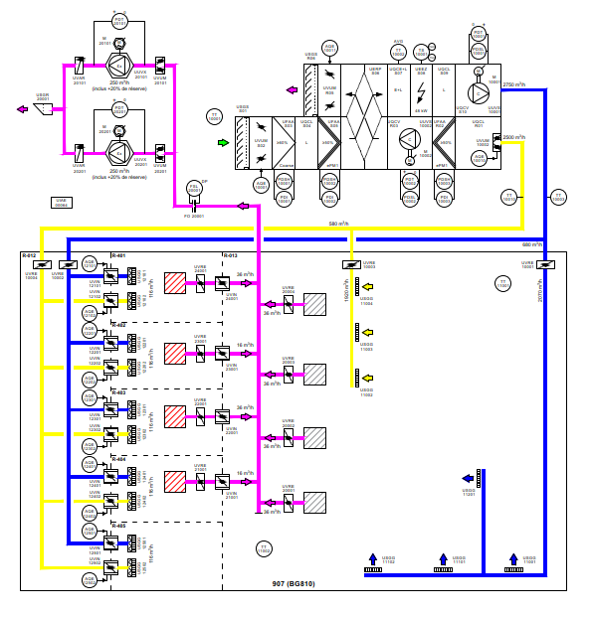
What is the solution implemented

Slide 4
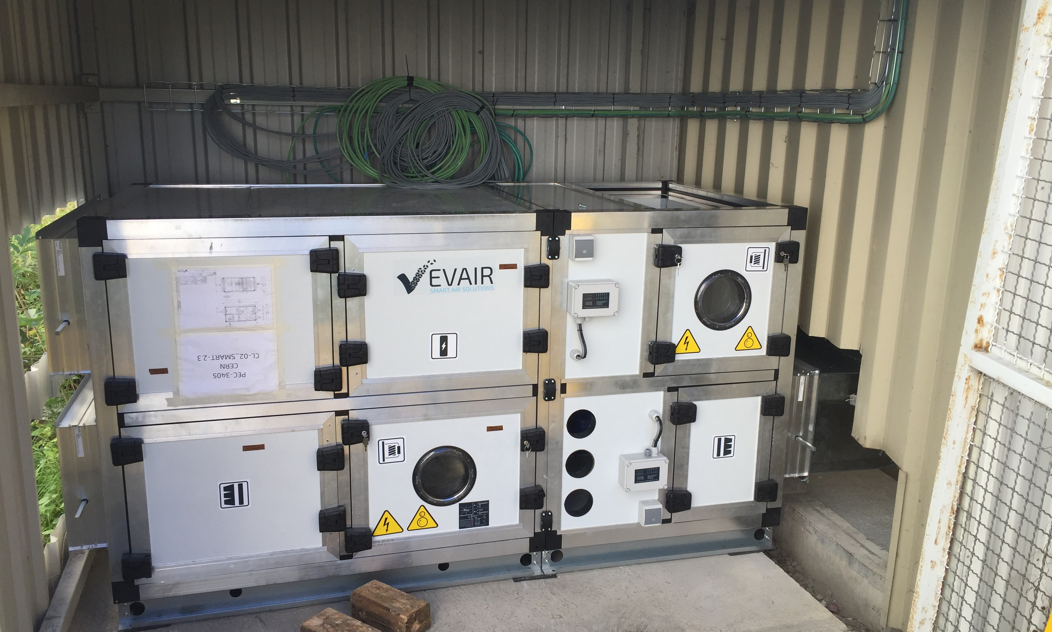
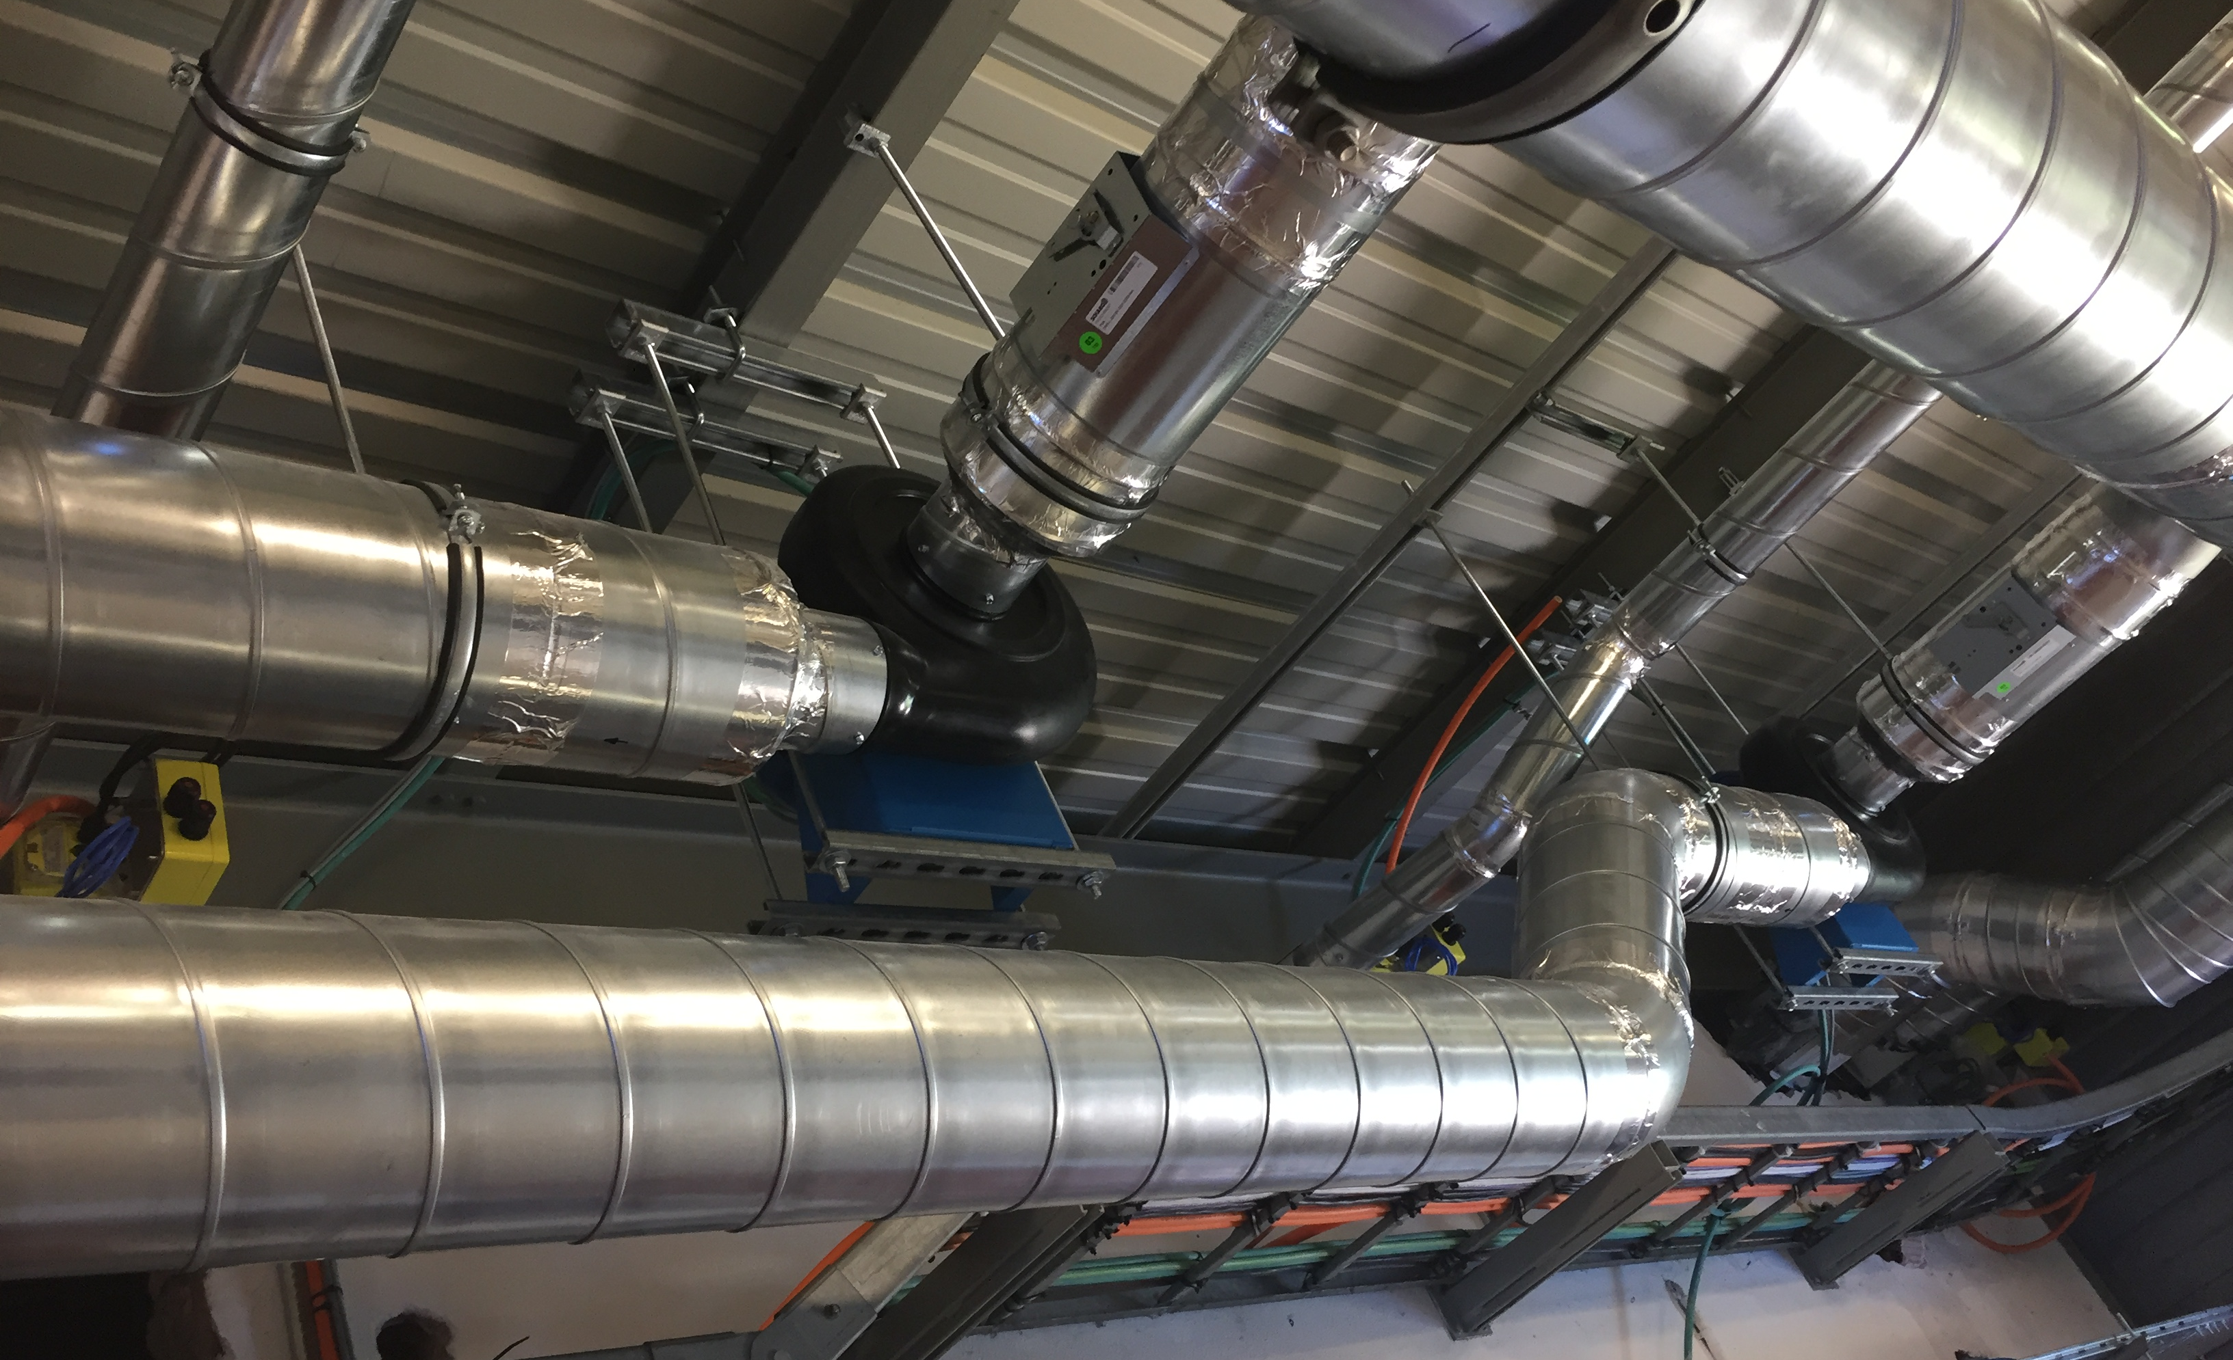
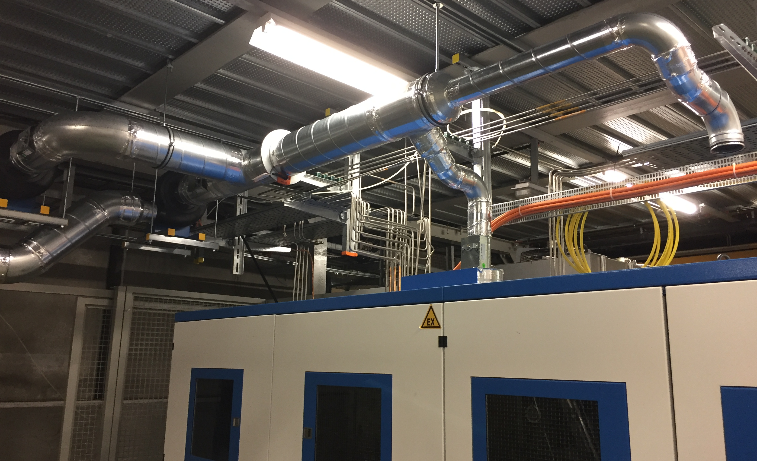
What is the solution implemented
New rooms HVAC to ensure minimum air renewal (per hour) and minimum temperature
Heat recovery exchanger for energy savings
New ATEX fans for the gas racks

Slide 5
Status of implementation today
B907 & 887 rooms:
Installation work done;
Electrical power supply & IT connections on 17/09.
B908:
Installation on going. To be done end of this week.
Electrical power supply & IT connection on 20/09.
Start commissionning all installations from 21/09 for 1 week.
Handover to the users end of September.
B920 renovation to be planned by the users end of 2021 (start on October ?).
B909 renovation should start January 2022 & to be ready for end of February 2022.

