Slide 1

ATLAS IBL Overview
LHCC Upgrades session
CERN, September, 21^{2t} 2010
G. Darbo - INFN / Genova
Indico agenda page:
http://indico.cern.ch/conferenceDisplay.py?confId=107477

Slide 2
Outline
Timeline and History of the IBL project
Motivation for IBL
  Ensure excellent tracking, vertexing and b-tagging performance during LHC phase I
  Recover from eventual failures in present Pixel system, especially in the present B-layer
  Add to robustness of tracking with high luminosity pileup
Status and Organization
  Plan to be ready in 2015
  Sensor choice in 2011
  ATLAS project, Organization in place, TDR, interim-MoU, expected cost
Study of tracking, vertexing and b-tagging performance:
  Markus’s talk
IBL Technical Description and status
  Heinz’s talk

Slide 3
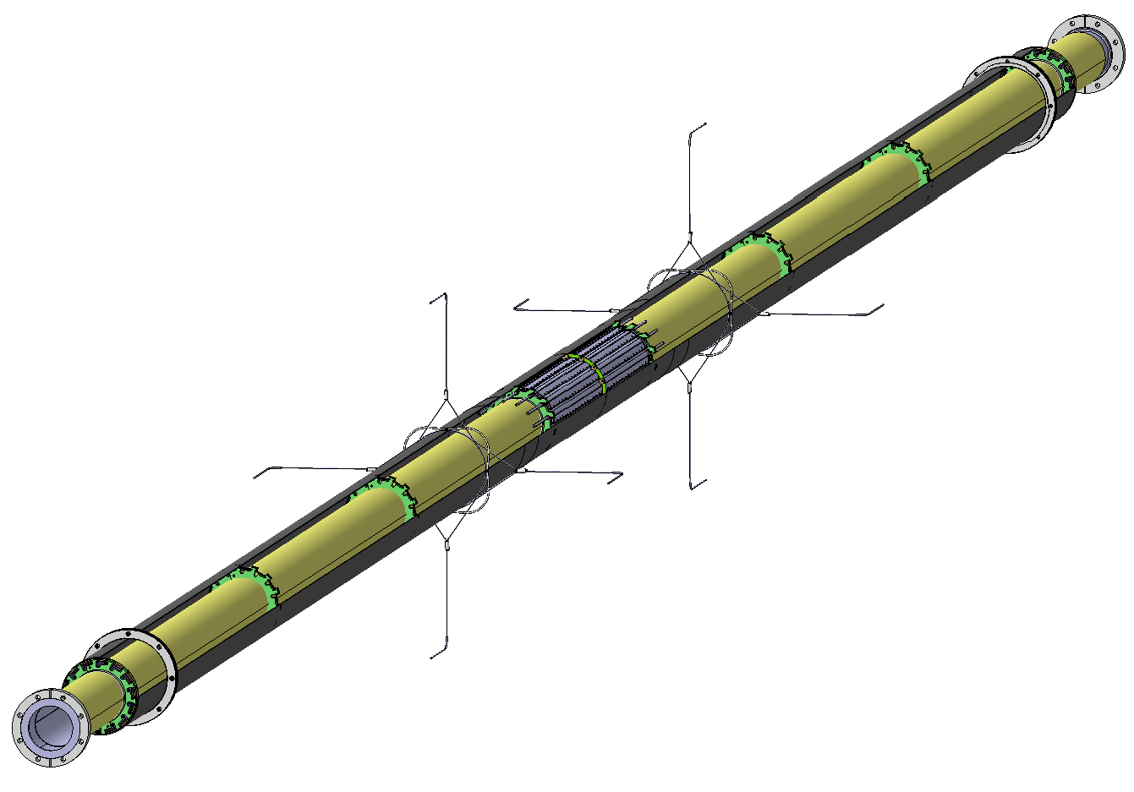
IBL Detector
Material from Raphael/Neal
The Insertable B-Layer (IBL) is a fourth layer added to the present Pixel detector between a new beam pipe and the current inner Pixel layer (B-layer).
PP1 Collar
Sealing service ring
Alignment wires
IBL key Specs / Params
14 staves, <R> = 33.25 mm
CO₂ cooling, T < -15ºC @ 0.2 W/cm²
X/X₀ < 1.5 % (B-layer is 2.7 %)
50 µm x 250 µm pixels
1.8º overlap in ϕ, <2% gaps in Z
32/16 single/double FE-I4 modules per stave
Radiation tolerance 5x10¹⁵ n_{eq}/cm²
IST
IBL Support Tube
IBL Staves

Slide 4
History of IBL Project - Time Line
1998: Pixel TDR
  B-layer designed to be substituted every 3 years of nominal LHC (300 fb⁻¹): due to then available radiation hard sensor and electronic technologies.
2002: B-layer replacement
  became part of ATLAS planning and was put into the M&O budget to RRB.
2008: B-layer taskforce
  B-layer replacement cannot be done – Engineering changes to fulfil delayed on-detector electronics (FE-I3, MCC) made it impossible even in a long shut down.
  Best (only viable) solution: “make a new smaller radius B-layer insertion using technology being developed for HL-LHC prototypes”. This became the IBL.
2009: ATLAS started IBL project:
  February: endorsed IBL PL and TC
  April: IBL organization in place (Endorsed by the ATLAS EB)
2010: TDR and interim-MoU
  TDR is under approval in ATLAS
  Interim-MoU is collecting last signatures.

Slide 5
Status and Failure Analysis in Current Pixel Detector
  Irreparable failures of modules in the B-layer, and in other Pixel layers, will appear with time: today 2.41 % of B-layer / 3.01 % of the whole pixel is dead.
Failures and IBL adopted solutions:
  Experience gained from failures in present Pixels leads to improved design for IBL.
  Titanium pipes: corrosion resistant.
  Permanent pipe joints inside the detector: avoid leakage at fittings.
  Move opto-boards to ID endplate: more easily serviceable site.
Affected System (failure classes) | No. of parts in the system | No of part fail / % of dead pixels
 |  | Whole Pixel | B-layer only
Pixel | 80 363 520 | 161 k / 0.20 % | 15 k / 0.11 %
Front-end | 27 904 | 42 / 0.15 % | 9 / 0.20 %
Module | 1 744 | 40 / 2.29 % | 6 / 2.10 %
Opto-board | 272 | 1 / 0.37 % | - / 0.00 %
Cooling loop (high leak) | 88 | (3) / 0.00 % | (0) / 0.00 %
Total dead pixels |  | 3.01 % | 2.41 %

Slide 6
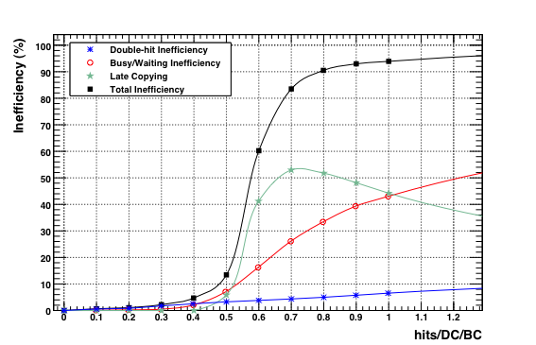
Occupancy Induced Inefficiencies in Present B-layer
Luminosity effects:
  The current Pixel detector (FE-I3, MCC) designed for a peak luminosity of 1×10³⁴ cm⁻²s⁻¹.
  A luminosity at least twice that high is expected before the High Luminosity LHC (HL-LHC) is complete after 2020. (S.Myers at ICHEP: 2.2×10³⁴)
  Event pileup: requires redundancy in the measurement of tracks to control the fake rate
  High occupancy: can induce readout inefficiencies, affects the B-layer more than other layers and would thereby limit the b tagging efficiency.
  IBL: low occupancy (with respect to SCT/TRT) reduces track fakes, FE-I4 has higher bandwidth than existing readout.
  Plot FE-I3 / Table MCC
  New architecture
  .
FE-I3 inefficiency vs occupancy for B-layer
2x10³⁴
FE-I3 has 5% inefficiencies at the B-layer occupancy for 2.2x10³⁴. Steep rising function of occupancy: no safety margin.
1x10³⁴

Slide 7
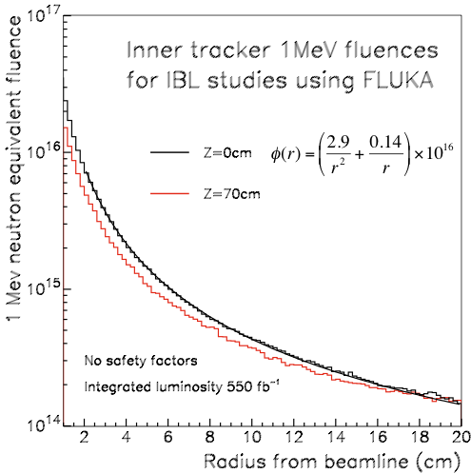
Radiation and Operation of IBL
Large radiation doses:
  With current expectations of the LHC luminosity profile (S.Myers at ICHEP 340 fb⁻¹ in 2020), radiation life dose is less of an issue than it was at the time of the Pixel TDR (730 fb⁻¹ in the Pixel life).
IBL: designed for 550 fb⁻¹ (provides margin should luminosity evolve more rapidly than expected or should 2020 HL-LHC shutdown be delayed)
At R = 3.2 cm corresponds to
3.3 × 10¹⁵ n_{eq}/cm²
Life dose requirements (with safety
factors):
  NIEL: 5.0 × 10¹⁵ n_{eq}/cm²
  TID: 250 Mrad

Slide 8
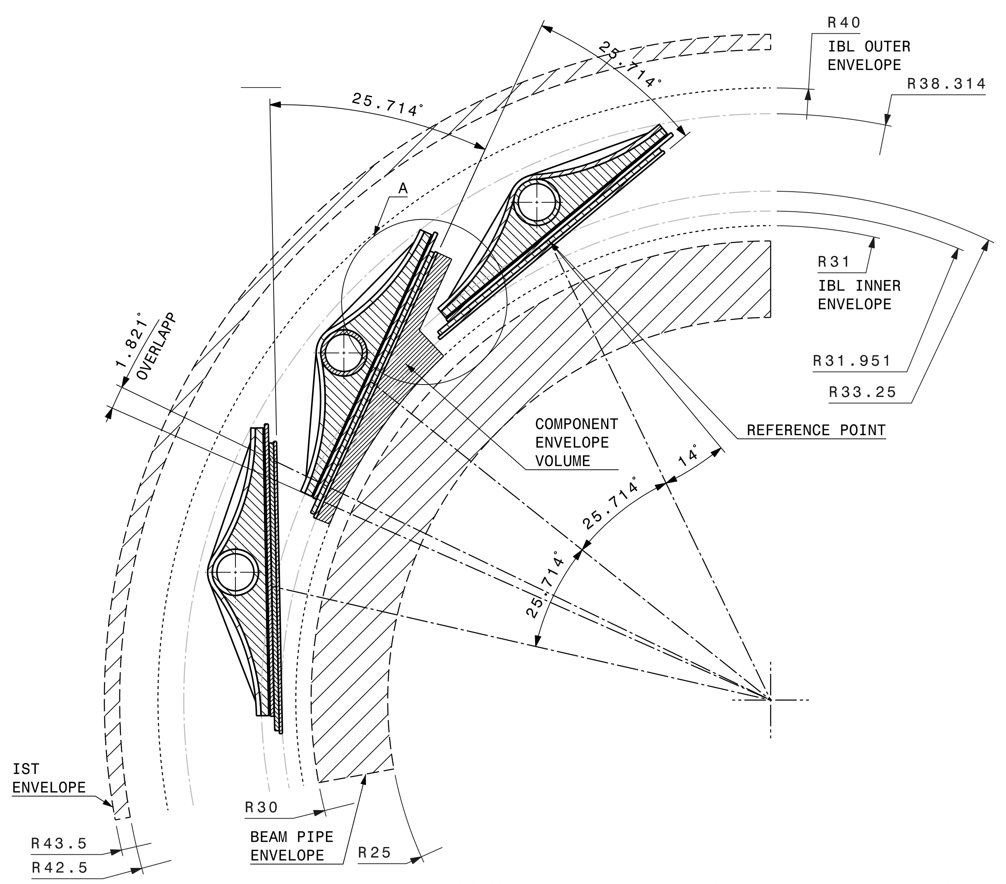
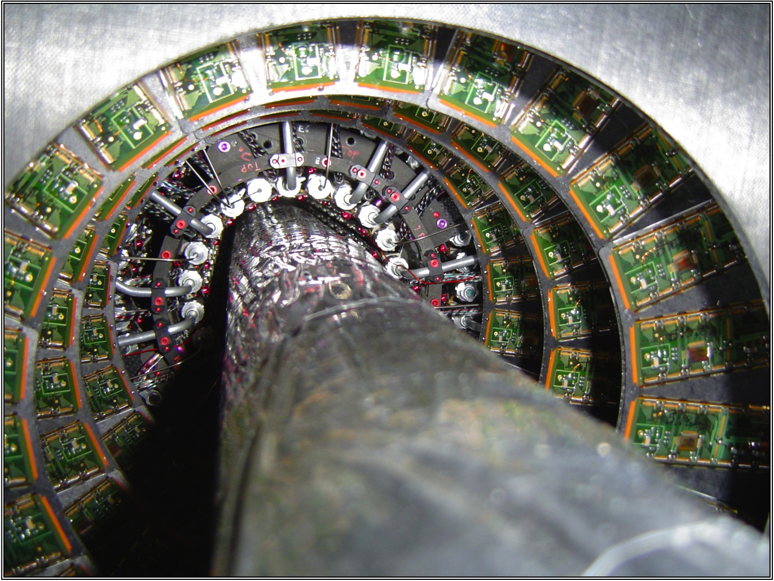
IBL Layout
Beam-pipe reduction:
  Inner R: 29 → 25 mm
Very tight clearance:
  “Hermetic” to straight tracks in Φ (1.8º overlap)
  No overlap in Z: minimize gap between sensor active area.
Material budget:
  Stave, el.serv. Module: 1.16 % X₀
  IBL Sup.Tube (IST): 0.28 % X₀
Beam-pipe (BP) extracted by cutting the flange on one side and sliding (guiding tube inside).
IBL Support Tube (IST) inserted.
IBL with smaller BP inserted in the IST

Slide 9
Schedule Plan
The IBL schedule is a compromise between:
  the drive to have the IBL ready as soon as possible, in order to benefit from its potential to recover possible irreparable failures of the existing B-layer (and of the Pixel detector more generally),
  and the time demanded for the substantial technology developments (to fit and perform to IBL requirements) and qualification tests required.
The IBL is scheduled “ready for installation” in May 2015 in case of an unexpectedly large failure rate of the current Pixel detector.
  In the absence of such problems, it will be installed in the long LHC shutdown foreseen for 2016.
  ≥ 8 months shutdown needed for opening ATLAS, removing the beam-pipe and install the IBL + smaller beam-pipe.
The IBL is in the roadmap of the new Pixel detector at HL-LHC:
  In addition to serving ATLAS until the HL-LHC upgrade in 2020, the IBL project will develop technologies and valuable experience for the subsequent high luminosity era.

Slide 10
Module Prototype Program
Three candidate sensor technologies address the IBL requirements with different trade-offs:
  Planar sensor n-on-n and n-on-p, 3D sensors with active edge (or <200µ edge), pCVD Diamond sensor
The module format satisfied with any of these technologies, thus some independence. Two parameters: operating temperature and bias voltage are different.
  Planar sensors require the lowest temperature and high bias voltage, but have very well understood manufacturing sources, mechanical properties, relatively low cost, and high yield.
  3-D sensors require the lowest bias voltage, intermediate operating temperature, and achieve the highest acceptance due to active edges, but their manufacturability with high yield and good uniformity must be demonstrated.
  Diamond sensors require the least cooling and have similar bias voltage requirements to planar sensors, but their manufacturability with high yield, moderate cost, and good uniformity must all be demonstrated.
Selection in summer 2011 driven by:
Module performance after irradiation and with test beam measurements.
Understanding of manufacturing yield
Planar Sensors
IBL
ATLAS Collaborations for HL-LHC R&D
3D Sensors
Diamond Sensors

Slide 11
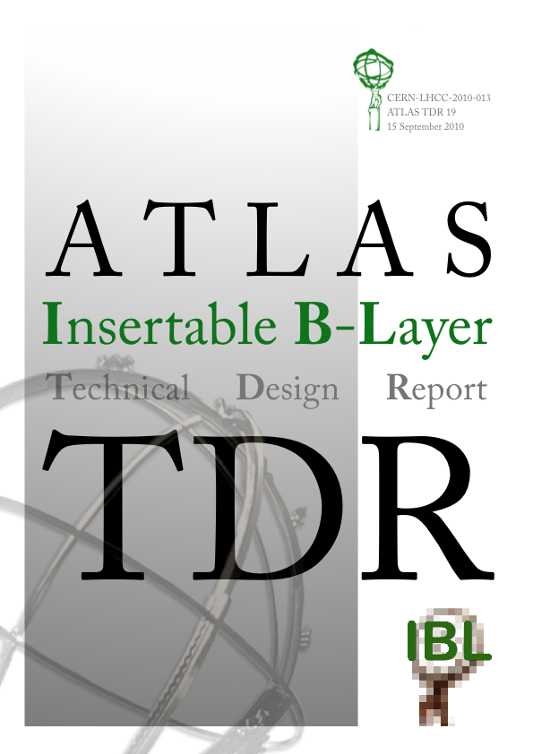
IBL Technical Design Report
ATLAS TDR includes:
  Overview and motivation for the project
  Study of the physics performance
  Technical description of the project with baseline and options for critical issues
  Three sensor technologies.
  Beam-pipe, extraction/insertion, installation, ALARA.
  Organization of the project and resources
Editorial team:
M. Capeans (technical editor), G. Darbo,
K. Einsweiller, M. Elsing, T. Flick,
M. Garcia-Sciveres, C. Gemme,
H. Pernegger, O. Rohne and R. Vuillermet.
  CERN-LHCC-2010-13, ATLAS TDR 19

Slide 12
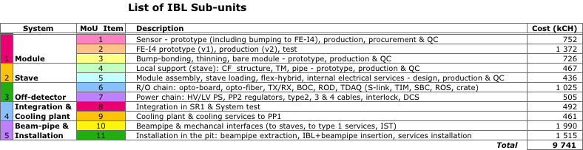
Memorandum of Understanding
Decided to go to an interim-MoU (iMoU):
  Until decision on sensor technology (Summer 2011)
  Consolidate interest of Institutes and availability of funds
  Status: Funding Agencies involved are sending their signed copies. The dead-line was end of August and we are waiting for the last ones to send them in.
Annexes:
  Define cost accordingly to project WBS (9.7 MCH)
  Participating Institutes/Institutions
  Sharing of work and cost amongst institutes.

Slide 13
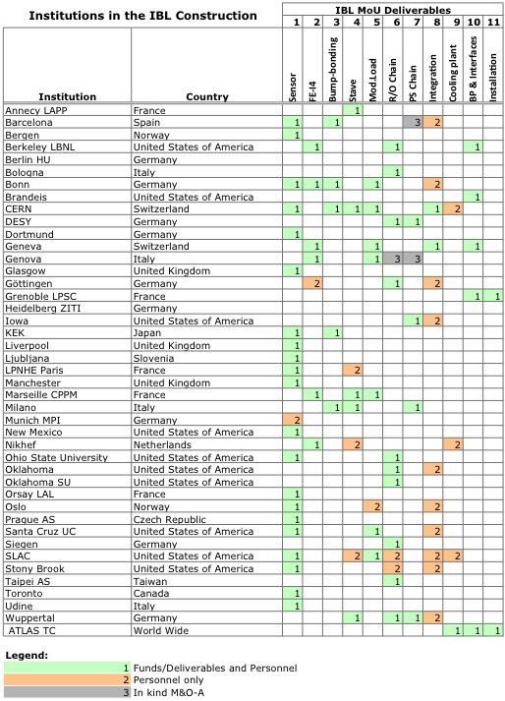
Interim-MoU - Institutions
There are 43 institutions in the IBL project
  Large interest for the sensor (22 Institutions)
  Full effort and funding requirements are covered
300 people have expressed their interest to contribute to the project
  many have already started to work.
  In most cases institutes contribute with money where also there is contribution with manpower.

Slide 14
Conclusions
IBL Project going ahead well:
  IBL restores performance lost by failures or inefficiencies of the present tracker and improves significantly ATLAS performance with (and without) pile-up → see Markus’ next talk.
  Technical solutions and prototypes exist for all aspects of the project → see Heinz’s next talks.
  Ready to install by mid 2015.
Technical Design report in final approval by ATLAS.
Interim-Memorandum of Understanding (iMoU) collecting last signatures.
Motivated groups and Institutes provide necessary effort and funding.
HL-LHC will profit of many developments from IBL.

Slide 15
Backup slides

Slide 16
Management Board (MB)
  MB ad-interim membership
  IBL Project Leader: G. Darbo
  IBL Technical Coordinator: H. Pernegger
  “Module” WG (2 Physicists): F. Hügging & M. Garcia-Sciveres
  “Stave” WG (1 Phy. + 1 M.E.): O. Rohne + D. Giugni
  “IBL Assembly & Installation” WG (2 M.E. initially, a Phy. Later): F. Cadoux + R. Vuillermet
  “Off-detector” WG (1 Phy. + 1 E.E.): T. Flick + S. Débieux
  “Extra” members:
  IBL/Pixel “liaison”: Off-line SW: A. Andreazza, DAQ: P. Morettini, DCS: S. Kersten
  Ex officio: Upgrade Coordinator (N. Hessey), PO Chair (M. Nessi), Pixel PL (B. Di Girolamo), ID PL (P. Wells), IB Chair (C. Gößling)
IBL Management Board (MB)
Membership:
IBL PL + IBL TC
2 cordinators from each WG
Plus “extra” members
Module WG
(2 cordinators)
FE-I4
Sensors
Bump-Bonding
Modules
Procurement & QC
Irradiation & Test Beam
Stave WG
(1 Phys + 1 Eng.)
Staves
Cooling Design & Stave TM
HDI (Flex Hybrid)
Internal services
Loaded stave
Procurement & QC
Integration & Installation WG
(2 Eng.)
Stave Integration
Global Supports
BP procurement
Ext. services inst.
BP extraction
IBL+BP Installation
Cooling Plant
Off-detector
(1 Phys + 1 E.Eng.)
BOC/ROD
Power chain & PP2
DCS & interlocks
Opto-link
Ext. serv .design/proc.
Procurement & QC
System Test

