Slide 1



Performance studies of Low Gain Avalanche Detectors coupled to the Timepix3 ASIC
39th RD50 Workshop, Valencia, Spain
Dima Maneuski, University of Glasgow
Jerome Alozy, CERN
Richard Bates, University of Glasgow
Mark Bullough, Micron Semiconductor Ltd
Lars Eklund, University of Uppsala
Lojius Lombigit, University of Glasgow
Neil Moffat, CNM Barcelona
Nicola Tartoni, Diamond Light Source
Mark Williams, University of Edinburgh
https://indico.cern.ch/event/1074989

Slide 2
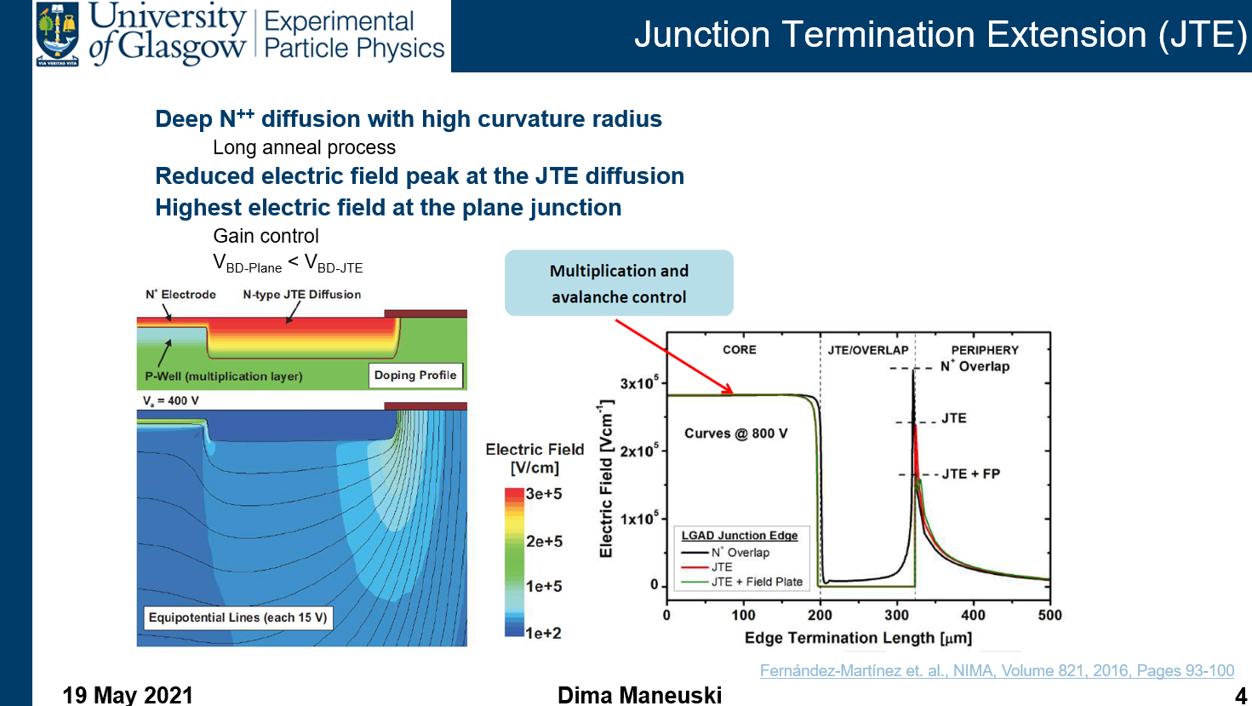
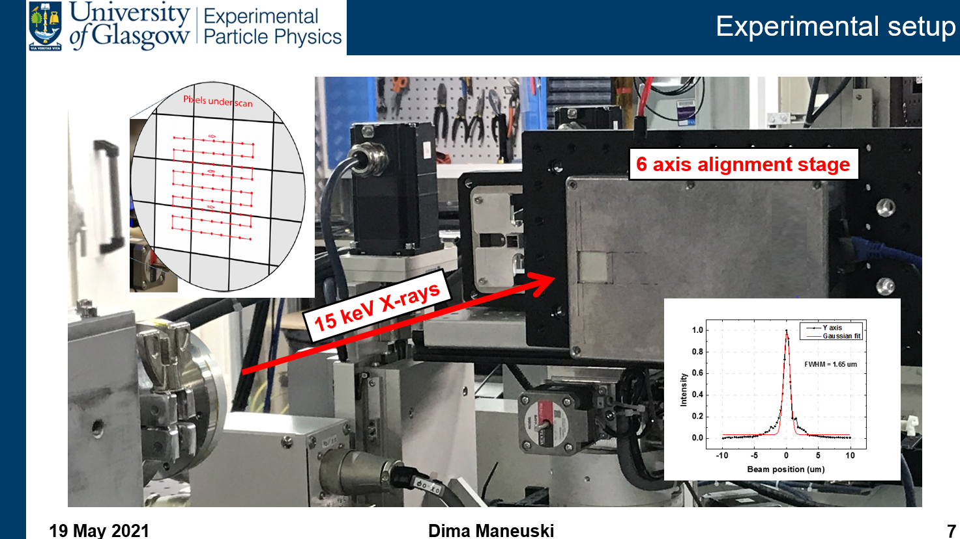
Content
Table of contents
Low Gain Avalanche Diodes (LGADs)
        Research agenda and motivation
Experiments at Diamond Light Source
        Experimental setup
        Devices under test
        Results and discussion
Future work
Conclusions

Slide 3
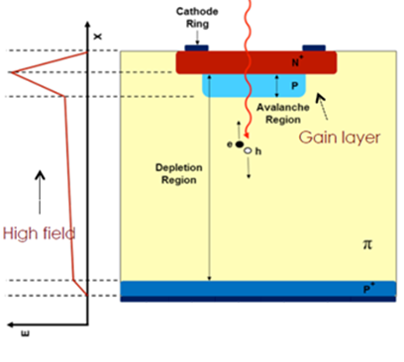
Glasgow LGAD sensors development program
LGAD principle
Research agenda and motivation
Fast timing silicon pixel detectors (sub 100 ps)
“Tender” energy x-rays detectors (and below)
Understand LGAD technology
Create simulation models
Develop fabrication process
Build characterisation infrastructure
Explore potential applications
Synchrotron applications
LHCb VELO upgrade
Moffat, (2020), PhD thesis

Slide 4
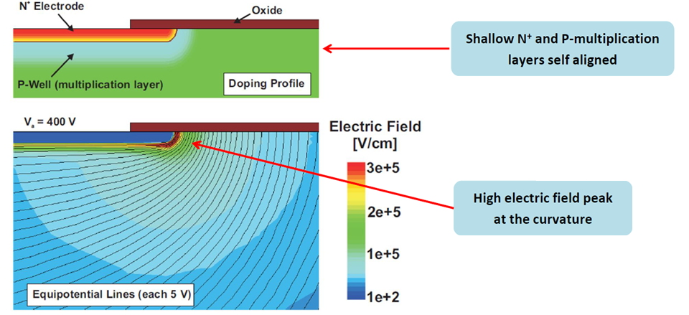
Edge termination: why is it needed?
The electric field at the corner curved section of the N⁺⁺/P⁺ junction is much higher than that of the flat junction region
  where Gain is required
Avalanche at the N⁺/P⁺ curvature at a very low reverse voltage
  -> premature breakdown
Fernández-Martínez et. al., NIMA, Volume 821, 2016, Pages 93-100

Slide 5
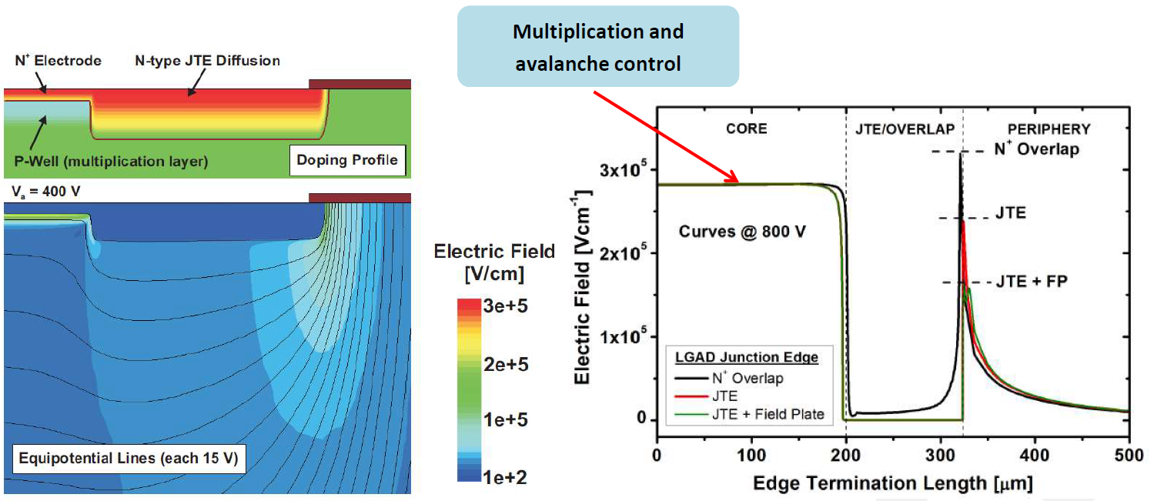
Junction Termination Extension (JTE)
Deep N⁺⁺ diffusion with high curvature radius
  Long anneal process
Reduced electric field peak at the JTE diffusion
Highest electric field at the plane junction
  Gain control
  V_{BD-Plane} < V_{BD-JTE}
Fernández-Martínez et. al., NIMA, Volume 821, 2016, Pages 93-100

Slide 6
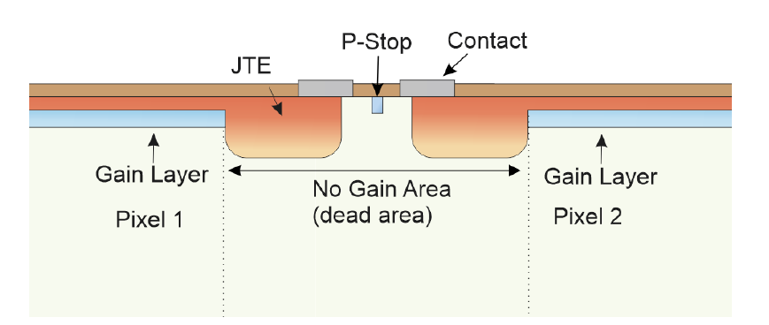
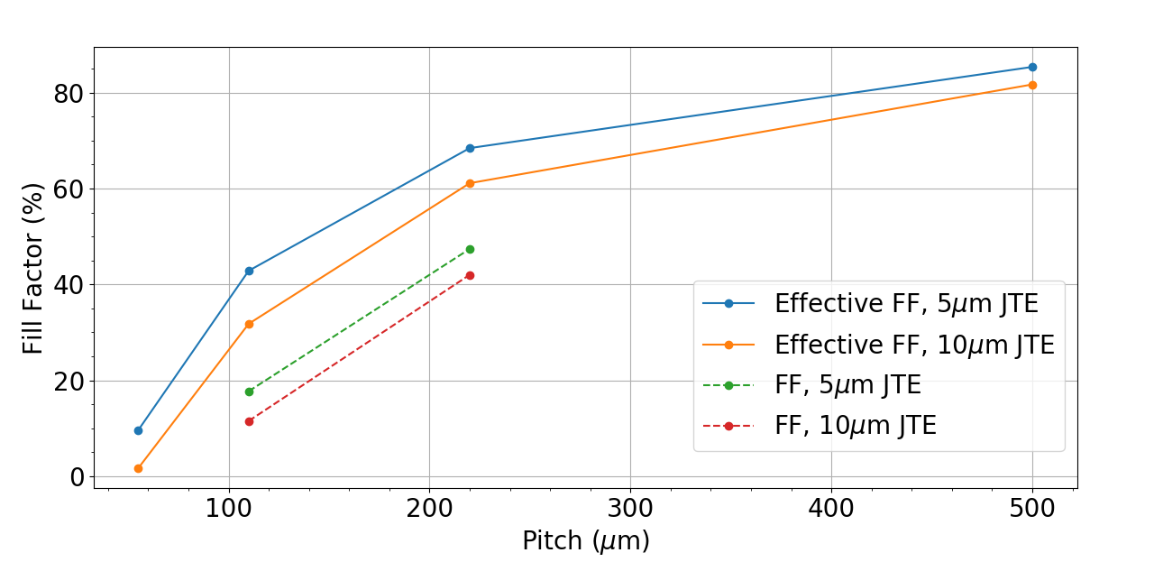

Small pixels – poor fill factor
$$Fill Factor =\frac{Gain Area}{Total Area}$$
Geometric fill factor
  Caused by JTE around each pixel
  Need to take into account diffusion on JTE
50 x 50 µm² pixel – JTE 10 μm -> fill factor < 10%
Moffat and Bates, NIMA, Volume 1018, 2021, 165746

Slide 7
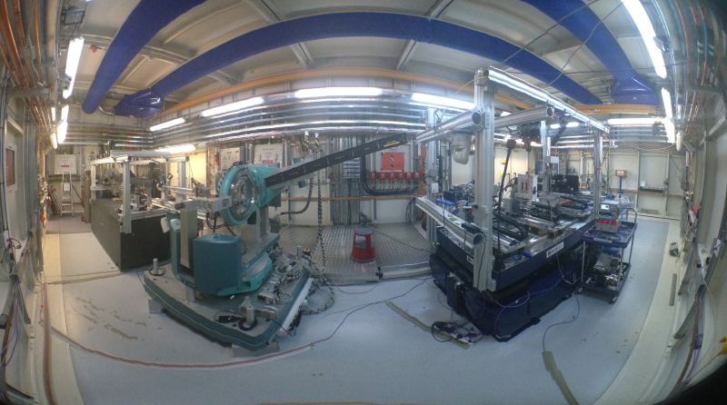
Diamond Light Source, B16
B16: Test Beamline
Flexible and versatile beamline for testing new developments in optics and detector technology and for trialling new experimental techniques
4 – 45 keV photon energy range
Operational modes:
  Focused, unfocused
  Monochromatic, white beam
  High flux
What we use
15 keV monochromatic beam
Focused to about a micron FWHM

Slide 8
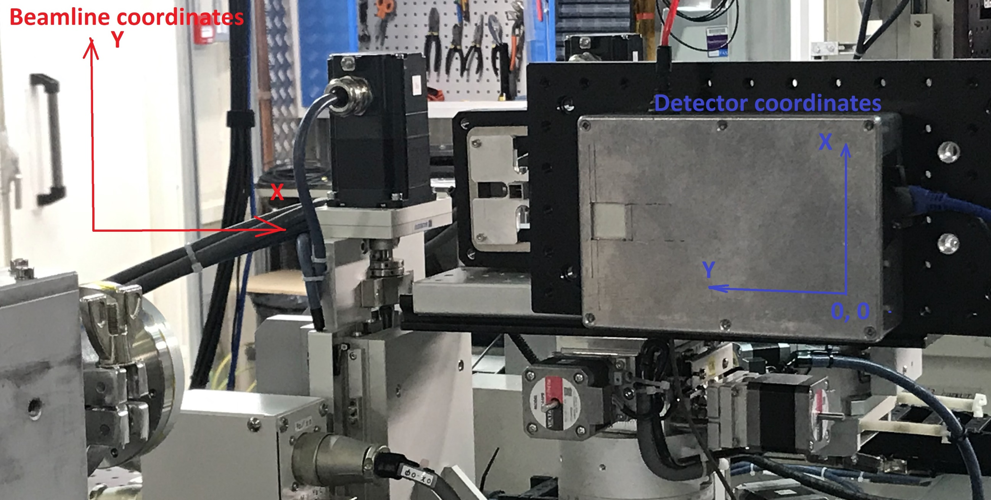
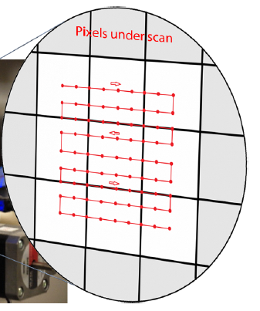
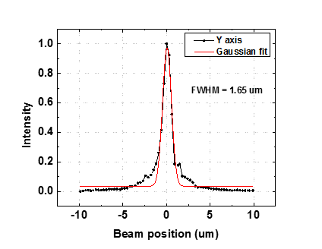
Experimental setup
6 axis alignment stage
15 keV X-rays

Slide 9
DUTs and tests
Devices produced and tested
C04 - 110 um pixel, 10 um JTE
C06 - 110 um pixel, 20 um JTE
D04 - 55 um pixel, 5 um JTE
Each device has control no-multiplication region of 9x9 pixels in the right bottom corner
Tests performed
Line scan over Pixel of Interest (POI) @ V
Voltage scan in the middle of PoI
2D scan @ Vmax
TPX3 settings
ToT+ToA mode, data-driven
AdvaDAQ TPX3 USB3.0
I will show 110 um, 10 um JTE in detail
I will show 110 um, 20 um JTE as comparison to 10 um JTE
I will show 55 um, 5 um JTE

Slide 10
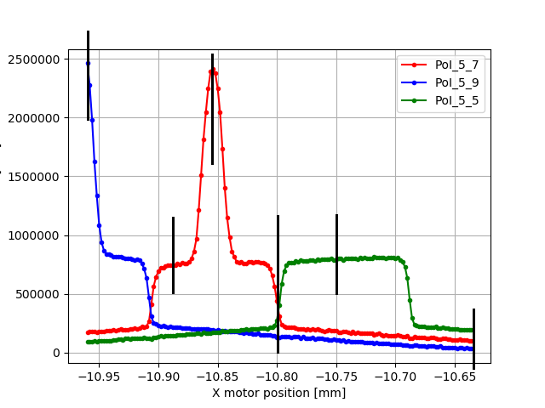
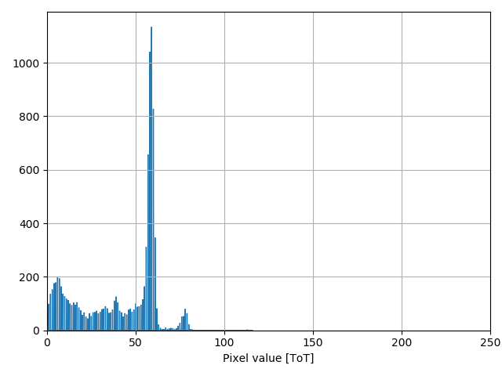
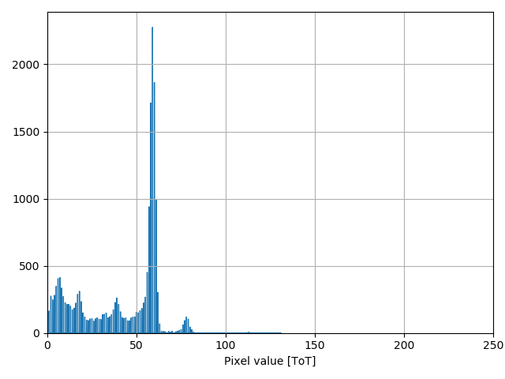
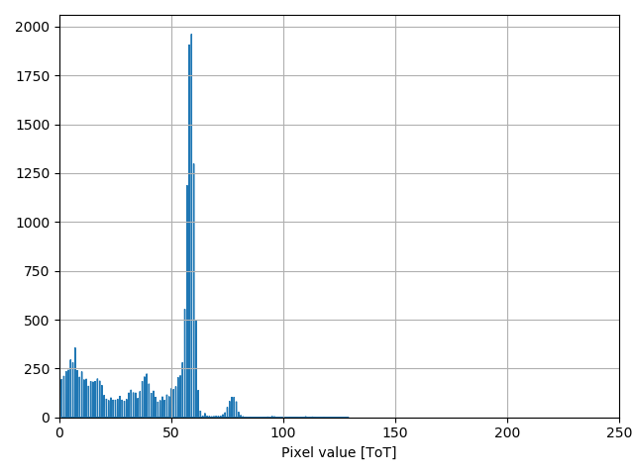
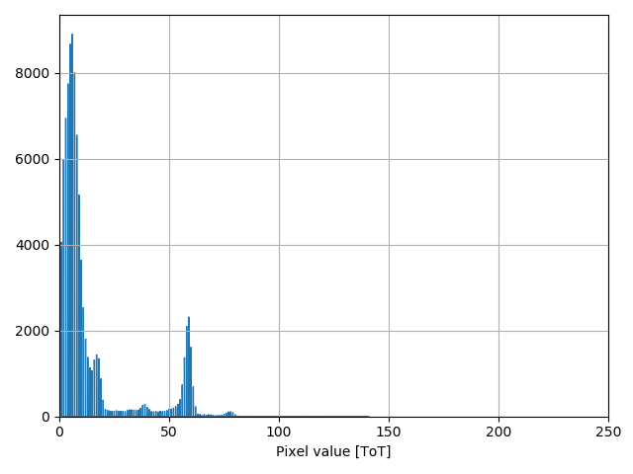
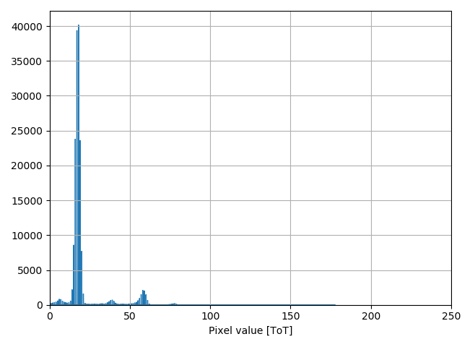
110 um pixel, 10 um JTE
4
1D line scan, no gain pixel (5, 5), -350V
6
6
4
5
3
2
15 keV, x2 count
15 keV
15 keV, x4 count
15 keV, x2 count
1
15 keV, x4 count
15 keV
5
3
2
1
Charge sharing
15 keV, x2 count
X3 count + 45 keV, third harmonic
15 keV, x4 count
15 keV, x2 count
15 keV, x3 count + 45 keV (3rd harmonic)

Slide 11
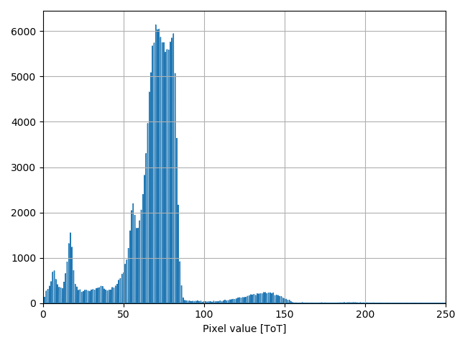
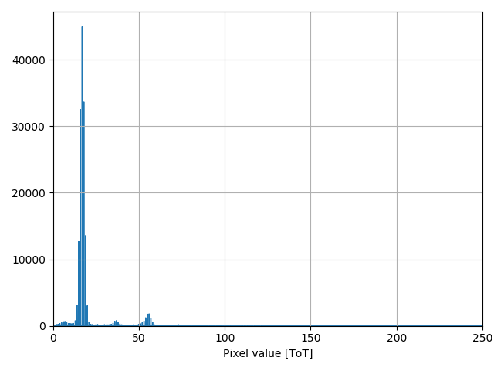
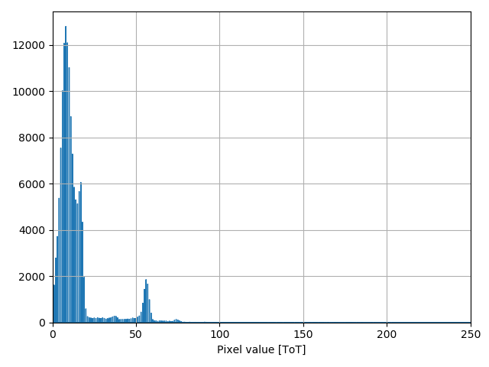
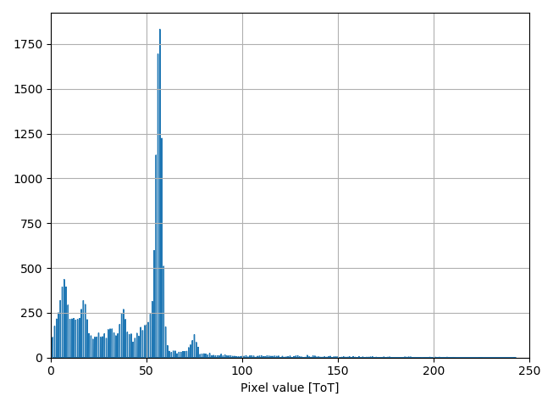
110 um pixel, 10 um JTE
4
1D line scan, gain pixel (5, 7), -350V
6
4
45 keV, 3rd harmonic
5
3
2
15 keV, gain
15 keV, no gain
15 keV, gain, x2 count
1
5
3
2
Charge sharing

Slide 12
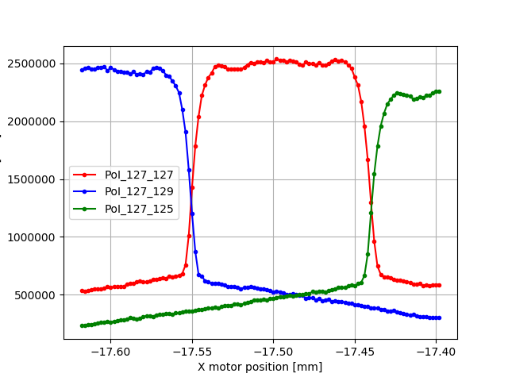
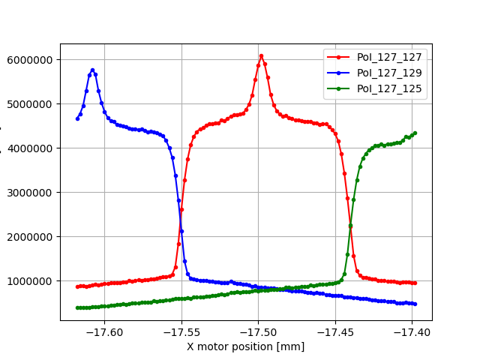
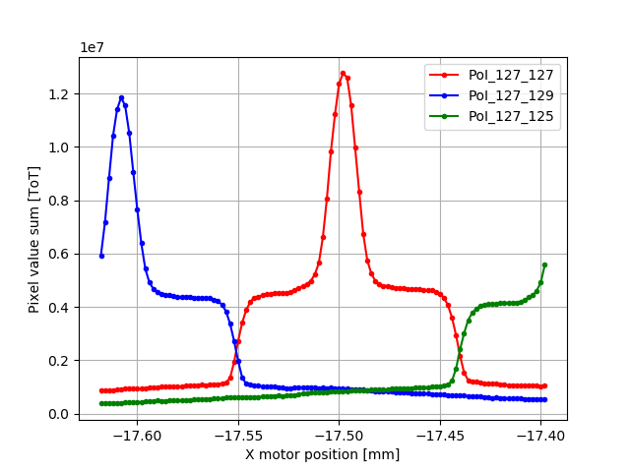
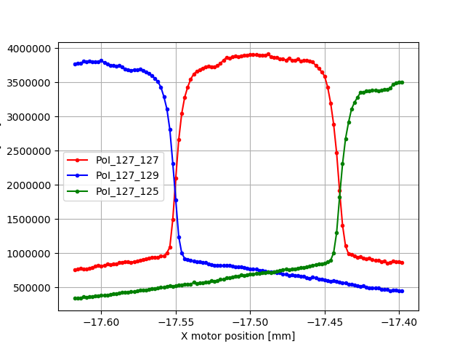
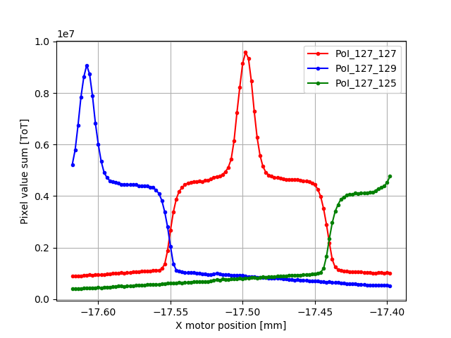
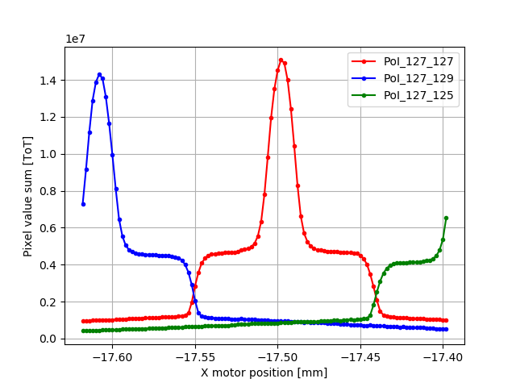
110 um pixel, 10 um JTE
1D line scans @ voltages, gain pixel (127, 127)
-50V
-250V
-150V
-200V
-300V
-100V

Slide 13
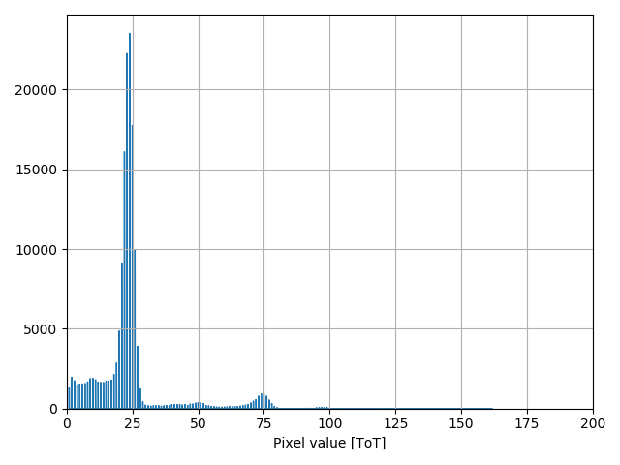
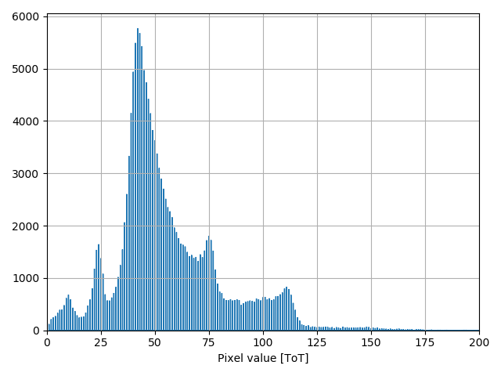
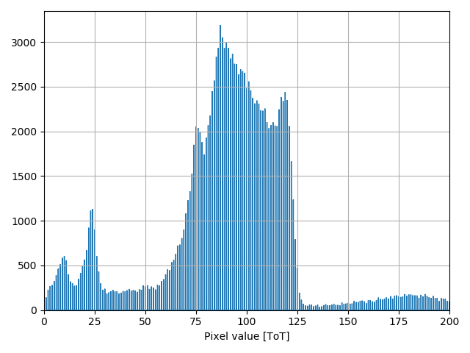
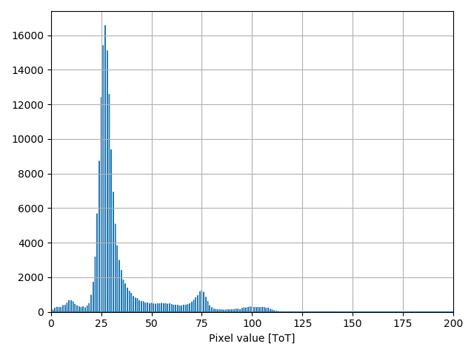
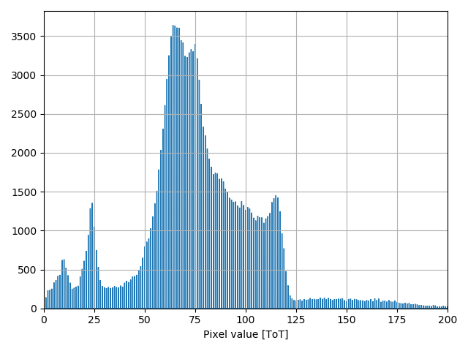
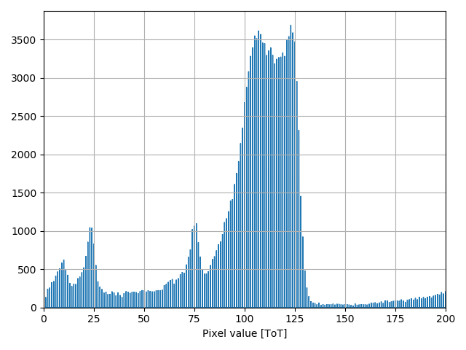
110 um pixel, 10 um JTE
Spectrum in the middle of gain pixel (127, 127)
-100V
-200V
-300V
No gain peak 24 ToT
-150V
-250V
-350V
Gain peak 107 ToT
Gain = 4.5

Slide 14

110 um pixel, 10 um JTE
1D line scans @ voltages, gain pixel (127, 127)
1.7
-350V
0.5
Gain: 3.4‬

Slide 15
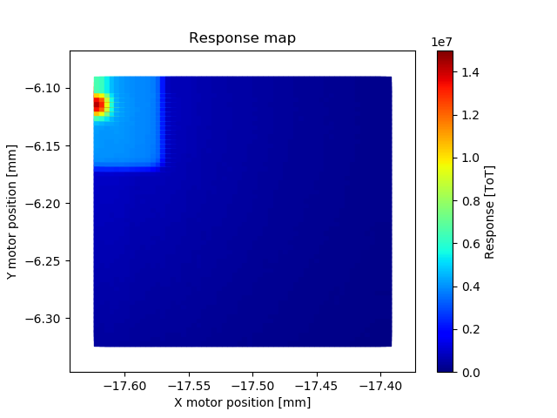
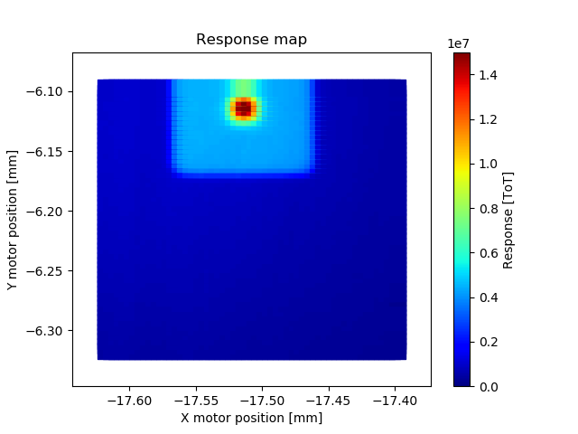
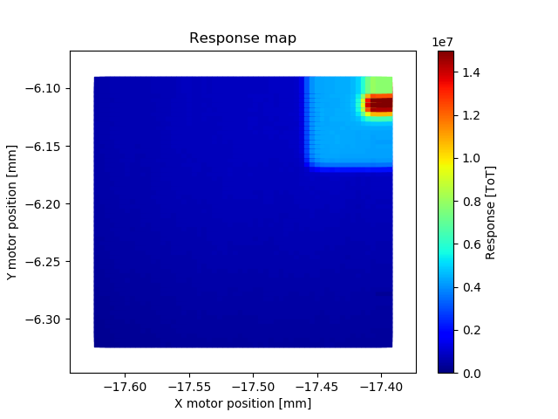
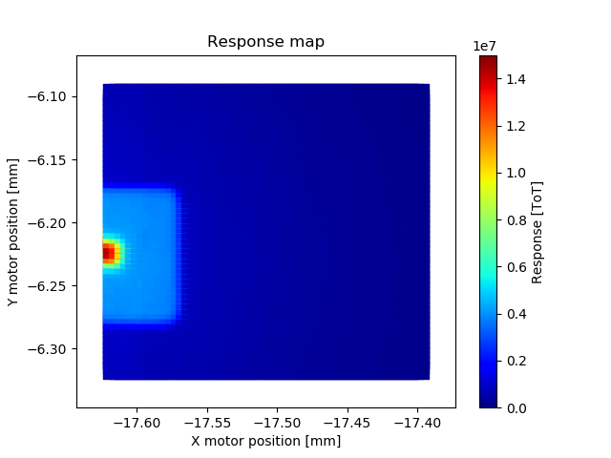
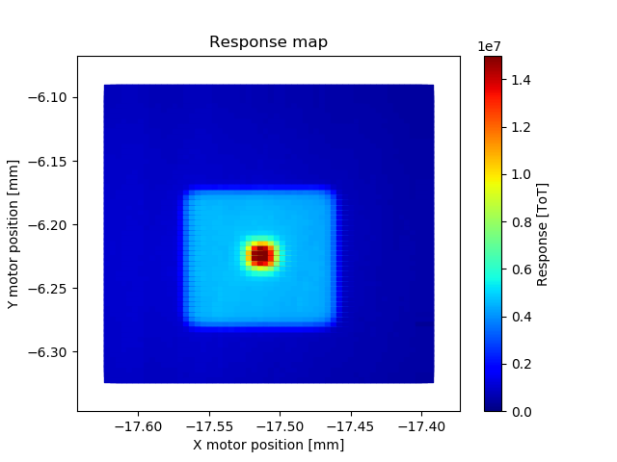
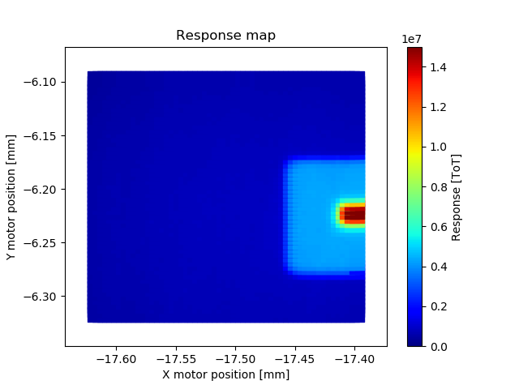
110 um pixel, 10 um JTE
2D scan (-350V)

Slide 16
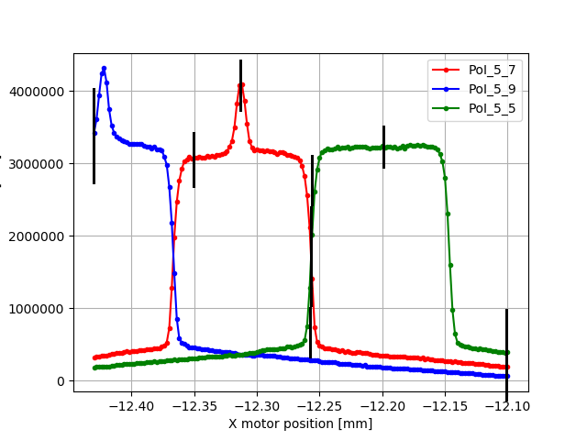
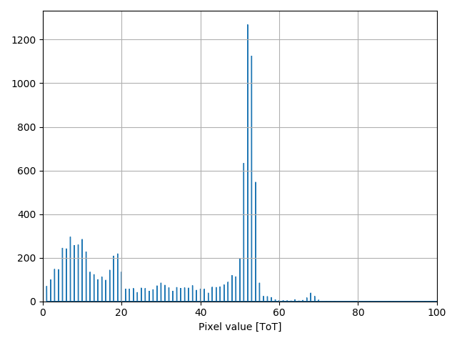
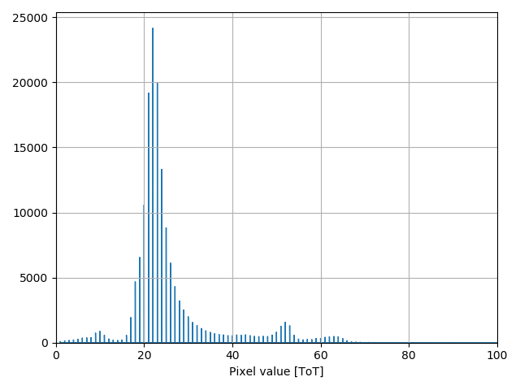
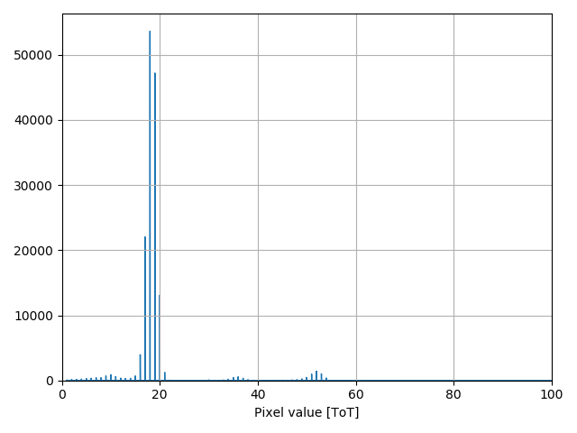
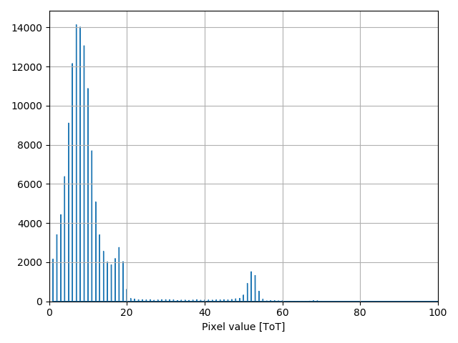
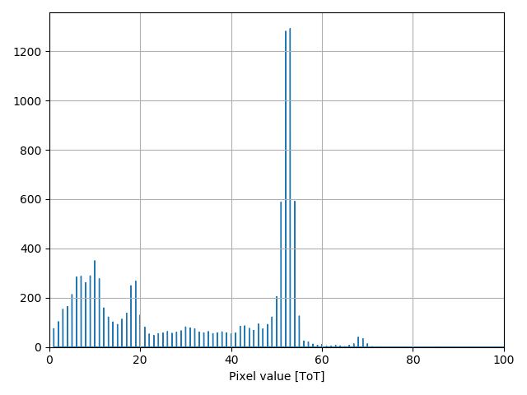
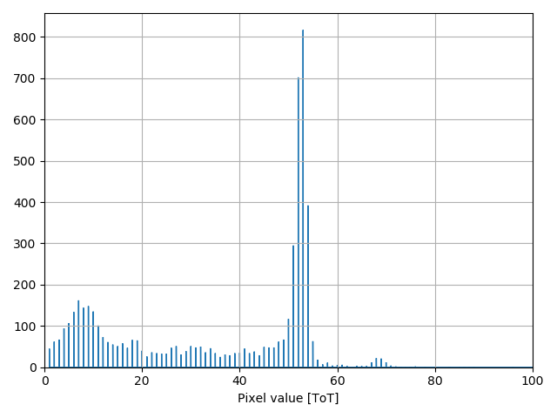
110 um pixel, 20 um JTE
Note! No x2 count peak, so 45 keV is 3rd harmonic only!
6
4
1D line scan, gain pixel (5, 7), -350V
Charge sharing
15 keV, gain
5
2
6
4
15 keV
45 keV, gain
3
1
45 keV
Charge sharing
5
3
2
45 keV
1
15 keV, no gain
Charge sharing
Charge sharing
15 keV, no gain
45 keV
15 keV, no gain
45 keV
45 keV

Slide 17
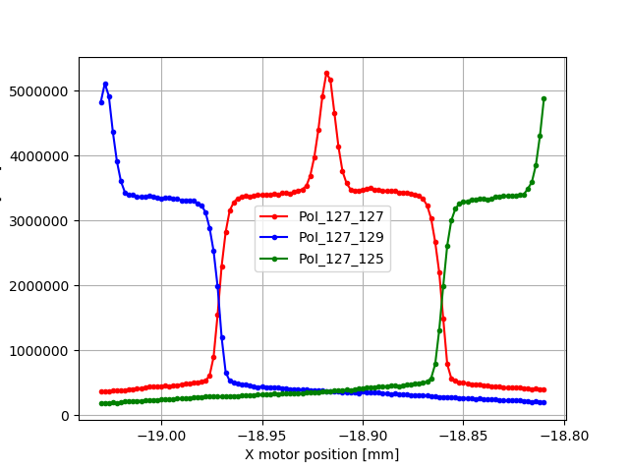
110 um pixel, 20 vs 10 um JTE
110 um pixel, 20 um JTE
110 um pixel, 10 um JTE
5.2
1.7
-350V
-450V
3.3
0.5
Gain: 1.6‬
Gain: 3.4‬

Slide 18
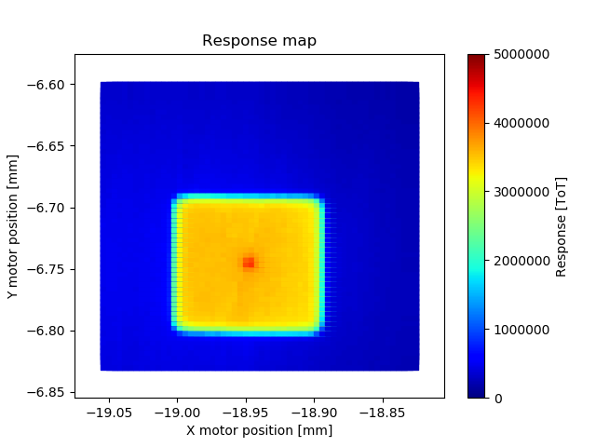
110 um pixel, 20 vs 10 um JTE
110 um pixel, 20 um JTE
110 um pixel, 10 um JTE
-350V
-450V

Slide 19
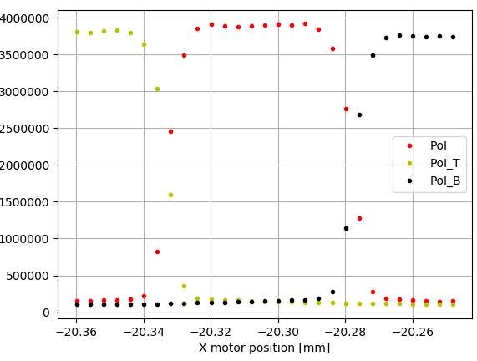
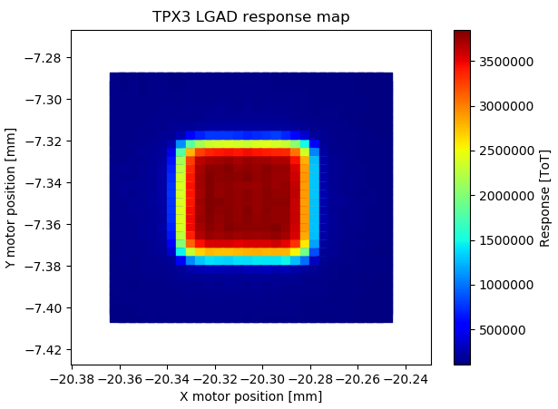
55 um pixel, 5 um JTE
-400V
No gain observed as expected

Slide 20

Options for small pixels - Inverse LGAD
Segmentation at the ohmic contact: strip and pixels.
Multiplication extended over all the CORE.
P-type collector ring at the ohmic side to extract leakage current.
JTE to protect the n+/p curvature and channel stopper to avoid the depletion reaches the end of the detector.
Readout is made by the strips/pixels: holes collection.
Cons
Double side processing
Backside Sensitive to Scratches
Needs to be fully depleted
Albert Doblas Moreno, 16th Trento workshop, 2021

Slide 21

Summary and conclusion
Summary
Strong program to design, produce and test LGAD devices
        TCAD simulations
        Mask design, device fabrication
        Device characterisation by means of TCT and X-rays
Predicted and demonstrated gain in small pixel devices
        Various pixel sizes
        Various JTE sizes
Pathway for overcome existing limitations
        Inverse LGAD design (fabricated, ready to test)
        Trench isolation design (work in progress)
3D representation
110 um pixel, 10 um JTE

