Slide 1

Development of 2D GaN and 3D SiC detectors
Hongwei Liang¹, Xin Shi², Xiaochuan Xia¹, Zhenzhong Zhang¹
¹ Dalian University of Technology
² Institute of High Energy Physics Chinese Academy of Sciences
17-11-2021

Slide 2
Outline
Motivation
2D GaN partical detector
3D SiC radiation detector
Prospect

Slide 3
Advantages of semiconductor radiation detectors
Narrow band gap
semiconductor detector
w~3eV
Gas detector
w~30eV
  Energy resolution
  Detection efficiency
Fano factor (~0.1)
Fano factor (0.2~0.5)
VS
Energy resolution
Detection efficiency
Pulse rise time
Energy linear range
Integrated
  Small size
  Radiation damage
  High temperature
  Protect from light
Scintillator detector
w~300eV
  Detection efficiency
    Energy resolution
    Carrier collection
Fano factor (~1)
Wide bandgap semiconductor based detector
can met the demand

Slide 4
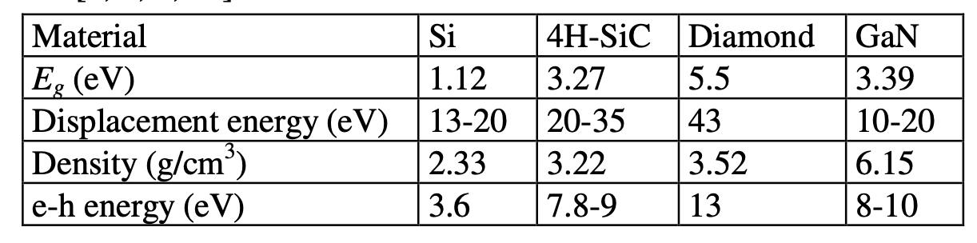
Table 1: Basic physical parameters of semiconductor materials

Slide 5
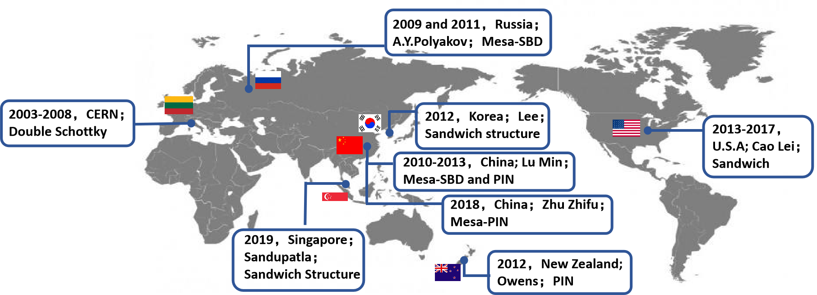
Motivation for the development of 2D(planer) GaN radiation detector
1. The band gap of GaN is 3.4 eV, suggesting excellent high temperature resistance
2. High breakdown field strength, suggesting better carrier collection efficiency
3. Mature process technology, suggesting large-scale integration
4. Industrialized epitaxial growth, suggesting low device cost
High temperature resistance
and radiation resistance
Main research units of GaN-based α particle detectors：

Slide 6
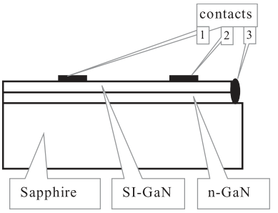
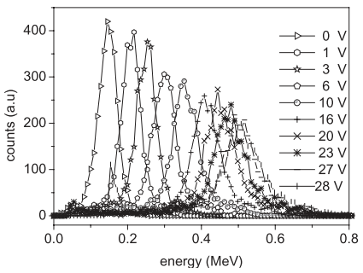
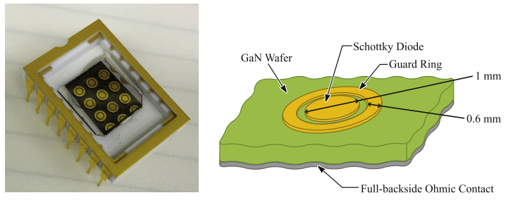
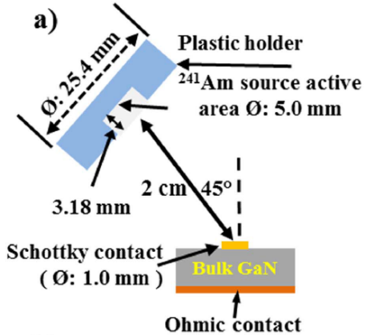
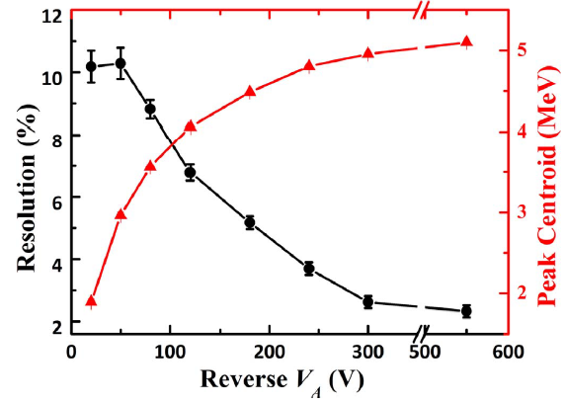
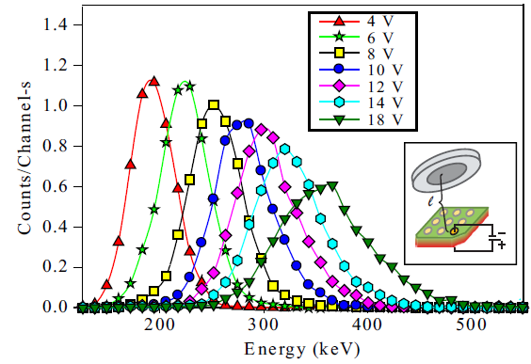
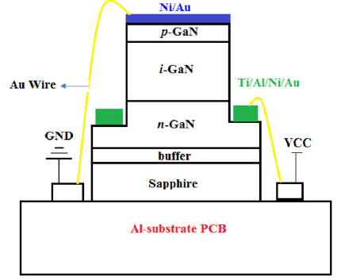
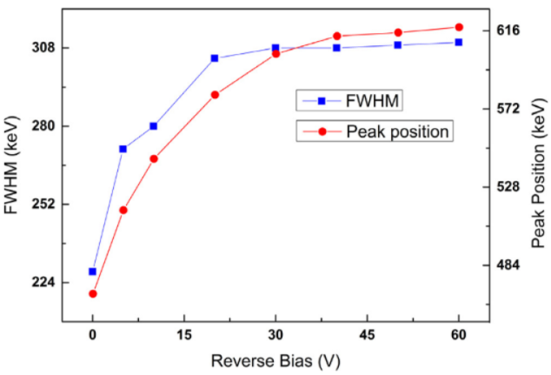
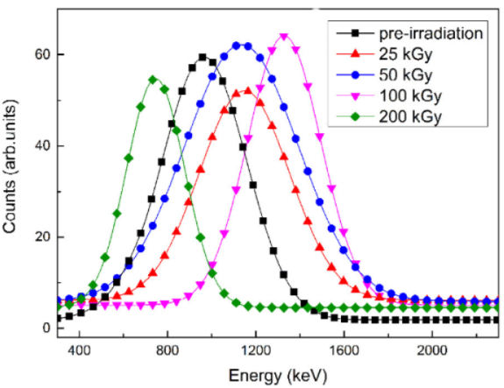
GaN α particle detector structure:
(a) Double-Schottky contact structure：
(b) Sandwich Structure ( schottky structure)：
J. Vaitkus, W. Cunningham, E. Gaubas, M. Rahman, S. Sakai, K. M. Smith, and T. Wang, Nucl. Instrum. Methods Phys. Res., Sect. A 509(1–3), 60–64 (2003).
Q. Xu, P. Mulligan, J. H. Wang, W. Chuirazzi, and L. Cao, “Bulk GaN alpha-particle detector with large depletion region and improved energy resolution,” Nucl. Instrum. Methods Phys. Res. A, vol. 849, pp. 11-15, Dec. 2016.
P. Mulligan, J. H. Wang, and L. Cao, “Evaluation of freestanding GaN as an alpha and neutron detector,” Nucl. Instrum. Methods Phys. Res. A, vol. 719, pp. 13-16, Apr. 2013.
(c) p-i-n structure
Lower leakage current noise
Z. F. Zhu, H. Q. Zhang, H. W. Liang, B. Tang, X. C. Peng, and J. X. Liu et al., “High-temperature performance of gallium-nitride-based pin alpha-particle detectors grown on sapphire substrates,” Nucl. Instrum. Methods Phys. Res. A, vol. 893, pp. 39–42, Mar. 2018.

Slide 7
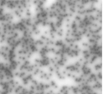
The main problems in the development of Mesa pin detectors
High dislocation density
High background carrier concentration
The mismatch between GaN and sapphire reaches16%
GaN sensitive area
Buffer layer
Sapphire Substrate
Thick films
Leakage mechanism

Slide 8
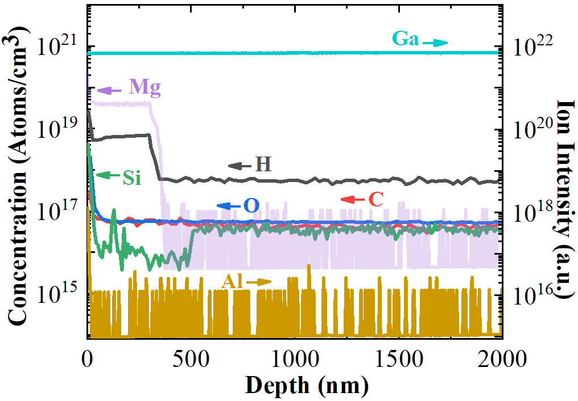
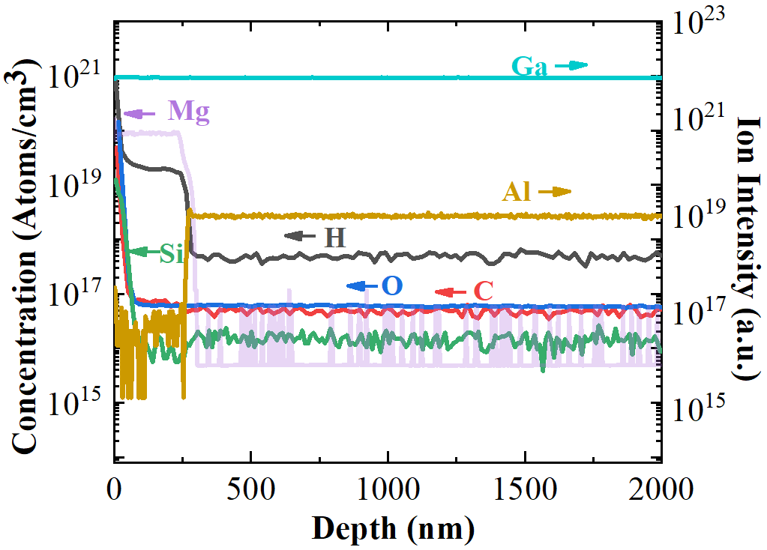
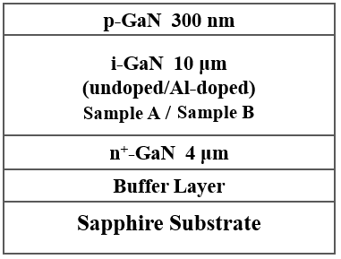
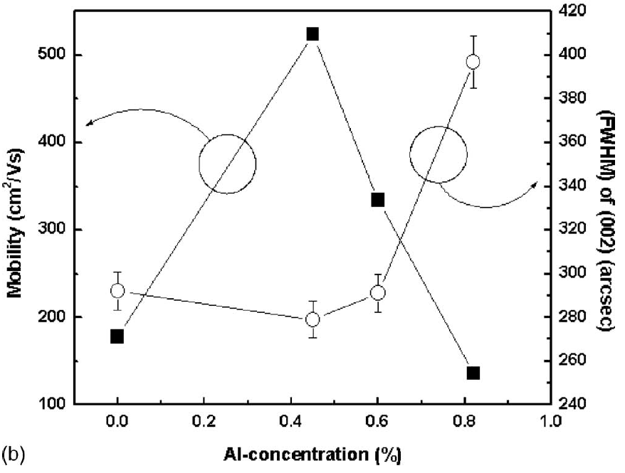
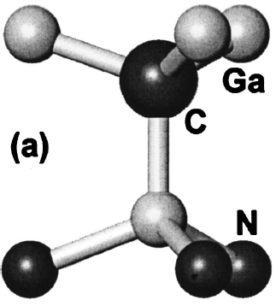
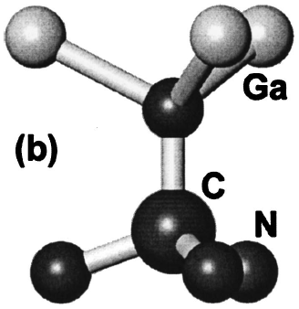
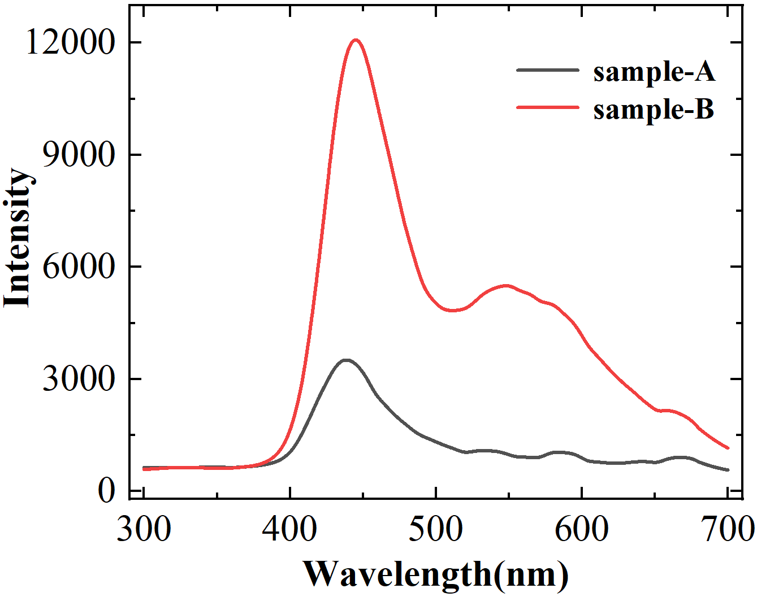
Our solution: Aluminum Isoelectronic doping technique
Epitaxial layer structure
Sample A: undoped i-GaN
Sample B: Al-doped i-GaN
Al concentration：0.214%
SIMS Results
SIMS Results
Al_{x}Ga_{1-x}N
J. H. Lee, and J. H. Lee, J. Appl. Phys., vol. 105, p. 064508, Mar. 2009.
[Si]≈[C], N_{d}=[Si]+[O]-[C]
≈10¹⁶ cm⁻³
[Si]<[C], N_{d}≠[Si]+[O]-[C]
<[Si] or [C], 10¹⁴ cm⁻³
Al_{x}Ga_{1-x}N tends to grow
C_{N}
C_{N} and C_{Ga}
Self-compensation
Decrease in electron concentration
The role of Si, O, C impurities in different positions in the GaN lattice：
PL
test
 | Si | O | C
Ga | (12-17 meV) donor | (30-33 meV) donor | (200 meV) donor
N | —— | —— | (900 meV) acceptor
C_{Ga} to C_{N} transitions
C_{N}

Slide 9
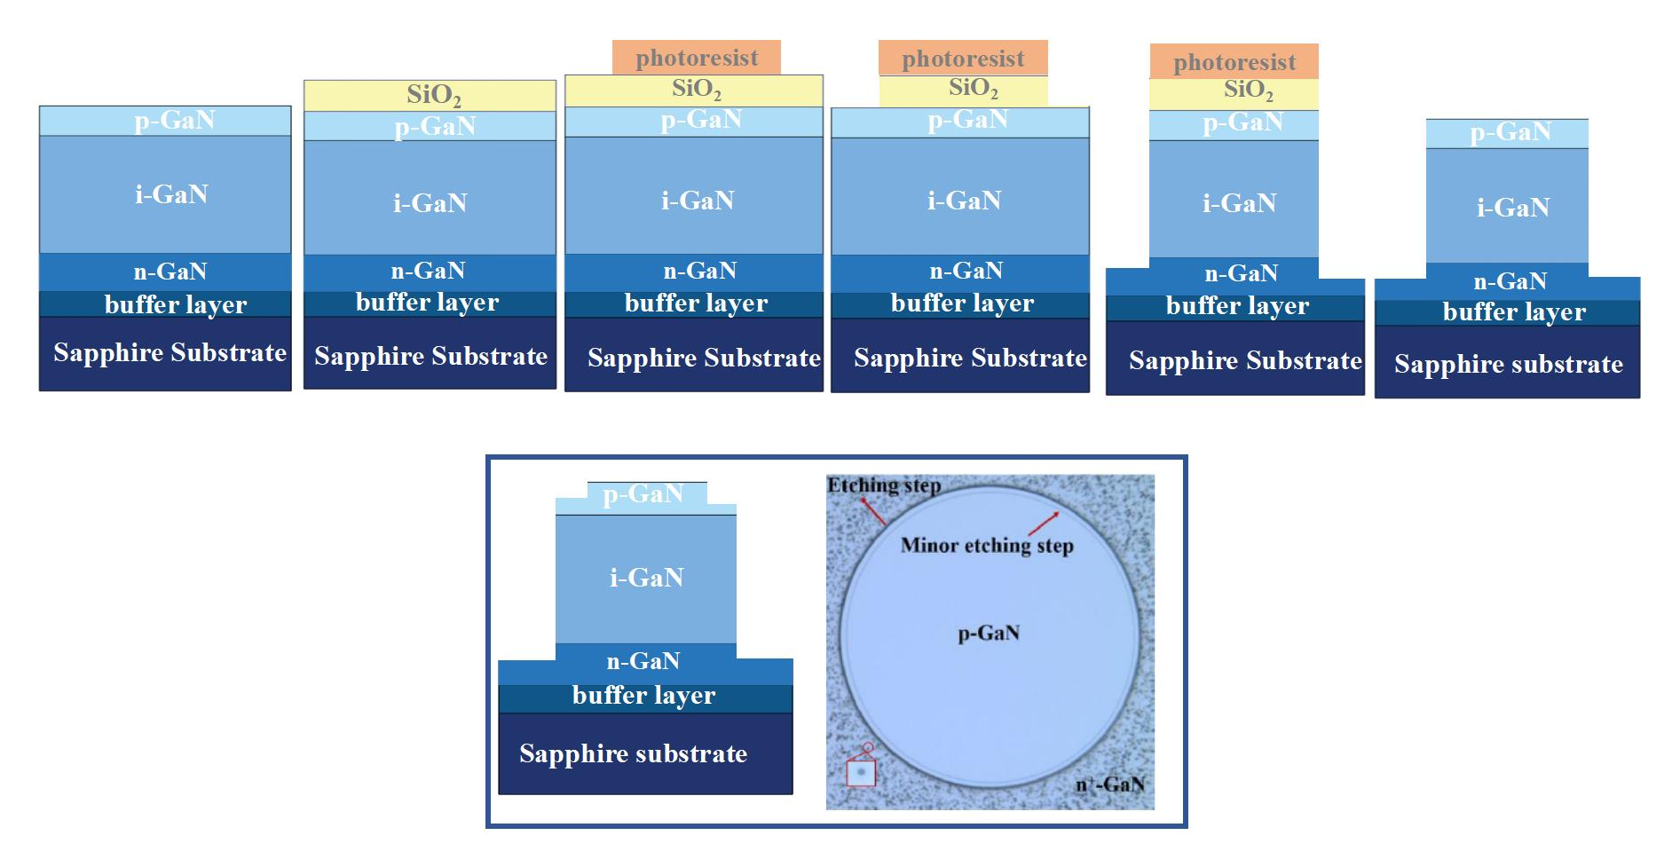
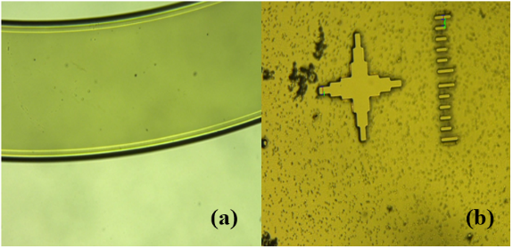
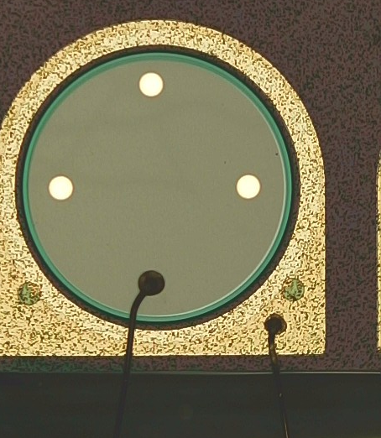
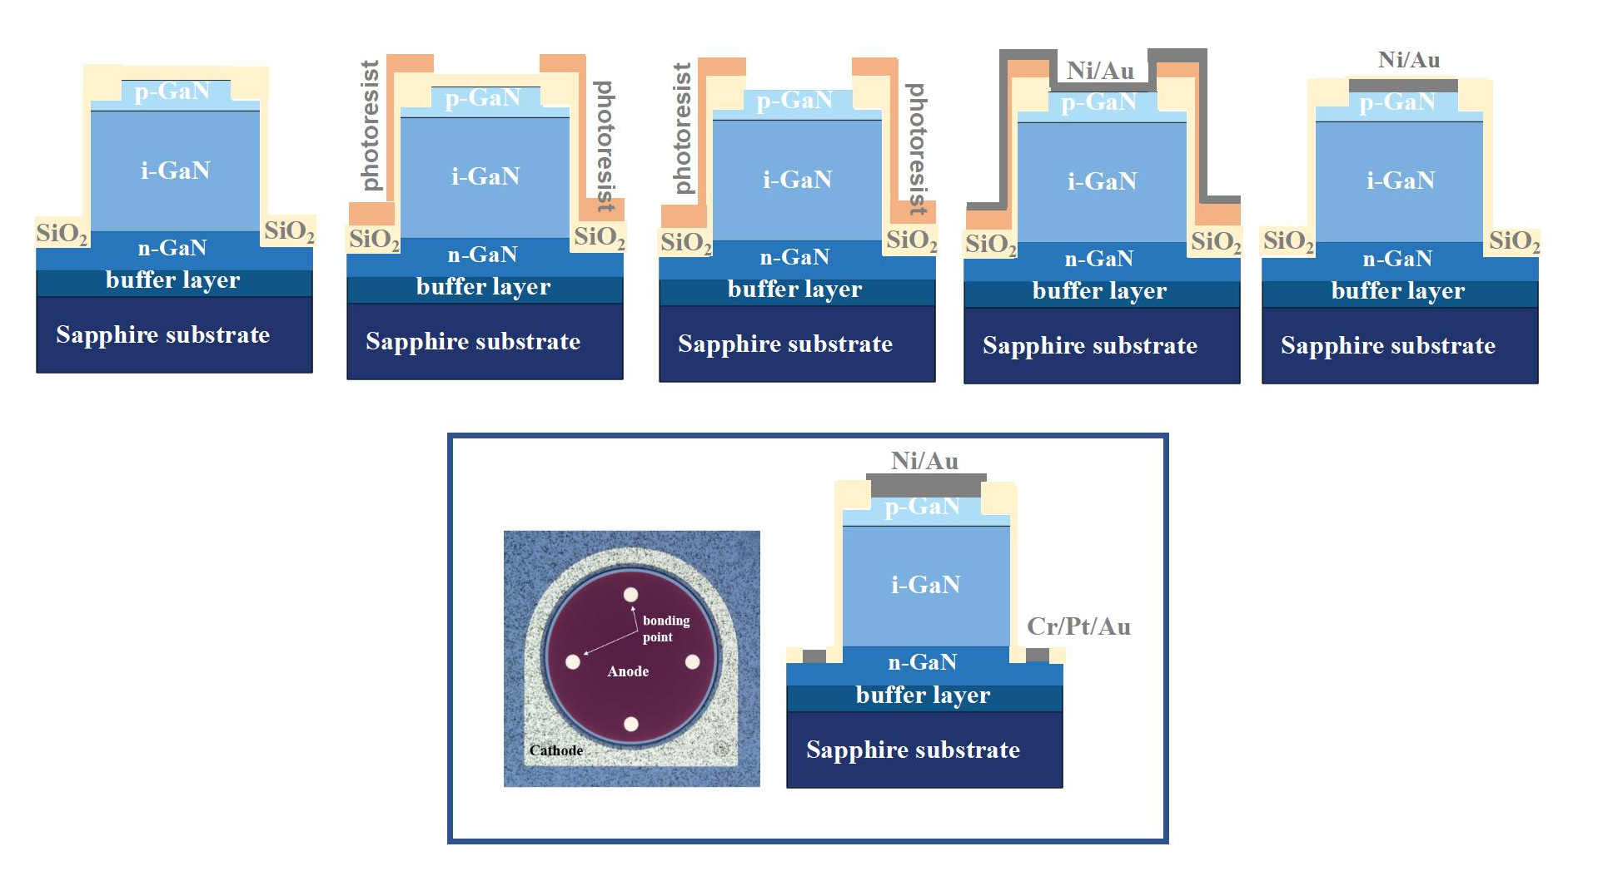
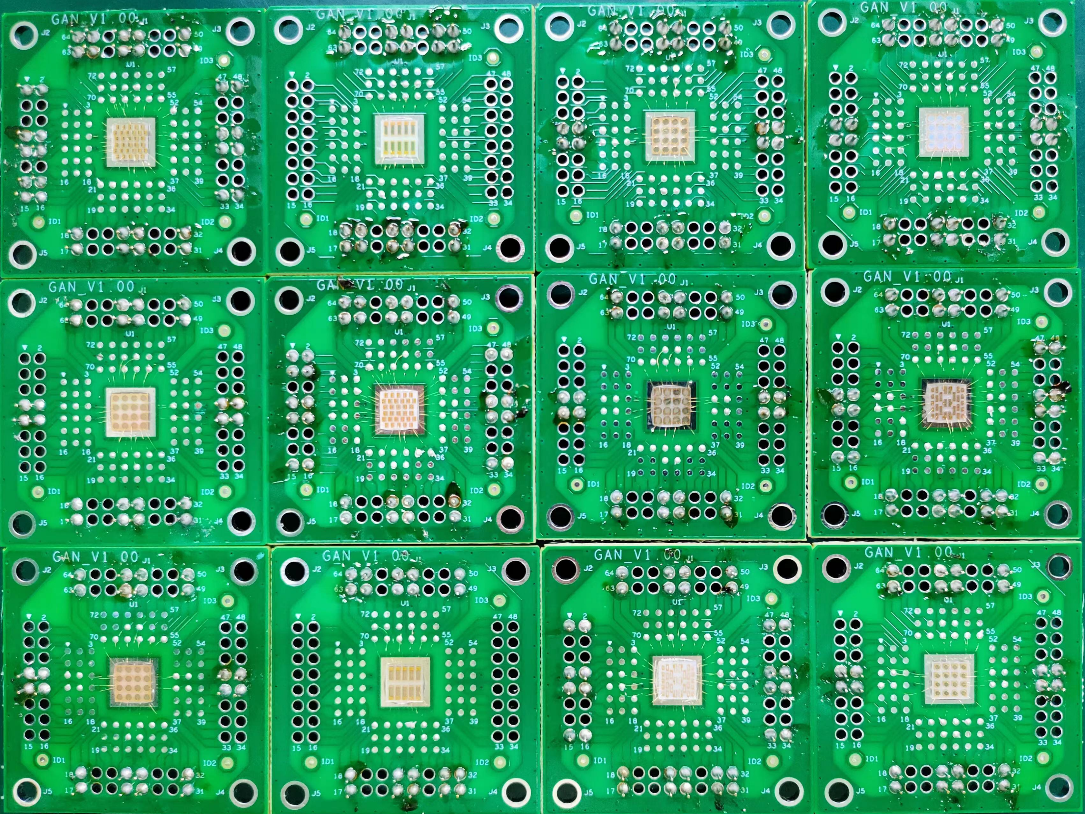
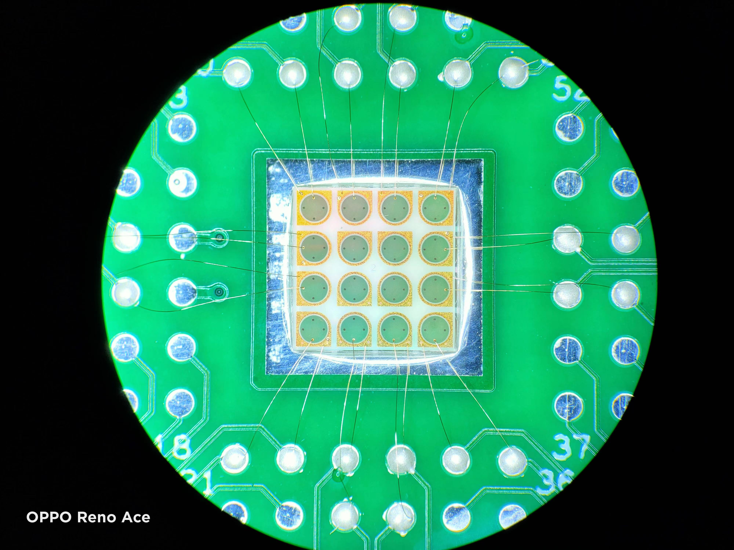
Process flow
Clean
DepositionSiO₂
Photolithography
Etch SiO₂
ICP
Lift off
Etch steps
TMAH
Deposition SiO₂
Photolithography
Etch
Metal deposition
Lift off
Annealing

Slide 10
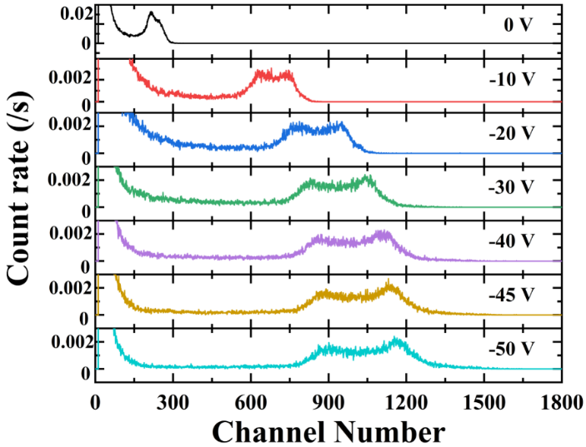
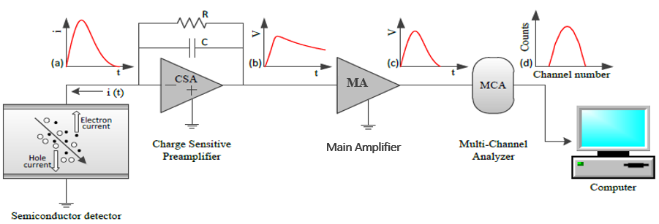
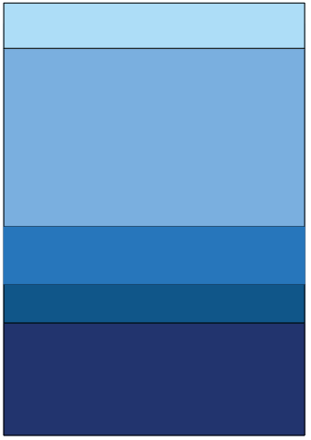
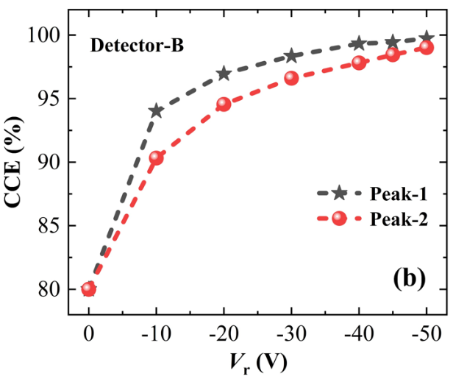
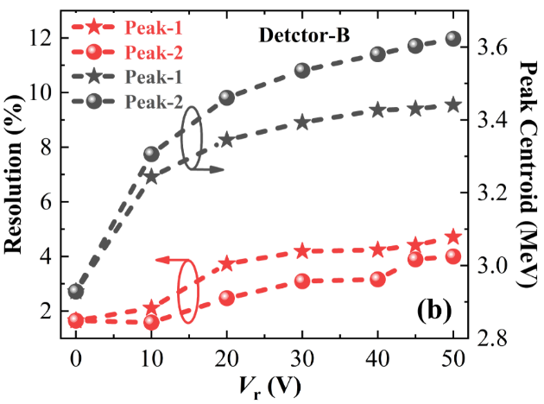
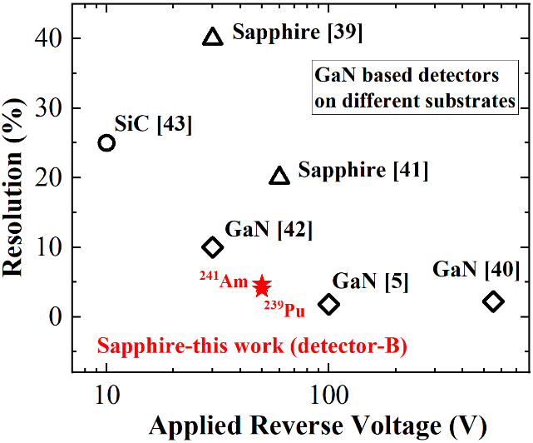
Schematic diagram of particle irradiation detection system
（²³⁹Pu+²⁴¹Am）
αPartical
Ni/Au
p-GaN
i-GaN
Ti/Al/Ni/Au
n-GaN
buffer layer
Sapphire substrate
Dead zone includes: 1mm Air、Ni/Au electrode and p-GaN
Spectra acquired by detector
at varied Vr from 0 to -50 V
CCE datas of detector
under different Vr.
FWHM and peak centroid datas
for detector with the varied Vr
Resolution comparisons with
GaN alpha-particle detectors

Slide 11
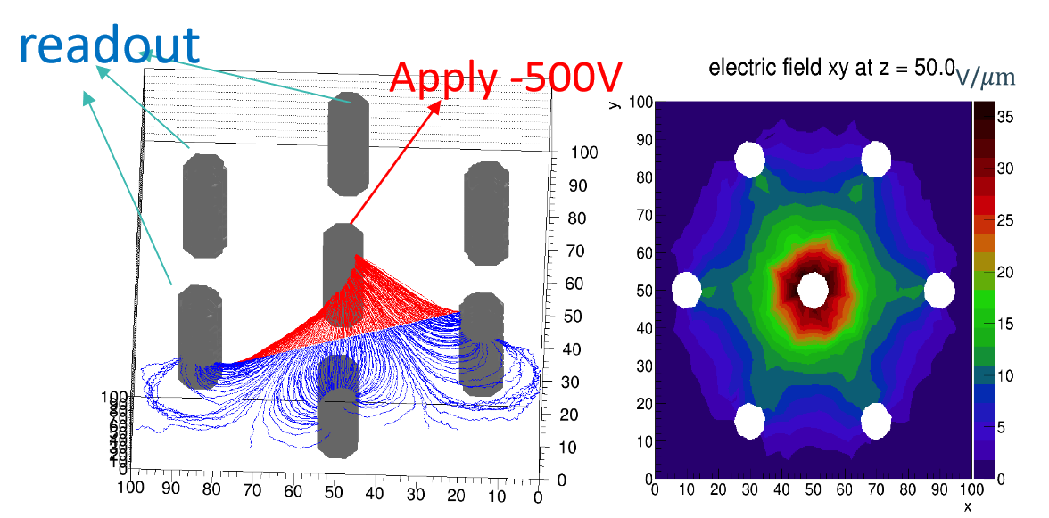
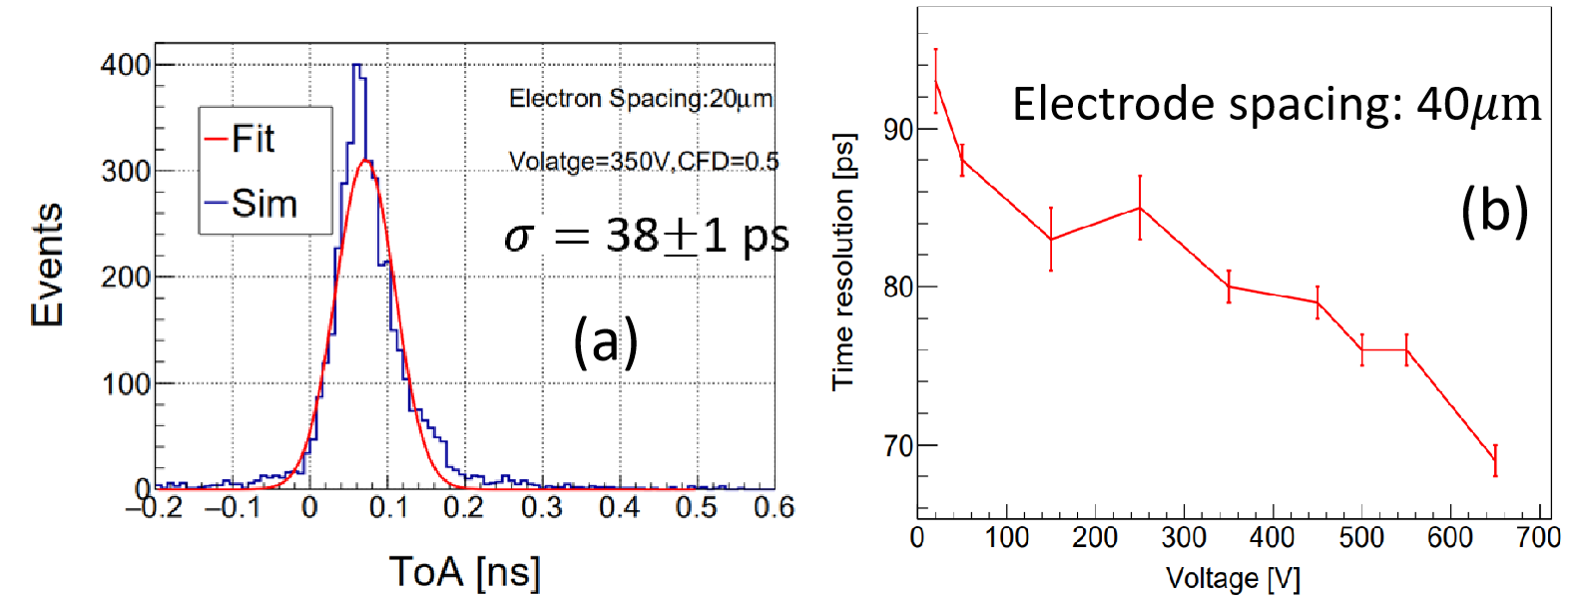
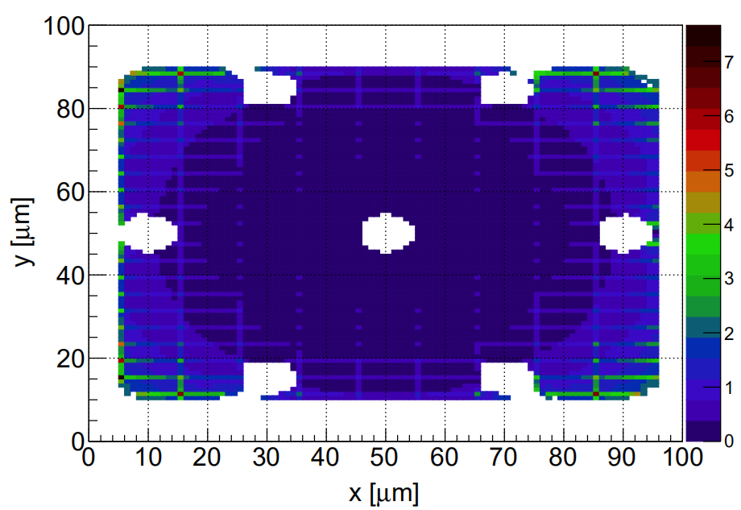
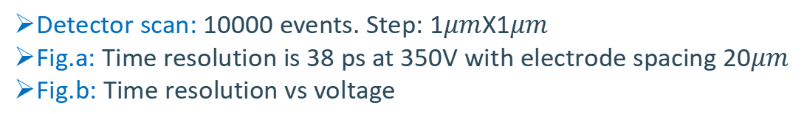
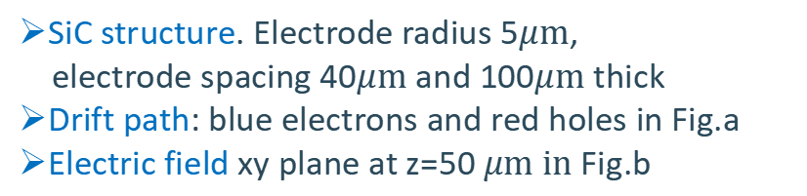
Motivation for the development of 3D SiC radiation detector
1. Wide band gap (3.2 eV), High breakdown field strength, Mature process technology
2. Narrow electrode spacing – good time resolution and charge collection
3. Good singlecrystal quality – Thick thickness – larger charge collection and signal
4. More radiation resistant than 2D SiC
3D-SiC simulation – time resolution：
Device structure
Device performance
Vertical incidence
TOA[ns]
SiC structure. Electrode radius 5$μm$,
electrode spacing 40$μm$and 100$μm$thick
Drift path: blue electrons and red holes in Fig.a
Electric field xy plane at z=50$μm$ in Fig.b
Detector scan: 10000 events. Step: 1$μm$X1$μm$
Fig.a: Time resolution is 38 ps at 350V with electrode spacing 20$μm$
Fig.b: Time resolution vs voltage

Slide 12
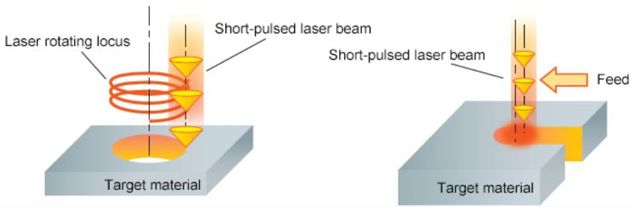
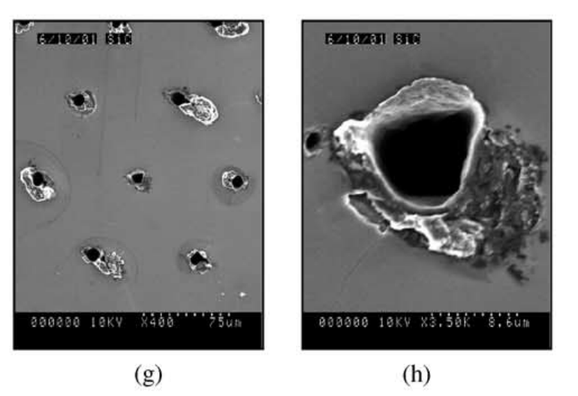
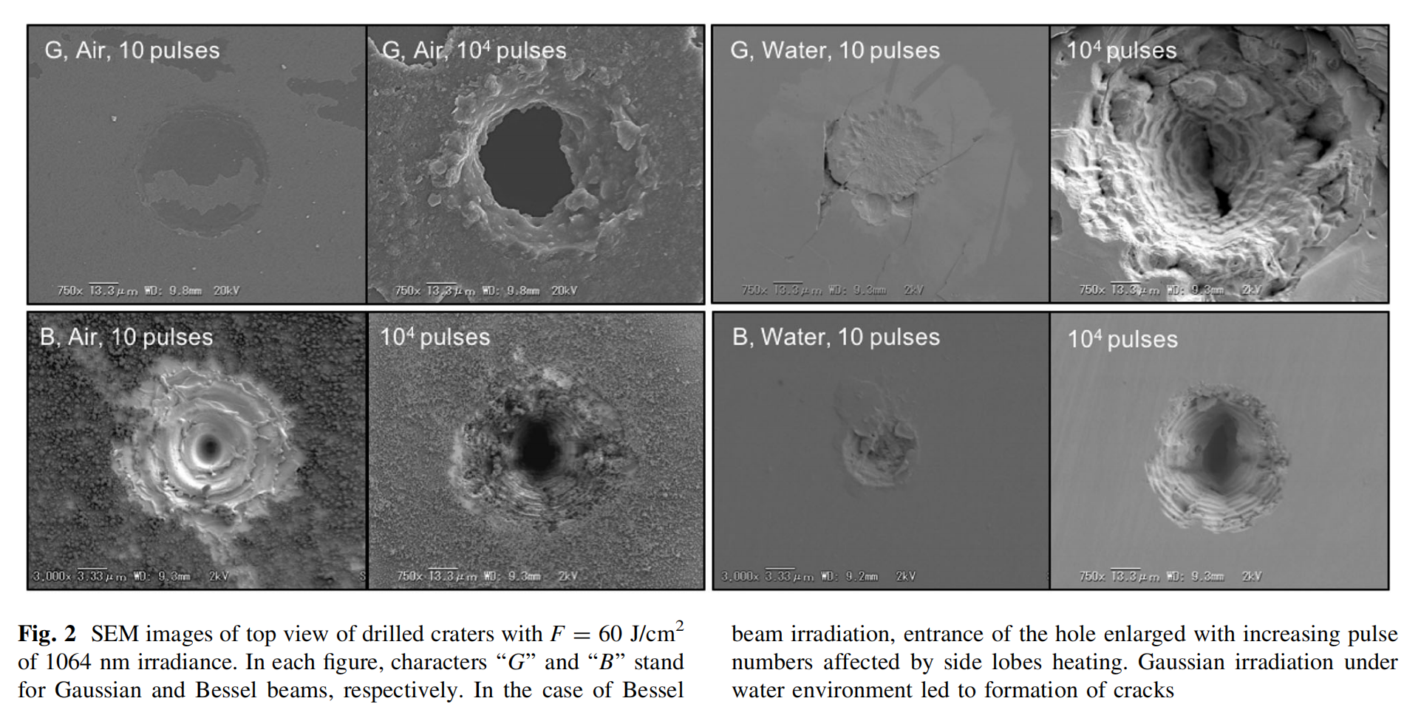
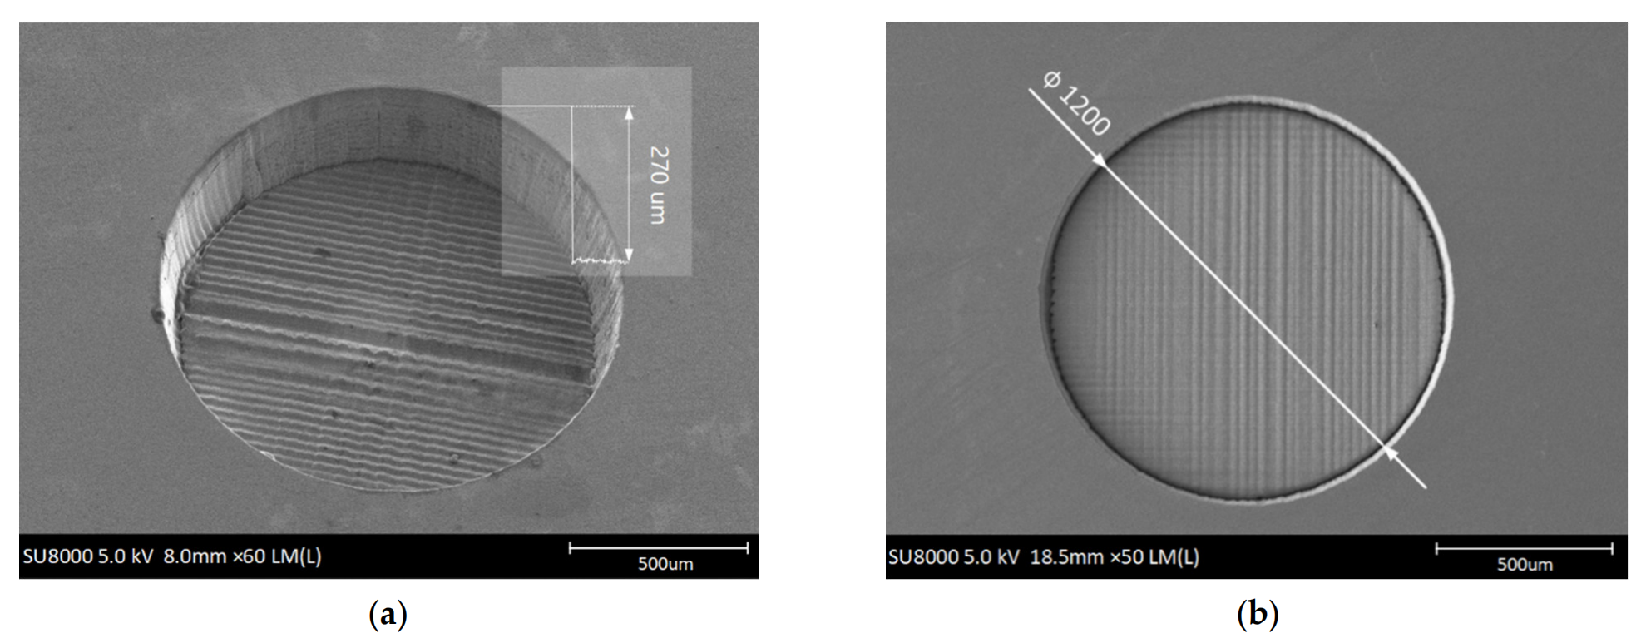
Method of making 3D structure
1. ICP etching (Inductive Coupled Plasma Emission Spectrometer Etch)
2. Chemical or electrochemical etching
3. Laser drilling
Auger drilling Pulse drilling
Advantage of laser drilling technology
1. Suitable for a variety of materials
2. Few steps and parameters
3. Short process time
Giulio Pellegrini and P. Roy et al., “Technology development of 3D detectors for high-energy physics and imaging” Nuclear Instruments and Methods in Physics Research A 487 (2002) 19–26.
Byunggi Kim and Ryoichi Iida et al., “Mechanism of nanosecond laser drilling process of 4H-SiC for through substrate vias” Appl. Phys. A (2017) 123:392.
Lukang Wang and You Zhao et al., “Design and Fabrication of Bulk Micromachined 4H-SiC Piezoresistive Pressure Chips Based on Femtosecond Laser Technology” Micromachines 2021, 12, 56.

Slide 13
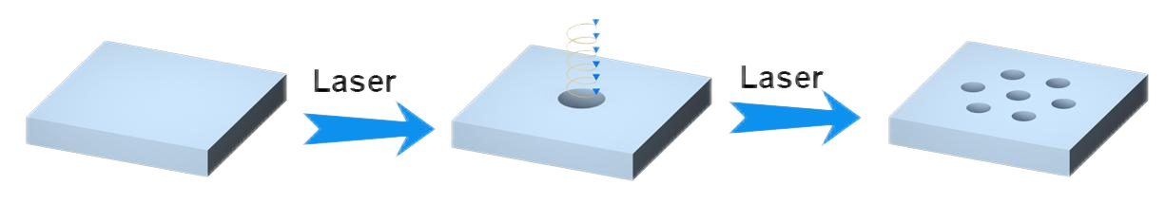
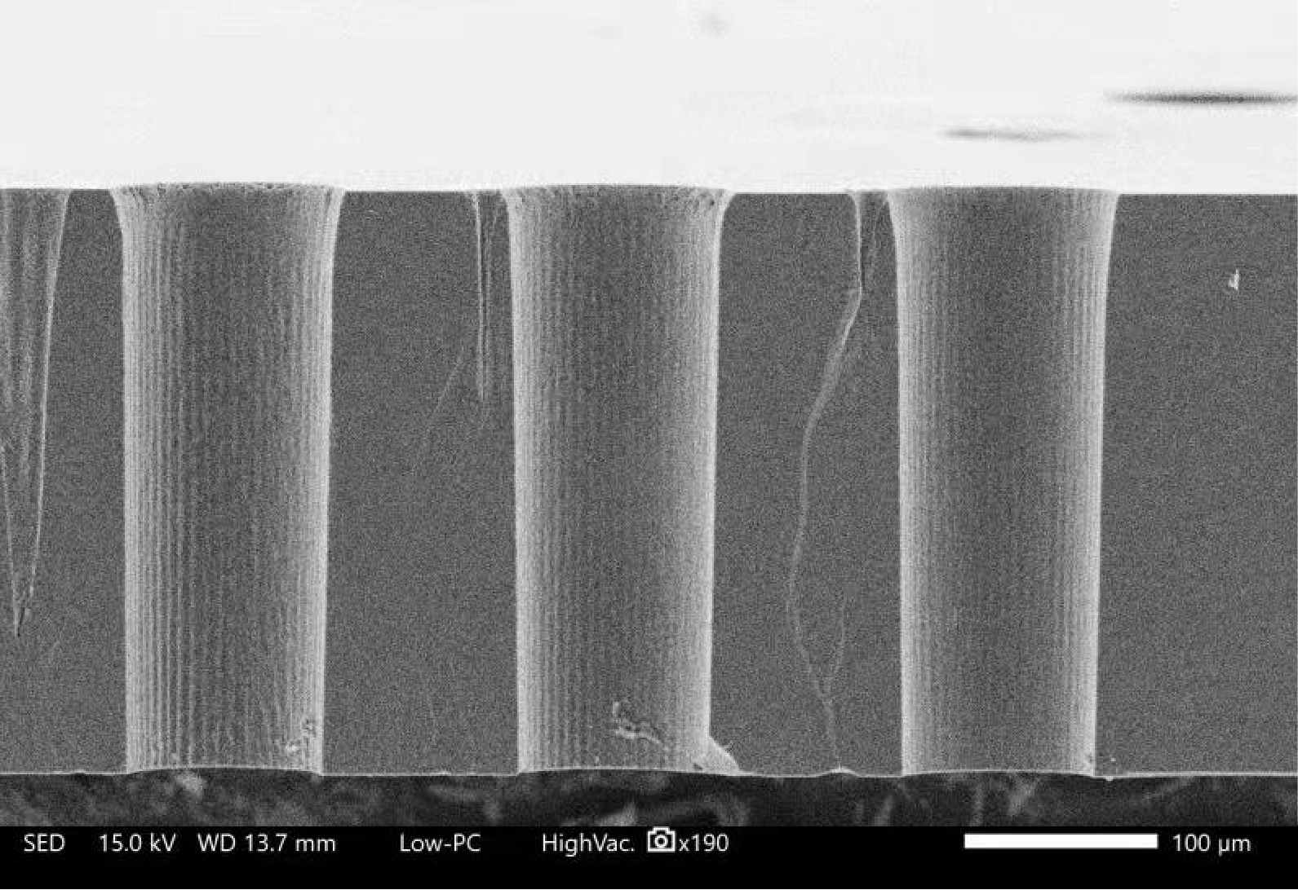
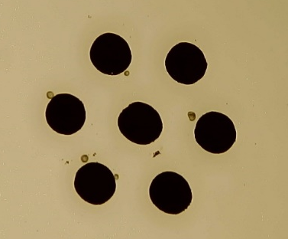
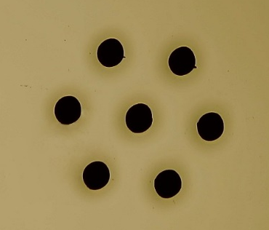
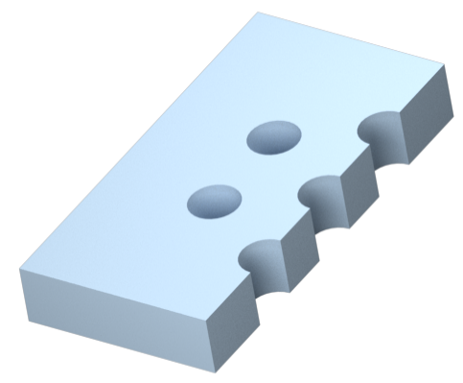
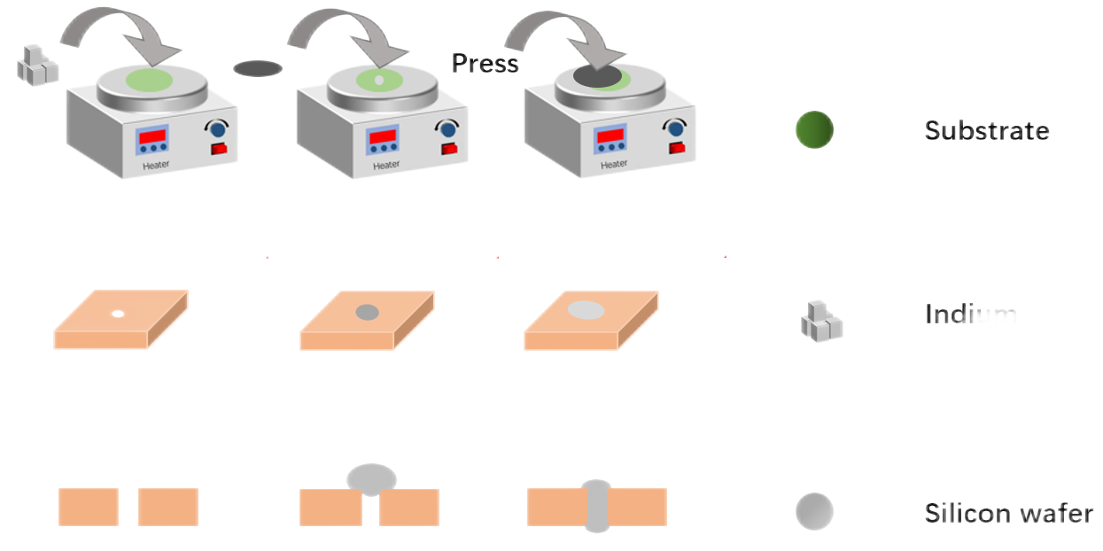
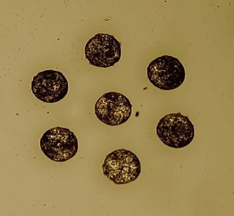
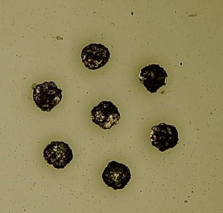
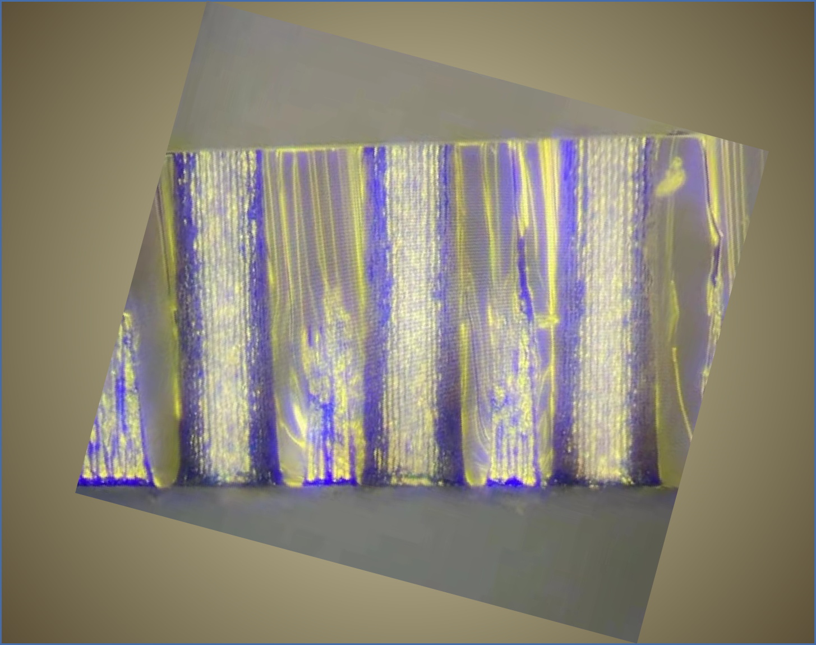

Process flow of making 3D SiC structure
Device model | FM-UVPM3A
Laser wavelength | 355nm
Processing power | 3W
Pulse Width | 12ps
Processing speed | 100mm/s
Processing time | 30min/pcs
Semi-insulating SiC single crystal
350 μm thickness
Diameter of the cylinder at the top and bottom of the sample
Hole | Diameter（μm）
Entrance | 103
Exit | 81
Entrance hole
Exit hole
SEM image
Image of the filled metal indium electrode
Cross-sectional image

Slide 14
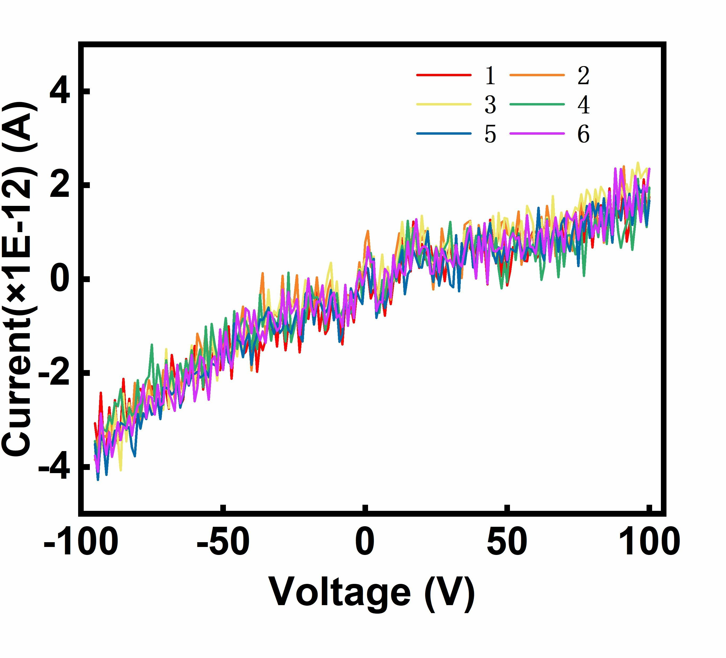



Electrical characteristics of 3D SiC structure
Label the electrode
White LED excitation
5
6
4
+
1
3
2
Protect from light
The test process diagram and electrode number
I-V curve of the 3D SiC device under dark and light status
Parameters extracted from the IV test
The device exhibits light response characteristics, indicating that radiation detection is possible!
 | Voltage(V) | Current(pA) | $$I_{Light}/I_{Dark}$$
Light | -100 | 139 | 32.55
Dark | -100 | 4.27

Slide 15
Prospect
Study the damage caused by laser drilling.
Investigate the effect of contact type on device performance.
Making terminal protection structuure.
Package the device to improve the reliability of the device.
Study radiation detection performance.
Carry out multi-device integration research

Slide 16

Thanks！

