Slide 1

Soft X-Ray Low Gain Avalanche Detectors with 55 µm pitch for Imaging Applications using the Timepix4 ASIC.
The 39th RD50 Workshop
19th November 2021
N. Moffat, J. Villegas, S. Hidalgo, G. Pellegrini

Slide 2
Introduction
Why small pixel LGAD’s?
Issue with Small Pixel LGADs
AC-LGAD – Solving the problem of small pixel LGAD’s
P-SPICE Model
TCAD Model
Conclusion

Slide 3
Why Small Pixel LGAD’s?
Small pixels provide a very good spatial resolution.
We want to benefit from the excellent capabilities of the Timepix3/Timepix4 ASIC.
Synchrotron Applications
  Timepix4 timing bin of 195 ps is well below the typical interbunch spacing of synchrotron electron bunches of a few ns.
  Material Science -to look at the absorption edges of transition metals, important for magnetic domain studies in the context of storage media. This would be in the 700 - 900 eV range
  Biological samples studies: LGADs with a charge gain somewhat higher than 20 would be needed to reach the so-called “water window”, between the Carbon and Oxygen edges (282 eV to 533 eV – Carbon and Oxygen being present in all biological samples).
  For all these studies, at photon energies below 1 keV the insensitive layer at the photon entrance side of the LGAD must be minimized.
High energy Physics
  LHCb –Velopix
Medical Physics
  Analysing biopsy's –typically thin, more information gathered by using “soft” Xrays

Slide 4
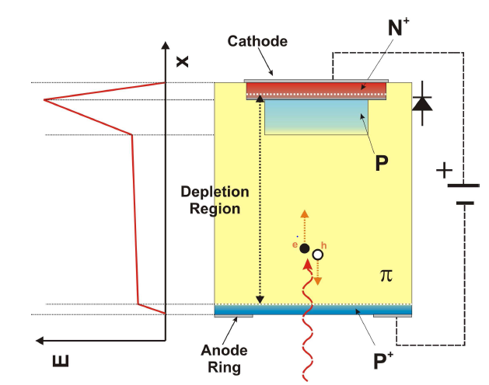
LGAD Basic Structure
Impact ionisation region
Electrons traveling at their saturation velocity (good for signal uniformity)

Slide 5
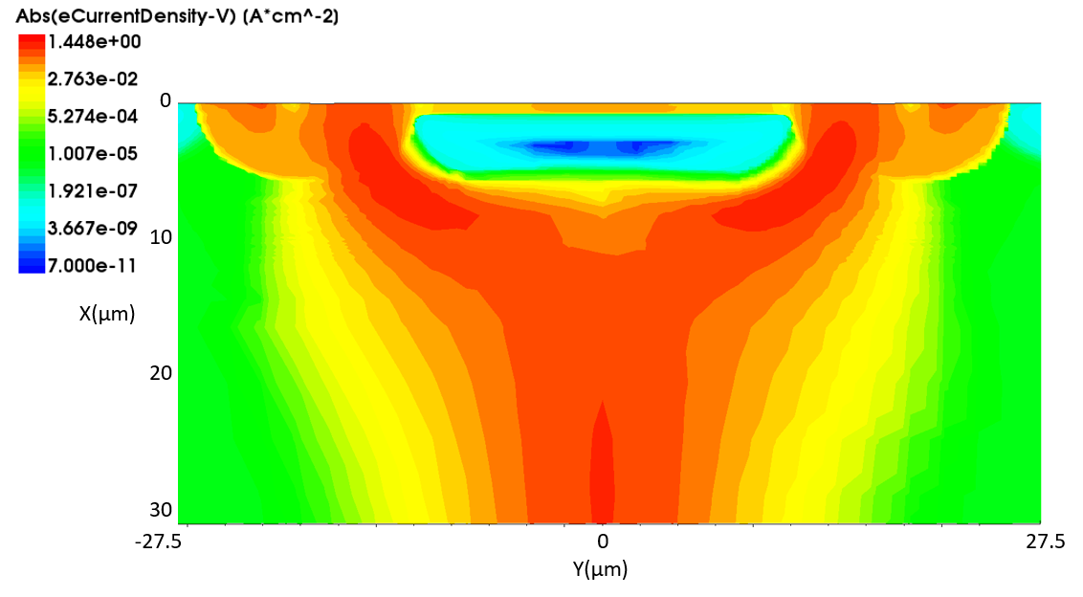
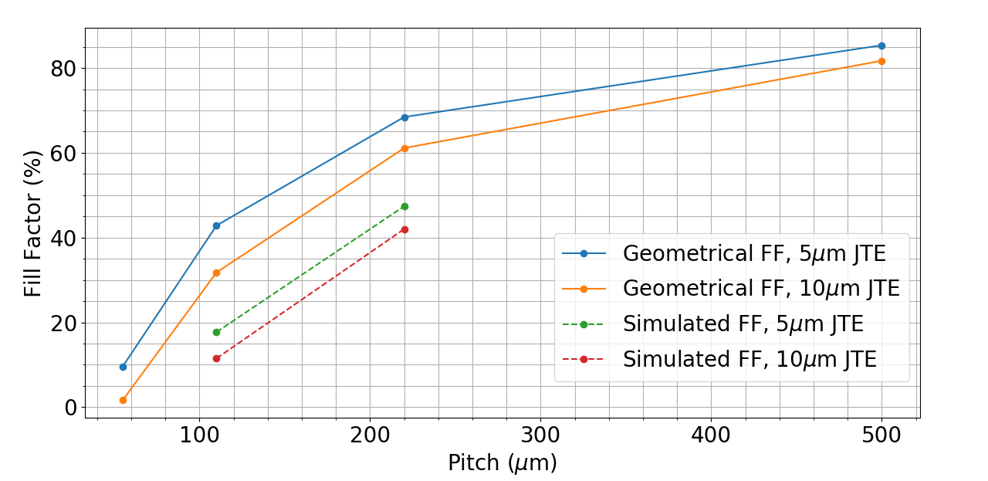
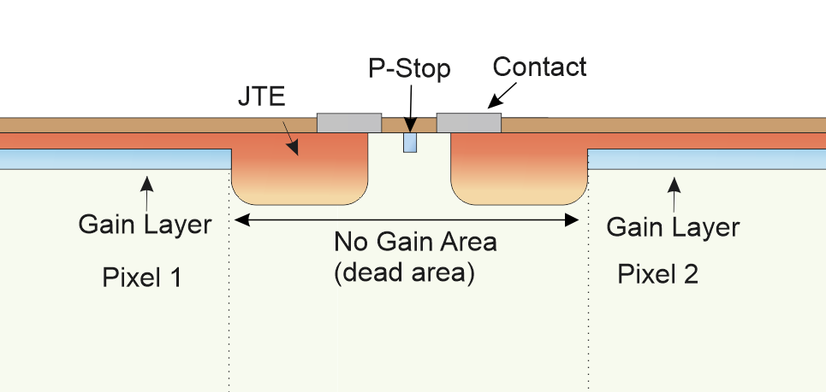
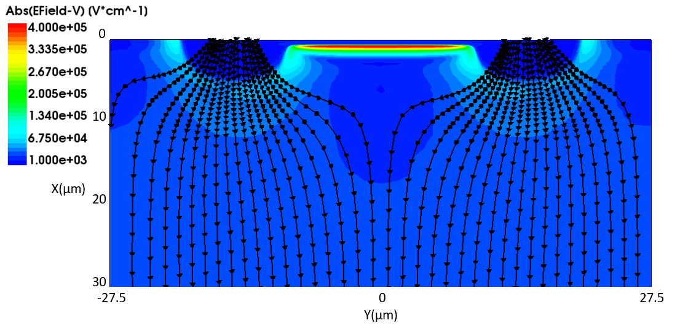
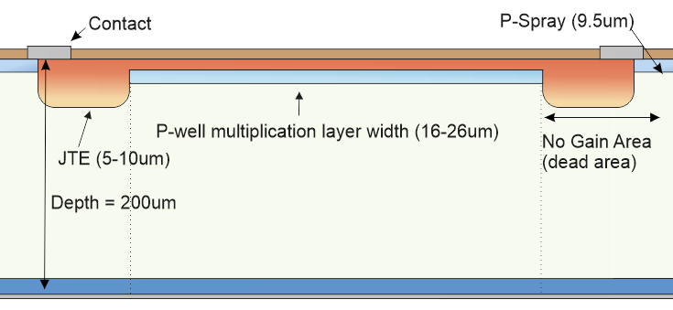
Small Pixel Problem
https://doi.org/10.1016/j.nima.2021.165746

Slide 6
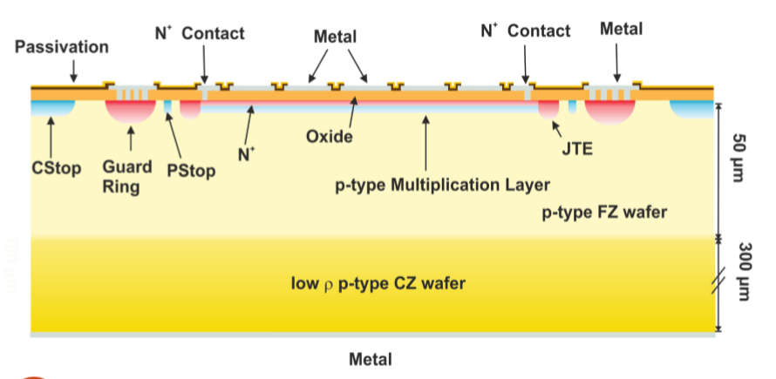
AC-LGAD Basics
AC-LGAD replaces the segmentation of the pad implants into continuous sheets of multiplication layer and n+ layer and only segments the metal connected to the readout
The signal is AC-coupled into the metal pads by another continuous sheet of coupling oxide.

Slide 7
P-SPICE Model

Slide 8
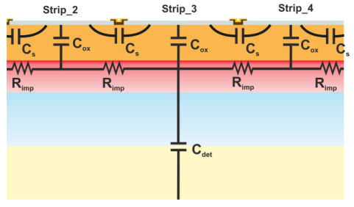
PSPICE Model
w
g
d
Timepix3 LGAD Standard values
w(μm) | 32
p(μm) | 55
g=w-p(μm) | 23
d(μm) | 50
25 square pixels
256x256 square pixels

Slide 9
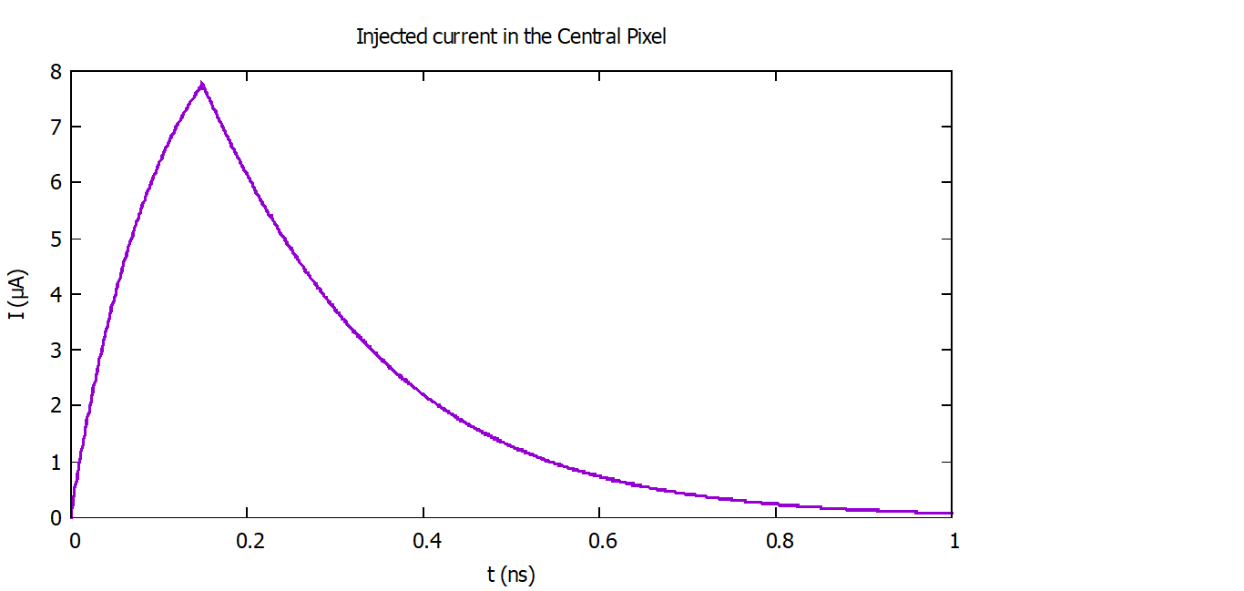
The injected pulse

Slide 10

PSPICE - Resistances
A
i
g
R_{i}=ρL/A=(ρ/t_{n})g/w=R_{S}(g/w)
R_{diag}=√2R_{i}
√2g
g
g

Slide 11

PSPICE - Capacitances
C_{det}=ϵ_{s}w/d C_{ox}=ϵ_{ox}w/t_{ox}
C_{s}=[0.23(d/w)^{0.75}/(g/d+0.18)-0.07d/w]C_{d}
C_{diag}=(0.1)^{w/d}[1-1.15(g/w)(7/(g/d+3)-1]C_{d}
A.Cerdeira, IEEE Transactions on Nuclear Science 44(1): 63-66, 1997

Slide 12
PSPICE - Noise
Flicker noise
Pspice calculates the noise spectral distribution in every part of the circuit due to all contributions of the entire device
Shot noise
v²(f)
[v²]=V²/Hz
Thermal noise

Slide 13
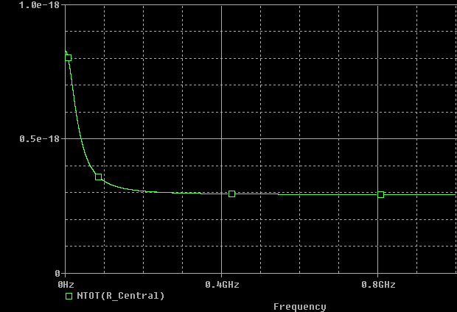
PSPICE - Noise
N=V_{RMS}=√(∫_{BW}v²(f)df)=√(∑^{N}v²(f)Δf)
v²(f)
BW=1GHz; Δf=1MHz;N=1000
[v²]=V²/Hz

Slide 14
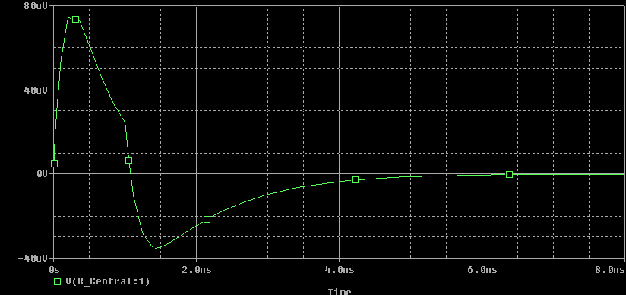
PSPICE - Signal
H=V_{max}
N=V_{RMS}=√(∫_{BW}v²(f)df)=√(∑^{N}v²(f)Δf)
Signal Height to noise ratio S/N=H/N(g(w), t_{ox},R_{s})
RiseTime : T_{r}=T(V=90%H)-T(V=10%H)
Jitter : σ_{jitter} (g(w),t_{ox},R_{s}) ≈ T_{r}/(S/N) → To be minimized

Slide 15
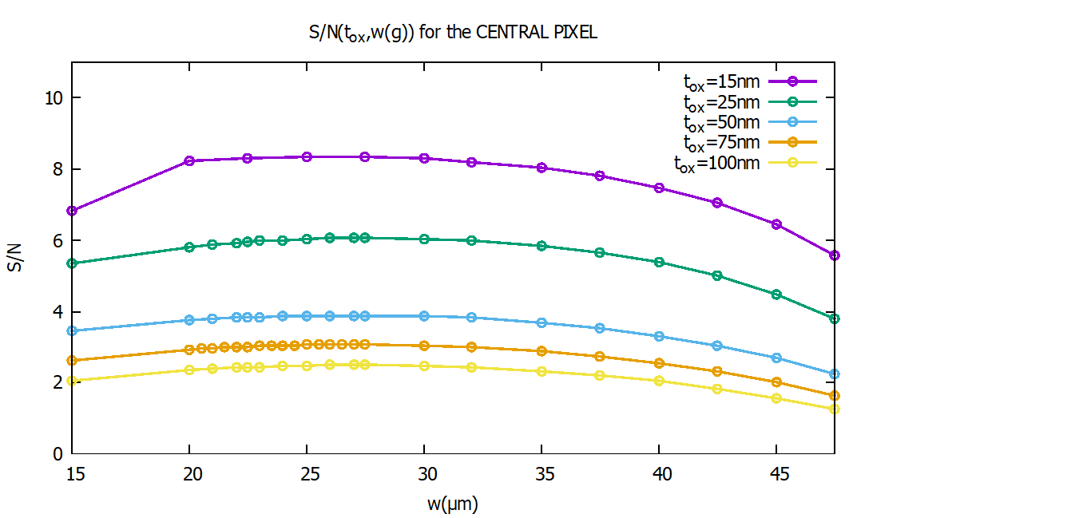
PSPICE – Some Results
TCAD:
Decreasing oxide thickness tox improves S/N.
Decreasing pad size w (increasing interpixel gap=p-w) improves S/N.
Rs=696Ω
d=50um
wstandard=32um
woptimal≈27.5um

Slide 16
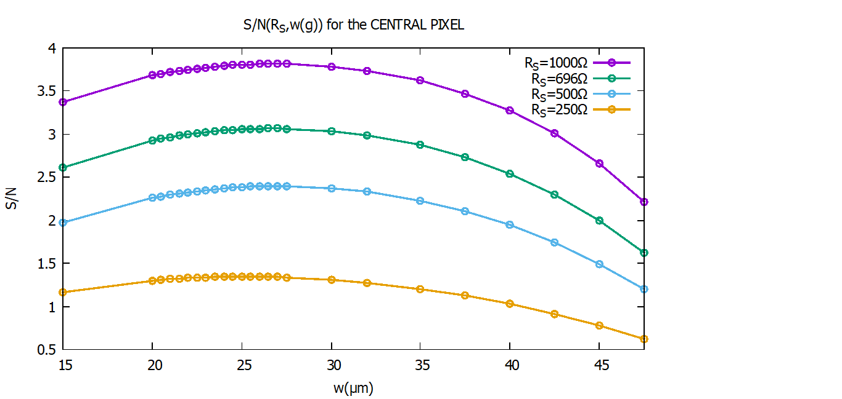
PSPICE – Some Results
TCAD:
Increasing sheet resistance Rs improves S/N.
Decreasing pad size w (increasing interpixel gap=p-w) improves S/N.
tox=75nm
d=50um
wstandard=32um
woptimal≈27.5um

Slide 17
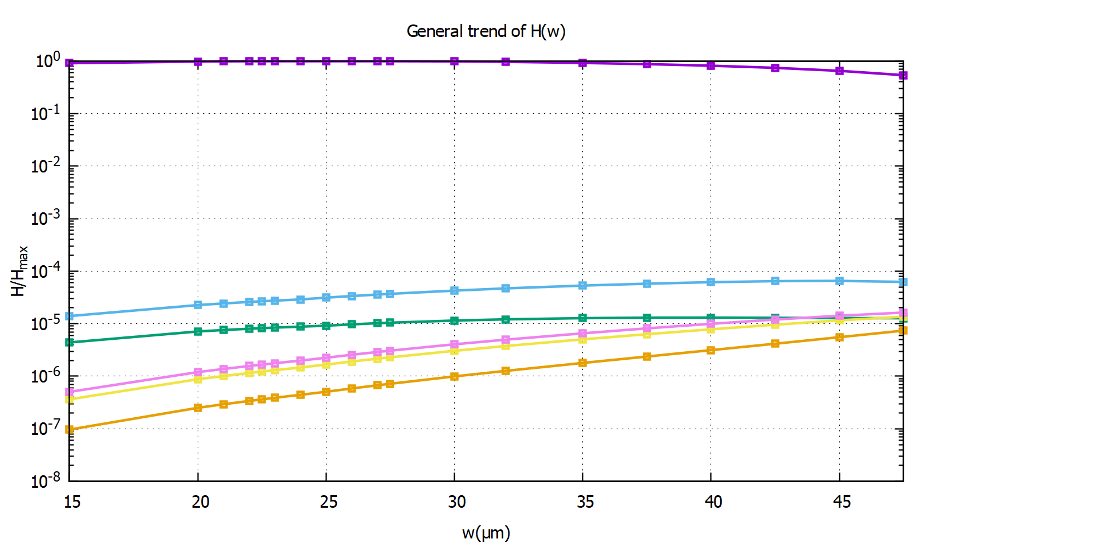
Neighboring pixels → General trend of H(w) (tox=75nm and Rs=696Ω)

Slide 18
PSPICE preliminary Results
Increasing sheet resistance Rs improves S/N.
Decreasing oxide thickness tox improves S/N.
PSPICE model optimised to reduce charge sharing between pixels.

Slide 19
TCAD Model

Slide 20
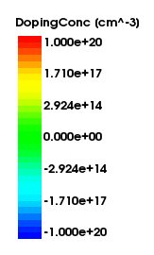
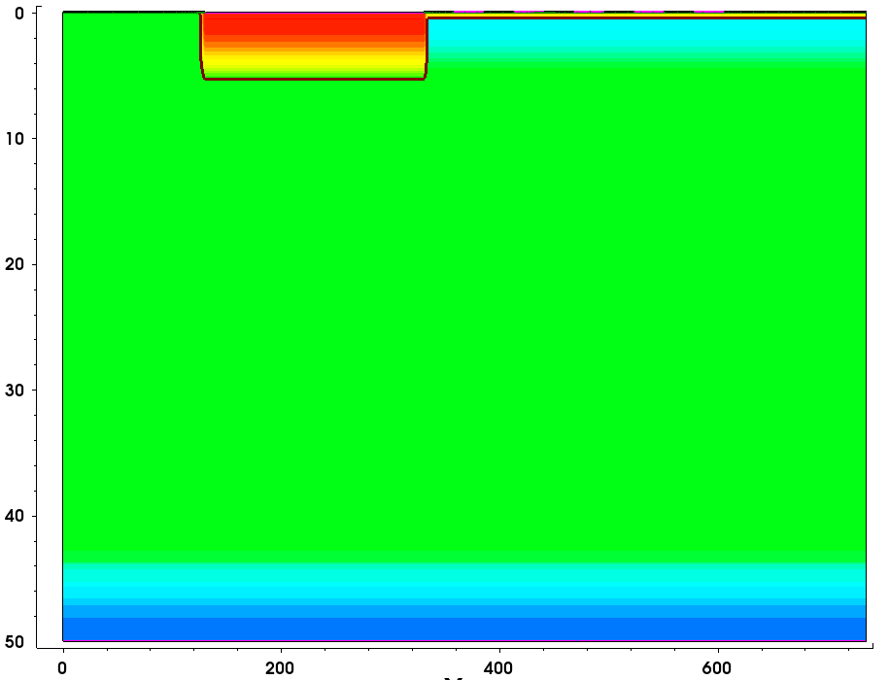
AC-LGAD structure for TCAD.
5 Pixels
55um Pitch Pixels
Pixel size of 27.5um
5 pixels.
High resistive N+ Implant.
Implant doping profiles generated in sprocess.
JTE
Depth [um]
Distance from edge of the device [um]

Slide 21
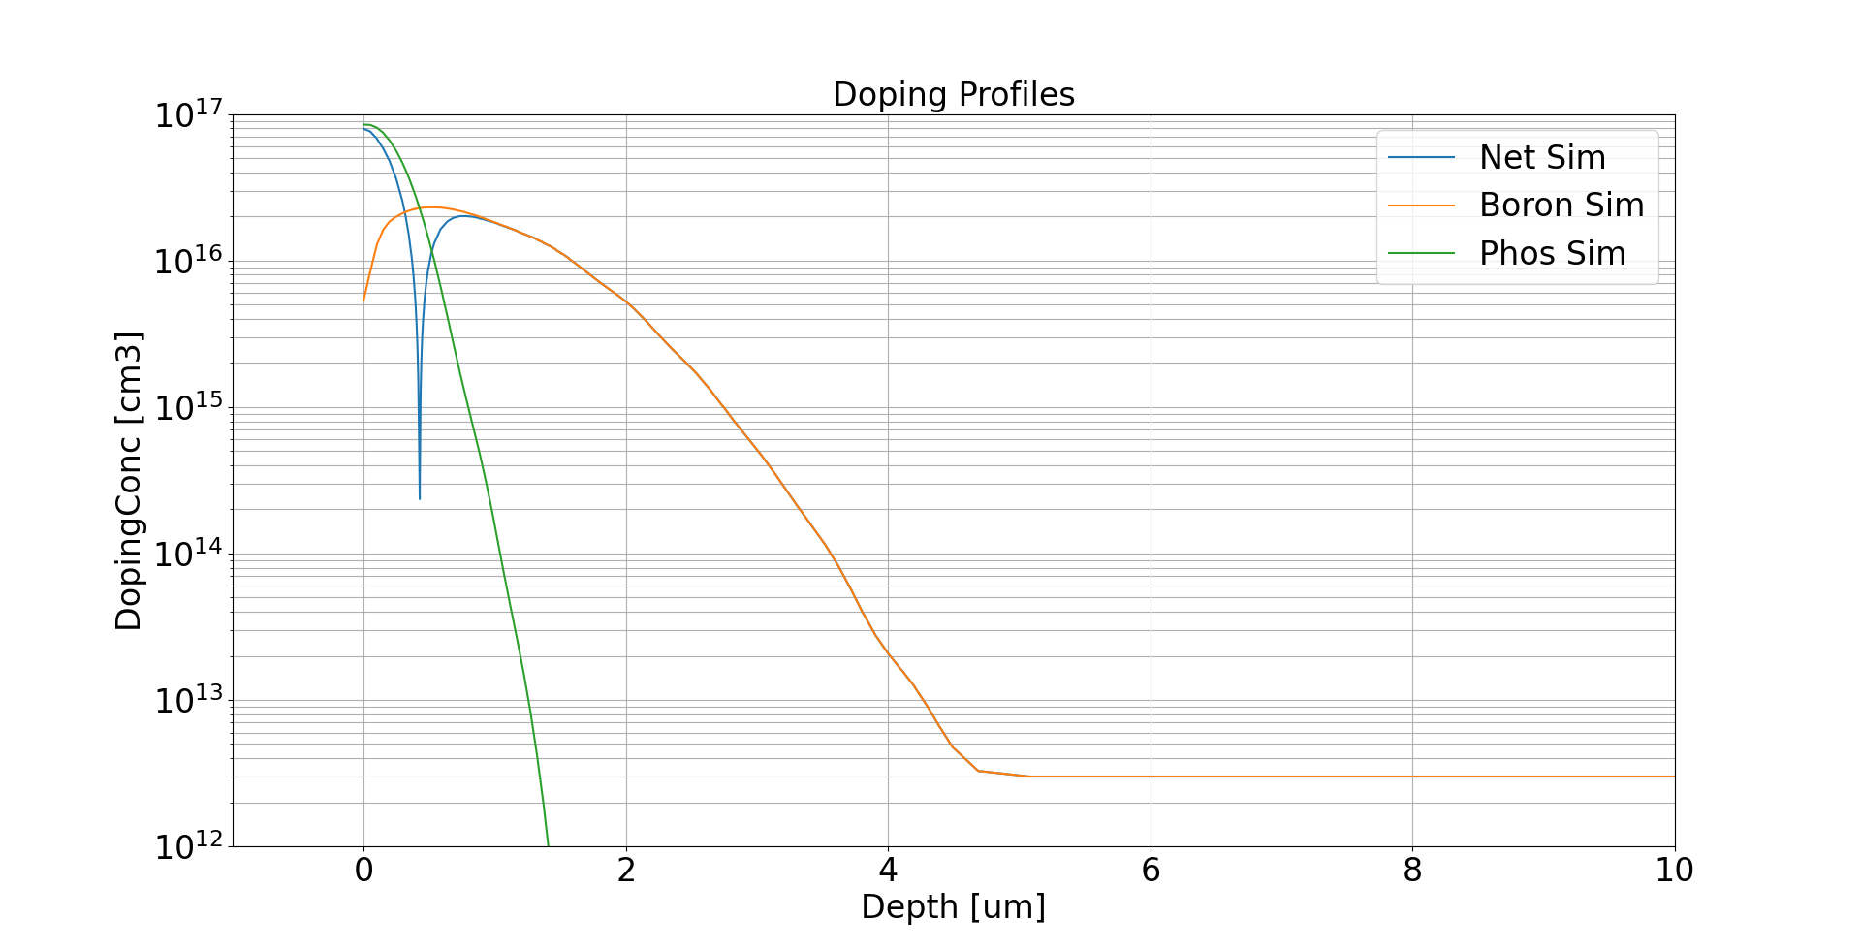
Doping Profiles
Low resistive implant – Lower doping concentration of junction implant.
Doping profiles generated using an analytical function with SDE

Slide 22
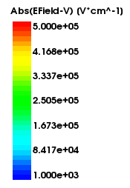
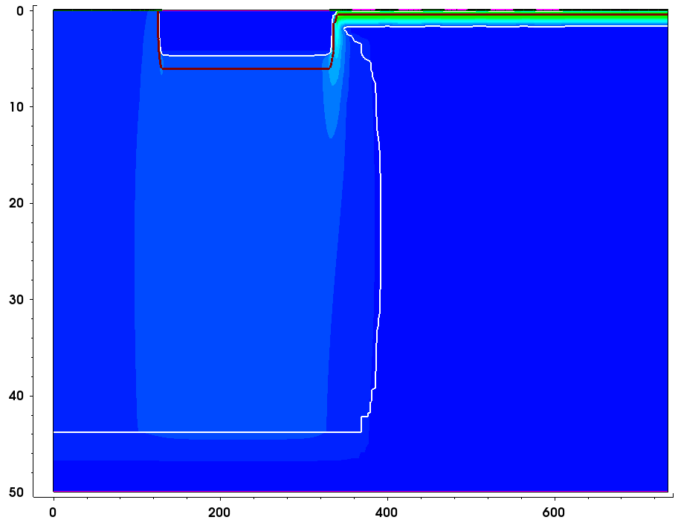
Efield at 180V of AC-LGAD
HV contact
Multiplication Region
High field seen at the junction –Multiplication
Bulk does not deplete as expected.
Depletion region extends into the bulk only in the region below the N++ region.
Bulk does not deplete below the multiplication region
N++ Resisitive implant too resisitive
Depth [um]
Distance from edge of the device [um]

Slide 23
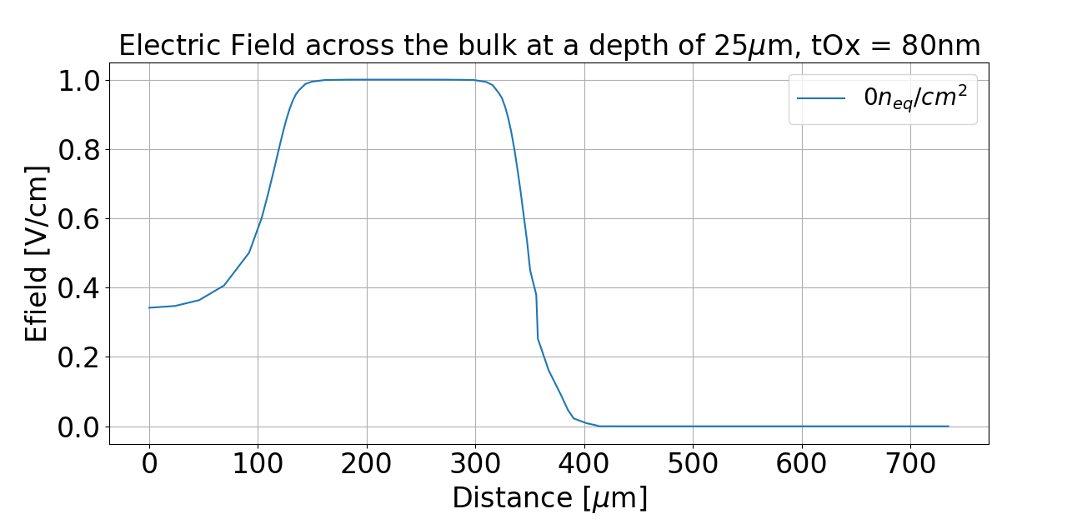
Efield Across device at a depth of 25um at 180V.
JTE
Bulk un-depleted

Slide 24
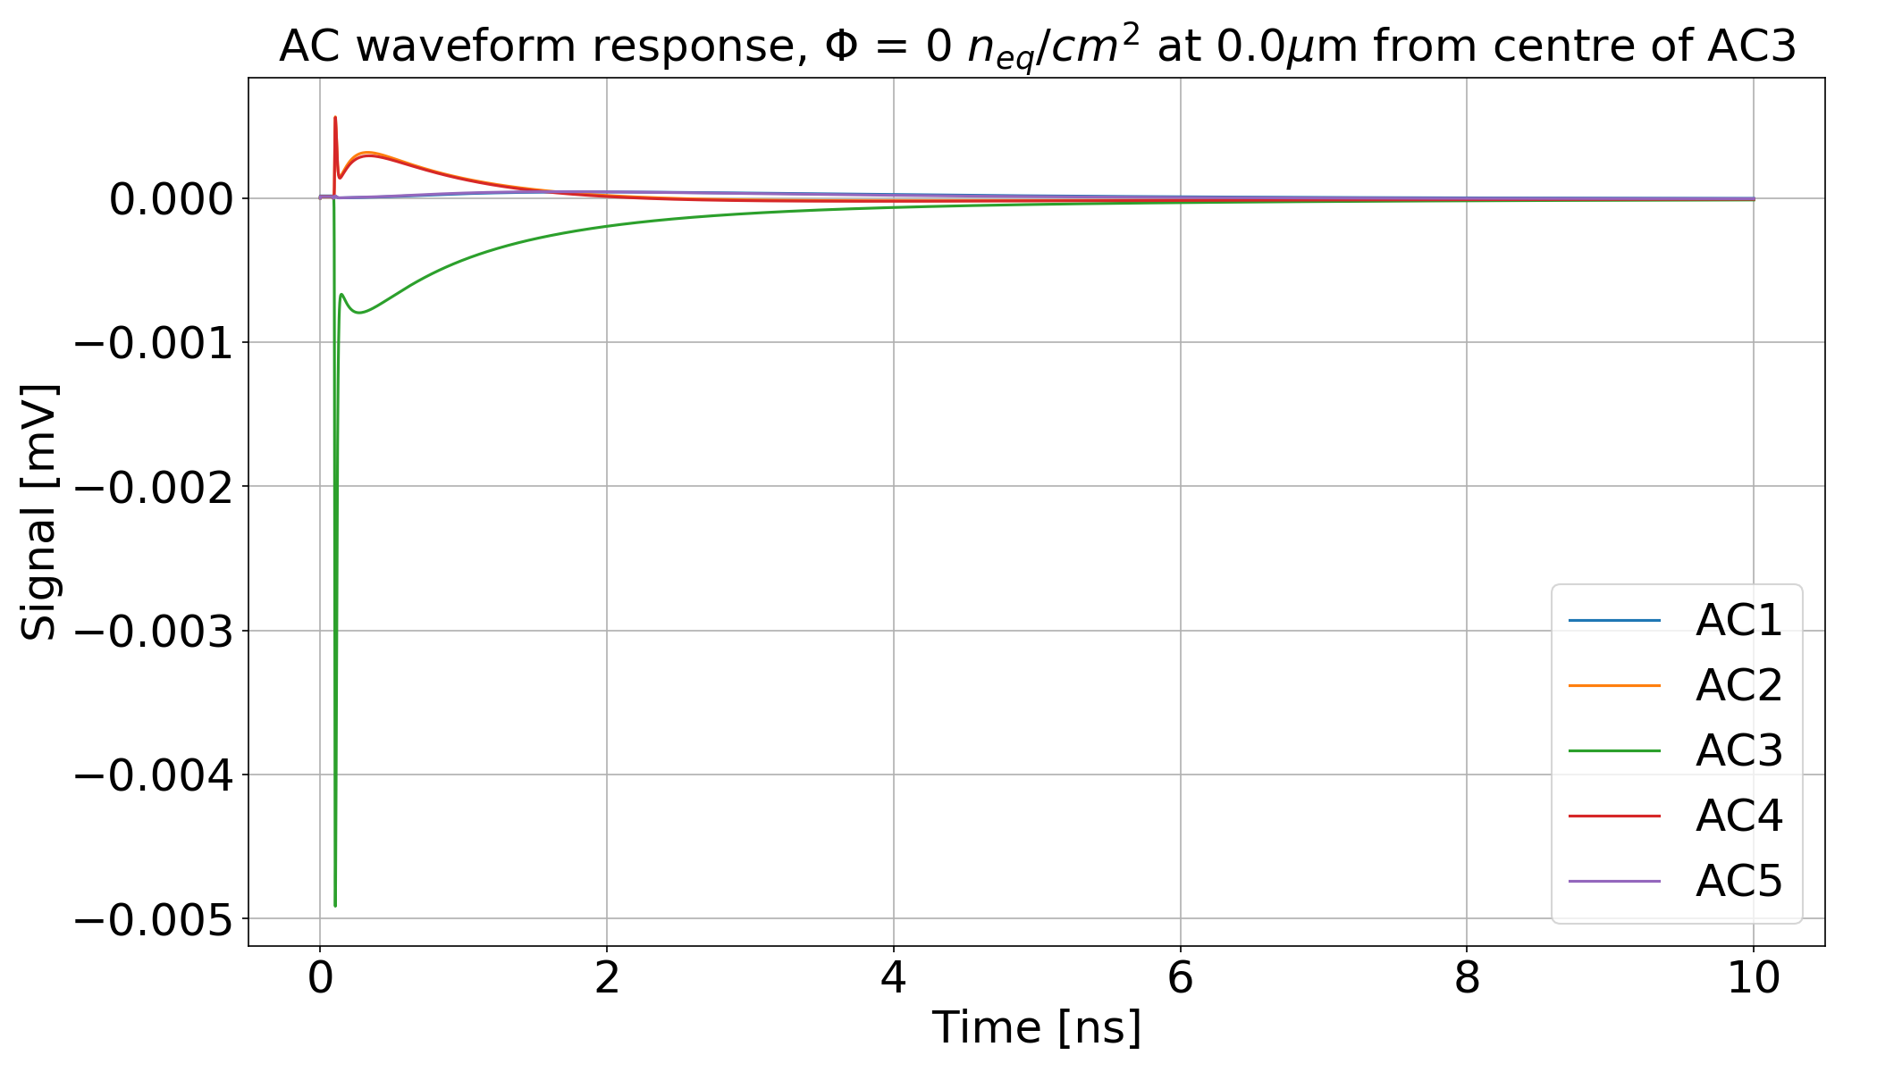
TCAD Results – Waveforms – 80nm Oxide
Rs=696Ω
Pitch=55um

Slide 25
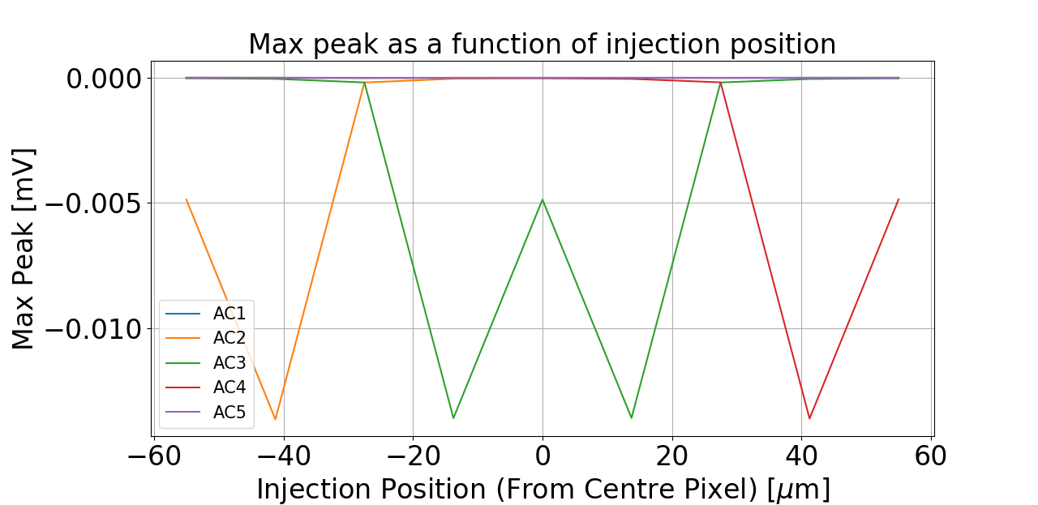
TCAD Results – Peak at each channel as a function of injection position – 80nm Oxide
Rs=696Ω
Pitch=55um

Slide 26
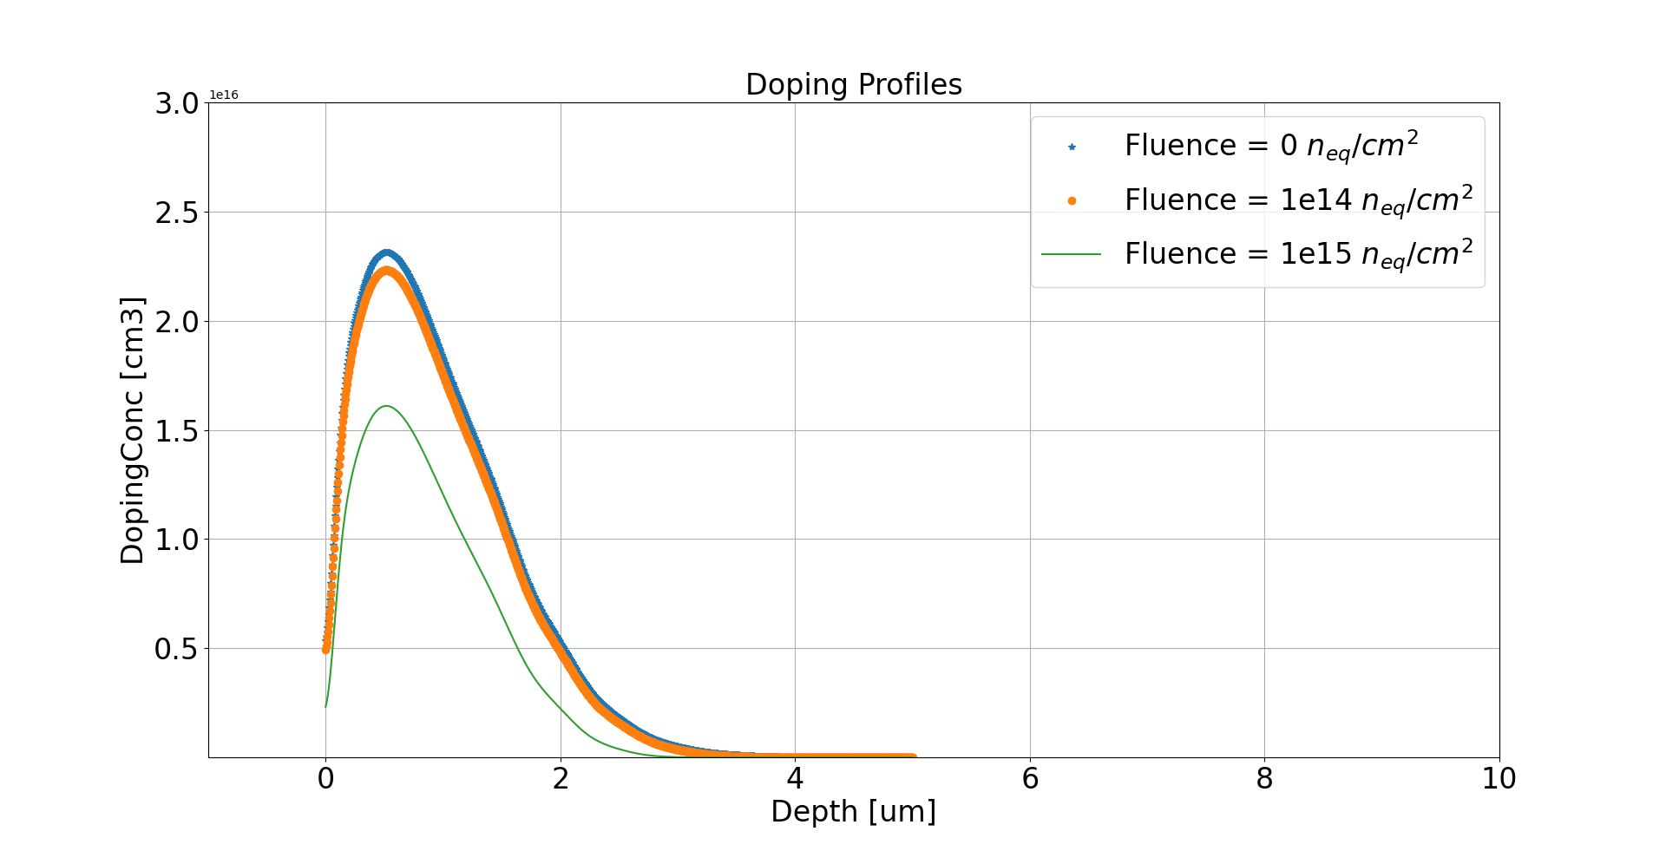

Doping Profiles - Irradiated
Radiation Model based on the AIDA deliverable for Radiation models and the RD50 talk given by Marco Mandurrino
AIDA Deliverable (cern.ch)
PowerPoint Presentation (cern.ch)
Microsoft PowerPoint - 2017Mandurrino_30thRD50.pptx (cern.ch)

Slide 27
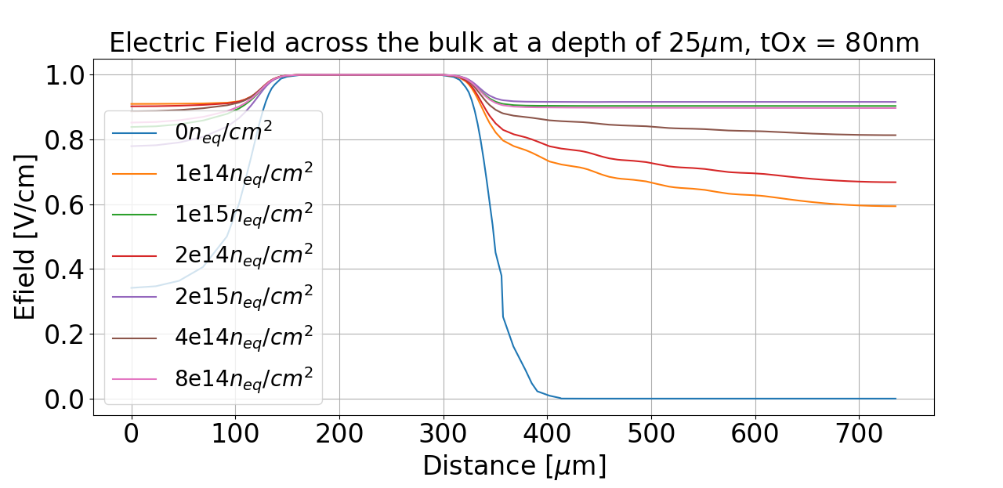
Efield Across device at a depth of 25um
JTE
Increasing Fluence
Bulk un-depleted

Slide 28
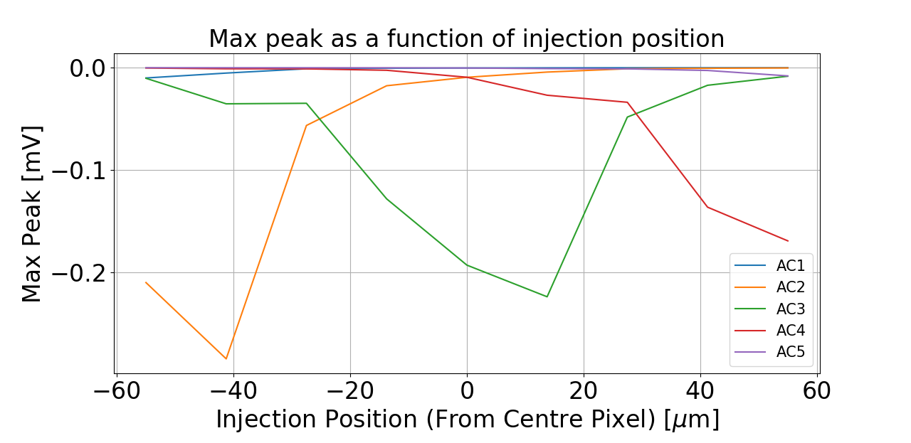
TCAD Results – Peak at each channel as a function of injection position – 80nm Oxide – 1e14
Rs=696Ω
Pitch=55um
Collection is not symmetric- due to slope in the electric field

Slide 29
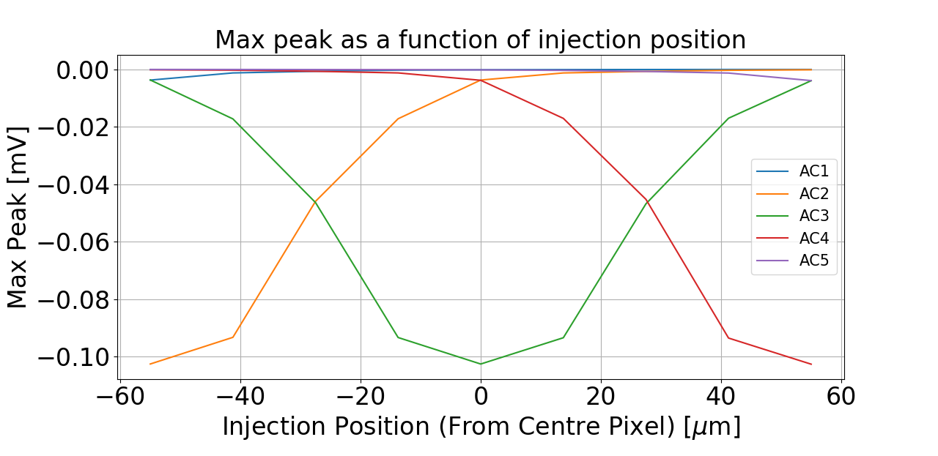
TCAD Results – Peak at each channel as a function of injection position – 80nm Oxide – 1e15
Rs=696Ω
Pitch=55um
Collection is symmetric- due to slope in the electric field

Slide 30
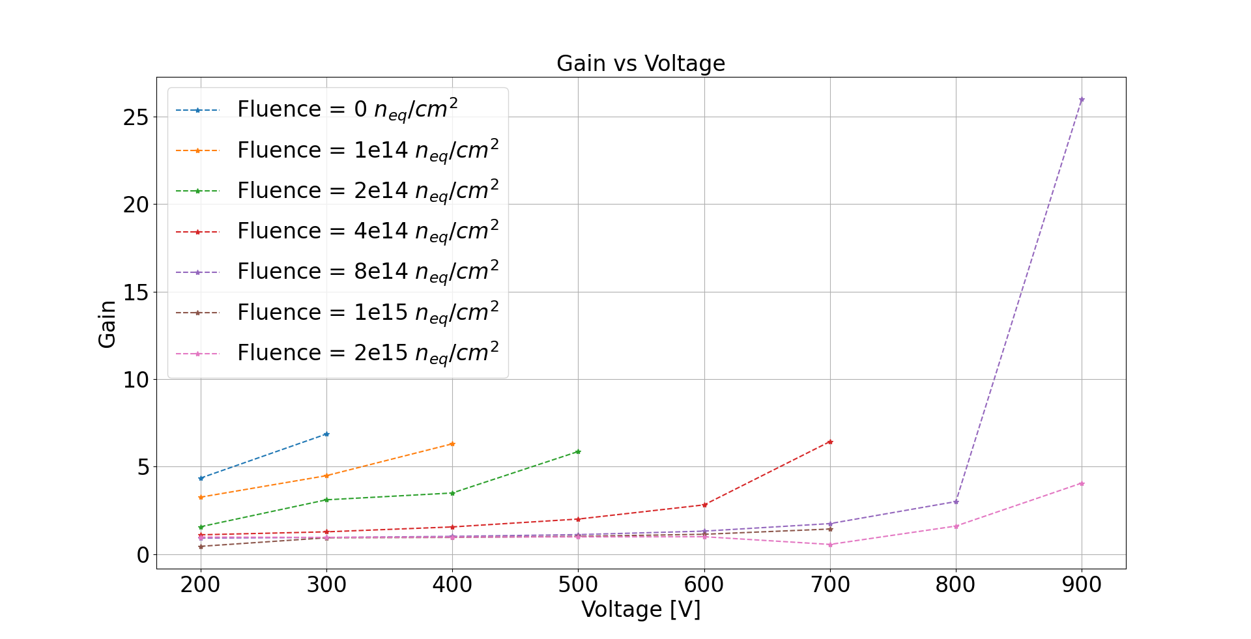
Gain of Irradiated AC-LGAD
Not Radiation Hard

Slide 31
Main Points to Takeaway from TCAD
Design not Radiation Hard
  Implement deep multiplication junction, higher dose boron.
Detector does not deplete
  Modify high resistive (n+) implant, i.e less resistive.
At high fluence, the AC-LGAD works well, we see a uniform charge collection at the neighbouring pixels.
Not much charge is shared between neighbouring pixels. Good for HEP?

Slide 32
Conclusion
Look at adapting profiles to make them more radiation hard –deep junction.
Junction implant may be to high resistivity, need to study the effect of reducing this resistivity.
The effect of the oxide thickness was also studied but the same effect was seen, this will be optimized after the Resistance is changed.
PSPICE modelled developed to optimize AC-LGAD to reduce charge sharing between pixels.
Can also model the detector to optimize for charge sharing ( Good for position resolution)
Next steps to optimize design for Soft-Xrays

Slide 33

Acknowledgements
This work has been financed by the Spanish Ministry of Science and Innovation (MCIN/AEI/10.13039/501100011033/)
Project references: SPID202000X118404SV1
Thanks for your attention!

