Slide 1





RBI microbeam experiment for HVCMOS RD50 MPW2 pixel matrix
Francisco Rogelio Palomo Pintoª , Aneliya Karadzhinova-Ferrer^{b} , Jose M.Hinojoª, Eva Villella^{c}, Sam Powell^{c}, Milko Jaksic^{d}, Milan Vicentijevic^{d}, Georgios Provatas^{d}
fpalomo@us.es, aneliya.karadzhinova@cern.ch
ª Electronic Engineering Department of School for Engineering in University of Seville, Spain
^{b} Helsinki Institute of Physics, Finland
^{c} University of Liverpool
^{d} Ruder Boskovic Institute, Zagreb, Croatia
Notes:
Para RD50 final: aumentar el número de autores, poner las diapositivas de puntería con el gadolinio, explicar las visualizaciones MCA y XY en una diapositiva adhoc, comparándolas con visualización de osciloscopio, establecer el valor de la ganancia final del DAQ para la comparativa. Dar una diapositiva de conclusiones

Slide 2
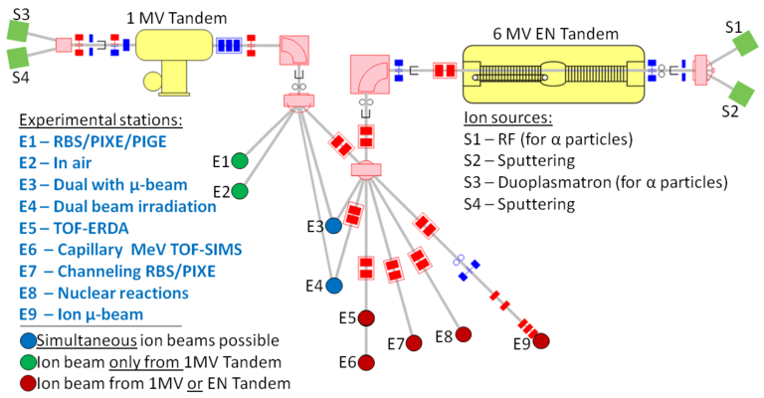
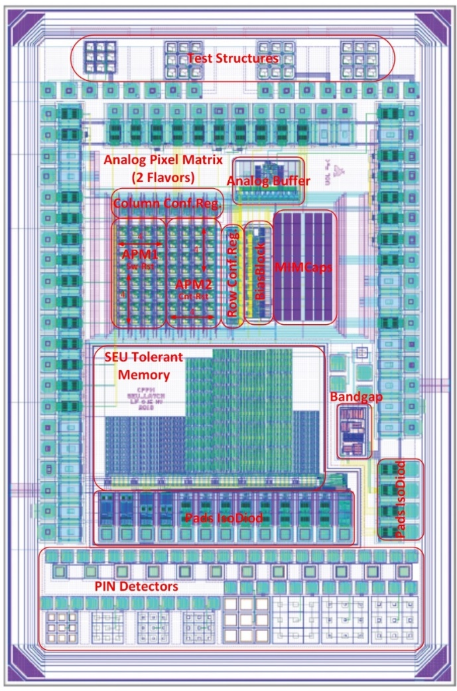
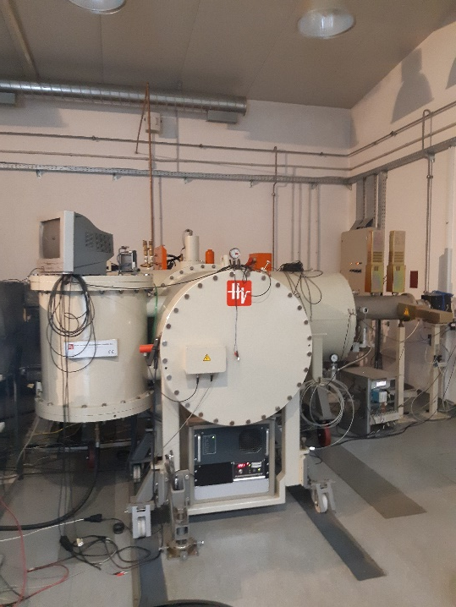



Testing the MPW2 pixel matrix at RBI microprobe
Testing of the Analog Pixel Matrix.
Line E3, proton microbeam, in air (2 MeV)

Slide 3
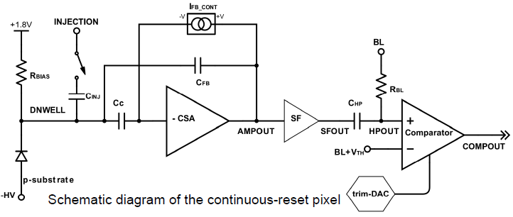
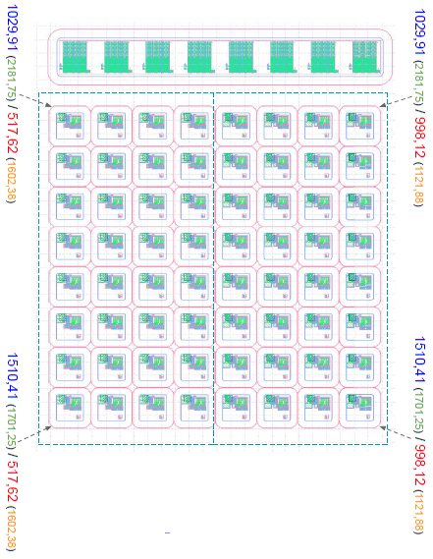
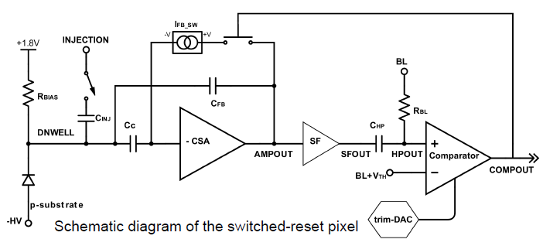
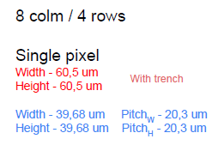
Testing the MPW2 pixel matrix at RBI microprobe
APM1
Columns 0-3
r0c0
r0c7
Vth defines the comparator threshold
BL (baseline) defines an offset to the analog output to ensure signal stability
r7c0
r7c7
Each APM (Analog Pixel Matrix) flavour has 4 cols / 8 rows
Size of a single pixel (with trench)
Width - 60,5 um
Height - 60,5 um
Size of a single pixel (without trench)
Width - 39,68 um Trench_{W} - 20,3 um
Height - 39,68 um Trench_{H} - 20,3 um
APM2
Columns 4-7

Slide 4
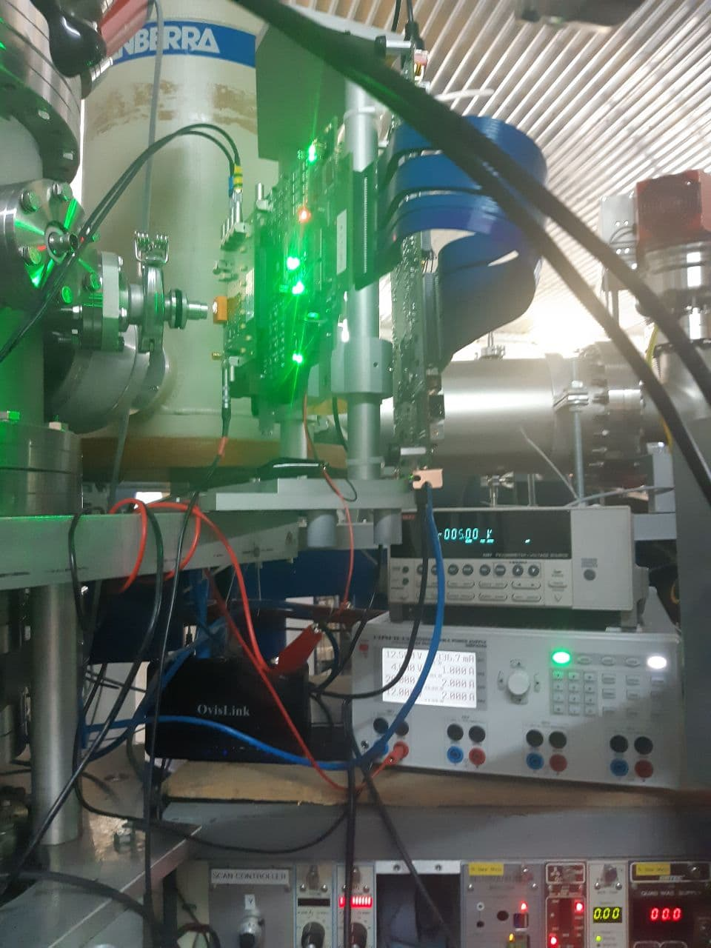
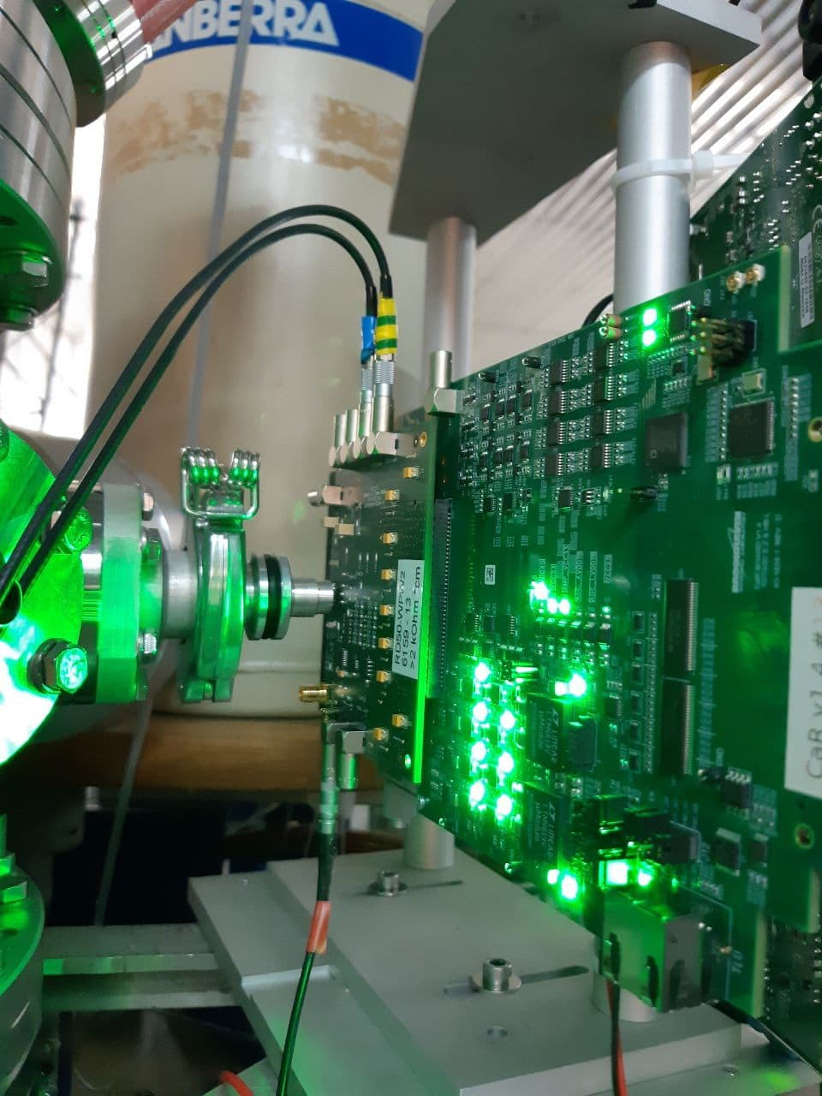
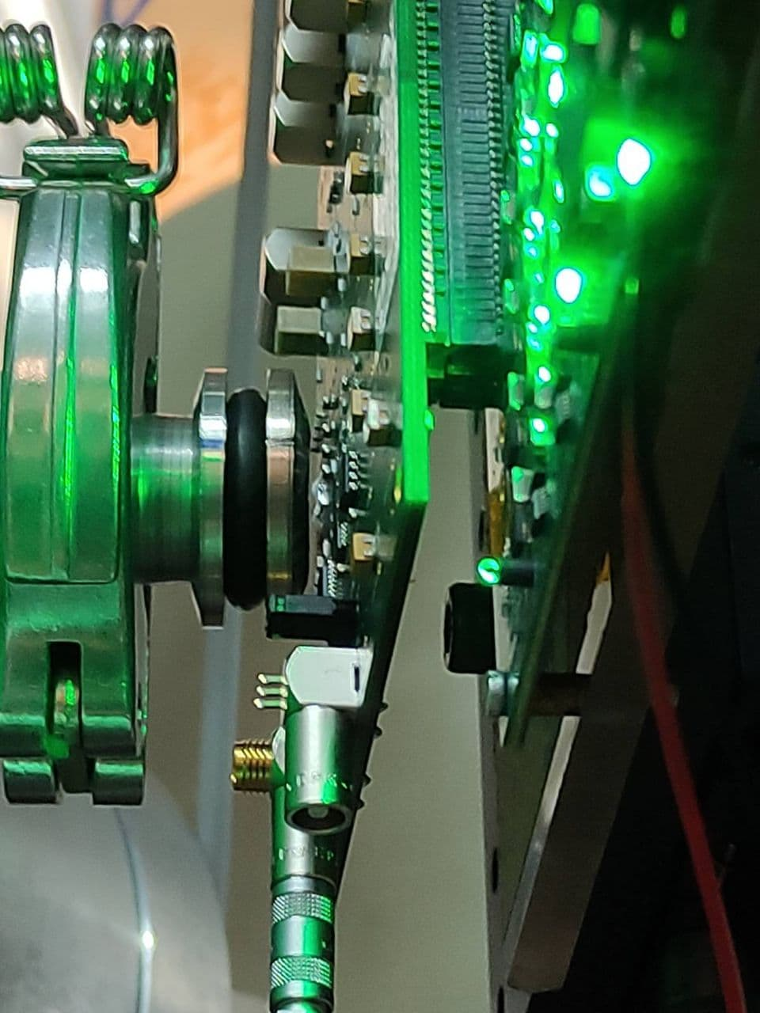
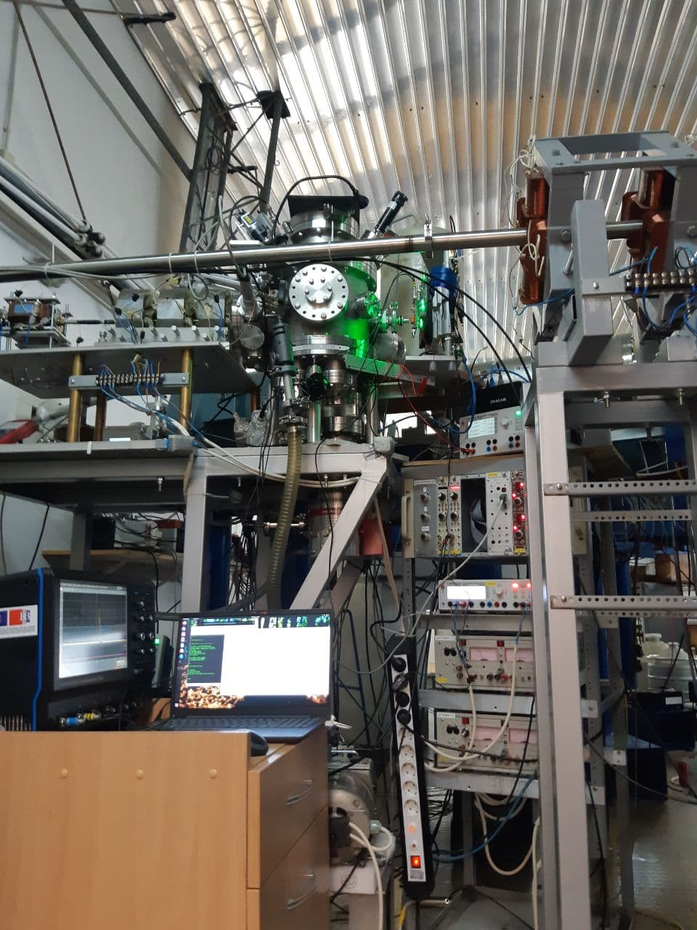
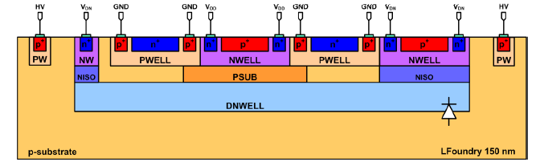
Testing the MPW2 pixel matrix at RBI microprobe
The MPW2 chip and DAQ setup (Caribou and ZC706 cards) are placed on a holder in front of the external microbeam outport window (Al). Proton Beam Energy at
beam pipe out, 2 MeV. Proton beam energy after the Al window (in air) 1.8 MeV

Slide 5
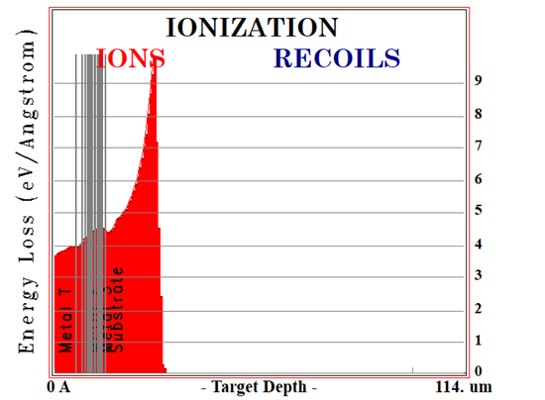
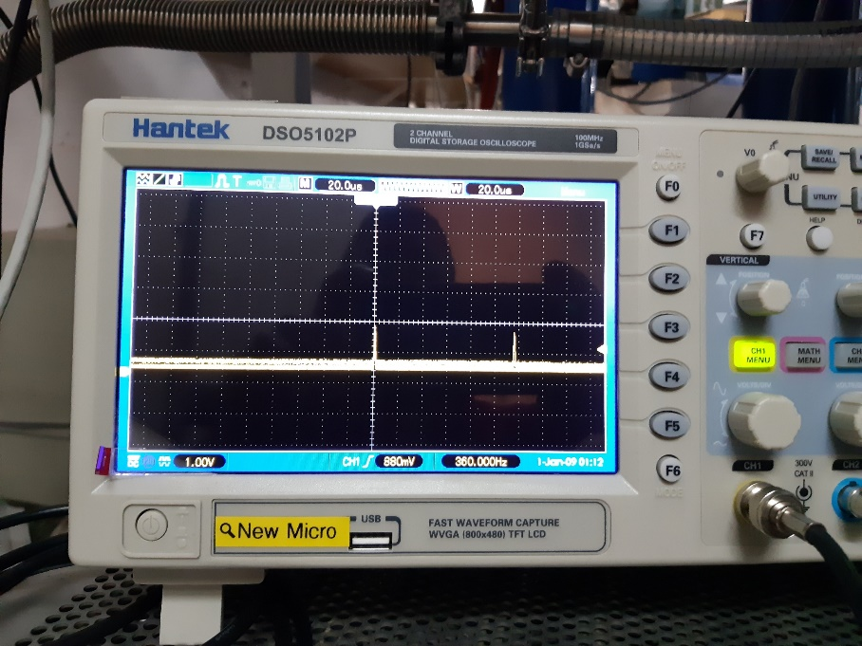
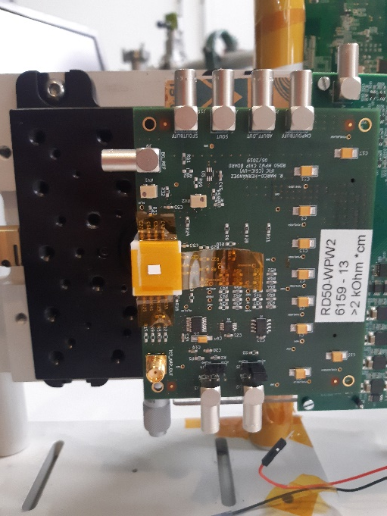
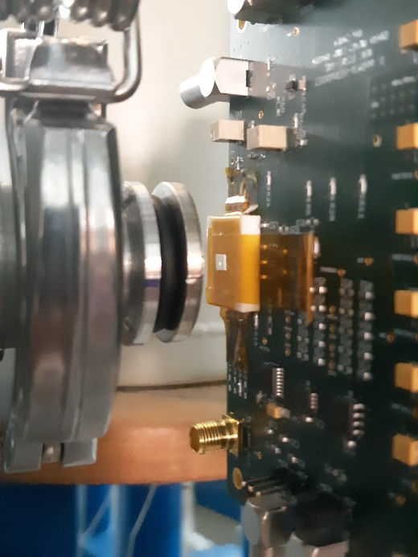
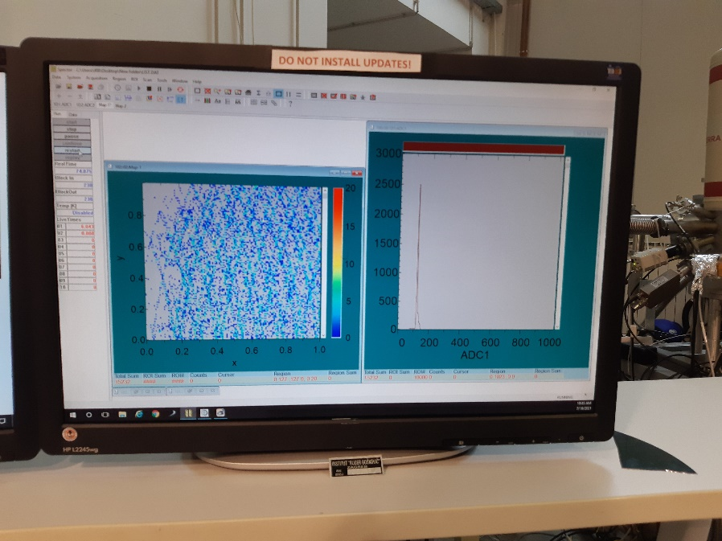
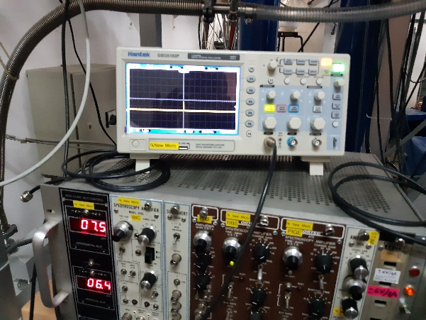
Testing the MPW2 pixel matrix at RBI microprobe
2 MeV Proton Flux control very precise by a local scope looking at the pick up signal
Coarse aiming with a gadolinium scintillator patch
By SRIM we can use up to 1.5 MeV
protons
Signals coming from the chosen pixel
are routed to the microprobe DAQ to
generate MCA histograms and XY maps
with the custom Spector software.
The beam centroid has a positioning
precision of 1.8 μm .
Notes:
Conclusiones

Slide 6
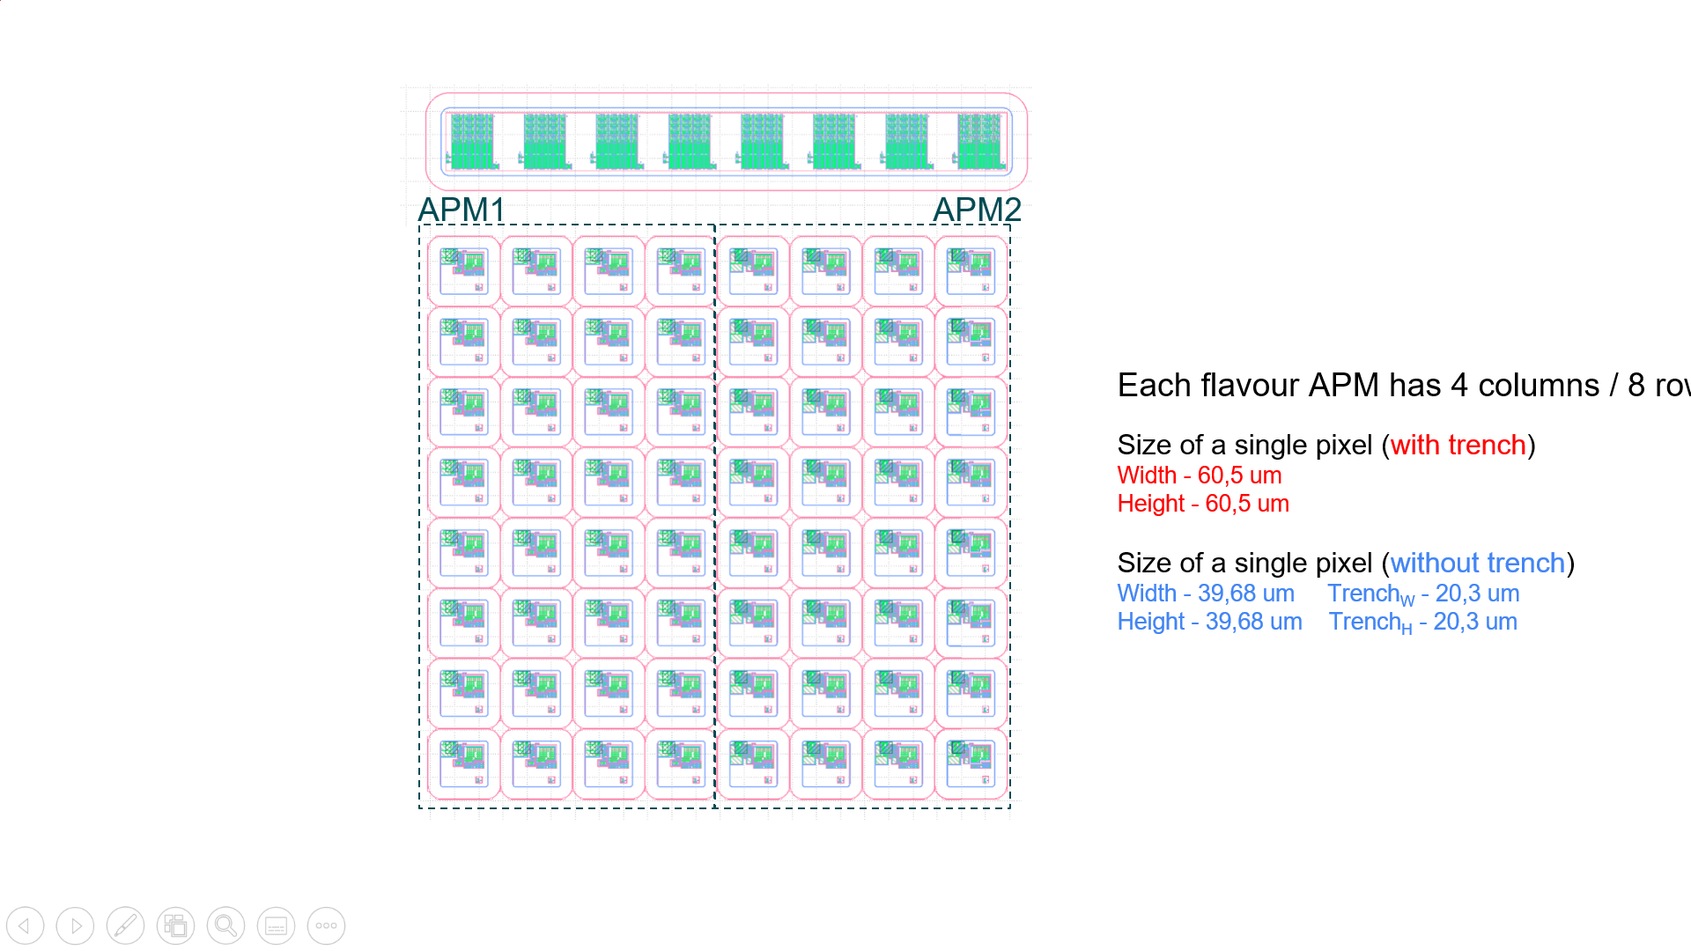
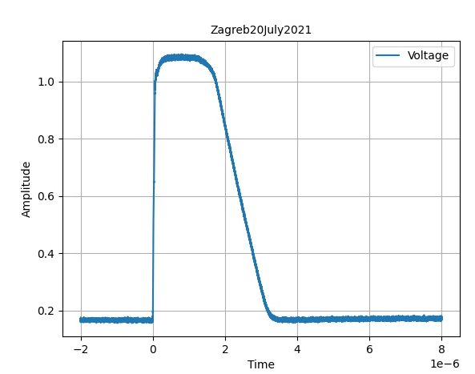
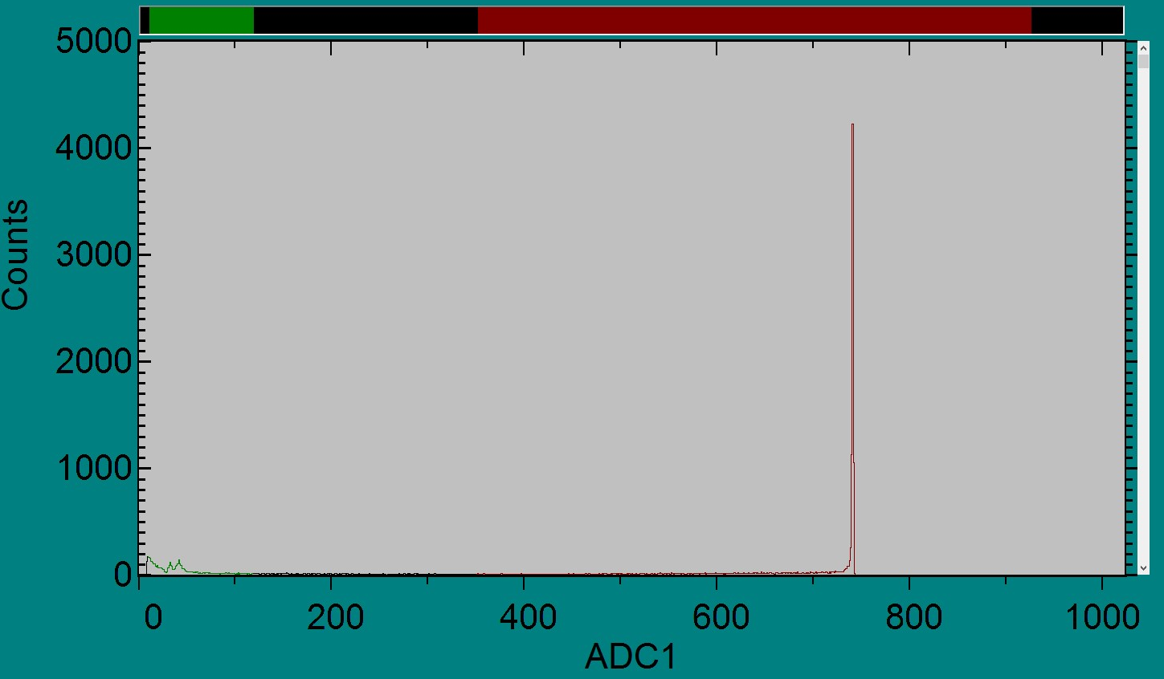
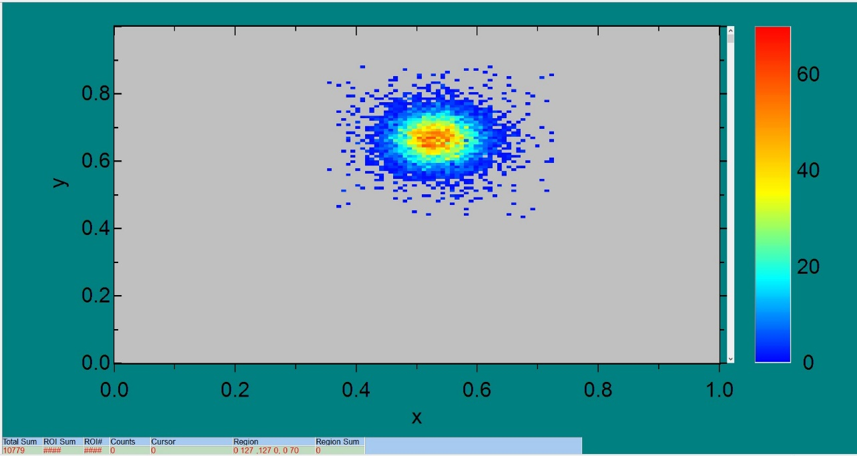


Testing the MPW2 pixel matrix at RBI microprobe
r4c2
r4c2
2 MeV 200 protons/sec, 640x640 μm² zig-zag scan, 60V bias, 30 μm² spot área 1 minute of scanning for each hitmap,
(Vth=1050 (1.0256V) for comparator, BL=900 (0.8791 V) for the baseline).
1.44 mV per channel Maximum Max statistical frequency at channel 741 Signal Amplitude 1.07 V
The scope raw signal gives us the calibration for the MCA histogram. The MCA histogram is relevant because inform us about the statistical frequency of signals when we shoot a proton zig-zag pattern. The XY histogram is relevant for aiming and also to know about posible halo effects.
r4c2
Notes:
Conclusiones

Slide 7
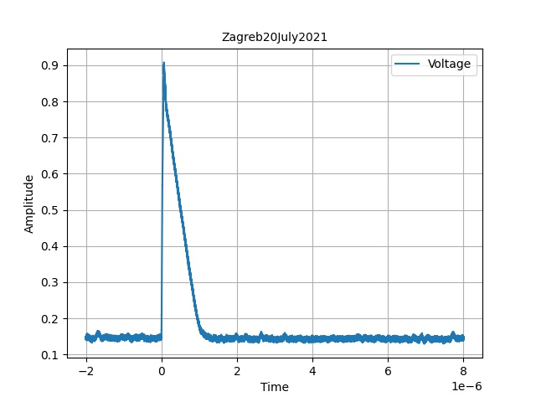
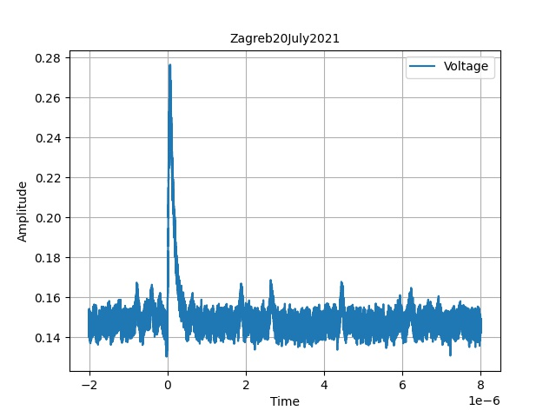
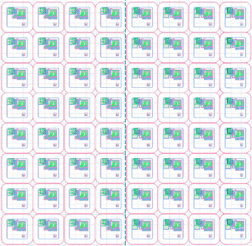
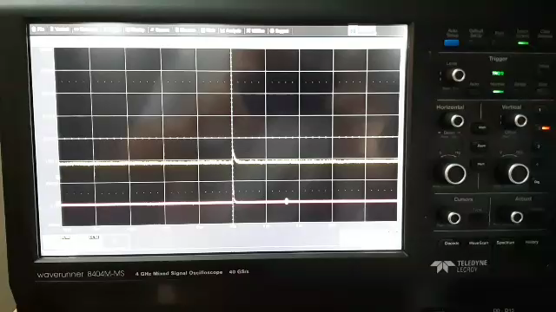
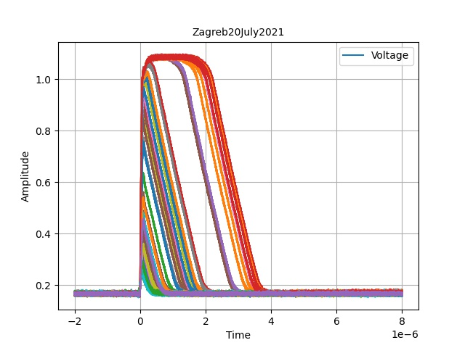
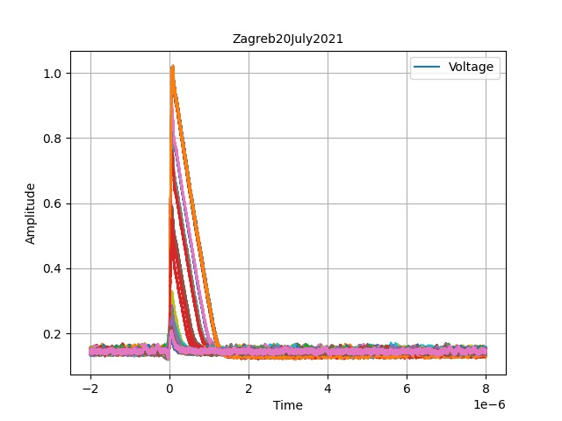
Testing the MPW2 pixel matrix at RBI microprobe
Scope
Capture triggered
by the detector
signal raising edge
(yellow signal in the movie)
r4c2
r4c5
2 MeV 200 protons/sec, 640x640 μm2 zig-zag scan, 60V bias, 30 μm² spot area
1 minute of scanning for each hitmap, Vth=1050 (1.0256V), BL=900 (0.8791 V) for the comparator signal (pink in the scope movie).
r4c2
APM1
r4c5
APM2

Slide 8
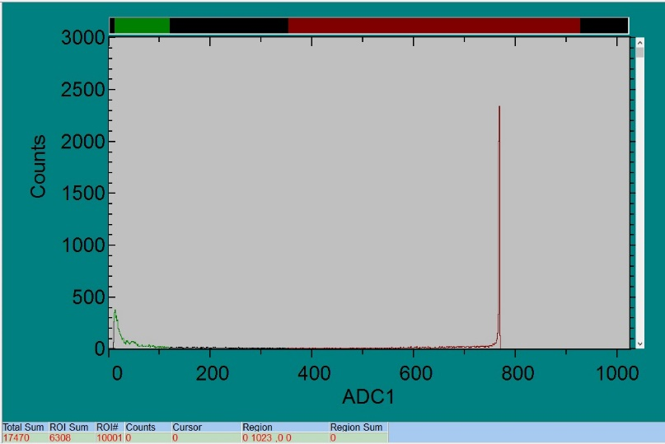
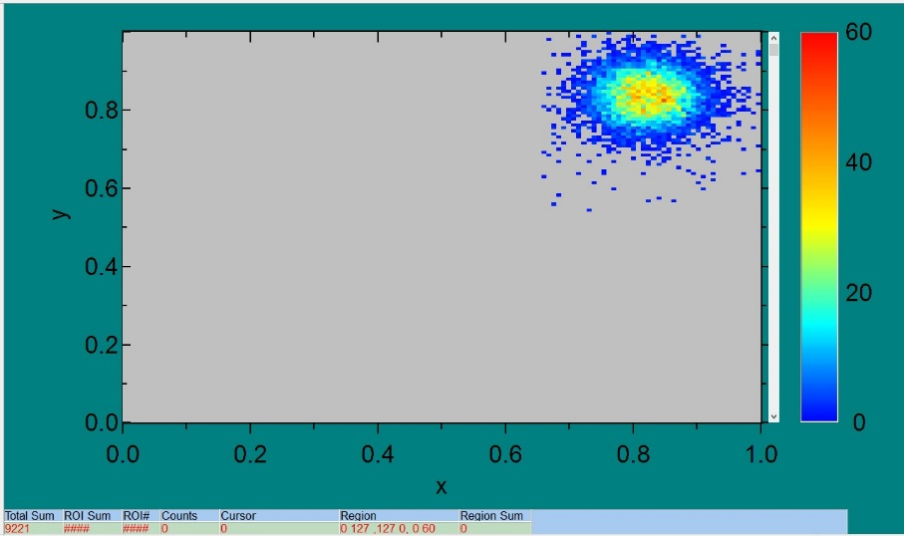
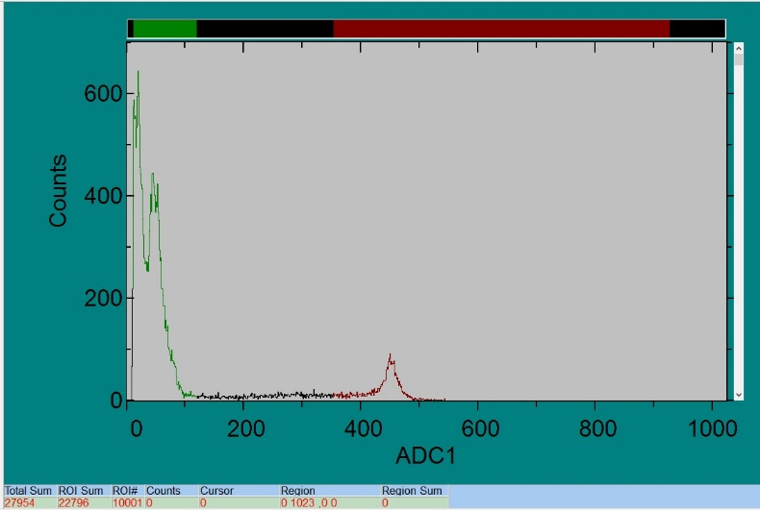
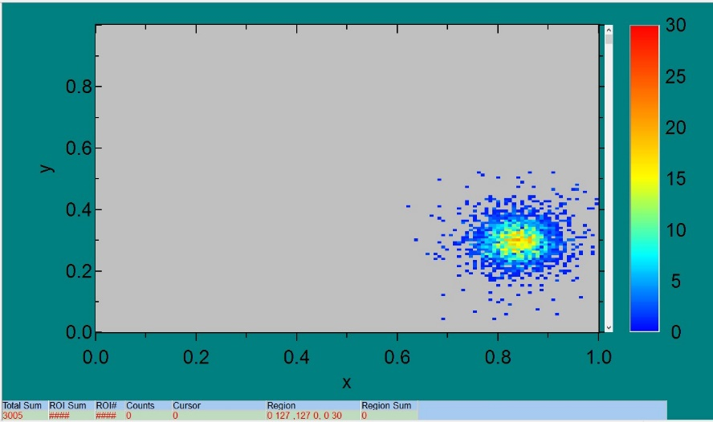
Testing the MPW2 pixel matrix at RBI microprobe
r0c0
r0c7
r0c0
r0c0
2 MeV 200 protons/sec, 640x640 μm2 zig-zag scan, 60V bias, 30 μm² spot area
1 minute of scanning for each hitmap, Vth=1050 (1.0256V), BL=900 (0.8791 V)
r0c7
r0c7
Each APM flavour has 4 cols / 8 rows
Size of a single pixel (with trench)
Width - 60,5 um
Height - 60,5 um
Size of a single pixel (without trench)
Width - 39,68 um Trench_{W} - 20,3 um
Height - 39,68 um Trench_{H} - 20,3 um

Slide 9
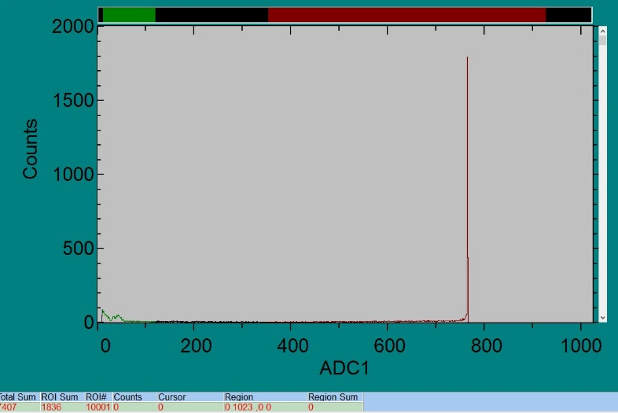
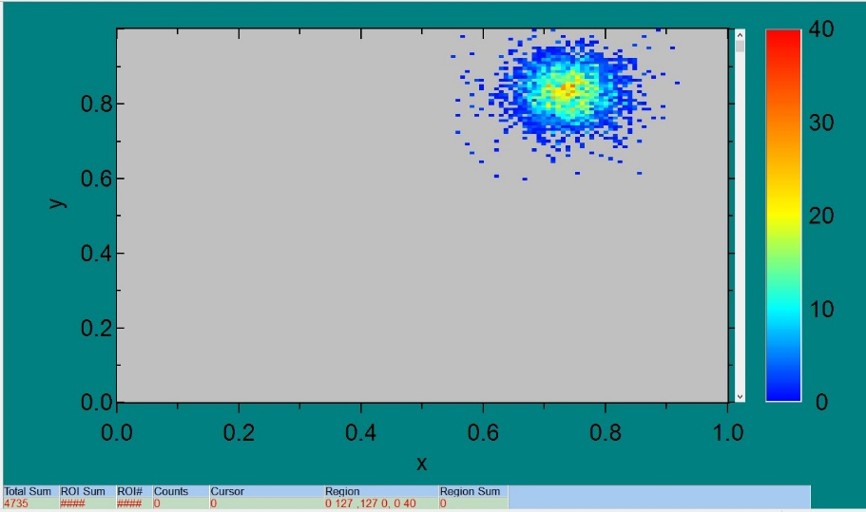
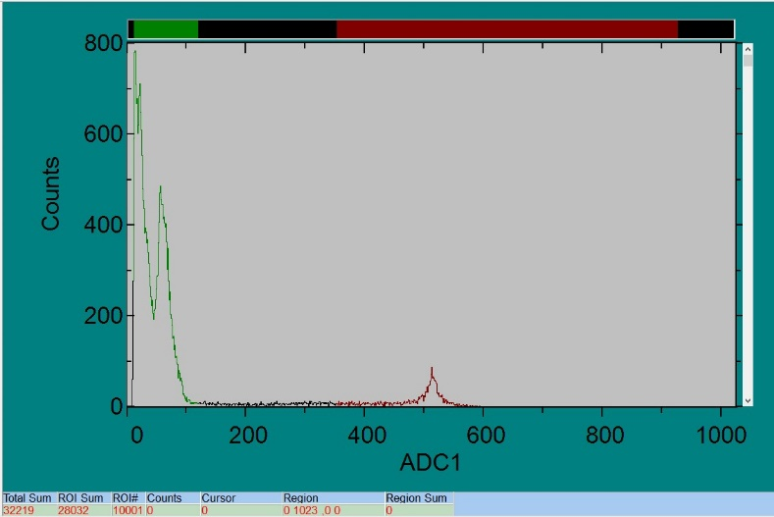
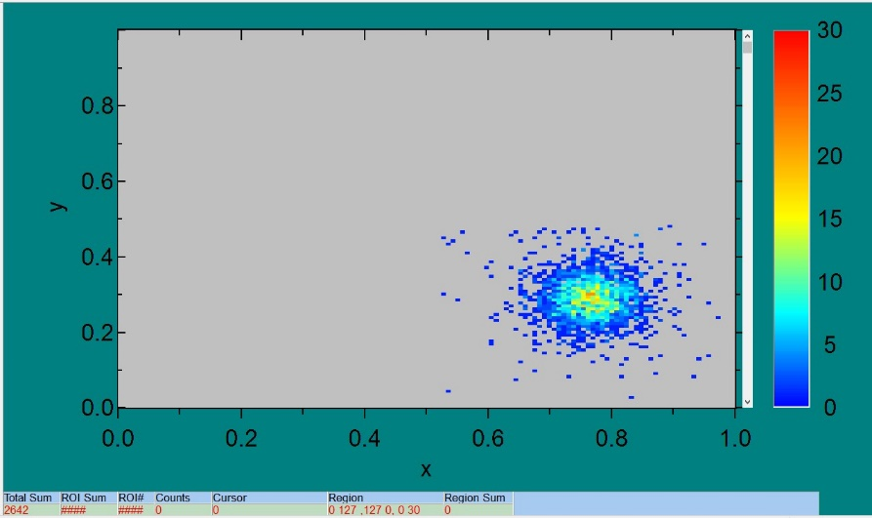
Testing the MPW2 pixel matrix at RBI microprobe
r1c0
r1c0
r1c0
r1c7
2 MeV 200 protons/sec, 640x640 μm2 zig-zag scan, 60V bias, 30 μm² spot area 1 minute of scanning for each hitmap, Vth=1050 (1.0256V), BL=900 (0.8791 V)
r1c7
r1c7
Each flavour APM has 4 cols / 8 rows
Size of a single pixel (with trench)
Width - 60,5 um
Height - 60,5 um
Size of a single pixel (without trench)
Width - 39,68 um Trench_{W} - 20,3 um
Height - 39,68 um Trench_{H} - 20,3 um

Slide 10
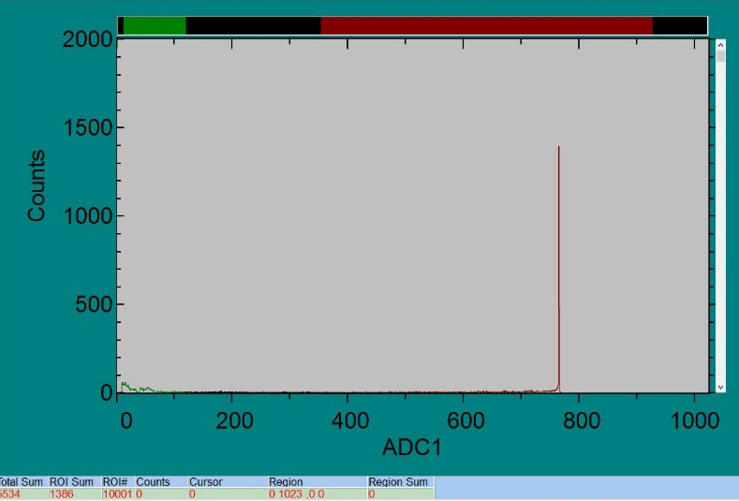
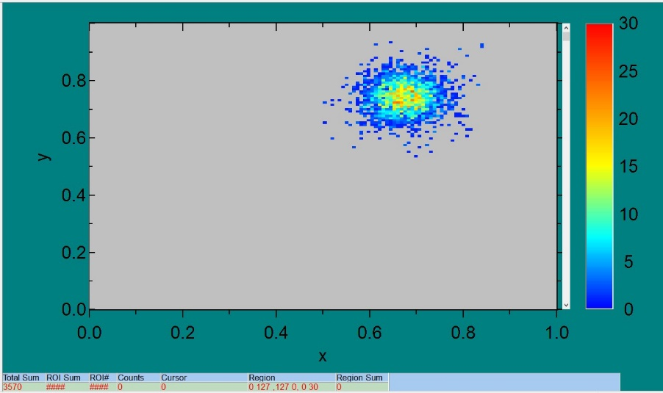
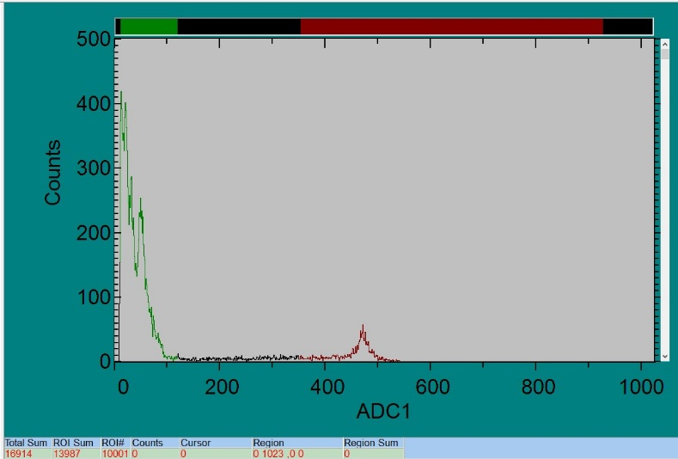
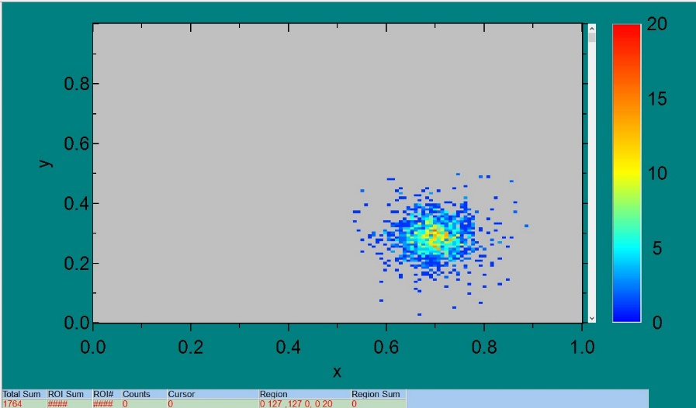
Testing the MPW2 pixel matrix at RBI microprobe
r2c1
r2c1
r2c1
r2c7
2 MeV 200 protons/sec, 640x640 μm2 zig-zag scan, 60V bias, 30 μm² spot area
1 minute of scanning for each hitmap, Vth=1050 (1.0256V), BL=900 (0.8791 V)
r2c7
r2c7
Each flavour APM has 4 cols / 8 rows
Size of a single pixel (with trench)
Width - 60,5 um
Height - 60,5 um
Size of a single pixel (without trench)
Width - 39,68 um Trench_{W} - 20,3 um
Height - 39,68 um Trench_{H} - 20,3 um

Slide 11
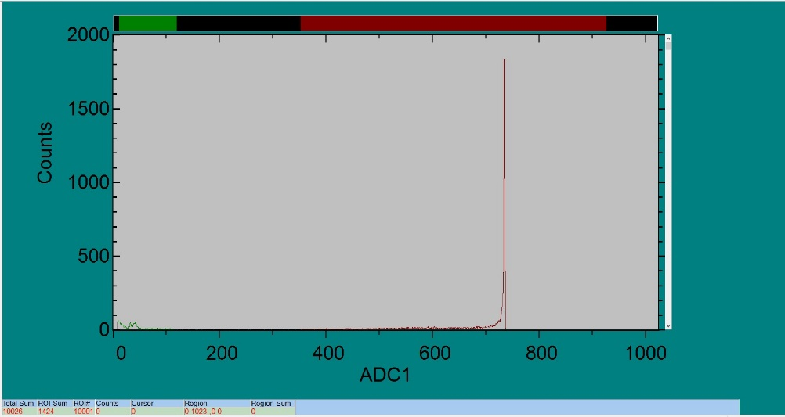
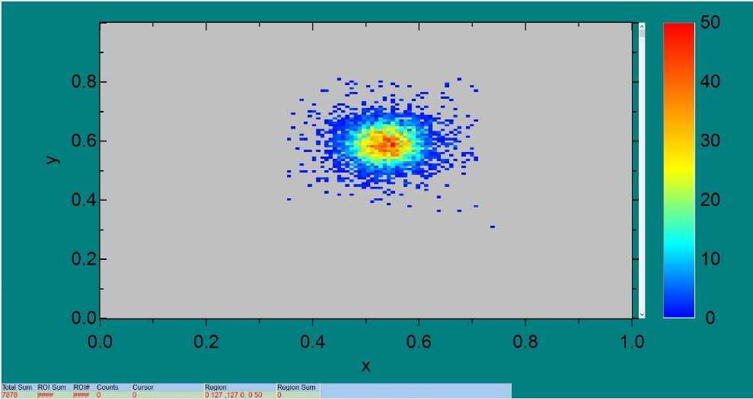
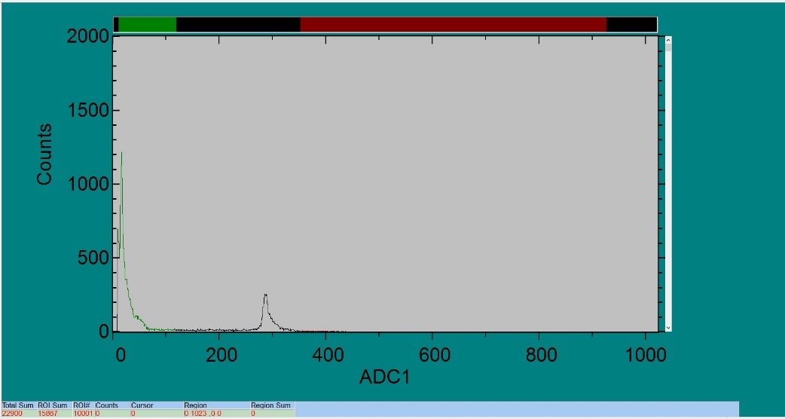
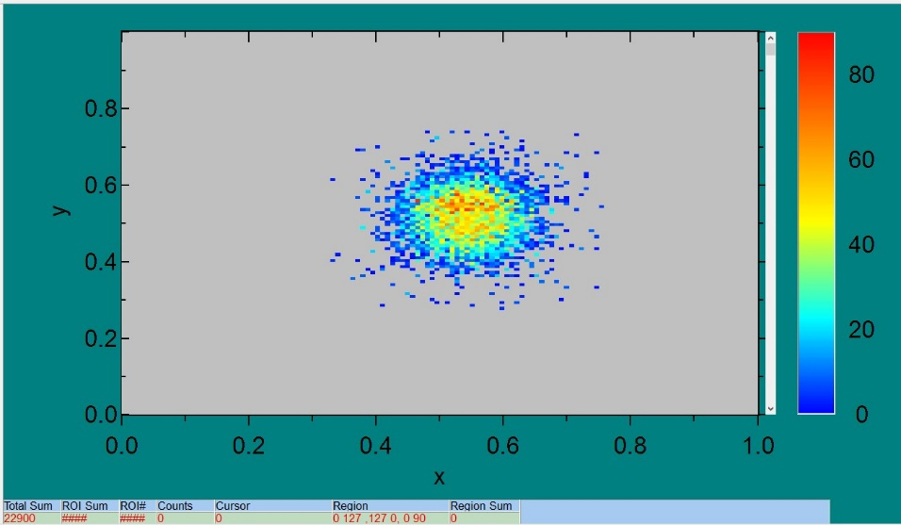
Testing the MPW2 pixel matrix at RBI microprobe
r4c3
r4c3
r4c3
r4c4
2 MeV 200 protons/sec, 640x640 μm2 zig-zag scan, 60V bias, 30 μm² spot area
1 minute of scanning for each hitmap, Vth=1050 (1.0256V), BL=900 (0.8791 V)
r4c4
r4c4
Each flavour APM has 4 cols / 8 rows
Size of a single pixel (with trench)
Width - 60,5 um
Height - 60,5 um
Size of a single pixel (without trench)
Width - 39,68 um Trench_{W} - 20,3 um
Height - 39,68 um Trench_{H} - 20,3 um

Slide 12
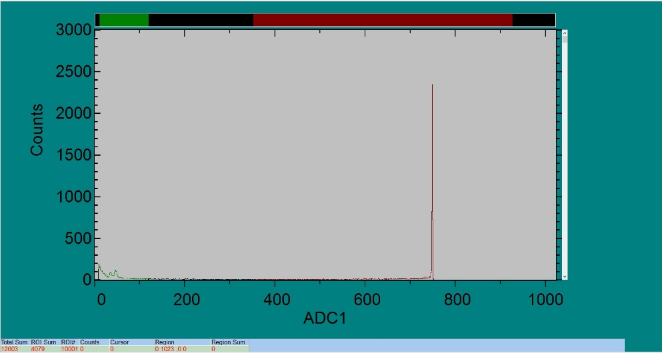
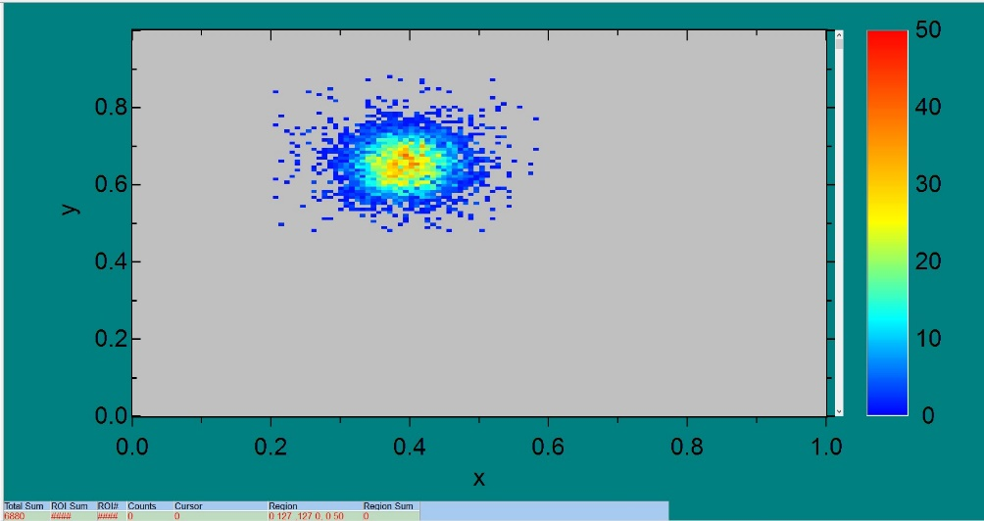
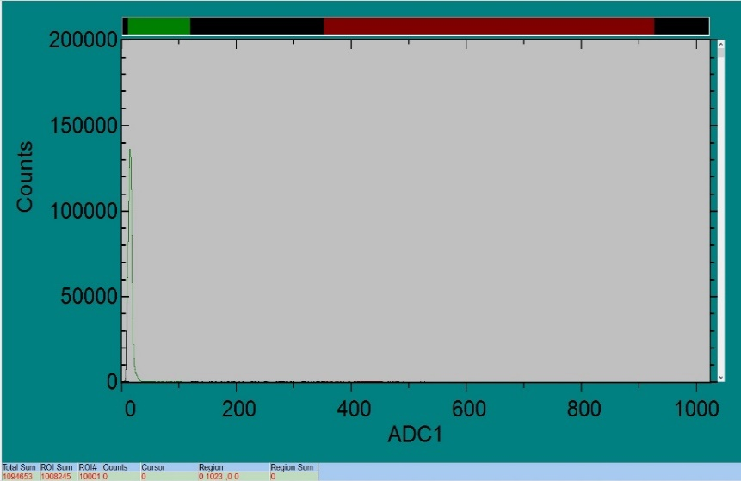
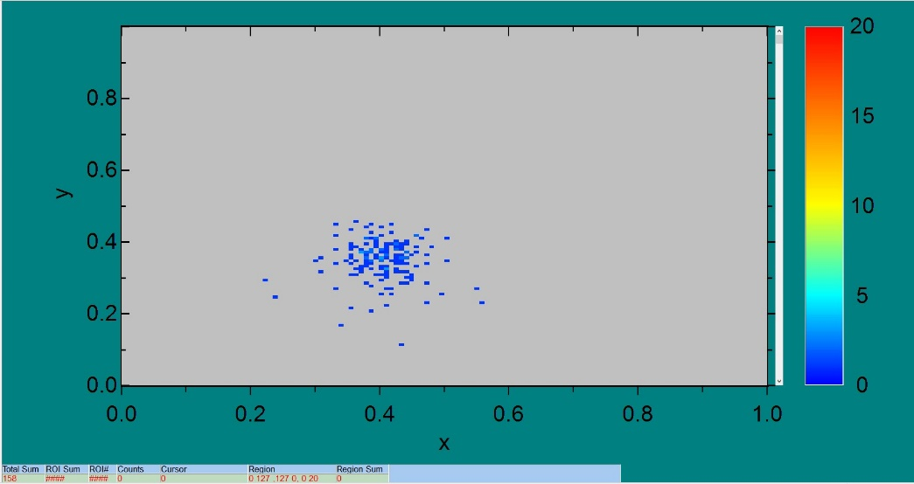
Testing the MPW2 pixel matrix at RBI microprobe
r6c2
r6c2
2 MeV 200 protons/sec, 640x640 μm2 zig-zag scan, 60V bias, 30 μm² spot area
1 minute of scanning for each hitmap, Vth=1050 (1.0256V), BL=900 (0.8791 V)
r6c2
r6c6
r6c6
r6c6
Each flavour APM has 4 cols / 8 rows
Size of a single pixel (with trench)
Width - 60,5 um
Height - 60,5 um
Size of a single pixel (without trench)
Width - 39,68 um Trench_{W} - 20,3 um
Height - 39,68 um Trench_{H} - 20,3 um

Slide 13

Testing the MPW2 pixel matrix at RBI microprobe
First Testing of a monolithic pixel sensor in a microbeam (protons 2MeV)
Flux control (200 protons/sec) is more important than XY precisión for pixel characterization
MCA histograms show clearly the relevance of each pixel signal
XY histograms informs about “halo detections”
We see too many small amplitude signals, possible SETs?, to be further analyzed by circuit
simulation (AFTU tool) from the design schematics.
Notes:
Conclusiones

Slide 14
Testing the MPW2 pixel matrix at RBI microprobe
Thanks for your attention!
fpalomo@us.es
aneliya.karadzhinova@cern.ch
Thanks to RADIATE Project 21002359-ST
and Project COMRAD-2, Spanish National
Science Programme, RTI2018-099189-B-C21

Slide 15

Testing the MPW2 pixel matrix at RBI microprobe
Spare Slides

Slide 16
What is AFTU?
The Analog FTU Hardware Debugging System
is a software tool to evaluate the SEE sensitivity
of analog/mixed signal circuits
at transistor level

Slide 17
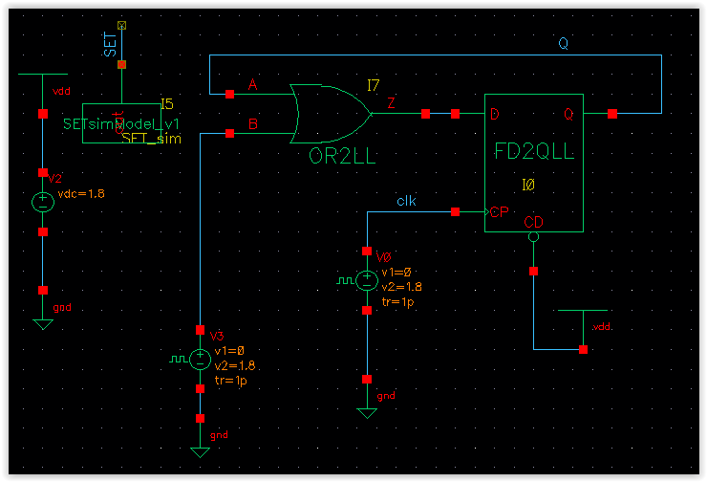
How does it work?
AFTU parses a Spectre design netlist...
…to generate a parametric simulation Ocean script
-Analysis of Transient Effects in Analogue Topologies, F.Marquez, F.Muñoz, F.R.Palomo, M.A.Aguirre and M.Ullán, AMICSA 2012, Noordvijk,
Netherlands 26th -28th August 2012, http://microelectronics.esa.int/amicsa/2012/amicsa2012.htm
-Automatic inspection of SET sensitivity in analog cells, F.Márquez, F.Muñoz, M.A.Aguirre, F.R.Palomo and M.Ullán, SMACD’12,
Sevilla, Spain, 19th-21st Sept. 2012 http://www2.imse-cnm.csic.es/~smacd2012/SMACD_2012/HOME.html
-AFTU, an analog single event effects automatic analysis tool, F.Marquez, L.Sanz, F.R.Palomo, F. Muñoz and M.A.Aguirre, AMICSA 2014, CERN,
Switzerland, 30th June-1st July 2014, https://indico.cern.ch/event/277669/
-Automatic Single Event Effects Sensitivity Analysis of a 13-Bit Successive Approximation ADC, F.Márquez, F.Muñoz, F.R.Palomo, L.Sanz,
E.López-Morillo, M.Aguirre and A.Jiménez, IEEE Transactions on Nuclear Science,62(4) 2015, pp.1609-1616

Slide 18
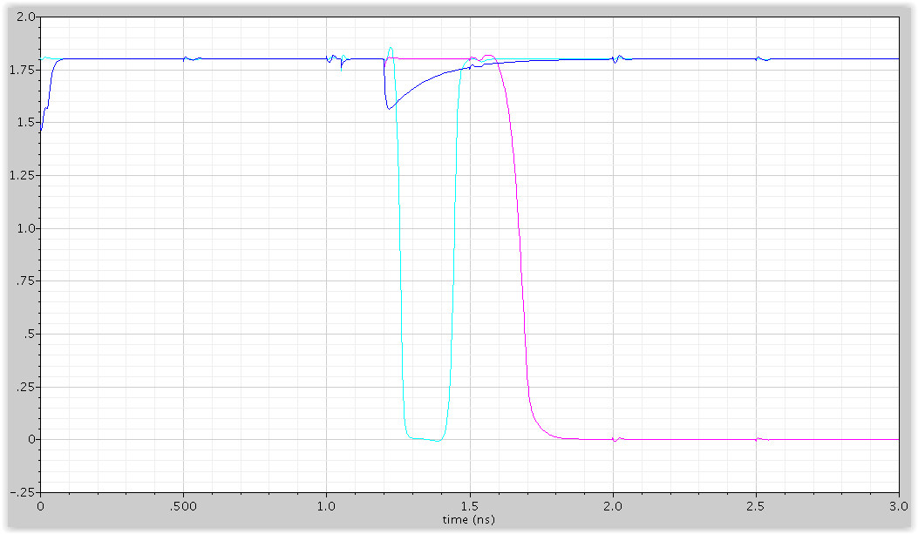




…emulates Single Event Effects…
An injection current source at every node or
at user selected nodes is the way to emulate
the SEE. The injection source model can be
changed.
Injection Current
Default Model

Slide 19

... and evaluates vulnerabilities
The user defines injection and evaluation
zones
and select the appropriate hard coded
heuristic to analyze the parametric simulation
results
D-latch circuit , STMicroelectronics 130 nm
The final result is a list of
vulnerabilities (in terms of the
heuristic) for each user selected
node in the design.

Slide 20

Hard Coded Heuristics
Deviation Recovery
(ex. analog circuits SET’s)
Time Ranges
(ex. digital SEU’s & differential circuits SET’s)
Recovery Time
Signal Voltage Deviation
Total time between
up to 4 signal thresholds
Notes:
Ilustraciones sacadas de

Slide 21

AFTU ToolChain
Before using AFTU:
The user designs a circuit with Cadence as usual.
The design is simulated through a testbench.
Of all files generated by Cadence, we pick the netlist.

Slide 22

AFTU instrumentalize
The instrumentalizer implements a parser for the SPECTRE language
Replaces the netlist with a functionally identical one allowing radiation emulation.
netlist.nodes lists all observable circuit nodes.
netlist.sources lists all transistors where an impact can be emulated.

Slide 23

AFTU ocean init
AFTU projects are flexible and give the user many options for analysis.
config contains paths, times, heuristics, initial values…
watch defines all elements in the circuit to be observed during the simulation
inject defines where, when and how much charge we inject (SEE emulation).

Slide 24

AFTU Ocean cook
From all this data an Ocean simulation script is produced
Includes all paths and required data.
Describes the way to perform the user defined test campaign.
Defines how to analyze the results of the campaign.

Slide 25

AFTU campaign
Cadence runs the provided script.
It produces a CSV file with the desired statistics.
This uncovers radiation vulnerabilities in the circuit.

Slide 26
A Practical Example
Let's say we have this circuit:
What is the critical charge to produce a SEU?

Slide 27


Netlist
D-latch transient testbench and schematic
view of the digital cell
STMicroelectronics 130 nm

Slide 28

Watch & Inject
watch Q = /Q :
threshold = 0.975 ;
inject I0_MP19:
Q = .025p, .05p, 0.1p, .2p, .5p, .75p, 1p, 1.5p;
t = 1.0n, 1.1n, 1.2n, 1.3n, 1.4n, 1.5n, 1.6n, 1.7n, 1.8n, 1.9n;
inject I0_MN19:
Q = .025p, .05p, 0.1p, .2p, .5p, .75p, 1p, 1.5p;
t = 1.0n, 1.1n, 1.2n, 1.3n, 1.4n, 1.5n, 1.6n, 1.7n, 1.8n, 1.9n;
inject I0_MP18:
Q = .025p, .05p, 0.1p, .2p, .5p, .75p, 1p, 1.5p;
t = 1.0n, 1.1n, 1.2n, 1.3n, 1.4n, 1.5n, 1.6n, 1.7n, 1.8n, 1.9n;

Slide 29

Results
Output ImpactNode Qinj Timp Trec Vmax
V_Q I0_MP18 2.5e-14 1e-09 0.000000 0.001941
V_Q I0_MP18 2.5e-14 1.1e-09 0.000000 0.00219
V_Q I0_MP18 2.5e-14 1.9e-09 0.000000 0.003664
V_Q I0_MP18 5e-14 1e-09 2.000000 1.807421
V_Q I0_MP18 5e-14 1.1e-09 1.910000 1.807422
V_Q I0_MP18 5e-14 1.2e-09 1.800000 1.807426
V_Q I0_MP18 5e-14 1.3e-09 1.700000 1.807384
V_Q I0_MP18 5e-14 1.8e-09 0.000000 0.519730
V_Q I0_MP18 5e-14 1.9e-09 1.100000 1.803023
Output ImpactNode Qinj Timp Trec Vmax
V_Q I0_MN11 2.5e-14 1e-09 0.000000 0.006827
V_Q I0_MN11 2.5e-14 1.9e-09 0.000000 0.016568
V_Q I0_MN11 5e-14 1e-09 0.000000 0.017084
V_Q I0_MN11 5e-14 1.3e-09 0.000000 0.005371
V_Q I0_MN11 5e-14 1.4e-09 1.610000 1.806680
V_Q I0_MN11 5e-14 1.5e-09 1.500000 1.806814
V_Q I0_MN11 5e-14 1.6e-09 1.400000 1.805740
V_Q I0_MN11 5e-14 1.7e-09 1.300000 1.802925
V_Q I0_MN11 5e-14 1.8e-09 0.240000 1.404223
“Deviation Recovery” heuristic analysis

Slide 30

Results

Slide 31

fpalomo@us.es
Electronic Engineering Dept.
School of Engineering
Sevilla

