Slide 1
THICKNESS dependence of the Seb bias threshold in fs-laser based mortality study on LGAD from different producers
39th CERN RD50 Workshop, 17-19 November 2021, Valencia
Gordana Lastovicka-Medin¹, Mateusz Rebarz², Gregor Kramberger³, Jakob Andreasson² Tomas Lastovicka⁴, Jiri Kroll⁴, Kamil Kropielnicki²
¹University of Montenegro
²Extreme Light Infrastructure
³Jozef Stefan Institute
⁴Czech Academy of Sciences

Slide 2
Study on irradiated LGADs - Fall 2021 campaign at ELI
The first set of samples: 6 LGADs wire bonded in Ljubljana and sent by Gregor directly to ELI (HPK, FBK)
Sensor typeor | Fluence | Thickness | Pad | Nominal max. bias | Damage | Performed experiments
HPK-P2 W36 LGAD | 1.5e15 | 50 um | 2x2 array | 650 V | SPA at 635V/30 pJ (unintentional breakdown) | Front - SPA
FBK UFSD3.2 W18 LGAD C+B | 1.5e15 | 45 um | 2x2 array | ~550 V | No damage | Front – SPA (+ guard ring) Back - SPA Front – TPA
FBK UFSD3.2 W18 LGAD C+B | 2.5e15 | 45 um | 2x2 array | ~550 V | SPA at 545V/1 pJ (unintentional breakdown) | No data
HPK-P1 W4 LGAD (type 1.2) | 1.5e15 | 35 um | 2x2 array | ~400 V (in practice ~550 V) | No damage | Front – SPA (+ interpad) Back - SPA Front – TPA Back - TPA
HPK-P1 W4 LGAD (type 1.2) | 2.25e15 | 35 um | single | ~400 V (in practice ~550 V) | TPA at 530V /1.45 nJ | Front – SPA (+ guard ring) Back - SPA Front – TPA
Due to time limitations most of studies were performed at laser energy 50 pJ for SPA and equivalent values for TPA studies. Temperature of the samples for all measurements were kept at -25 °C .

Slide 3
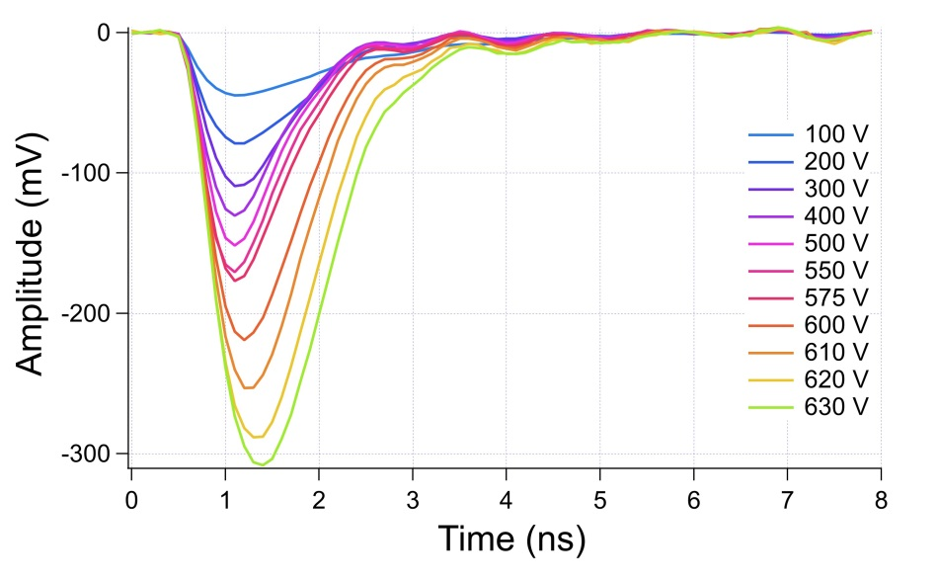
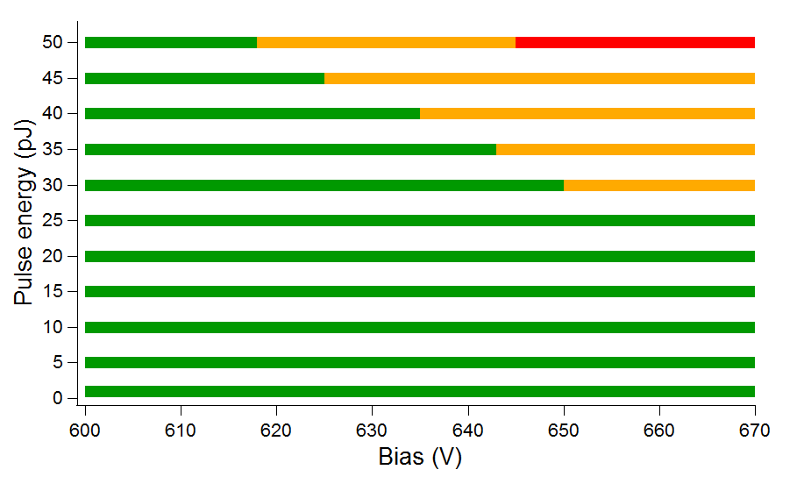
HPK-P2 W36 LGAD (1.5e15 50 um 2x2 array)
Front SPA, 800 nm
Signal at 50 pJ
Breakdown in the “safe” region asdefined
in previous study
Front SPA,
800 nm
This sample is from the same wafer we have already tested in our previous study (W36 LGAD 1.5e15).
This time we observed:
higher leak current at the same bias & higher amplitude signal at the same laser power for bias > 600 V (the most probable due to higher capacity – 2x2 LGAD area)
breakdown at lower laser power and bias (30 pJ/635 V vs 50 pJ/645 V previously)
no visible damage on the pad after breakdown
- it has to be inspected by microscope and further investigate in order to demonstrate that sensor died from the same mechanism as before (SEB and the same triggered conditions)
Experimental conditions were the same so maybe something in this sample or wire bonding.
Other samples of the same type are needed to verify these discrepancies. Unfortunately, no backup of the sample so no further studies were performed.
Difficult to justify behavior based on one sample

Slide 4
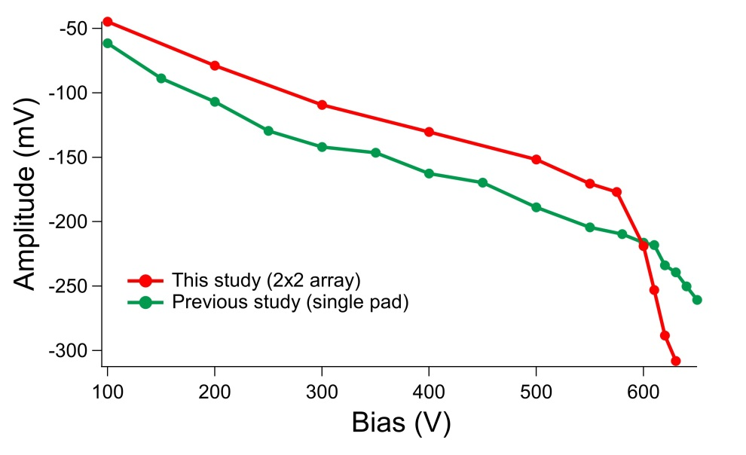
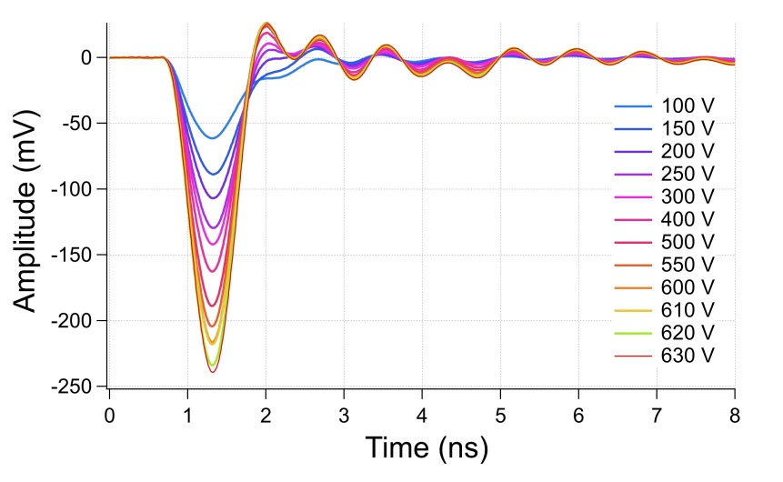
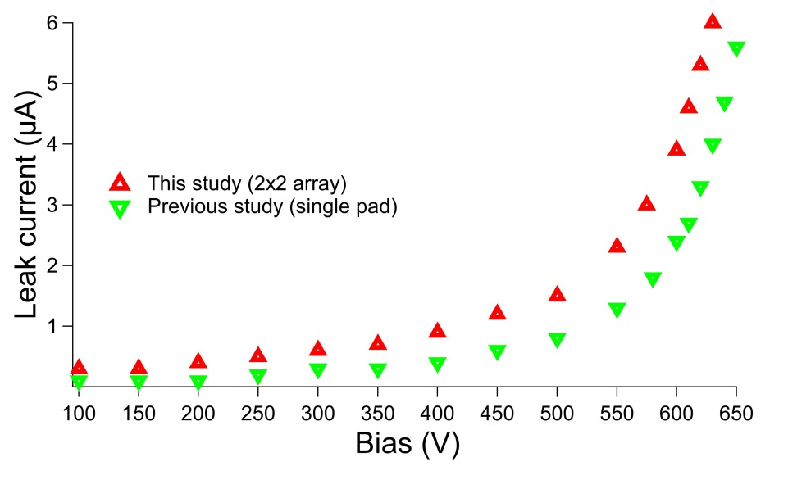
HPK-P2 W36 LGAD (1.5e15 50 um)
Comparison of new sample (2x2 array) with previous one (single pad)
Difference due to higher capacity of LGADs
New sample
(2x2 array)
Old sample
(single pad)
Above 600 V waveforms for new sample are significantly broadened

Slide 5
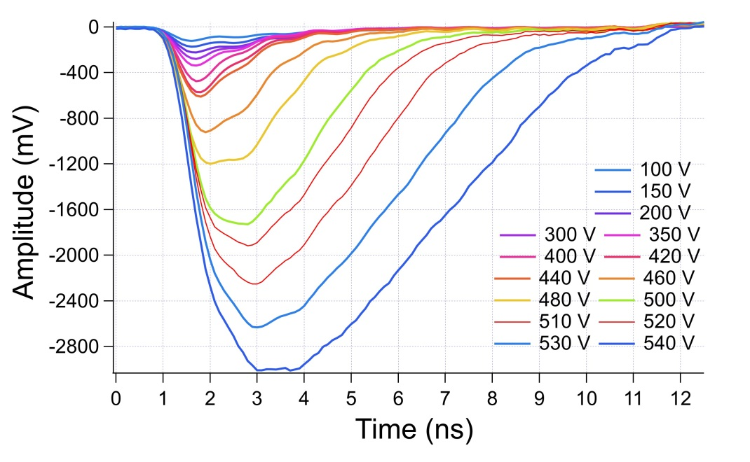
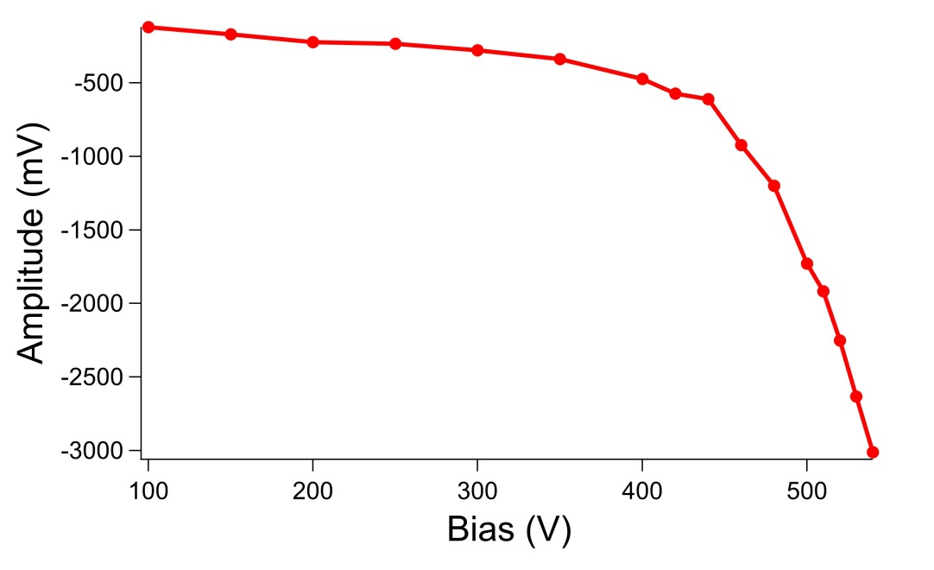
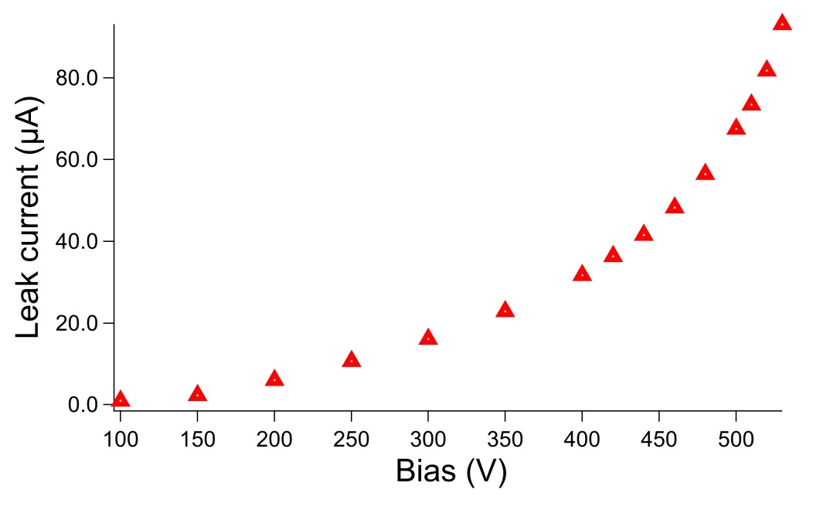
FBK UFSD3.2 W18 LGAD (1.5e15 45 um 2x2 array)
Signal at 50 pJ
this sensor has nominal max. bias ~550 V
waveforms start broadening significantly above 450 V but the signal is stable (no jumping) in all studied range
Leak current is stable below 550 V
Leak current jumps rapidly above 0.5 mA at 550V but not irreversible damage happens
sensor works normally after decreasing bias below 550 V
rapid jump of current at 550 V occurs also for low pulse energies < 10 pJ
Broader waveform in comparison to HPK
(0.5 mA is a safety limit of our HV power supply so further increase of bias is not possible)

Slide 6
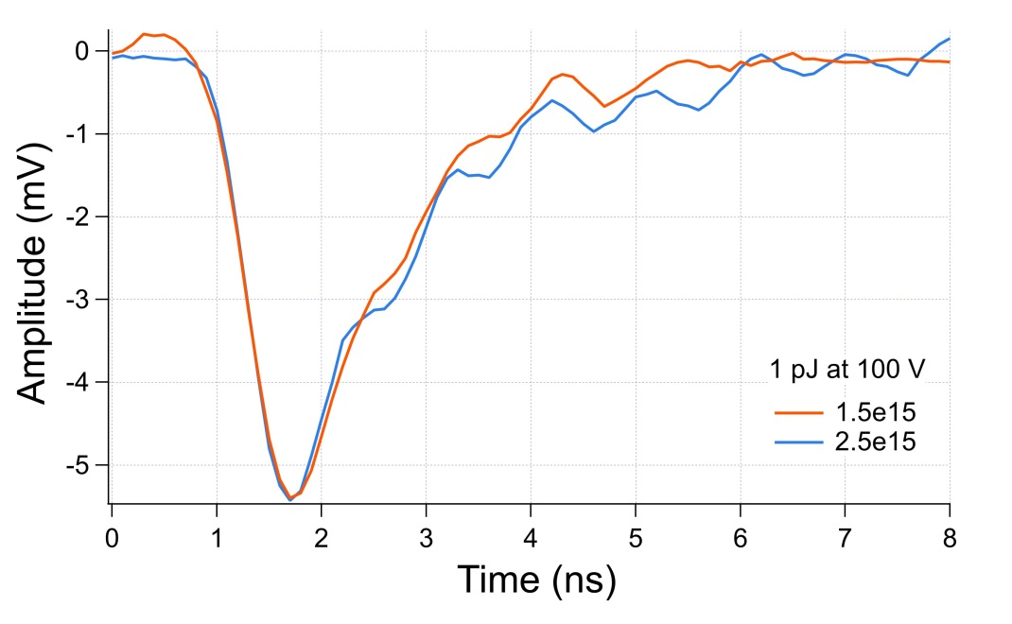
FBK UFSD3.2 W18 LGAD (2.5e15 45 um 2x2 array)
Irreversible damage of the sensor at 545V for 1 pJ pulse energy.
Unfortunately, this sample was unintentionally damaged during preliminary studies. On the other hand the first FBK sensor didn’t break down at 550 V.
Only one result we managed to get for this sample is single waveform we registered during alignment.
Below it’s comparison with the first FBK sample (1.5e15).
The waveforms for both samples are very similar.
No other data for this sample

Slide 7
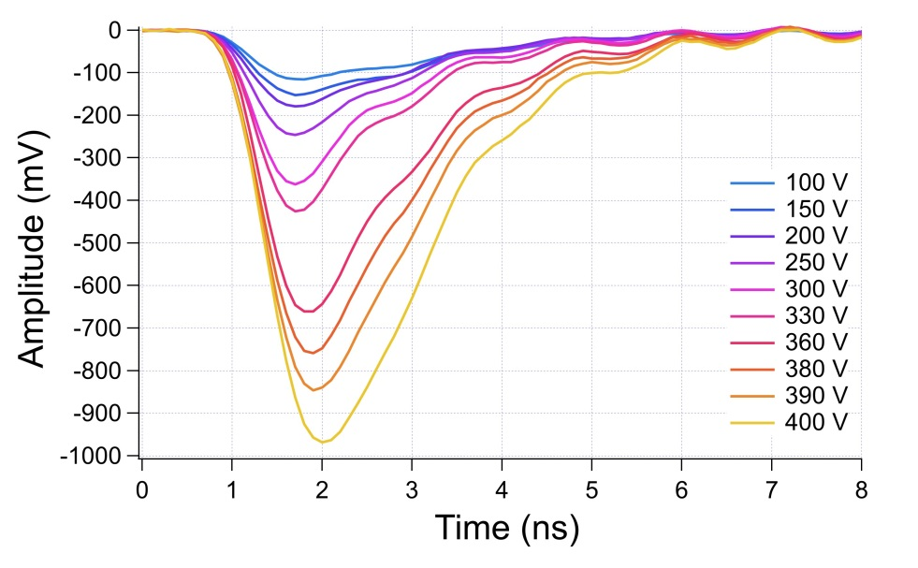
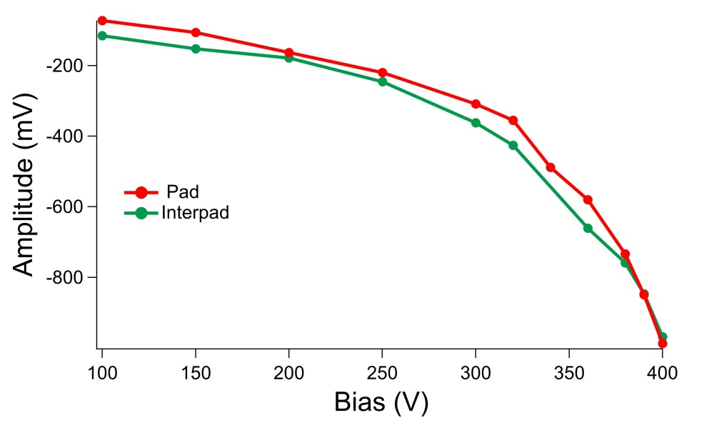
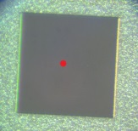
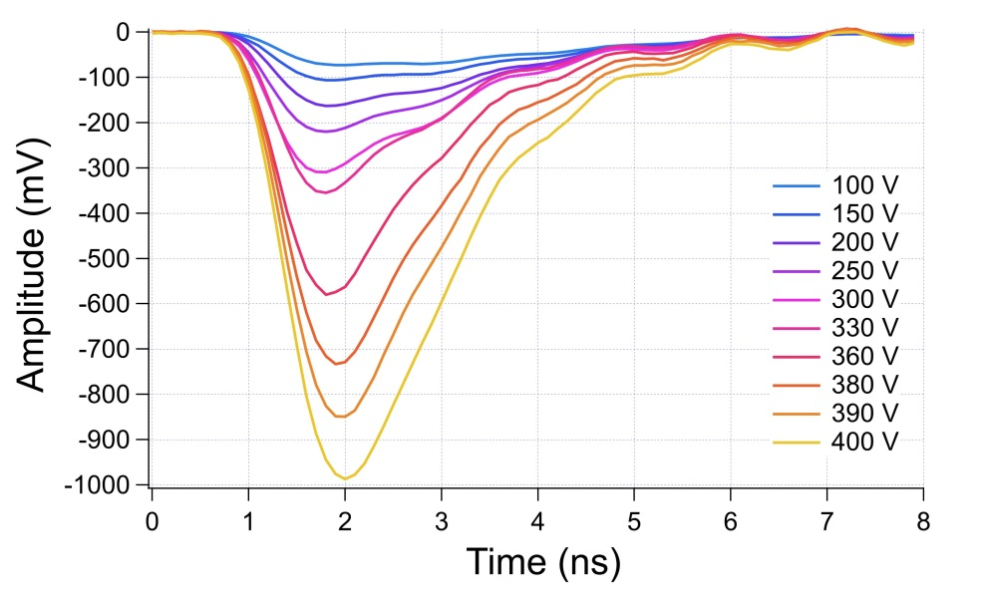
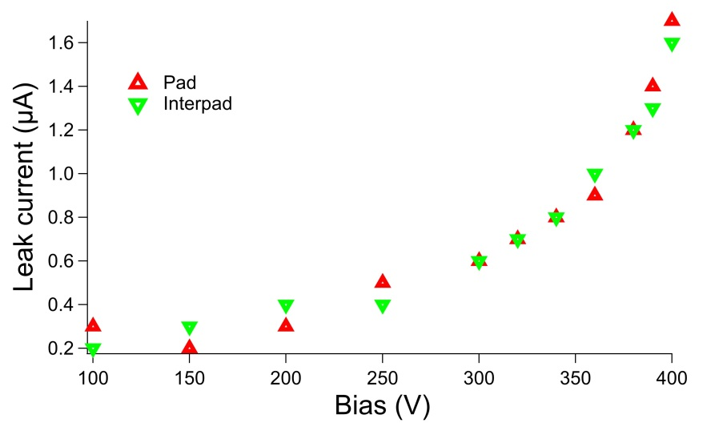
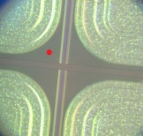
HPK-P1 W4 LGAD (1.5e15 35 um 2x2 array)
Opening window
this sensor has nominal max. bias ~400 V
the measurements in this range were performed for opening window and for the interpad region
the results are nearly identical
50 pJ
Interpad
50 pJ

Slide 8
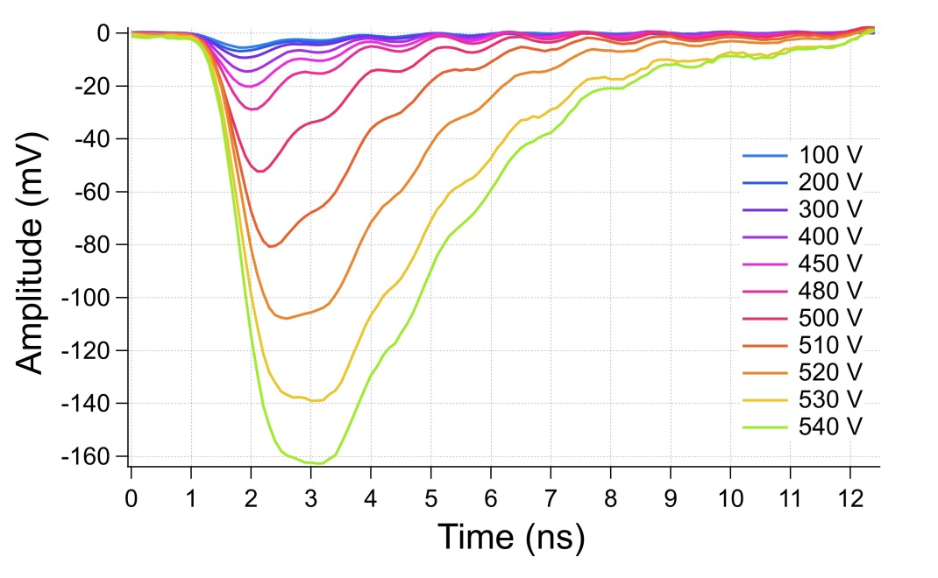
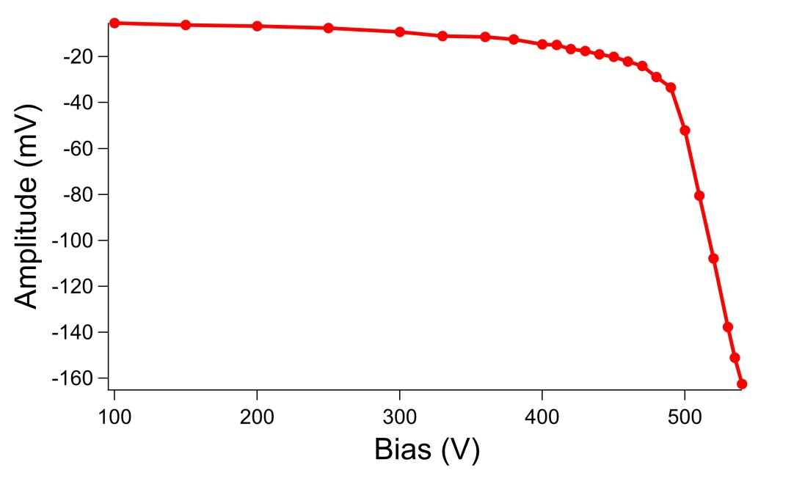
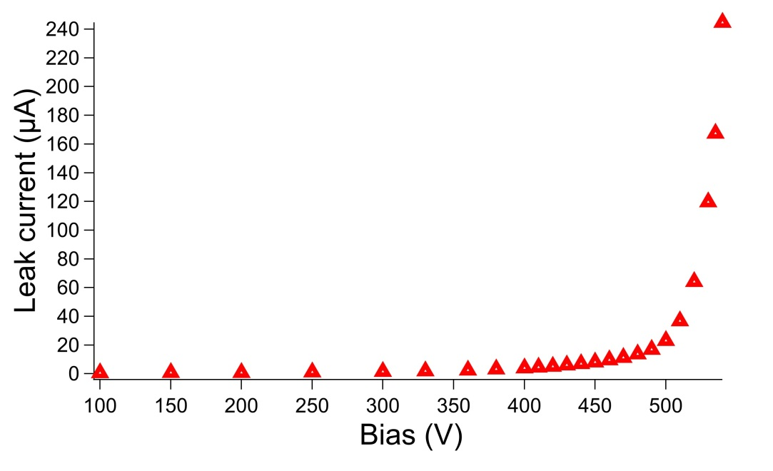
HPK-P1 W4 LGAD (1.5e15 35 um 2x2 array)
(backside illumination)
Fs-laser
to get a reasonable signal by illumination from the backside much higher pulse energy is necessary
more or less one order of magnitude higher pulse energy gives the signal comparable with front illuminated sensor (10 nJ vs 10 pJ)
although nominal max. bias for this sensor is ~400 V it turned out that it can survive significantly higher voltage (at least 544 V)
the signal became slightly instable (small jumping of amplitude) above 500 V
leak current jumps rapidly above 0.5 mA at 544V but not irreversible damage happens
10 nJ

Slide 9
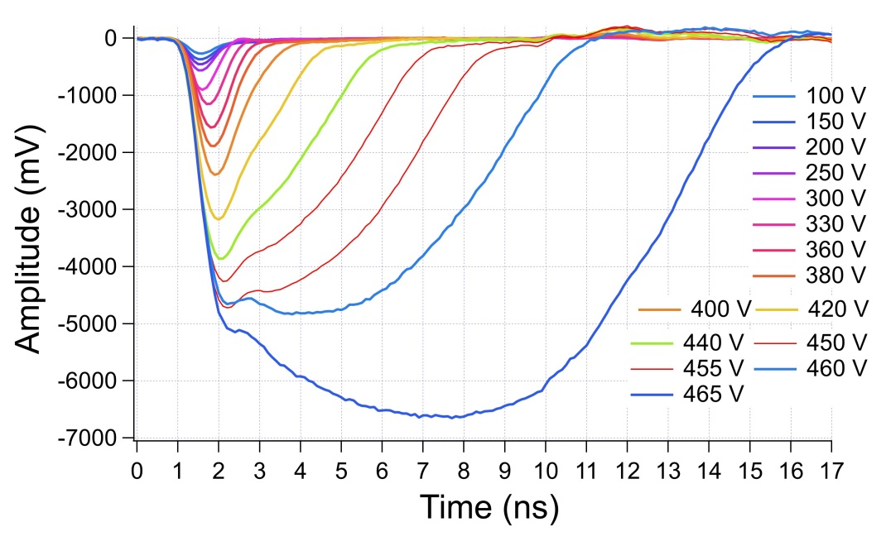
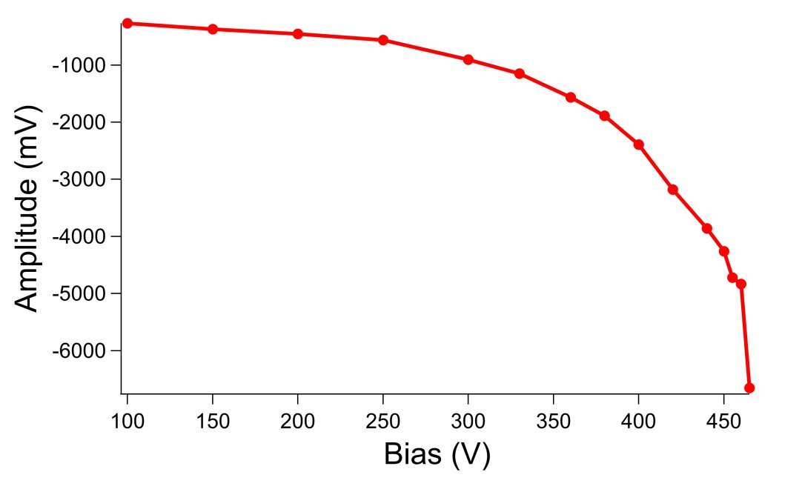
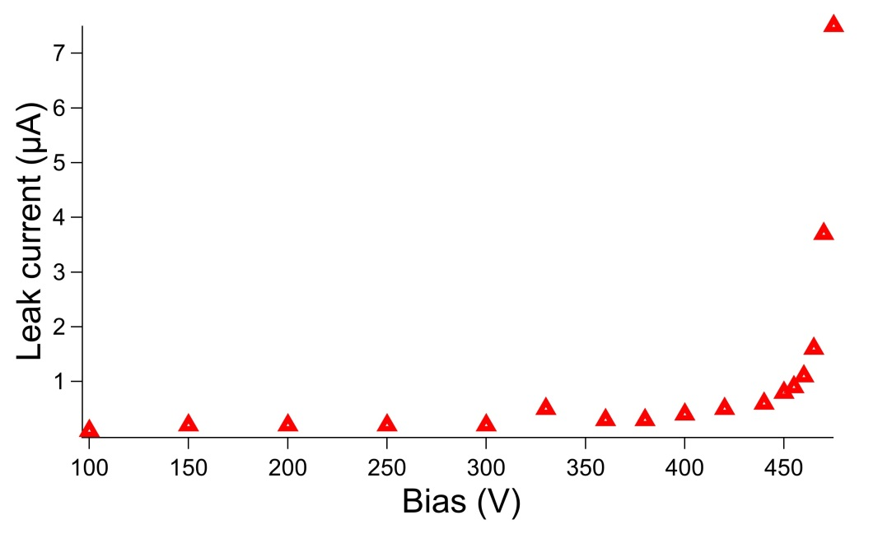
HPK-P1 W4 LGAD (2.25e15 35 um single pad)
Frontside
although nominal max. bias for this sensor is ~400 V it turned out that it can survive higher voltage (at least 505 V)
the signal became very broad above 420 V
the signal became slightly instable (small jumping of amplitude) at 450 V
the signal is highly deformed and extended at 470 V (see next slide)
above 470 V the signal is too high to be measured
leak current becomes unstable at 505 V
50 pJ

Slide 10
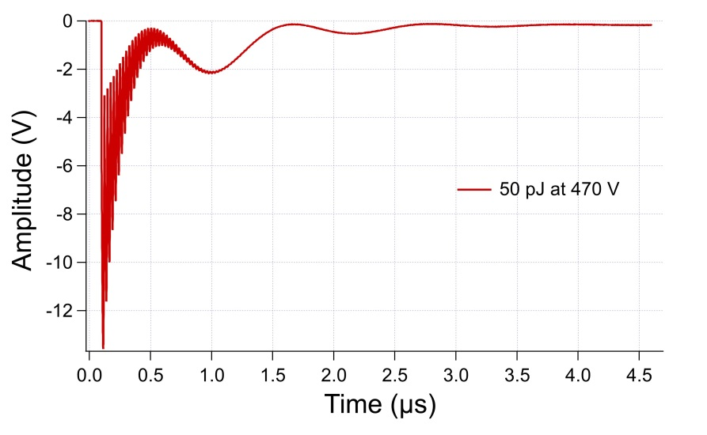
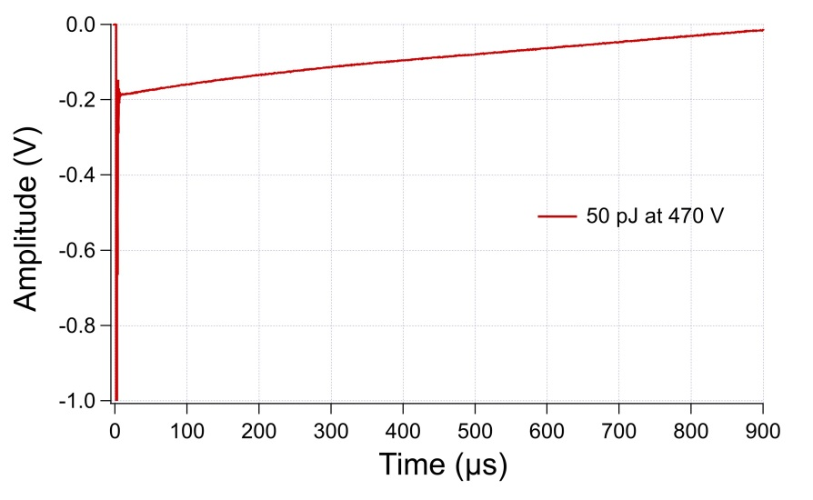
HPK-P1 W4 LGAD (2.25e15 35 um single pad)
(bias above nominal value 400 V)

Slide 11
Run9254 → 50/70um LGADs & PINs

Slide 12
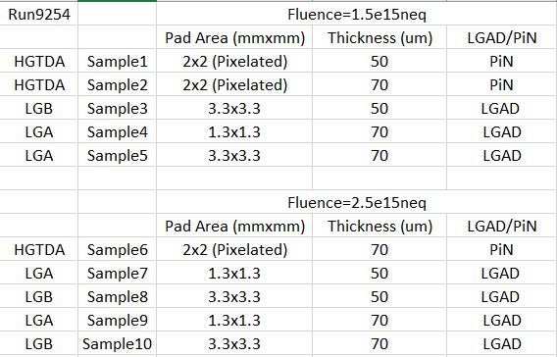
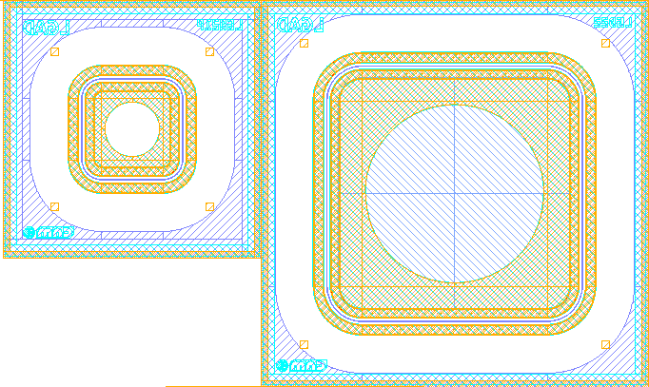
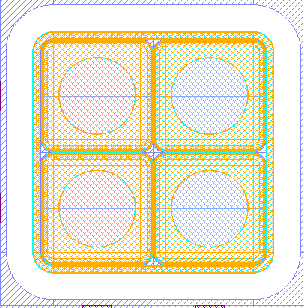
Devices Run9254
LGA (LGAD)
LGB (LGAD)
HGTDA (PIN)
1.3mm
3.3mm
2mm
Pixel1
Pixel2
Pixel3
Pixel4

Slide 13
Voltage range (at -20ºC)
Devices of this sort have been found to have their mortality at about 600V for thicknesses of 50um (either LGADs, with intrinsic multiplication, or PINs, without), thus they can stand 12V/um (more or less).
For the devices of 70um, it is expected that their mortality occurs beyond 600V (12V/um x 70um = 840V)
Request: If possible, the voltage range should cover a range up to 800-840V at -20ºC

Slide 14
Study on irradiated LGADs – CNM samples
Samples: 10 LGADs sent to Prague from CNM and 6 of them wire bonded by Jiri
Sensor type | Fluence | Thickness | Stability threshold | Breakdown
W1 LGAD LGB, 3.5x3.5mm² | 1.5e15 | 50 um | 600 V | 615 V
W2 LGAD LGB, 3.5x3.5mm² | 2.5e15 | 50 um | 600 V | > 545 V
PIN (2x2) 3.5x3.5mm² | 1.5e15 | 70 um | 840 V | 885 V
W3 LGAD LGB | 1.5e15 | 70 um | 840 V | 915 V
W3 LGAD LGB | 2.5e15 | 75 um | 820 V | > 910 V
W4 PIN 3.3x3.3 mm² | 2.5e15 | 75 um | 900 V | 910 V
All the samples were illuminated by 50 pJ laser pulses at 800 nm
All the samples were kept at temperature -25 °C
The waveforms of the signal were recorded vs HV bias
Leak current was monitored vs HV bias

Slide 15
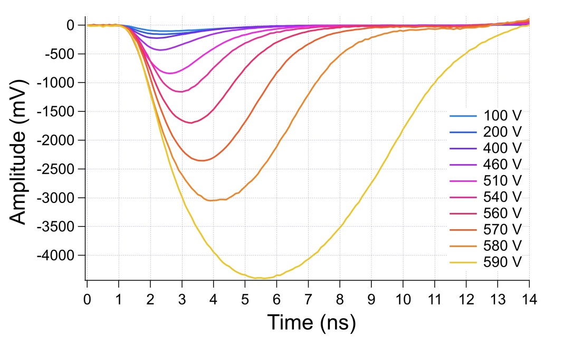
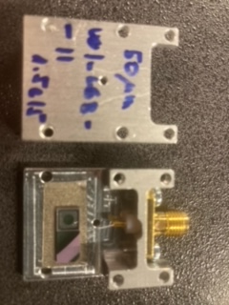
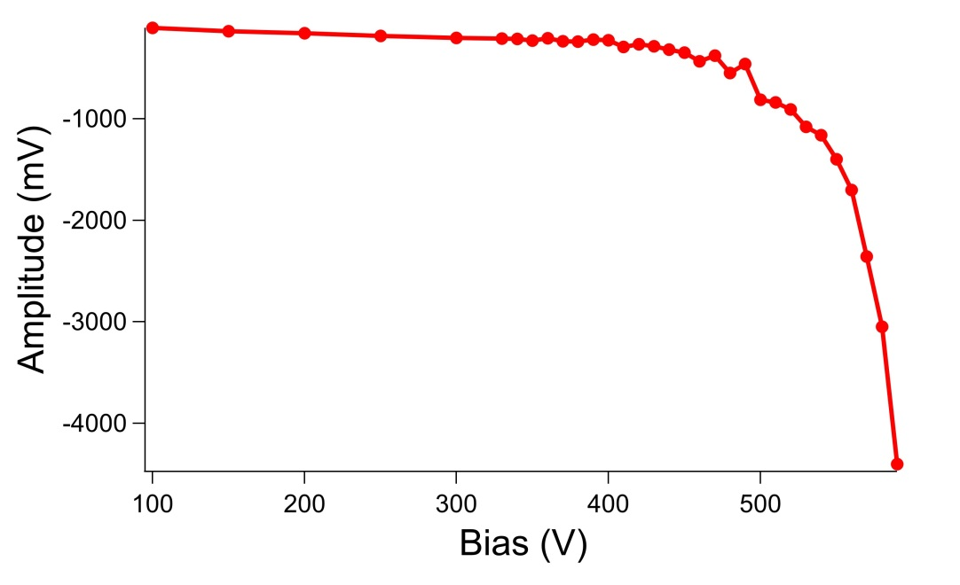
W1 LGAD (1.5e15 50 um)
LGB, 3.5x3.5 mm²
Signal of the sensor vs bias is relatively linear for lower values (up to 400 V). For higher values we observe rapid highly nonlinear increase of the signal amplitude and significant broadening of the waveforms.

Slide 16
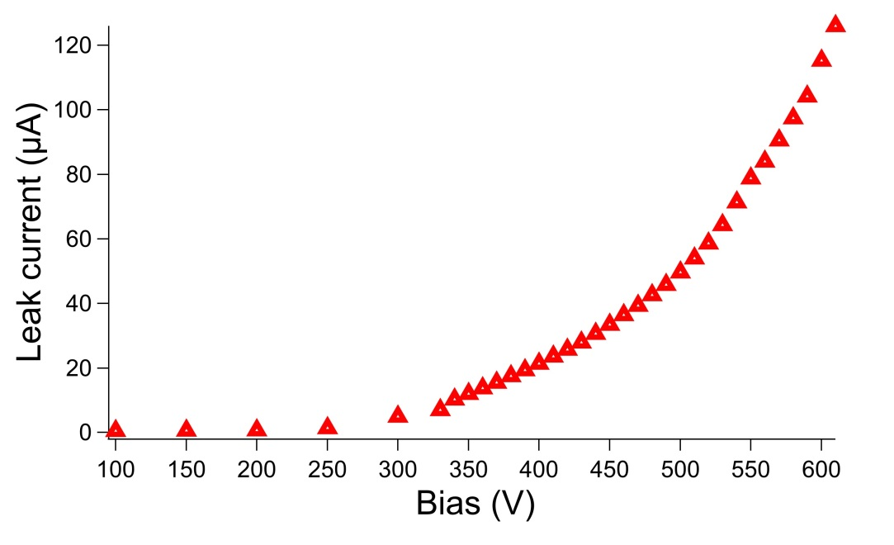
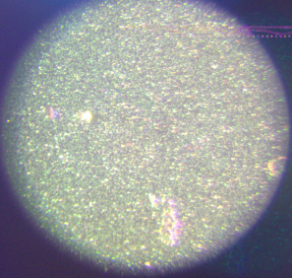
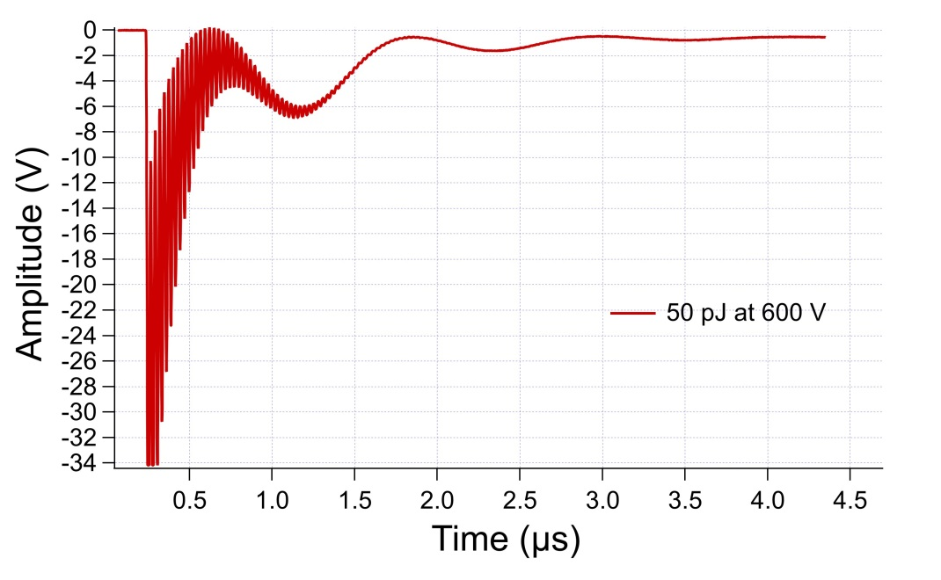
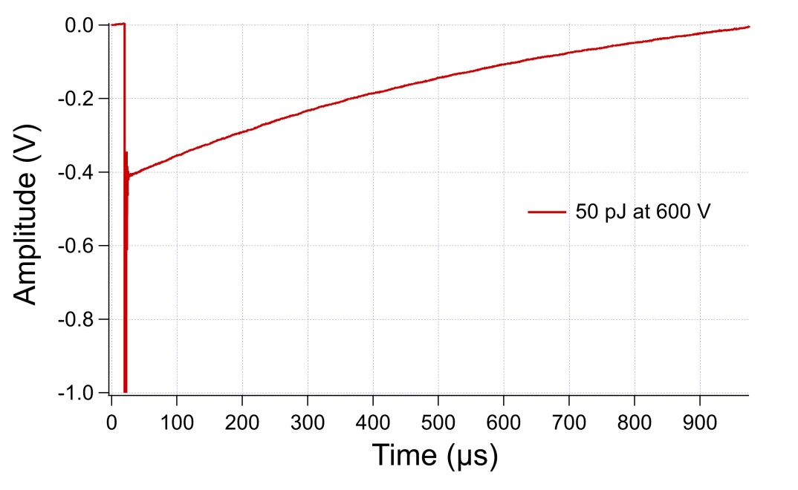
W1 LGAD (1.5e15 50 um):continuation
Signal is stable up to 600 V
Above 600 V signal becomes unstable (amplitude vary , the waveform is deformed and extended to microsecond scale)
At 615 V the sensor breaks down irreversibly
Probably some damage spots appear in the illuminated area after breakdown but further visual inspection with electron microscope is needed (we plan to do it in 1-2 weeks)
(some spots are visible but not clear in the simple imaging system of the setup)
Example waveforms in unstable region (at 600 V)

Slide 17
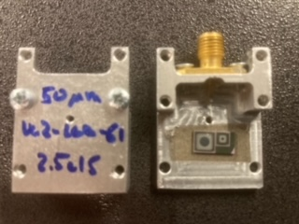
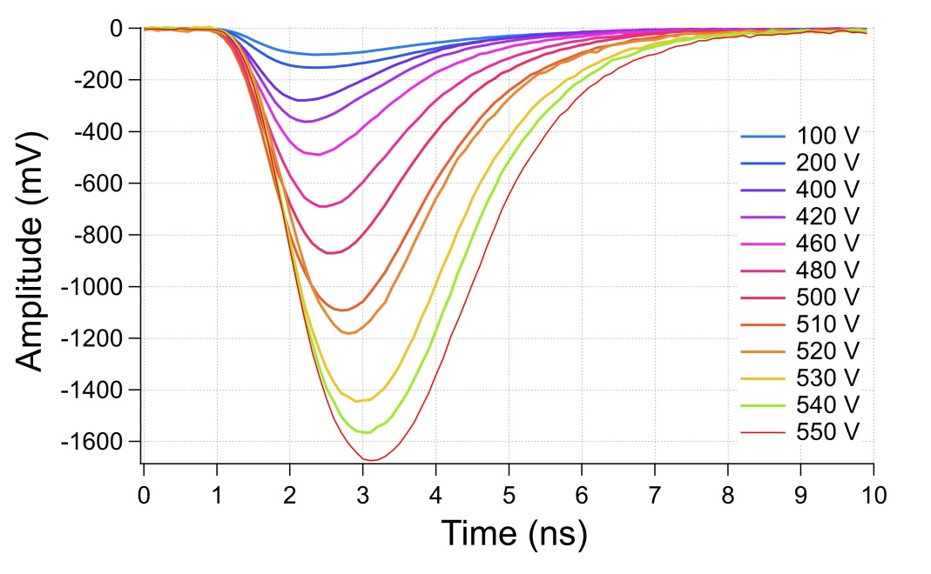
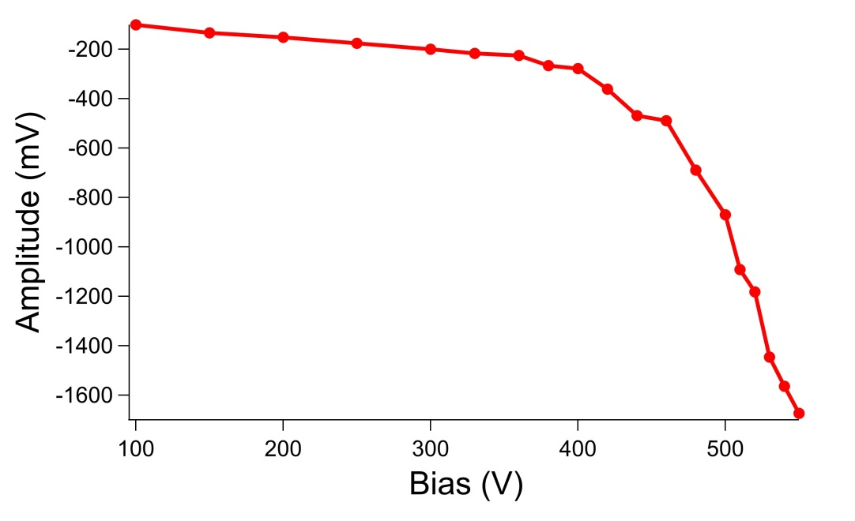
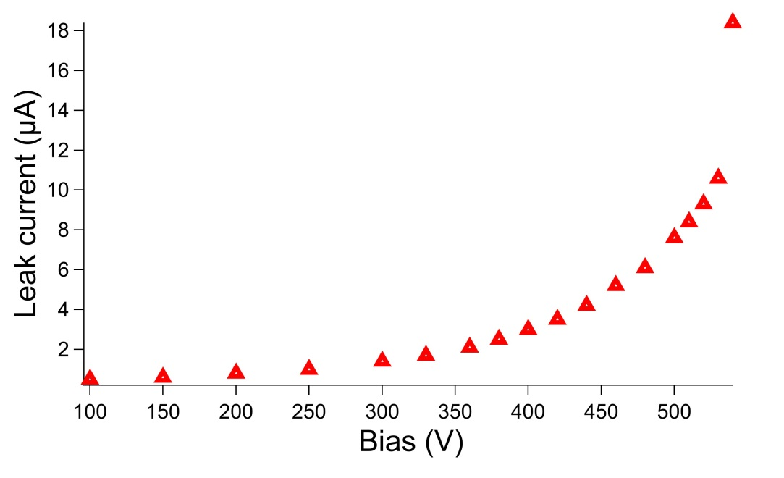
W2 LGAD (2.5e15 50 um)
LGB, 3.5x3.5 mm²
Signal is stable up to 540 V
Above 540 V signal becomes slightly unstable (amplitude varies) and the leak current start jumping.
At 545 V the leak current rapidly jumps above 0.5 mA what is a safety limit of our HV power supply. In such case further increase of bias is not possible in our setup.
No damage at 545 V (after decreasing the bias the sensor works normally)

Slide 18
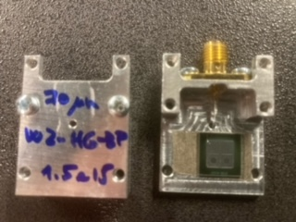
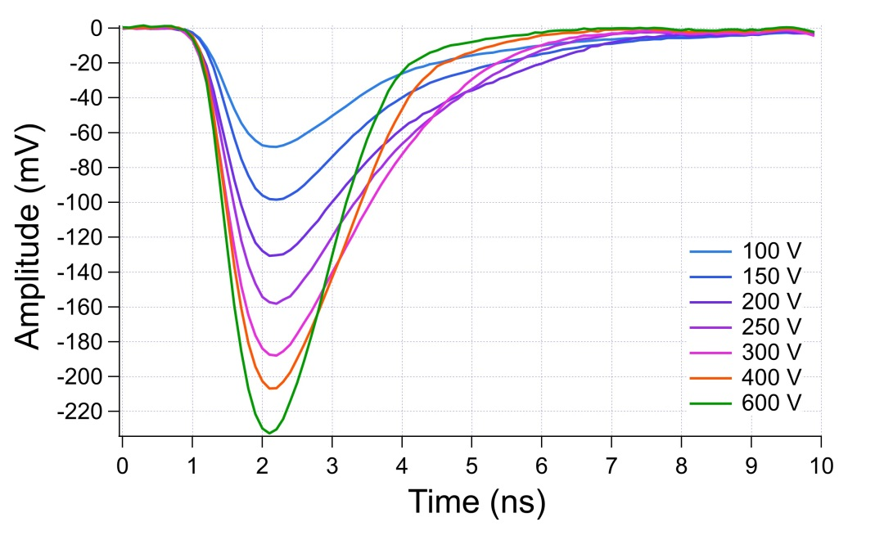
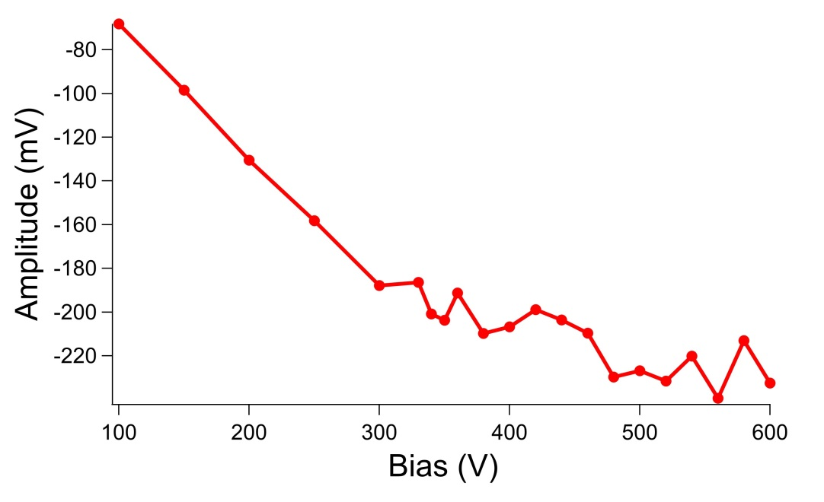
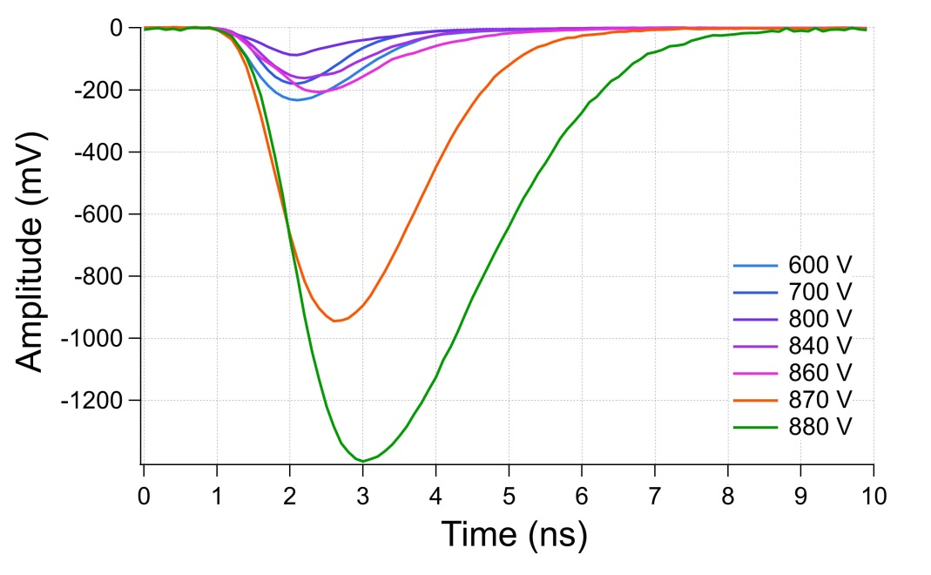
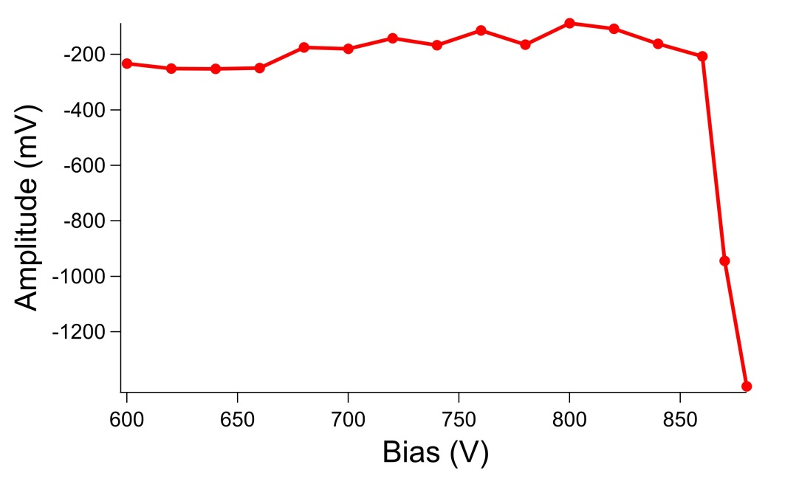
PIN - W2 LGAD (1.5e15 70 um)
Signal of this sensor shows 3-step behavior. First signal grows relatively homogenously with bias. (< 600 V) then is relatively independent on bias (600-850 V) and finally increase drastically when bias is close to the breakdown level (> 850 V). Similar behavior (see next slides) is observed for all 70-75 um sensors.
Full depletion nicely seen with the kink of the signal
Depletion well seen
Drif velosity saturation
Gain at higher bias

Slide 19
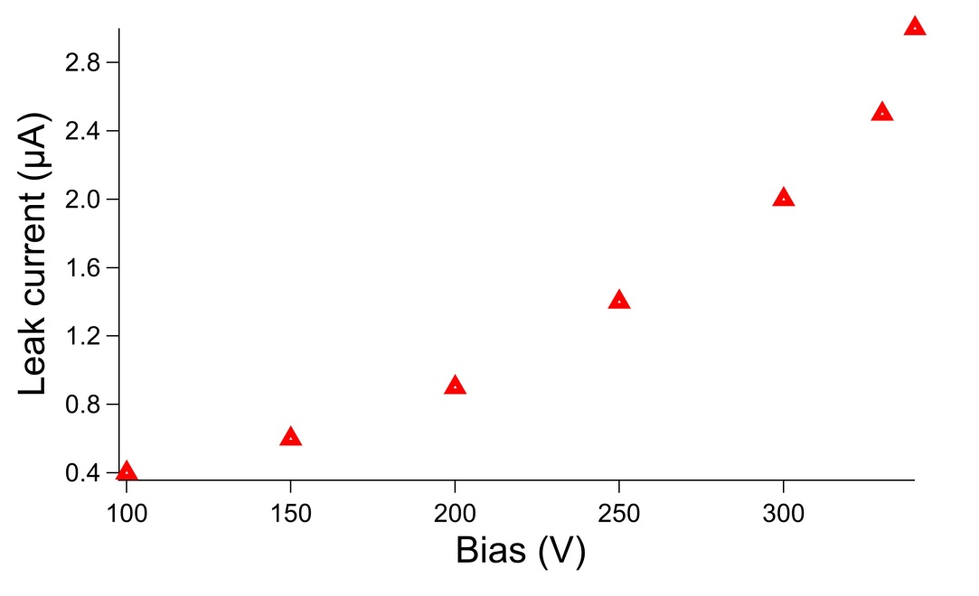
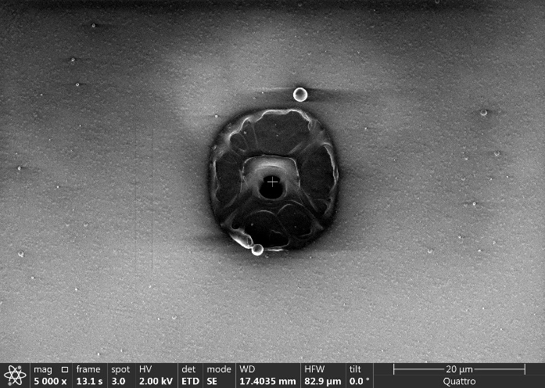
W2 LGAD (1.5e15 70 um)
LGM, 3.3x3.3 mm²
In this particular sensor the leak current becomes very unstable at relatively low bias 340 V. We observe rapid amplitude jumping between 3 and 90 uA.
However the current instability is not reflected in the signal and it looks quite stable up to 800 V
Signal becomes unstable above 800 V (amplitude and broadening vary)
Irreversible break down occurred at 885 V
No visible damage in illuminated area
Fatality signature at the same place where illumination was performed (seen in our study as characteristic feature for CNM sesnosr; not HPK)

Slide 20
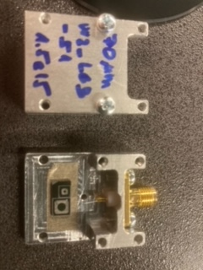
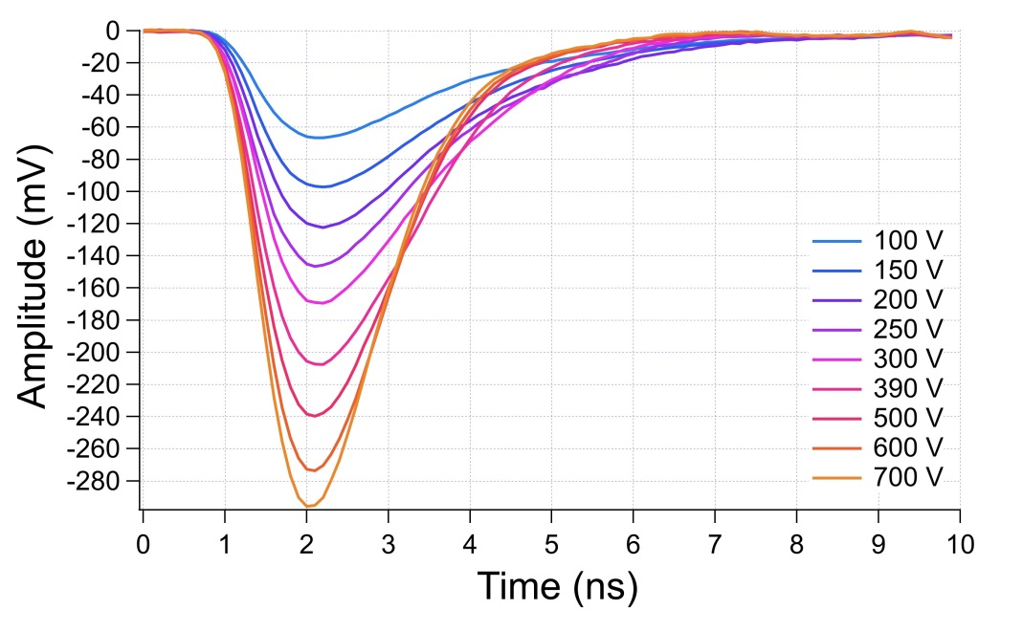
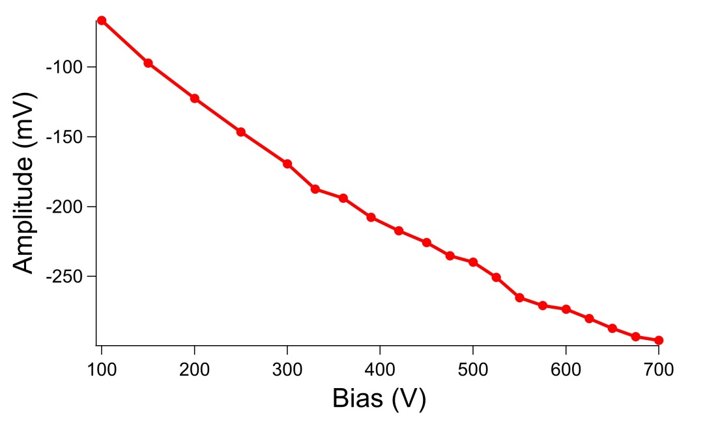
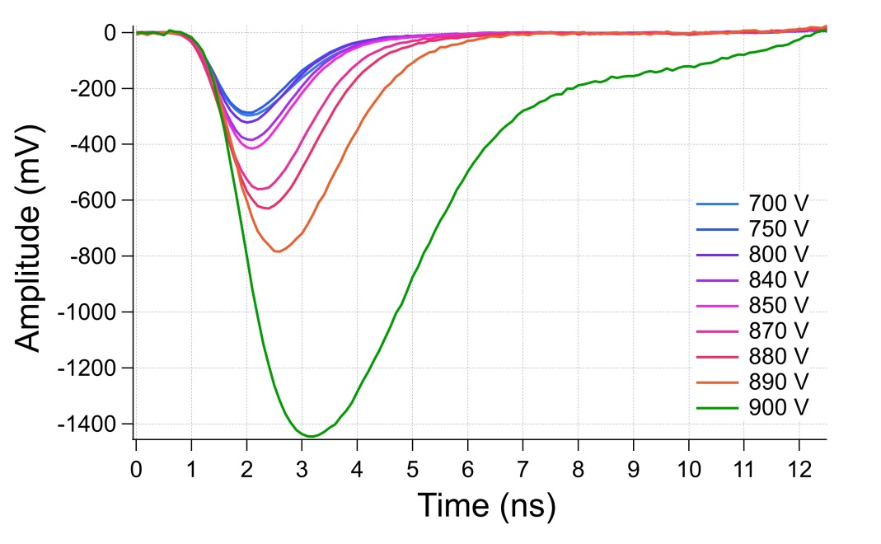
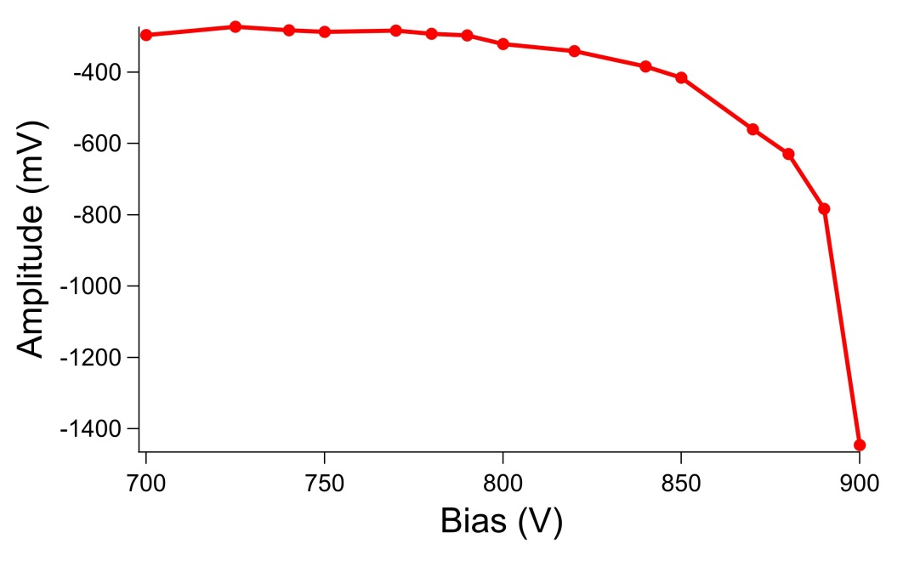
W3 LGAD (1.5e15 70 um)
Similarly to other 70/75 um sensors we observe 3-steps in the signal vs bias

Slide 21
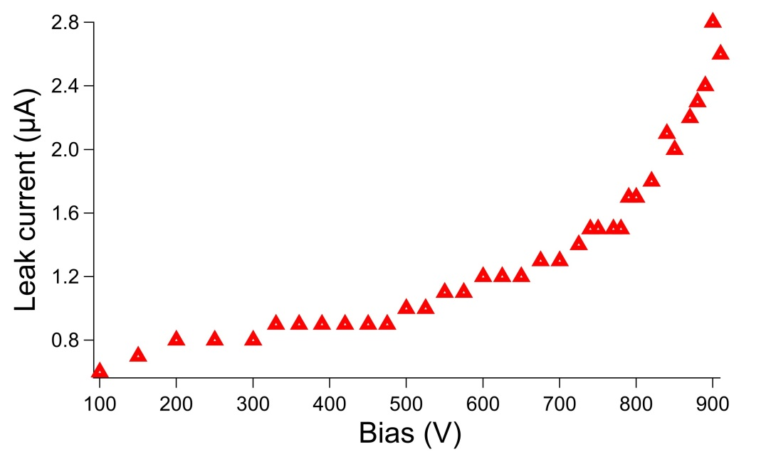



W3 LGAD (1.5e15 70 um)
Signal is stable up to 720 V
Between 720 and 840 V signal is slightly unstable (small jumping of amplitude)
Signal is unstable above 840 V (amplitude and broadening vary)
Irreversible break down occurred at 910 V
Clear damage spot in the place of illumination
Example waveforms in unstable region (at 900 V)

Slide 22





LGB, W3 LGAD (2.5e15 75 um)
Similarly to other 70/75 um sensors we observe 3-steps in the signal vs bias

Slide 23




W3 LGAD (2.5e15 75 um)
Signal is stable up to 820 V
Between 820 and 860 V signal is slightly unstable (small jumping of amplitude)
Signal is unstable above 860 V (amplitude and broadening vary)
Leak current becomes unstable at 890 V
At 915 V signal is too high to be measured
It was possible to apply higher bias to reach the breakdown and know exact damage threshold but we decided to save this sensor for other studies. However, the waveforms recorded at 915 V shows that this value is very close to the breakdown limit.
Example waveforms in unstable region (at 915 V)
Breakdown at > 915 V; fatality signature where sensor was illuminated

Slide 24






PIN (2.5e15 75 um)
Similarly, to other 70/75 um sensors we observe 3-steps in the signal vs bias
Breakdown at > 910 V; fatality signature where sensor was illuminated

Slide 25

TPA back/front
All TPA studies were performed with 1550 nm wavelength and at temperature -25 °C.
Signal was measured at Zmax position
(Z-scan was always performed first)

Slide 26



FBK UFSD3.2 W18 LGAD (1.5e15 45 um 2x2 array)
(Frontside TPA)
To generate the signal comparable to 50 pJ SPA the pulse energy 17 nJ was used for TPA
The signal and its evolution vs HV are very similar to SPA results.
Similarly, to SPA the leak current jumps rapidly above 0.5 mA at 550V but not irreversible damage happens
sensor works normally after decreasing bias below 550 V
We didn’t succeed to get any reasonable signal by backside illumination (metal mesh has to be removed)
17 nJ

Slide 27





HPK-P1 W4 LGAD (1.5e15 35 um 2x2 array)
(frontside TPA)
To generate the signal comparable to 50 pJ SPA the pulse energy 12 nJ was used for TPA
Signal is stable up to 460 V
Above 460V signal starts jumping and extends to microsecond region
at 480 V is too high to be measured
We didn’t push the bias further to save the sample for backside illumination test (see next slide)
12 nJ
for bias at 470 V

Slide 28


HPK-P1 W4 LGAD (1.5e15 35 um 2x2 array)
(backside TPA illumination)
To generate the signal comparable to front-TPA the pulse energy 30 nJ was used for backside illumination
The signal and its evolution vs HV are very similar to front-TPA
Signal is stable up to 470 V
Above 470V signal starts jumping and extends to microsecond region
above 480 V is too high to be measured
30 nJ

Slide 29


HPK-P1 W4 LGAD (1.5e15 35 um 2x2 array)
(backside TPA illumination)
Example waveforms in unstable region (at 480 V)
This sensor is only one where we succeeded to get backside illumination TPA signal.
here only slightly higher power (30 nJ vs 12 nJ) is needed to get comparable signal to front side TPA;
Front and back-TPA gives very similar results in terms of the stability; well in agreement with frontv SPA regarding the fatality bias threshold.

Slide 30






HPK-P1 W4 LGAD (2.25e15 35 um); single pad
(frontside TPA)
To generate the signal comparable to 50 pJ SPA the pulse energy 1.5 nJ was used for TPA (this is much less than for other sensors, no explanation for the moment)
The signal and its evolution vs HV are similar to SPA results.
Signal is stable up to 460 V
Above 460V signal starts jumping and extends to microsecond region
above 480 V is too high to be measured
the bias was pushed further and the sensor broke down irreversibly at 530 V.
1.5 nJ
Example waveforms in unstable region at 480 V
Edge effect (symptomatic behaviour for HPK)

Slide 31
Conclusion
Sensor from different vendors have been studied (HPK, UFSD, CNM)
SPA, TPA (Front, backside) was utilized
Thickness – 35, 45, 50, 70 and 75 microns have been explored
Results are in according with expectations
CNM fatality studies at the place of illumination
HPK at the metal/Si edge
Thinner HPK -35 microns survived longer then we expected

Slide 32

Devices Run9254
Some of the LGA and LGB samples are not diced (they are stick together as the photo below shows). However they are short-circuited with regard to each other. One can be wirebond and measured while the other don’t.
The priority set by CNM was to test the mortality of the LGA samples (1.3x1.3mm, the small ones)
LGA (LGAD)
LGB (LGAD)
There are 6 housings and 10 devices. The priority is to test first the mortality of the 6 devices enlisted in the following slide (samples1, 2, 4, 6, 7 and 9)

Slide 33
IV @ -20ºC → Neutron irradiated samples to test → PRIORITY
Annealing 80min @ 60ºC

Slide 34





HPK-P1 W4 LGAD (2.25e15 35 um single pad)
(comparison of opening window with guard ring)
Opening window
this sensor has nominal max. bias ~400 V
the measurements in this range were performed for opening window and for the guard ring
the results are nearly identical
50 pJ
Guard ring
50 pJ

Slide 35





FBK UFSD3.2 W18 LGAD (1.5e15 45 um 2x2 array)
(comparison of opening window with guard ring)
Opening window
The opening window in FBK sensors are much smaller than in others but still big enough (~10x10 um) to safely focus the beam inside.
The response of the sensor was checked when illuminated in the guard ring region.
At exactly the same conditions the signal looks almost identical for window and ring. Leak current was also identical in both cases.
50 pJ
Guard ring
50 pJ

Slide 36




HPK-P1 W4 LGAD (2.5e15 35 um single pad)
(backside illumination)
to get a reasonable signal by illumination from the backside much higher pulse energy is necessary (10s of nJ regime)
although nominal max. bias for this sensor is ~400 V it turned out that it can survive significantly higher voltage (at least 560 V)
leak current jumps rapidly above 0.5 mA at 560V but not irreversible damage happens *not enough deposited charge
10 nJ
Edge fatality signature
Damaged by TPA at 530 V, see later

