Slide 1
LGAD Discussion session
WP 3.2. Sensors with intrinsic gain
  M1: Understand the effect of Carbon and Gallium on gain after irradiation (Q1/2019)
  M2: Model the acceptor removal effect after irradiation (Q3/2019)
  M3: Produce new LGAD design to increase the fill factor (Q2/2020)
  M4: Design and simulate new LGAD geometries for operation at 1×10¹⁷n_{eq}/cm² (Q4/2022)

Slide 2
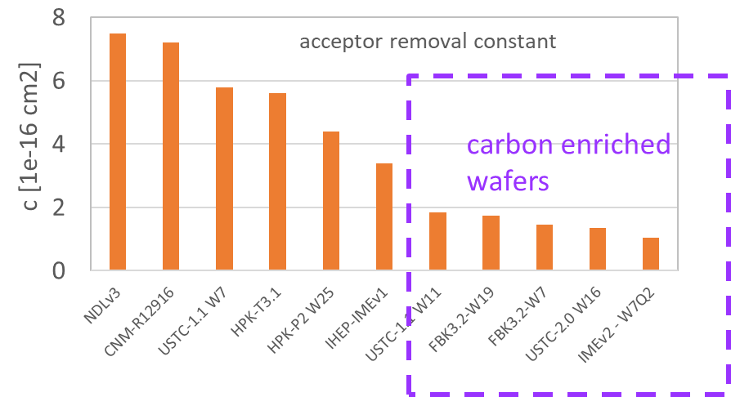
LGADs – points for discussion
SEB observed in particle beams
  It driven by the average electric field in the device – safe <11 V/mm, danger >12 V/mm
  Limits the operation voltage range and ability for compensation of radiation damage
  Can we increase it by the device design?
    Quenching resistors?
Improvement of radiation hardness
  C enrichment mastered to the level that sensors can survive 2.5e15 cm-2 (HL-LHC) timing was mastered by FBK/IME (IHEP,USTC). Very good results and promising performance in the TB recently.
  Can we invent some other impurity that would reduce the removal constant even further?
  Replace the B with something else?
  Understanding the acceptor removal on microscopic level:
    BiOi
    g_{Bi}-g_{BiOi}= ?
Improvement of inter-pad distance
  TI-LGADSs
  iLGADs ?
Detection of non-mip particles?

Slide 3
LGADs – points for discussion
AC-LGAD :
  Lots of activities – investigation for 4D in less busy environments
  Test beam with BNL AC-LGAD
  ALTIROC readout
  Deep junction-LGADs
Extreme fluences

