Slide 1








Status Report on FCC Accelerator Science and Technology
Frank Zimmermann, CERN
Pakistan, Engagement Meeting,
14 September 2021
LHC
PS
SPS
FCC
http://cern.ch/fcc
Work supported by the European Commission under the HORIZON 2020 projects EuroCirCol, grant agreement 654305; EASITrain, grant agreement no. 764879; ARIES, grant agreement 730871, FCCIS, grant agreement 951754, and I.FAST, grant agreement 101004730.
photo: J. Wenninger

Slide 2

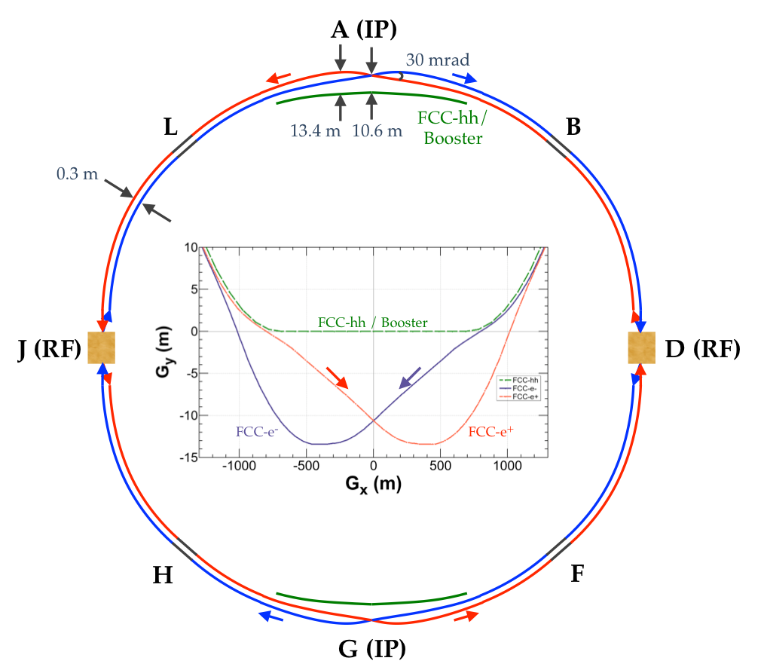
FCC-ee basic design choices
Double ring e+ e- collider
Common footprint with FCC-hh, except around IPs
Asymmetric IR layout and optics to limit synchrotron radiation towards the detector
2 IPs, large horizontal crossing angle 30 mrad, crab-waist collision optics (alternative layouts with 4 IPs under study now)
Synchrotron radiation power 50 MW/beam at all beam energies
Top-up injection scheme for high luminosity Requires booster synchrotron in collider tunnel

Slide 3
FCC-ee collider parameters (stage 1)
parameter | Z | WW | H (ZH) | ttbar
beam energy [GeV] | 45 | 80 | 120 | 182.5
beam current [mA] | 1390 | 147 | 29 | 5.4
no. bunches/beam | 16640 | 2000 | 393 | 48
bunch intensity [10¹¹] | 1.7 | 1.5 | 1.5 | 2.3
SR energy loss / turn [GeV] | 0.036 | 0.34 | 1.72 | 9.21
total RF voltage [GV] | 0.1 | 0.44 | 2.0 | 10.9
long. damping time [turns] | 1281 | 235 | 70 | 20
horizontal beta* [m] | 0.15 | 0.2 | 0.3 | 1
vertical beta* [mm] | 0.8 | 1 | 1 | 1.6
horiz. geometric emittance [nm] | 0.27 | 0.28 | 0.63 | 1.46
vert. geom. emittance [pm] | 1.0 | 1.7 | 1.3 | 2.9
bunch length with SR / BS [mm] | 3.5 / 12.1 | 3.0 / 6.0 | 3.3 / 5.3 | 2.0 / 2.5
luminosity per IP [10³⁴ cm⁻²s⁻¹] | 230 | 28 | 8.5 | 1.55
beam lifetime rad Bhabha / BS [min] | 68 / >200 | 49 / >1000 | 38 / 18 | 40 / 18

Slide 4
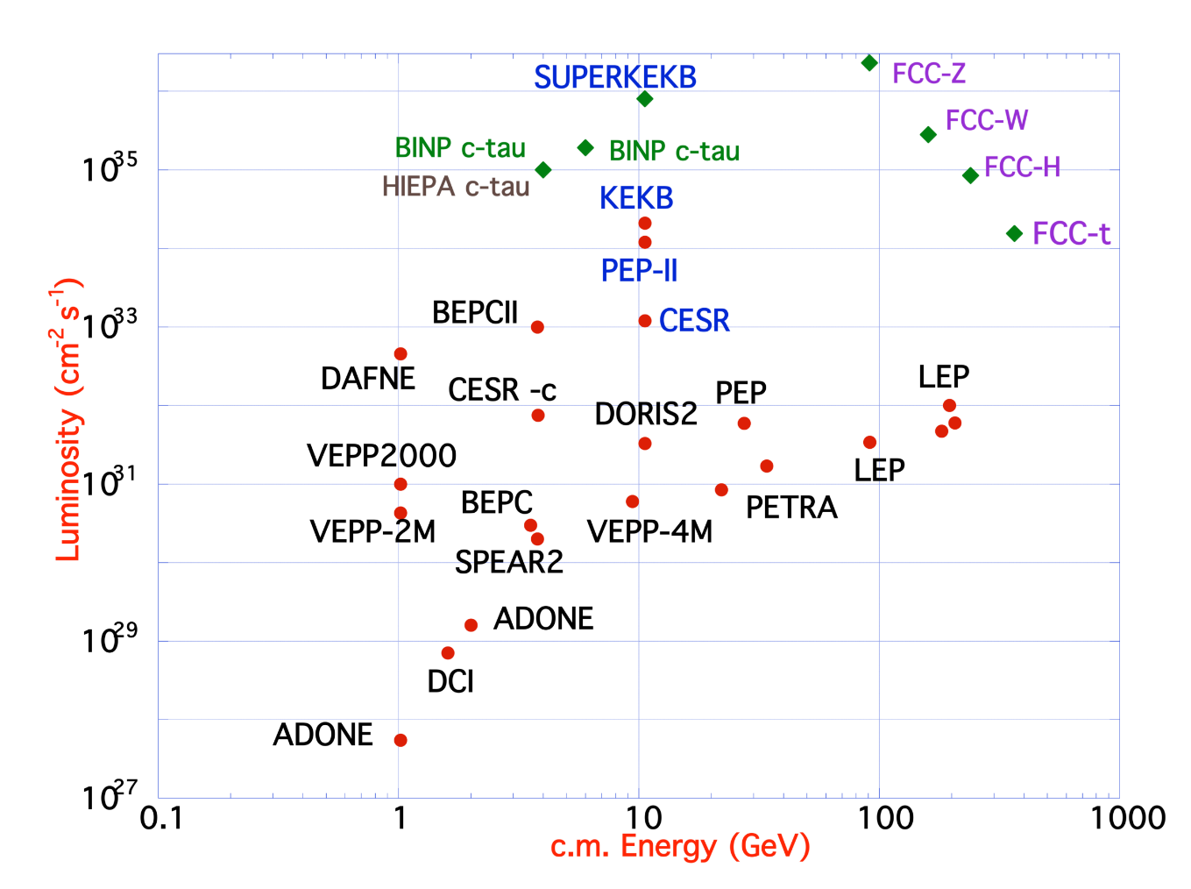
FCC-ee design concept
based on lessons and techniques from past colliders (last 40 years)
B-factories: KEKB & PEP-II:
double-ring lepton colliders,
high beam currents,
top-up injection
DAFNE: crab waist, double ring
S-KEKB: low β_{y}*, crab waist
LEP: high energy, SR effects
VEPP-4M, LEP: precision E calibration
KEKB: e⁺ source
HERA, LEP, RHIC: spin gymnastics
Marica Biagini
Marica Biagini
combining successful ingredients of several recent colliders → highest luminosities & energies

Slide 5
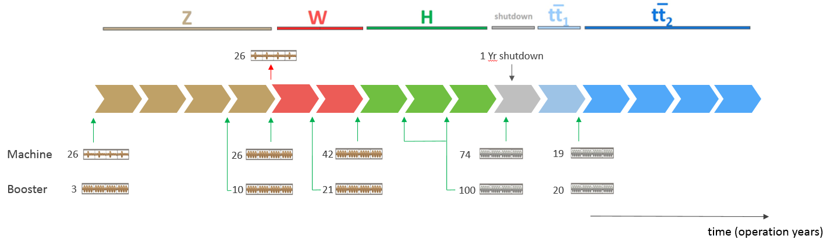
FCC-ee RF staging scenario
“Ampere-class” machine
three sets of RF cavities to cover all options for FCC-ee & booster:
high intensity (Z, FCC-hh): 400 MHz mono-cell cavities (4/cryom.)
higher energy (W, H, t): 400 MHz four-cell cavities (4/cryomodule)
ttbar machine complement: 800 MHz five-cell cavities (4/cryom.)
installation sequence comparable to LEP ( ≈ 30 CM/shutdown)
WP | V_{rf} [GV] | #bunches | I_{beam} [mA]
Z | 0.1 | 16640 | 1390
W | 0.44 | 2000 | 147
H | 2.0 | 393 | 29
ttbar | 10.9 | 48 | 5.4
“high-gradient” machine
Notes:
“Continuous flow” operation: succession of 8 months operation, 4 months installation shutdown (LEP-like)
Three sets of cavities to cover all options (+ booster):
high intensity (Z, FCC_hh): 400 MHz mono-cell cavities, ≈1MW RF source
high energy (H, t): 400 MHz four-cell cavities -> will be used for the W machine
booster and t machine complement: 800 MHz four-cell cavities (400 MHz would do the job as well)
High energy set for the W-machine not optimal (20-30% reduction of beam current) – building & installing 48 specialized CM would impact more (>>1 year delay)
Optimize the re-use of the 100MW, 400MHz RF power & controls hardware installed for the ‘Z-machine’
design an easily adaptable and modular RF power distribution system

Slide 6
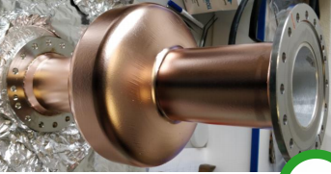
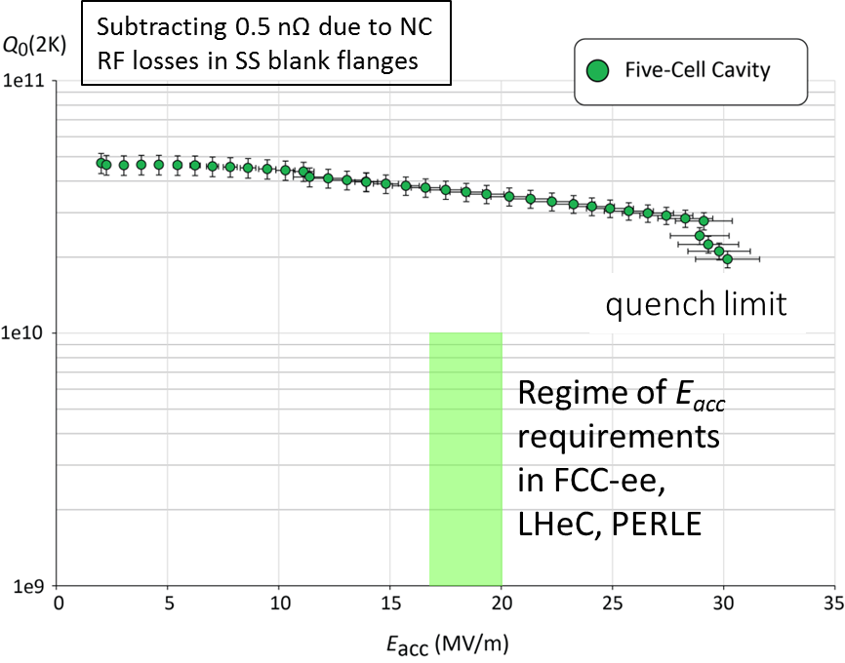
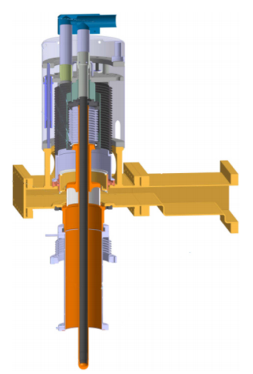
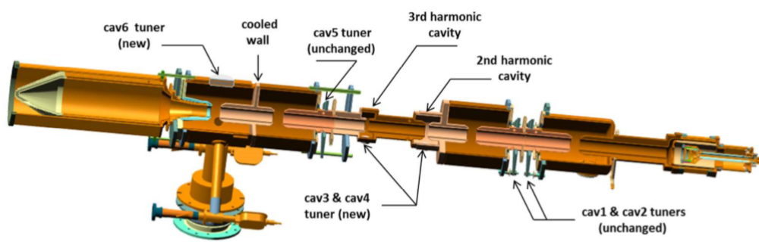
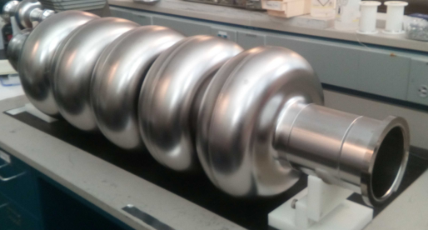
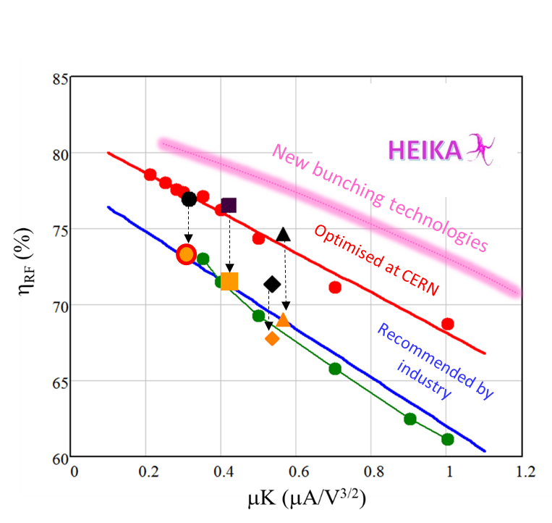
FCC SRF R&D Program Structure in a Nutshell
Cavity Studies
Optimized Cavity Shape, Technology and Operating Temperature (complexity, power consumption, Q_{o}, E_{acc})
Design 1- & 4-cell Cavities
Beam-Cavity Interaction
Cavity Control System (LLRF)
SRF & Substrate Technologies
Improved Cavity Engineering: New SC Materials, Novel Fabrication Methods, Substrate Surface Preparation, Coating Techniques
Fabrication & Testing of 1-l & 4-cell cavities for new cryomodule
Collaboration with international Partners
Cryomodule Development
Engineering design of 400 MHz cryomodule including ancillaries
Building a 2 cavity CM which can host 1-/4-cell 400 MHz cavities
R&D Collaboration with int’l Partners (e.g. JLAB)
800 MHz CM: Profit from Ongoing Development @ PERLE in Paris
FPC & HOM RF Couplers
Improved design, fabrication and testing of 400 MHz Fundamental Power Coupler (FPC)
FPC R&D towards 1MW CW fixed/movable FPC
‘Adjustable’ FPC (external large adaptation of Q_{ext})
HOM coupler production
RF Power Sources
novel klystron bunching methods
LHC klystron retrofit as proof of principle
prototype design, fabrication and testing

Slide 7
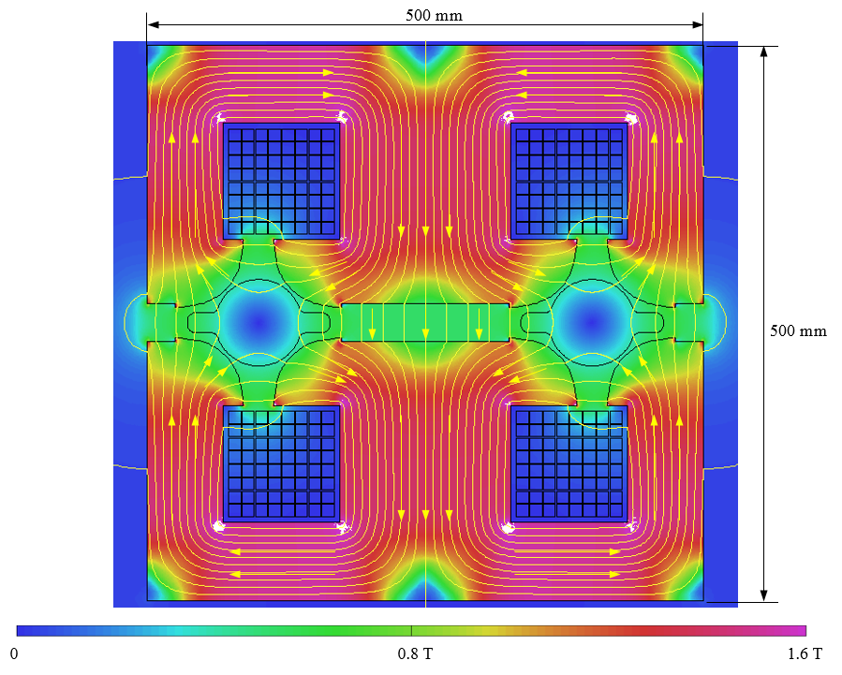
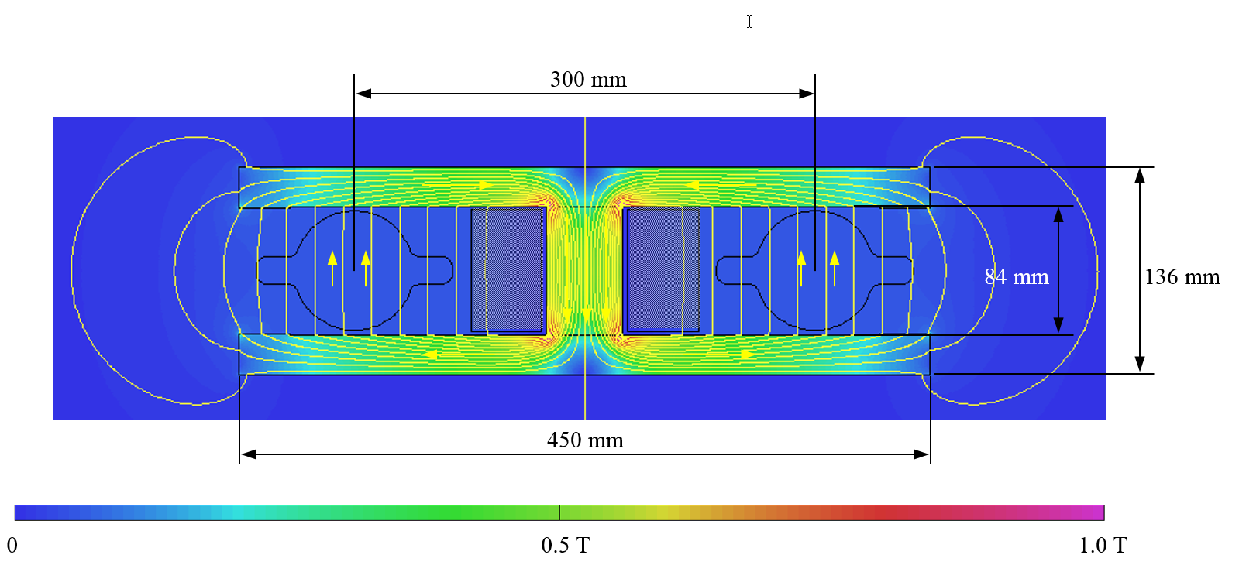
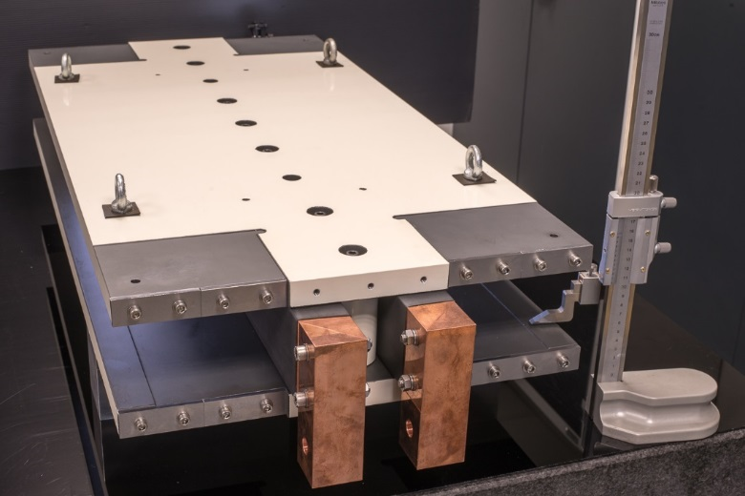
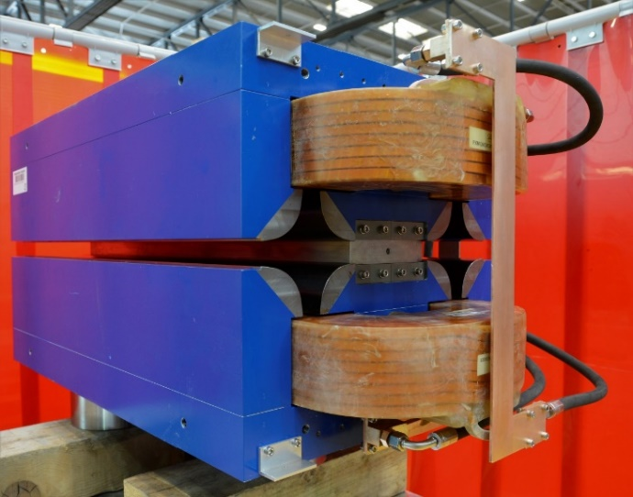
Prototypes of FCC-ee low-power magnets
Twin-dipole design with 2× power saving
16 MW (at 175 GeV), with Al busbars
Twin F/D arc quad design with 2× power saving
25 MW (at 175 GeV), with Cu conductor
prototype
prototype

Slide 8

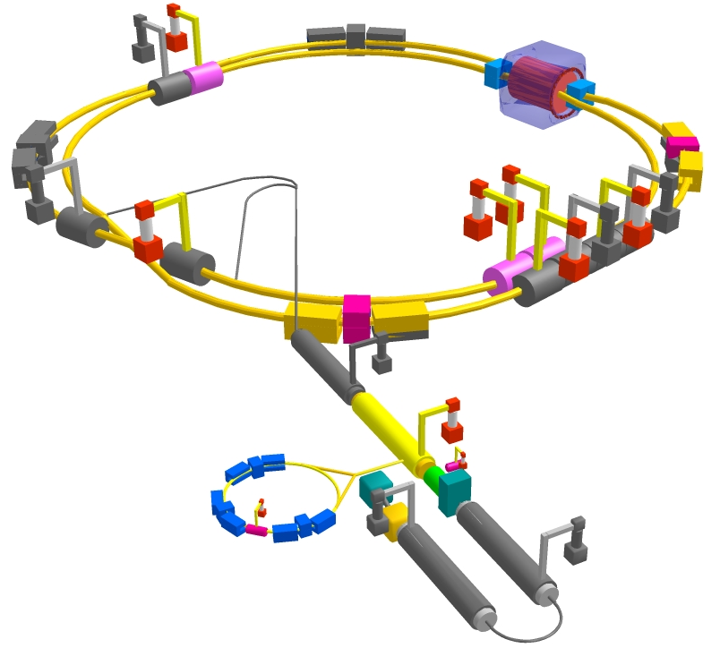
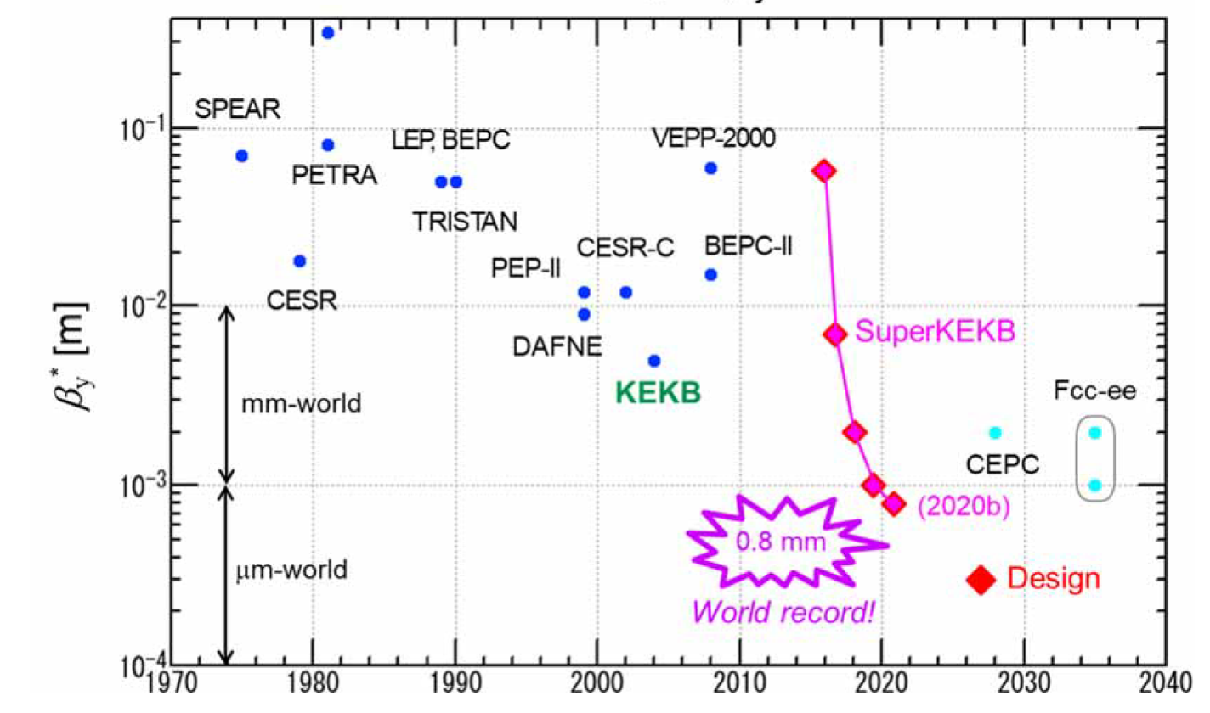
SuperKEKB – pushing luminosity and β*
Design: double ring e⁺e⁻ collider as B-factory at 7(e⁻) & 4(e⁺) GeV; design luminosity $\sim$8 x 10³⁵ cm⁻²s⁻¹; β_{y}* $\sim$0.3 mm;
nano-beam – large crossing angle collision scheme (crab waist w/o sextupoles); beam lifetime$\sim$5 minutes; top-up injection;
e⁺ rate up to $\sim$ 2.5 10¹² /s ; under commissioning
M. Tobiyama, K. Oide
SuperKEKB is demonstrating FCC-ee key concepts
β_{y}* = 0.8 mm achieved in both rings – using the
FCC-ee-style “virtual” crab-waist collision scheme
Y. Funakoshi, Y. Ohnishi, K. Oide
new world record L = 3.12 x 10³⁴ cm⁻²s⁻¹ on 22 June ‘21

Slide 9
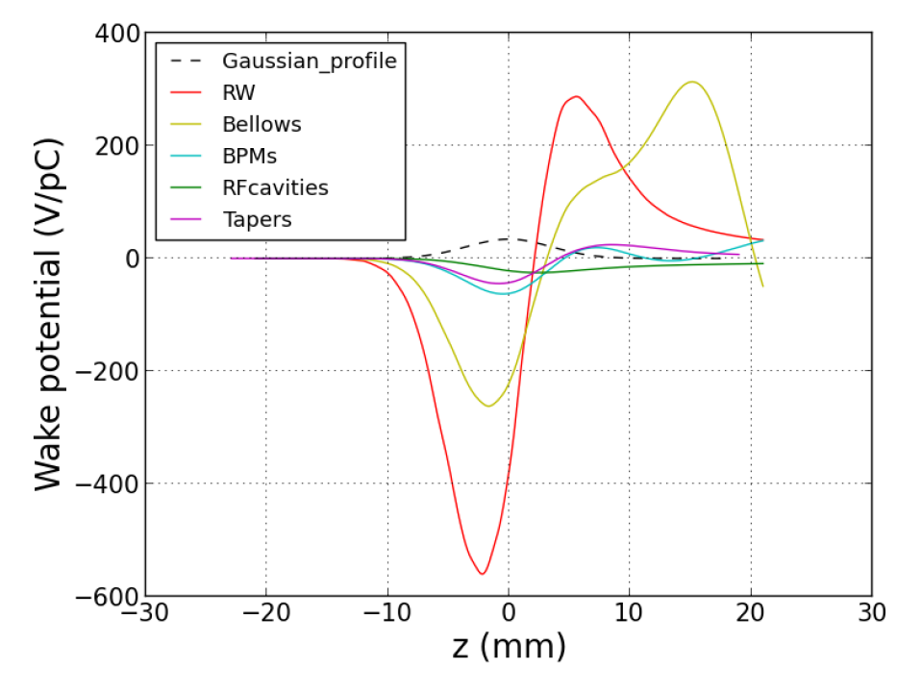
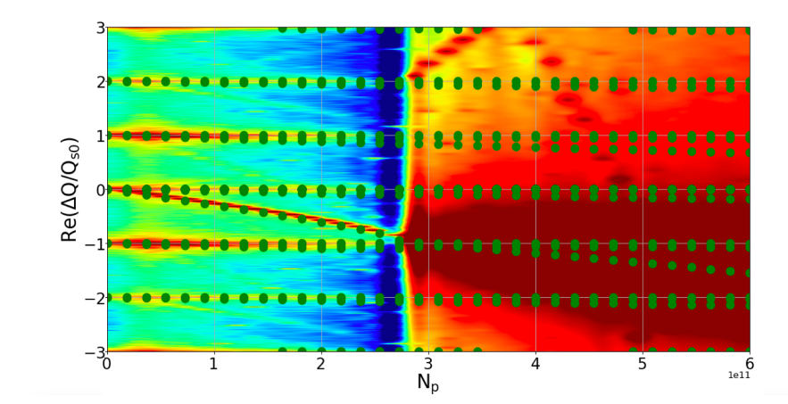
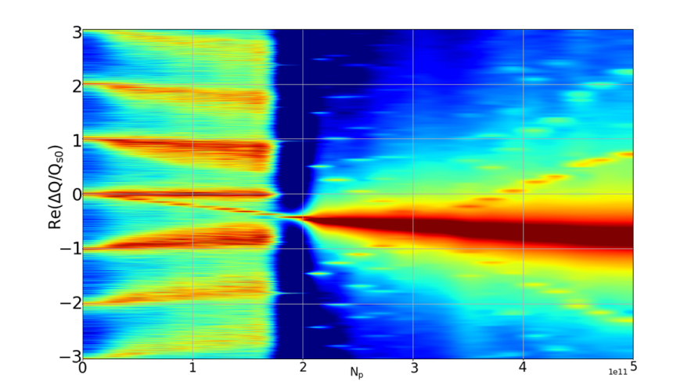
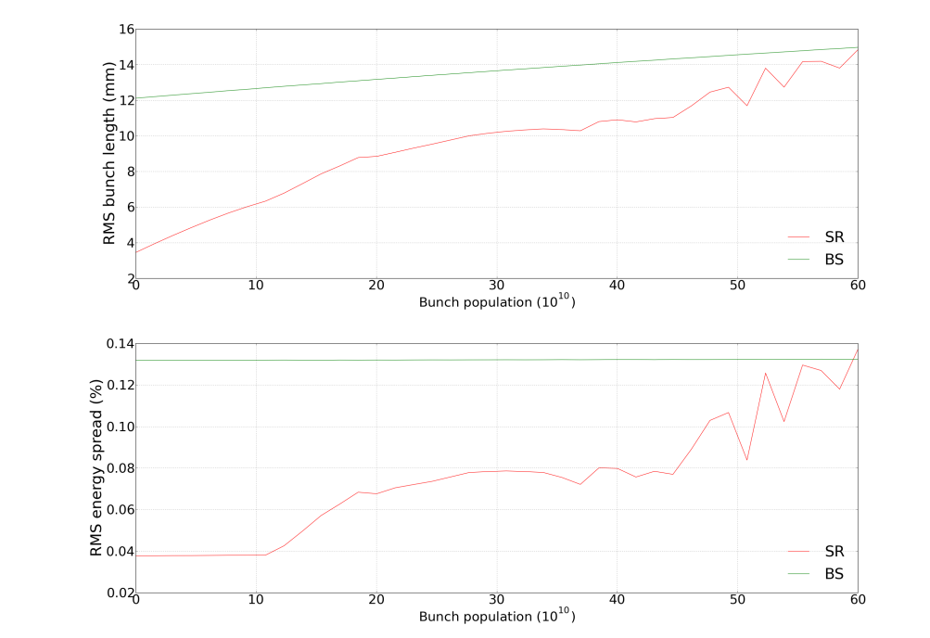
collective effects & impedance database
longitudinal wake potentials
Coordinated by M. Migliorati, Sapienza & INFN Roma
TMCI threshold
Emanuela Carideo, Mauro Migliorati
Re (Q_{x}) vs N_{b},
comparing
PyHEADTAIL & DELPHI
for transverse
resistive wall wakefield
TMCI threshold greatly reduced
when including longitudinal wake !
Bunch lengthenting & microwave inst.
Re (Q_{x}) vs N_{b},
from PyHEADTAIL
for combined effect of
transverse & longitudinal
resistive wall wakefield
σ_{z} (top) & σ_{δ} (bottom)
vs N_{b}
with and
without beam-strahlung
benchmarking FCC-ee calculations at SuperKEKB

Slide 10
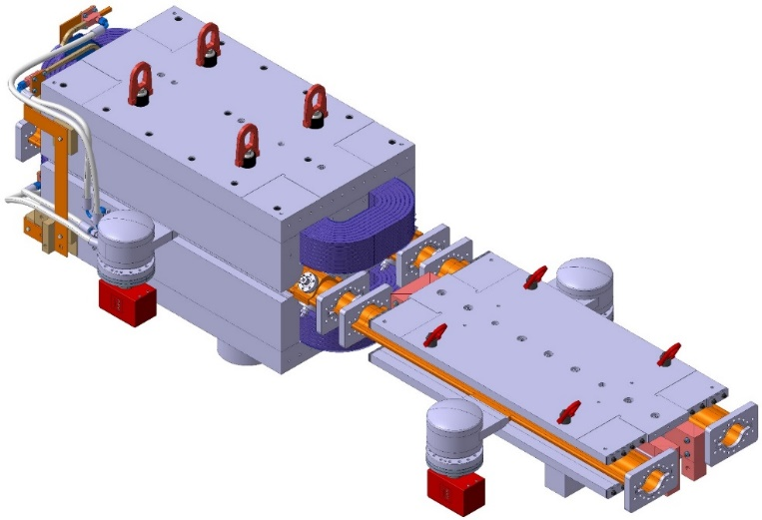
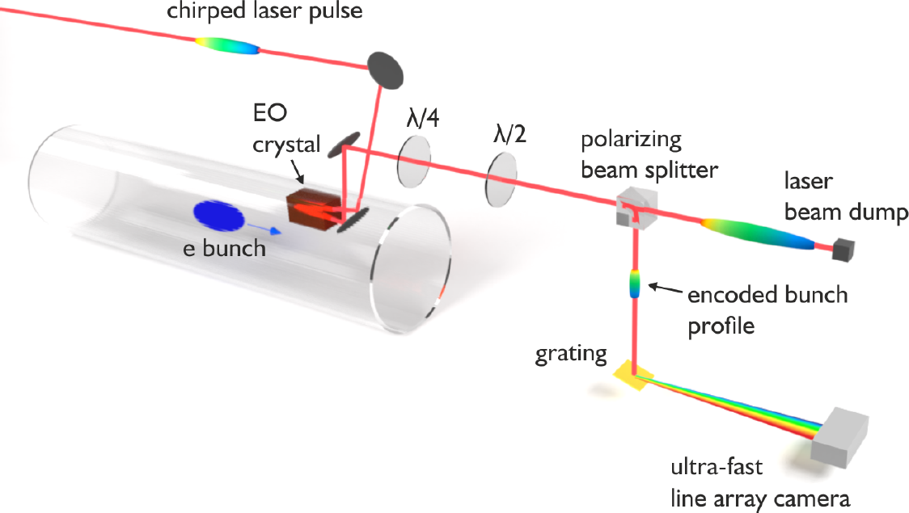
FCC key deliverables: prototypes by 2025
FCC-ee complete arc half-cell mock up
including girder, vacuum system with antechamber + pumps, dipole, quadrupole + sext. magnets, BPMs, cooling + alignment systems, technical infrastructure interfaces.
key beam diagnostics elements
bunch-by-bunch turn-by-turn longitudinal charge density profiles based on electro-optical spectral decoding (beam tests at KIT/KARA) ; ultra-low emittance measurement (X-ray interferometer tests at SuperKEKB, ALBA) ; beam-loss monitors (IJCLab/KEK?) ;
beamstrahlung monitor (KEK); polarimeter ; luminometer
A.-S. Müller
bunch electric field at the crystal
changes the laser pulse polarization

Slide 11
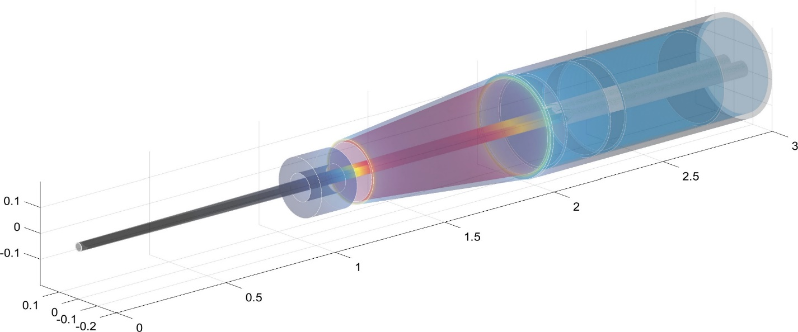
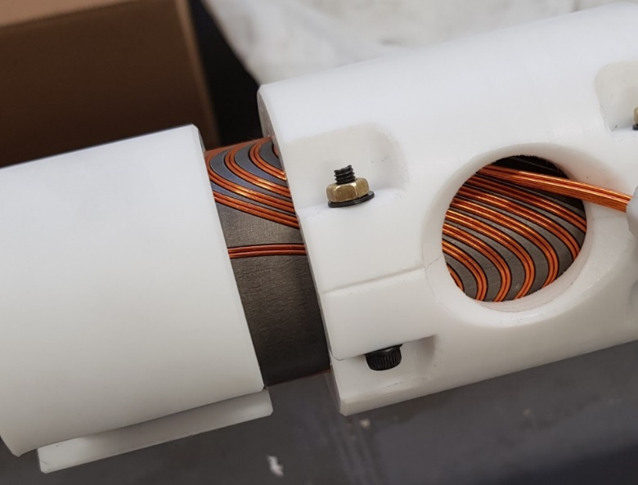
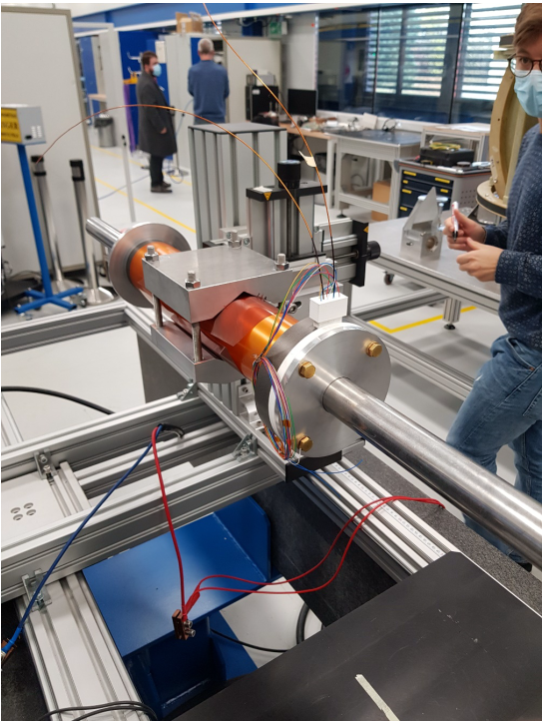
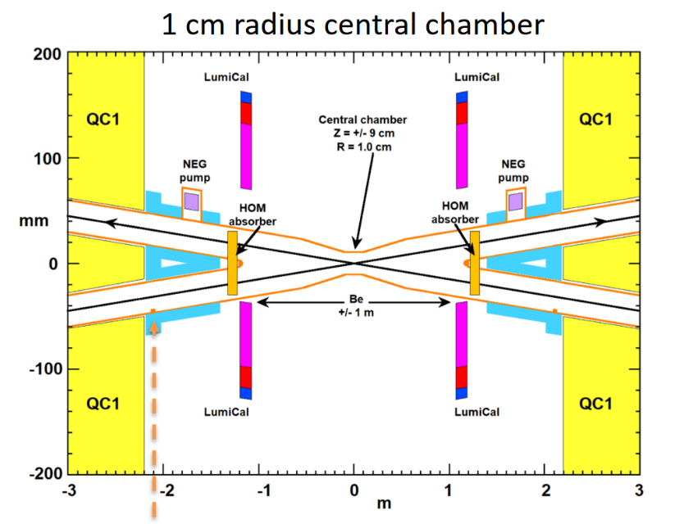
FCC-ee Machine Detector Interface
screening
solenoid
challenging integration:
2 T detector solenoid,
luminosity monitor
(Bhabha scattering),
compensation &
shielding solenoids
M. Dam,
A. Bogomyagkov,
E. Levichev,
M. Koratzinos
Compensating solenoid
FF quads
Lumical
100 mrad
IP
M. Boscolo,
A. Novokhatski,
M. Sullivan
prototype Q1
canted cosine theta
with fringe field
correction,
using LHC SC cable
field measurement
at warm
narrow central chamber
with 1 cm radius,
also avoids trapped modes
M. Koratzinos

Slide 12

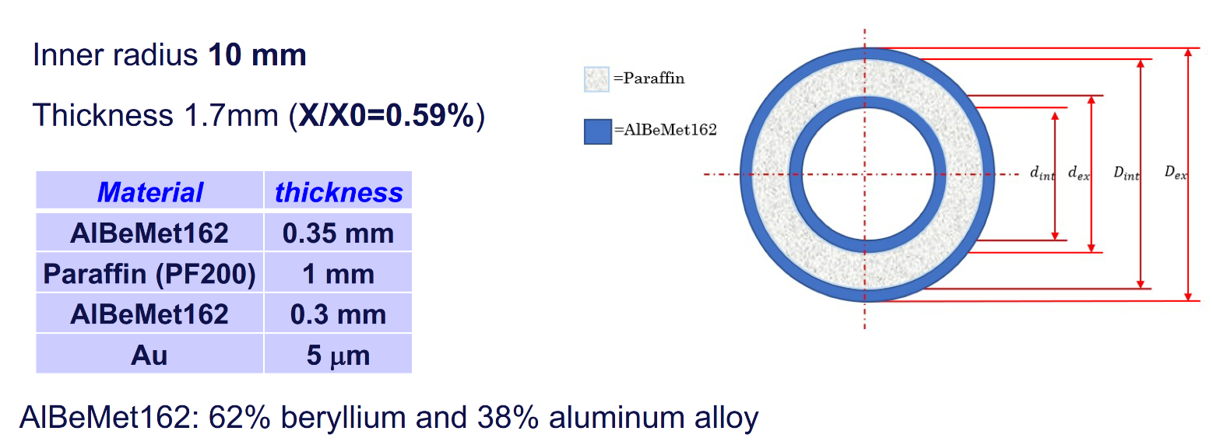
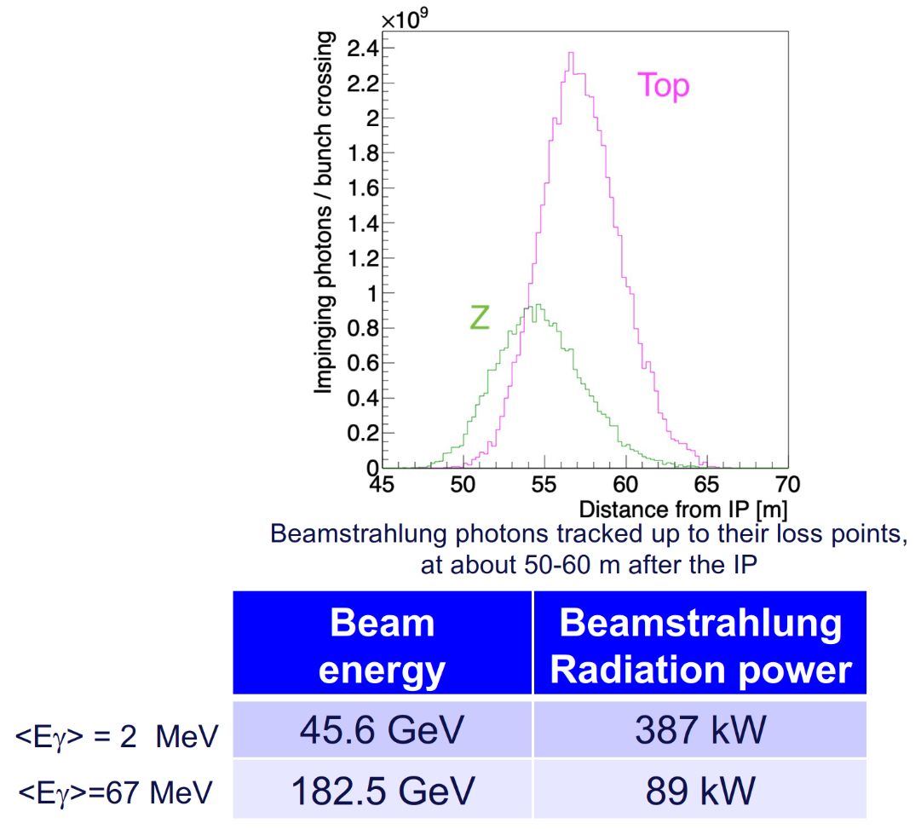
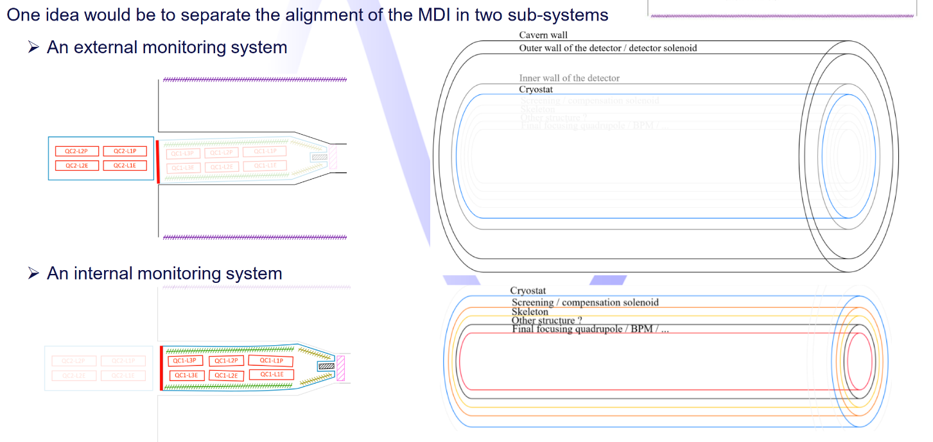
FCC-ee Machine Detector Interface cont’d
3D IR assembly, mechanical structural behaviour, & heat transfer study
central beam pipe
L. Pellegrino, F. Fransesini, M. Boscolo
A. Ciarma
Beamstrahlung:
handling and
monitoring
F. Fransesini, L. Pellegrino
IR survey &
alignment
systems
L. Watrelot

Slide 13
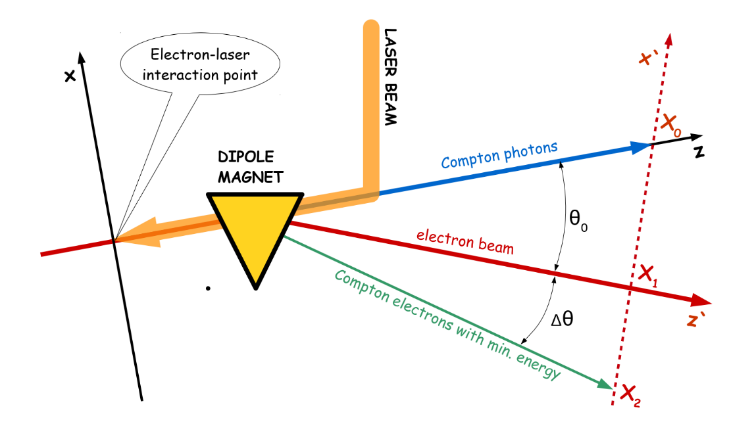
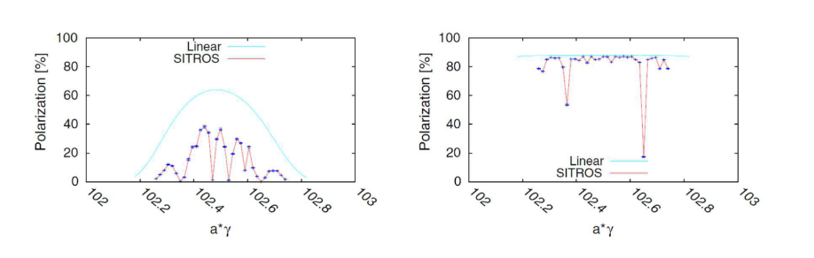
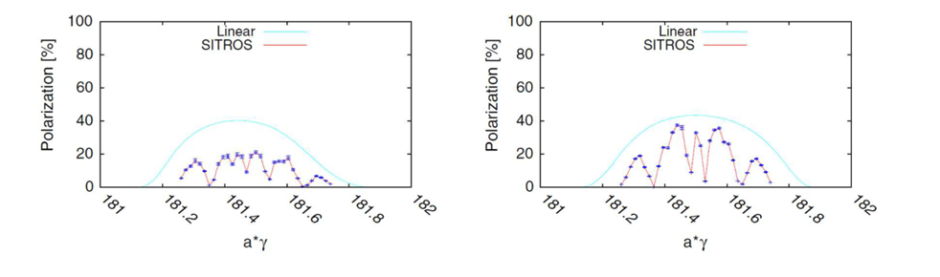
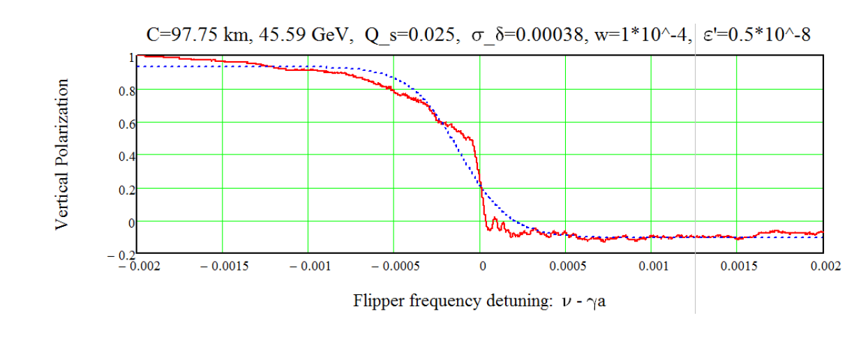
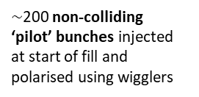
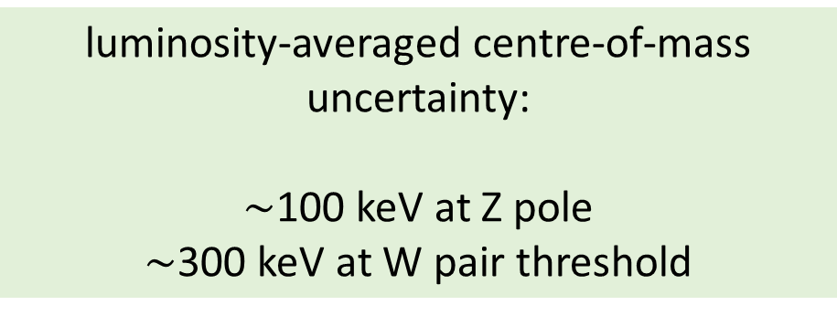
energy calibration by resonant depolarisation
Z pole with polarisation wigglers
E. Gianfelice-Wendt, Investigation of beam self-polarization in the future e⁺e⁻ circular collider, Phys. Rev. Accel. Beams 19, 101005 (2016).
orbit correction
+ harmonic bumps
Z pole: 8 asymmetric wigglers per beam lower the polarisation rise time to 12 hours allowing a level of 10% (5%) beam polarisation, sufficient for the energy calibration by RDP, to be obtained in 90 (45) minutes.
W pair threshold: spontaneous polarisation with a rise-time of around 10 hours without wigglers.
for Z and W: precise energy calibration at 10⁻⁶ level
WW threshold
RF located in one point ! Largest remaining systematic error:
vertical closed-orbit distortions - at the Z, 300 μm error will induce a possible systematic shift of around 45 keV.
orbit correction
+ harmonic bumps
N. Muchnoi, arXiv:1803.09595 (2018).
$\sim$200 non-colliding
‘pilot’ bunches injected at start of fill and polarised using wigglers
luminosity-averaged centre-of-mass uncertainty:
$\sim$100 keV at Z pole
$\sim$300 keV at W pair threshold
simulated frequency sweep with depolariser
depolarisation
technique used at LEP

Slide 14
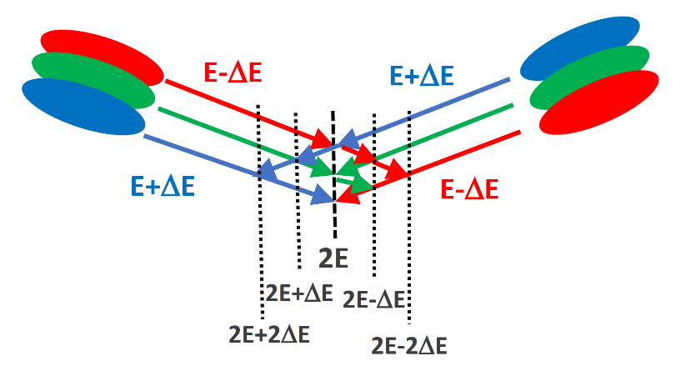
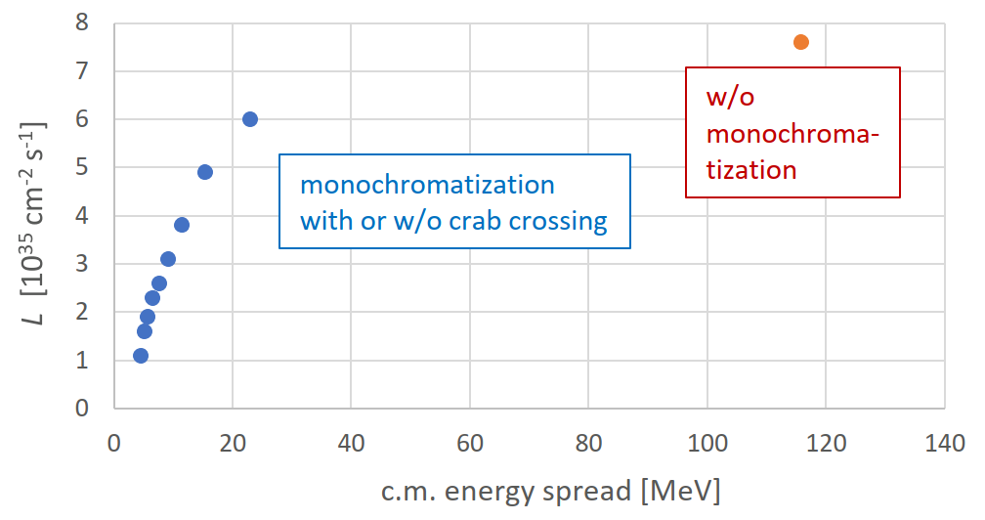
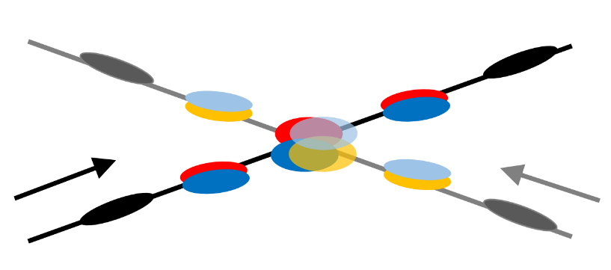
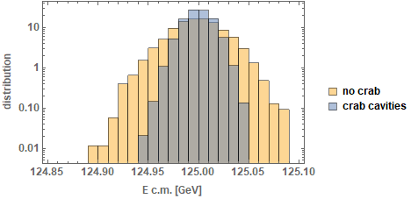
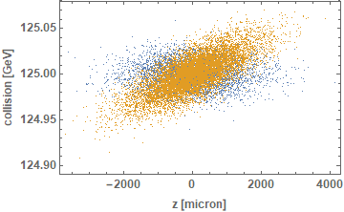

monochromatized direct Higgs production?
$$D_{x}^{∗}≠0$$
M.A. Valdivia Garcia,
A. Faus-Golfe, et al.
w crab cavities
w/o crab cavities
including beamstrahlung !
integrated resonance scan
a few times higher Higgs production rate thanks to monochromatization
possibly the only available approach to measure the electron Yukawa coupling !

Slide 15
FCC hh basic design choices
dual aperture superconducting magnets
two high-luminosity experiments (A & G)
two other experiments (L & B) combined with injection upstream of experiments
two collimation insertions
  betatron cleaning (J)
  momentum cleaning (F)
extraction/dump insertion (D)
RF insertion (H)
Injection from LHC (~3 TeV) or scSPS (~1.2 TeV)
Alternative layouts under study

Slide 16
FCC-hh (pp) collider parameters (stage 2)
parameter | FCC-hh |  | HL-LHC | LHC
collision energy cms [TeV] | 100 |  | 14 | 14
dipole field [T] | 16 |  | 8.33 | 8.33
circumference [km] | 97.75 |  | 26.7 | 26.7
beam current [A] | 0.5 |  | 1.1 | 0.58
bunch intensity [10¹¹] | 1 | 1 | 2.2 | 1.15
bunch spacing [ns] | 25 | 25 | 25 | 25
synchr. rad. power / ring [kW] | 2400 |  | 7.3 | 3.6
SR power / length [W/m/ap.] | 28.4 |  | 0.33 | 0.17
long. emit. damping time [h] | 0.54 |  | 12.9 | 12.9
beta* [m] | 1.1 | 0.3 | 0.15 (min.) | 0.55
normalized emittance [μm] | 2.2 |  | 2.5 | 3.75
peak luminosity [10³⁴ cm⁻²s⁻¹] | 5 | 30 | 5 (lev.) | 1
events/bunch crossing | 170 | 1000 | 132 | 27
stored energy/beam [GJ] | 8.4 |  | 0.7 | 0.36

Slide 17
worldwide FCC Nb₃Sn program
Main development goal is wire performance increase:
J_{c} (16T, 4.2K) > 1500 A/mm² →50% increase wrt HL-LHC wire
Reduction of coil & magnet cross-section
5400 mm²
3150 mm²
~1.7 times less SC
After 1-2 years development, prototype Nb₃Sn wires from several new industrial FCC partners already achieve HL-LHC J_{c} performance
~10% margin
HL-LHC
~10% margin
FCC ultimate
FCC conductor development collaboration:
Bochvar Institute (production at TVEL), Russia
Bruker, Germany, Luvata Pori, Finland
KEK (Jastec and Furukawa), Japan
KAT, Korea, Columbus, Italy
University of Geneva, Switzerland
Technical University of Vienna, Austria
SPIN, Italy, University of Freiberg, Germany
2019/20 results from US, meeting FCC J_{c} specs:
Florida State University: high-J_{c} Nb₃Sn via Hf addition
Hyper Tech /Ohio SU/FNAL: high-J_{c} Nb₃Sn via artificial pinning centres based on Zr oxide.

Slide 18

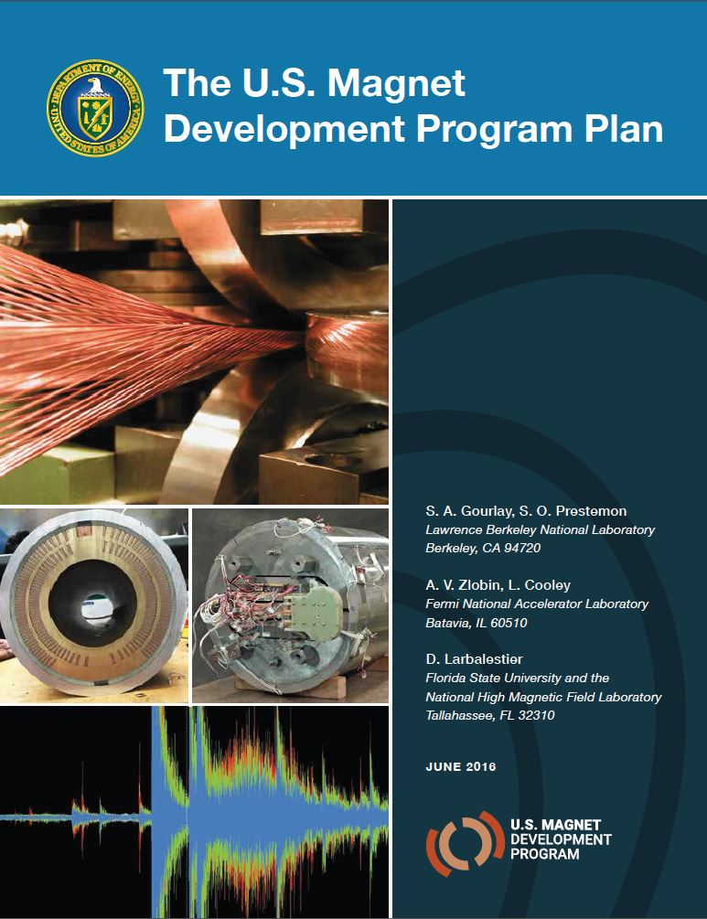
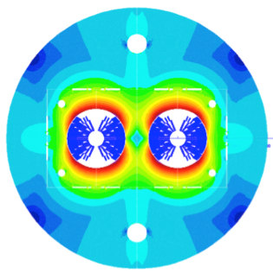
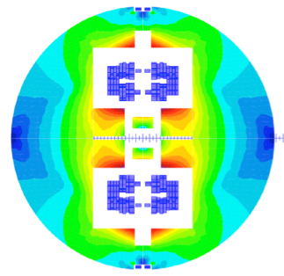

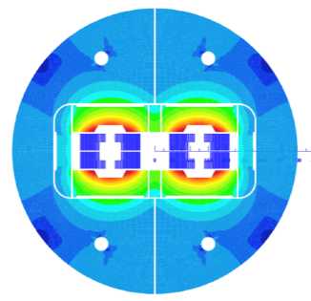
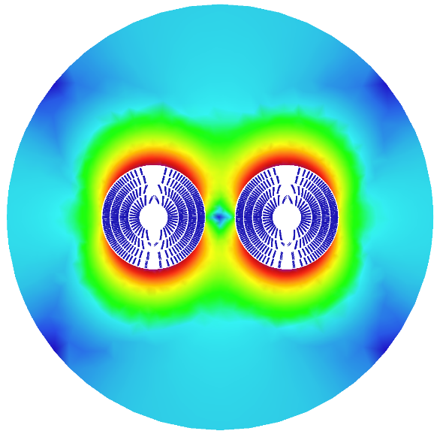
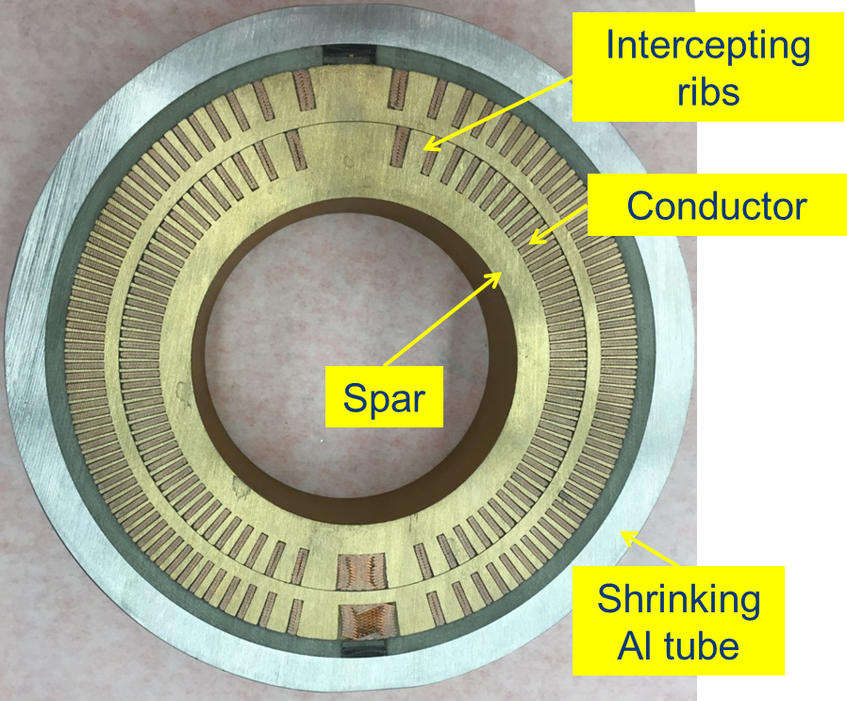
16 T dipole design activities and options
H2020
Swiss contribution
Cos-theta
Common coils
Canted
Cos-theta
Blocks
INFN
CIEMAT
LBNL
CEA
PSI
FNAL
Short model magnets (1.5 m lengths) will be built until 2025

Slide 19
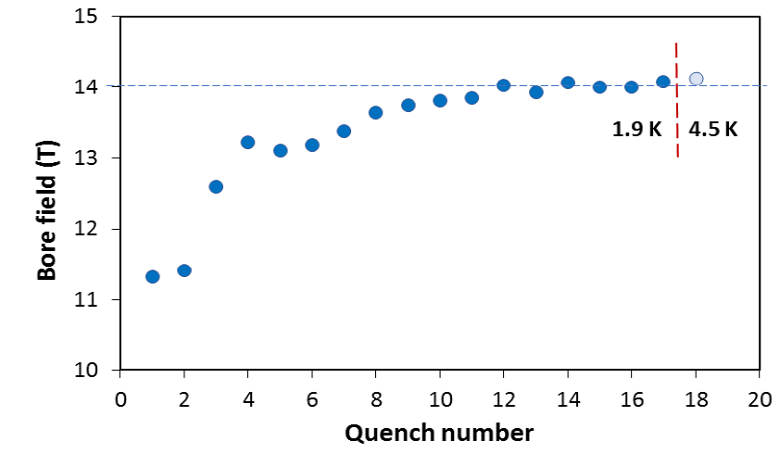
US – MDP: 14.5 T magnet tested at FNAL
84% on the laodline at 1.9 K
92% on the loadline at 4.2 K
60-mm aperture
4-layer graded coil
15 T dipole demonstrator
Staged approach: In first step pre-stressed for 14 T
Second test in June 2020 with additional pre-stress reached 14.5 T

Slide 20
Take home messages
FCC-ee is first stage of FCC integrated programme; first physics ~2040
FCC-ee design incorporates many lessons from recent & present e⁺e⁻ colliders, and goes further! SuperKEKB demonstrates key concepts
FCC-ee = efficient and sustainable collider at the e⁺e⁻ energy frontier: highest luminosity per input power, highest luminosity per construction cost, most precise energy calibration, and ultimate upgrade potentials (ERL-based FCC-ee, 100 TeV FCC-hh, …)
Prototypes of FCC-ee key components by 2025
Superconducting cable & high-field magnet programme prepares for 100 TeV proton-proton collider, FCC-hh, in the same tunnel, to begin operation around ~2065

