Slide 1


LSTM Application for Automatic LHC Collimator Alignments
Gabriella Azzopardi
gabriella.azzopardi@cern.ch
ICALEPCS’21 - 15 Oct 2021

Slide 2

Introduction
Left jaw
Beam axis
Right jaw
The LHC relies on a collimation system for passive protection
Step precision of 5 μm
Concentrate beam losses into warm location
Each year of operation begins with a commissioning phase to align all collimators.
  Ensure the correct settings for nominal operation
Alignments performed at all machine states:
  Injection, Flat top, Squeeze, Collisions
123 movable collimators at the start of Run 3

Slide 3
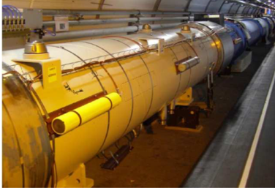
Beam Instrumentation
Beam Loss Monitors (BLMs) used to align collimators.
Record beam losses generated by collimators as they touch the beam.
Beam-based alignment (BBA)
Collimator i
BLM_{i}
Left jaw
showers
Beam
Right jaw

Slide 4
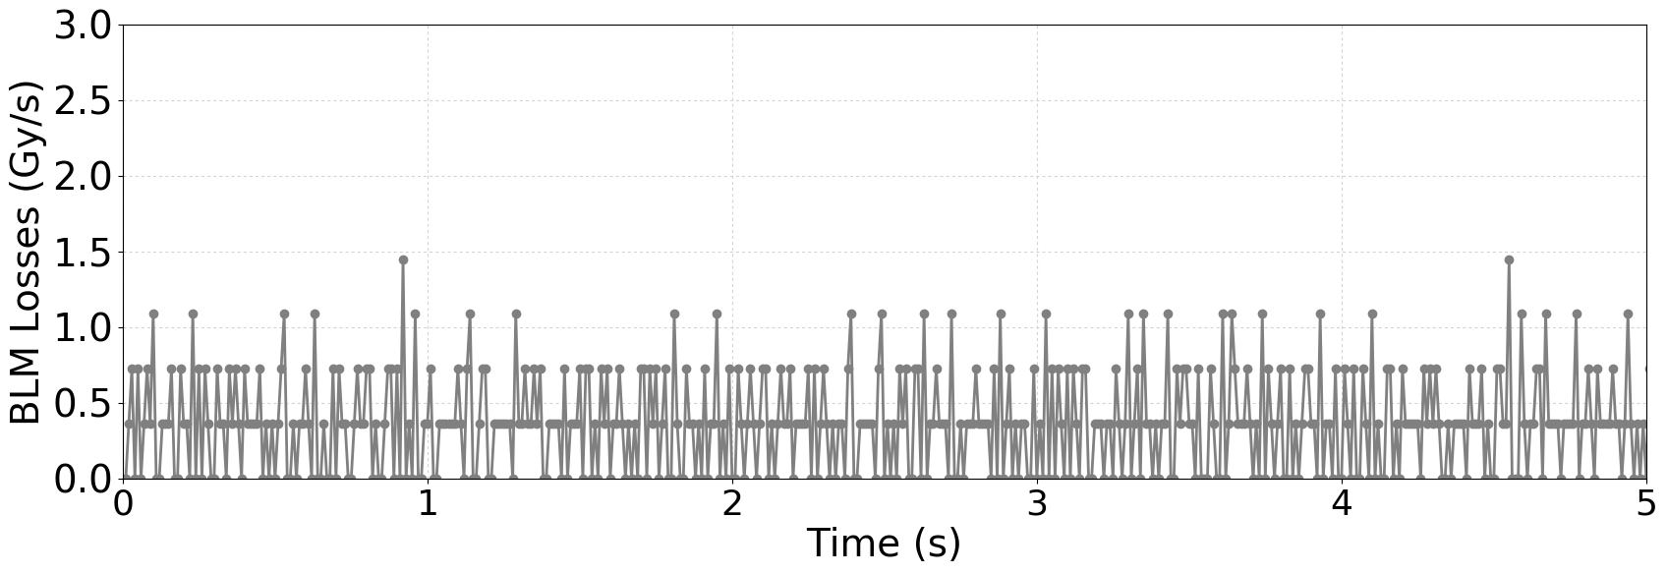
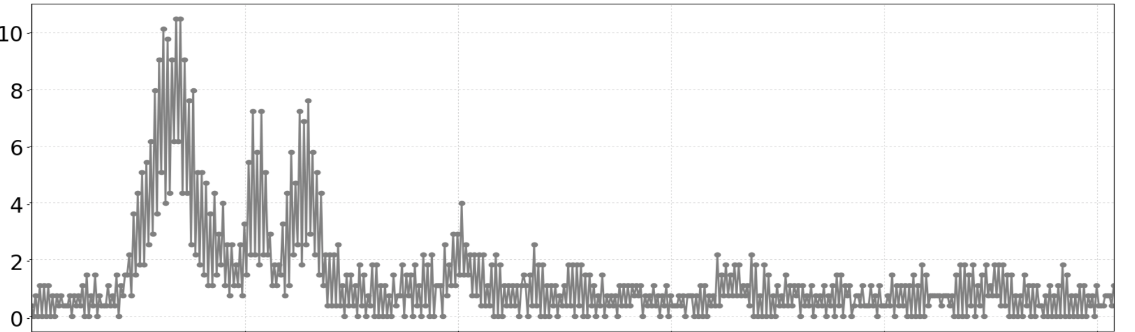
Beam-Based Alignment
x10⁻⁶
Collimator i
BLM_{i}
showers
Beam
Move jaw towards beam until loss spike detected in BLM signal.
Wait for loss spike to decay between alignments.
A complete alignment campaign can produce 1000+ observation spikes (1000+ alignments).

Slide 5
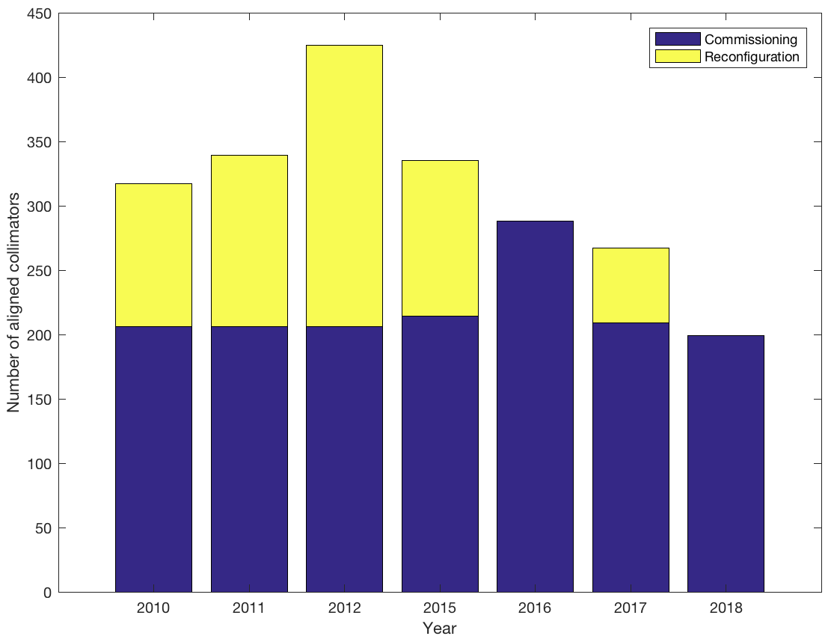
Beam-Based Alignment
All alignment campaigns for all machine states during commissioning and any reconfigurations throughout the years.
  Excluding alignments required for dedicated setups for machine developments and operational measurements/tests.
Aligning each collimator with BLMs requires multiple alignments:
  2018: ~8 alignments / collimator
  2016-2017: ~25 alignments / collimator
  2010-2015: >25 alignments / collimator
x10⁻⁶
Collimator i
BLM_{i}
showers
Beam
Move jaw towards beam until loss spike detected in BLM signal.
Wait for loss spike to decay between alignments.
A complete alignment campaign can produce 1000+ observation spikes (1000+ alignments).

Slide 6
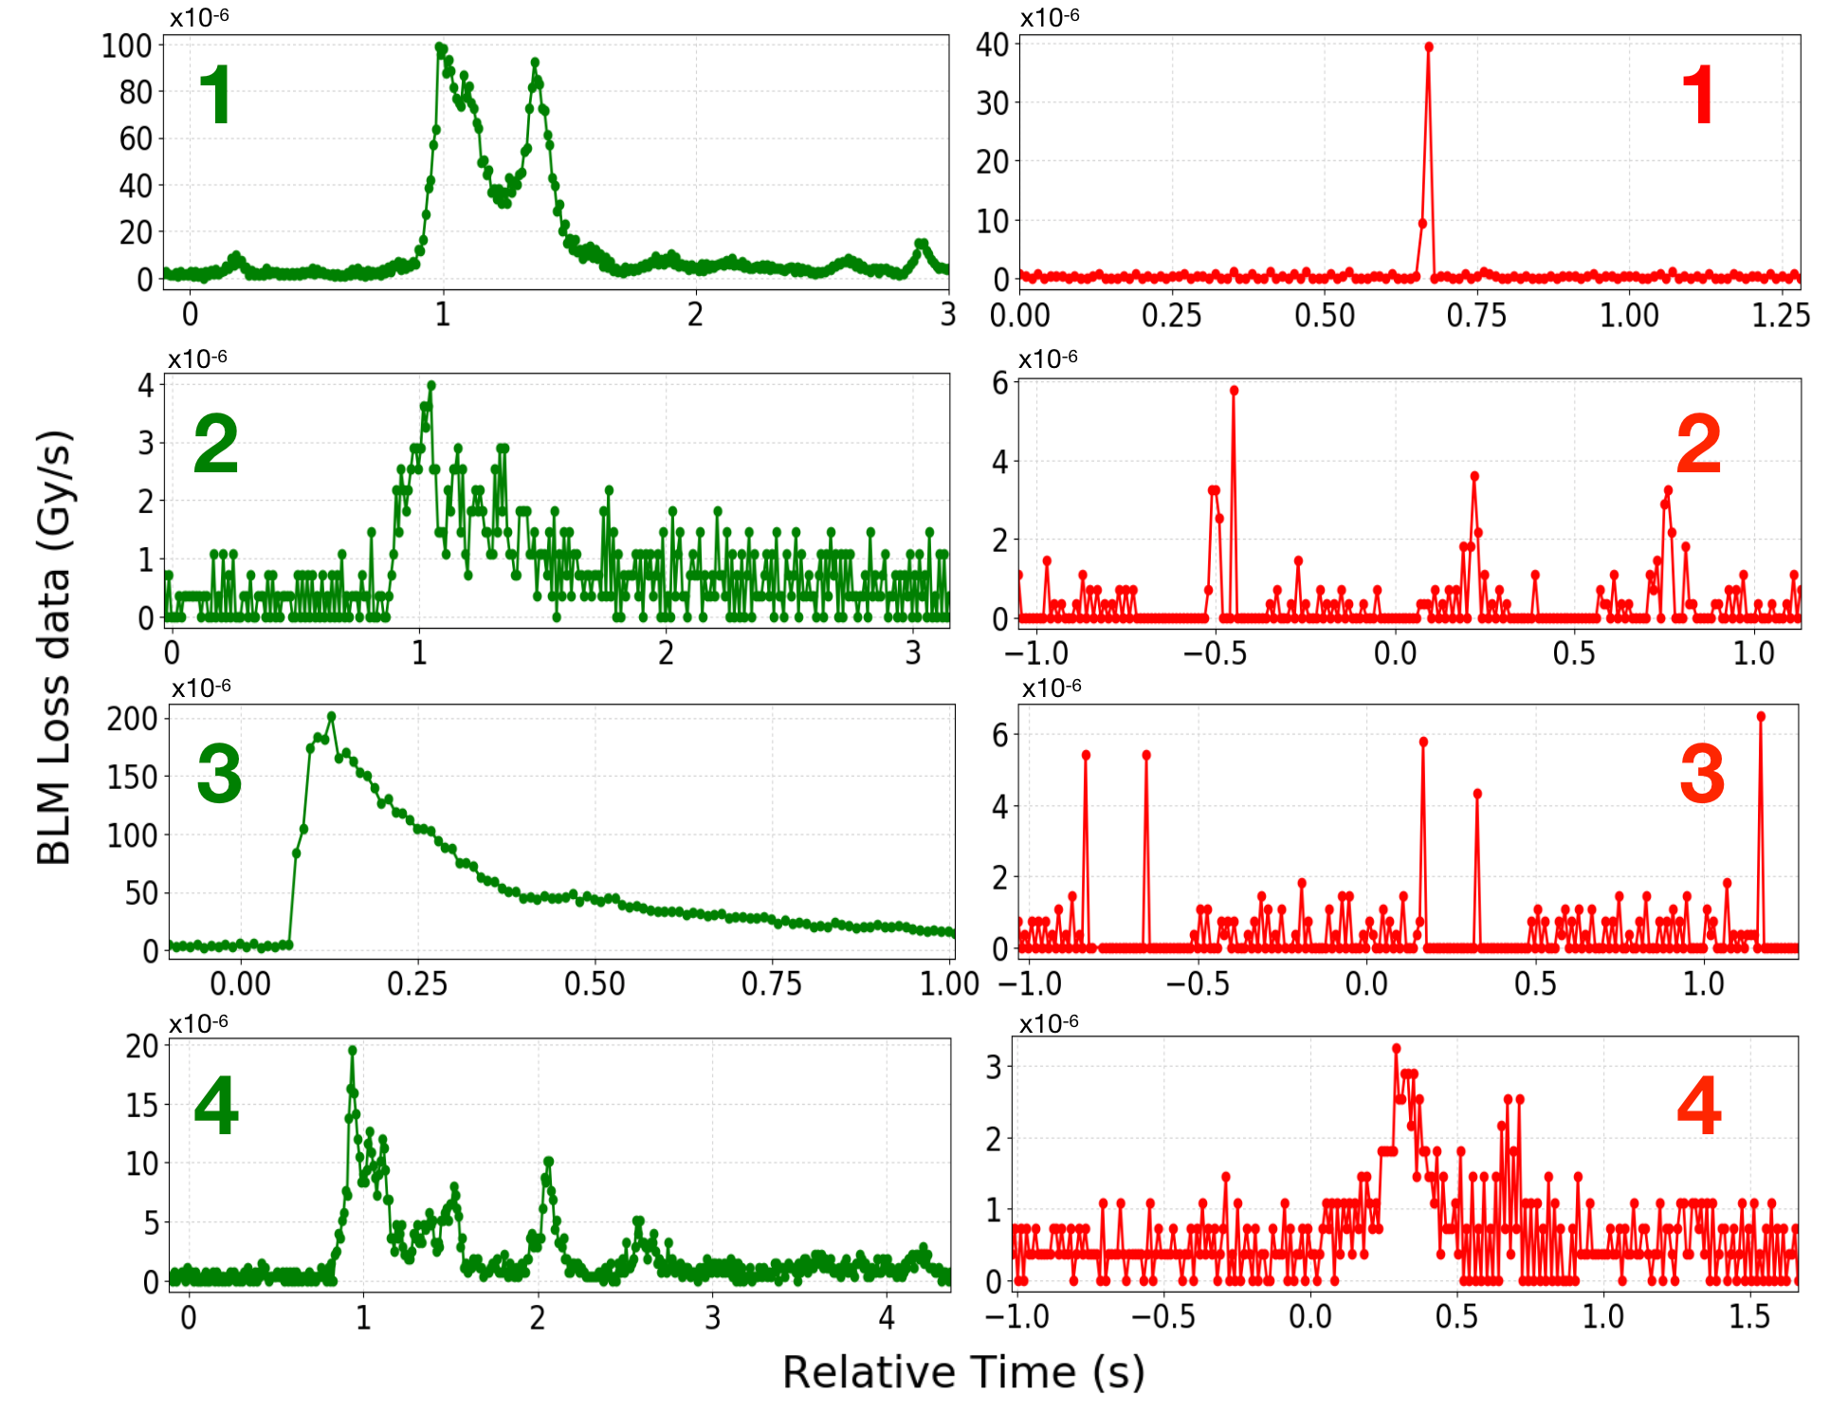
Beam-Based Alignment Observation Spikes

Slide 7
Recap. Collimator Alignments
Since 2011: Semi-Automatic Alignment
User
Select collimator
User
Select BLM threshold to stop jaw movement
AUTO
Collimator moves towards beam
Movement stops when threshold is exceeded
Deliverable 3
User
Collimator aligned? No - repeat, Yes - save
BBA alignment of 40+ collimators require 4-5 collimation experts.

Slide 8
Recap. Collimator Alignments
Since 2018: Fully-Automatic Alignment
AUTO
Select collimator
AUTO
Select BLM threshold to stop jaw movement
AUTO
Collimator moves towards beam
Movement stops when threshold is exceeded
Deliverable 3
Supervised Machine Learning
AUTO
Collimator aligned? No - repeat, Yes - save
    G. Azzopardi, et al., Software Architecture for Automatic LHC Collimator Alignment using Machine Learning, ICALEPCS’19

Slide 9
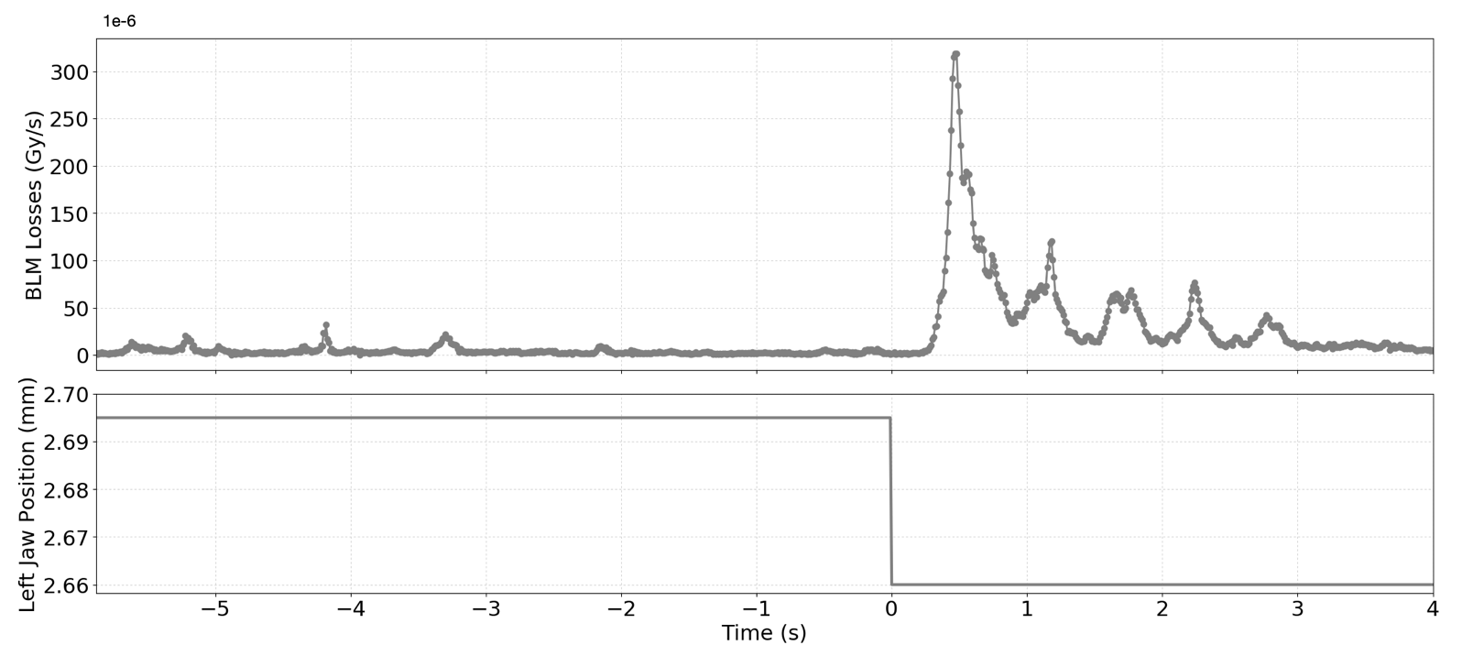
Recap. Collimator Alignments ML
Data sample taken when collimator stops moving:
  100 Hz BLM data
  1 Hz Jaw Position (mm)
Fixed waiting time:
  4 s @ injection
  6 s @ flat top
314.94
229.12, 4.03, 21.98
spike
height
exponential
decay
3.01
jaw position in σ
5 features extracted:
  Spike Height (x1 feature)
  Exponential Decay (x3 features)
  Jaw Position in σ (x1 feature)
Precision > 95%
    G. Azzopardi, et al., Automatic Spike Detection in Beam Loss Signals for LHC Collimator Alignment, NIM-A, 2019

Slide 10
Recap. Collimator Alignments Results
Beam 1
Run I
Run II
Beam 2
20.5 hours
17.5
Machine Learning
12.5
79 collimators in 50 minutes!
5.5
2.9
2.83
1.5
0.83
2010
2011
2012
2015
2016
2017
2018
2018 Parallel
    G. Azzopardi, et al., Operational Results of LHC Collimator Alignment using Machine Learning, IPAC’19

Slide 11
Semi- Vs Fully- Automatic Alignment
Data collected using:
  Semi-automation in 2016
  Parallel fully-automation in 2018
Can speed up the fully-automatic alignment by decreasing the time waiting for the signal to decay before extracting the features.
 | Semi-Automatic | Fully-Automatic
Collimators | 75 | 77
Total time | 2h 31m 59s | 49m 17s
Moving time | 58m 13s | 18m 14s
Total alignments | 1903 | 637
Moving time | 38.3 % | 38.0 %
Alignments / Collimator | 25.37 | 8.27

Slide 12
Decay Time Analysis
Analysis: Actual time required for BLM signal to decay.
Modelled the decay rate as an exponentially falling distribution, with optimal losses achieved after 6 half-lives.
Mean decay time:
0.61 s at injection
2 s at flat top

Slide 13
LSTM-RNN for Spike Classification
Proposed Solution: Long Short-Term Memory (LSTM) - Recurrent Neural Network (RNN):
  Continuously classify spikes in real-time.
  Automatically adjust to spike decay length.
Dataset collected from alignments during 2016-2018:
  1550 alignment spikes
  1423 spurious spikes
Input:
  BLM signal scaled with the collimator position in sigma.
  Z-Score used as the normalization technique to re-scale the features.
Courtesy of G. Ricci, Sapienza Università di Roma

Slide 14
LSTM-RNN for Spike Classification
Results collected over a 10-fold cross-validation randomly stratified 30 times.
Average of 94% precision on testing sets.
Precision is used to avoid false positives:
  False detection of an alignment spike is more grievous than not detecting an alignment spike.
Precision calculated by evaluating the classification probability at the end of the available sample:
  A classification score >50 % is classified as an alignment spike.
Further analysis to determine the best moment to predict the spike class and the ideal probability threshold, to possibly improve the model’s precision.
Classification

Slide 15
Spike Classification Analysis
Analysis: LSTM continuous classification of each sample at each time step.
  Clear distinction between spike classes at 1.5 s.
  Rate of change of classification probabilities for alignment spikes falls below 0.2.
  No overlap at 80 % probability at a latency of 1.5 s.

Slide 16
Spike Classification Analysis
Analysis: Latency required to obtain max. probability per spike class:
  ~98% of spurious spikes obtain a max probability within 1.5 s.
  100% of spurious spikes constantly < 80 % classification probability.
Conclusion: The LSTM can be used classify:
  When the probability gradient < 0.2 (requires ∼1-1.5 s @ Inj).
  Classify spurious spike when probability <80 %, then the next alignment can begin.
  Otherwise alignment spike, then fit an exponential function to determine when ~98.5 % of the BLM signal decays
    On average already decayed (mean 0.61 s).

Slide 17
Classification Results
Classifying the BLM signals as proposed by the presented analysis increases the classification precision on the dataset to 98 %.
Analysis: The time taken to classify the BLM signals at the two machine states.
 | Injection | Flat top
Start time | 1 s | 1.5 s
Mean | 1.07 s | 1.54 s
Stand. dev. | 0.1 s | 0.06 s
Maximum | 1.72 s | 2.04 s
Factor 4 speed-up compared to the present implementation with supervised ML .

Slide 18
Theoretical Improvement of Alignment Time
The time required for automatic alignments using supervised machine learning.
Step | Action | Time (s)
1 | Move both jaws to 4 mm | ~8
2 | Wait for losses to decay | x
3 | Classification delay | 1
4a | Align Left Jaw | 2*(0.1 + x + 1)
4b | Align Right Jaw | 2*(0.1 + x + 1)
5a | TCP before (Left Jaw) | 0.1 + x + 1
5b | TCP before (Right Jaw) | 0.1 + x + 1
6 | TCP after (Left + Right ) | 2 * (0.1 + x + 1)
Total | 17.8 + 9x | @Inj x >= 4 @FT x >= 6
The proposed LSTM model is capable of dynamically classifying spikes of varying lengths in real-time.
This will decrease the mean time waiting for the losses to decay:
  x₁ = 1.07 s @ Inj, 2 s @ FT
  x₀ = 1.07 s @ Inj, 1.54 s @ FT
  (from slides 11, 16)

Slide 19
Theoretical Improvement of Alignment Time
~50% speed-up
Case | Supervised ML | LSTM-RNN
1 coll @ Inj | 53.8 s | 27.43 s
+ 1 spurious spike/align | 69.1 s | 33.94 s
79 colls @ Inj | 70.84 mins | 36.12 mins
+1 spurious spike/align | 90.98 mins | 44.69 mins
1 coll @ FT | 71.8 s | 35.8 s
+1 spurious spike/align | 93.1 s | 43.72 s
79 colls @ FT | 94.53 mins | 47.14 mins
+1 spurious spike/align | 122.58 mins | 57.56 mins
The average theoretical minimum time to sequentially align LHC collimators.
Aligning the two beams in parallel, resulted in 79 collimators aligned in 50 minutes at injection.
  The LSTM could theoretically align 79 collimators at injection in ∼24.56 minutes.
1 spurious spike/align = 3 * (0.1 + x₀ + 1)

Slide 20
Summary
123 LHC collimators automatically aligned using supervised ML, using the software introduced in 2018.
First-use performance analysis identified a bottleneck caused by the fixed observation window used by the ML model to classify the BLM loss signal.
Trained an LSTM model to continuously classify BLM signals.
Able to classify spikes within 1-2 s of a collimator stopping its movement, once the rate of change in classification probabilities is below 0.2.
  Following each alignment spike classification, the suggestion is to fit an exponential function to the losses to determine whether the next alignment can begin.
This work allows for classifying BLM signals independent of whether the losses decayed or not, decreasing the alignment time by ~50 %.
The LSTM is readily available to be incorporated into the alignment software for testing during the LHC Run 3.

Slide 21
Thank you for your attention!
Questions?
LSTM for Automatic Alignment
Automatic Alignment Software
Collimation Controls for Run 3
THPV040
WEPV016
THPV012

Slide 22
Backup slides

Slide 23
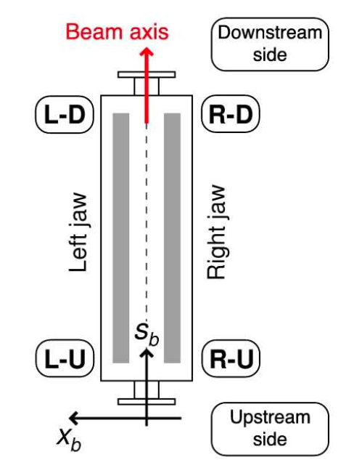
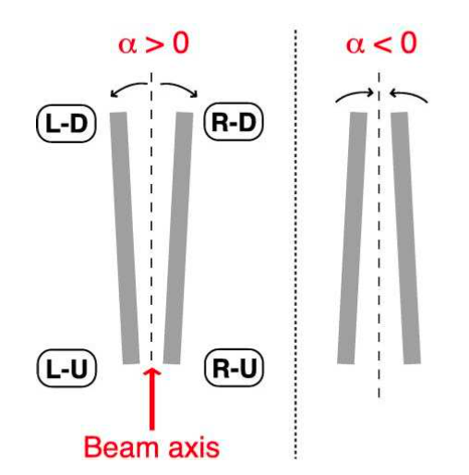
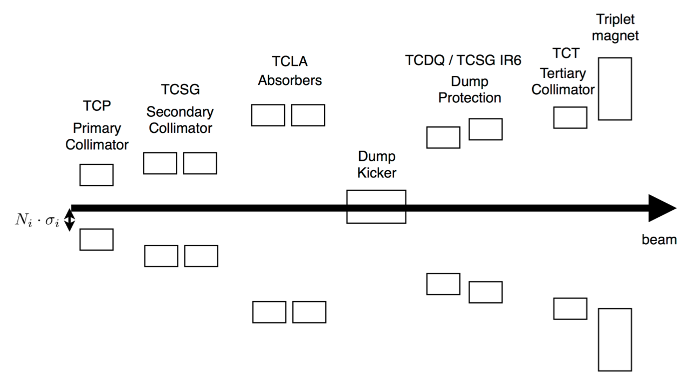
The Collimation System
Collimators are positioned to clean in 3 planes: Horizontal, Vertical and Skew
Collimation Hierarchy
Collimator

Slide 24


LHC Machine Commissioning
Flattop
Squeeze
Collisions
β*
Ramp
Injection
E
To prepare the machine cycle the collimators must be aligned at all machine states:
Injection: 75 collimators + 4 injection protection collimators
Flattop: 75 collimators
Squeeze: 16 tertiary collimators
Collisions: 16 tertiary collimators + 12 physics debris collimators
In 2018

Slide 25
Collimator Alignment Procedure
    G. Azzopardi, et al., The Automatic LHC Collimator Beam-based Alignment Software Package, ICALEPCS’21

Slide 26


Misclassification Rate Explained
90% precision => NOT 10% of this misaligned but 10% of this misclassified!
~1 misclassified per collimator
100 collimators
300 jaw cases aligned
X_{B}=X_{L}=X_{R}=2:
1100 classifications
X_{B} non spikes
B
1 spike
X_{B}+X_{L}+X_{R}+5
L
X_{L}+X_{R} non spikes
R
2 + 2 spikes

Slide 27
Long Short-Term Memory model
LSTMs are a type of RNN that can learn long-term dependencies.
3 activations inside:
  Forget gate layer: What information to keep from the cell state.
  Input gate layer: Which values to be updated.
  Output layer: Decide what to output.
Cell state
Understanding LSTM networks, colah’s blog, 2015.

Slide 28

Alignment Implementation
1. Get data
Java
Display
Software before 2018
FESA
Collimator control
FESA
Semi-automatic alignment
2. Send collimator commands
Collimators
(FESA - Real-time control framework to develop LHC ring front-end equipment software)

Slide 29

Alignment Implementation
2018: Ready and used in CERN Control Centre!
1. Get data
Java
Display
First ML application used for LHC operation
FESA
Collimator control
FESA
Semi-automatic alignment
1. Get data
FESA
Fully-automatic alignment
NEW
4. Send collimator commands
2. Send data
3. Get ML result
Python
Machine Learning
scikit-learn library
Collimators
NEW
(FESA - Real-time control framework to develop LHC ring front-end equipment software)

Slide 30
Fully-Automatic Alignment Results
79.6 hours
Beam 1
Run I
Run II
Beam 2
Reconfigure
53.8
Machine Learning
Time
37.8
No Parallelisation
17.6
6.4
5.7
4.7
2010
2011
2012
2015
2016
2017
2018
    G. Azzopardi, et al., Operational Results of LHC Collimator Alignment using Machine Learning, IPAC’19

Slide 31
Spike Classification Analysis @ FT

Slide 32
Spike Classification Analysis Results Overview
 | Proton beams |  | Ion beams
 | Injection | Flat top | Collisions
Decay time | ~0.61 s | ~2 s | ~1.08 s
Classification probability threshold | 80 % | 80 % | 80 %
Classification probability gradient | 0.2 | 0.2 | 0.2
Classification latency | ~1.07 s | ~1.54 s | ~2.08 s
Classification precision | 98 % |  | 97 %

