Slide 1


Machine Learning for the Tune Estimation in the LHC
Data Science and Machine Learning Workshop
ICALEPCS 2021
Leander Grech
15th October, 2021

Slide 2
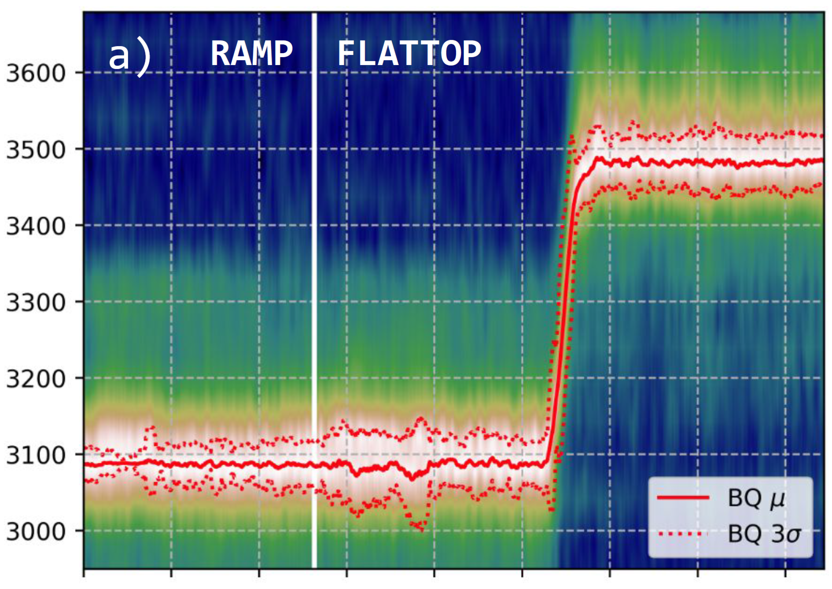
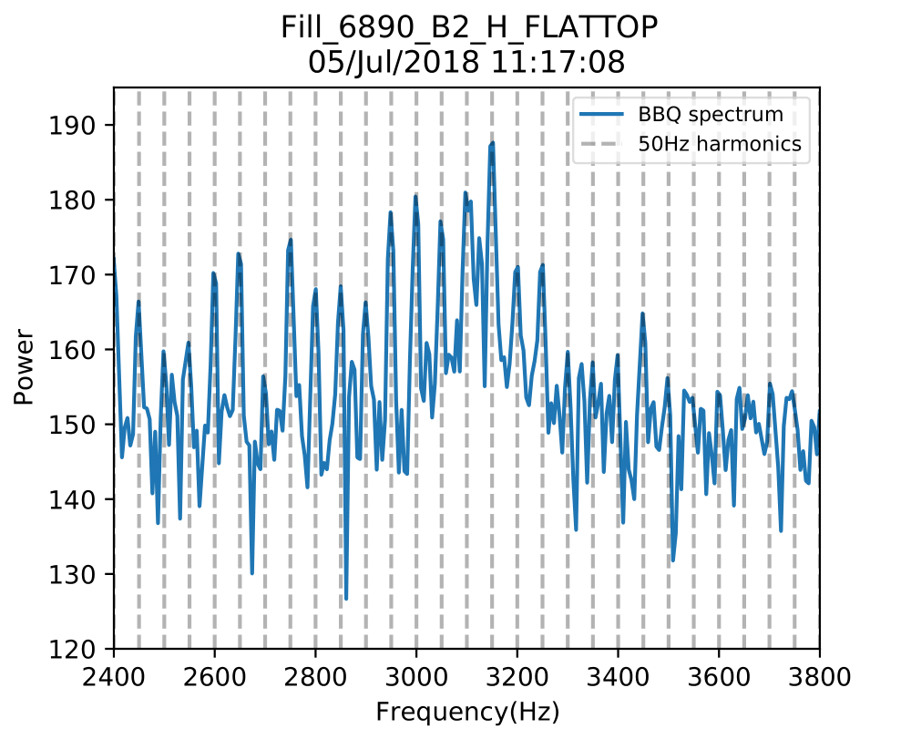
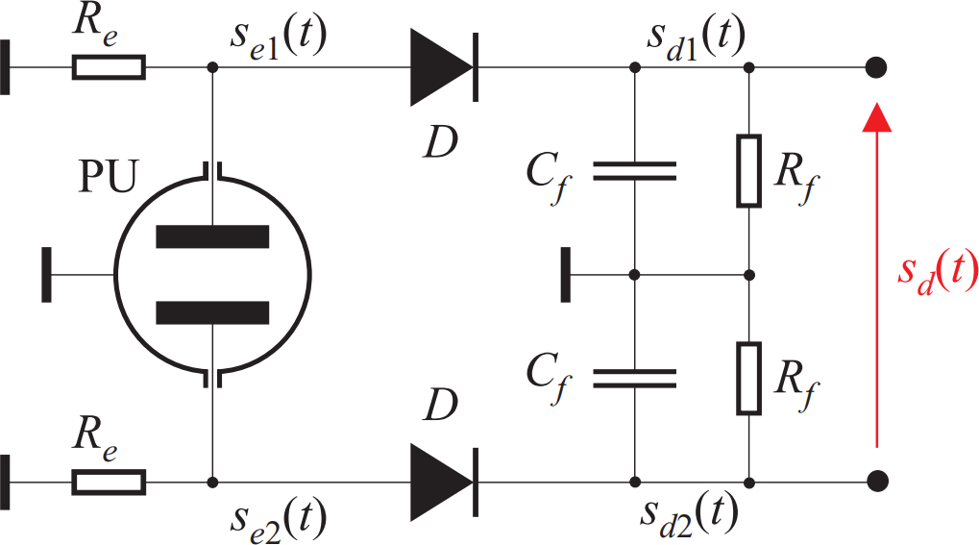
How is tune estimation done?
Tune (Q) is the frequency of betatron oscillations
The Base-Band Q (BBQ) system is responsible for estimating the tune in the LHC
  BBQ systems obtains time series data sampled at revolution frequency → ACQ data
  Fast Fourier Transform (FFT) 2048 samples of ACQ data → FFT spectrum (contains 1024 frequency bins)
  EMA per frequency bin in FFT spectrum over time → EMA spectrum
  Median and moving average filters over EMA spectrum → Filtered spectrum
  Estimate peak position → Q-coarse
  Check Q-coarse on EMA spectrum → Q-refined
  Perform 3-point Gaussian fit centered around Q-refined → Q
BQ Algorithm
BBQ samples beam with Pick-Up (PU) to get s_{e}(t)
Applies Direct Diode Detection (DDD) principle to get ACQ data
FFT on ACQ data to get FFT spectrum
X-axis is time and Y--axis is frequency [Hz]
BQ tune estimation evolution (red) superimposed on smoothed EMA spectra.

Slide 3
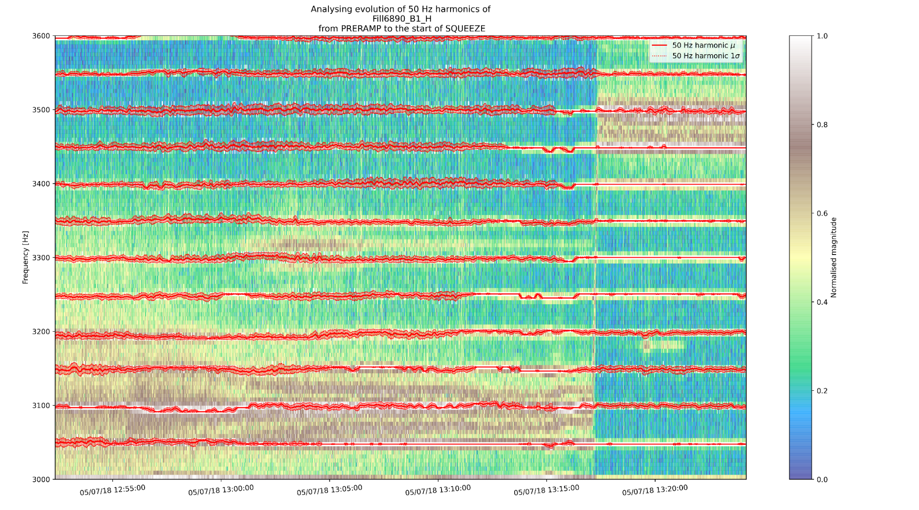
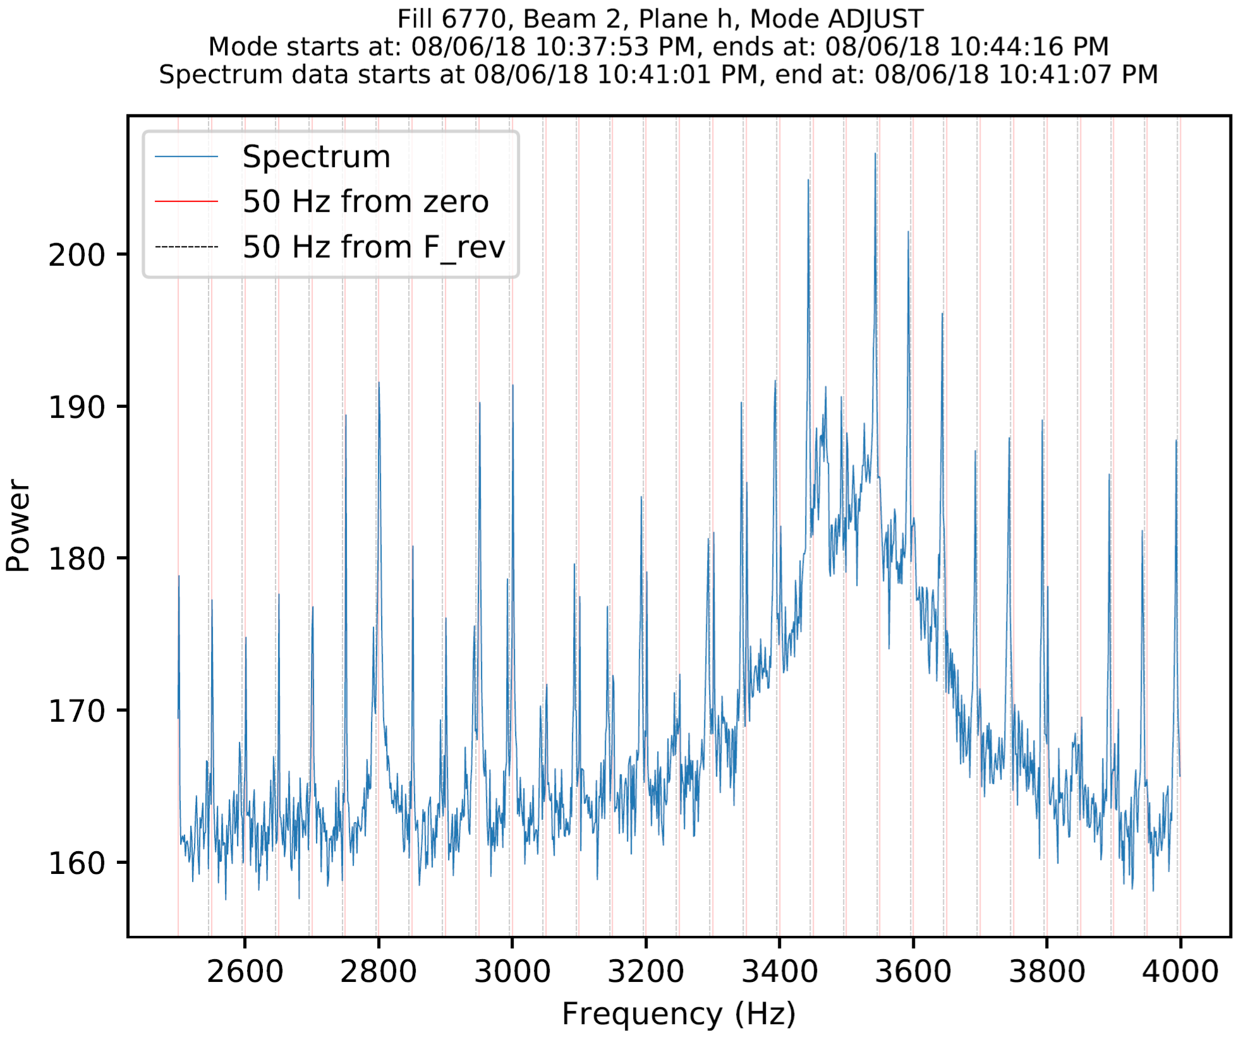
Problems from the start
Since 1st LHC operation, 50 Hz noise harmonics were observed in BBQ spectrum
Creates spectra like this one:
Tracking the evolution of 50 Hz harmonics
Main peak’s center frequency is the tune

Slide 4
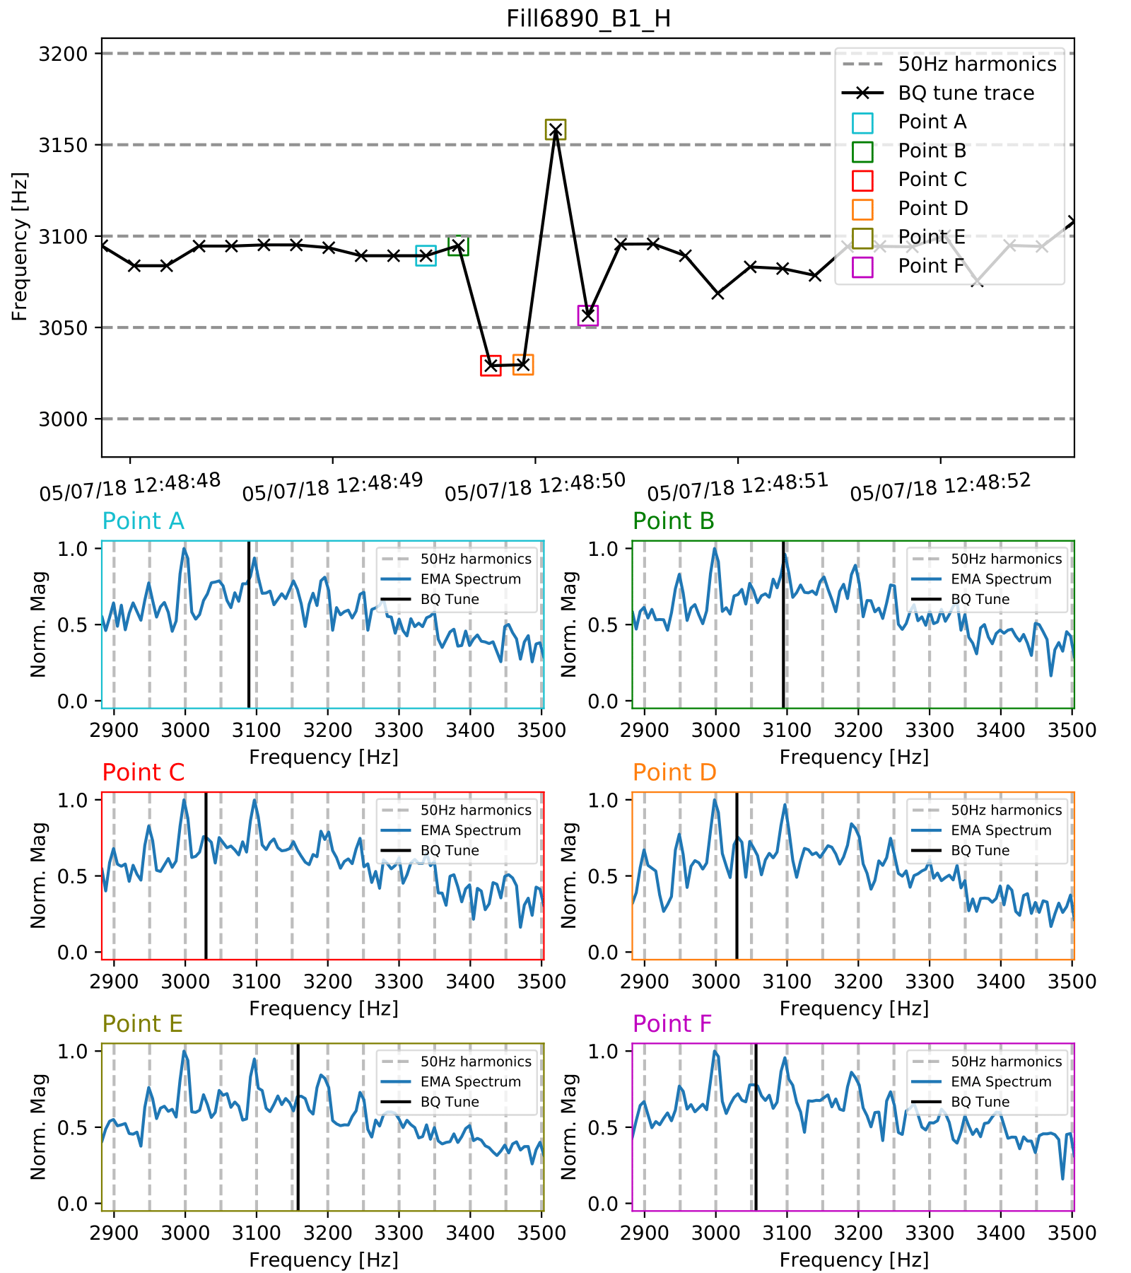
So, what was happening with BQ algorithm?
Tune estimates exhibited large variance

Slide 5
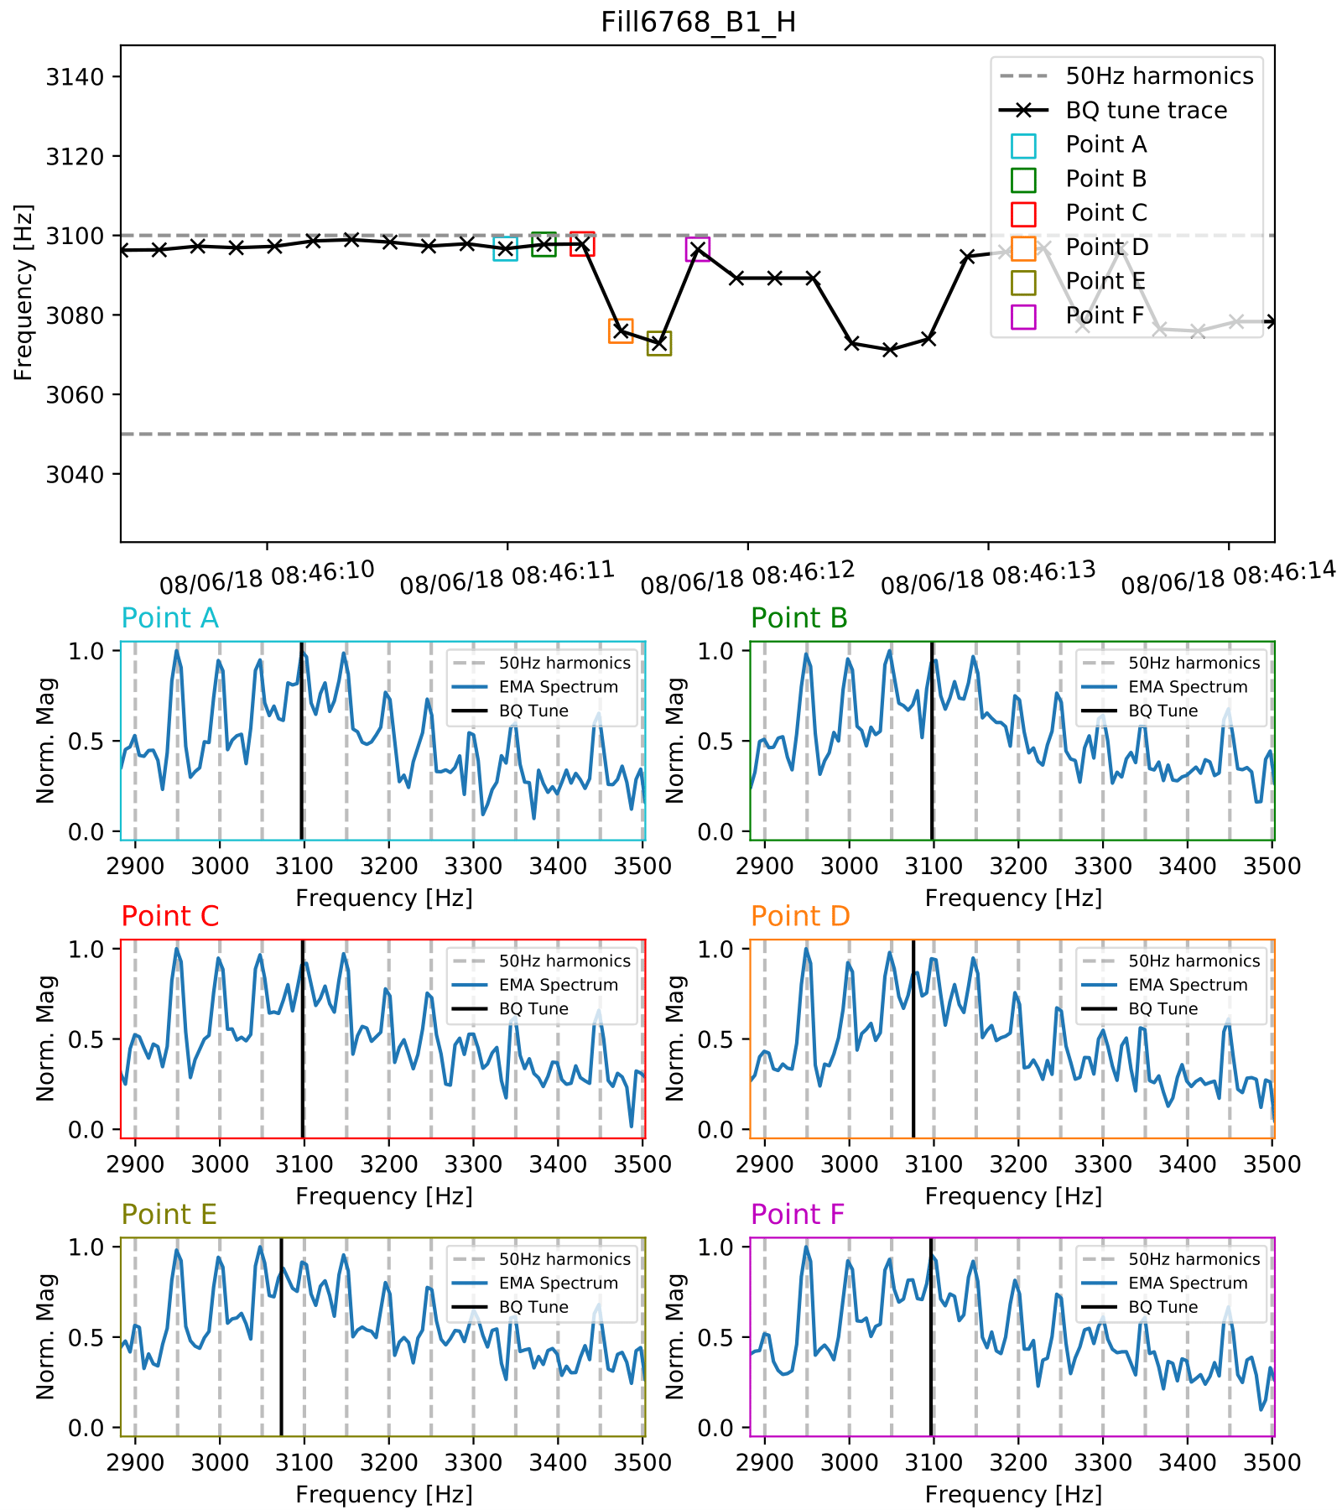
So, what was happening with BQ algorithm?
Tune estimates had a tendency to get stuck to harmonic frequencies

Slide 6
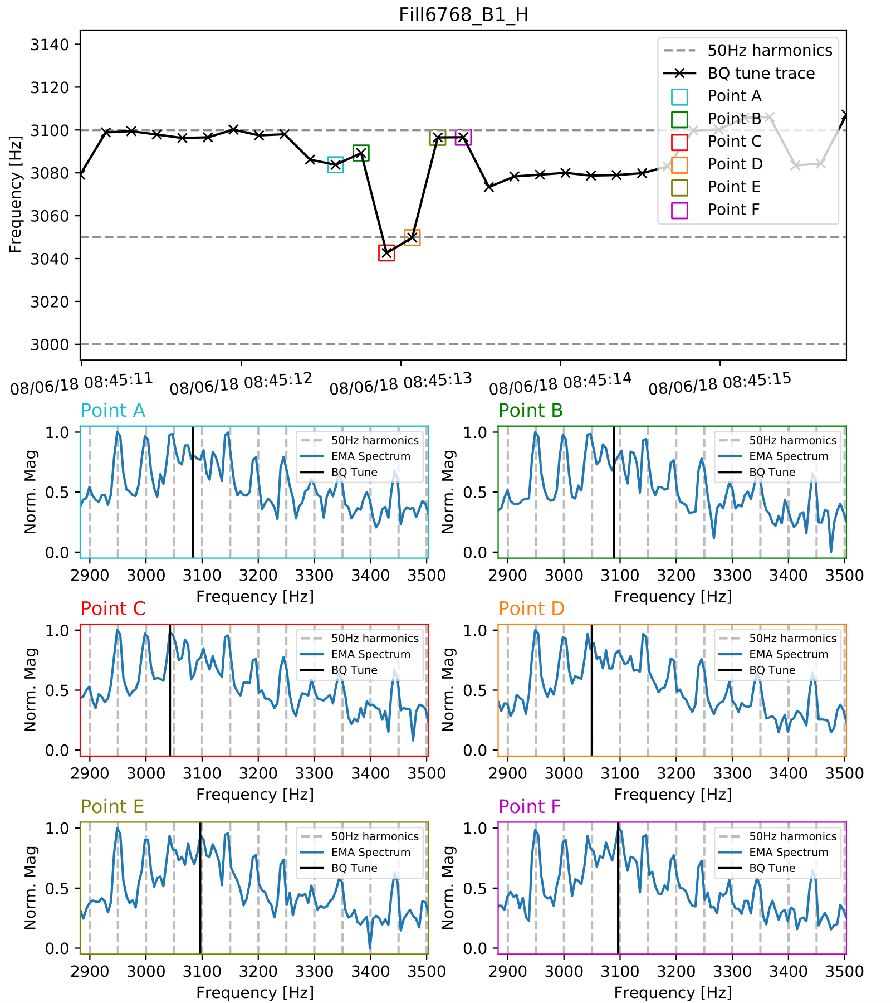
So, what was happening with BQ algorithm?
Tune estimates also jumped from one harmonic to the other

Slide 7
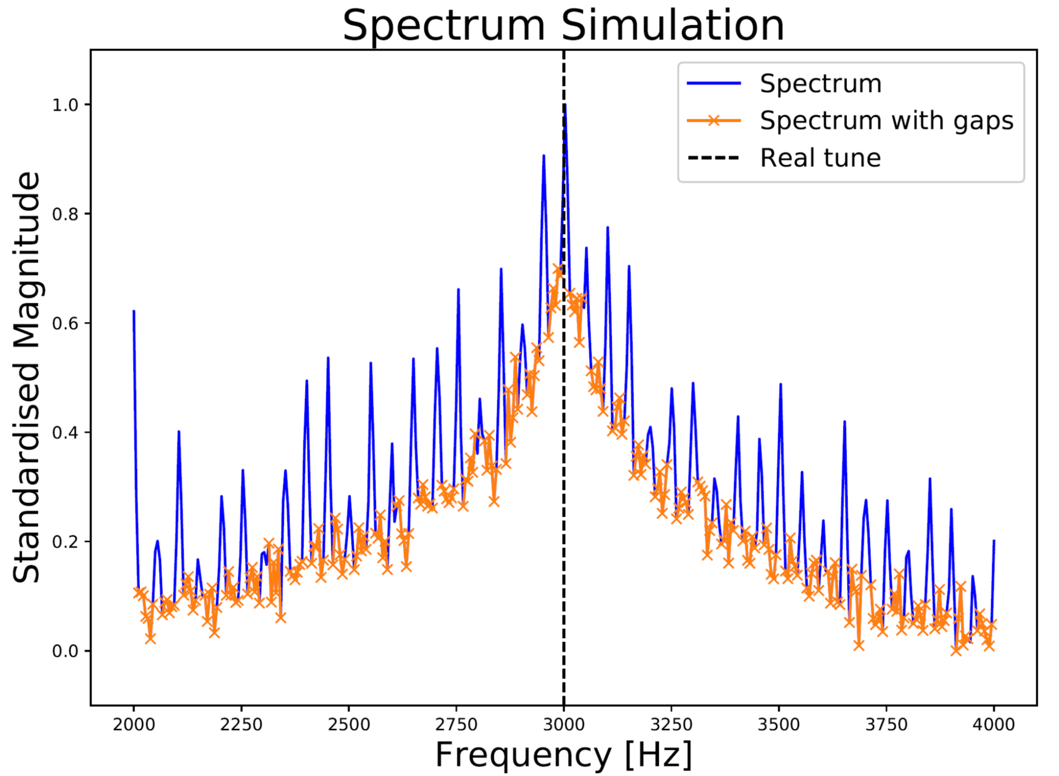
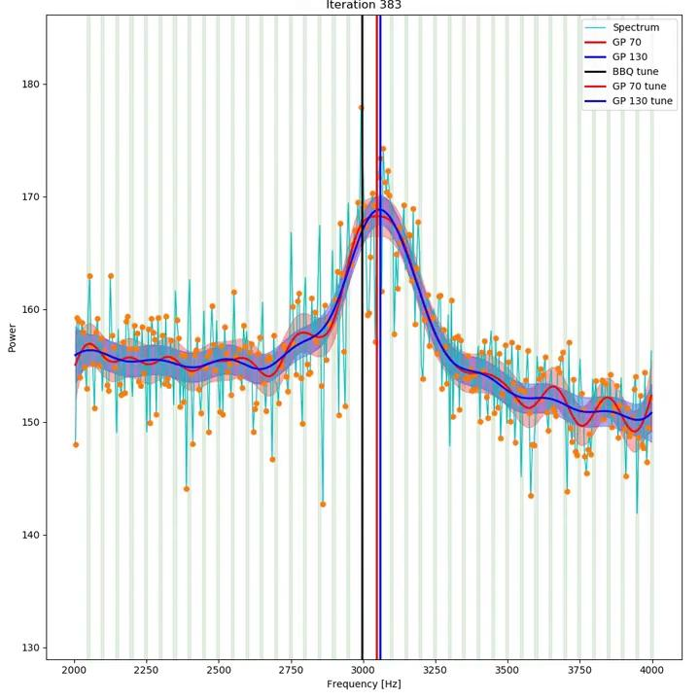
Can different algorithmic approaches achieve better results?
A series of alternative algorithms were attempted that take into consideration the 50 Hz harmonics¹
  Since their frequency location is quite stable, we can explicitly remove them
  This created spectra with gaps
  Gaussian Processes (GP), Weighted Moving Average (WMA) and Polynomial fitting (POLY) were used on spectra with gaps to obtain tune
Performance was somewhat improved but…
  WMA and POLY were sensitive to hyperparameter tuning
  GP was very computationally expensive (inverting 100x100 matrix per tune estimate)
  Tuning harmonic removal is also tricky!`
¹L. Grech et al., “An Alternative Processing Algorithm for the Tune Measurement System in the LHC,” in Proceedings of the 9th International Beam Instrumentation Conference (IBIC 2020), Virtual, 2020.

Slide 8
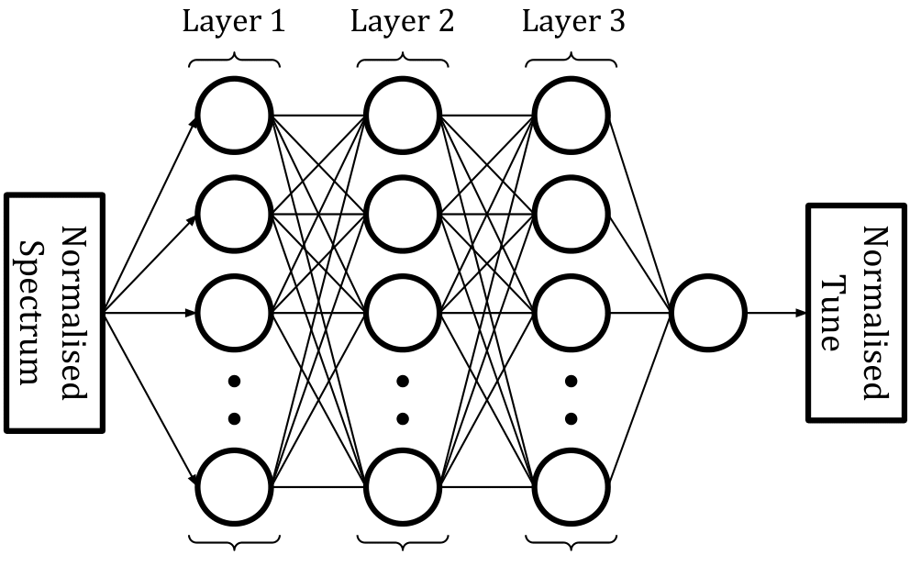
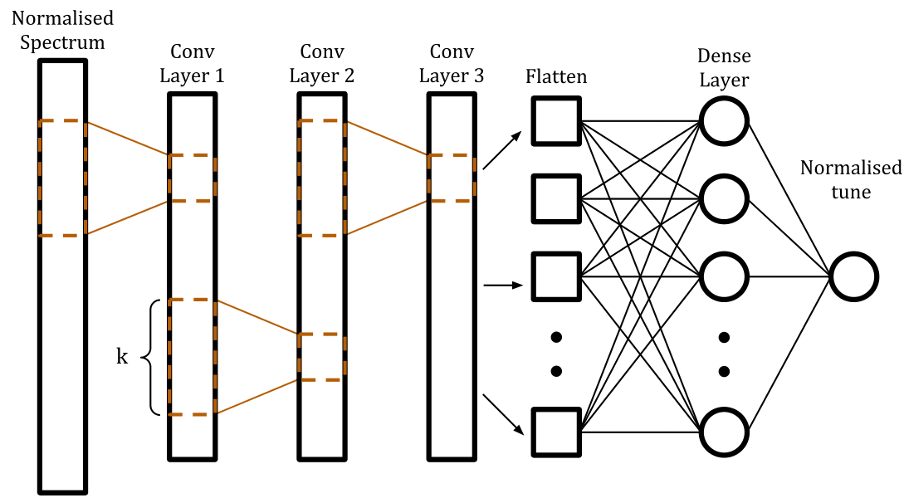
Naive approach
Obtain dataset made up of logged BBQ spectra and BBQ tune estimates
Train a model (DNN/CNN)
  Input: normalised BBQ spectrum
  Label: tune position
Correct tune predictions, right?
Logged BBQ spectra and tune estimates
OR

Slide 9
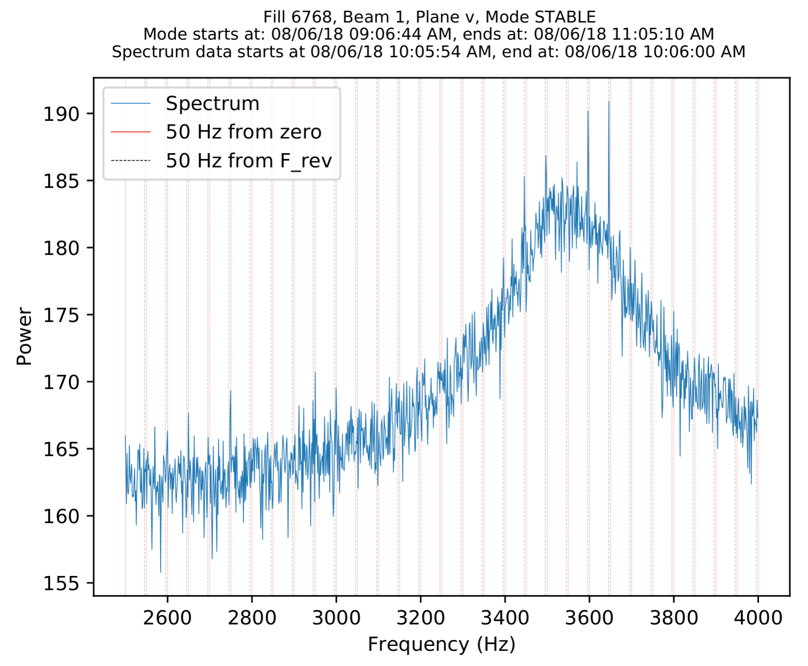
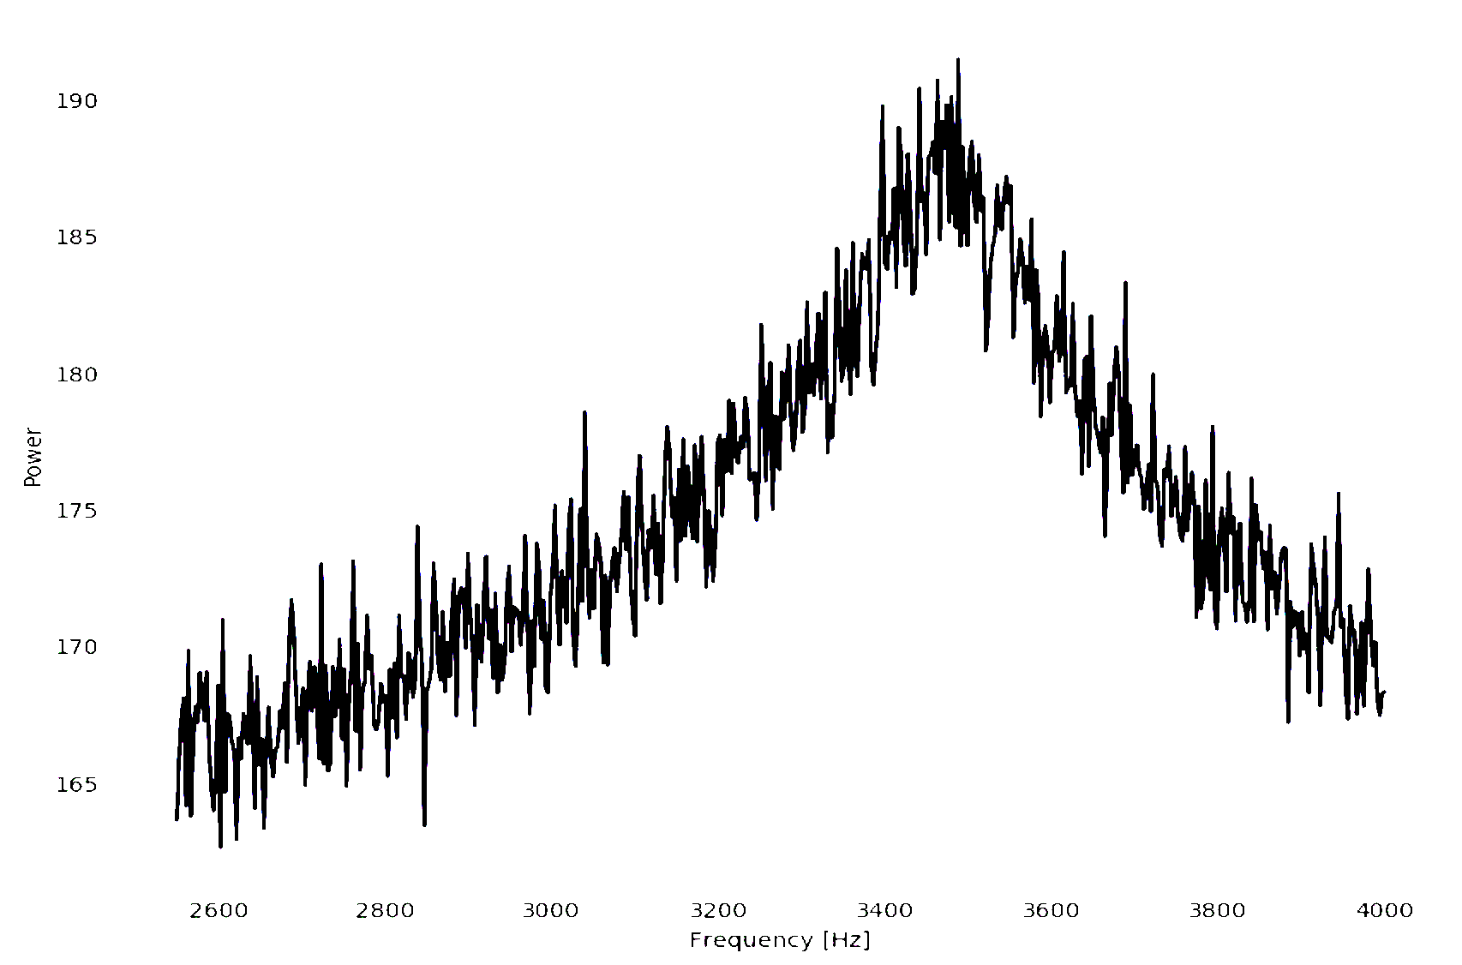
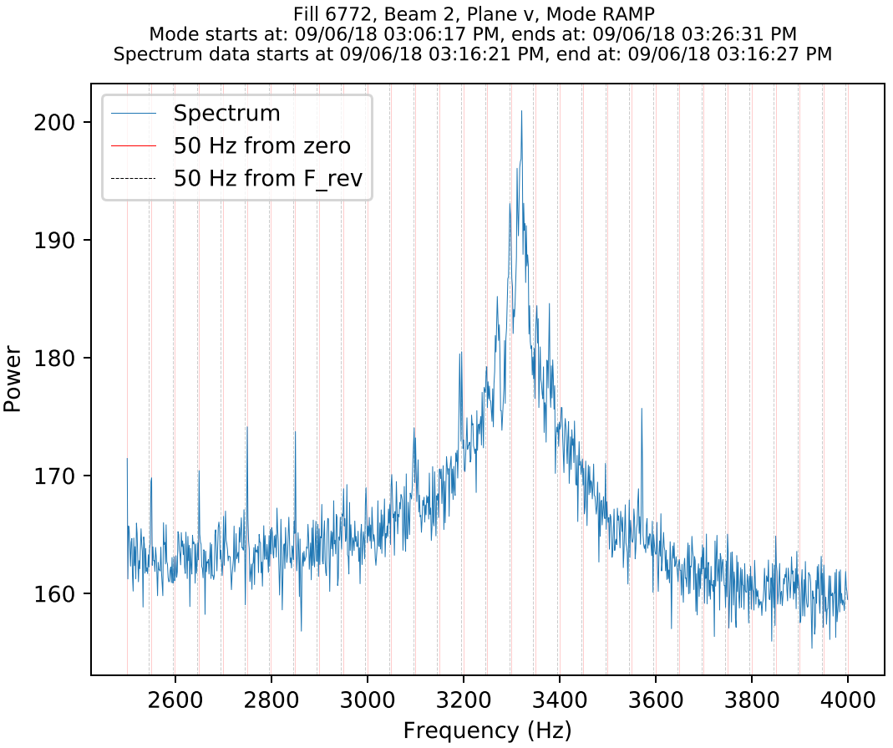
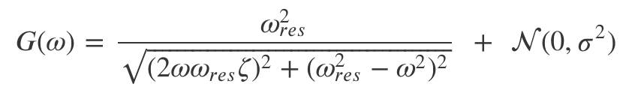
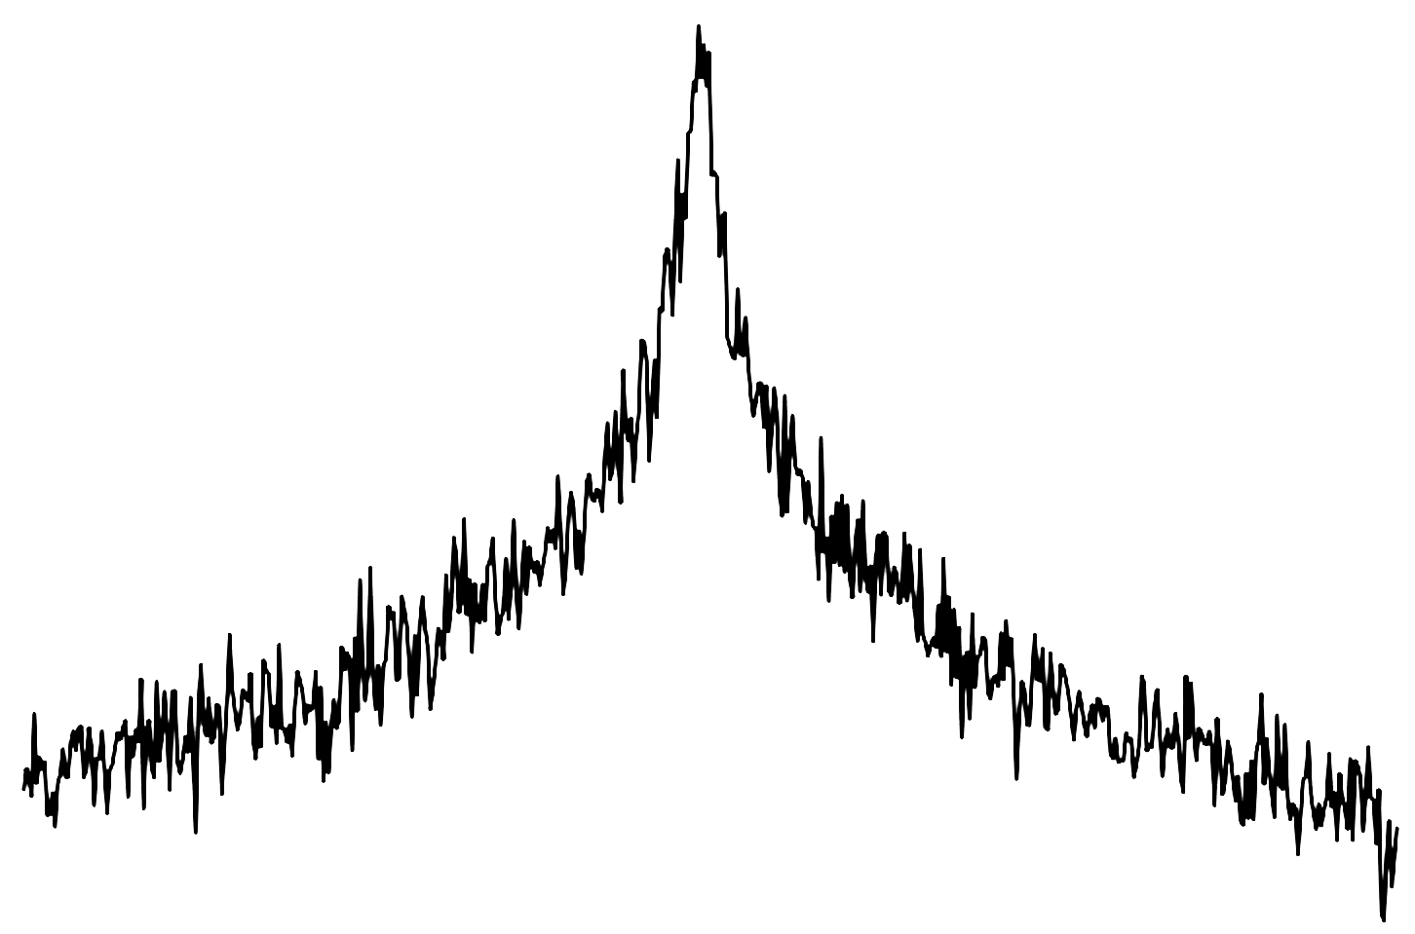

Naive approach I is too naive
Logged BBQ spectra do not have correct labels
  Logged tune estimates come from BQ algorithm!
  We can simulate spectra as done in ¹
2nd order system simulation
Some examples of real spectra ...
… and simulated spectra on top
¹L. Grech et al., “An Alternative Processing Algorithm for the Tune Measurement System in the LHC,” in Proceedings of the 9th International Beam Instrumentation Conference (IBIC 2020), Virtual, 2020.

Slide 10
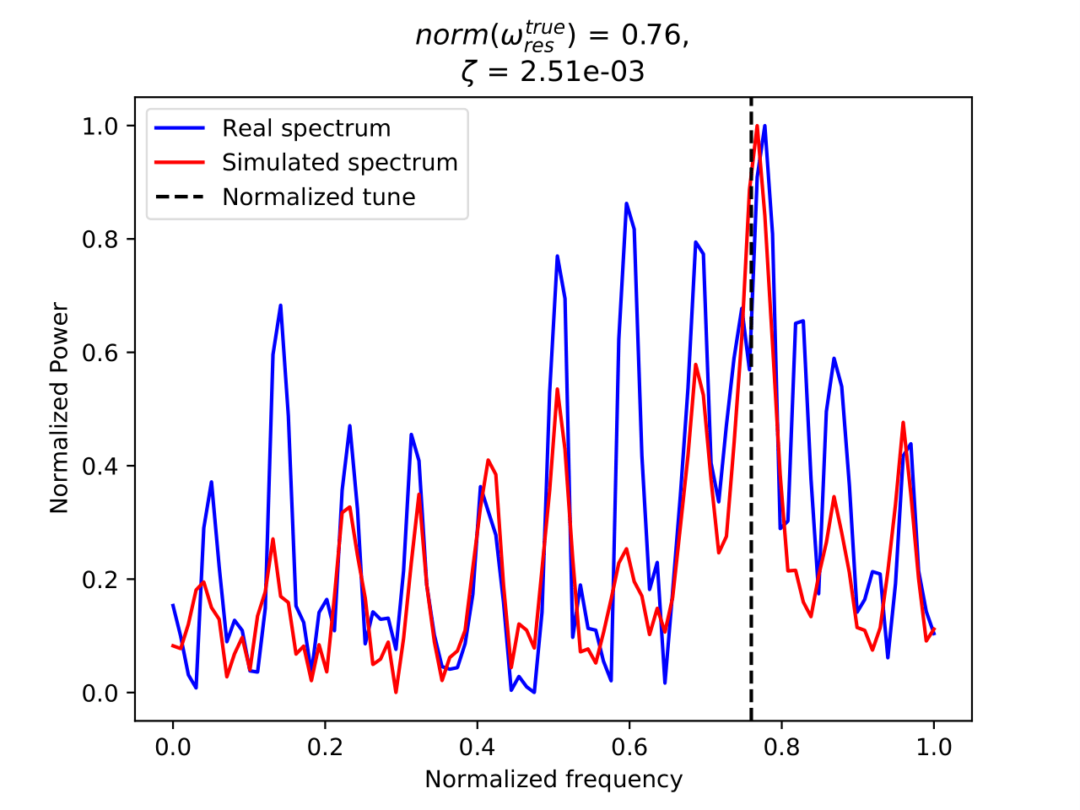
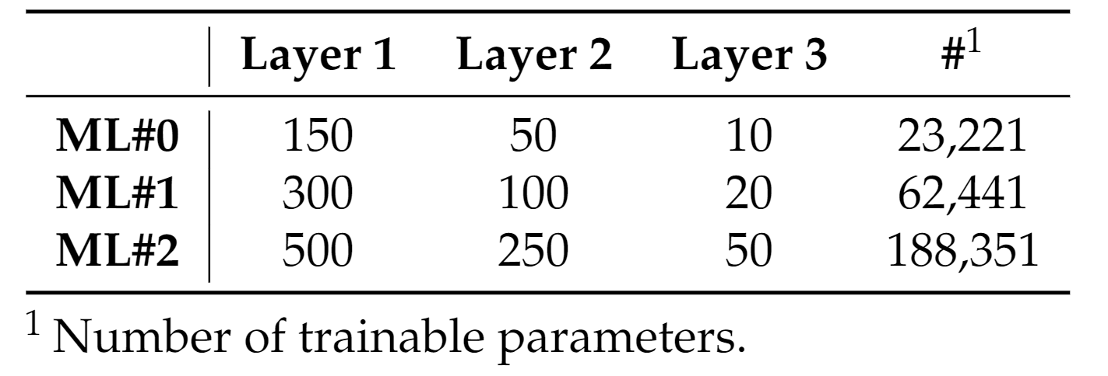
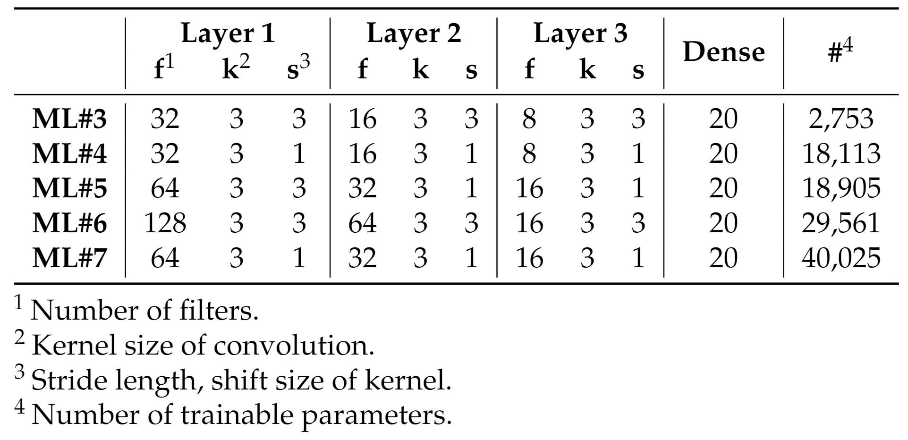
Simple approach I
Create a simulated dataset:
  Monte Carlo simulation - create different spectra
  Inject 50 Hz harmonics with random amplitudes
  Apply digital filter to widen harmonics
Train DNNs and 1D CNNs with different architectures
DNNs
1D CNNs

Slide 11
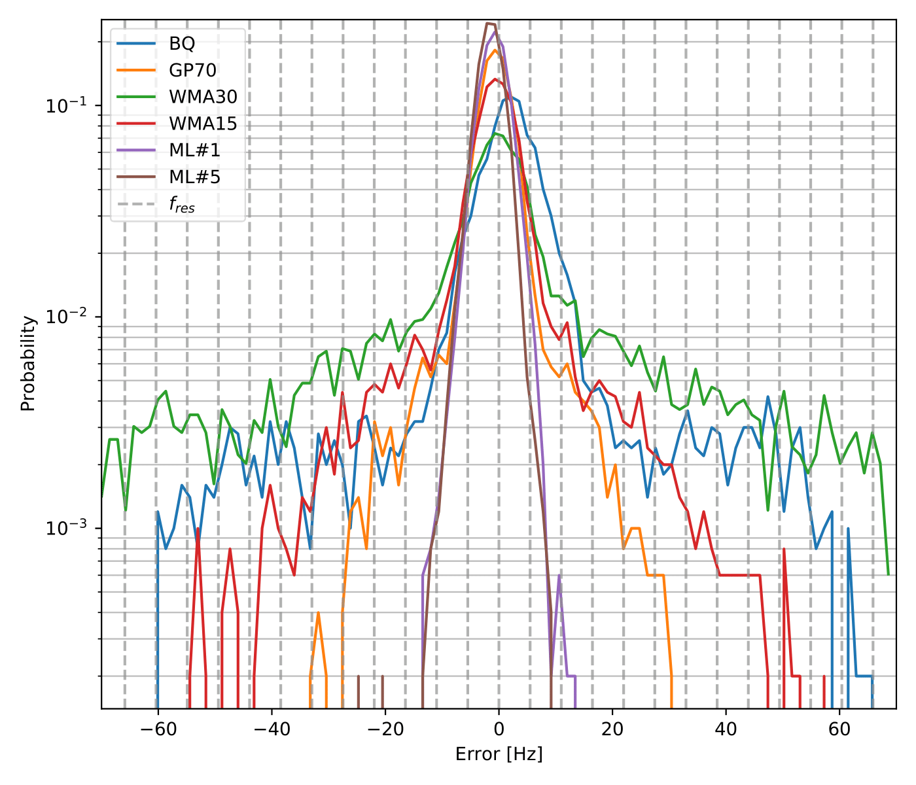
Simple approach II
Evaluation
  Compare predicted tunes to ground truth tune from simulation
  Error = Prediction - Groundtruth
  Do it over 5000 simulated spectra
Error probability distribution of errors from different models and algorithms
  BQ - original tune estimation algorithm
  GP and WMA - alternative algorithms¹
  ML #1 - best DNN model
  ML #5 - best CNN model
¹L. Grech et al., “An Alternative Processing Algorithm for the Tune Measurement System in the LHC,” in Proceedings of the 9th International Beam Instrumentation Conference (IBIC 2020), Virtual, 2020.

Slide 12
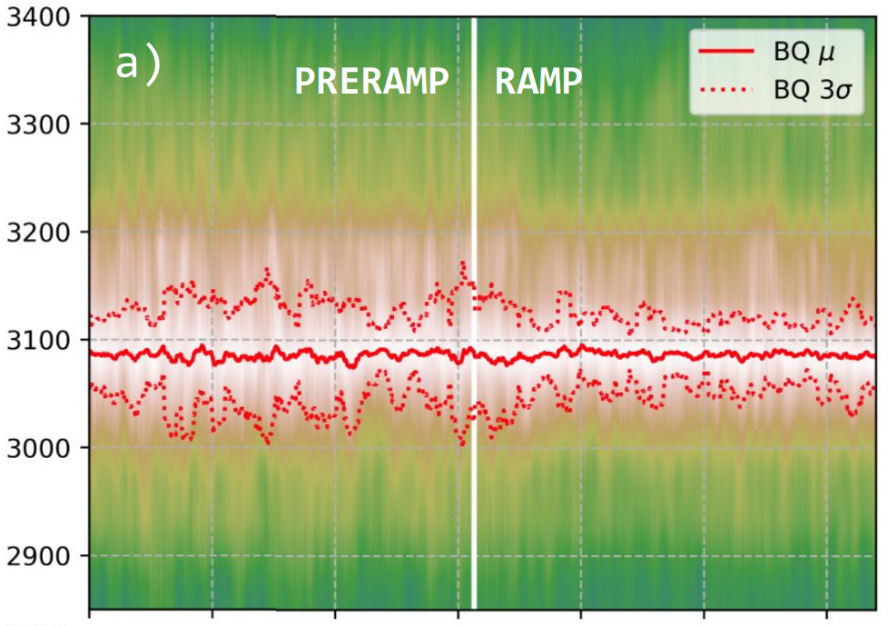
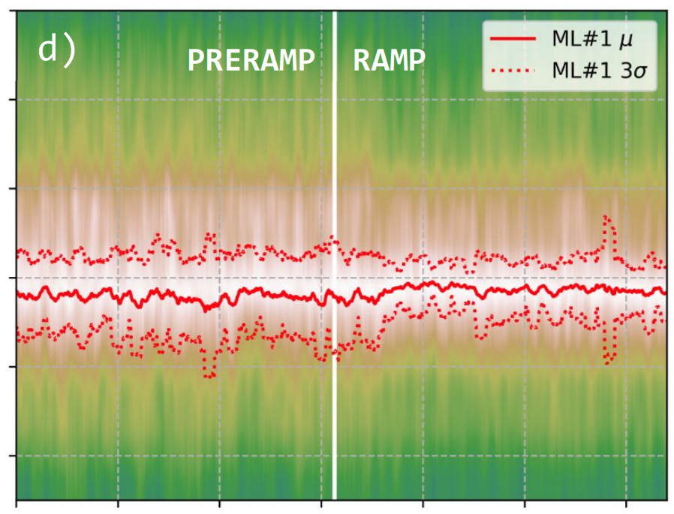
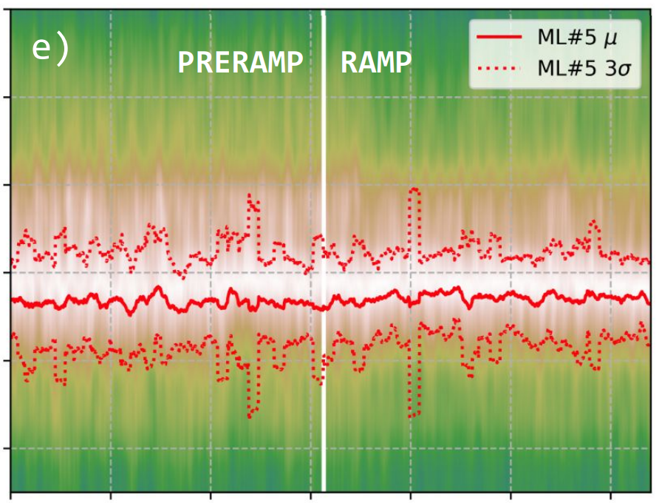
Simple approach III
Evaluation on simulated spectra show promising results ...
… but when trying ML#1 and ML#5 on real spectra ...
Same spectra - smoothed in time and frequency
Frequency
Time
Time
Time
… the results are similar to BQ

Slide 13
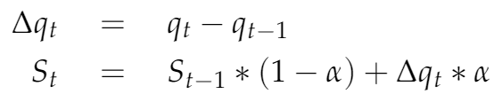
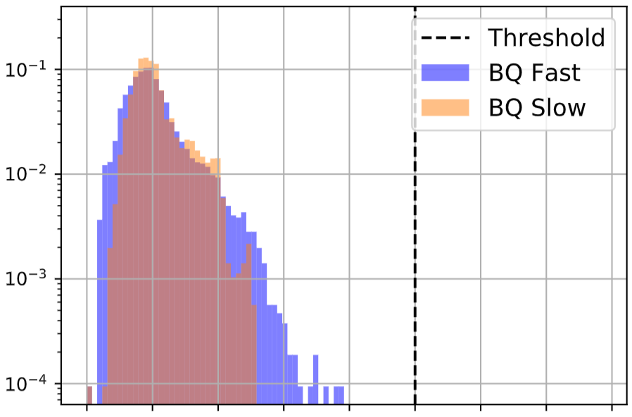
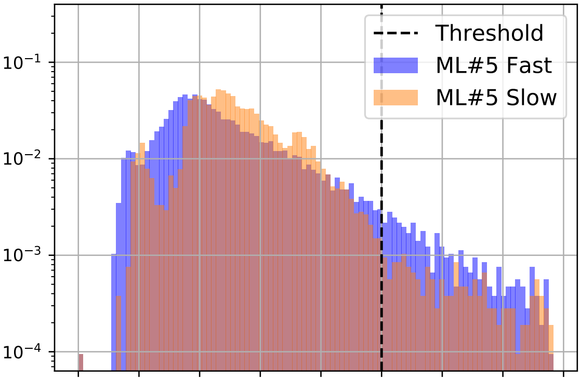
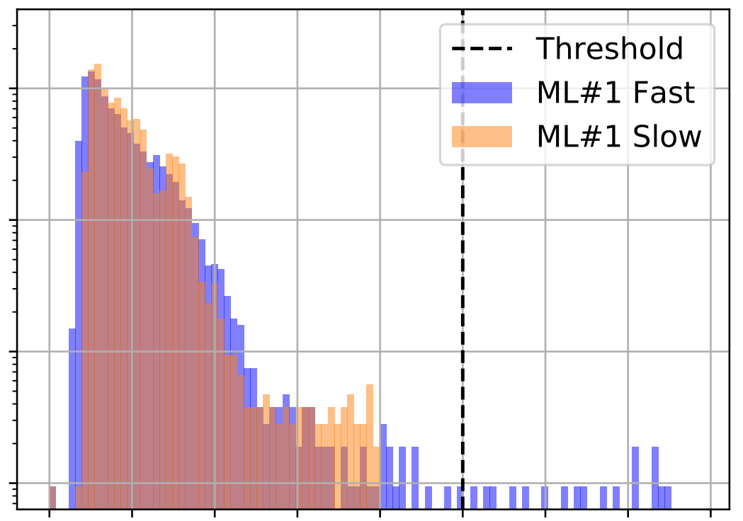

Simple Approach IV
BQ tune estimates were turning off the Tune Feedback (QFB)
  Too unstable
QFB had a stability metric:
1 Fast - 1 s
Spectra from one fill were used to obtain these stability plots
(Different fill from the one used for SimGAN)
1 Slow- 10 s
Probability
Stability
If both stabilities are beyond this point, QFB switches off
Does not look good for Simple Approach...

Slide 14
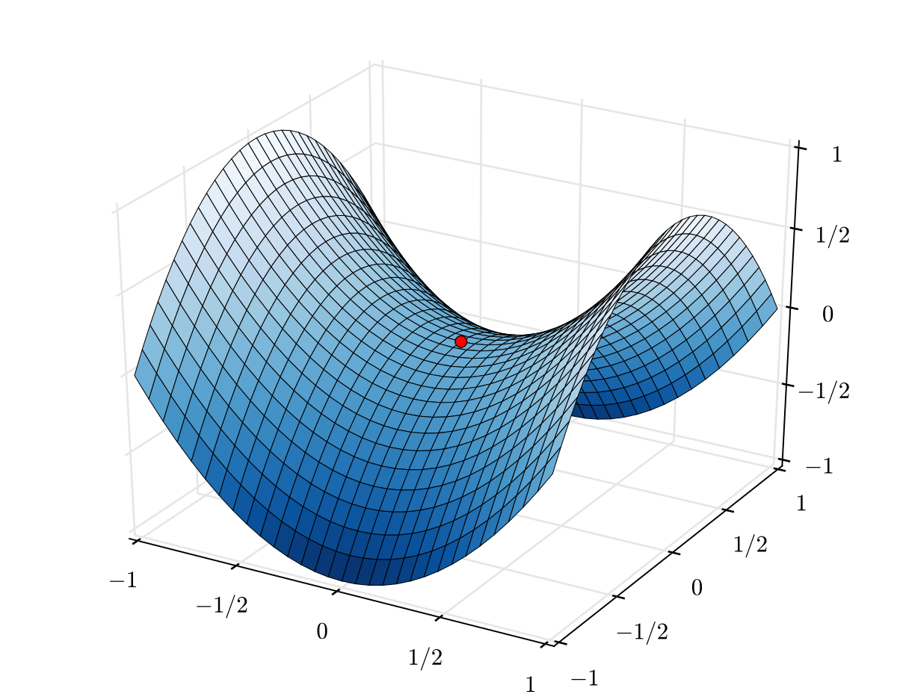
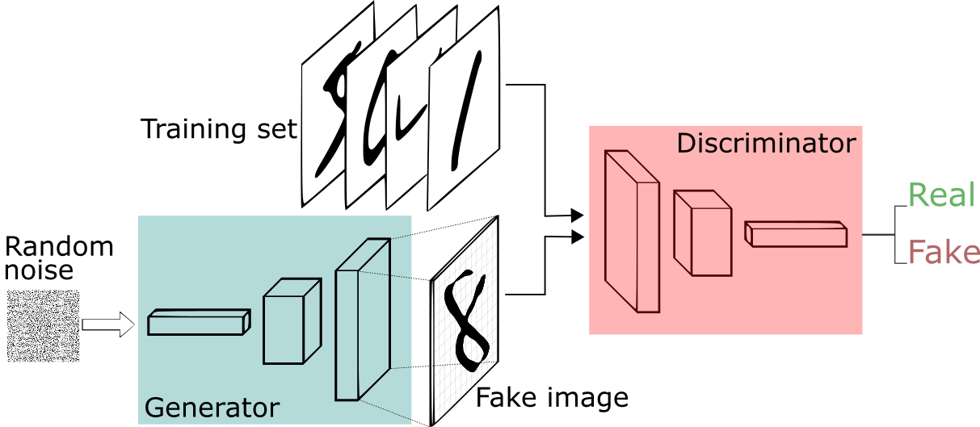
Improving the dataset I
It was known that simulated spectra do not look perfectly real
This affected training
  Models overfit to simulations
We can make the training dataset better by using a type of Generative Adversarial Network (GAN)
Train Generator (G) to create fake images
Train Discriminator (D) to classify real\fake images
Minimax problem
G maximises loss of D
D minimises class. loss

Slide 15
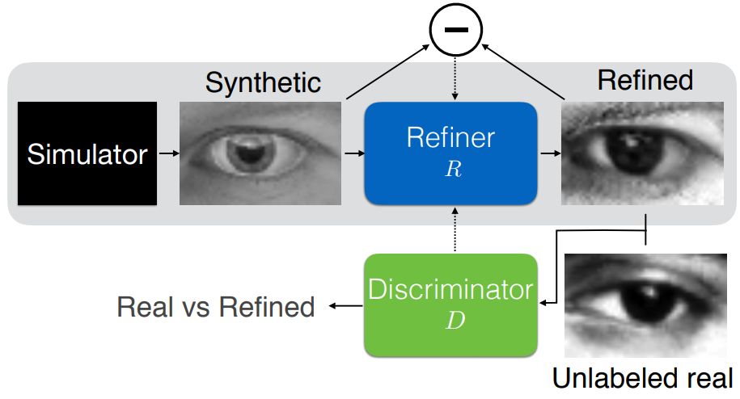
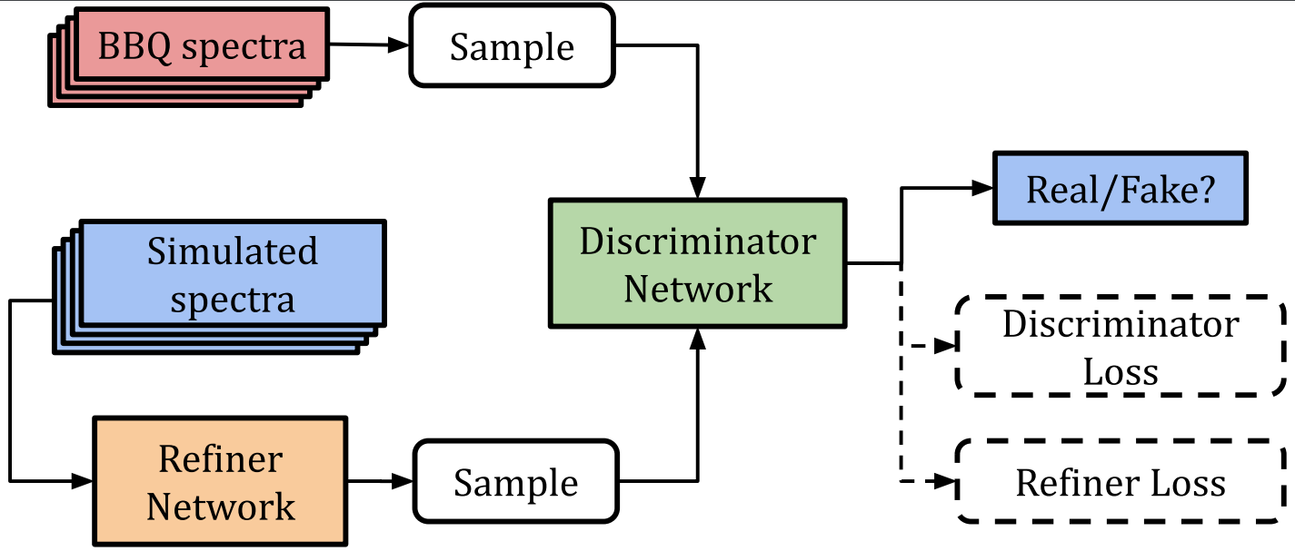
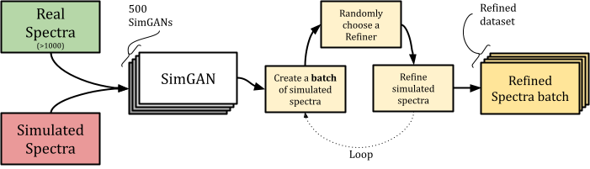
Improving the dataset II
Variant of GAN called SimGAN¹
Applying it to simulated and real BBQ spectra
Slight problem
  1 Refiner is not enough! It can produce similar looking artefacts
Solution
  Train 500 SimGANs with slightly different parameters
¹A. Shrivastava, T. Pfister, O. Tuzel, J. Susskind, W. Wang, and R. Webb, “Learning from simulated and unsupervised images through adversarial training,” in Proceedings of the IEEE conference on computer vision and pattern recognition, Hawaiʻi Convention Center, Honolulu, Hawaii, United States, 2017, pp. 2107–2116.

Slide 16
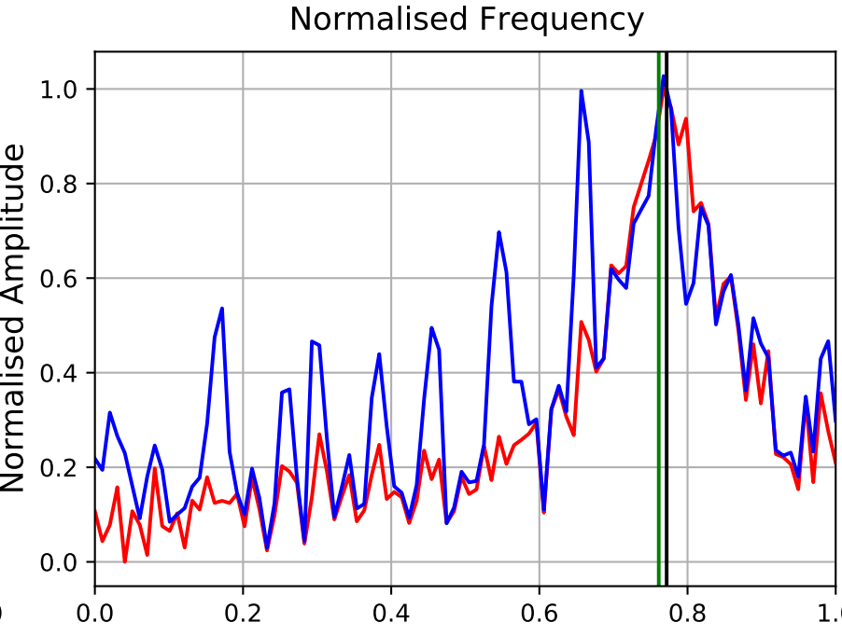
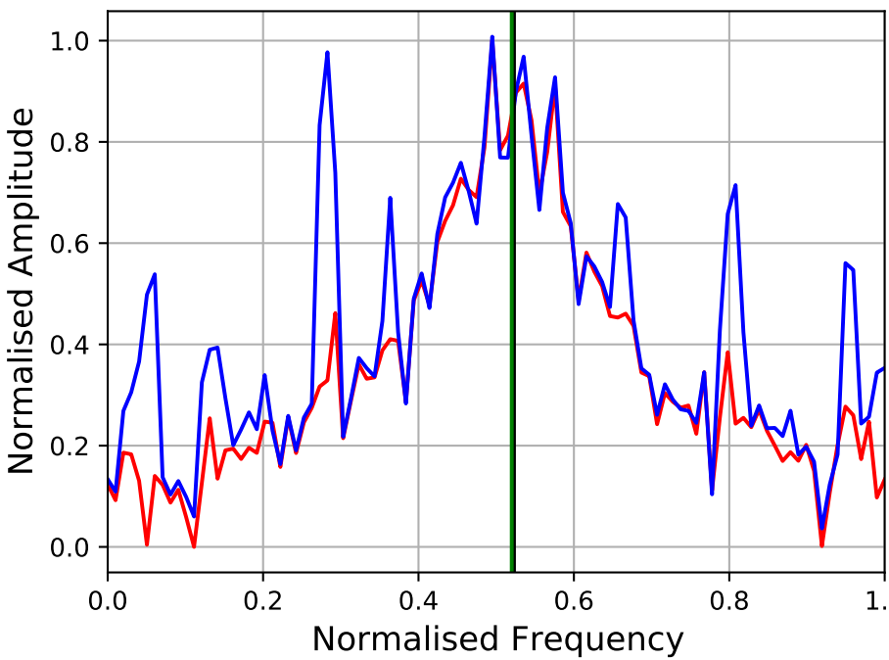
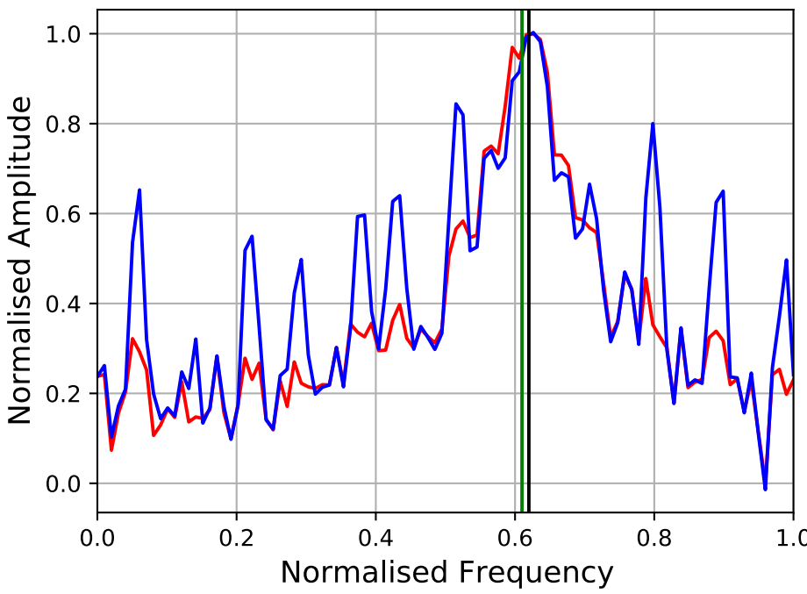
Improving the dataset III
Some examples of refined spectra
  Synthetic = Simulated
Artefacts added by SimGAN Refiner

Slide 17
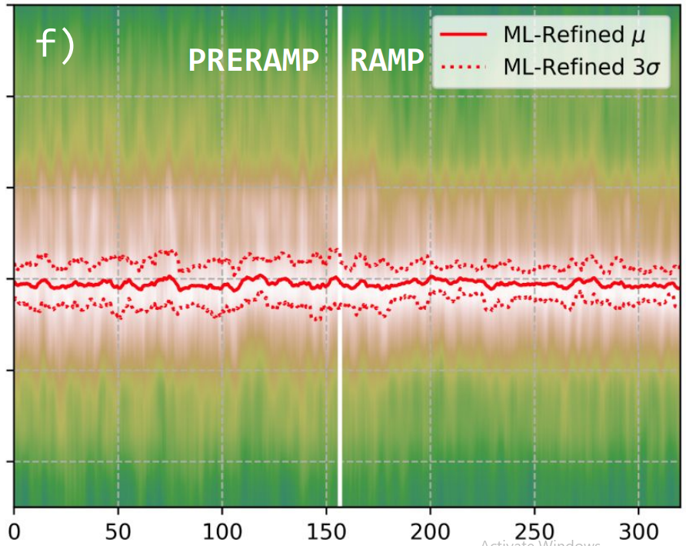
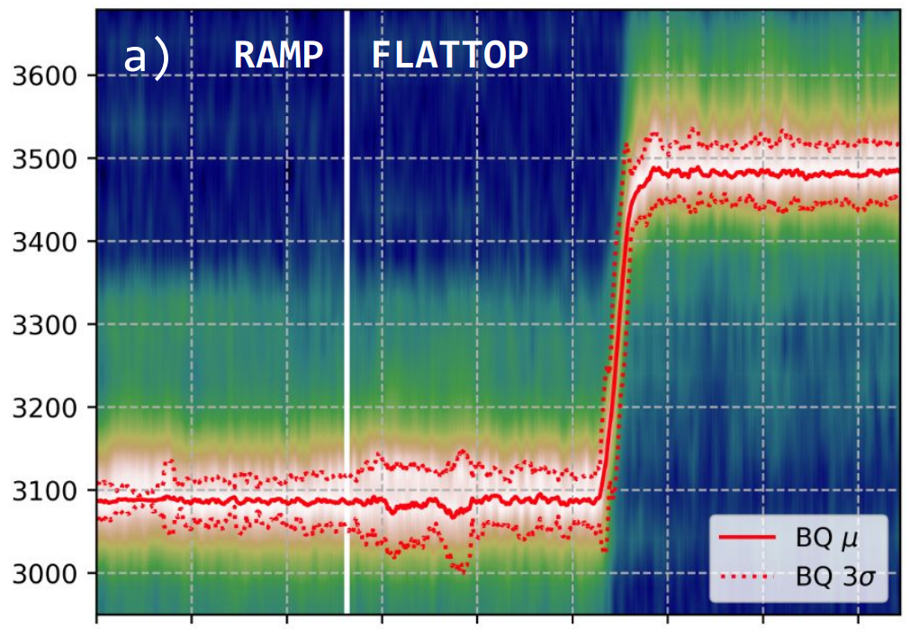
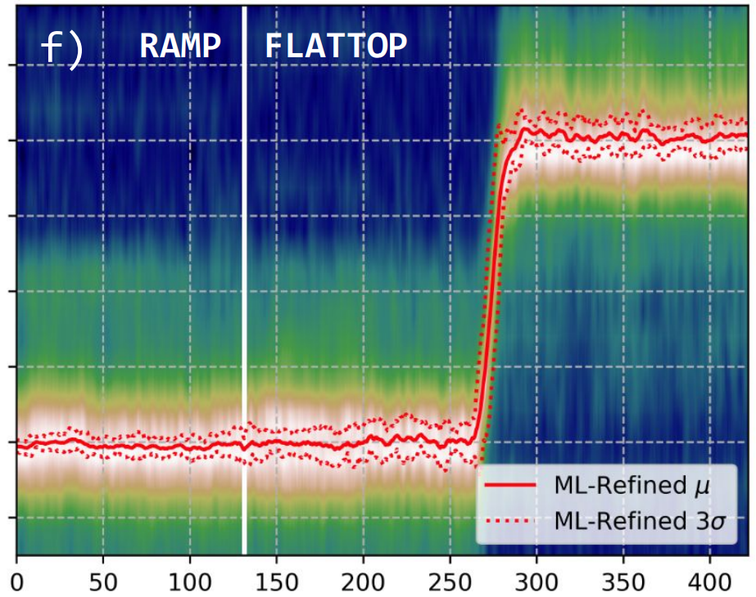
Refined Approach I
Train the best model architecture attempted in Simple Approach (ML#1) with refined dataset - ML-Refined
Frequency
Frequency
Time
Time

Slide 18
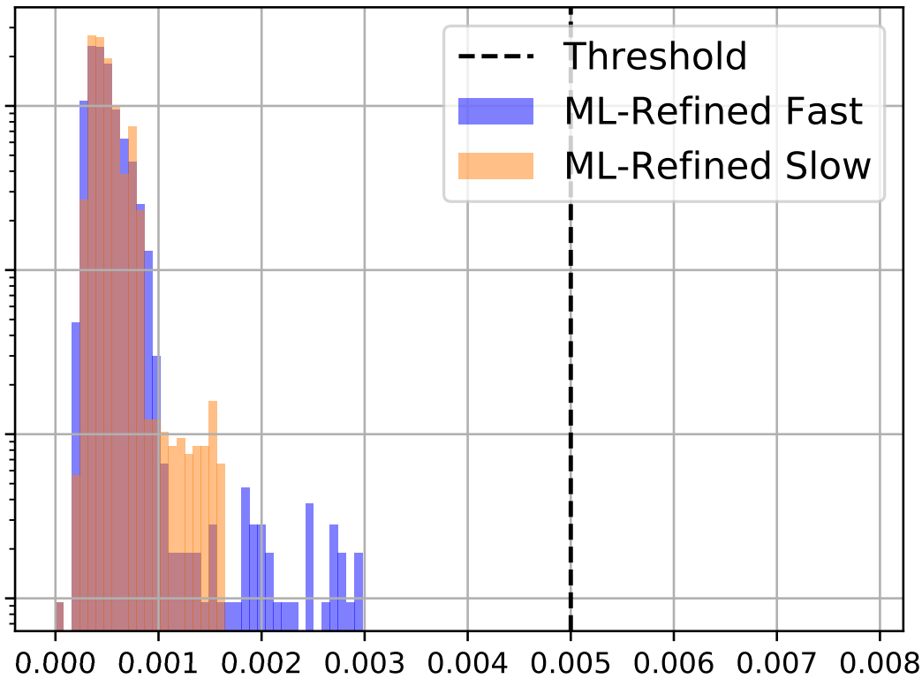

Refined Approach II
What about the QFB stability metric?
Probability
Stability
Stability
ML-Refined gave the most stable estimates from all tune estimation systems attempted

Slide 19
Conclusion
Train a NN to estimate the tune from a BBQ spectrum
Naive approach
  Use logged data as is
  Too simple
Simple approach
  Use simulated spectra
  Overfit to simulation
Refined approach
  Refine simulated spectra with SimGANs
  Produced good results

Slide 20
Publication
L. Grech, G. Valentino, and D. Alves, “A Machine Learning Approach for the Tune Estimation in the LHC,” Information, vol. 12, no. 5, p. 197, Apr. 2021.

