Slide 1
Grain inside SAND
Supporting
Structure
Cryostat
LAr Cryostat
Sup insulated and vacuum
Openable ( detectors inside)
LAr
Y
Z
Kloe
calorimeter
Inner Tracker
06/09/2021
G.Laurenti

Slide 2
Y
Grain LAr Cryostat
Dimensions: mm
200 mm
Outer vessel support rods
Inner Vessel
Thickeness 12 mm Aluminium
Density 2,7
Ay=1456 Ax = 475 L = 1200
Vol = 0,652 m^3
End cap reinforcement
Thickness 10 mm
Inner vessel support rods
Calorimeter inner
envelope
Inner Vessel
Z
Vacuum and super insulation 48 mm
Outer Vessel
Thickness 12 mm Material CFR
Average density 1,6
Ay = 1576 Ax = 595 L=1632
Vol = 1,2 m^3
LAr
Outer vessel
Schematic ZY cross section

Slide 3
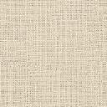
Schematic XY cross section
Supporting beam
Outer vessel
supporting rods
Outer vessel
Covers INOX
16 mm
Inner vessel
supporting rods
Covers Alum 16 mm thick
Super
insulation
200 mm
1200 mm
200 mm
Inner Vessel
Alum 12 mm
Y
LAr out
1632
X
Ribs
Ribs
1664

Slide 4
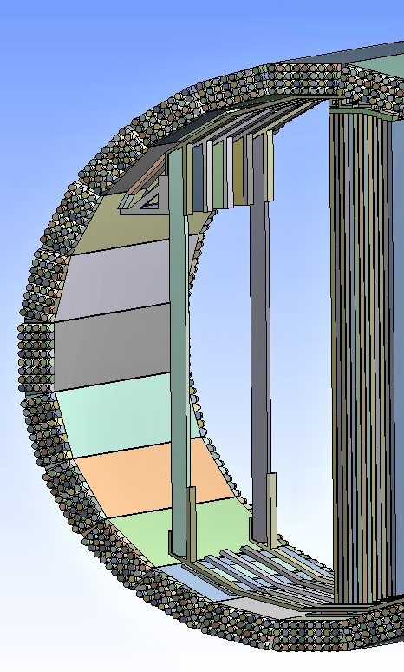
Grain Cryostat
Y
Calorimeter inner
envelope
200 mm
End cap reinforcement
Thickness 10 mm
Sup Struc
Vertical beams
Lar Vessel
150mm
Mounting
Clearance 3 mm
Z
2.6
Sup structure /Out
ves wall
Gap = 80 mm
Cal /out ves wall
Gap = 80 mm
LAr
3.0
Outer vessel
Vacuum and super insulation 48 mm
Detectors (Tracking modules)
can be accomodated
between the beams
Area 2.6x3.0 mt^2 about
779

Slide 5

Clearance
Kloe cal
30 mm
80 mm
Outer Vessel
Inner Vessel
50 mm
Outer Vessel
side Cover
16
Superinsulation
48 mm
Vacuum
16
Helicoflex
Inner Vessel side Cover
LAr

Slide 6
Clearance
Kloe cal
120
30 mm
80 mm
Outer Vessel
Inner Vessel
50 mm
Outer Vessel
side Cover
16
Superinsulation
48 mm
Vacuum
16
Helicoflex
Inner Vessel side Cover
LAr

Slide 7
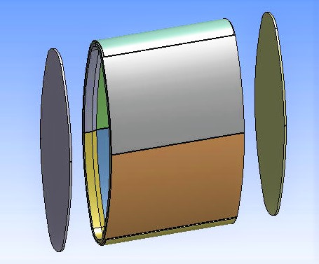
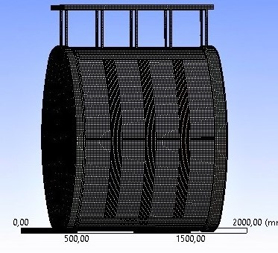
Alu Inner Vessel (12mm thick)
CFR Outer Vessel (12mm thick)

