Slide 1
WP3/WP6 General Meeting
Update on Task 3.1
Task 3.1 Physics design of the positron target and capture system
23/09/2021

Slide 2
General Updates
FCC-ee injector review (April 19th) => Positron source advantages/disadvantages of single bunch vs multi-bunch operation.
Report from the review committee is available (to be distributed ?)
The multibunch operation scheme should only be considered if it is needed in order to guarantee the target performance of the collider. Otherwise an optimized design based on a conservative approach with only a few bunches per pulse, like at the SLC and SuperKEKB, should be preferred.
As for the FCC-ee positron source:
The hybrid positron target complex predicts a very high increase in the positron yield, to a value way beyond what was achieved in previous facilities.
The tumbling (trolling) positron target used at the SLC worked quite well with a long lifetime (~ few years). Its vacuum aspects with no rotating vacuum seals proved to be a sound principle. Further investigation of this design is suggested.
Recommendations:
The project should perform an in-depth technical review of the realistically achievable positron yield, taking into account the yields achieved in existing facilities and explaining the factors contributing to the predicted gain in yield for the FCC-ee.
Frank Zimmermann
https://indico.cern.ch/event/1047479/

Slide 3
Current status
All the studies should be focused now on the operation scheme: 6 (20) GeV, 2 bunches/pulse, 100-200 Hz rep. rate.
N_{e-}/bunch ⨯ Y_{e+/e-} ≥ 3.5 nC/bunch ⨯ 2
Schemes under consideration now
Positron production:
  Conventional scheme (mainly studied until now)
  Hybrid scheme: benchmark of simulation codes and first simulation/optimization studies => in progress
Positron capture:
  Flux Concentrator as the matching device
  SC solenoid as the matching device
https://indico.cern.ch/event/1014180/

Slide 4
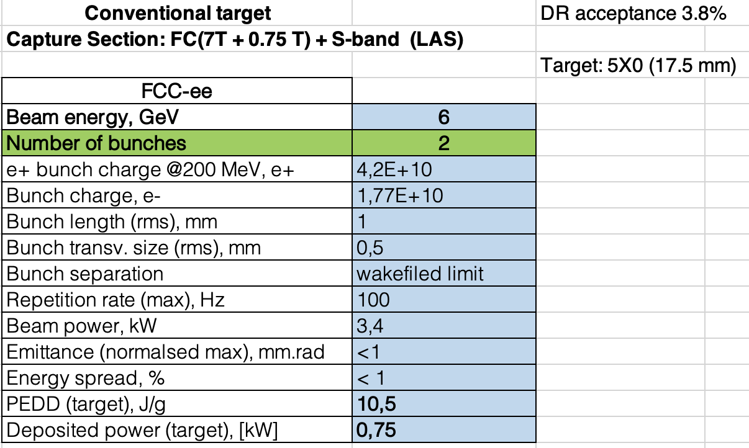
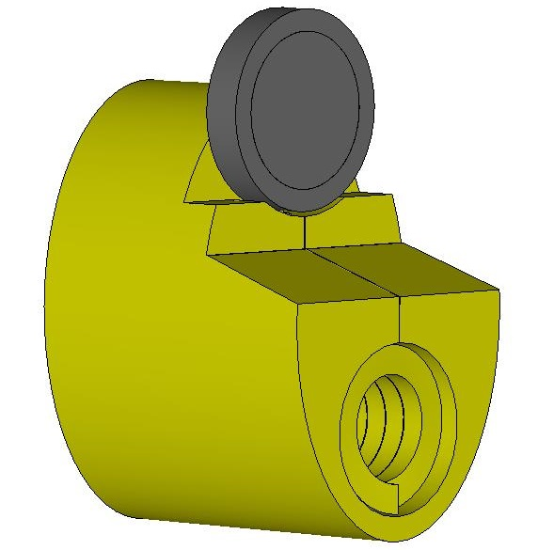
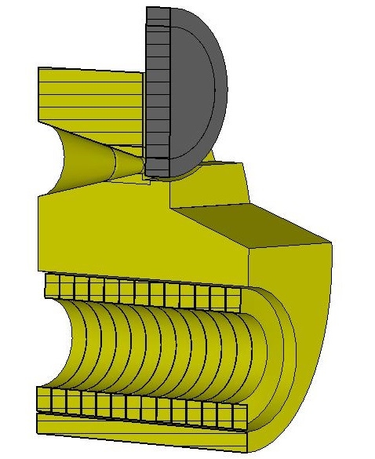
FC-based capture system
P. Martyshkin
For the FC option, we have the preliminary e- beam parameters, FC design and expected accepted positron yield.
Next step: together with CERN-STI group perform the first estimation for the target design. First mechanical integration.
See update on Task 3.2 by Pavel

Slide 5
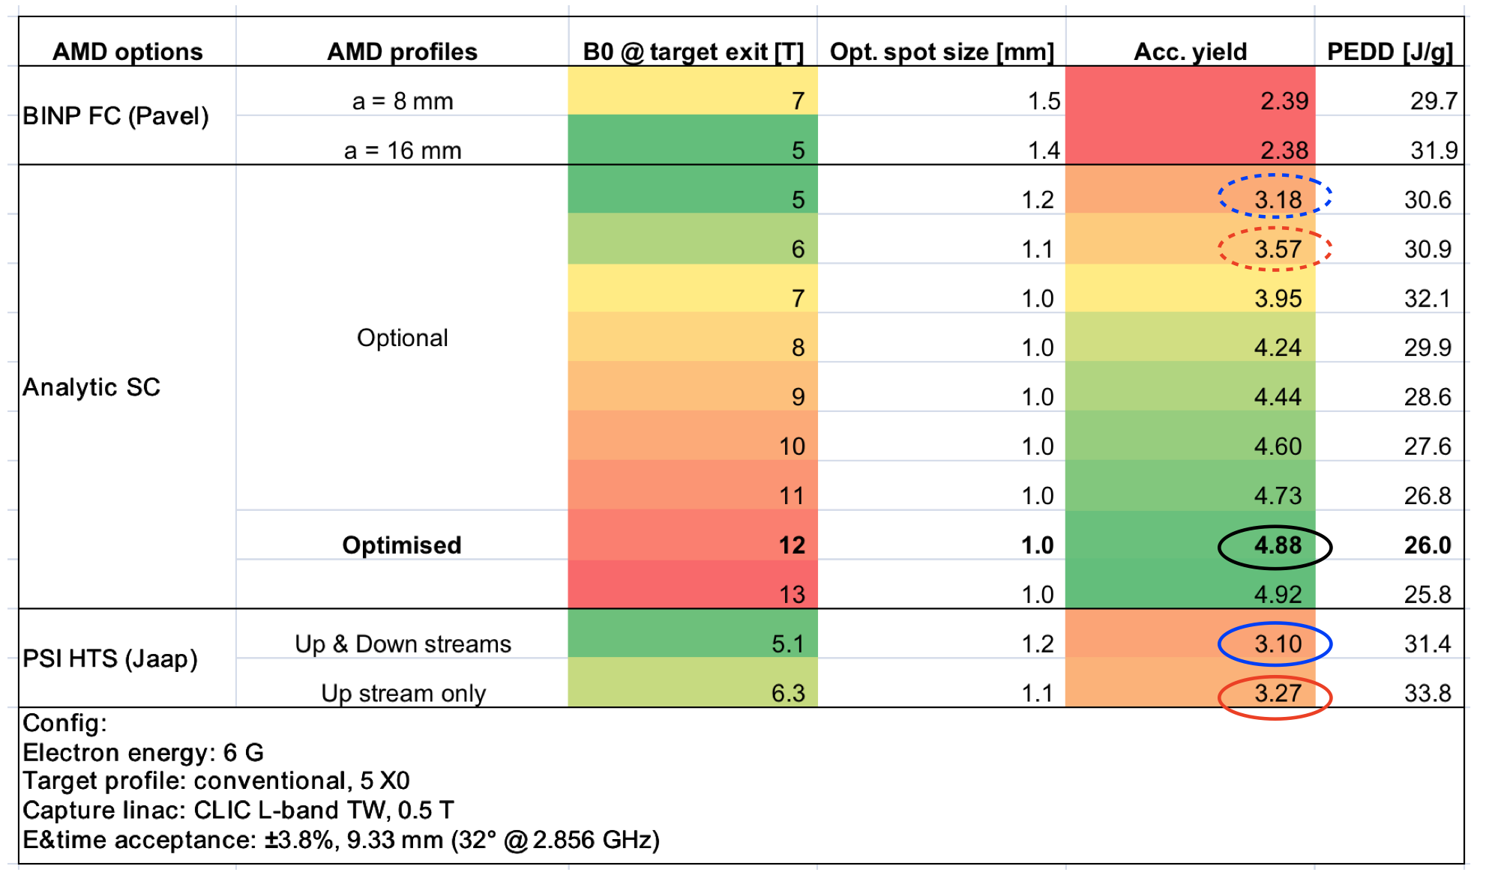
SC solenoid-based scheme
https://indico.cern.ch/event/1072704/
https://indico.cern.ch/event/1075027/
Y. Zhao
For the SC solenoid option, there are currently two designs: upstream coil and upstream + downstream coils (PSI, CERN-STI group)
Next step: detailed studies of the positron capture with the available field maps.
Together with PSI and CERN-STI groups perform optimization studies for the magnet parameters (peak field, profile) First mechanical integration.
See update on Task 3.2 and 3.5 by Jaap and Anton

