Slide 1
Task 3.2 Capture system: Concepts of a SC solenoid and/or of flux concentrator
  Realistic design and optimization of the FC geometrical parameters with Bridge Coils and SC solenoid
  (field profiles in the vicinity of the target, peak field, FC diameter, compatibility with target design,
  gaps size between FC and target, placement of the target with respect to the SC solenoid).
=> Input (including iterations) for task 3.4

Slide 2
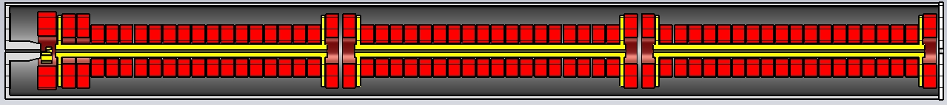
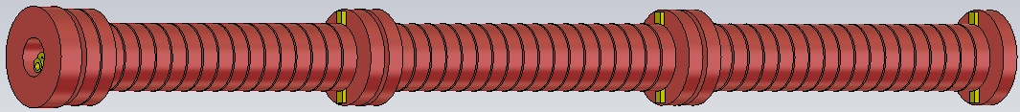
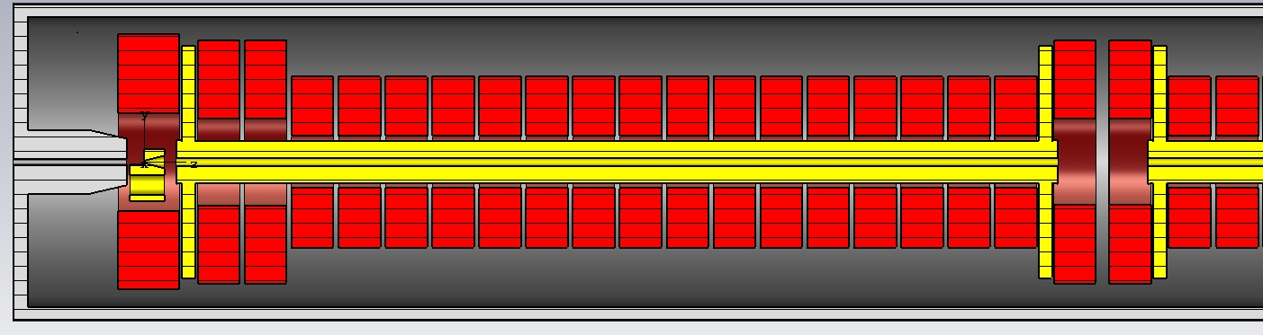
FC&NC Solenoid and accelerating structures layout

Slide 3
Magnetic field of FC at the target exit practically twice lower of a peak field (it is not well from point of view a positron dynamics).
Bridge Coil and Ferromagnetic Yoke are required in order to increase magnetic field at the target exit and compensate a field dip between Bridge and first coil of solenoid making a total field smoothed.
First 2 coils around of solenoid have enlarged diameters for the same reason and to have additional space around of acc. structure to put dipole correctors for a positron beam well centering with channel axis.

Slide 4
SC Coils as a Matching Device for a positron system
Bridge Coil is not required anymore.
Ferromagnetic Yoke is not required anymore.
Three SC coils generate an AMD field profile (for example)
  First coil generates a peak field part of AMD profile
  Second coil generates a middle part of AMD profile
  Third coil generates a long low field tail.
Total field profile should be considered as
a superposition of SC coils and DC solenoid
fields all together.
Gap width between 1-st SC coil and 2-nd SC coils should be taken from point of view enough room for a target.
Length of 2-nd SC coil should be as shorter as possible.

Slide 5
BC
C1-1
C1-3
C1-10
C1-18
C2-1
C2-10
C2-18
C3-1
C3-10
C3-18
C1-2
C1 C2
C3 C4
C5
Coil # | I×N, kA•turn | Turns number | Dint, mm | Dext, mm | Coil width, mm
C1-3÷C1-18, C2-1÷C2-18, C3-1÷C3-18 | 96 ~1 kA/turn | 96 (8×12 layers) (16×16 mm) | 180 | 590 | 144
C1-1,C1-2, C1,C2,C3,C4,C5 | 128 1 kA/turn | 128 (8×16 layers) (16×16 mm) | 300 | 840 | 144
BC | 192 1.15 kA/turn | 192 (12×16 layers) (16×16 mm) | 340 | 880 | 214

Slide 6
Accelerating structure size parameters (preliminary)
308
308
63
2901
63
2901
63
2901
63
2901
3027
3027
3027
3027

Slide 7
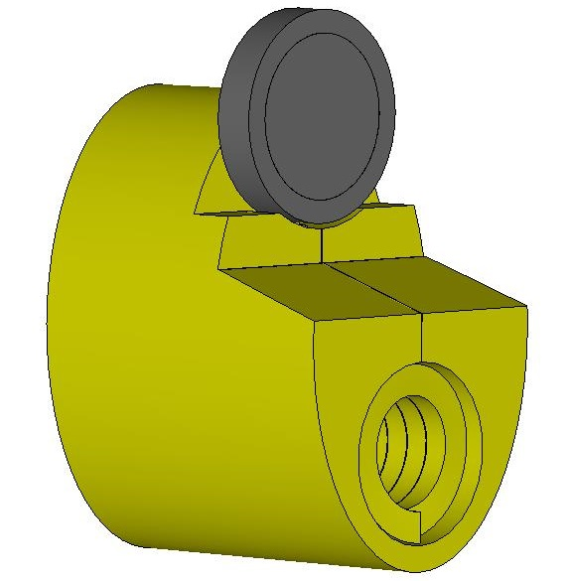
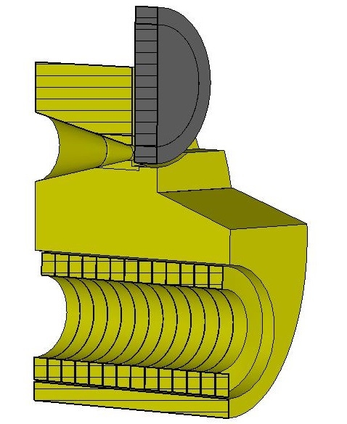
FCC-ee FC Computer model with a positron production target
Elliptical cylinder 120x180 mm
Total length is140 mm
Conical part length is 70 mm
Min cone diameter is 8 mm
Max cone diameter is 44 mm
Cone angle is ≈29 degrees
Cylindrical hole diameter is 70 mm
Coil has 13 turns
Current profile is a half of sine with a pulse length of 25 µs
Peak current is ~ 20 kA (peak field is 7 Tesla)
Gap between coil turns is 0.4 mm
Gap between coil and FC body is 1 mm
Turns size is 9.6x14 mm
Target (W74Re26) diameter is 90 mm, thickness is 17.5 mm
Gap between target and FC front face is 2mm

Slide 8
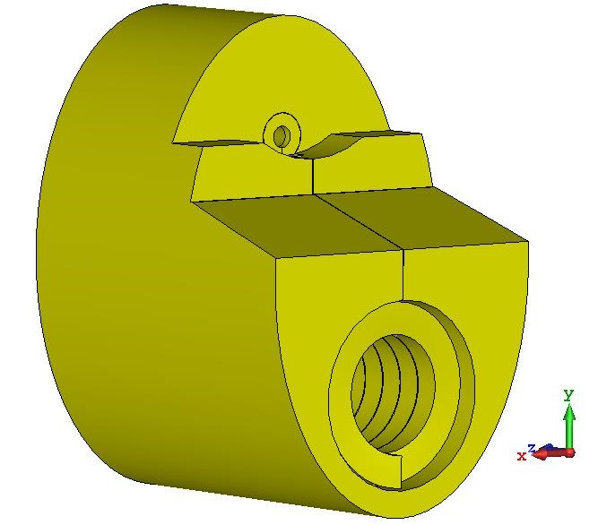
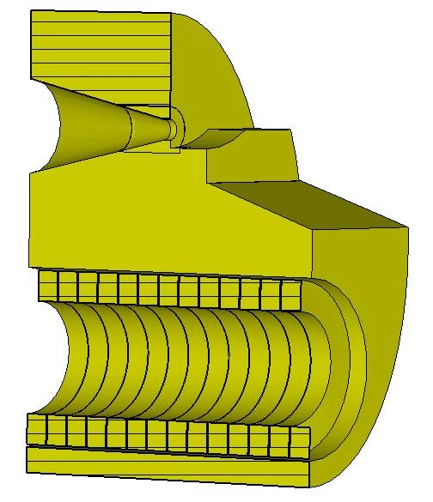
FCC-ee FC Computer model with a positron production target
Elliptical cylinder 120x180 mm
Total length is140 mm
Conical part length is 70 mm
Min cone diameter is 8 mm
Max cone diameter is 44 mm
Cone angle is ≈29 degrees
Cylindrical hole diameter is 70 mm
Coil has 13 turns
Current profile is a half of sine with a pulse length of 25 µs
Peak current is ~ 20 kA (peak field is 7 Tesla)
Gap between coil turns is 0.4 mm
Gap between coil and FC body is 1 mm
Turns size is 9.6x14 mm
Target (W74Re26) diameter is 90 mm, thickness is 17.5 mm
Gap between target and FC front face is 2mm

Slide 9
