Slide 1
WP6; P³ (PSI Positron Production) in SwissFEL
R. Zennaro, :: Paul Scherrer Institute
23.09.2021

Slide 2
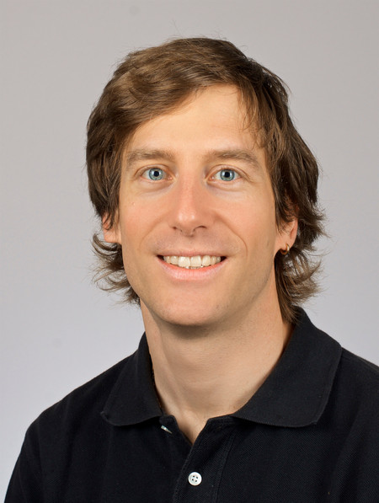
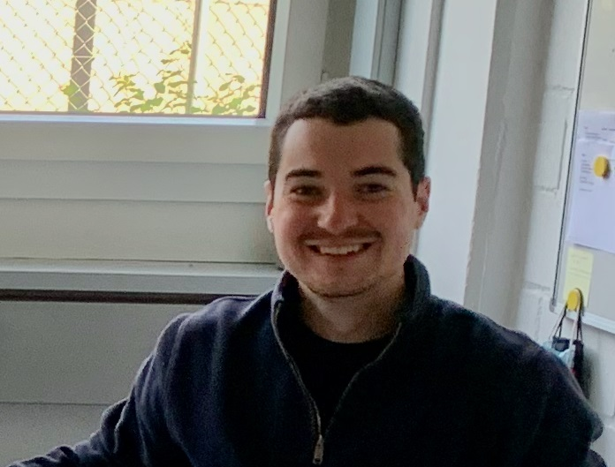
P³ PSI Positron Production (WP6)
Welcome to
Mattia Schaer
physicist, staff
Beam dynamics and coordination
@ PSI rom 1st of July
Nicolás Vallis Maestre
Engineer PhD student
Beam dynamics
@ PSI rom 1st of July
Michal Duda
Supraleitende Magnete
@ WP6/WP3 from 1st of September
Support from Ilaria Besana
Strahlungstransport und Multiphysik group @ PSI
Rdiation and radioprotection study
Open position
Draftman

Slide 3
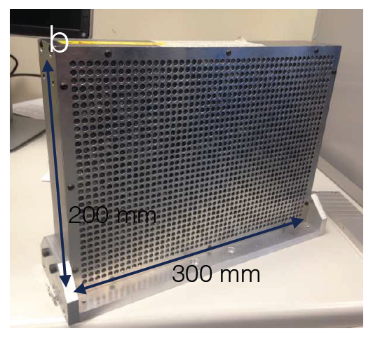
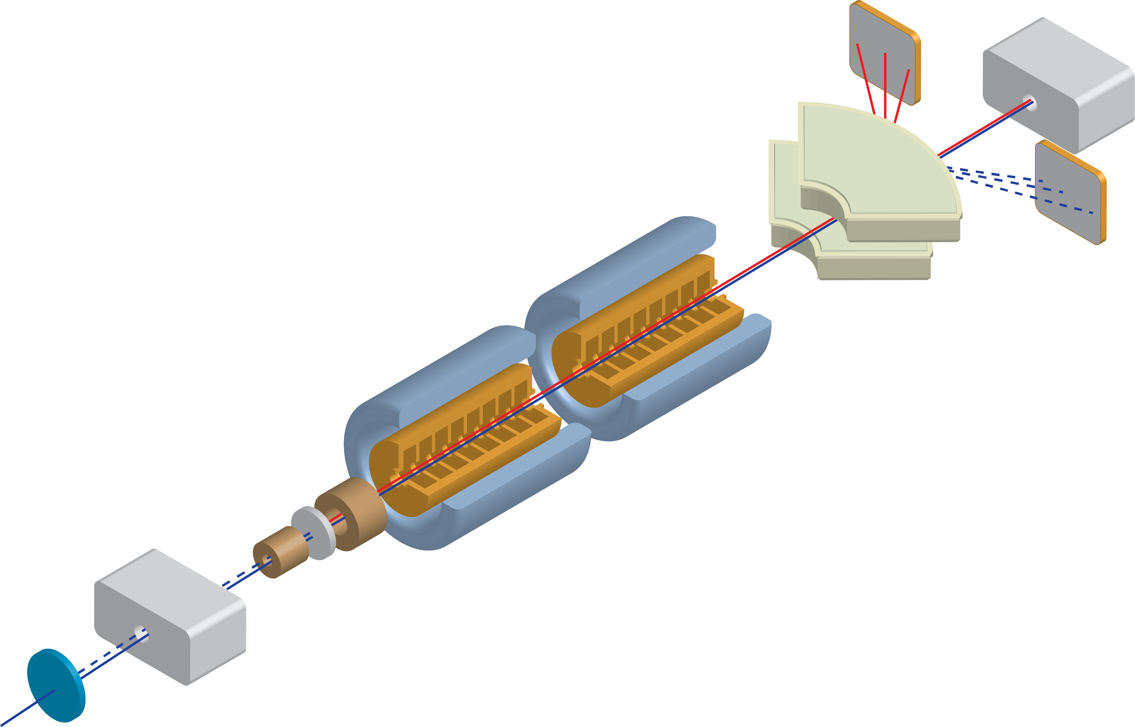
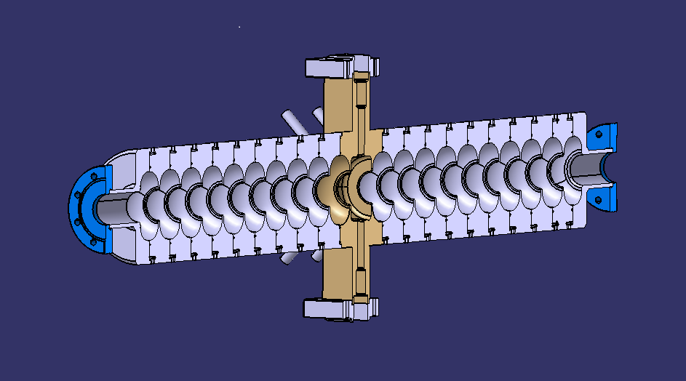
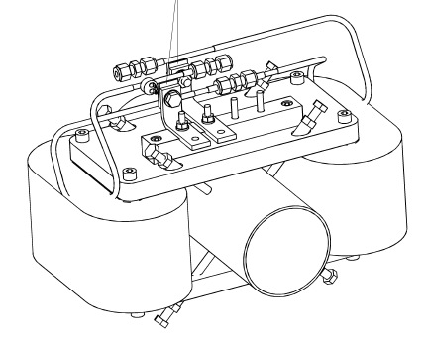
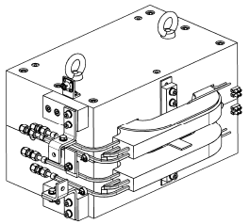
P³ PSI Positron Production (WP6)
Faraday cup (as beam stopper), design not yet started (lack of manpower)
3 GHz 1.2 m, new design (shorter), new coupler, new cooling circuit
Photon diagnostic:
CsI array. Diagnostic group at PSI starting working on a possible design
Vertical dipole, AFBC1 x4 available at PSI
NC solenoid, design not yet started
Spectrometer: SHA x1 available at PSI
Superconducting AMD under study
Crystal insertion device, design not yet started, (lack of manpower)

Slide 4
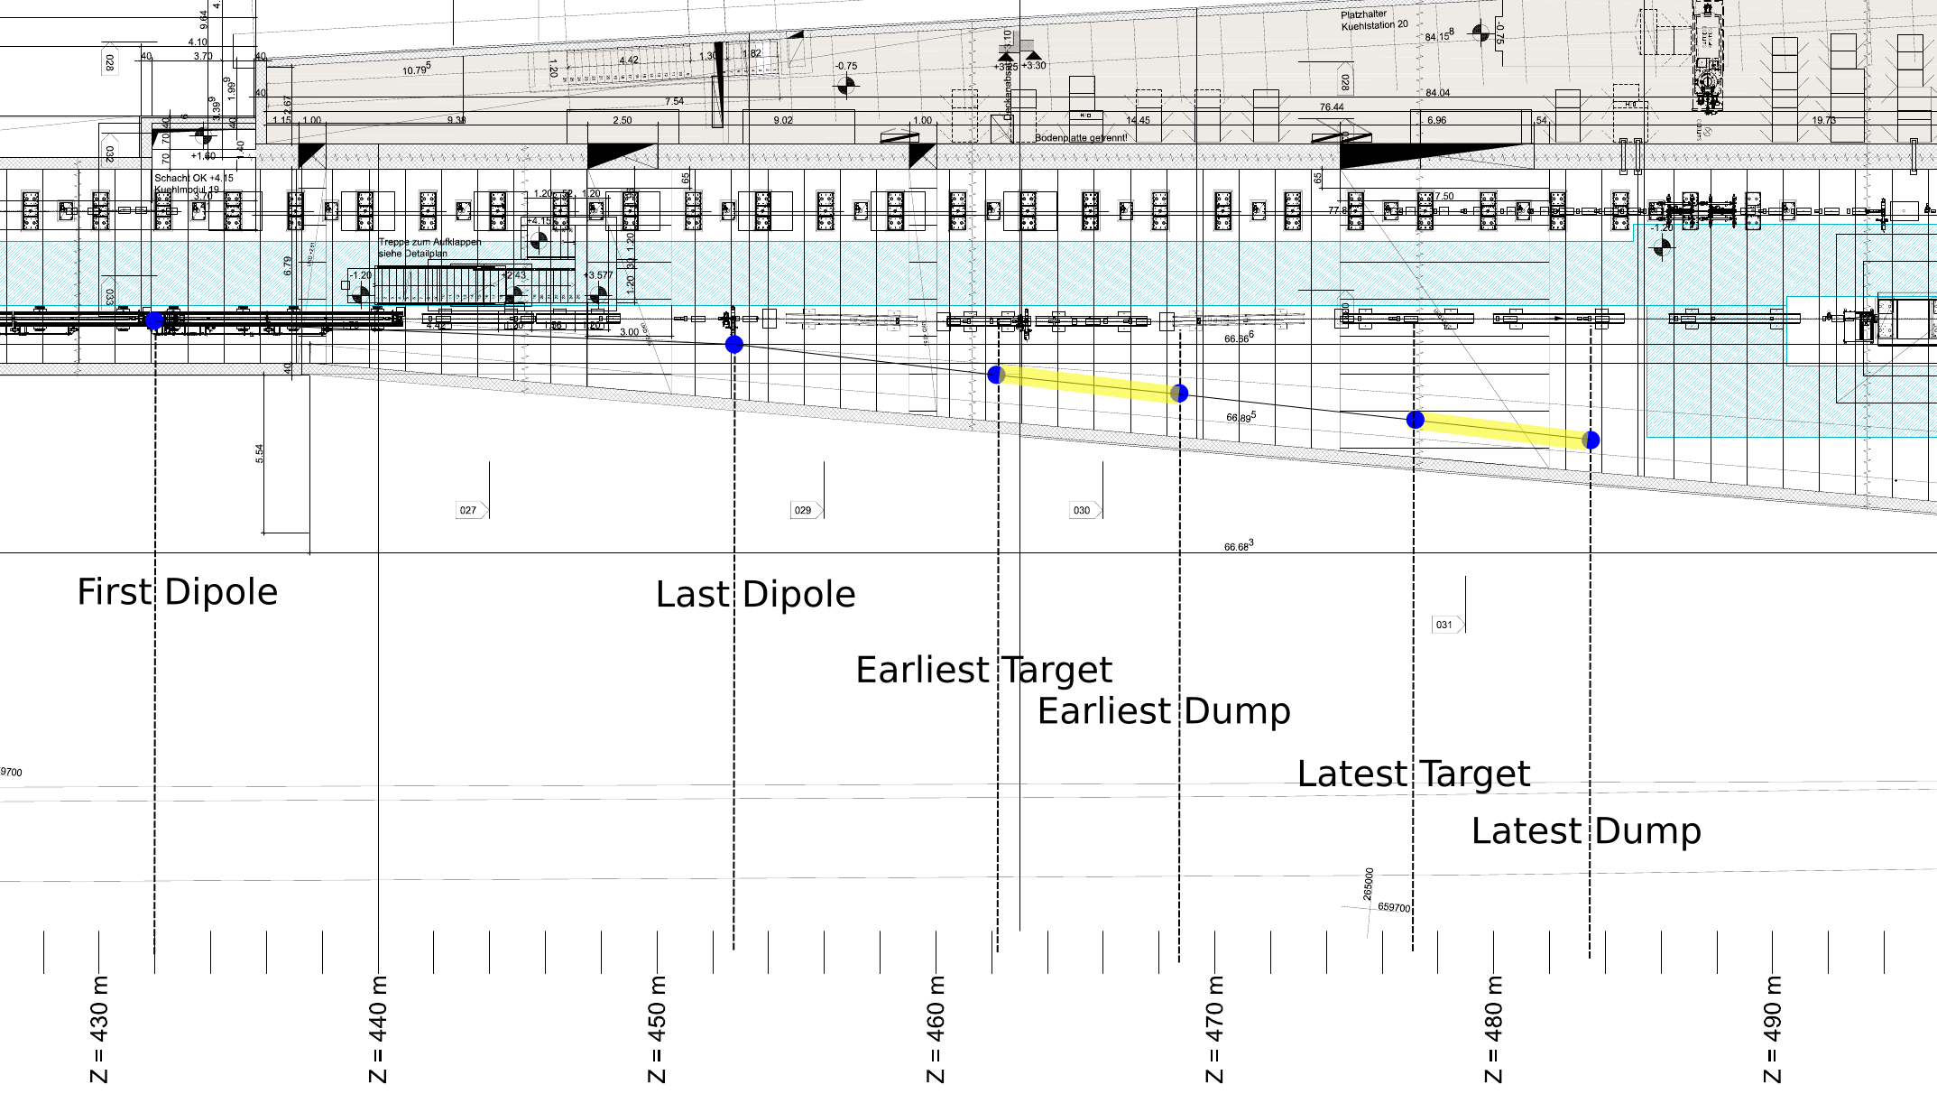
Experiment location 1: Porthos transfer line
Crystal at Z= 462.8
Transverse and longitudinal space, possibility to have a wall chicane
No interference with beam for users
Cost
Time and manpower
Very long waveguide (> 40m, ~20% losses)
Requires shielding on top of the experiment
Possible loan of two B190 dipoles from CERN (J. Bauche )

Slide 5
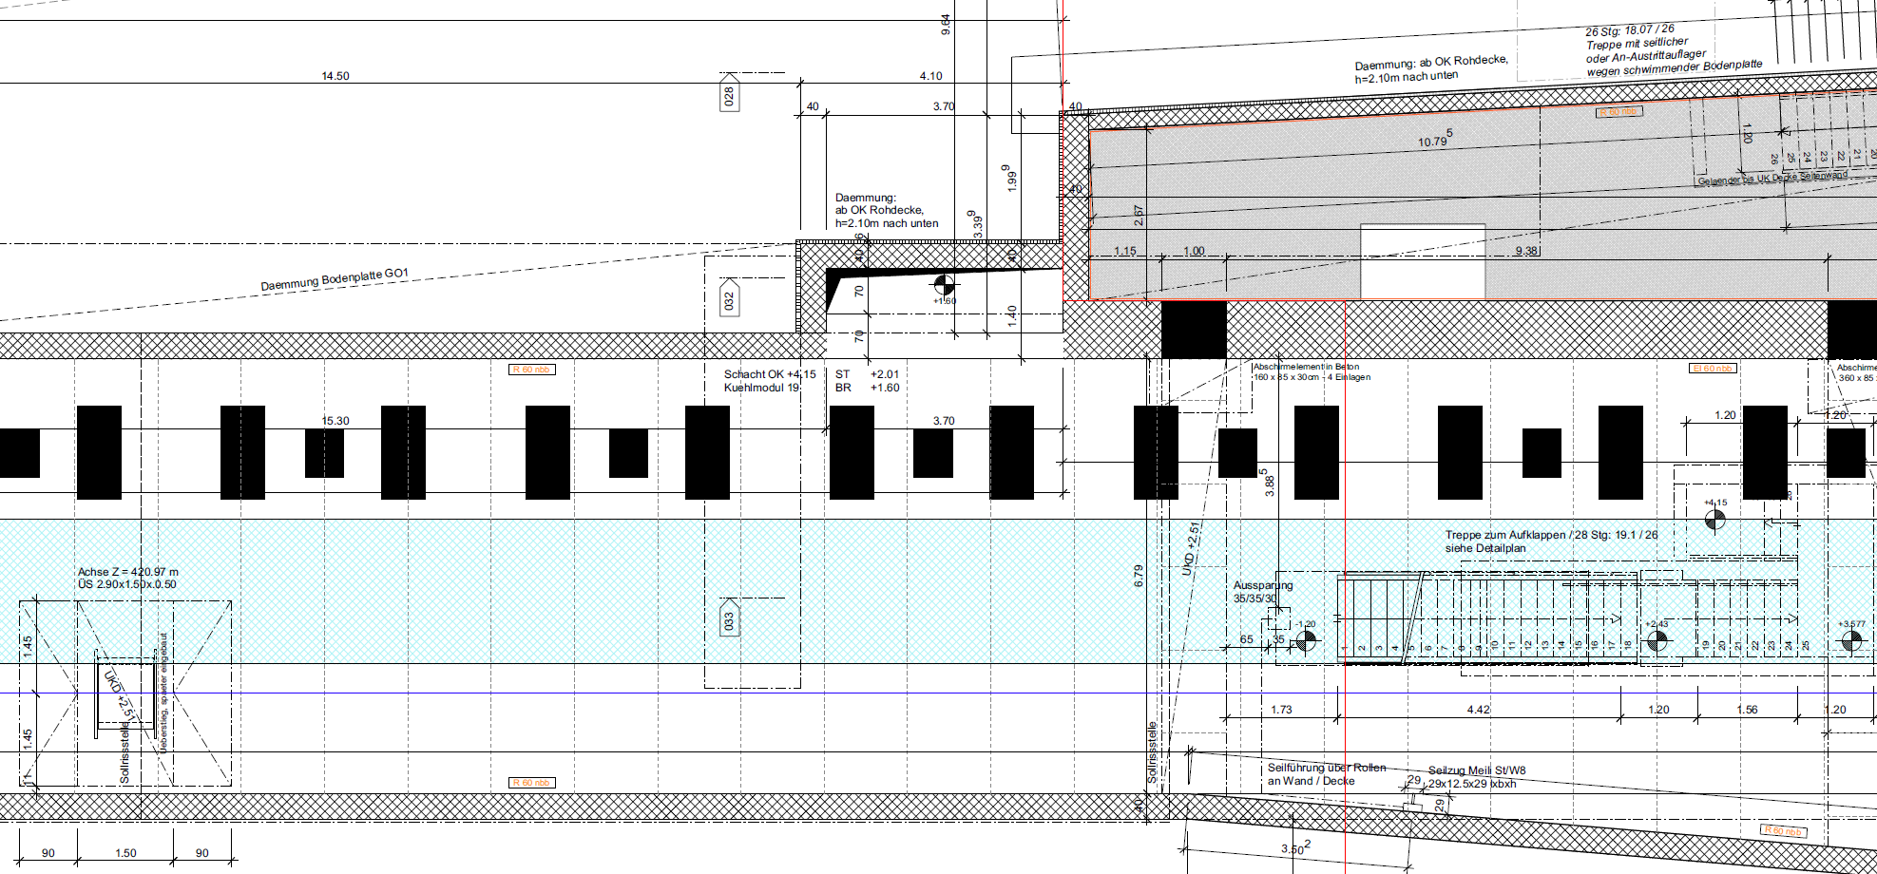
Experiment location 2: End of Linac3
Crystal at Z= 422.8
Next to the klystron ideal for waveguide layout
Cost, no need of dedicated beamline
Installation time and manpower
Below technical gallery, no need of shielding on top of the experiment (?)
Reduced transverse available space, conflict with transport corridor
Reduced longitudinal shielding space, no space for wall chicane
Risk of interference with beam for users (in-out devices, residual magnetic fields (?), closing of vacuum valves during RF conditioning)
Requires a movable beam stopper
≥ 3 m

Slide 6
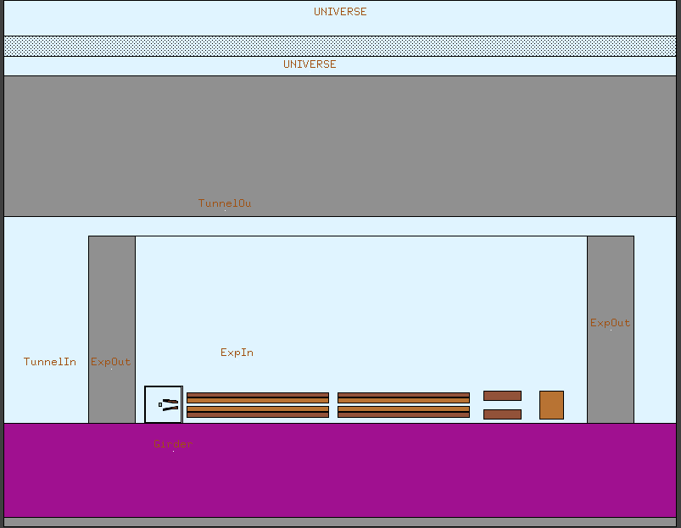
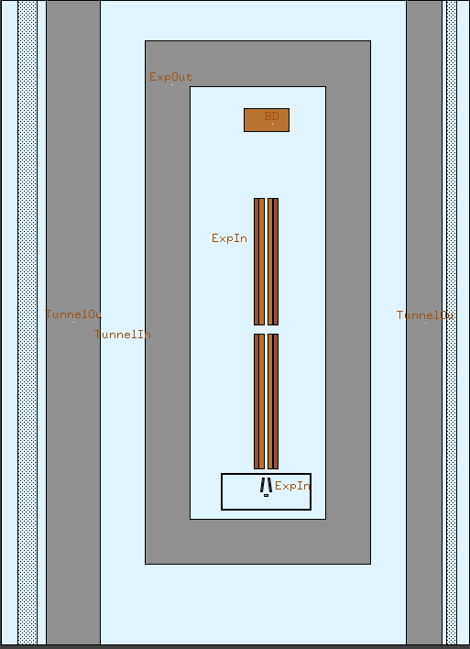
Radiological aspects - FLUKA implementation
Dose Top
Dose Left
Dose Right
Constraints:
Primary beam: e⁻ (7 GeV)
Walls: Concrete (top: 150 cm, left: 60 cm, right 40 cm)
Shielding experiment: Concrete (50 cm)
Beam Stop: Cu, (dz, dy, dx) = 25 cm x 30 cm x 50 cm
Courtesy of Eike Hohmann

Slide 7
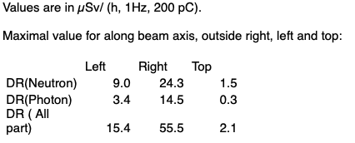
Radiological aspects - Results
Total dose rate xz-plane (beam height)
Limits:
Outside fence: 0.1 µSv/h (top)
Inside fence: 0.6 µSv/h (top)
Technical Gallery: 10 µSv/h (top)
Soil: 1 mS/h
Courtesy of Eike Hohmann

Slide 8
Comparison of the locations
 | Location 1 (Porthos TL) | Location 2 (Aramis Linac 3)
Space availability for the shielding | ++ | --
Radioprotection (without additional top shielding) | 8 pC, 1Hz | 200 pC, 1 Hz
General security aspects (i.e. escape routes) | + | --
Risk of interference with normal operation | ++ | --
RF network | -- | ++
Costs (including TL) | - | +
Required manpower | - | +
Time schedule | - | +

Slide 9
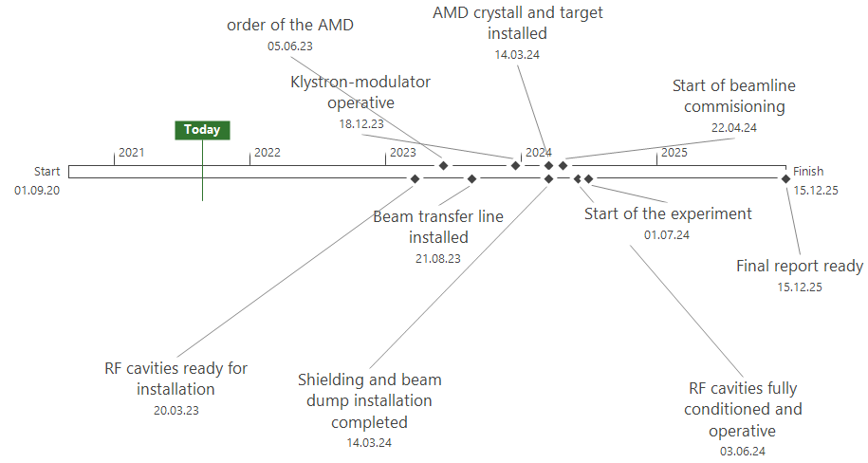
Preliminary time schedule
Criticalities:
Installation only during shutdowns
→ Very limited time and manpower
(SLS2 high priority vs. P³…)
Experiment in user facility
→Limited beam time

