Slide 1
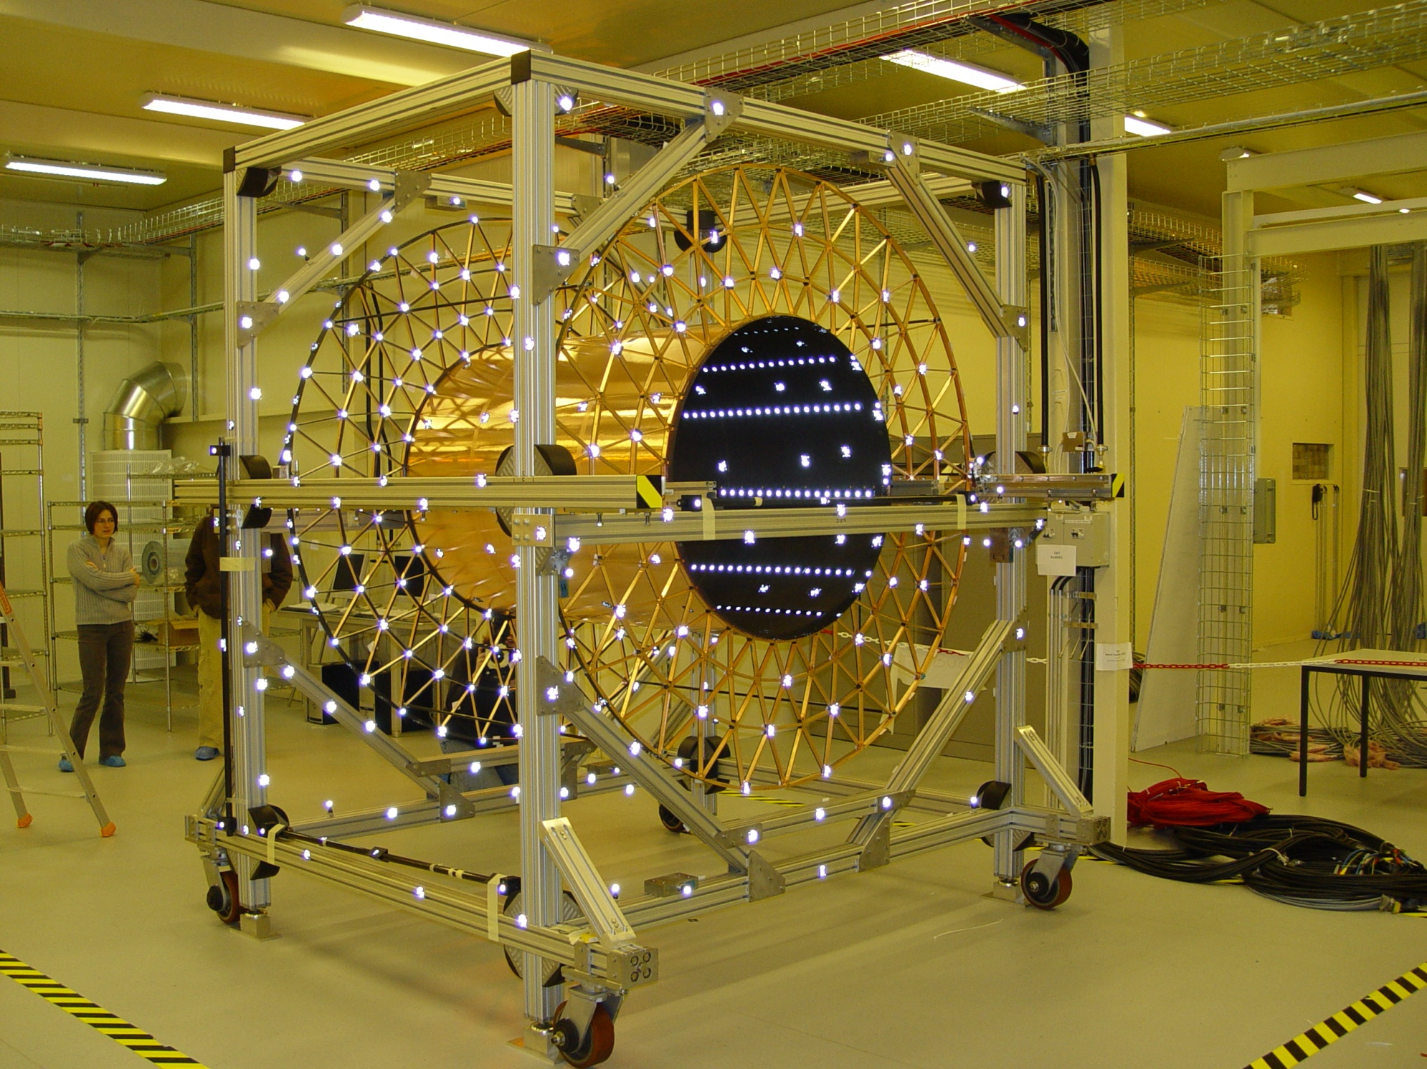
Survey techniques for experiments and advanced 3 D Digital Reconstruction
Aurelie Maurisset, Christophe Bault , Andrea Catinaccio
October 1st 2010
Ref. CERN-PH, options for future common projects in Mechanical Engineering:
http://indico.cern.ch/conferenceDisplay.py?confId=36704
Notes:
1

Slide 2
Introduction
  Aurelie will present: standard survey and new laser scanning techniques for experiments
    A long and essential collaboration with the Survey team (BE-ABP) throughout the years of construction and installation of our detectors.
Christophe will present: application examples of the laser point cloud and CAD reconstruction
As a brief introduction I will show a typical application of survey to build and install a detector - and how we came to new requirements for surface scanning / reverse engineering techniques (3D).
A. Catinaccio - CERN
2
Notes:
2

Slide 3
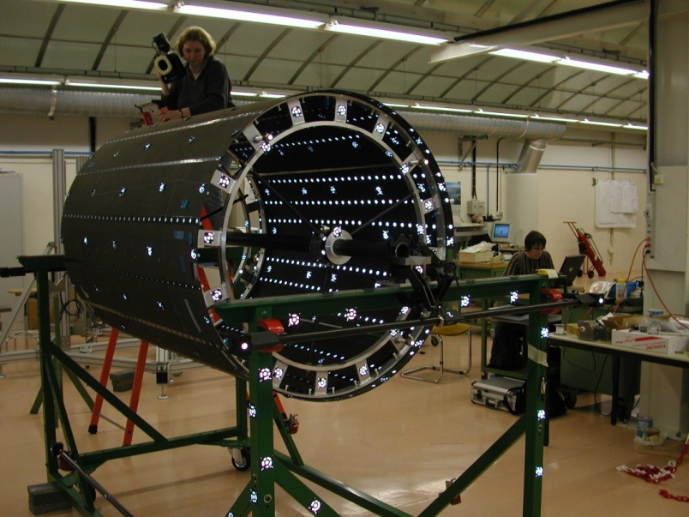
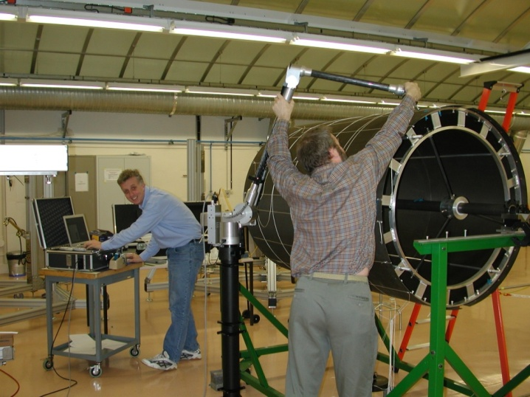
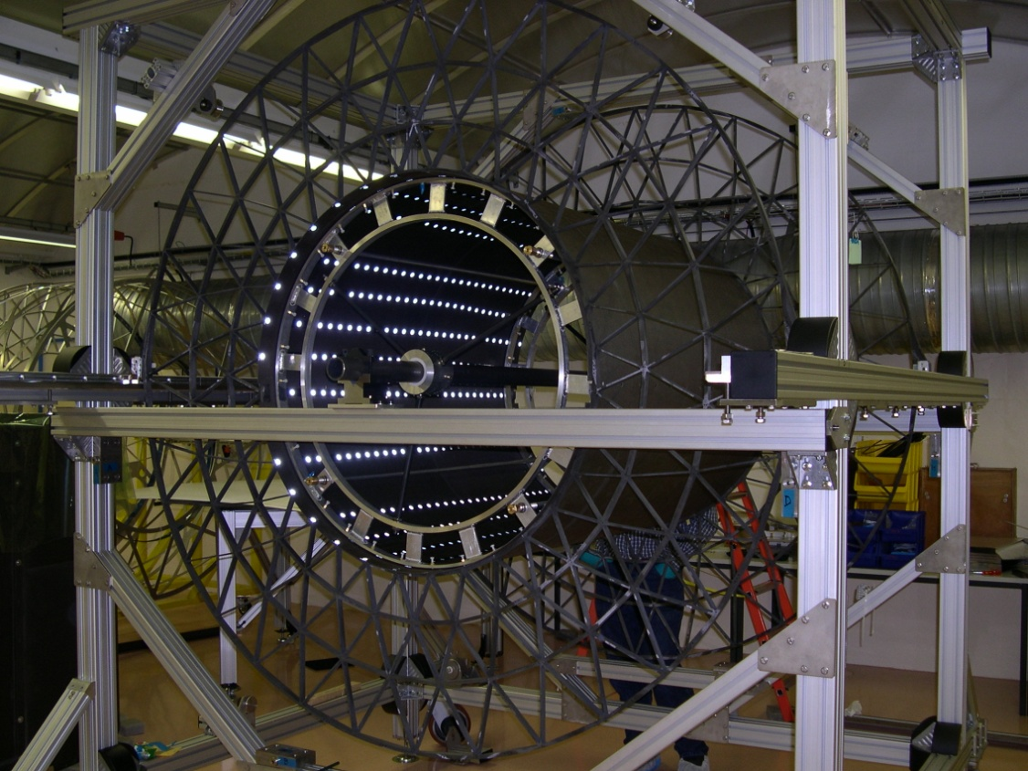
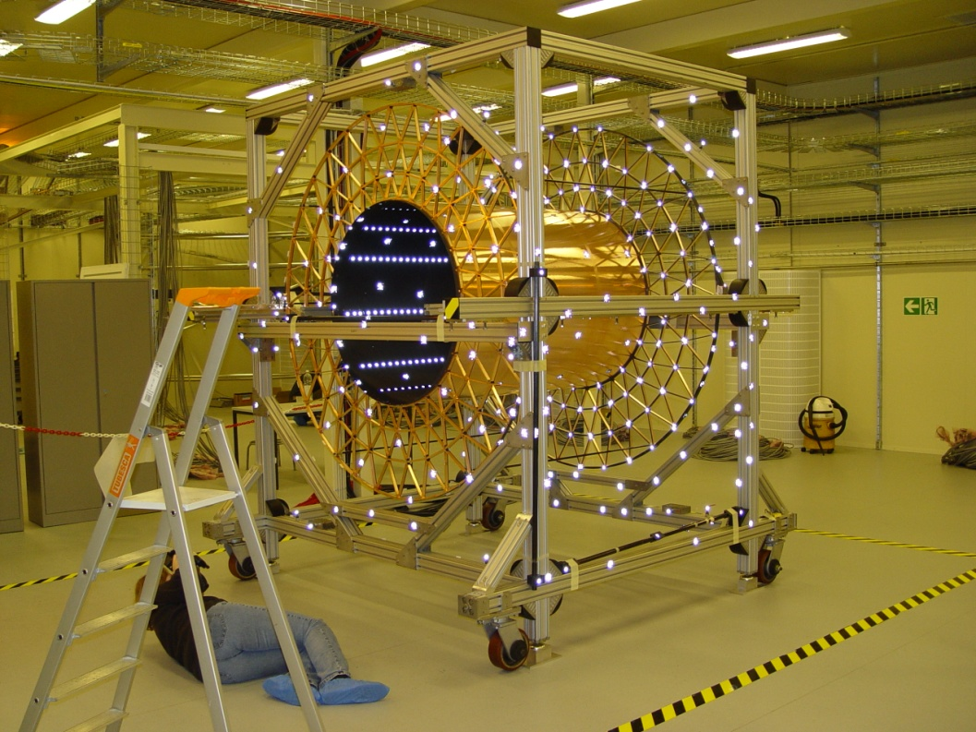
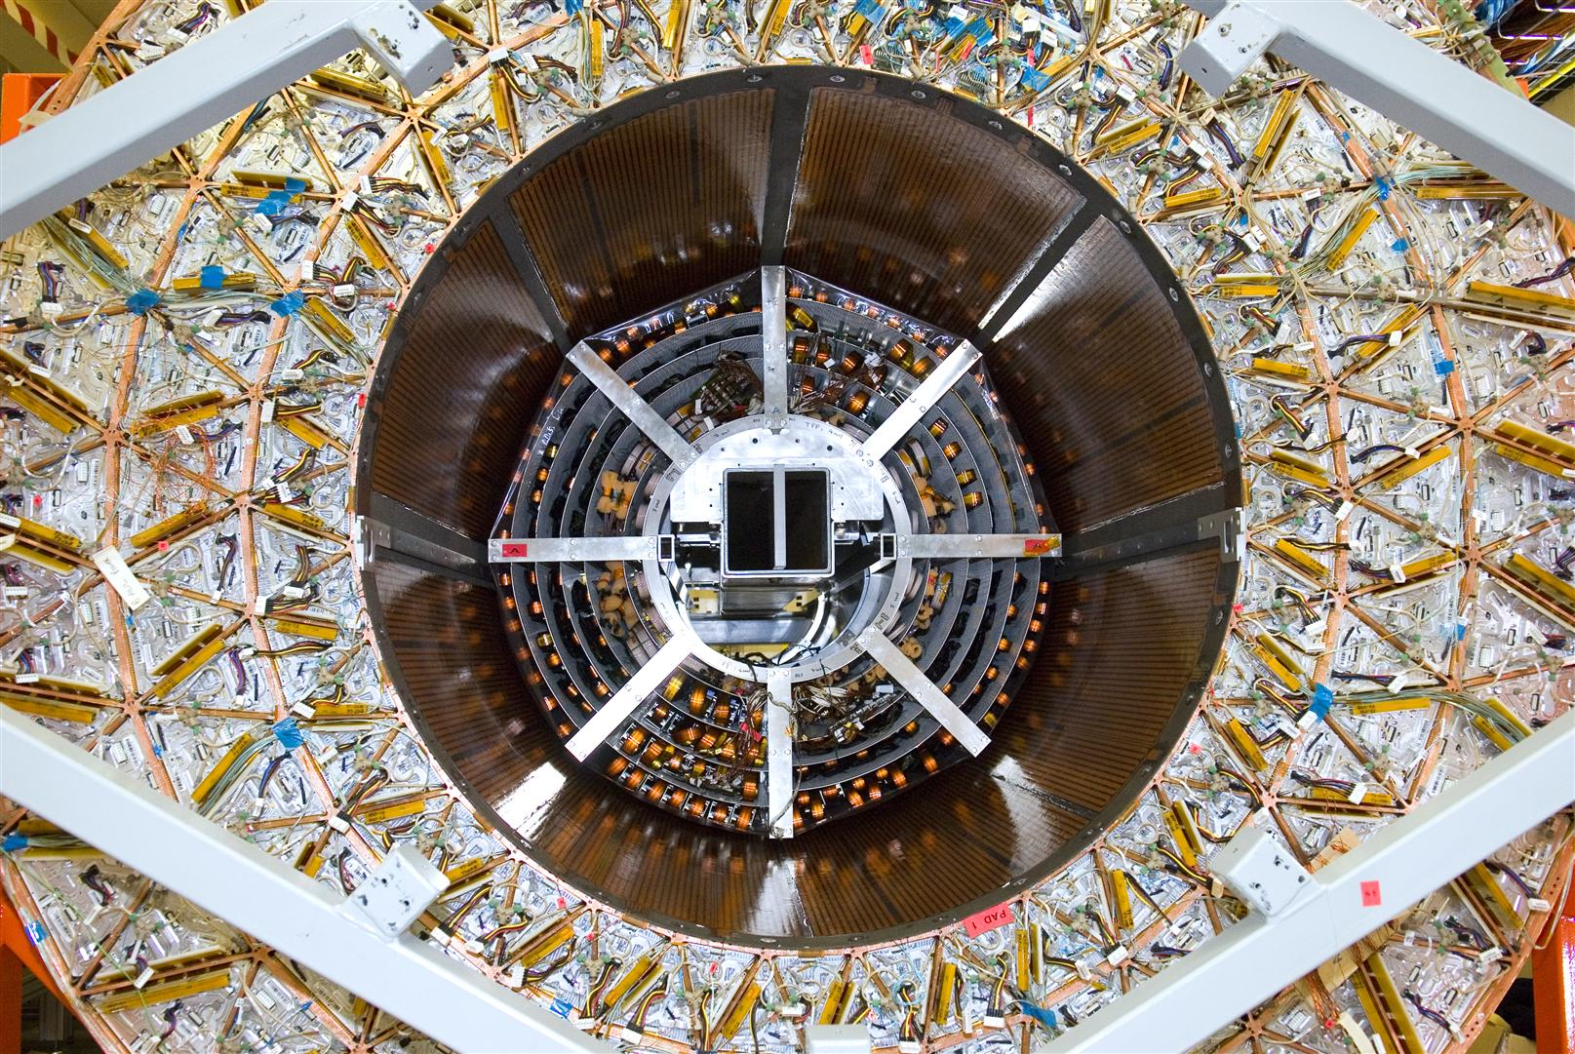
Sequence of Assembly & Survey of the Atlas ID Barrel
ASIC power 5.3 W
FEA
A. Catinaccio - CERN
3

Slide 4
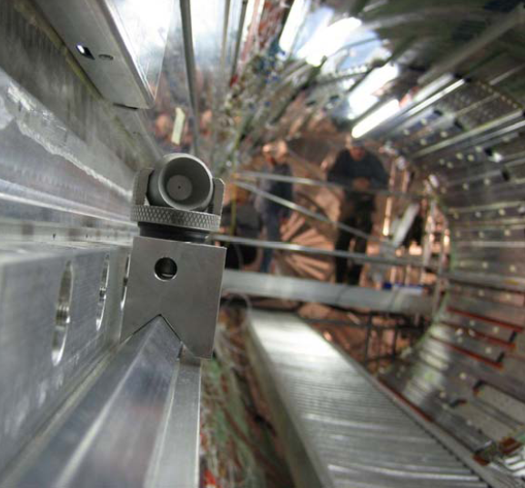
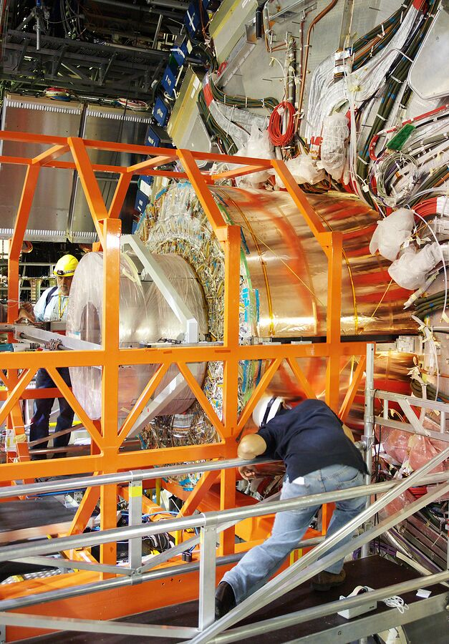
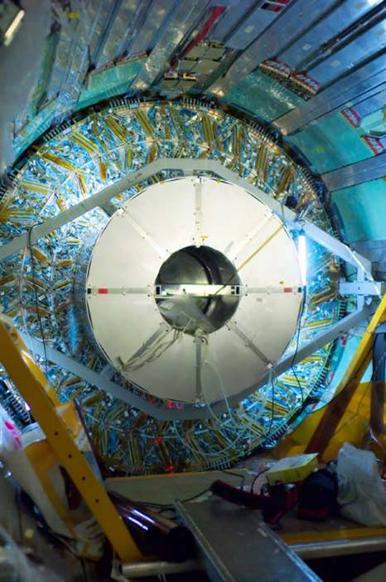
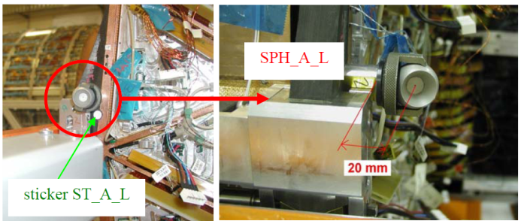
Adjustment and positioning by external references (theodolite and photogrammetry)
Atlas ID barrel installation
ASIC power 5.3 W
FEA
A. Catinaccio - CERN
4

Slide 5
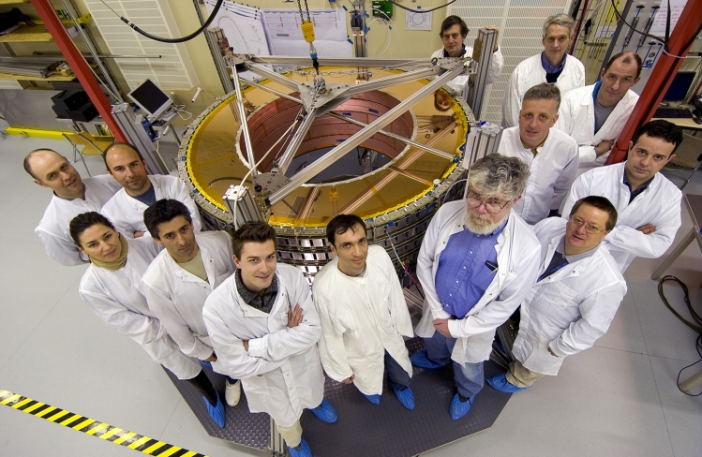
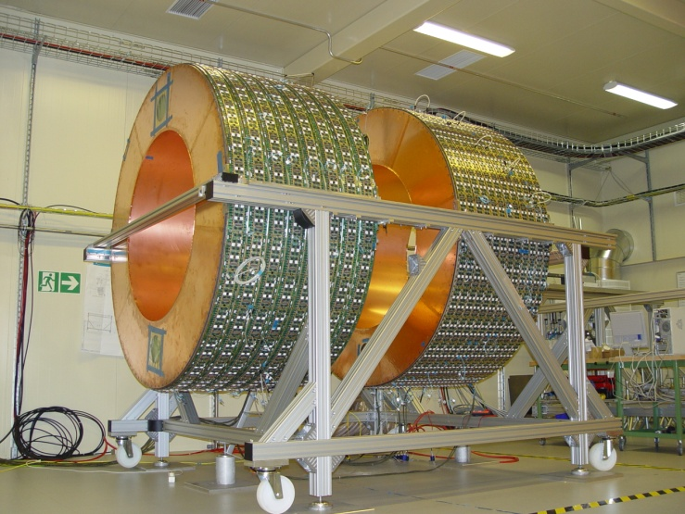
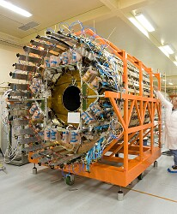
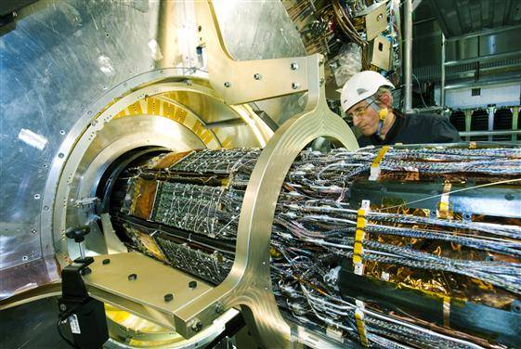
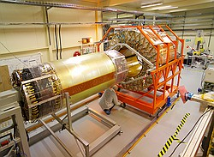
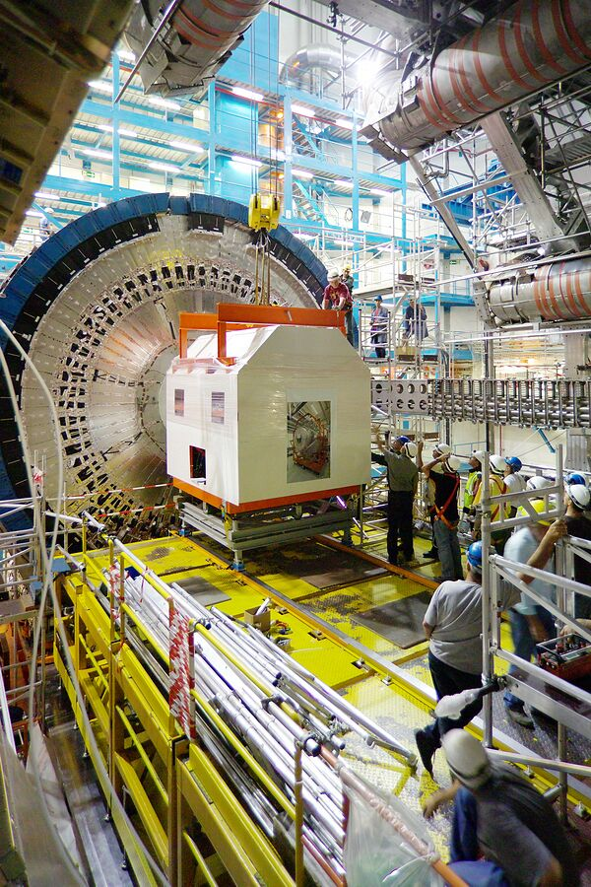
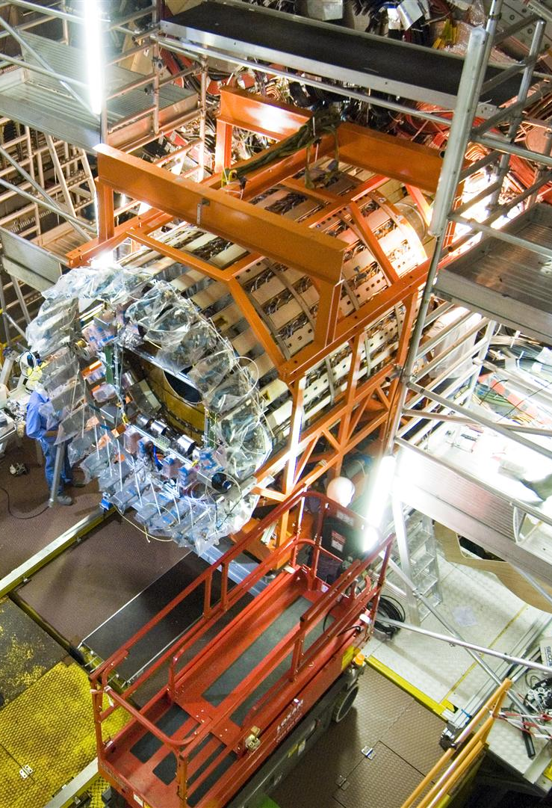
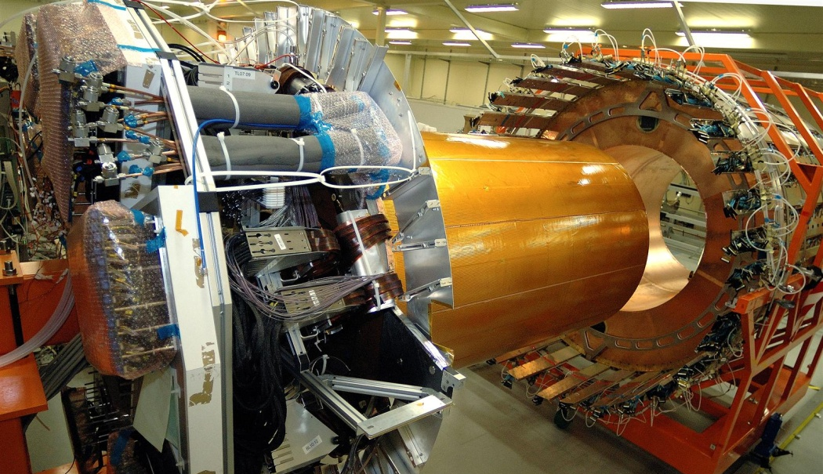
Several other applications - measurements needed for Integration and Installation
5
Notes:
5

Slide 6
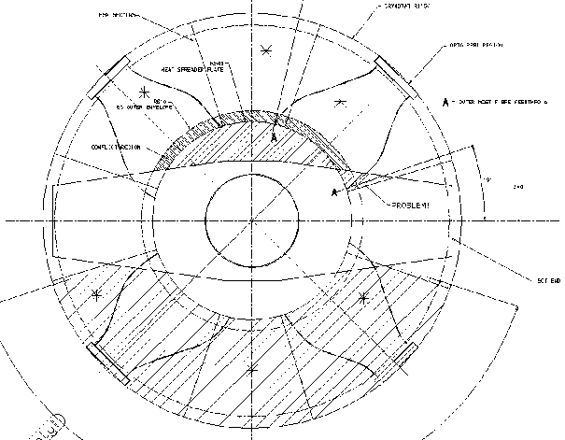
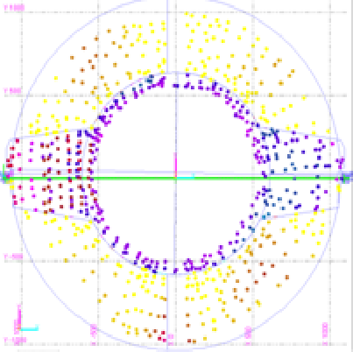
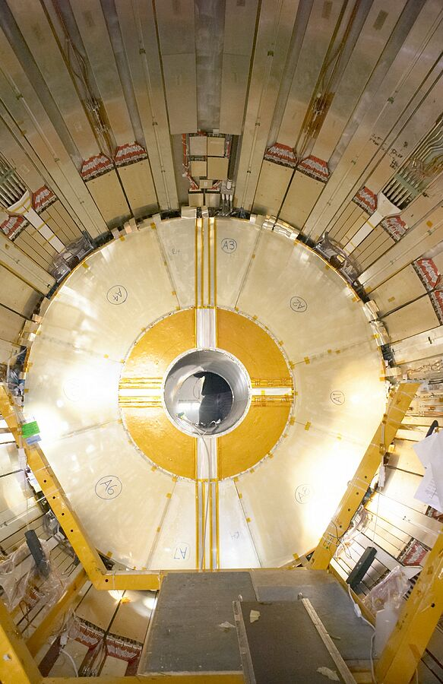
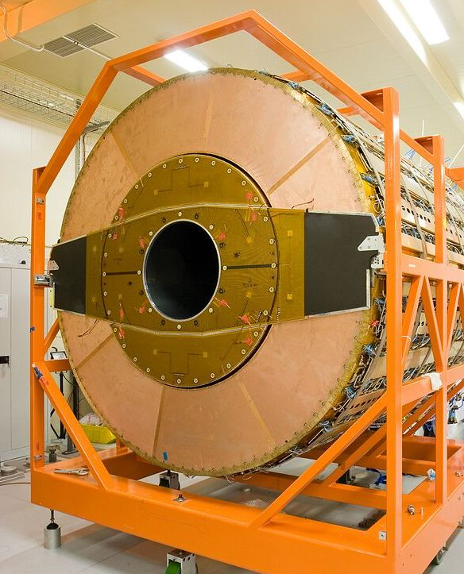
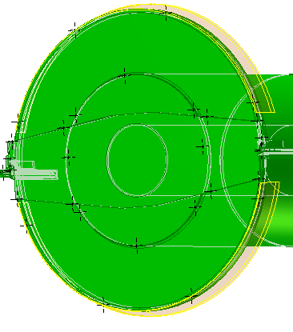
ID EC’s Installation: 1st creation of virtual envelope
6
By Photogrammetry and Romer arm
Notes:
6

Slide 7
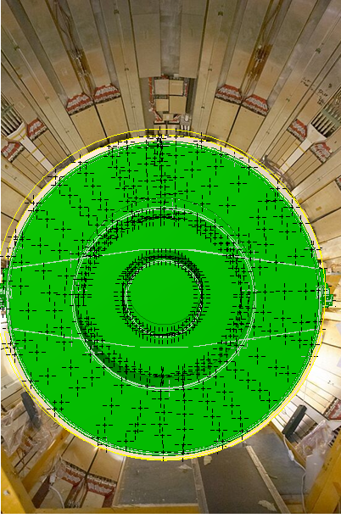
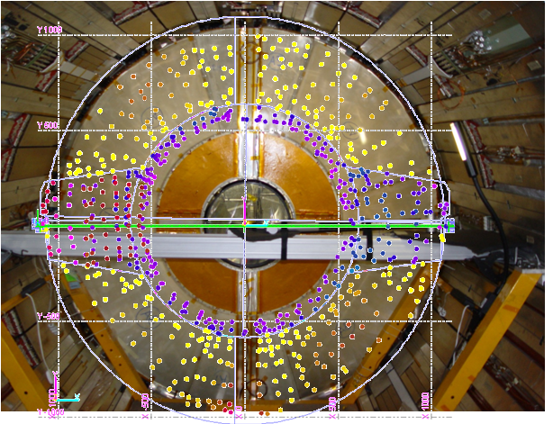
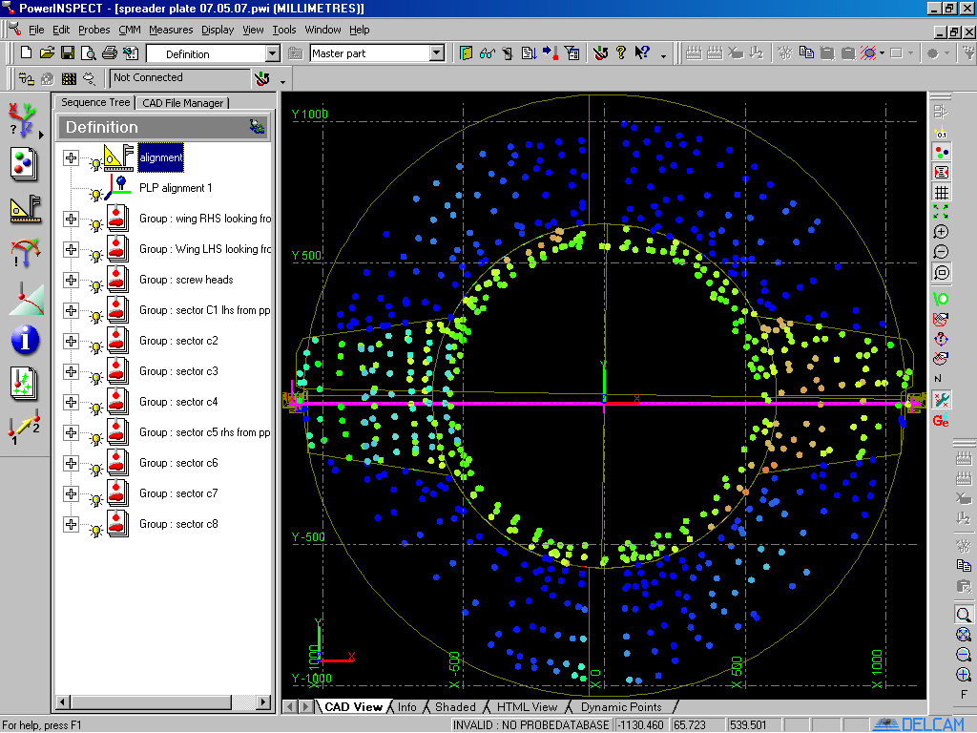
ID EC’s Installation: 2nd installation of virtual envelope ~ 3D scan
Virtual positioning and probing (envelope of the front IDEC-A re-constructed)
A. Catinaccio - CERN
7

Slide 8
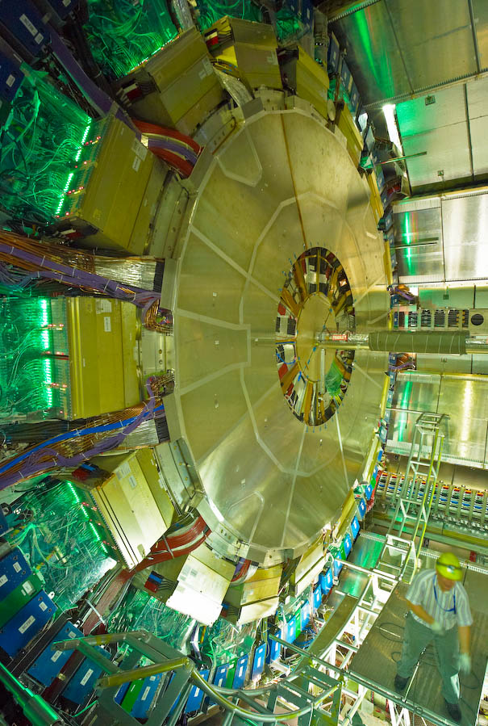
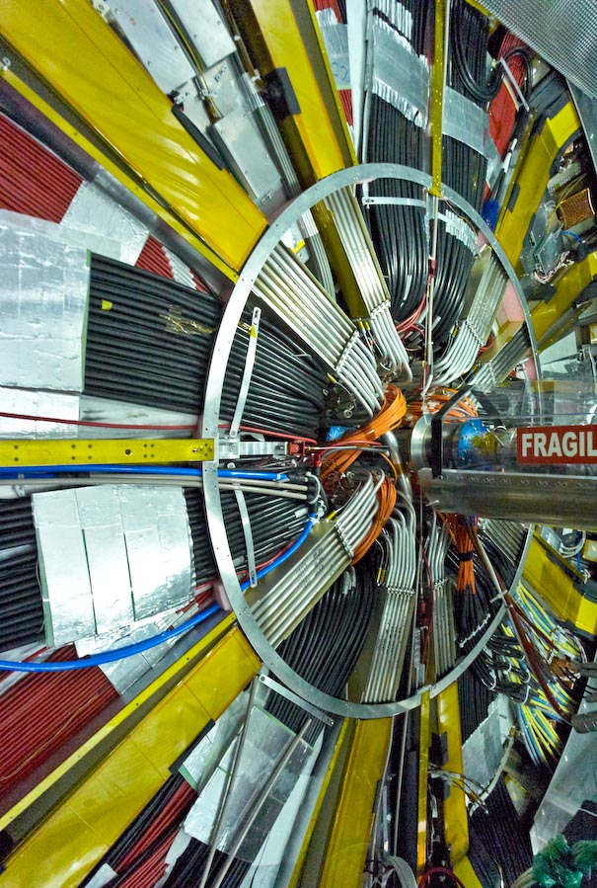
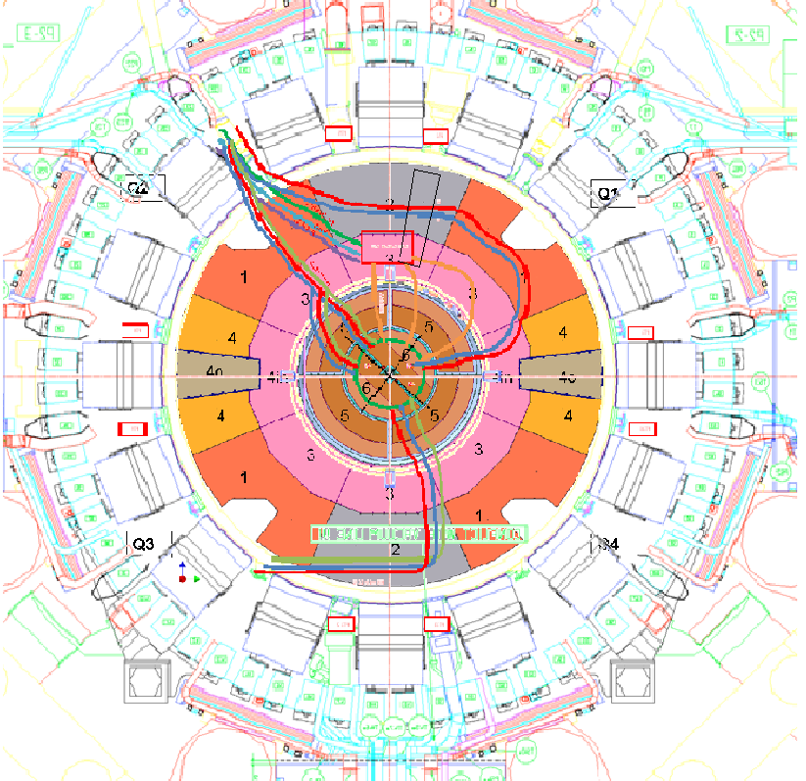
For future interventions and upgrades
Document as installed services
Define an envelope for cables and pipes
Visualize free space for future routing
Accuracy: 1…2mm
A. Catinaccio - CERN
8
Notes:
8

Slide 9
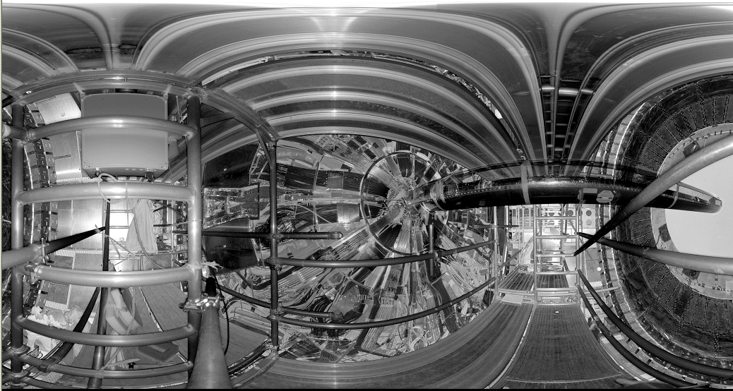
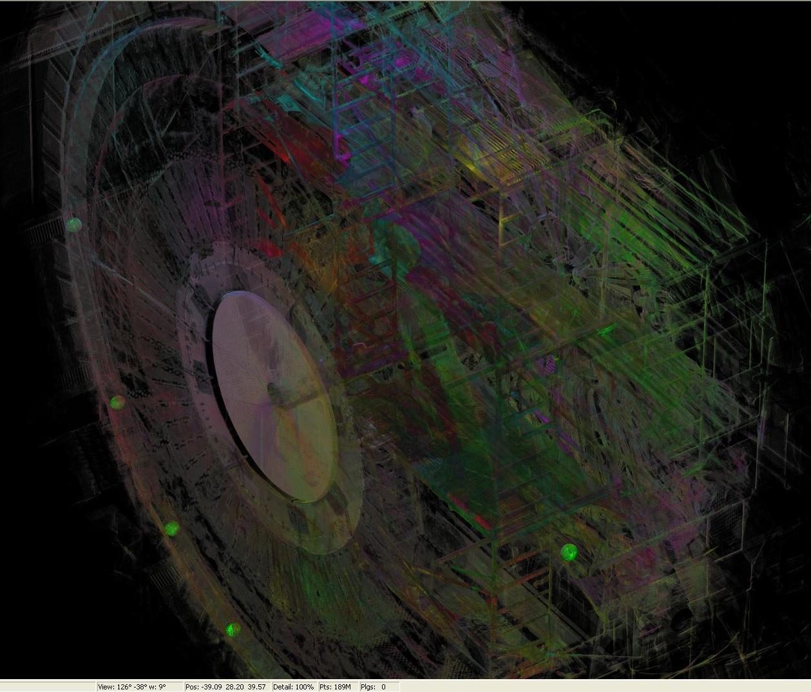
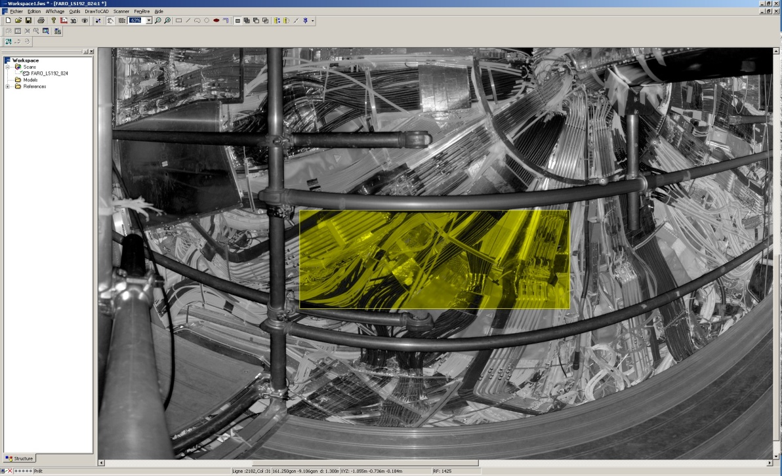
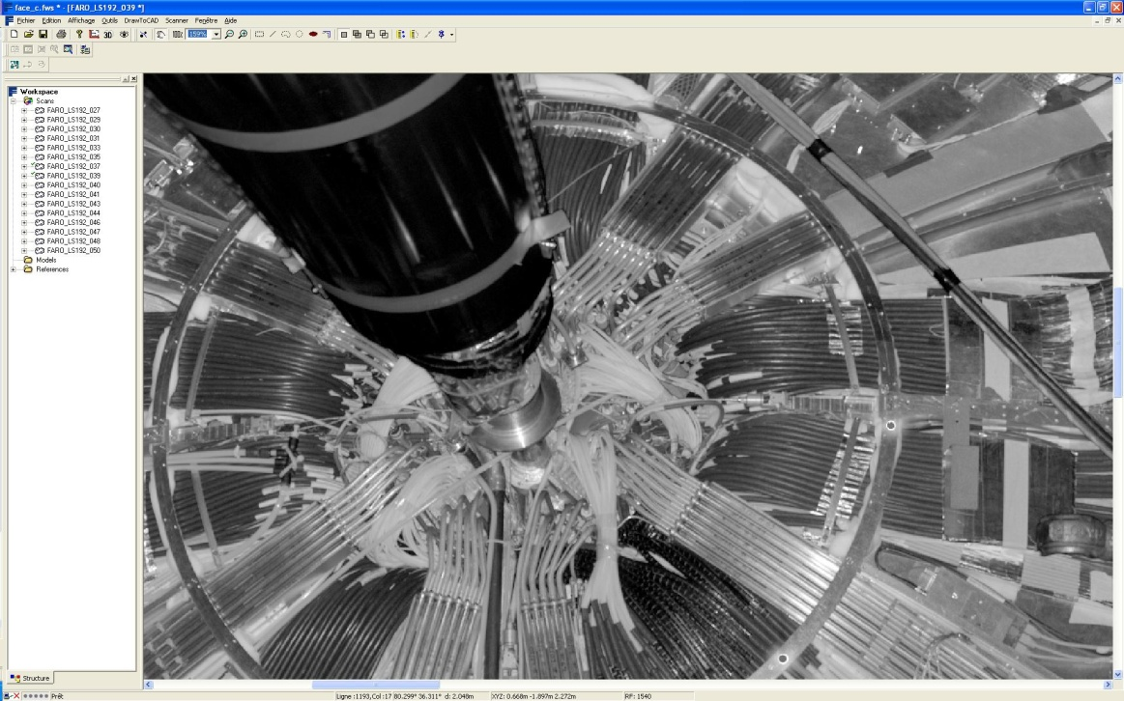
Laser Scan of services on the flange
A. Catinaccio - CERN
9
Feb. 2009
Notes:
9

Slide 10
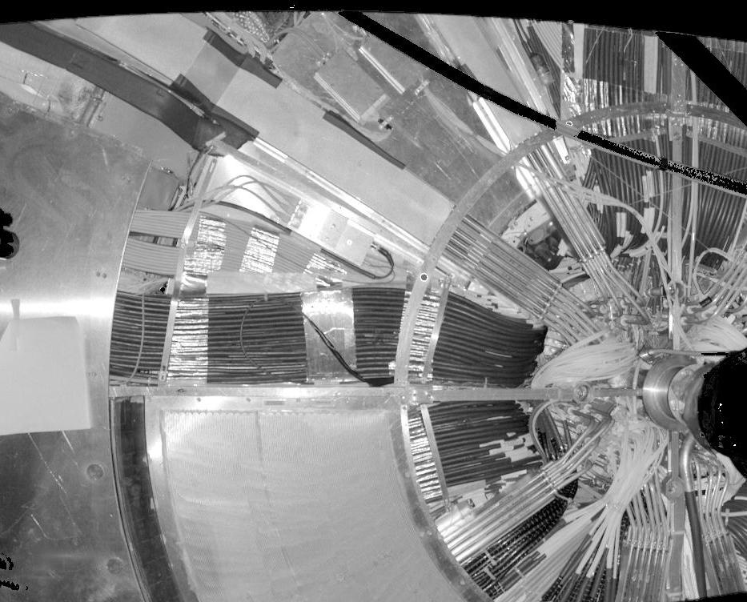
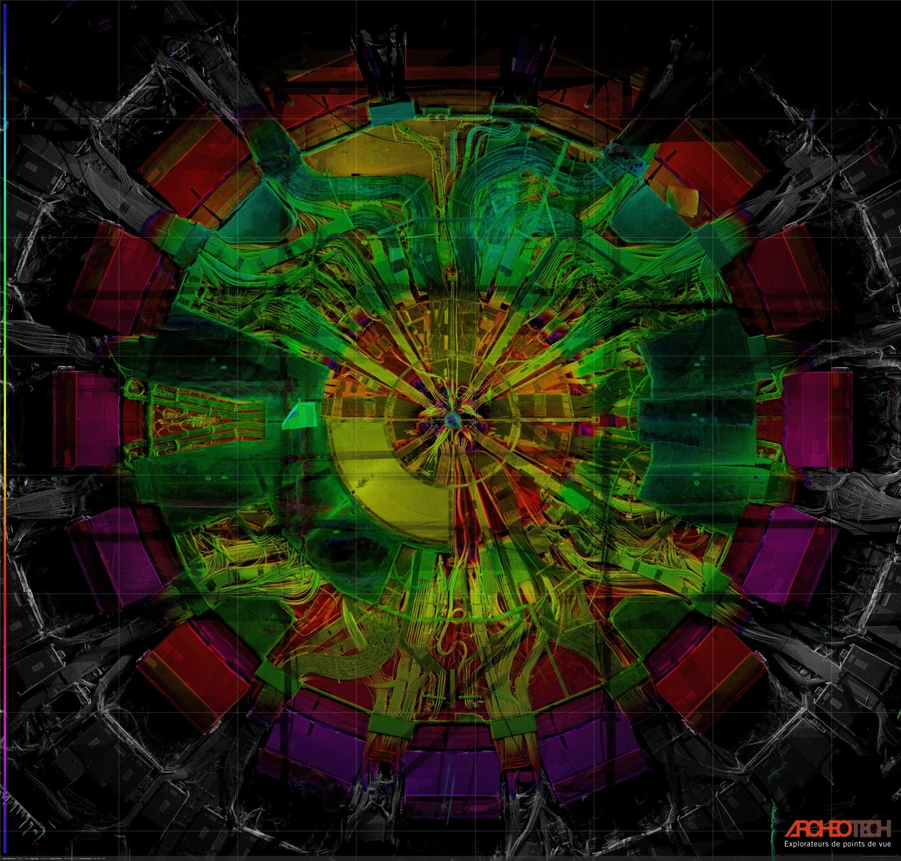
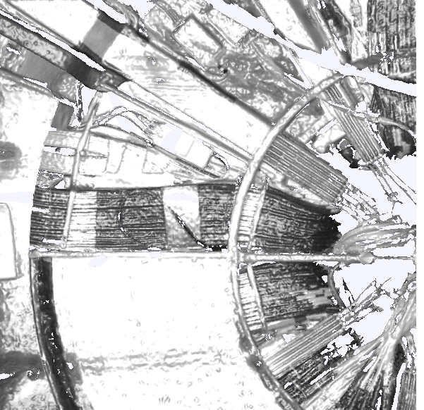
Scan of services on the flange
Photo
Laser scan
Laser scan
A. Catinaccio - CERN
10
Notes:
10

Slide 11
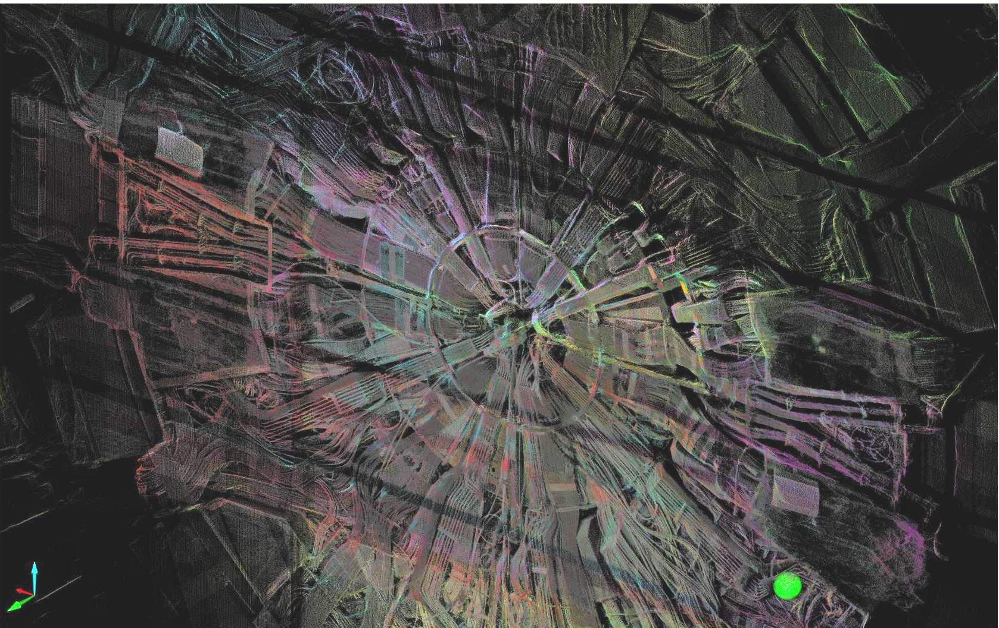
Laser scan of ID services
Notes:
11

