Slide 1
The Science Mesh and its core applications
Holger Angenent

Slide 2

Science Mesh in a Nutshell
Science Mesh - global collaboration platform for researchers
  Integrating (open) data and (open-source) tools
  Provided as building block for European Open Science Cloud (EOSC)
Open, bottom-up approach
  Applications: working closely with user communities we take existing best practices, services and technologies, improve them and open them up for other scientific communities

Slide 3
Who needs Science Mesh?
What are our users doing?

Slide 4



HEP: data challenges, collaborative data science
LHC produces unprecedented volumes of data
  Raw stream from detectors: 600TB per second, or 50 000 PB per day
    The raw data per event ~1MB, 600 million events per second
  Storing only fraction of this (total volume of all stored data: 350PB)
    Filtering of events/data need to be smart and fast!
  Large distributed infrastructure for transferring and large-scale processing
Constant innovation in tools and methods for analytics.
  Data streams from LHC increase with each upgrade
Distributed teams of scientists from institutes all over the world
  a variety of storage systems and processing tools.
One of the challenges: providing tools in this distributed environment for effective collaboration in Data Science

Slide 5

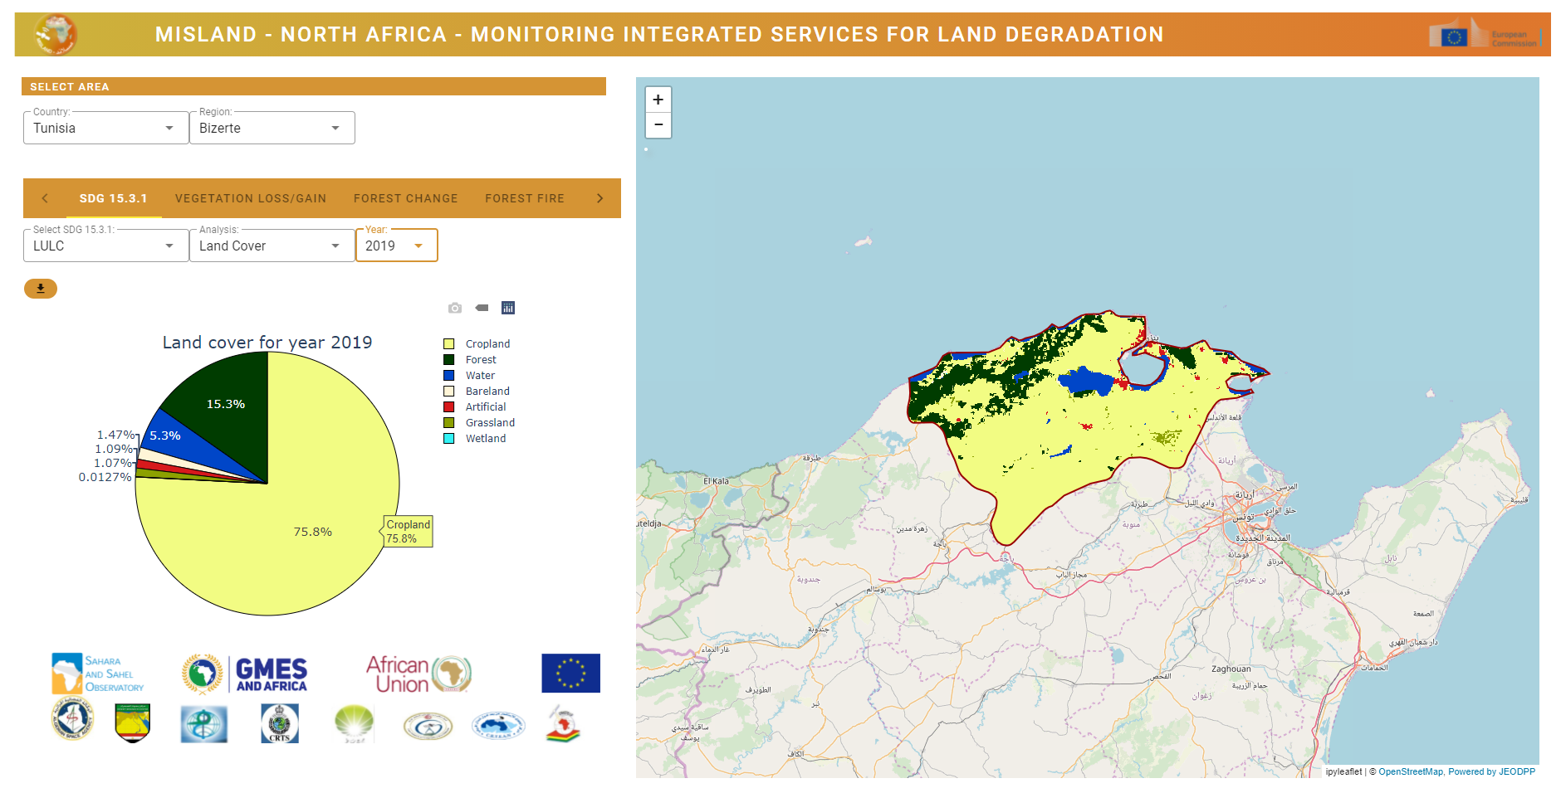
Earth Observation use case

Slide 6
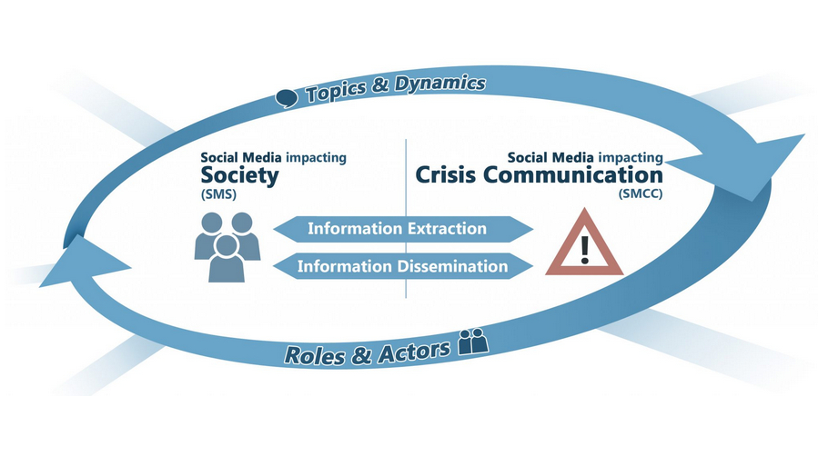
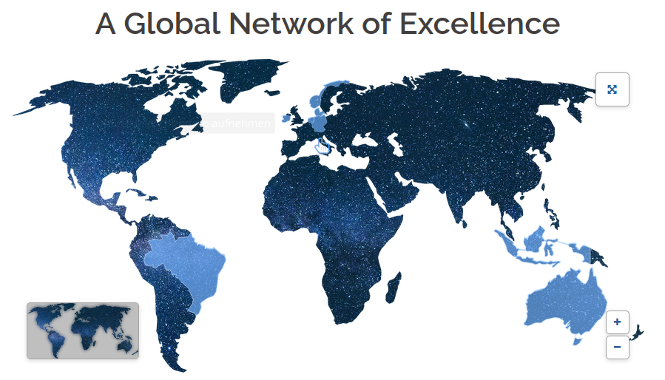
Use Case: RISE_SMA
Social Media Analytics for Society and Crisis Communication
https://social-media-analytics.org/
Project partners world wide
06/02/21

Slide 7
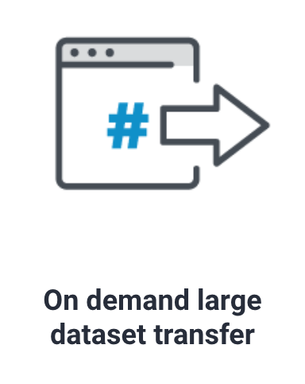
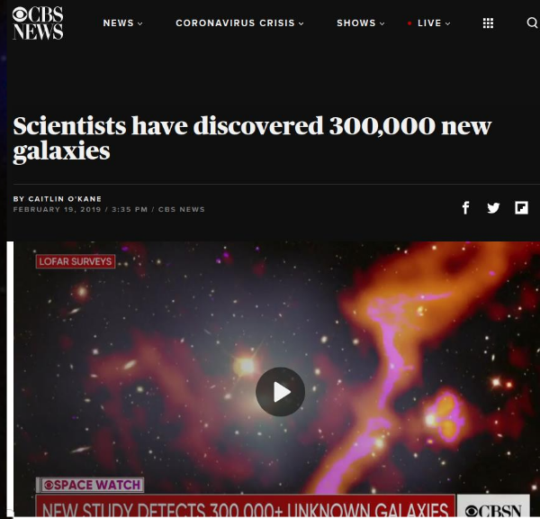
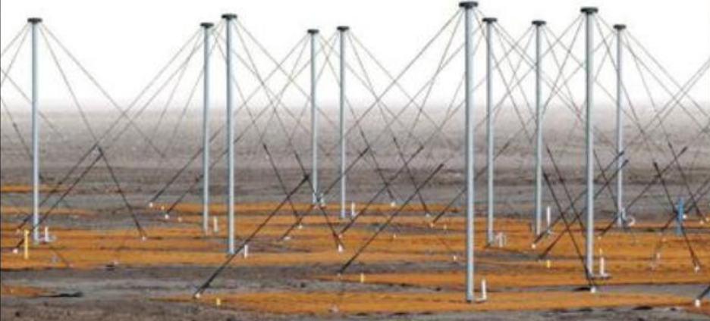




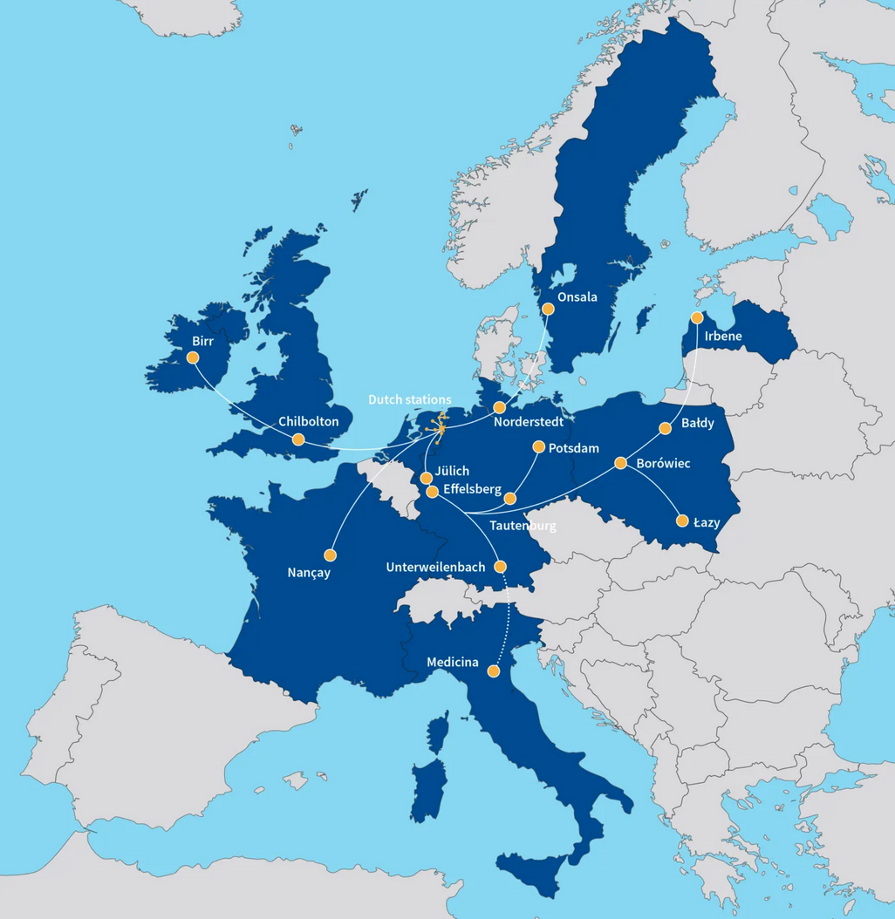


LOFAR use-case:
Dataset transfer between research groups
Data stored at PSNC, SURF and FZJ.
Initially processing (64x reduction).
LOFAR Surveys Key Science Project​
Collaboration between researchers​
  Leiden University and ASTRON (NL)​
  Jagiellonian University, Kraków (PL)
06/02/21

Slide 8
Other Use Cases
Of course, there are many other use cases which can profit from Science Mesh:
  Cross-border data sharing
  In need of streamlined work flows
  Intuitive interfaces for data transfer
  Pushing the same data to HPC cluster
  Doing computations with data stored in your EFSS system
  Pushing data to other users (from same or other EFSS)
  Direct editing of files from your EFSS (with non-MS editors...)
06/02/21

Slide 9
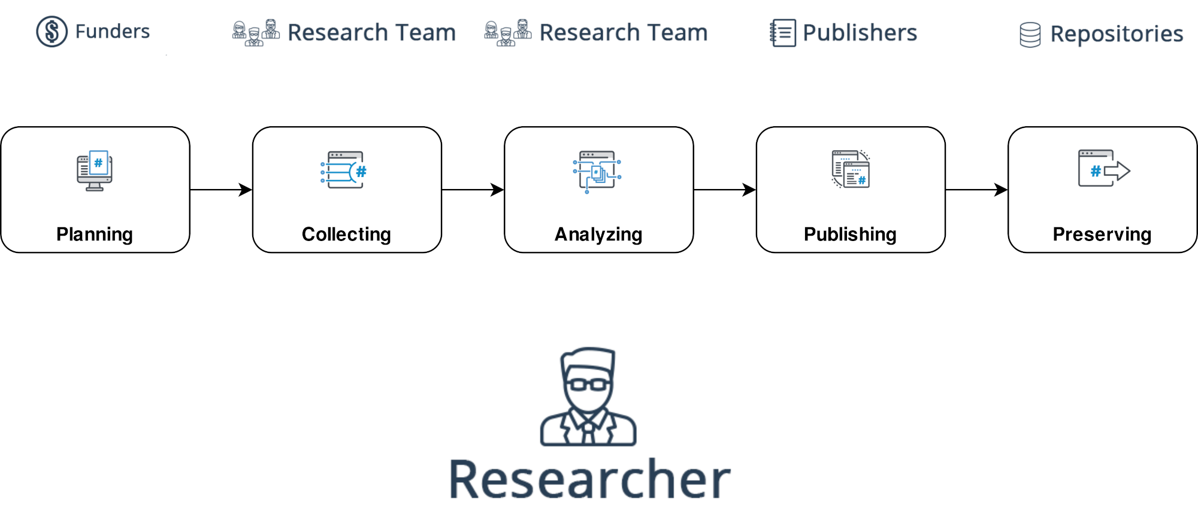
Common data workflow
More general, what does the typical researcher’s workflow look like?
06/02/21

Slide 10
What does Science Mesh offer for the users?

Slide 11
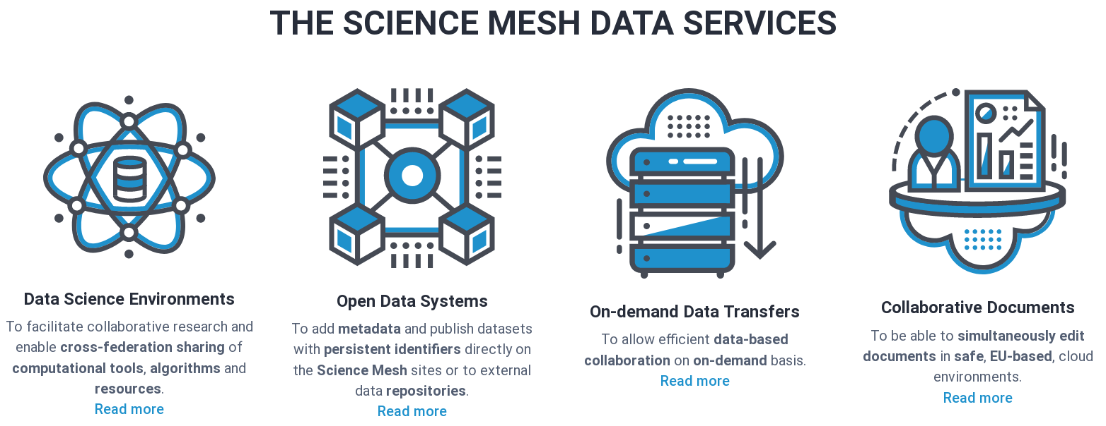
Services offered by Science Mesh
06/02/21

Slide 12
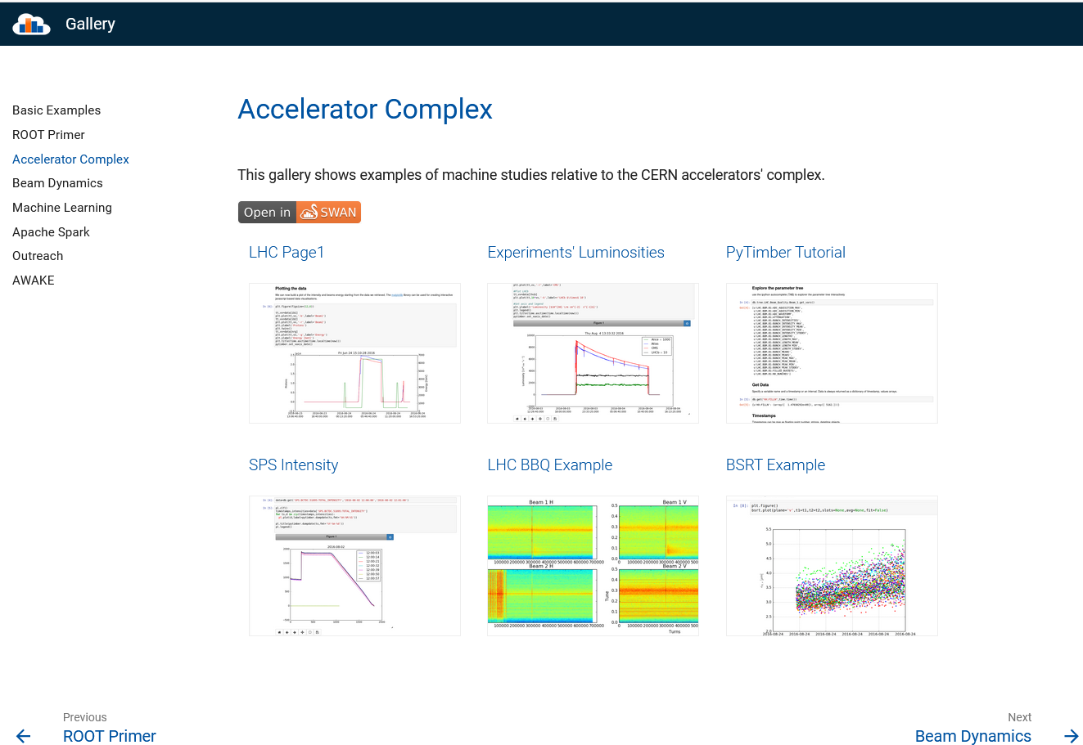
Jupyter Notebook in HEP: SWAN galery https://swan-gallery.web.cern.ch/

Slide 13









Open Data Systems
Current integration of different research data management tools
Cloud
RDS core
Services
RDS
BYOC
Current dataflow
Planned dataflow
<Foliennummer>

Slide 14
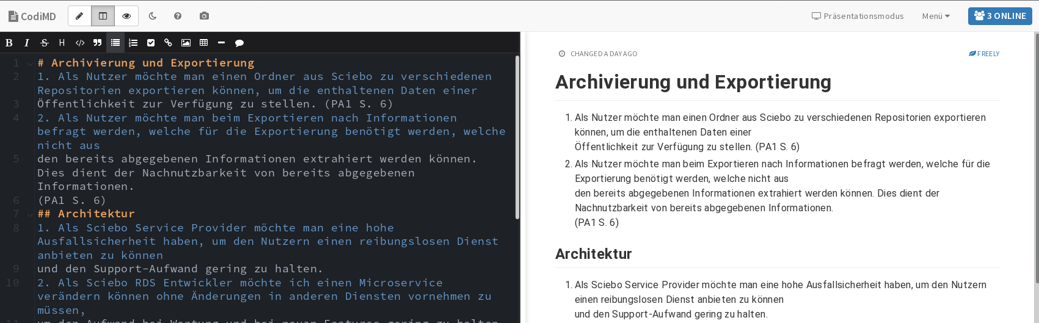
Document Editor: CodiMD
Lightweight markdown editor
No big overhead or complicated menus, just type your content
Ideal as note taking tool, grasp some ideas while talking about it, easily write simple structured documentation
Notes:
Update Screenshot

Slide 15
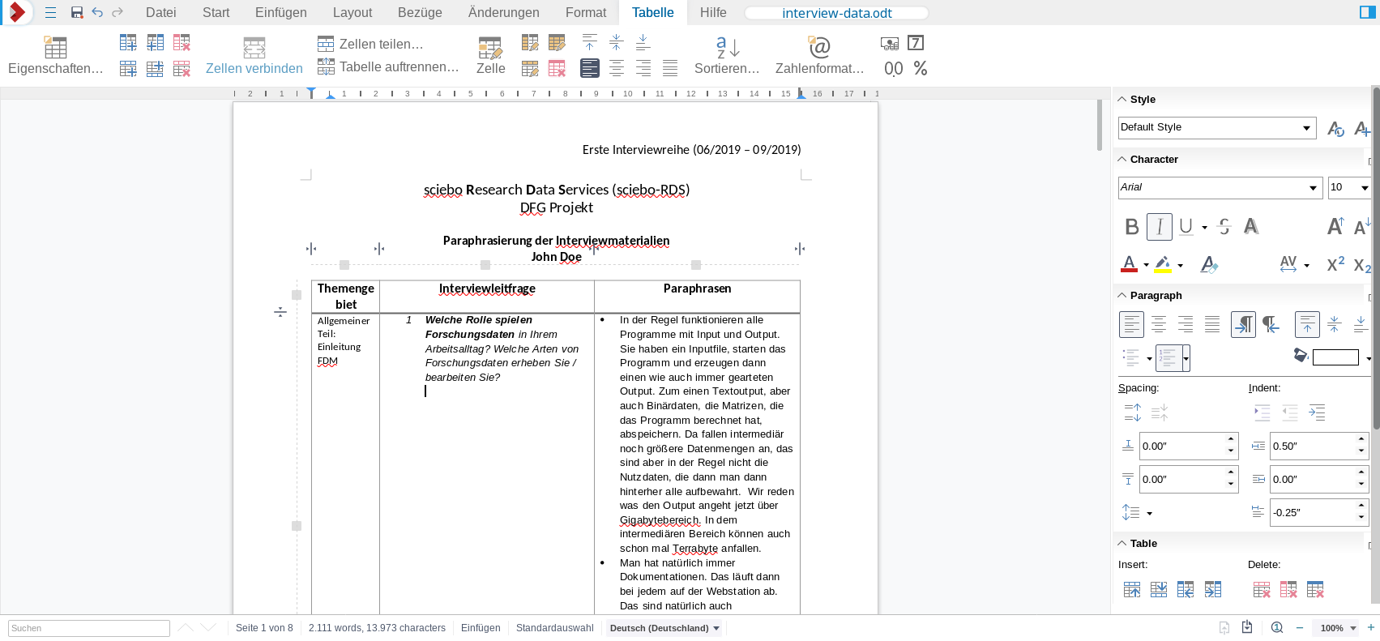
Document Editor: Collabora
Powerful editor especially for, but not limited to Open Document format
Texts documents, spread sheets and presentations can be edited
Notes:
Update screenshot

Slide 16
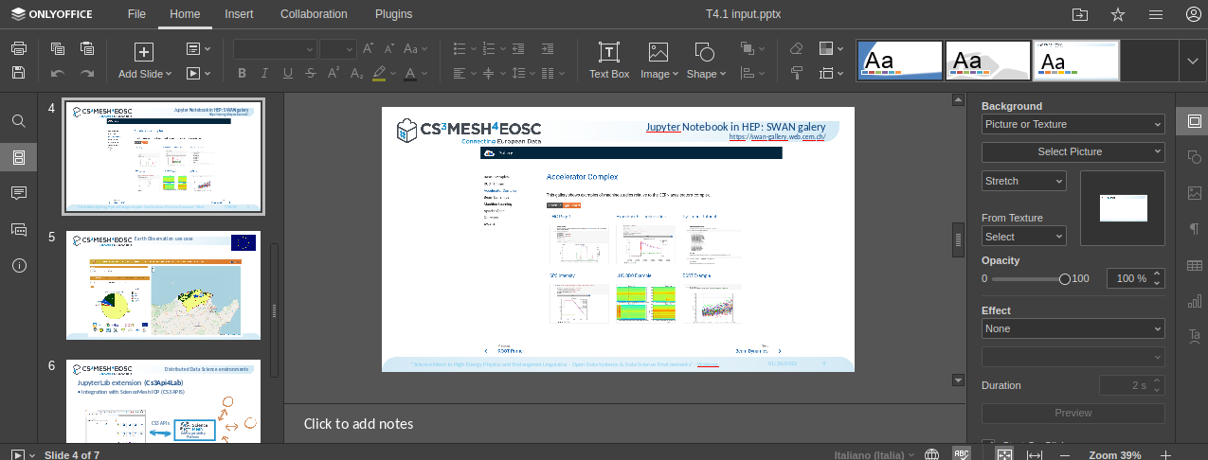
Document Editor: Onlyoffice
Powerful editor with focus on MS office documents
As the other tools, too, connected via WOPI
→ Since we support WOPI, potentially other similar editors can be connected, too.
Notes:
Update screenshot

Slide 17



On-demand data transfers
On-demand data transfers in two flavours
  Ad-hoc data transfers
    For small/medium sized data transfer needs
    Individual researchers or individual research groups
    having access to their own sync-and-share service
    Typically local identity management system
    Based on Rclone
      Rclone is a tool to manage files on cloud storages
  Managed data transfers
    Connecting Big(ger) Science with sync-and-share (EFSS)
    Scientific communities having access to multiple
    storage systems and EFSS systems
    Federated AAI using Indigo IAM
    Based on Rucio & FTS
      Rucio is a data management tool
      FTS is a data transfer scheduler

Slide 18
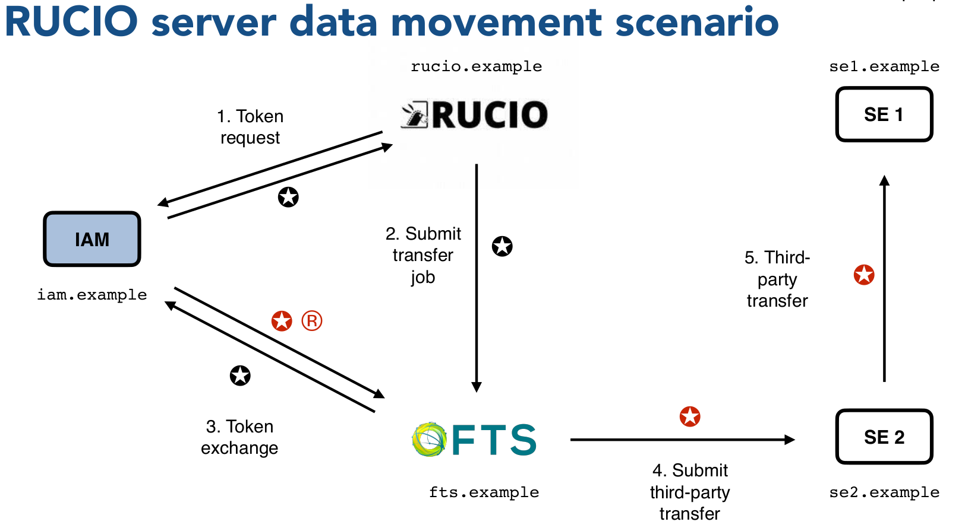
Managed data transfers
EFSS as Rucio/FTS
storage endpoint
From EFSS issue
  Uploads
  Downloads
  Replications
  Metadata queries
  …....
(Slide stolen from A. Ceccanti)

Slide 19
06/02/21

