Slide 1
FCCee Parameters

Slide 2
Timeline
Major milestones:
  Parameter update September, 2021
  Specification of RF Baseline configuration and Alternates, September, 2021
  Collider arc cell configuration, November, 2021
  Tuning and Simulation tool workshop, November, 2021
  Tuning, Diagnostic, Tolerance and stability specification, June 2022
  Collimation system specification, June 2022
  LLRF and feedback system specification, June 2022
  Booster and Pre-Injector update, June 2022
  Survey and Alignment system specification, June 2022
  Document baseline for costing exercise, January 2023
  Parameters Iteration, July 2023
  Update Baseline calculations and specifications using new tools over next 1.5 years
  Document Baseline for Feasibility Study costing exercise, January 2025
  Start Feasibility Study baseline documentation, January 2025

Slide 3
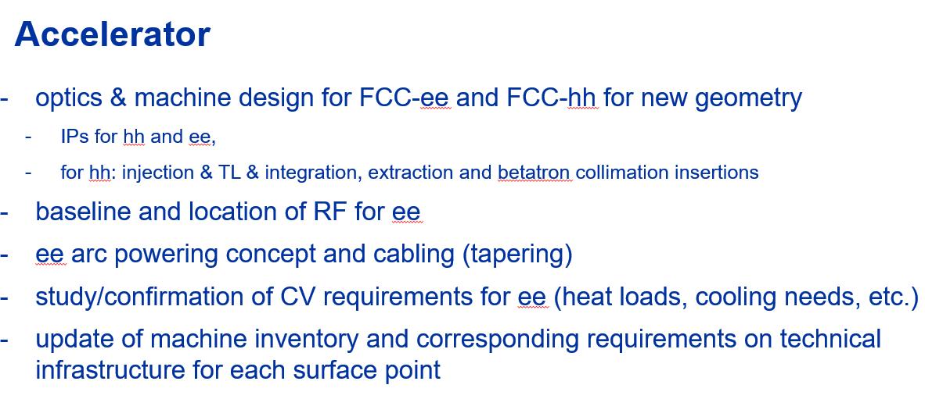
Interfaces to other groups
From Michael Benedikt

Slide 4
Parameter Issues
  Circumference and IP layout → 91 km circ.
  Beam-beam, instabilities, and dynamic aperture
  SuperKEKB experience
  RF configurations
  Arc cell layout and parameters
  Long / Short Straight sections with RF, collimation, and injection/extraction regions
  Injector / booster system
Raubenheimer, FCC Week, June 2021

Slide 5
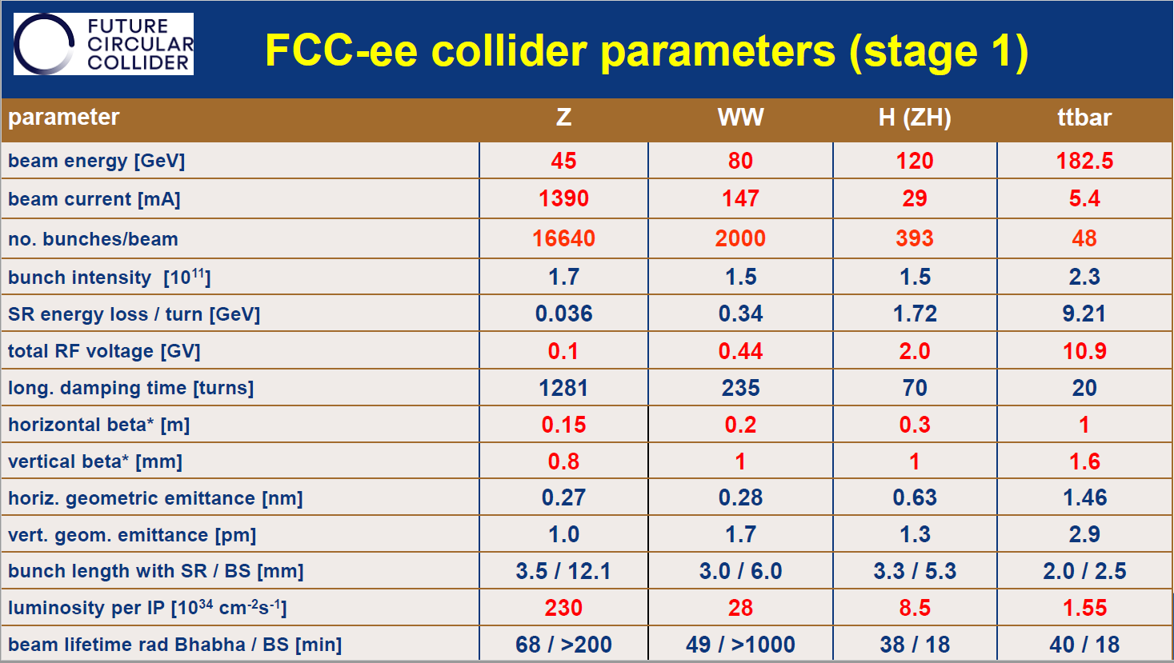
CDR Parameters

Slide 6
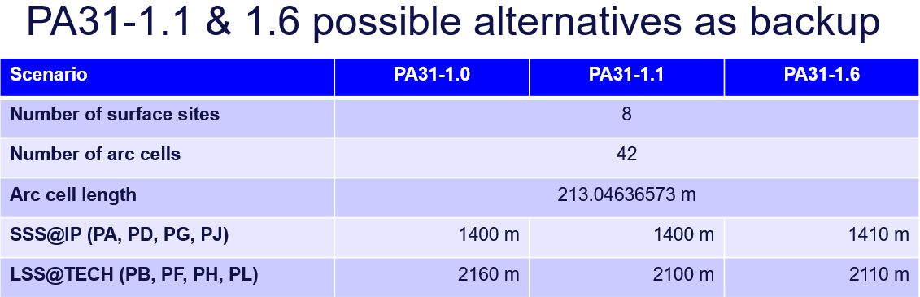
Ring Circumference and Straight Sections

Slide 7
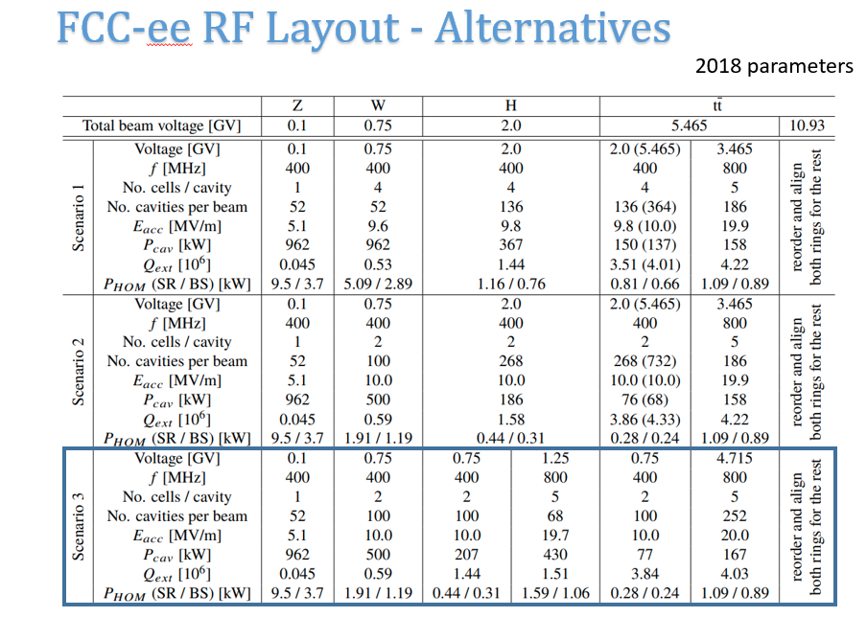
RF Parameters
Rama Calaga –
August 5, 2021
SRF Review,
April, 2021

Slide 8
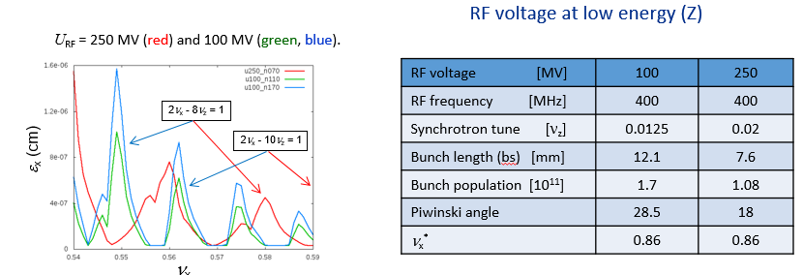
IP Parameters
Beam-beam drives choice of Qz
3rd harmonic cavity?
Options at W and
Higgs
What about 2 versus 4 IP’s?
Dmitri Shatilov

Slide 9
Parameter discussions
beam-beam constraints
Impedance modeling and needs
Rf Configuration
Arc cell and collimation/injection/extraction
Ip configuration
What else?

