Slide 1
Muon Cooling Demonstrator RF system parameters and layout. First look
Alexej Grudiev, Roberto Losito, Chris Rogers
28/09/2021

Slide 2
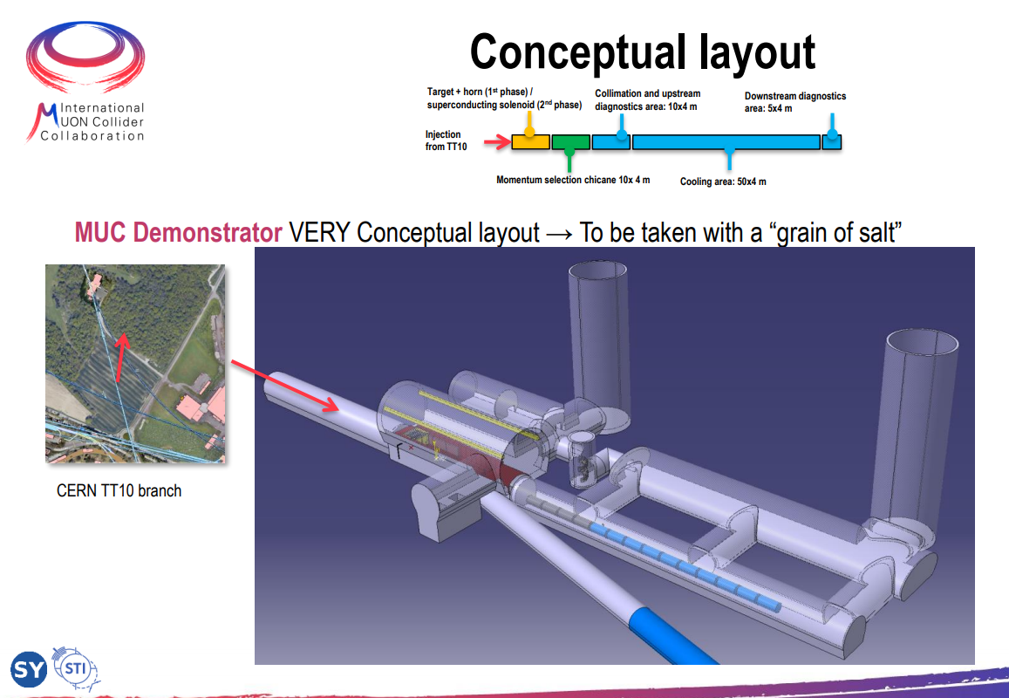
Rui Ximenes
2nd Community meeting

Slide 3
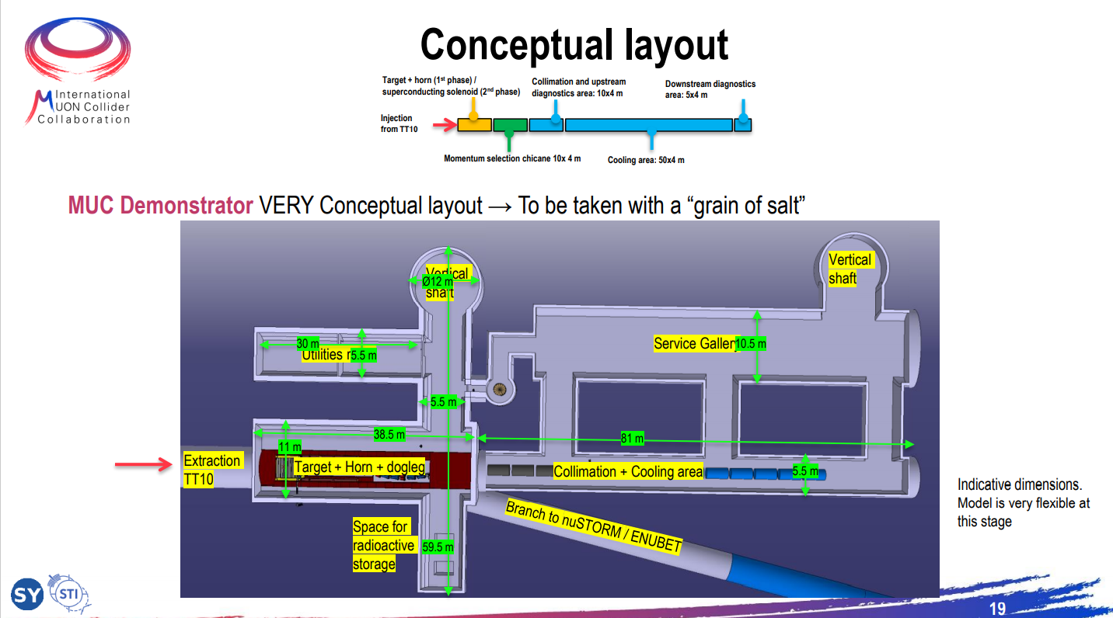
Rui Ximenes
2nd Community meeting

Slide 4
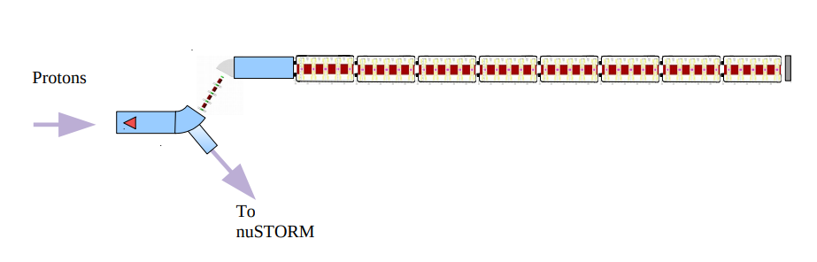
Muon cooling demonstrator layout
Chris Rogers
32m
2m

Slide 5
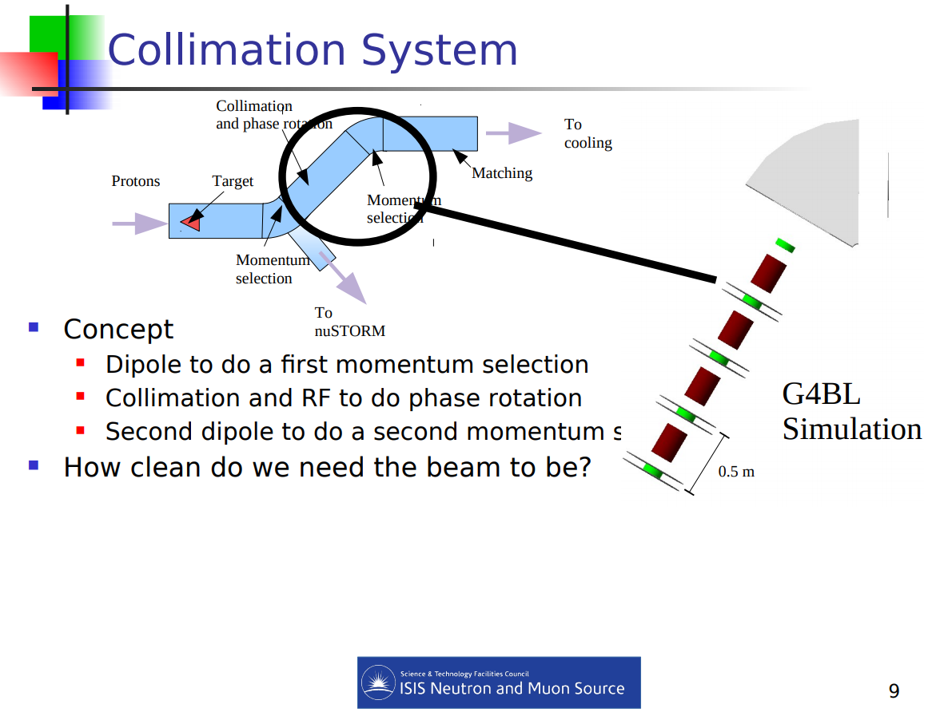
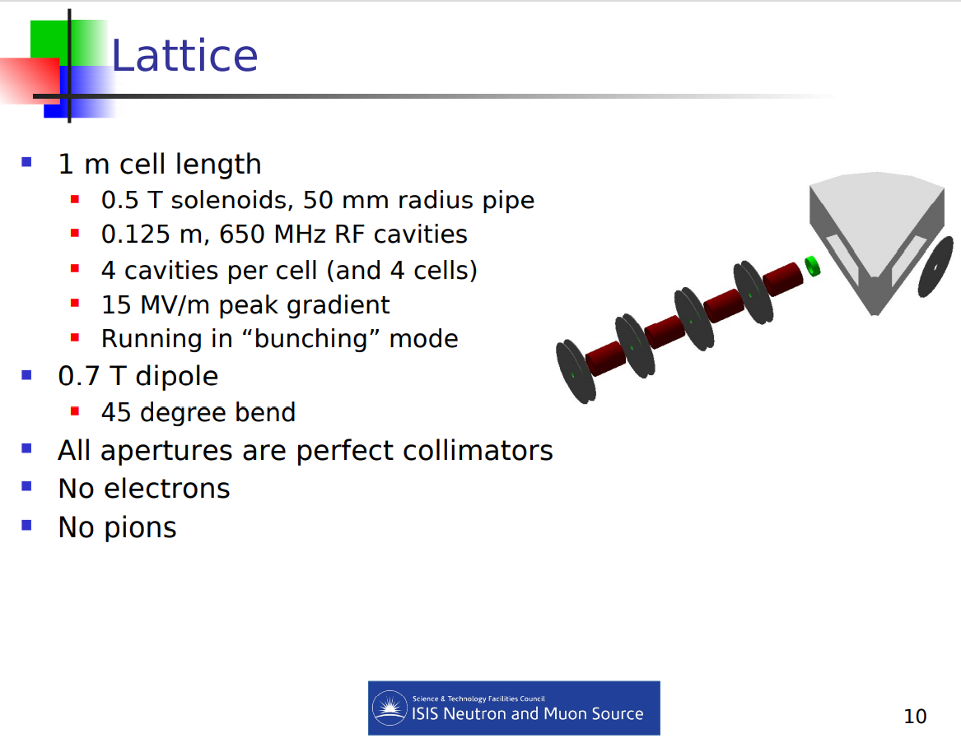
Collimation Chris Rogers

Slide 6
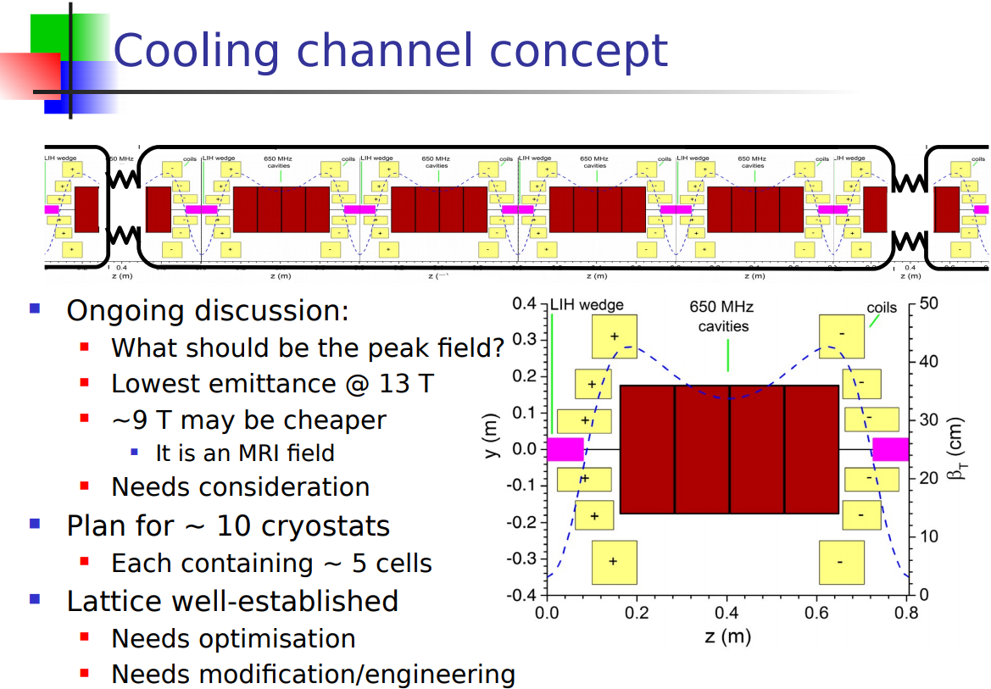
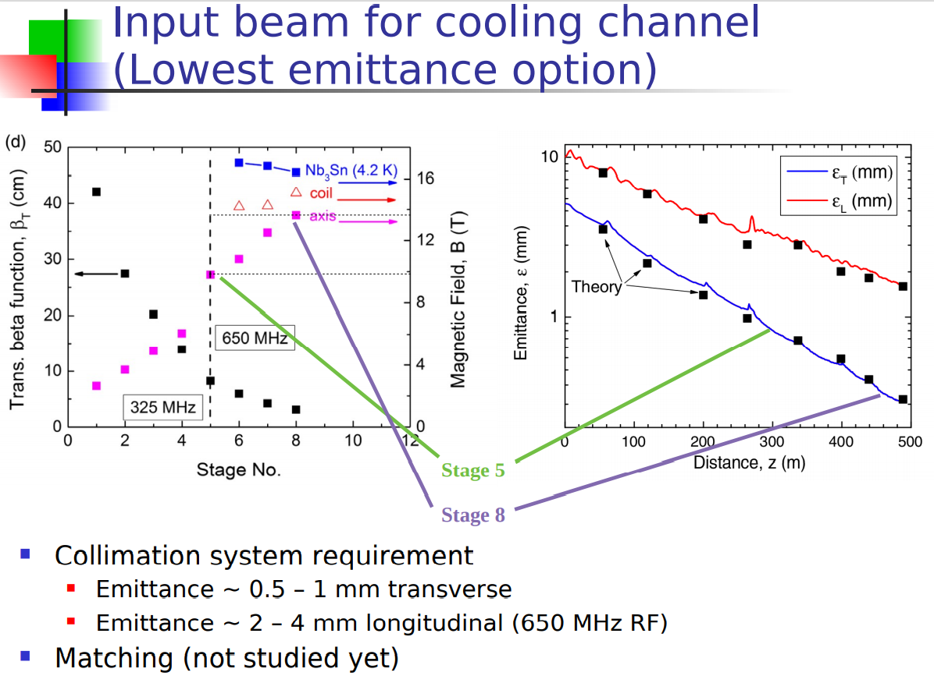
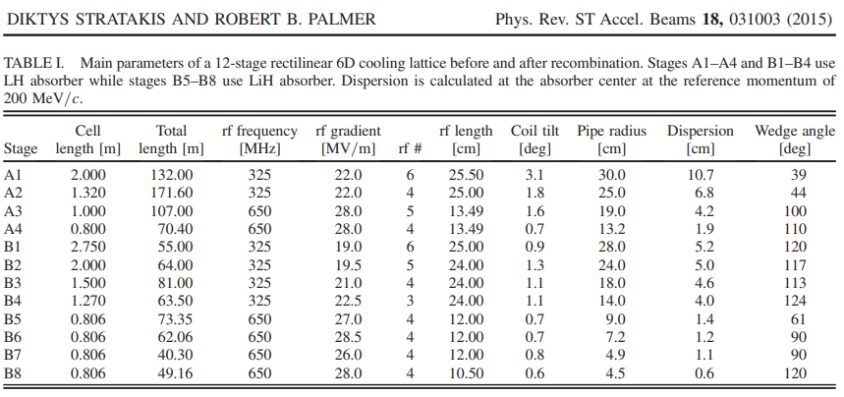
Muon Cooling channel
Chris Rogers
Stage B8
One of the 4 types: B5 – B8, still to be defined

Slide 7
Parameters of RF system (beam dynamics specifications)
 | Collimation system | Cooling cells | comments
 | Cavity type 1 | Cavity type 1 | One single cavity design can be used
Number of RF cavities | 16 | 18 x 8 modules = 144
RF frequency [MHz] | 650 | 650 | Transitioning to 704 MHz should not be a problem. Initially, the channel was tuned for 805 MHz. Then we re-optimized to 650 MHz without any issues. 704 MHz is somewhere in the middle so I don't see this being a problem either. Diktys
Accelerating gradient [MV/m] | 15 | 28.5 | No transit time factor is included. It is the amplitude of the accelerating electric field on crest, on axis (For ideal pillbox it is also max surface electric field).
Cavity length [m] | 0.125 | 0.105 or 0.120 (TBC) | Should be wiggle room to get collimation and cooling cell cavities to be same dimensions (might need a bit more voltage in collimation)
Beam window radius [m] | 0.050 | 0.045 to 0.090 (TBC) | Should be wiggle room to get collimation and cooling cell cavities to be same dimensions (might need a bit more voltage in collimation)
Beam window thickness (Be) [um] |  |  | Assuming 2 windows per cavity
All numbers are highly provisional

Slide 8
Parameters of RF system
 | Collimation system | Cooling cells | comments
Cavity parameters | Cavity type 1 | Cavity type 1 | One single cavity design is used
f [MHz] | 704 | -
Q-factor | ~26000 | -
R/Q [circOhm] | ~100 | -
Filling time: ~Q/f [us] | ~30 | -
Power source requirements
Max. Nominal Gradient [MV/m] | 20 | 30
RF power loss in one cavity [MW] | 1 | 2
Pulse length: [us] | ~30 + 0.1 | ~30 + 0.1 | ~ filling time + bunch train
Repetition rate: [Hz] | ~5 | ~5 | ?
RF power from the klystron(s) [MW] | 1.5 | 3 | 50% margin for all. ESS:30%
Number of klystrons | 16 | 2x144 = 288 | 1.5 MW per klystron ESS has ~200 klystrons

Slide 9
RF power source: 704 MHz
Commercially available RF power sources with the parameters closest to the specs are at the frequencies of currently running proton linacs:
  For example, ESS:
    CPI: VKP-8352A/B: 352MHz, 2.8MW, 100kW
    CPI: VKP-8292A: 704MHz, 1.5MW, 74kW
    CANON: E37504 704MHz, 1.5MW, 74kW, 3.5ms, 14 Hz
    Thales: 2182A 704MHz, 1.6MW
650MHz: No high >1MW RF power sources

Slide 10
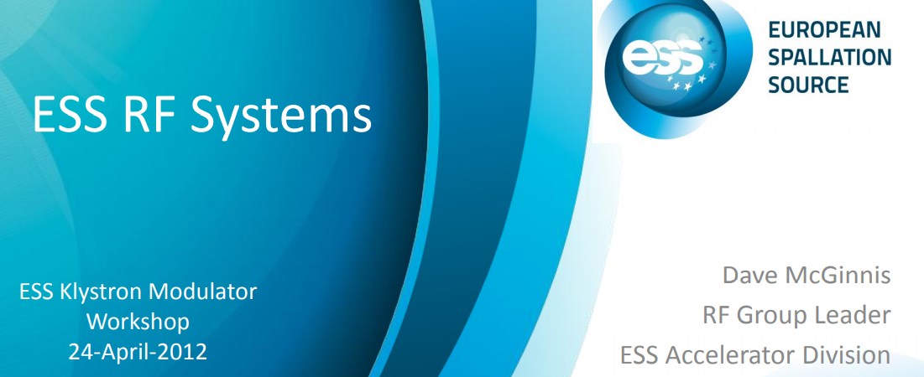
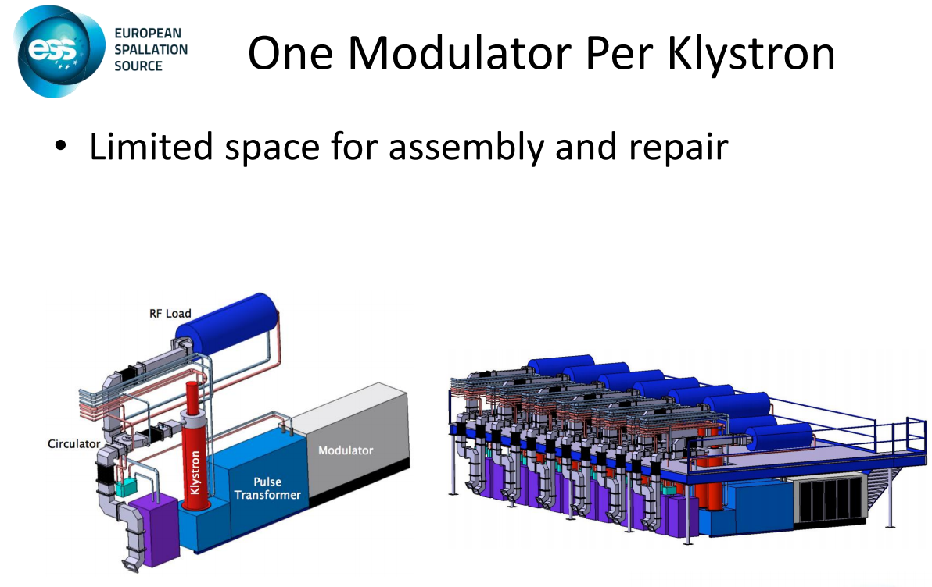
RF station layouts (1) one klystron per modulator
modulator
klystron
WG
cavity

Slide 11
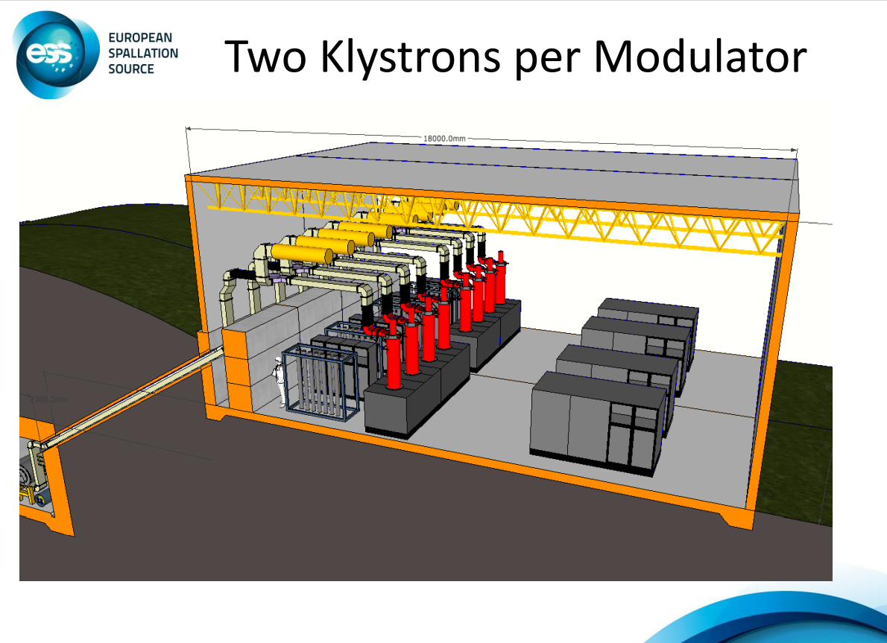
RF station layouts (2) two klystrons per modulator
modulator
klystron
klystron
WG
WG
cavity
cavity

Slide 12
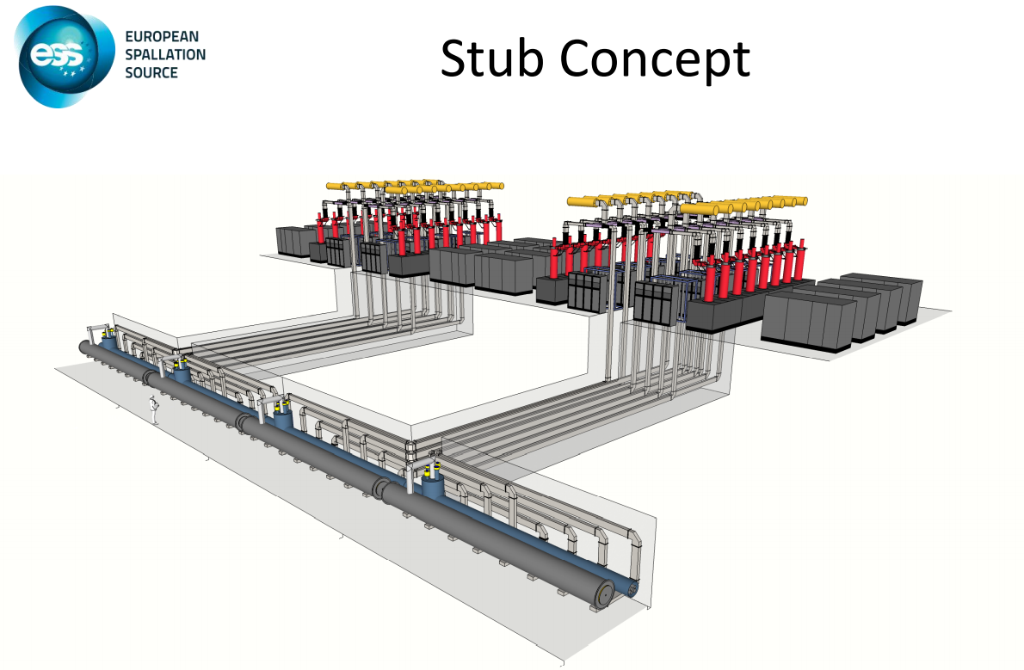
RF station layouts overall
Footprint of 8
RF power sources:
15m x 12m
8m
RF: 8x1.5MW
15m x 12m
12m
15m
15m

Slide 13
Muon cooling demonstrator layout
RF for 4 cavities
15m x 12m
RF for 4 cavities
15m x 12m
RF for cooling
gradient 30MV/m
RF for collimation
RF for 4 cavities
15m x 12m
RF for 4 cavities
15m x 12m
modulator
RF for 8 cavities
15m x 12m
RF for 4 cavities
15m x 12m
RF for 4 cavities
15m x 12m
klystron
klystron
RF for 8 cavities
15m x 12m
RF for 4 cavities
15m x 12m
RF for 4 cavities
15m x 12m
WG
WG
WG
RF for 4 cavities
15m x 12m
cavity
4m

Slide 14
Muon cooling demonstrator layout nominal gradient
RF for collimation: Max 20MV/m
RF for 16 cavities 15m x 12m x 2
RF for cooling: Max. gradient 30 MV/m
RF for 144 cavities at ~30 MV/m
15m x 2 x 12m x 18 = 30m x 216m
OR
15m x 4 x 12m x 9 = 60m x 108m
Big building:
(surface)
30m x 230m
Height: 8-10 m
Large number of very long waveguides
100m surface
+50m shaft
32m
216m
Some reduction of the size of the modulators due to shorter pulse and lower rep. rate is possible.

Slide 15
Muon cooling demonstrator layout lower gradient: 20 MV/m
RF for collimation: Max 20MV/m
RF for 16 cavities 15m x 12m x 2
RF for cooling: Max. gradient 20 MV/m
RF for 144 cavities at ~20 MV/m
15m x 2 x 12m x 9 = 30m x 108m
Not an option since gradient is part of the cooling design
Big building:
(surface ?)
30m x 120m
Height: 8-10 m
Very long waveguides
50m surface
+50m shaft ?
32m
108m
Some reduction of the size of the modulators due to shorter pulse and lower rep. rate is possible.

Slide 16
Muon cooling demonstrator layout lower shorter cooling channel
RF for collimation: Max 20MV/m
RF for 16 cavities 15m x 12m x 2
RF for cooling: 2x shorter cooling channel
RF for 72 cavities at ~30 MV/m
15m x 2 x 12m x 9 = 30m x 108m
Big building:
(surface ?)
30m x 120m
Height: 8-10 m
Very long waveguides
50m surface
+50m shaft ?
16m
108m
Some reduction of the size of the modulators due to shorter pulse and lower rep. rate is possible.

Slide 17
Some R&D ideas for MC RF system optimization
Pulse compressors
Higher peak power RF sources
Feeding several cavities from one line (source)
Probably a combination of all 3 is the best

Slide 18
Muon cooling demonstrator layout
RF pulse compression: x2
modulator
RF for cooling: Max. gradient 30 MV/m
klystron
RF for 144 cavities at ~30 MV/m
15m x 2 x 12m x 9 = 30m x 108m
144 RF pulse compressors with
power gain factor 2
Big building:
(surface ?)
30m x 120m
Height: 8-10 m
Very long waveguides
50m surface
+50m shaft ?
32m
PC2
WG
cavity
Some additional space is needed 2mx2m in the tunnel
See more details here S. Arsenyev, MC RF WG meeting 31st Aug. 2021: Diapositive 1 (cern.ch)
108m

Slide 19
Muon cooling demonstrator layout
RF pulse compression: x4
modulator
RF for cooling: Max. gradient 30 MV/m
klystron
Some additional space is needed 2mx2m in the tunnel
WG distribution with phase adjustment to feed 2 cavities
RF for 144 cavities at
~30 MV/m
30m x 54m
72 RF pulse compressors with
power gain factor 4
Big building:
(surface ?)
30m x 60m
Height: 8-10 m
Very long waveguides
30m surface
+50m shaft ?
32m
PC4
WG
cavity
cavity
54m

Slide 20
Muon cooling demonstrator layout
High peak power klystron: 12 MW
modulator
RF for cooling: Max. gradient 30 MV/m
klystron
12MW
RF for 144 cavities at
~30 MV/m
30mx27m
36 RF stations
Building:
(surface ?)
30m x 30m
Height: 8-10 m
Long waveguides
15m surface
+50m shaft ?
WG distribution with phase adjustment to feed 4 cavities
32m
WG
cavity
cavity
cavity
cavity
27m

Slide 21
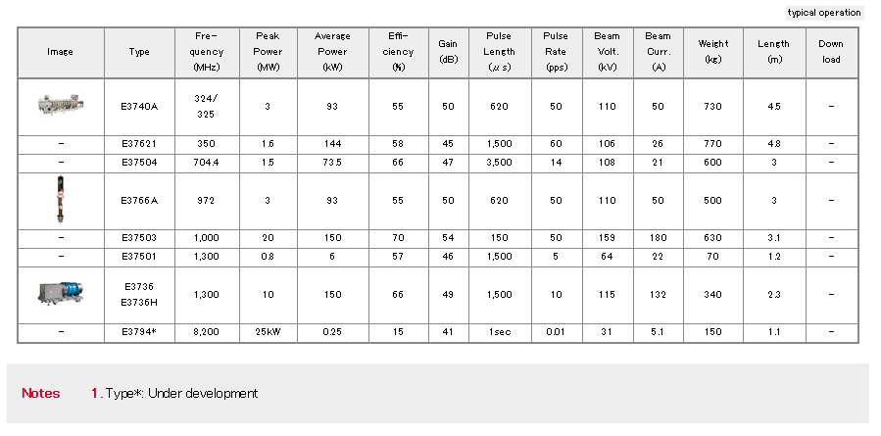
High peak power klystron for CLIC: 1GHz
CANON
Commercial tube
Custom design for CLIC:
  f=1GHz
  P=20MW,
  T_p=150us,
  Rep.rate=50Hz
High efficiency: 70%
Multibeam
This design could probably be scaled to 704 MHz
More redesign is probably needed for 350 MHz
ESS
CLIC

Slide 22
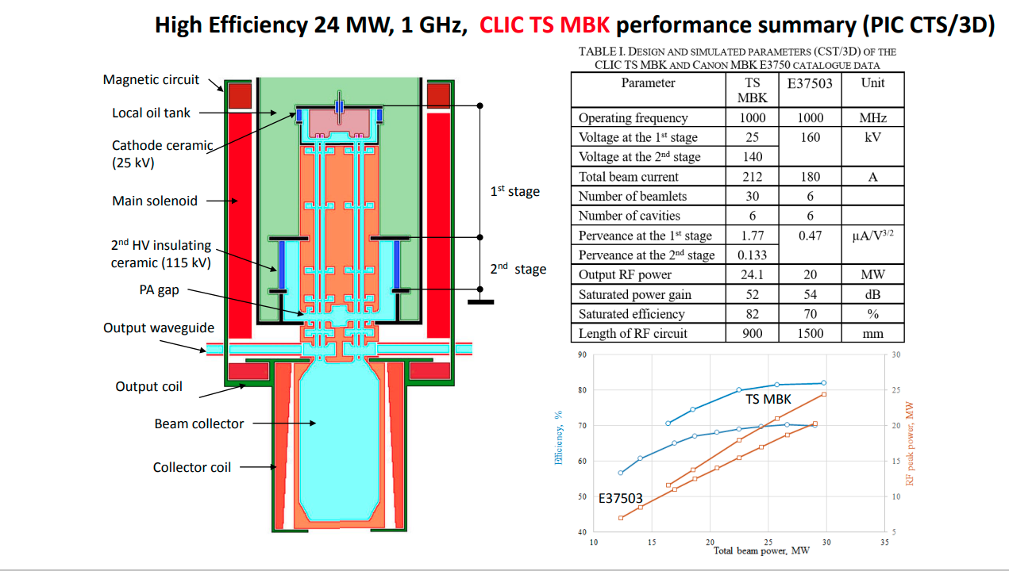
New ideas for CLIC 1GHz klystron
Novel design
Two-stage (TS)
multi beam klystron (MBK)
CLIC project meeting
15 June 2021
Igor Syratchev (cern.ch)

Slide 23
Muon cooling demonstrator layout
High peak power klystron: 24 MW
modulator
RF for cooling: Max. gradient 30 MV/m
klystron
24MW
WG distribution with phase adjustment to feed 2 x 4 cavities
RF for 144 cavities at
~30 MV/m
30mx14m
18 RF stations
Building -> Gallery :
(underground might be possible)
30m x 15m
Height: 8-10 m
32m
WG
WG
cavity
cavity
cavity
cavity
cavity
cavity
cavity
cavity
14m

Slide 24
Some preliminary conclusions
Total number of RF power sources and total footprint of the RF system have been estimated based on currently available parameters of RF system for the muon cooling demonstrator (MCD) and assuming commercially available RF power sources similar to what is used at ESS.
Total number of klystrons for the MCD is ~300 which is larger than for example for ESS (~200)
The footprint is ~30x200m which is probably too large to go underground. It requires large number (~300) of long (~100m) waveguides
Possible reduction of the footprint is possible by scaling done modulator size for operating at lower (than ESS) pulse length and rep. rate required for MCD. (~10-50% for the modulator, small impact on the overall footprint, TBC)
Significant reduction of the number of RF power sources and RF waveguides is possible by
  Adding RF pulse compression system with power gain of 2 to 4.
  Using higher peak power klystron: 1.5 -> 24 MW, factor 16.
  Both approaches require development of distributed coupling system for feeding RF power to several cavities (from 2 to 8) from one source
All options require strong R&D program before application to the design of MCD

