Slide 1
    Beam optics studies for GaToroid
    Ewa Oponowicz, Yann Dutheil
    In collaboration with Alex Gerbershagen, Luca Bottura, Ariel Haziot
CERN Knowledge Transfer Seminar
6 October 2021

Slide 2
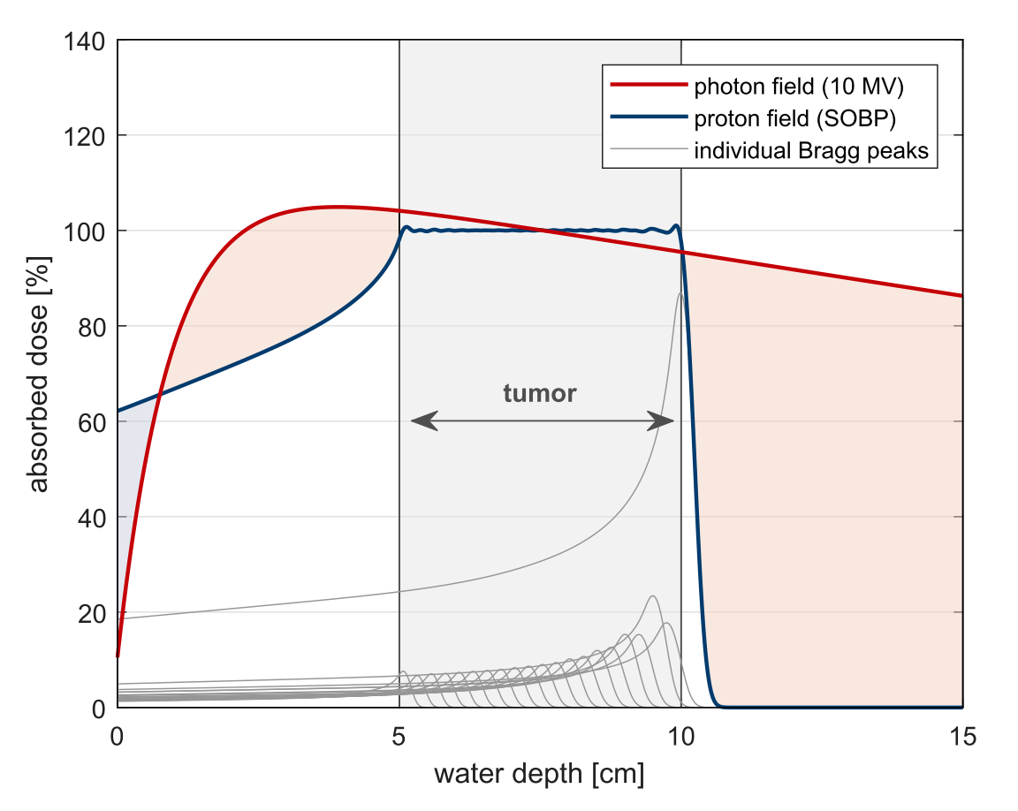

Photon, proton or carbon ion therapy?
Aim: deliver large enough dose per unit mass to the tumour and spare the healthy tissues
Radiation therapy worldwide:
  Mainly photon therapy (15.000 centres)
  Around 100 centres for charged particle therapy (protons and carbon ions)
photon field (10 MV)
proton field (SOBP)
individual proton BP
individual carbon ion BP
Physical dose of protons and carbon ions is similar:
  C-ions have a sharper Bragg peak
  and a tail on the fall-off part
Main difference between protons and carbon ions from a clinical point of view: relative biological effectiveness
G. Klimpki, “Continuous irradiations in proton therapy: balancing risks and benefits” 2018

Slide 3
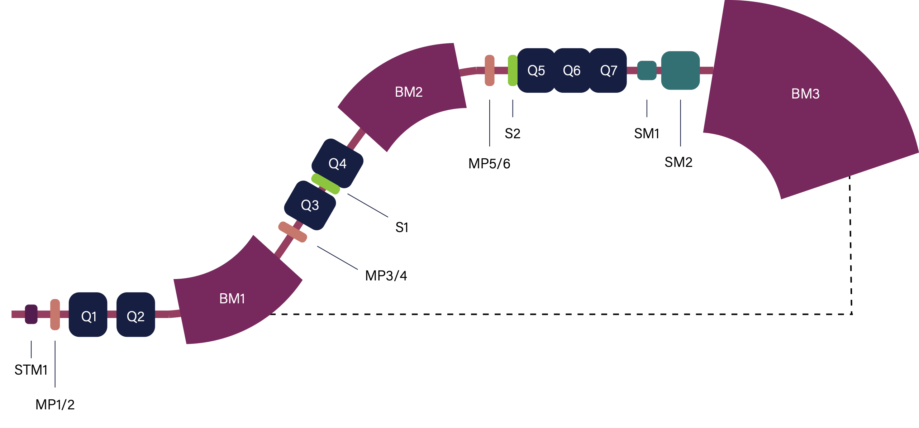





Hadron beam delivery
Some requirements at the isocentre:
  Round beam x/y = 4-10 mm FWHM
  Spot precision < 0.5 mm
  Beam normal to the irradiation plane
  Zero dispersion
  Irradiation field around 30x40 cm²
Kinetic energies for the same penetration depth (3-30 cm):
  Protons @ 60-220 MeV (1.1-2.3 Tm)
  C-ions @ 120-430 MeV/u (3.2-6.6 Tm)
Ideally 360 degrees irradiation
$$β$$
ISOCENTRE
PSI Gantry 2:
Normal-conducting system for protons
200 tons
Radius 3.2 m, length 8.9 m
270 deg rotation
$$α$$
Notes:
Rotation of gantry in vertical plane with polar angle α and patient in horizontal plane with azimuth angle β enables 4π irradiation

Slide 4
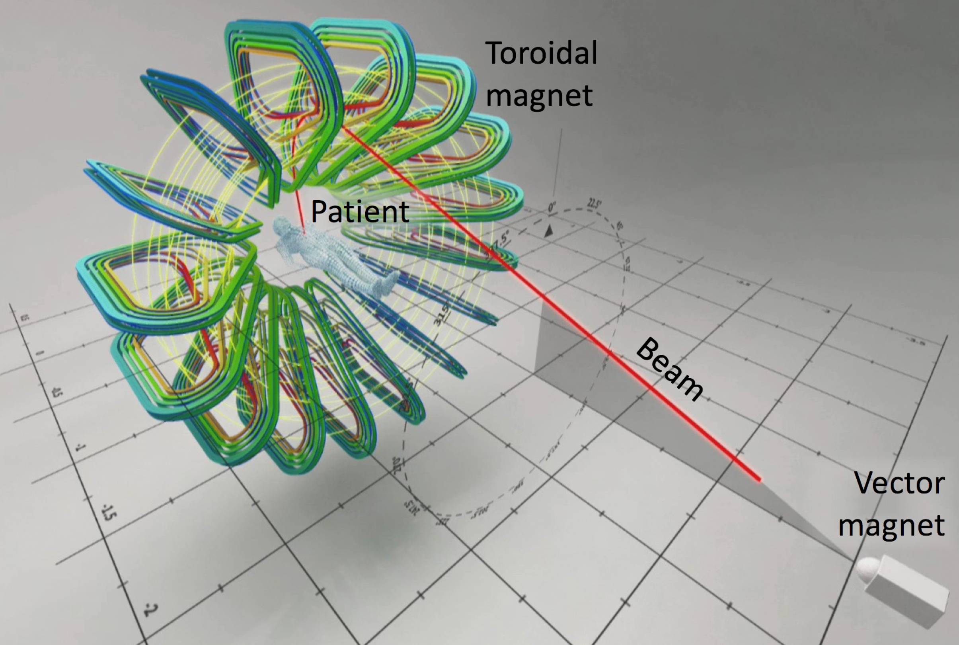
GaToroid: the concept
In most cases carbon ions are delivered via fixed beamlines
Operating gantries for carbon ion therapy:
  1 normal-conducting (Germany)
  2 superconducting (Japan)
GaToroid is a superconducting and steady state system:
  Lower weight, size, footprint
  Lower cost
  No rotation
  No magnetic field ramping
E. Felcini, “Analysis of a novel toroidal configuration for hadron therapy gantries” 2020
Notes:
Two main parts that realize the basic idea:
— A vector magnet, receiving beam from the accelerator extraction line, and providing a kick that depends on the energy of the beam and the desired direction of beam delivery;
— One toroidal magnet that bends the beam by using a combination of their shape and field variation with radius and length.
- The patient is placed in the axis of the toroid, in the bore, where the magnetic field is relatively small.
GaToroid has several advantages.
The first benefit is that the mechanical structure of the steady and axis-symmetric configuration is much simpler and lighter than a rotating gantry. The magnet is fixed in space and operates in steady state, so it is appropriate to conceive the use of superconducting materials for the toroidal magnet, generating significantly higher field than existing normal-conducting solutions. This has the further potential of a very significant reduction of the footprint.
Last but not least, the steady state nature of the gantry would allow quasisimultaneous irradiations from different directions at different energies, with the only limitation imposed by the ability of the accelerator to deliver such beams, and the vector magnet to follow the desired changes.

Slide 5
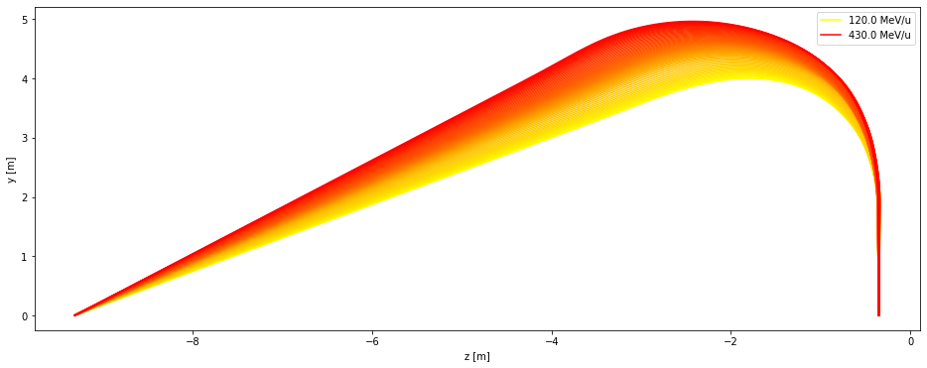

2D: central trajectories
Carbon ion beams of various energies:
  are given different kicks in the vector magnet point (VM), e.i. entrance angle to the region of the coil
  should reach the isocentre normal to the irradiation plane
Where is the VM?
Where is the isocentre?
400
350
300
250
200
150
C¹² kinetic energy [MeV/u]
VECTOR MAGNET POINT
ISOCENTRE
Notes:
The beam path in air (after leaving the exit window(s) of the gantry) shall be energy independent, i.e. the beam orbits at different energies must be coincident at the exit of the gantry
A procedure, restricted to the symmetry plane between each pair of coils, to define different beam orbits, function of the beam energy - for the complete energy range of Carbon ions treatment.

Slide 6
2D: central trajectories
Backward-tracking (for many energies)
from a fixed isocentre position vertically up
to find an average distance between the vector magnet point and the field map
VECTOR MAGNET POINT
ISOCENTRE
Forward-tracking
from the average distance between the vector magnet point and the field map
optimising the alpha input angle for a given energy to reach as close as possible to the previously fixed isocentre & as vertically as possible
checking the theta angle at the isocentre as a function of different fixed isocentre position
VECTOR MAGNET POINT
ISOCENTRE
~10 m

Slide 7
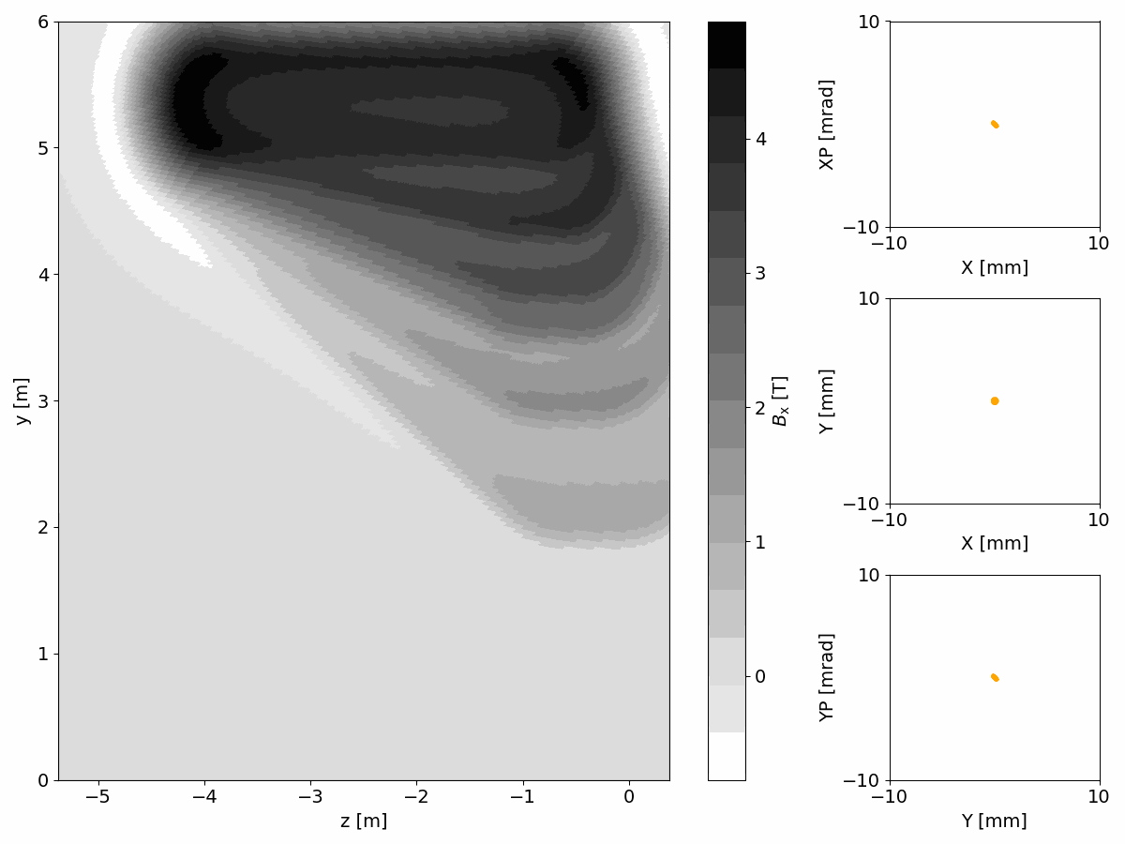
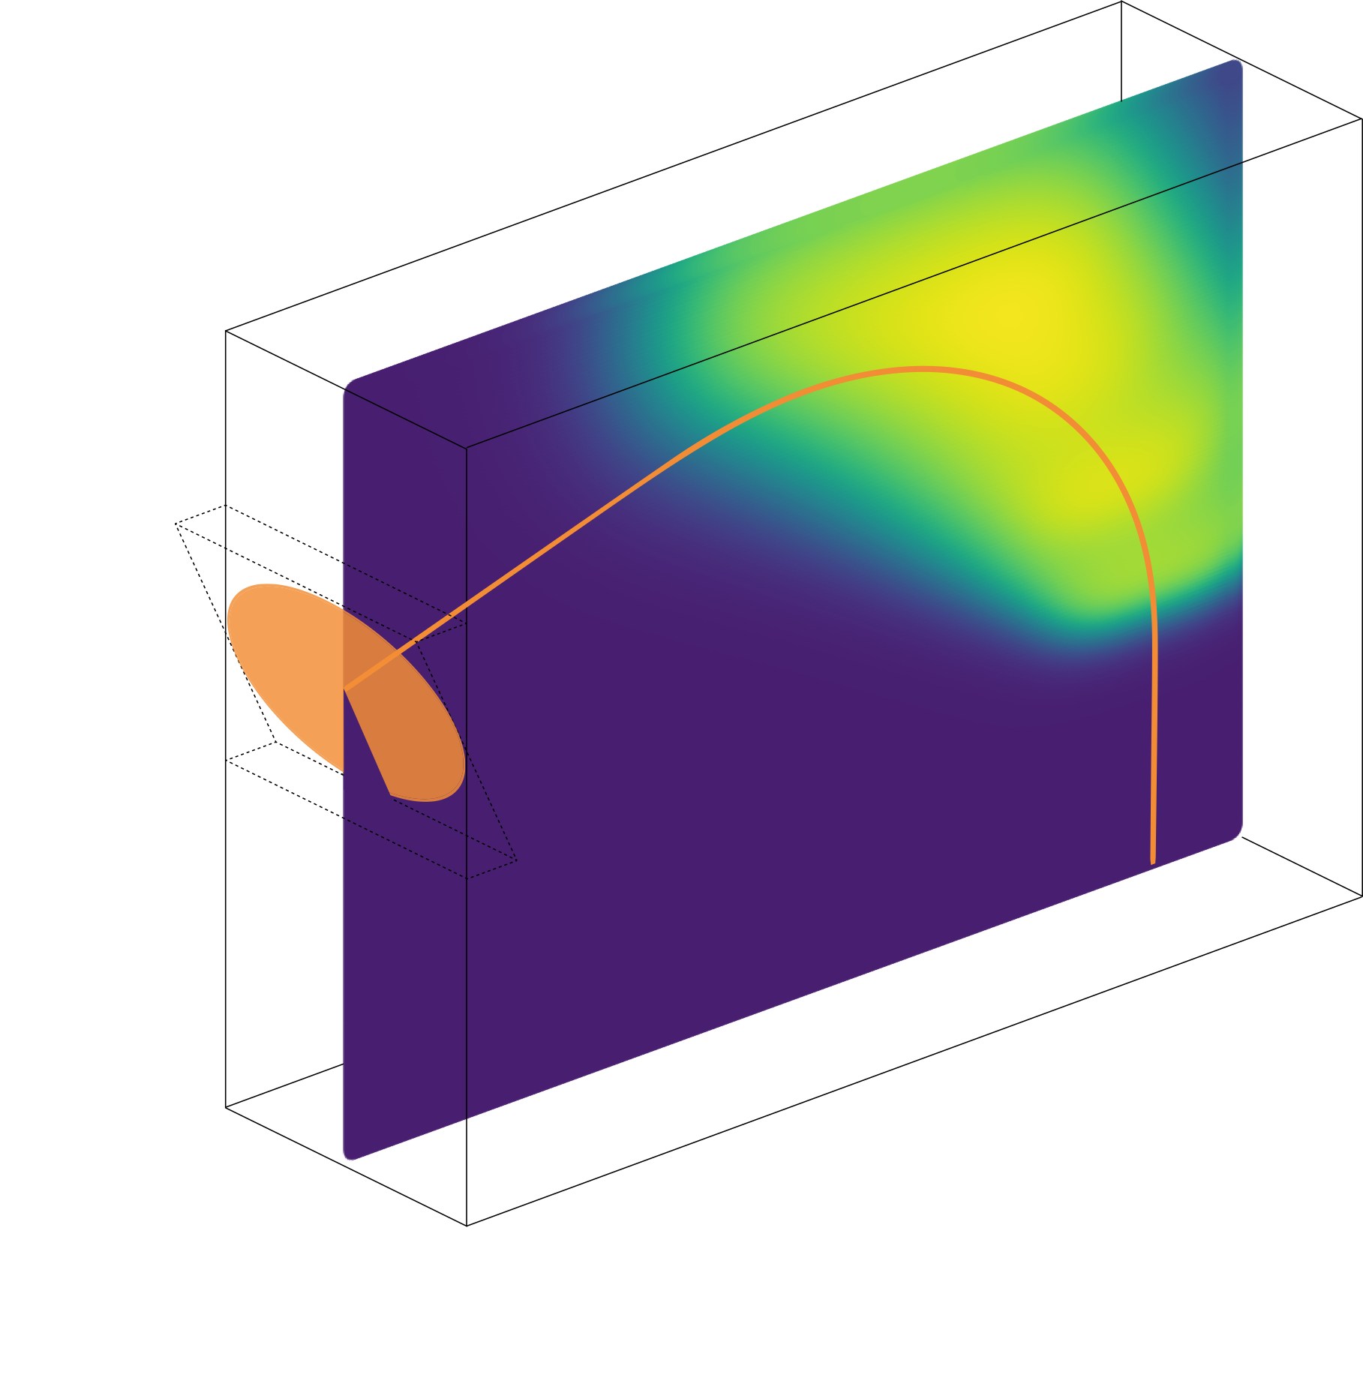
3D beam dynamics
ISOCENTRE
VECTOR MAGNET

Slide 8
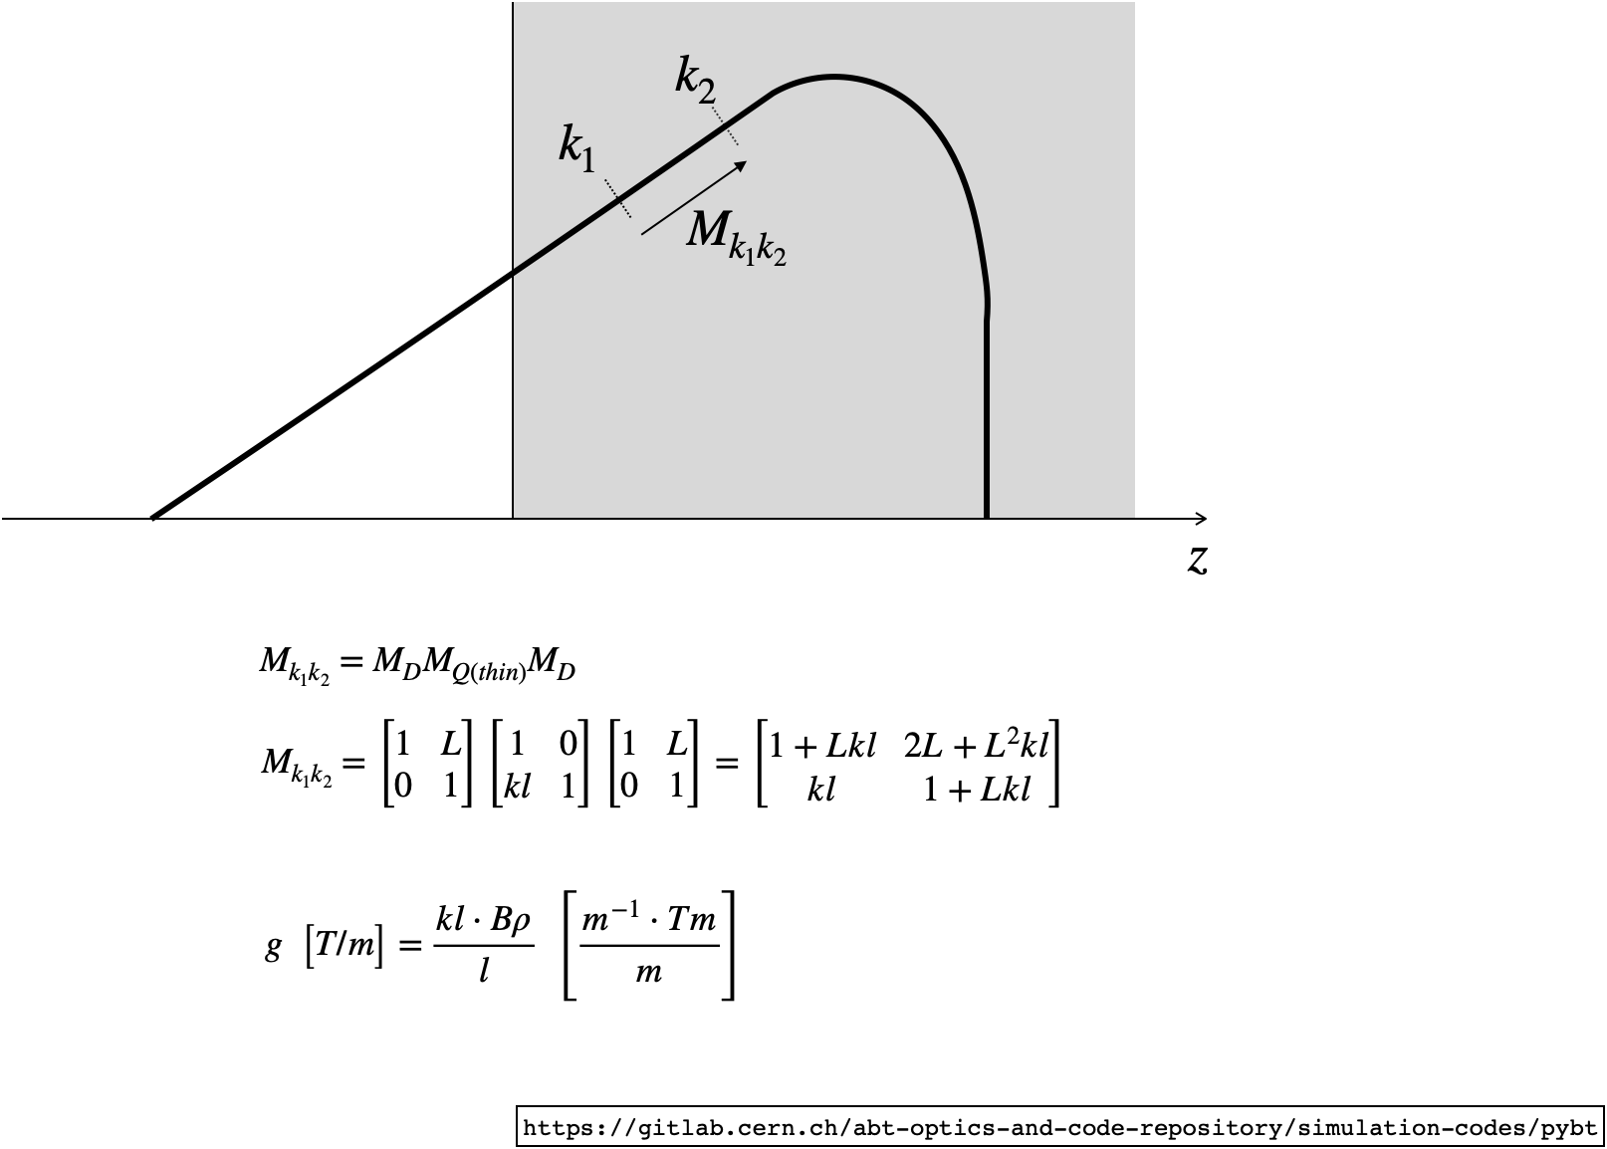
3D beam dynamics: focusing terms

Slide 9
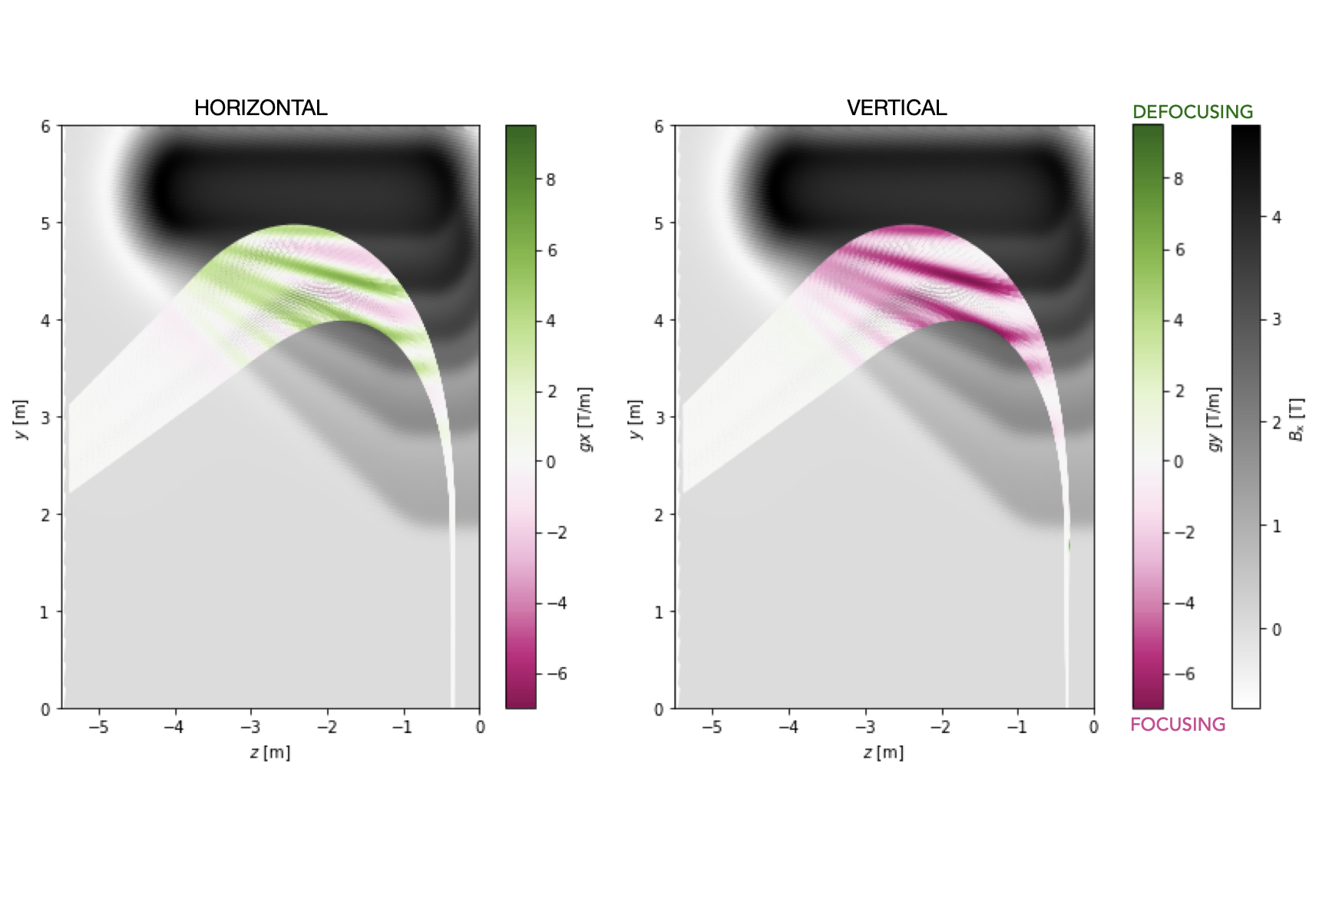
3D beam dynamics: focusing terms

Slide 10





Next steps
Coil design optimisation
  Iterative process including beam dynamics and parameters of the set of coil
  Decreasing computing time
Considerations of the upstream beamline elements:
  GaToroid as a complete system from the synchrotron extraction point to the patient
Both protons and carbon ions
$$β$$
Coil configuration:
Shape of the coil
Number of windings
Spacing between the windings
Current adjustment
Field recalculation
Central trajectories
$$α$$
$$γ$$
Beam optics
$$f_{in}$$
$$f_{out}$$
VECTOR MAGNET
Notes:
VM:
— a single dipole rotating around its axis with the ability to sweep the field strength
— a two-axis vector magnet, producing a combination of horizontal and vertical dipole with arbitrary direction. In this case the two dipoles should change setting frequently, providing the ability for rapid energy and direction changes, and eliminating the need for a heavy rotating machinery
OR more complex:
— it would be conceptually possible to reduce the strength requirements on the x-y kick by adding a forward toroid to the beam line - adds a deflection to the one provided by the vector magnet, and acts as an “angle amplifier”. The drawback is that the accuracy requirement at the location of the vector magnet, already demanding, is further amplified.
— a sequence of toroids of appropriate shape and field gradient. In this case the beam extracted from the accelerator at E enters a first toroidal bending magnet TB1. The effect of this magnet is to bend the beam off the axis, with a kick that decreases as the energy is increased (the three trajectories plotted in Figure 45). This is followed by a “toroidal quadrupole” TQ1, beam passing through the toroidal quadrupole TQ1 receives a kick that depends on its position, and with the geometry and parameters selected the result is to make the trajectories for the different energies converge in a point F. (a series of points on a ring in 3D space). The beam finally enters the second toroidal bending magnet TB2 that provides for convergence at the isocentre I. This configuration, which is built with steady state magnets, has some evident benefits. It can be built so that its energy acceptance is very large and does not require a fast vector magnet to work. In fact, the function of the vector magnet is now taken by the TB1 and TQ1, and no element in the line needs to be ramped as the energy is changed.
In both cases: also handling fringe fields and dose verification channels
TAA:
— two design options:
- constant angle magnification factor (BL of magnet dependent on the incoming position, like quadrupole) and the magnified deflection will mean magnified sensitivity (element misalignment, scanning magnet precision etc)
- constant deflection angle (the differences in overall deflection for different energies would still depend on vector magnet only)
TTL:
- will need to handle higher order effects from quadrupoles
- if the system is achromatic - how do we verify the beam energy?

Slide 12

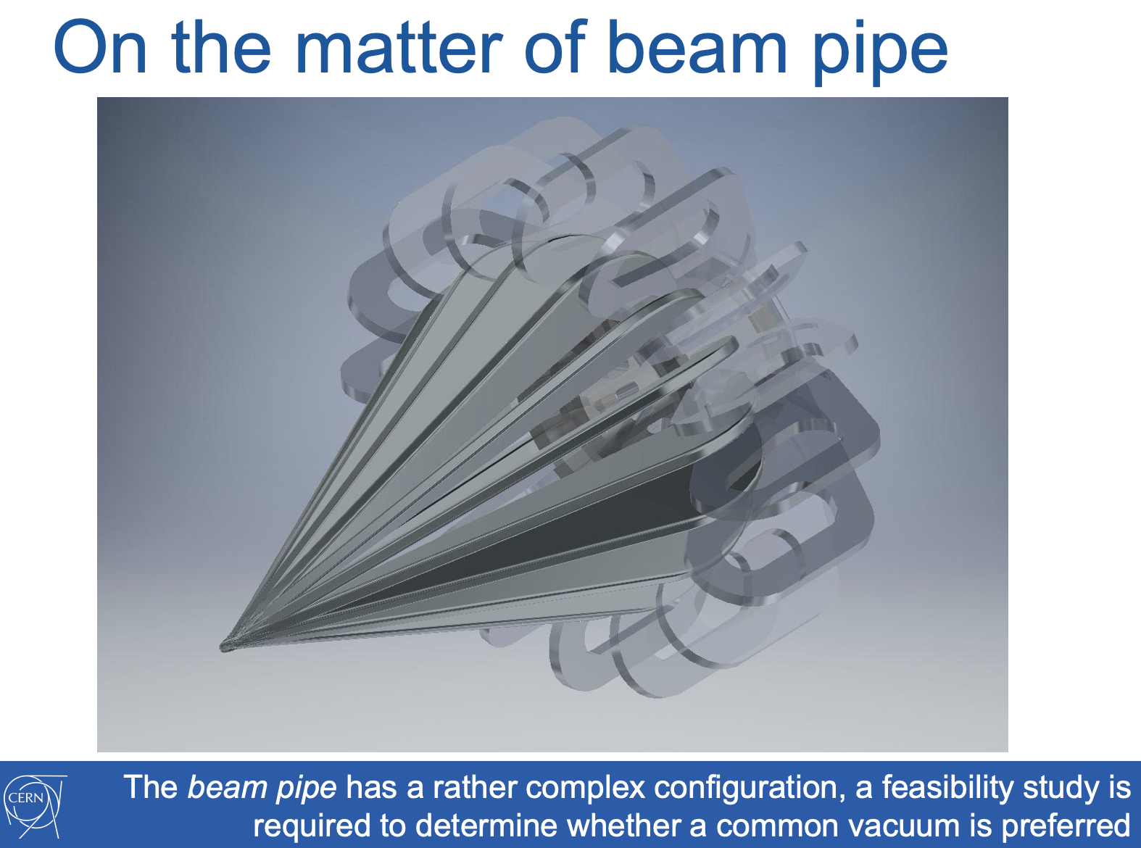
L.Bottura: https://indico.cern.ch/event/754093/attachments/1757883/2850771/GaToroid_LBEF_KT_final.pdf

Slide 13

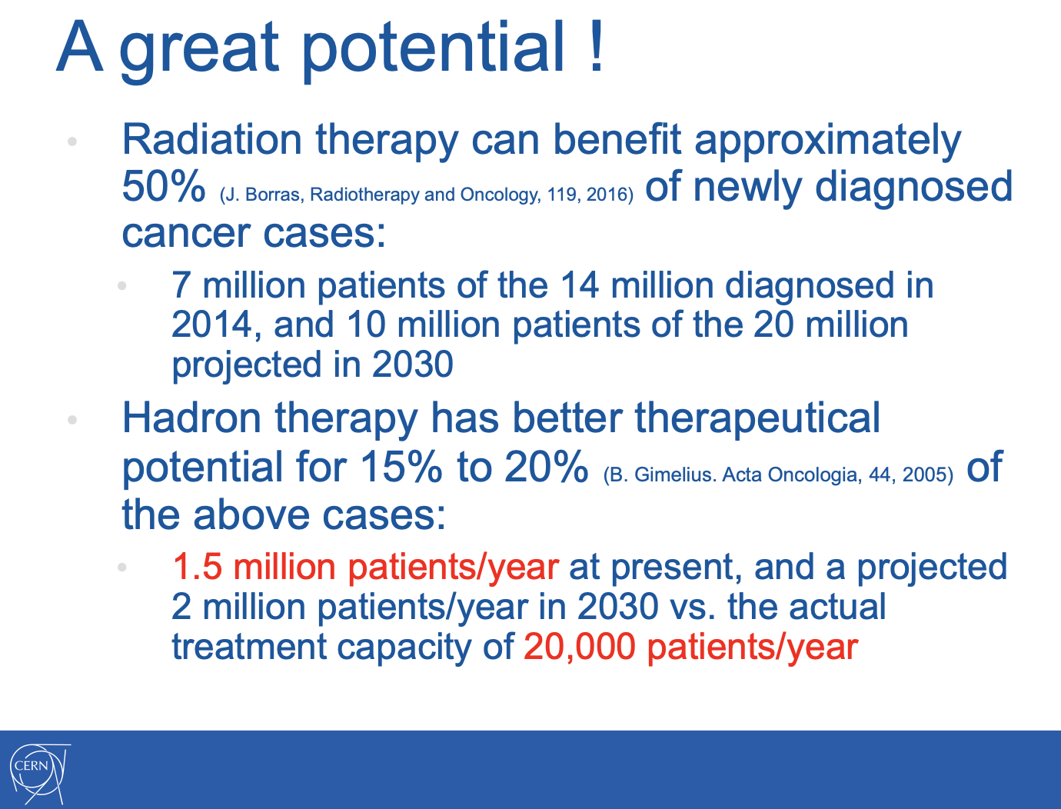
L.Bottura: https://indico.cern.ch/event/754093/attachments/1757883/2850771/GaToroid_LBEF_KT_final.pdf

Slide 14
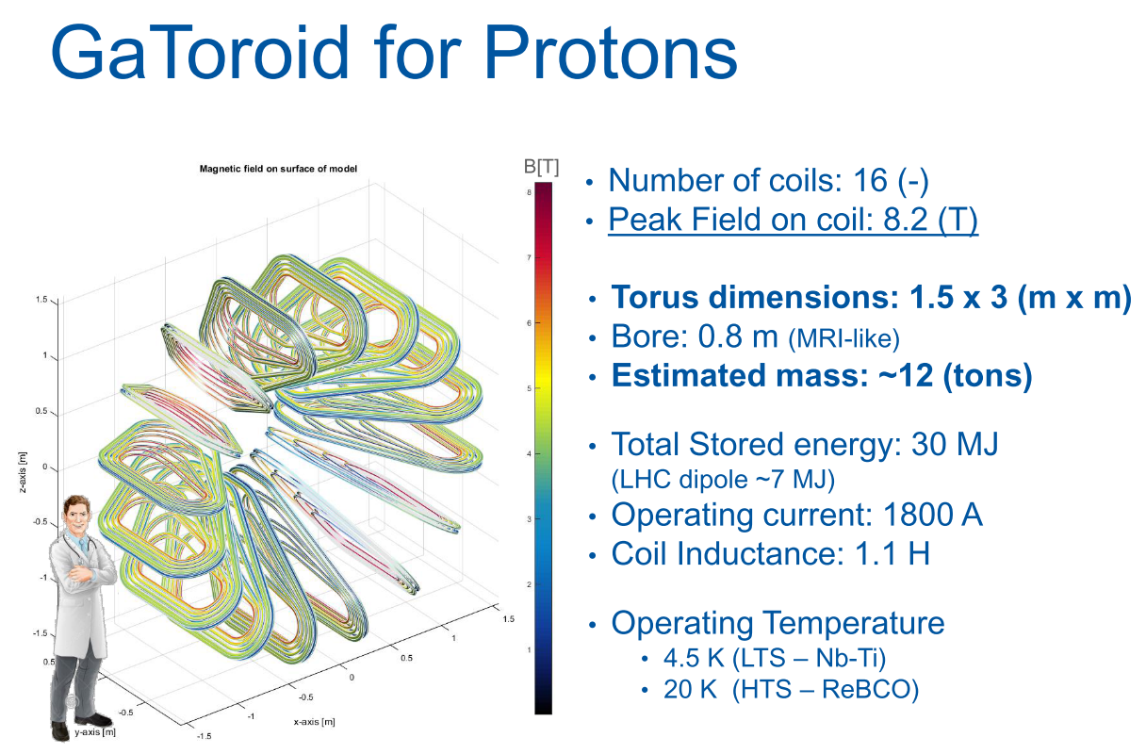
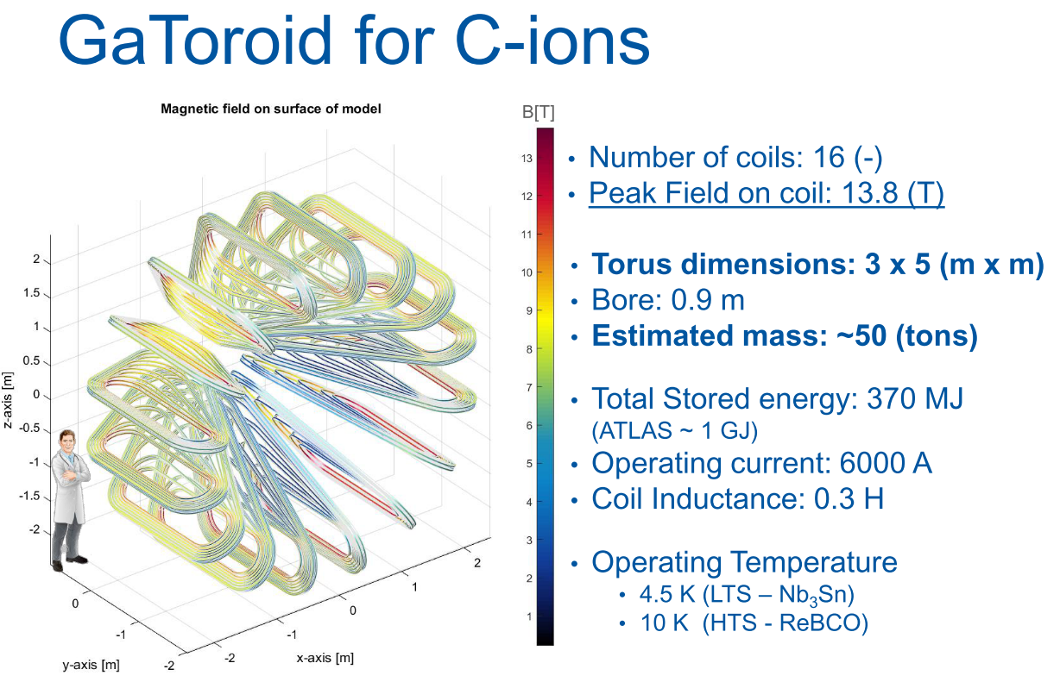
GaToroid: current design
Courtesy: E. Felcini
Patent: L. Bottura 2018
TYPICAL GANTRIES
 | PROTON |  | C-IONS
 | NC | SC | HIT (NC) | NIRS (SC)
LENGTH [M] | 8 | 8 | 25 | 13
RADIUS [M] | 4 | 4 | 13 | 6
WEIGHT [TONS] | 100 | 25 | 600 | 350

Slide 15
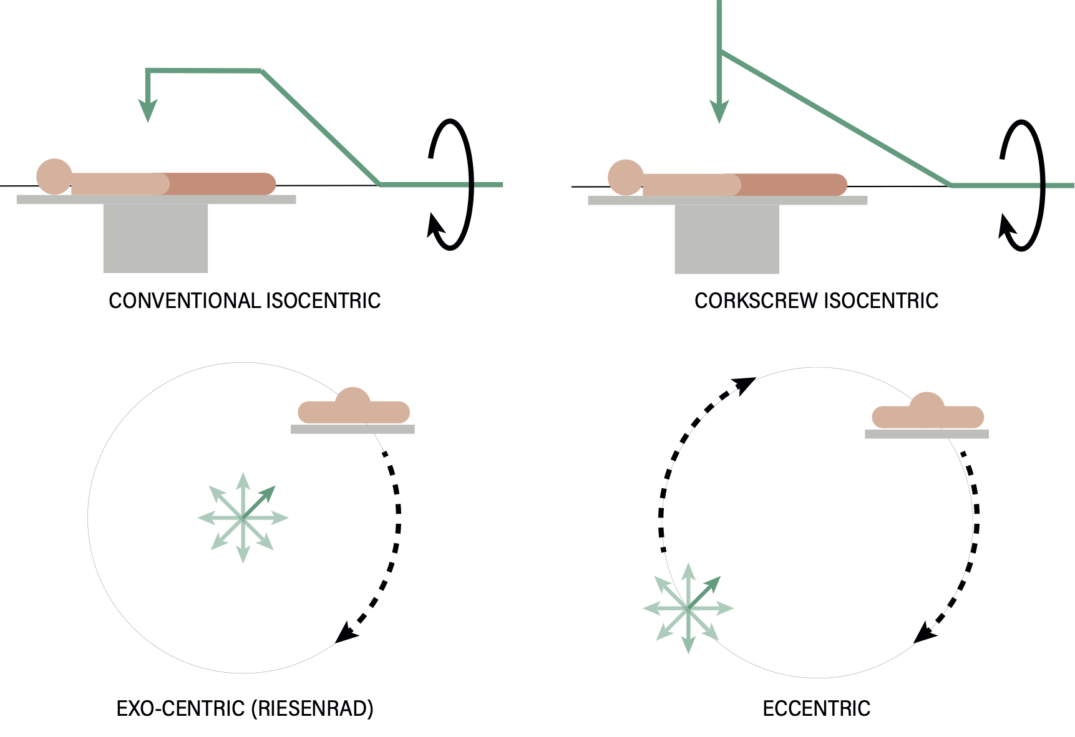
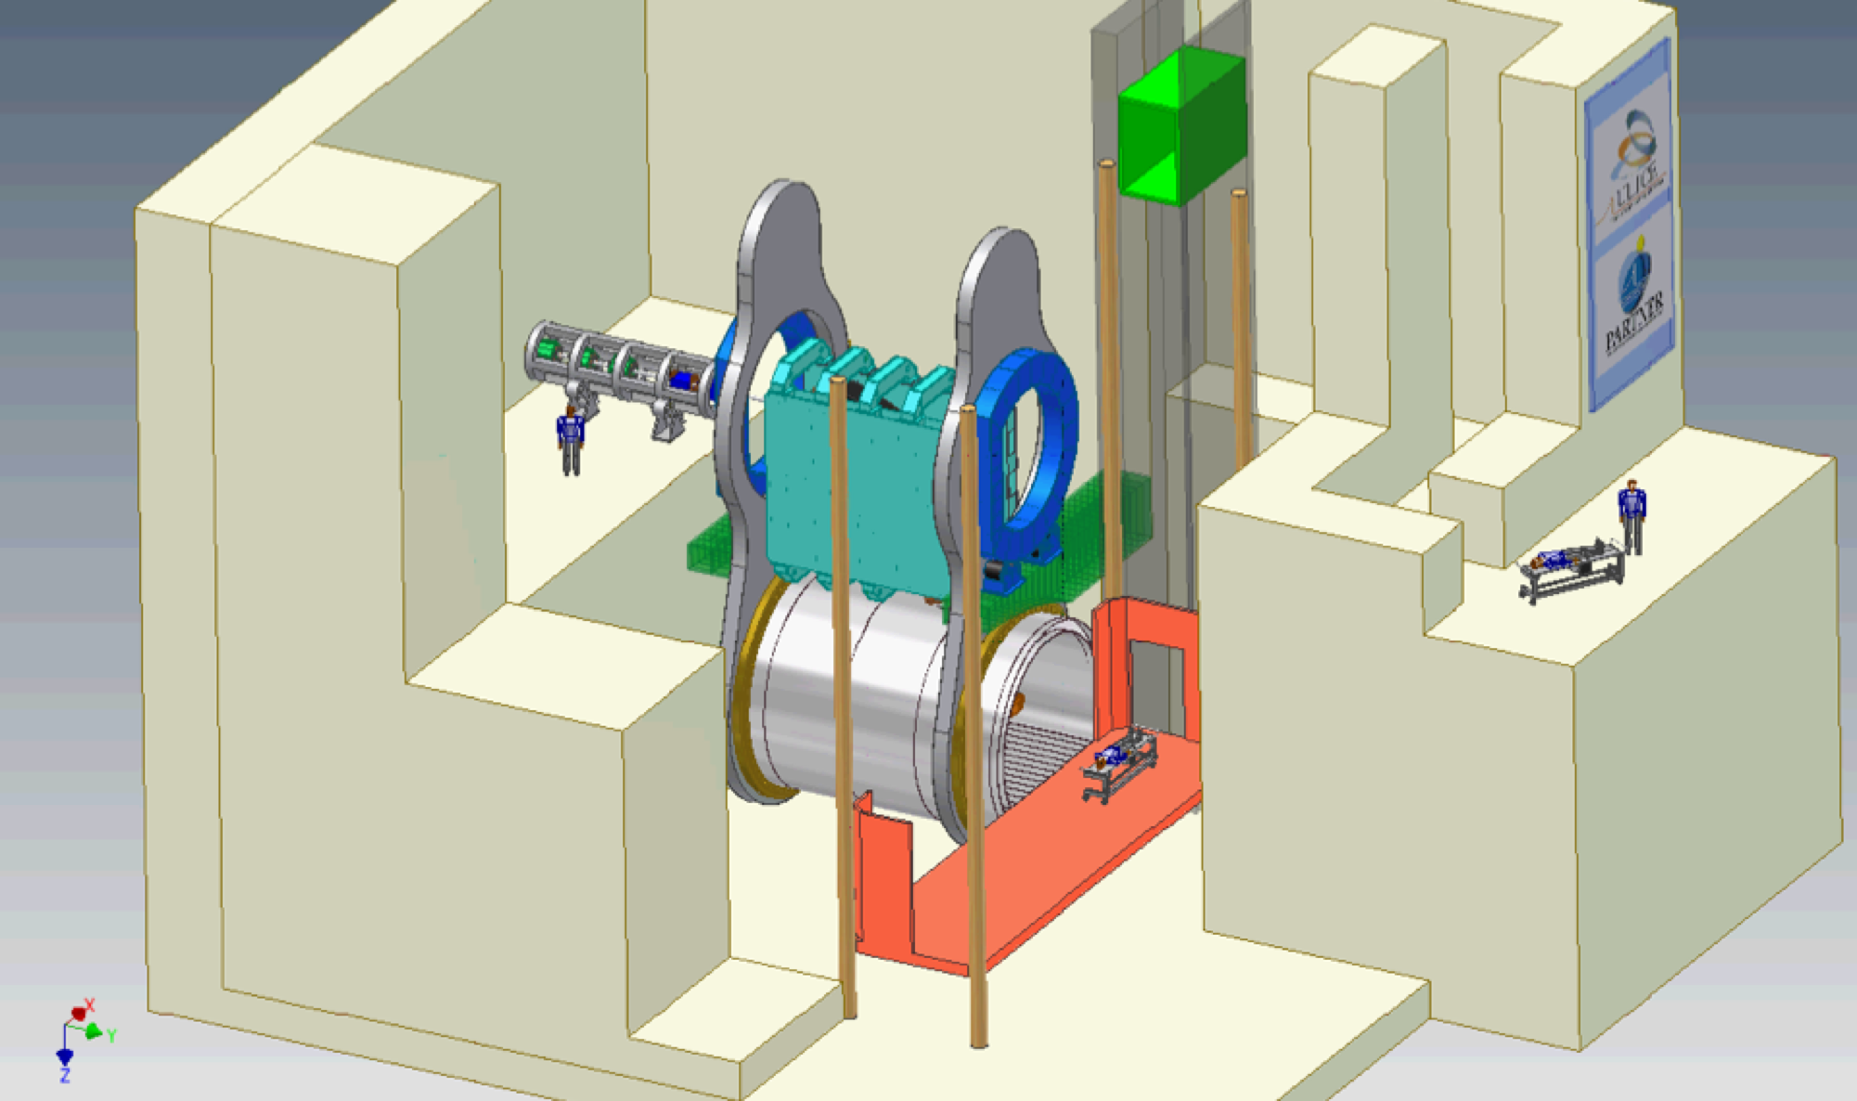
Conventional gantry arrangements
Notes:
The isocentric gantries – with all elements lying in one plane and rotating around supine patient – remain the most widely-used arrangement. In this setup, a full 4π coverage of the irradiation angles can be delivered with a 360◦ rotation of the gantry. Alternatively, to restrict the treatment room surface, a narrower rotation angle is combined with the movement of the patient couch in the horizontal plane.
To shorten the conventional gantry radius, a cork-screw concept was proposed that bends the beam in more than one plane.
To minimise the cost and complexity of the facilities, eccentric gantries have been developed, based only on a single 90◦ bending magnet. However, this requires movement of the patient’s couch or the entire cabin.
In the exo-centric, so called ‘Riesenrad’, gantry the magnet is located on the central axis and rotates 360◦ around it with the couch moving along the outside ‘radius’. In an eccentric design, both the gantry and the cabin move on the outside orbits.
In general: the rotating nature of the gantry introduces significant complexity in terms of cryogenics and mechanical stability.

Slide 16
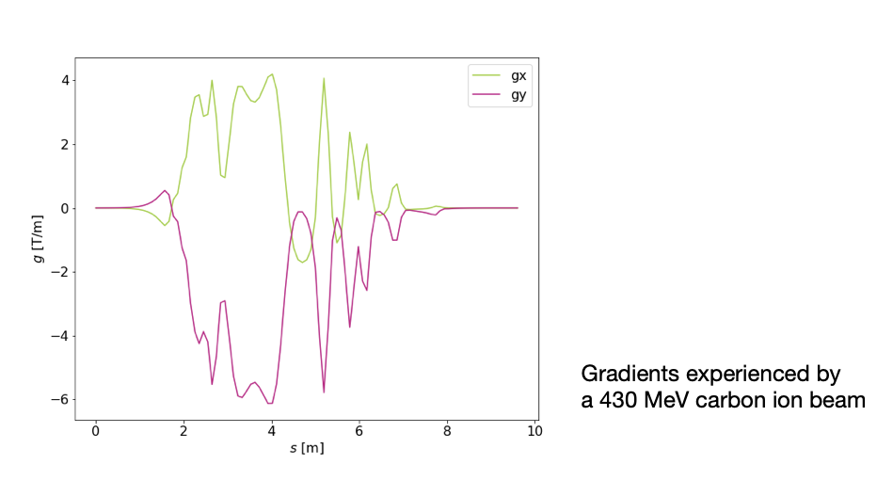
3D beam dynamics: focusing terms

Slide 17
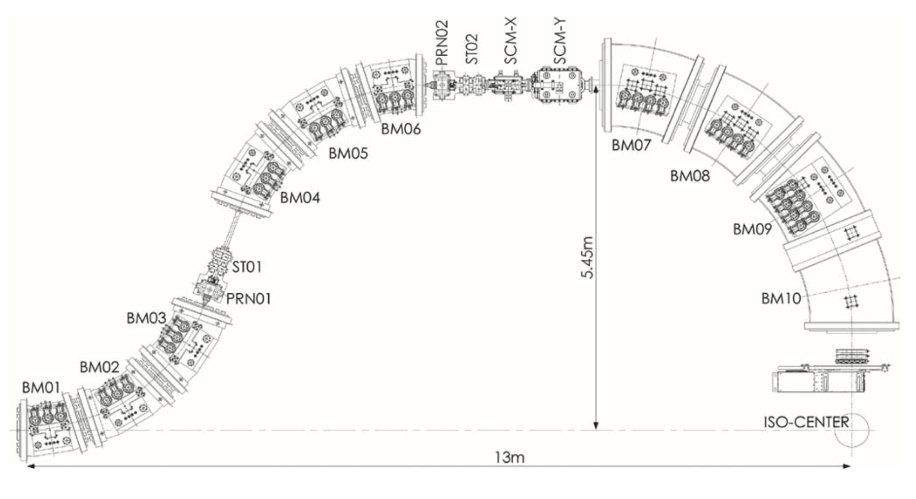
2D: central trajectories
~10 m
~13 m
~25 m
Y. Iwata et al., “Development of curved combined-function superconducting magnets for a heavy-ion rotating-gantry” 2014
Notes:
The beam path in air (after leaving the exit window(s) of the gantry) shall be energy independent, i.e. the beam orbits at different energies must be coincident at the exit of the gantry
A procedure, restricted to the symmetry plane between each pair of coils, to define different beam orbits, function of the beam energy - for the complete energy range of Carbon ions treatment.

Slide 18
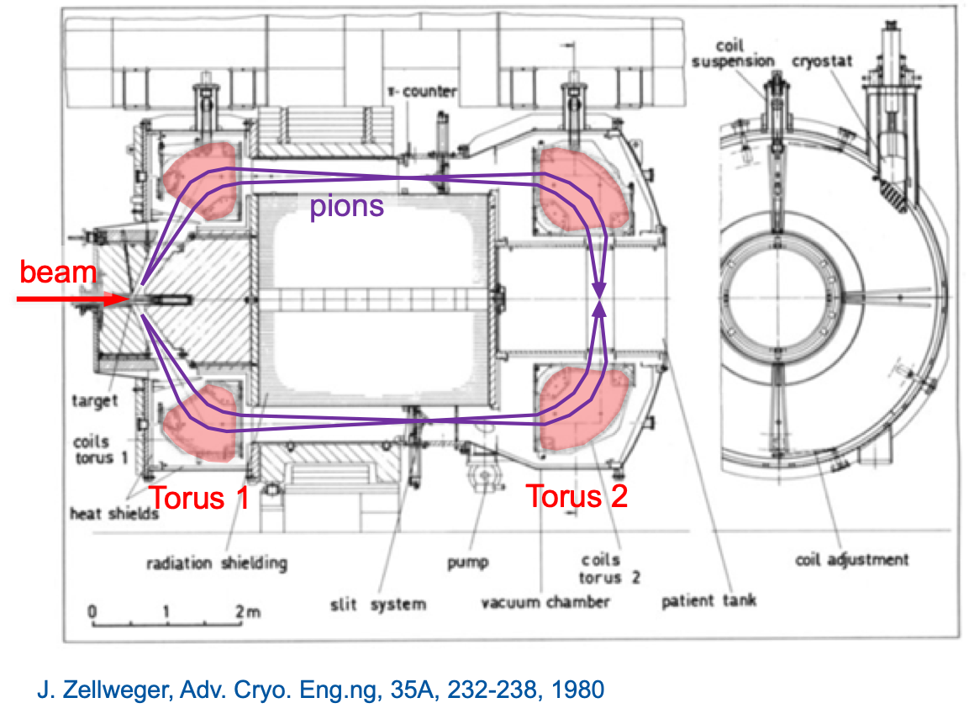
GaToroid: the principle
Patent: L. Bottura 2018
Courtesy: L. Bottura
Notes:
The concept is not completely new; a similar idea was in operation at PSI, using two toroidal magnets. Around 500 patients were treated with Piotron until 1993. (Biological effects were not as high as expected)

Slide 19
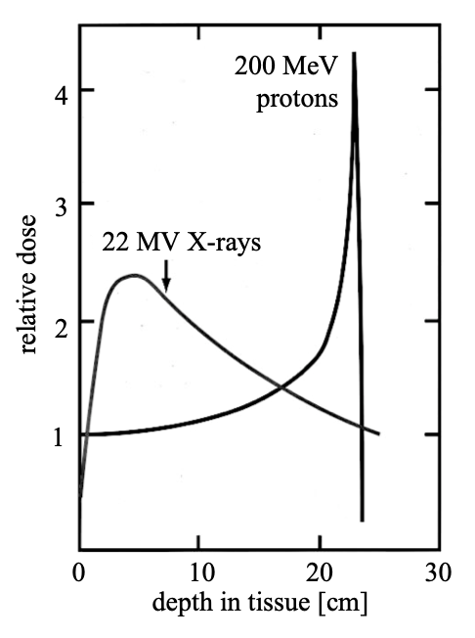
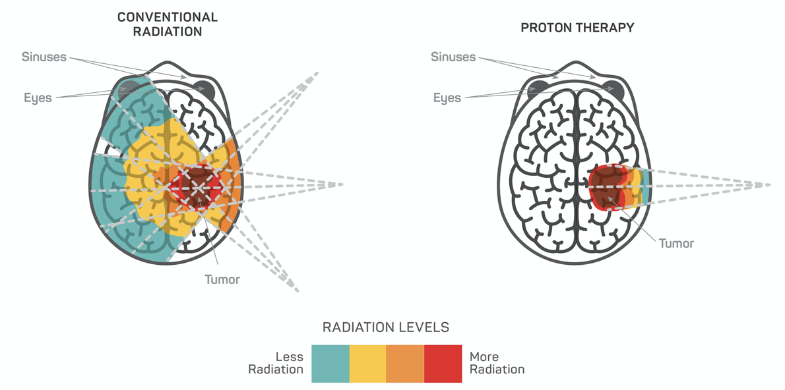
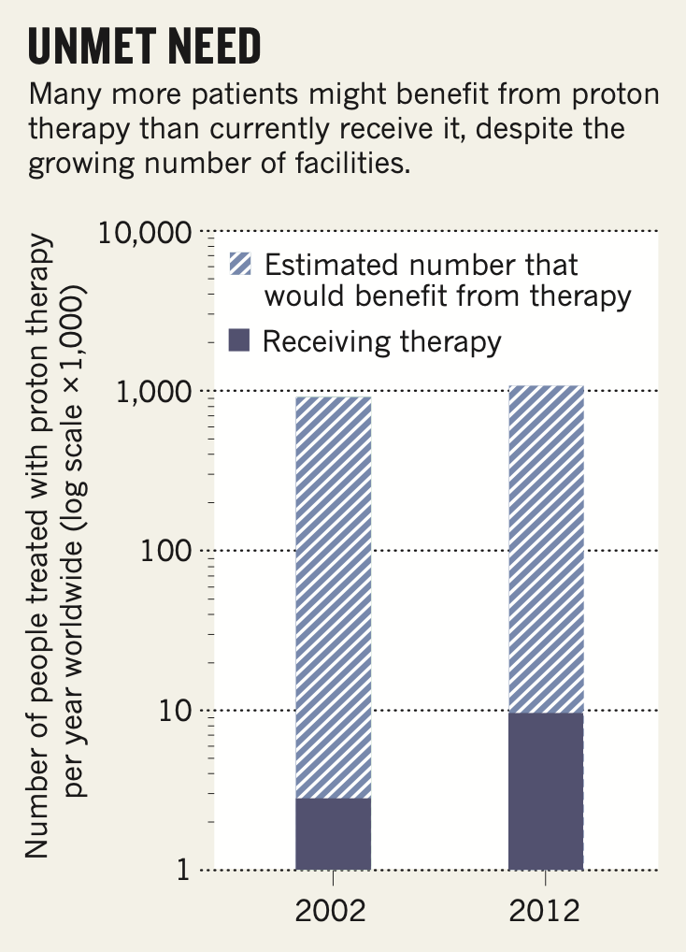
Charged particle therapy
Key indications of CPT:
head & neck
spinal cord
eyes
paediatric cases
https://www.sccaprotontherapy.com
T. R. Bortfeld and J. S. Loeffler, “Three ways to make proton therapy affordable,” Nature, vol. 549, no. 7673, pp. 451–453, Sep. 2017.
Notes:
Most cancers in radiation are treated with X-rays,
depth-dose profile shown in black
and X-rays have such characteristic that they enter to the body on one side and exit on the other.
The maximum energy is deposited close to the surface and an exponential attenuation after. There is a significantly larger dose on the proximal (near) side of the target volume than in the target volume itself and a considerable dose on the distal (far) side of the target volume.
Further significant improvements may only be achievable with the use of charged particles.
Unlike X-rays, protons and other light charged ions deposit most of their energy at the very end of their range, exhibiting a so-called Bragg peak. There will be a relatively small dose as the beam enters the tissue, a large dose deposition at a precise depth (the Bragg peak) determined by the incoming beam energy and little or no dose in the region beyond the Bragg peak.
Because protons can be targeted more precisely than X-rays, so the tissues around the tumour receive two to three times less radiation, the main indications for ion therapy would be …
So why most hospitals do not offer proton therapy

Slide 20
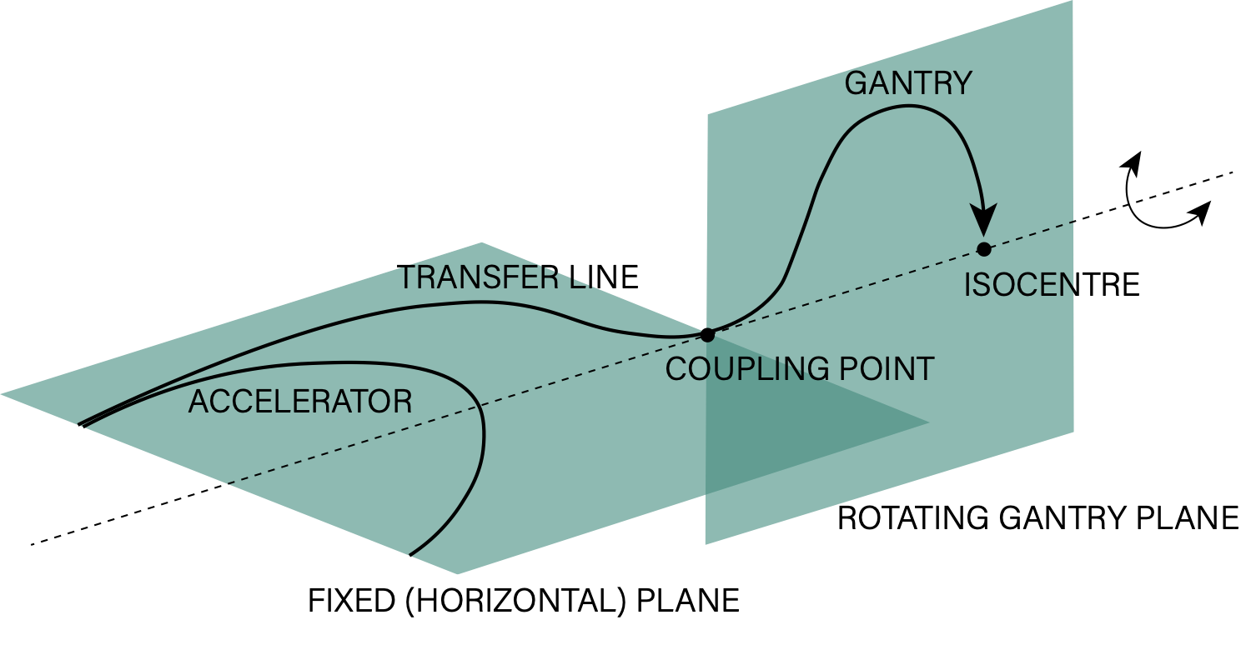
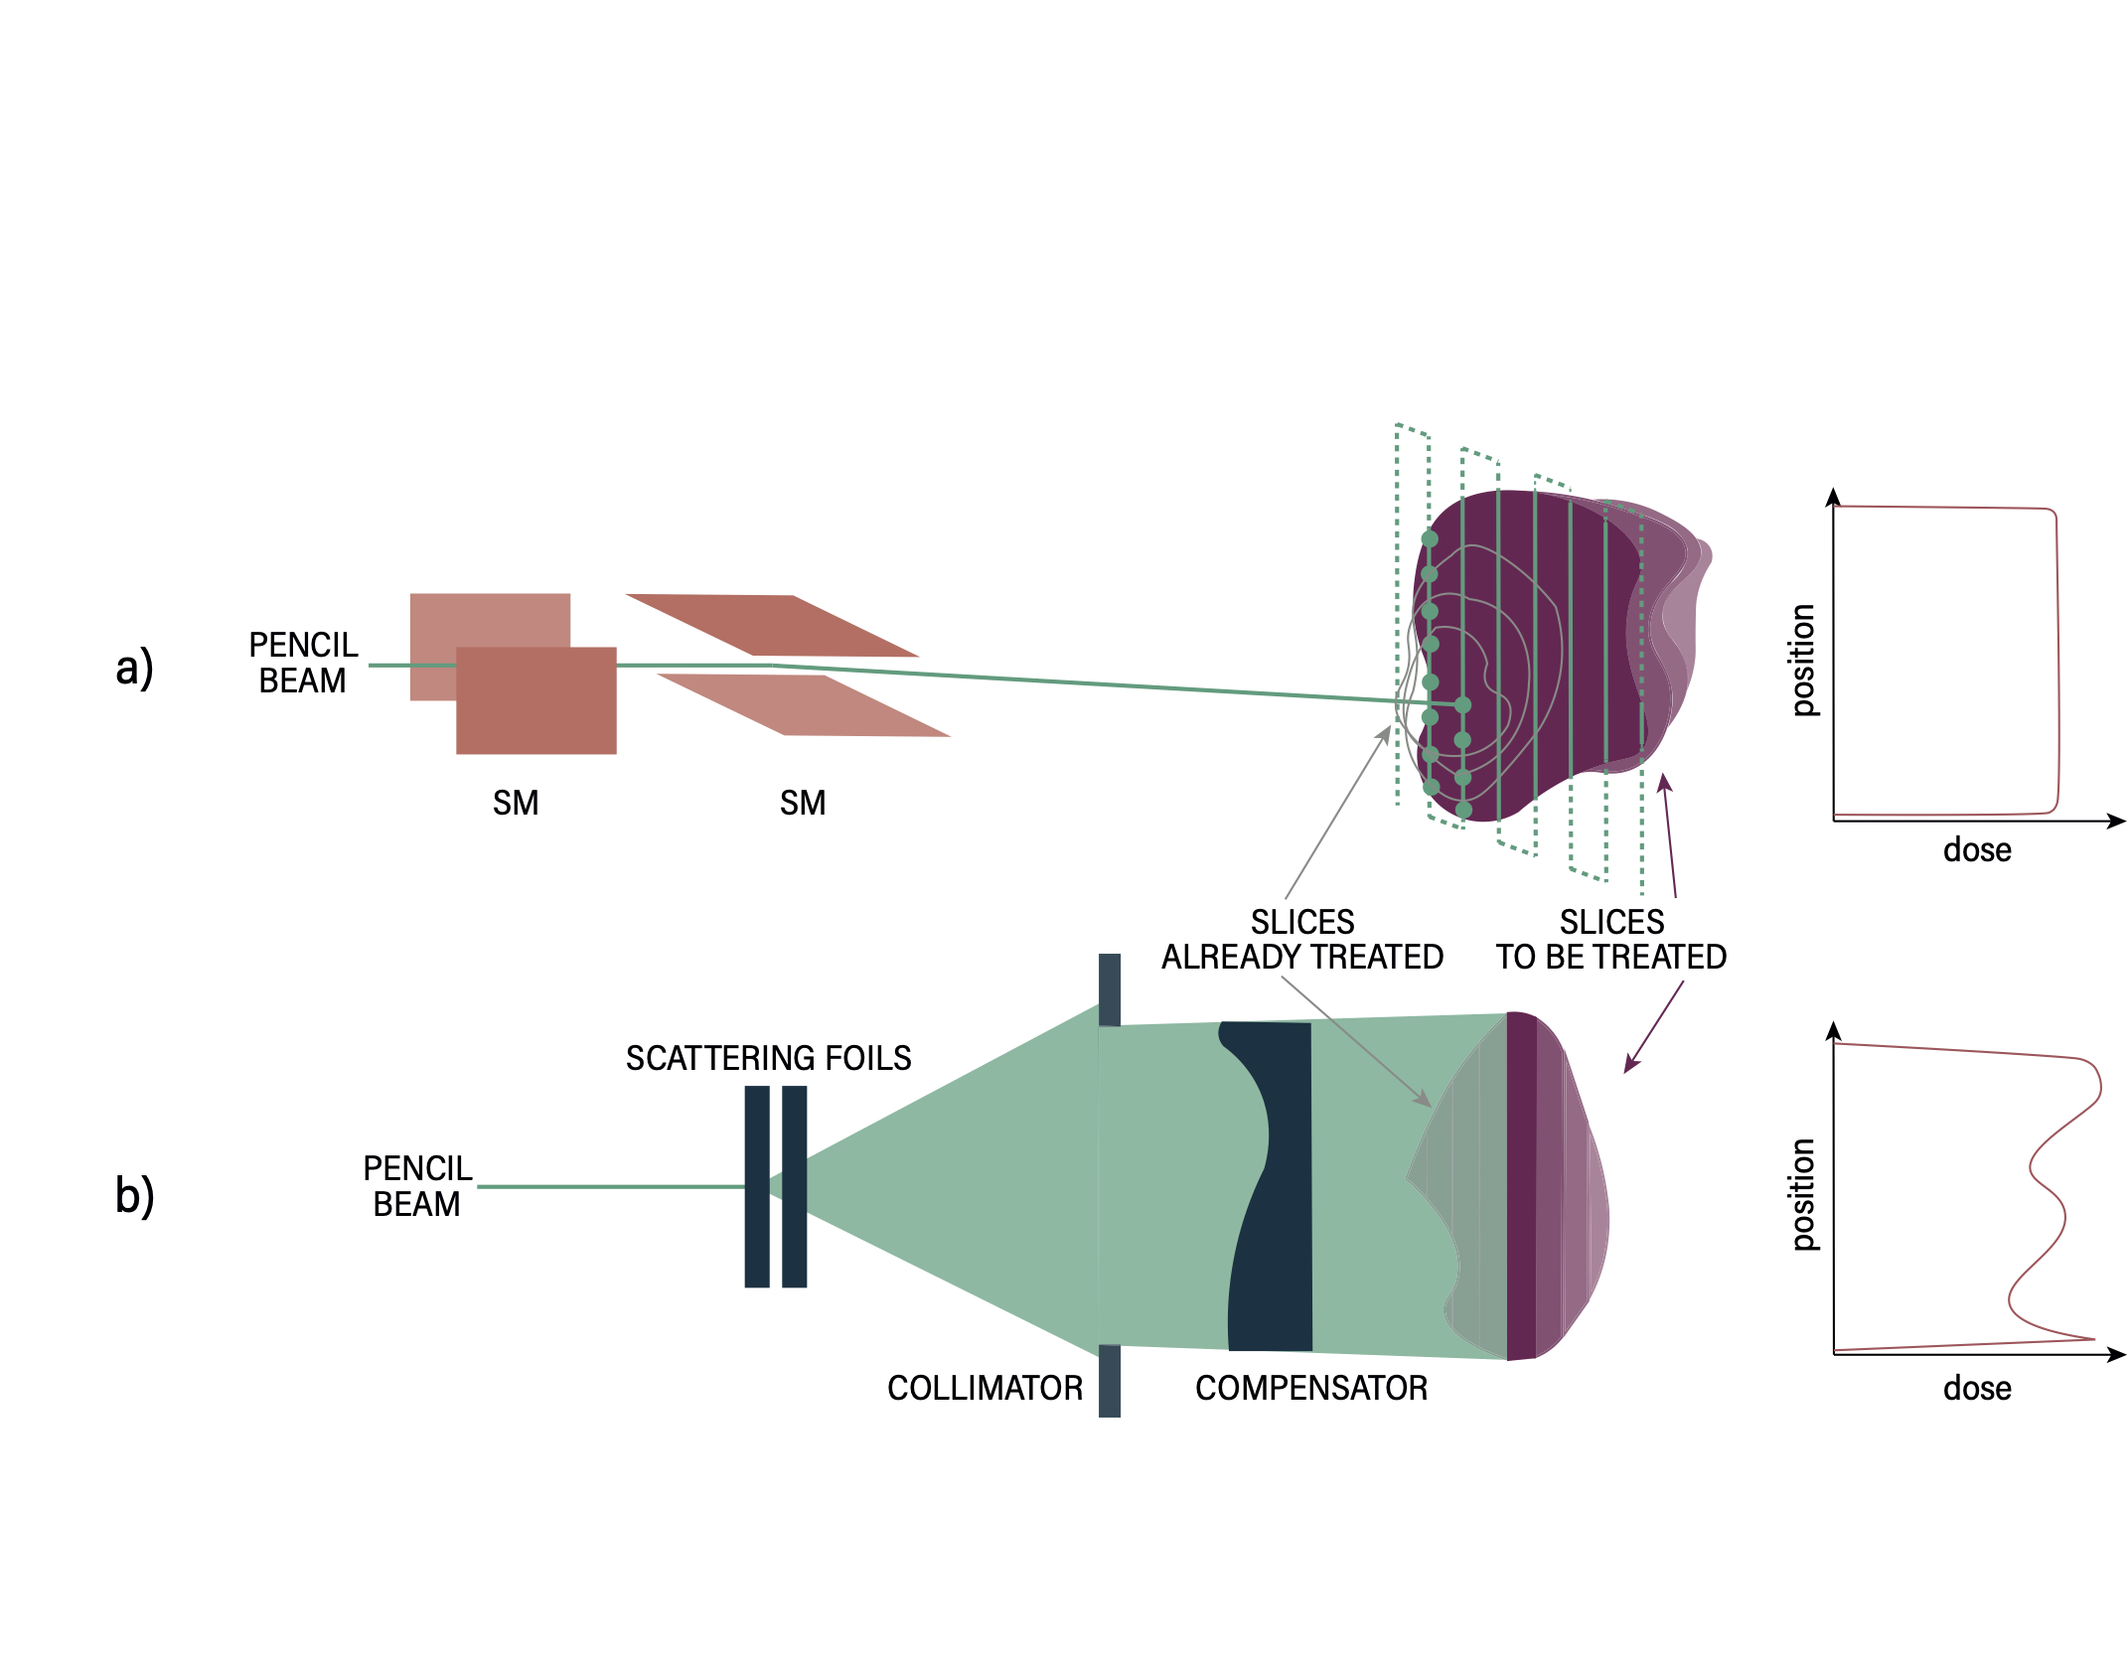
Gantry
By 2019:
169 gantries in 103 operating particle therapy centres worldwide
almost half of the sites are equipped with more than one gantry
BEAM DELIVERY
PASSIVE
ACTIVE
Notes:
Gantry is a more complex solution and results in a larger footprint of the installation, it also offers a superior flexibility of the treatment and is the system chosen by most treatment centres.
To laterally cover the irradiation field two categories of beam delivery can be distinguished: pencil beam scanning technique and beam scattering.
Passive spreading, involves using scattering foils to adjust the size of the beam in addition to collimators and apertures which further assist in providing a dose which is highly conformed to the tumour shape in the lateral plane. The scattering technique is a simple method with over 40 years of experience in clinics, but one of the major objections involves the production of neutrons in the scattering system which may provide an unwanted dose to the patient.
A major recent advance in CPT is the use of active beam scanning, usually in the form of spot scanning. In this technique, the charge of the proton or ion beam is utilised to enable magnetic scanning of small ‘pencil beams’ of particles in order to ‘paint’ the tumour in three dimensions.
When compared to the passive methods, PBS is more efficient (no beam losses at individual collimators) and offers higher dose conformity. The main drawback of the technique is its high sensitivity to anatomical variations between delivered fractions.

Slide 21
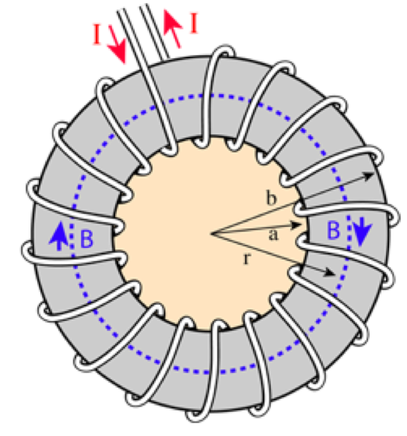
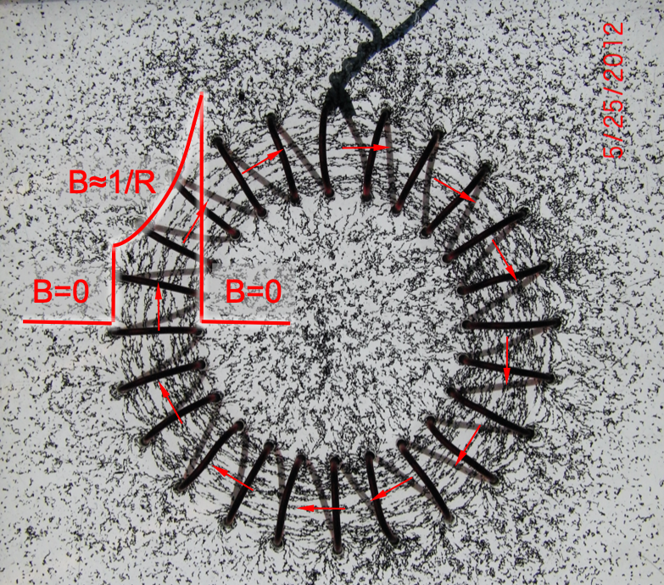
GaToroid: the principle
Patent: L. Bottura 2018
Courtesy: L. Bottura
Notes:
Magnetic configuration which does not need to be rotated nor ramped to focus the beam on the patient. This is the idea behind GaToroid - to use the axis-symmetric toroidal magnetic field between each pair of coils to bend and focus particles down to the isocenter.
Toroidal field - what does it mean? It is a field generated by a torus. We have a spiral winding of current around a donut shape.
The field goes around the torus.
An interesting property is that the field goes like 1/r, so it higher in the centre, and decreases with the radius. But inside and outside of the torus, it is ZERO.

Slide 22

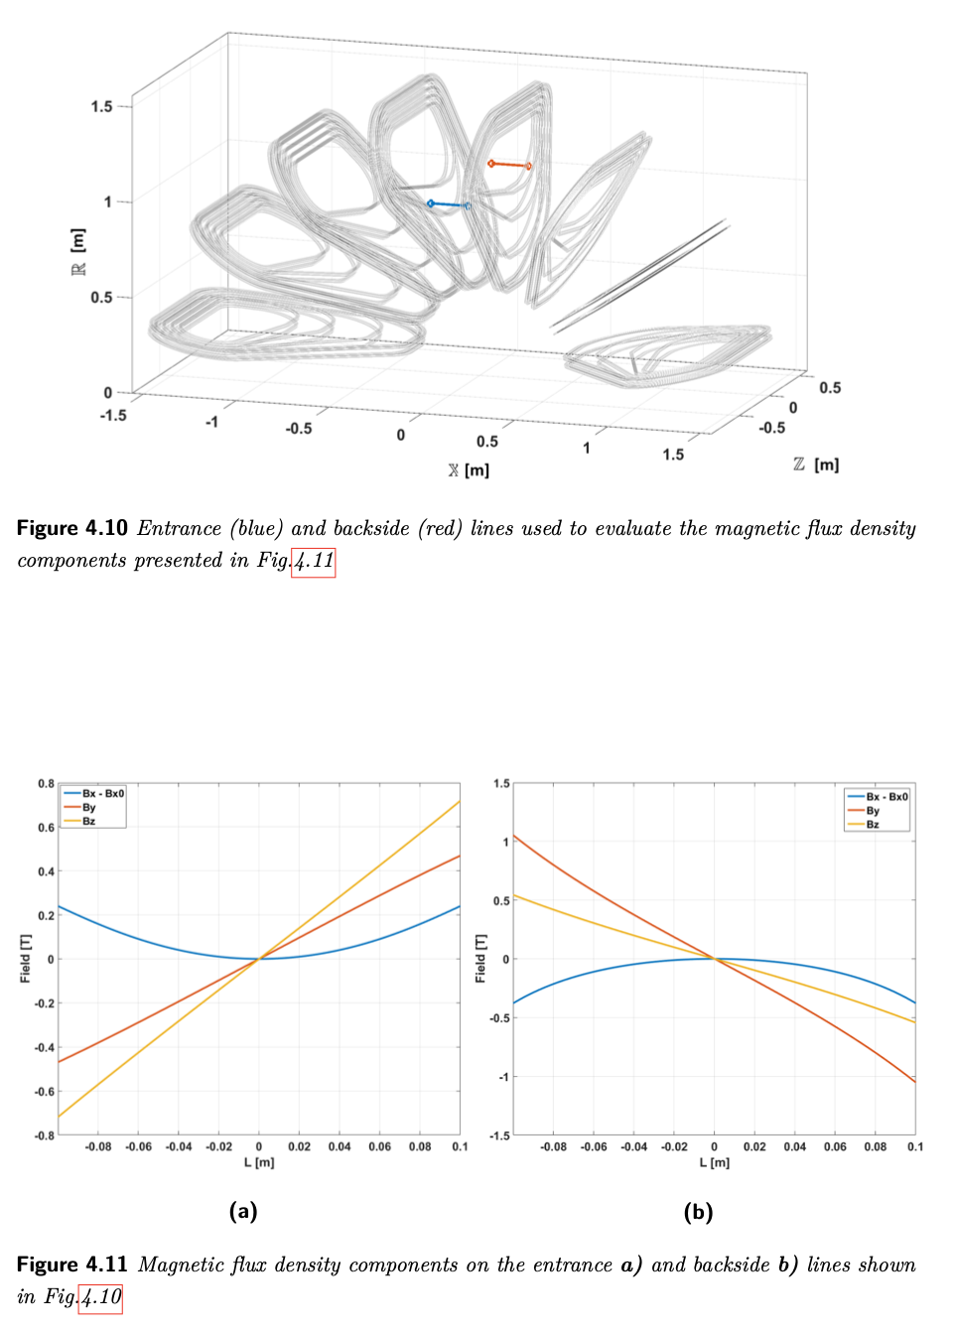

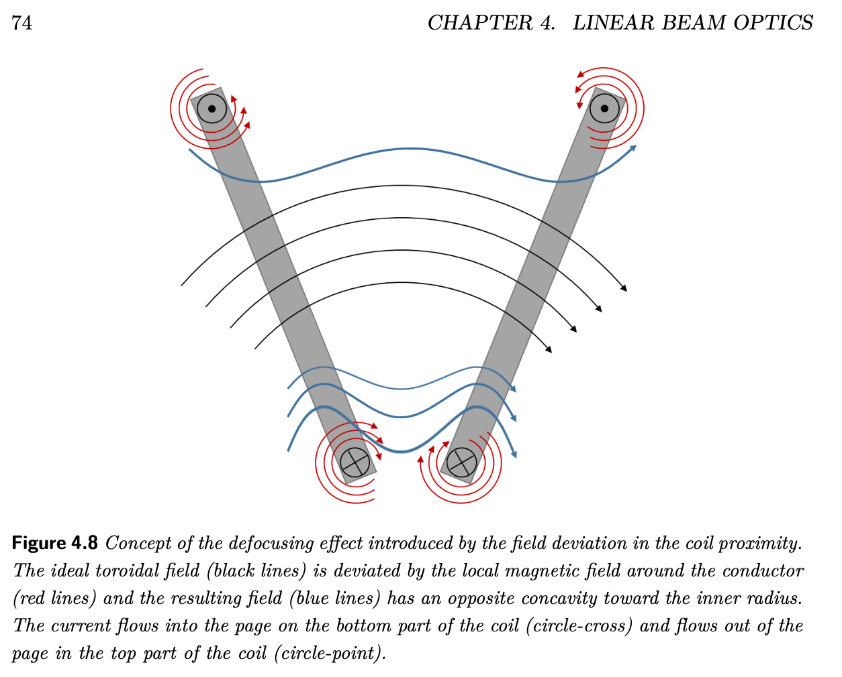
De/focusing effect (E. Felcini thesis)

Slide 23

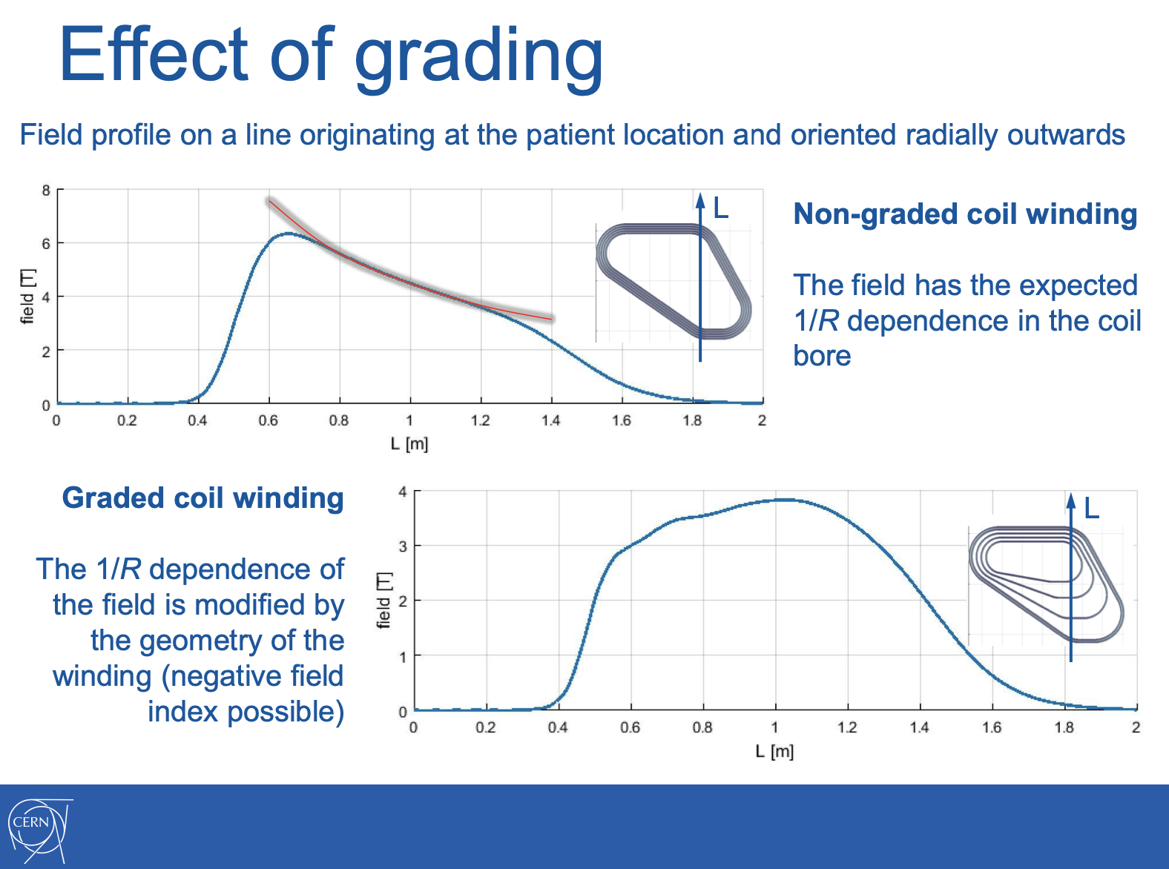
L.Bottura: https://indico.cern.ch/event/754093/attachments/1757883/2850771/GaToroid_LBEF_KT_final.pdf

Slide 24
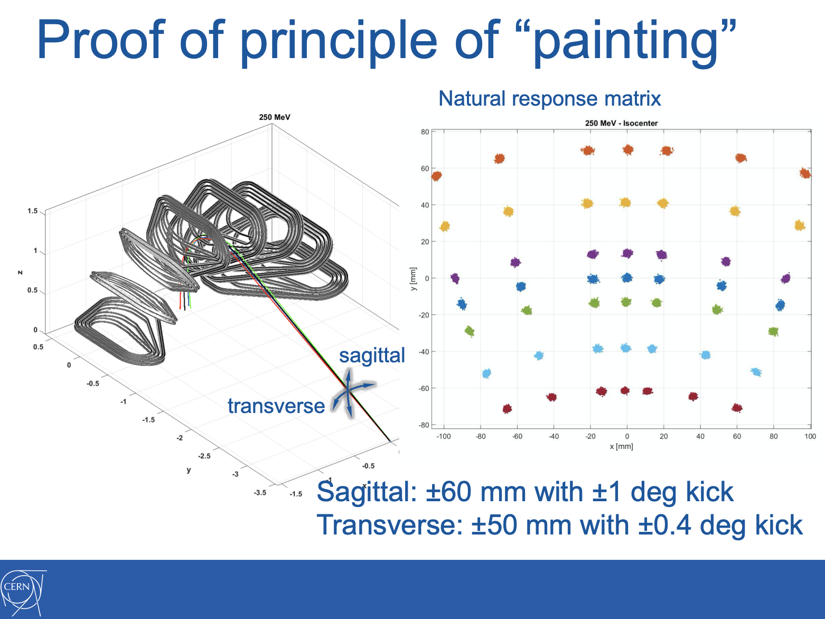
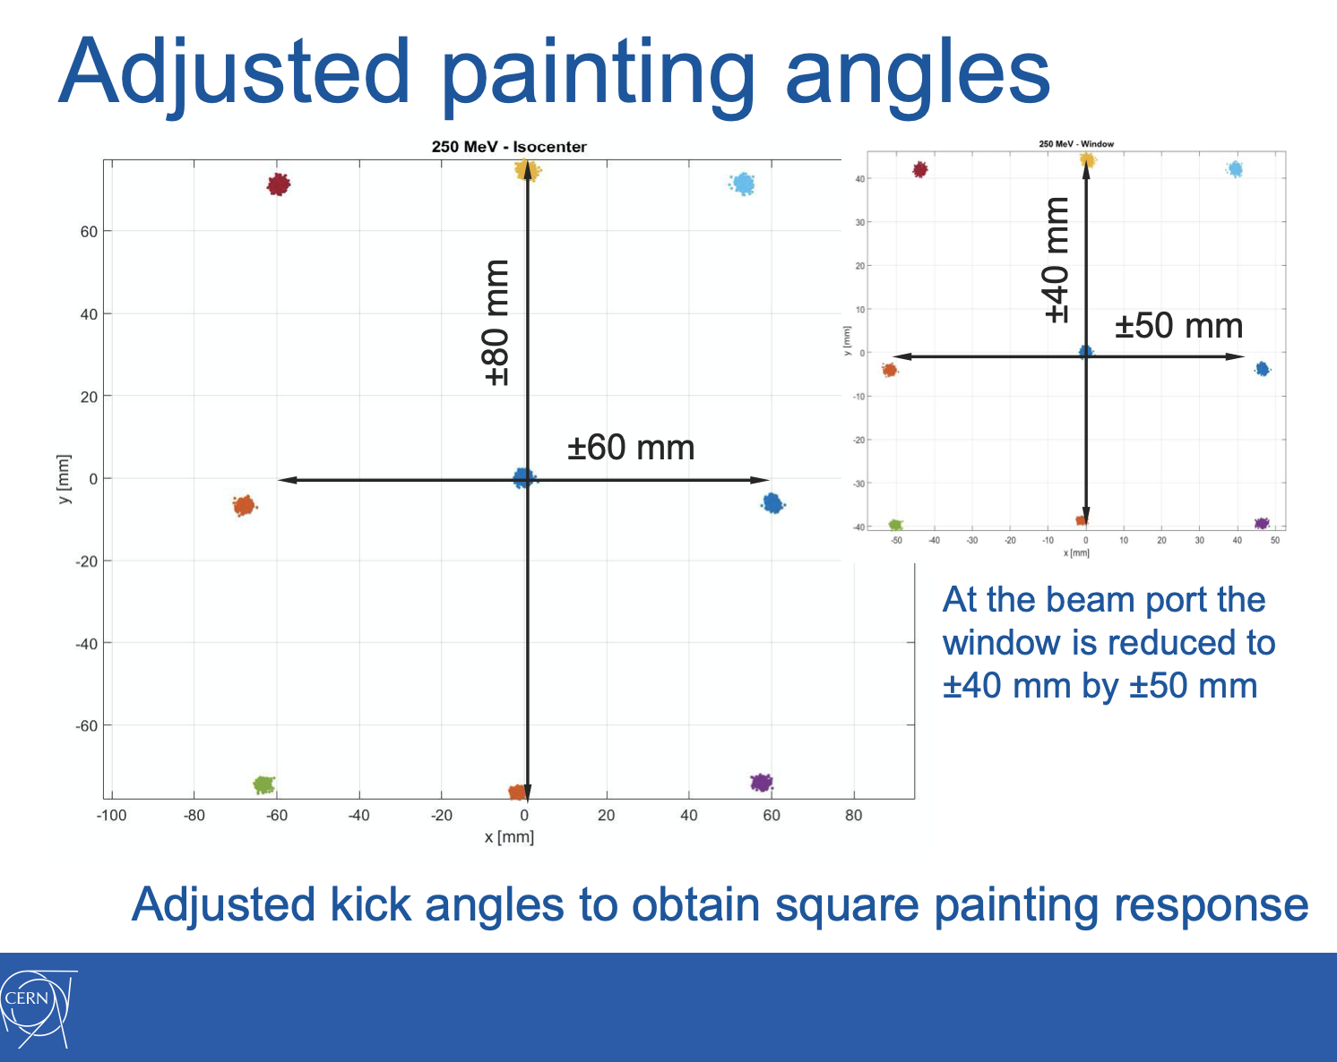
L.Bottura: https://indico.cern.ch/event/754093/attachments/1757883/2850771/GaToroid_LBEF_KT_final.pdf

Slide 25

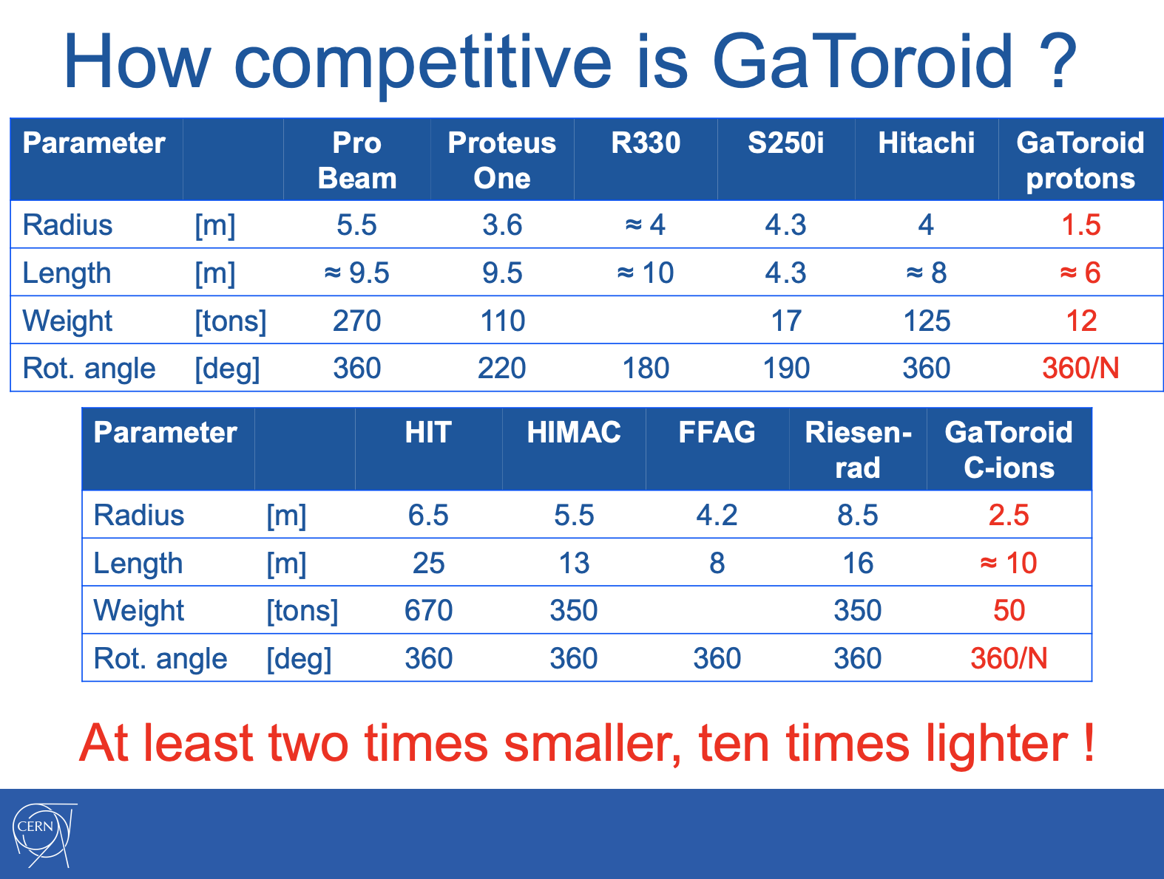
L.Bottura: https://indico.cern.ch/event/754093/attachments/1757883/2850771/GaToroid_LBEF_KT_final.pdf

Slide 26

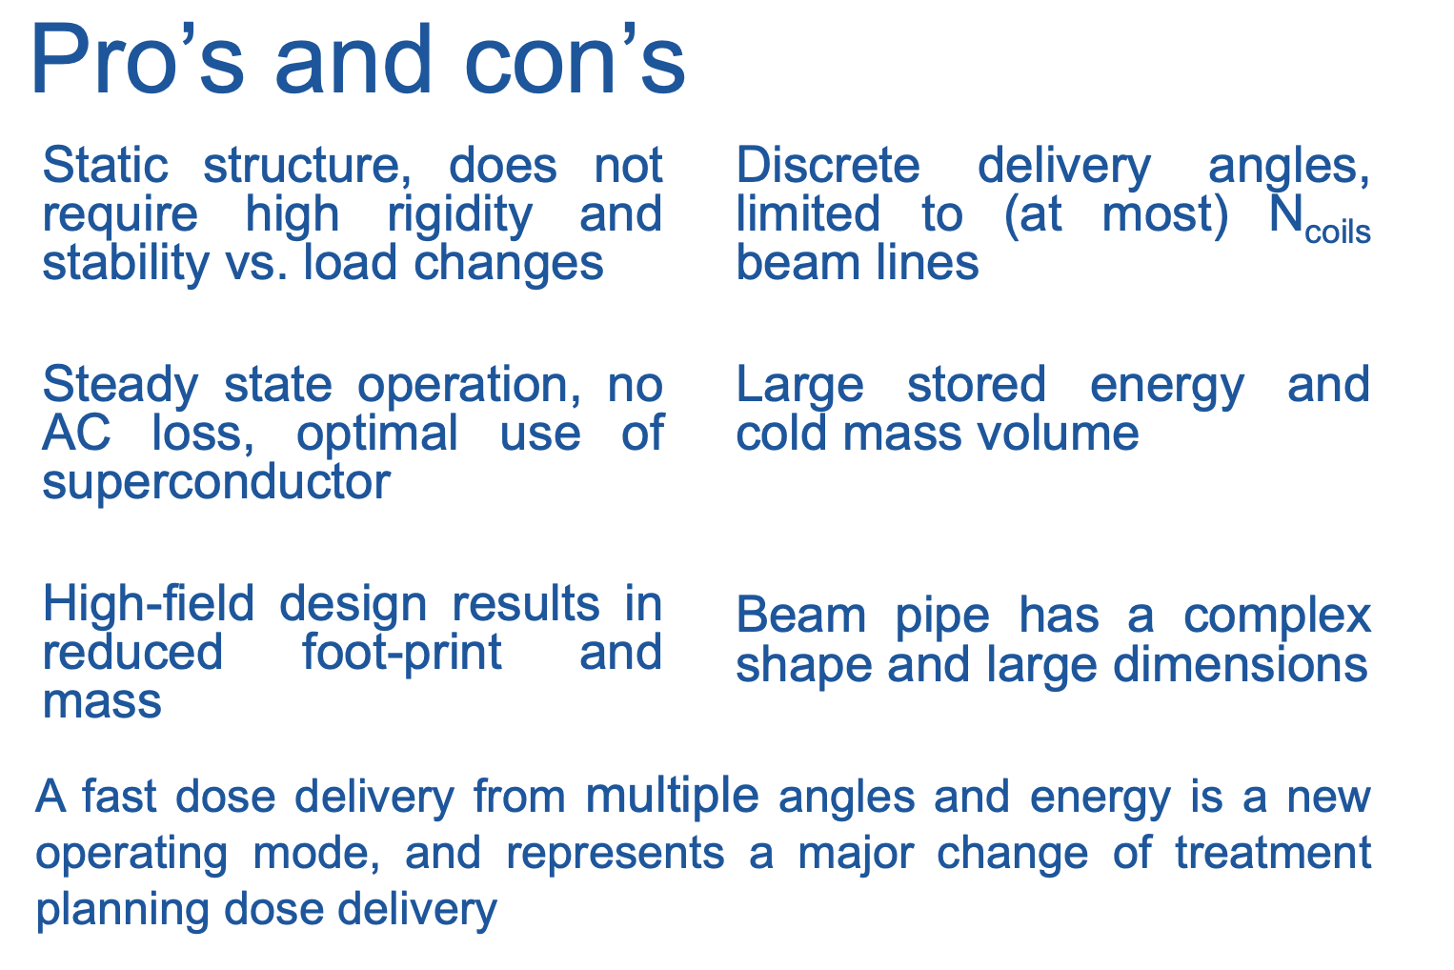
L.Bottura: https://indico.cern.ch/event/754093/attachments/1757883/2850771/GaToroid_LBEF_KT_final.pdf

Slide 27

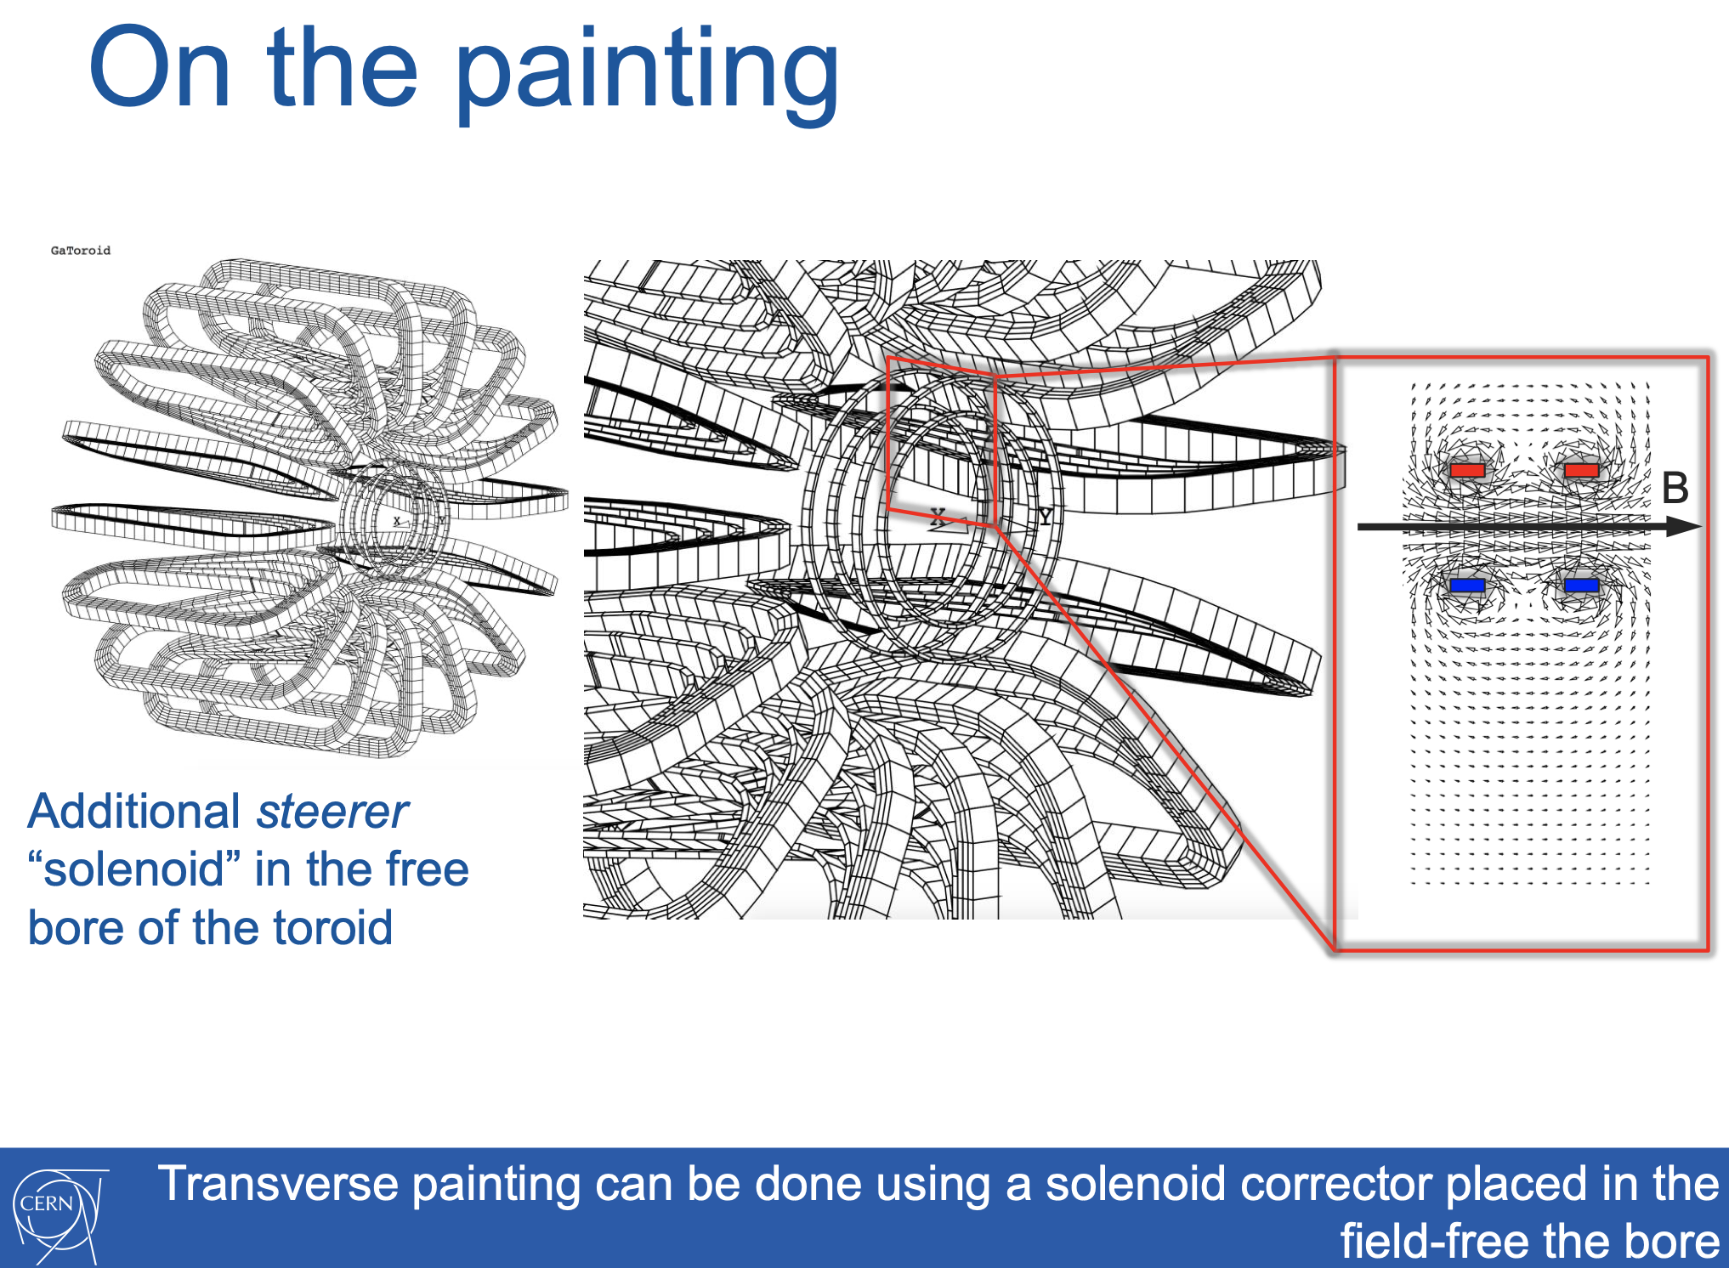
L.Bottura: https://indico.cern.ch/event/754093/attachments/1757883/2850771/GaToroid_LBEF_KT_final.pdf

Slide 28
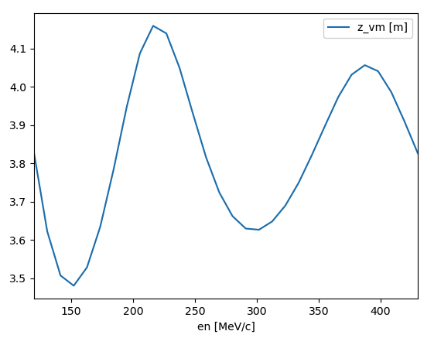







GaToroid: central trajectories
Backward-tracking (for many energies)
from a fixed isocentre position vertically up
to find an average distance between the vector magnet point and the field map
$$E_{1}$$
$$E_{2}$$
$$d_{vm}$$
$$z_{iso}$$
$$z$$
$$d[m]$$
$$E[MeV/u]$$

Slide 29





GaToroid: central trajectories
Backward-tracking (for many energies)
from a fixed isocentre position vertically up
to find an average distance between the vector magnet point and the field map
$$E_{1}$$
$$E_{2}$$
$$d_{vm}$$
$$z_{iso}$$
$$z$$
Forward-tracking
from the average distance between the vector magnet point and the field map
optimising the alpha input angle for a given energy to reach as close as possible to the previously fixed isocentre & as vertically as possible
$$z_{1_{b}}$$
$$α_{1}$$
$$z_{iso}$$
$$z_{1_{a}}$$
$$z$$
$$d_{vm}$$

Slide 30












GaToroid: central trajectories
Forward-tracking
from the average distance between the vector magnet point and the field map
with the optimised input angles
$$E_{1}$$
$$E_{2}$$
Checking the theta angle at the isocentre as a function of different fixed isocentre position
$$θ_{1}$$
$$θ_{2}$$
$$α_{1}$$
$$α_{2}$$
$$d_{vm}$$
$$z_{iso}$$
$$z$$
Dimensions of superconducting gantries for C-ions
 | GaToroid | NIRS (SC)
Length [m] | 10 | 13
Radius [m] | 5 | 6
$$z_{iso}≈−0.38m$$
$$|θ|_{max}={0.3}^{∘}$$
$$d_{vm}≈4.09m$$
Notes:
The convergence at isocentre is within sub-mm range, with a maximum angle difference between the orbits of about 0.3 deg.

