Slide 1
Beam dynamics simulations for Gamma Factory
Alexey Petrenko
(Budker Institute of Nuclear Physics, Novosibirsk, Russia)
Gamma Factory Software Development Workshop, CERN, Oct. 19, 2021

Slide 2
The full-scale Gamma Factory will extract MWs of gamma radiation from the LHC beam in a single interaction point. (By the way, the beam energy loss due to SR in LEP was 11 MW).
H-like Pb in the LHC example: Ion charge Z = 81, mass A = 208, γ = 2928, p_{z} = 567 TeV/c,
ℏω′ = 69 keV (Lyman-alpha line), laser ℏω = 12 eV, emitted gamma ℏω_{1,max}= 402 MeV,
typical angle of emission θ₁ ~ 1/γ ~ 0.3 mrad.
Typical transverse kick due to gamma emission:
p_{x}/p_{z}~ ℏω′/p_{z}c ~ 69 keV/567 TeV ~ 10^{‒7} mrad.
Typical transverse beam parameters at the LHC interaction point for example:
Transverse beam size = 0.026 mm, angular spread = 0.026 mrad (10⁵ times higher).
Typical energy spread in the beam is Δp/p ~ 10^{‒4}, while the average δp_{z} due to the photon emission is 200 MeV/c => δp_{z} / p_{z} = 200 MeV / 567 TeV = 3.5· 10^{‒7} => Δp/δp ≈ 300, even with one scattering per turn the longitudinal effects will be significant in 100s of turns.

Slide 3
From: Expanding Nuclear Physics Horizons with the Gamma Factory. D. Budker et al. (2021)

Slide 4
Gamma Factory ion beam dynamics
This topic is rather new and not well studied. Gamma Factory ion beam dynamics and equilibrium beam parameters will be largely defined by the effects of radiation emission.
Main effects of radiation emission:
Longitudinal cooling: because energy loss grows with the ion energy.
Transverse cooling: because all components of ion momentum are lost due to the photon scattering but only the longitudinal component is restored in the RF resonator.
Heating: because angle of photon emission in the ion’s frame is random.
Dispersive coupling between ion energy and its transverse position can be used to transfer transverse oscillations into the longitudinal:

Slide 5
Broad-band cooling vs fast cooling:
The natural width of the absorption line (~10⁻⁶) typically << Doppler shift due to energy spread (~10⁻⁴)
E. G. Bessonov, K.-J. Kim. Radiative Cooling of Ion Beams in Storage Rings by Broad-Band Lasers, PRL, 1996.
1. Broad-band laser covers the full spectrum of particle energies:
Cooling in all planes. The time of cooling is the time to radiate full ion energy E.
See: E. G. Bessonov, R. M. Feshchenko Stimulated Radiation Cooling. RuPAC’2008.
Broad-band laser with a sharp low-frequency cut-off:
Much faster cooling, but only longitudinal. Time of cooling is the time to radiate energy spread ΔE.

Slide 6
There are several ways to cool high-energy hadron beams
1. Synchrotron radiation cooling
For protons and ions occurs naturally at very high energies. Takes hours. For the AWAKE-like PWFA applications probably practical only starting from the energy of High-Energy LHC (a project to upgrade LHC to 12-16 TeV).
2. Optical stochastic cooling
Was seriously considered for the Tevatron. Can be applied for protons in the LHC (for luminosity leveling and beam halo control). The test experiment with electrons is under construction at Fermilab. For details see: V. Lebedev. Optical Stochastic Cooling (2012).
V. Lebedev and A. Romanov. Optical Stochastic Cooling at IOTA Ring (2015).
E. Bessonov, M. Gorbunkov, A. Mikhailichenko. Enhanced optical cooling system test in an electron storage ring (2008) – fast version of optical stochastic cooling.
4. Coherent electron cooling V. Litvinenko and Ya. Derbenev, PRL 102, 114801 (2009).
3. Laser cooling of partially stripped ions
Well-developed at low-energy. Cooling is faster at high energy because the energy radiated by the ion grows as γ². Never tested above few 100 MeV/u

Slide 7
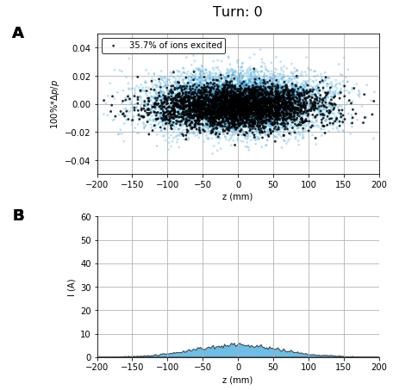
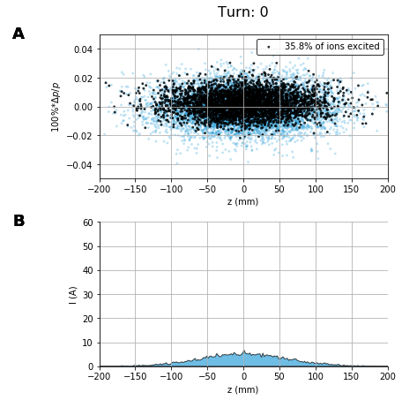
The longitudinal beam dynamics is quite sensitive to imbalance of energy radiated at Δp>0 vs Δp<0:
Fourier-limited Gaussian laser pulse with σ(Δω/ω) = σ(Δp/p) centered on p₀(1±0.5Δp/p)
Laser waist size w₀ = 2σ_{x,y} = 40 μm, energy = 42 μJ.
Slightly shorter central laser wavelength:
Slightly longer central laser wavelength:
Black dots – excited ions, blue dots – not excited ions.
(H-like Pb in the LHC)

Slide 8
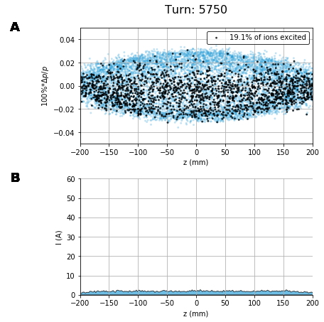
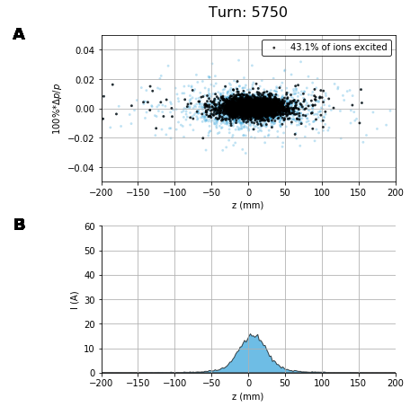
The longitudinal beam dynamics is quite sensitive to imbalance of energy radiated at Δp>0 vs Δp<0:
Fourier-limited Gaussian laser pulse with σ(Δω/ω) = σ(Δp/p) centered on p₀(1±0.5Δp/p)
Laser waist size w₀ = 2σ_{x,y} = 40 μm, energy = 42 μJ.
(0.5 sec.)
(H-like Pb in the LHC)

Slide 9
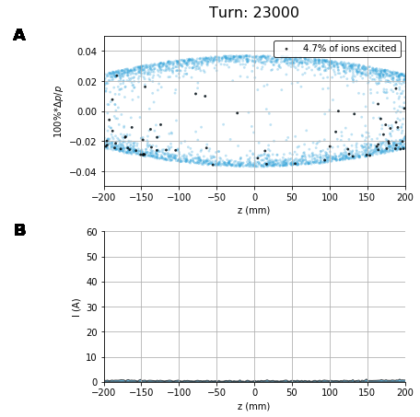
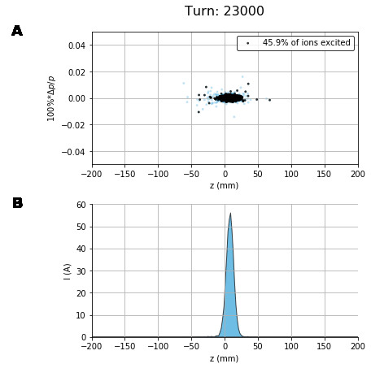
The longitudinal beam dynamics is quite sensitive to imbalance of energy radiated at Δp>0 vs Δp<0:
Fourier-limited Gaussian laser pulse with σ(Δω/ω) = σ(Δp/p) centered on p₀(1±0.5Δp/p)
Laser waist size w₀ = 2σ_{x,y} = 40 μm, energy = 42 μJ.
(2 sec.)
(H-like Pb in the LHC)

Slide 10
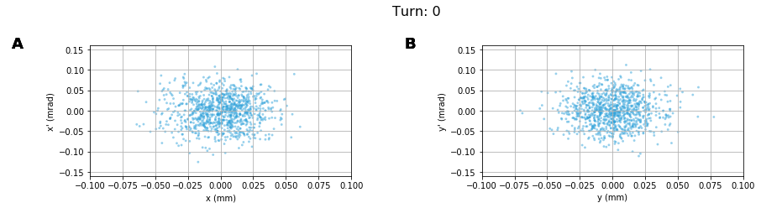
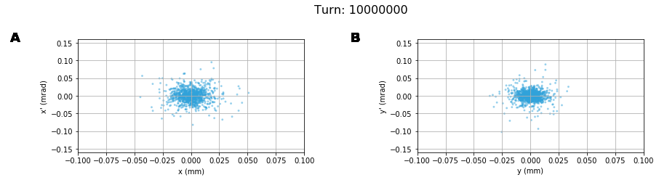
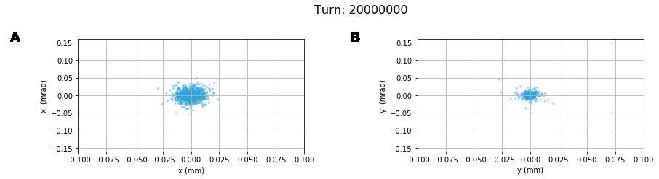
Natural transverse cooling is much slower:
https://anaconda.org/petrenko/lhc_psi_beam_vs_laser
(15 min.)
(H-like Pb in the LHC)
(30 min.)
Cooling time ~ time to radiate the full ion energy: 530 TeV / (0.5 * 190 MeV) = 5.6e6 turns (8.5 min)

Slide 11
The ion beam parameters at the full-scale Gamma Factory might be possible to improve significantly by employing a more complicated multi-stage laser cooling schemes:
For example:
Instead of using H-like Pb we could think of Li-like U or Th.
Li-like ions can be cooled/accumulated even at lower energies in the SPS using the 2s-2p transition (like in the GF Proof-of-Principle experiment at the SPS).
The lower emittance ion beam means smaller beam size at the IP and lower requirements on the primary laser (FEL) power. Also, smaller longitudinal beam size might be useful in case the laser-ion beam interaction is at an angle.
Of course, the primary question is the stability of such low-emittance beams in the LHC. (Under the high energy loss due to radiation emission the beams might be more stable).

Slide 12
Momentum slip-stacking + laser cooling can potentially increase the single bunch charge multiple times:
ΔE cooling
Momentum slip-stacking in CERN SPS for the ion beams. T. Argyropoulos et al. IPAC 2019.

Slide 13
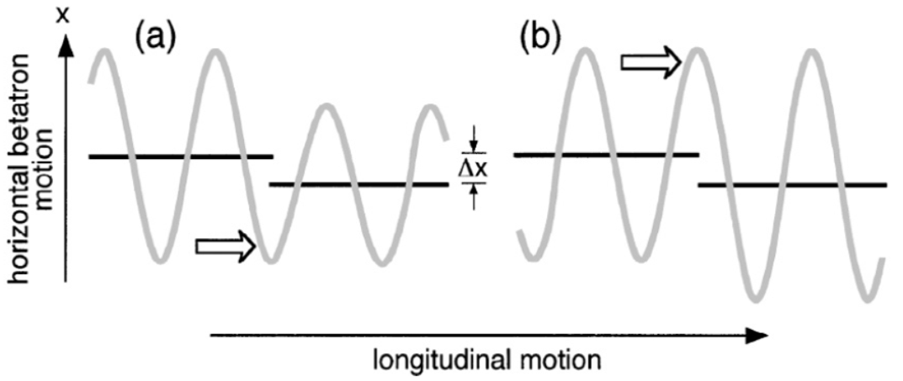
Transverse cooling of Li-like Ca beam in the SPS:
First laser transfers betatron oscillations into energy oscillations (synchrotron oscillations)
From our recent article: High-luminosity Large Hadron Collider with laser-cooled
isoscalar ion beams
Second laser cools the beam in energy (longitudinally)

Slide 14
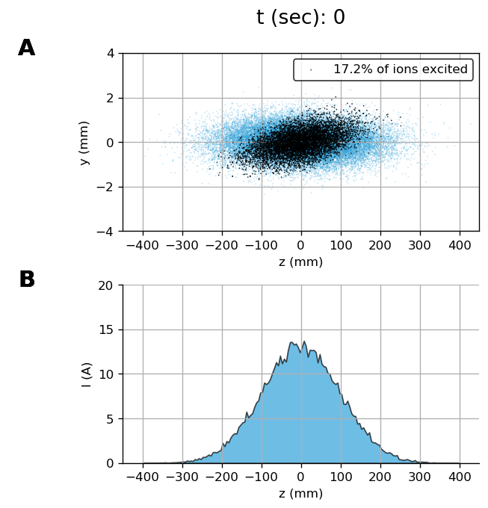
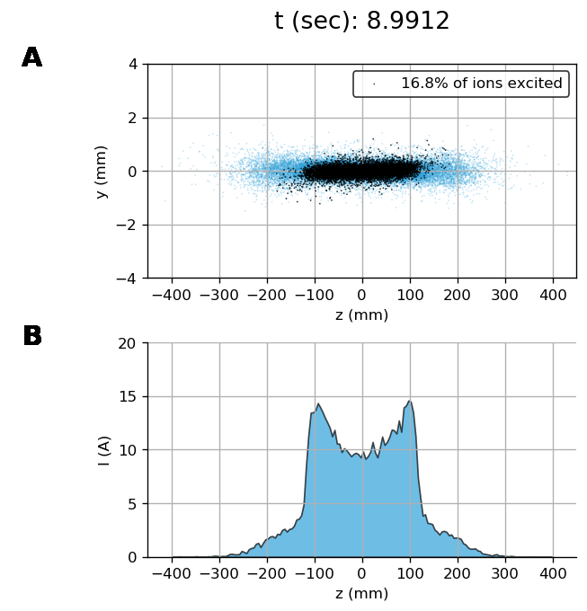
Transverse cooling of Li-like Ca beam in the SPS:
Simulation details: https://anaconda.org/petrenko/li_like_ca_in_sps_transv

Slide 15
Transverse cooling of Li-like Ca beam in the SPS:
From our recent article: High-luminosity Large Hadron Collider with laser-cooled isoscalar ion beams
Simulation details: https://anaconda.org/petrenko/li_like_ca_in_sps_transv

Slide 16
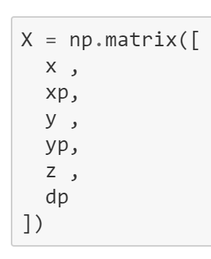
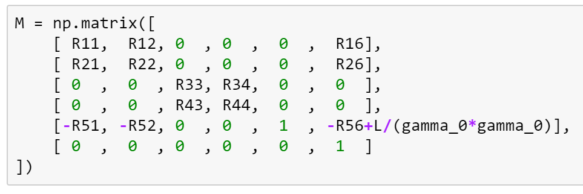
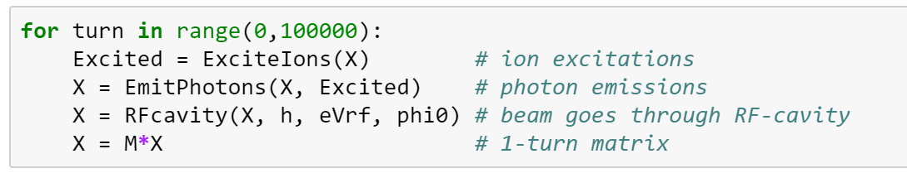
Monte Carlo scheme implemented in Python:
1) Define the ion beam
2) Define the 1-turn transformation (matrix + RF-cavity as a function)
3) Define laser beam
Then turn-by turn simulation is defined in a simple loop:
Additional effects like wakefields, coupling, etc., can be added.
The idea is to release it as a python library and use it as a part of other tracking programs.
Some simulation examples: https://anaconda.org/petrenko/psi_beam_vs_laser https://anaconda.org/petrenko/li_like_ca_in_sps_transv

Slide 17
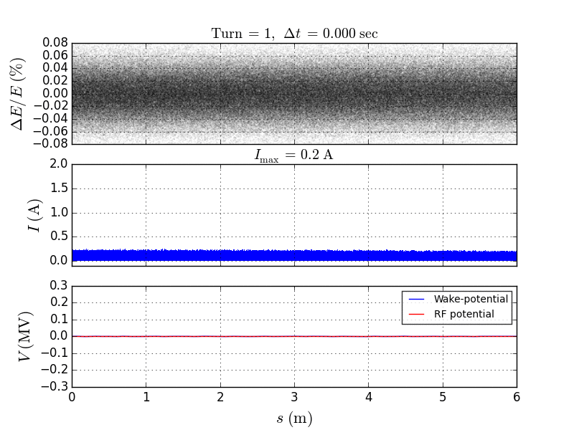
Some collective effects: fast cooling of unbunched beam (SPS)
Xenon with 7 remaining electrons in the SPS
SPS longitudinal impedance model from C. Zannini’s talk with some input from T. Argyropoulos (in 2012)

Slide 18
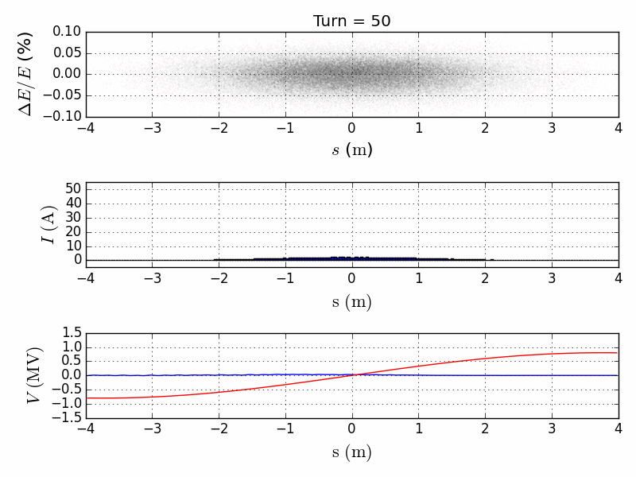
Some collective effects: bunch compression by triang. laser spectr.
Xenon with 7 remaining electrons in the SPS
SPS longitudinal impedance model from C. Zannini’s talk with some input from T. Argyropoulos (in 2012)

Slide 19
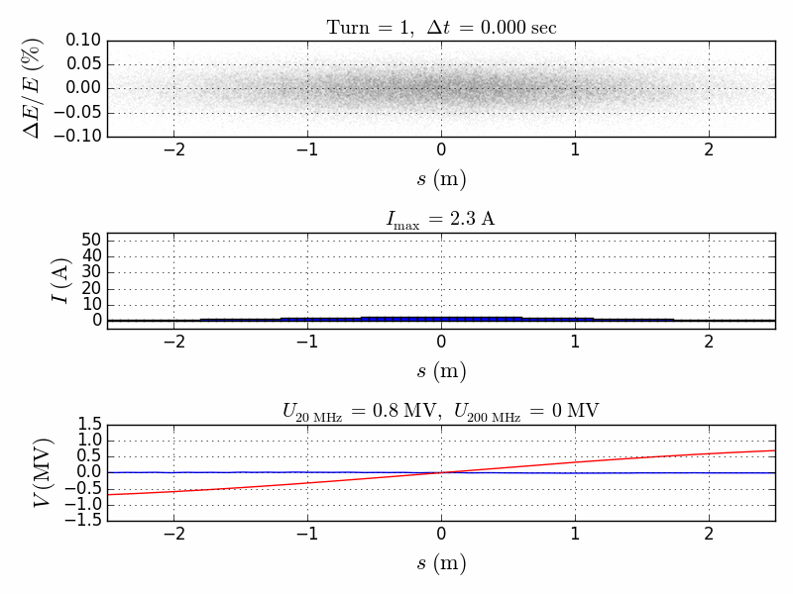
Some collective effects: bunch compression by triang. laser spectr.
For a very short bunch the wakefield is no longer valid (need higher frequency impedance model)
SPS longitudinal impedance model from C. Zannini’s talk with some input from T. Argyropoulos (in 2012)

Slide 20
Conclusions/Plans
Gamma Factory beam dynamics seems to be a very interesting and novel topic with lots of unexplored questions:
Integration of the detailed quantum mechanical simulations into the turn-by-turn simulations (chirped lasers, polarization, etc.)
Explore the limits of laser cooling due to collective effects in general and in particular for the case of SPS/LHC storage rings.
Stable regimes of the full-scale Gamma Factory operation.
Other applications of our laser cooling technology (e.g. AWAKE, Nuclear Physics).

Slide 21
Back-up slides

Slide 22
Transverse cooling of Li-like Ca beam in the SPS:
Betatron oscillations are fully coupled via the coupling resonance.
https://cds.cern.ch/record/300856/files/p43.pdf
https://indico.cern.ch/event/856751/

Slide 23
Link to Padua seminar presentation on high-energy laser cooling:
Beam stability and cooling aspects for the partially stripped ions in the storage rings, Padua, 2017

Slide 24
Partially stripped ions in the SPS
D. Manglunki et al. CERN's Fixed Target Primary Ion Programme. IPAC’2016.
J. Wenninger et al. Energy Calibration of the SPS with Proton and Lead Ion Beams. PAC’2005:
(fully str.)
100x less than in AWAKE.
Maybe could be optimized for high beam charge.
Number of charges: 9·10¹⁰ 3.2·10¹⁰ 2.5·10¹⁰
Less than in AWAKE 3x less 10x less 10x less
Production efficiency for partially stripped ions can be higher than for the fully stripped ions.
Possible variant: Xe⁴⁷⁺ (7 electrons left, N-like). γ = 162. Atomic excitation ⁴S_{3/2} → ⁴P_{3/2}. Krypton laser: 647 nm (1.87 eV) will be converted to gamma-photons with E_{max} = 196 keV. I_{sat.} = 1.7·10⁸ W/cm² , decay length = 3.4 cm => with a 1 mm wide beam to have one interaction per turn we need a single laser pulse energy ≈ 1.7·10⁸ W/cm² · 0.1·0.1 cm² · 3.4 cm / (3·10¹⁰ cm/sec) ≈ 0.2 mJ => Average laser power ~ 0.2·10⁻³ J / (7000 m / 3·10⁸ m/sec) ~ 10 W.
(Xe⁴⁷⁺ suggested by Bessonov and Kim PRL’1996 and in W. Krasny’s proposal for gamma-factory test at SPS).

Slide 25
Transverse cooling via dispersive coupling:
(I’ve rearned about this experiment after reading the Lewin Eidam’s PhD Thesis which was sent to me by W. Krasny)

Slide 26
Transverse cooling of Li-like Ca beam in the SPS:
The configuration is very similar to the Gamma Factory Proof-of-Principle experiment.
Many thanks to Aurelien Martens for checking the laser parameters!

Slide 27
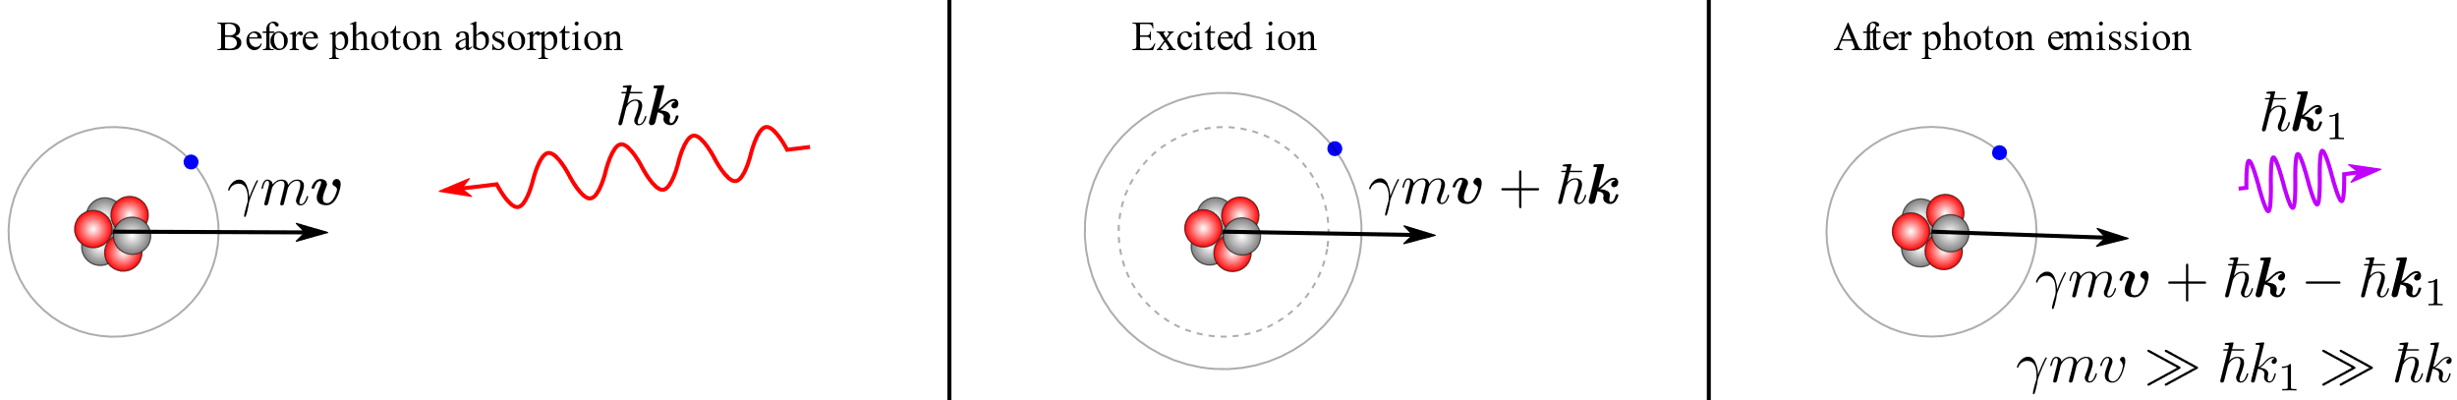

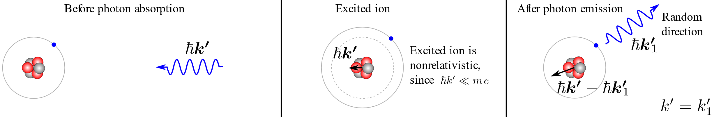
Laser-ion interaction kinematics
In the lab frame:
In the ion’s frame:
Longitudinal cooling: because energy loss grows with ion energy:
Transverse cooling: because all components of ion momentum are lost due to the photon scattering but only the longitudinal component is restored in the RF resonator.
Heating: because angle of photon emission in the ion’s frame is random.
We would like to find an equilibrium between the cooling and heating processes.

Slide 28
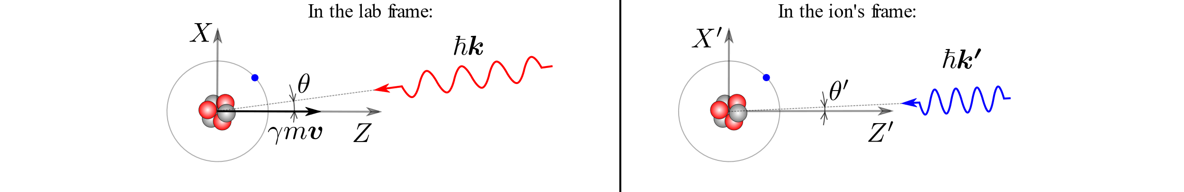
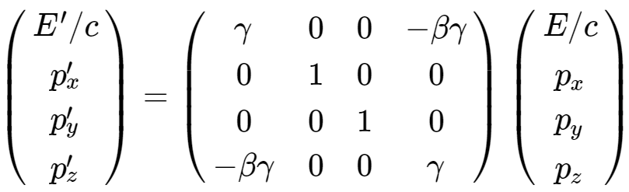
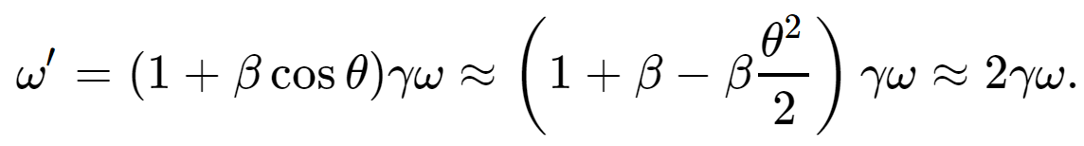
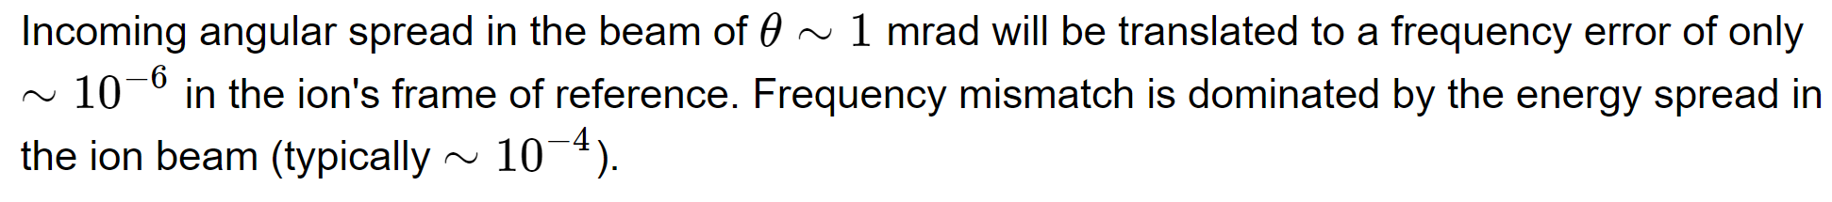
Photon absorption
4-vector Lorentz transformation:

Slide 29
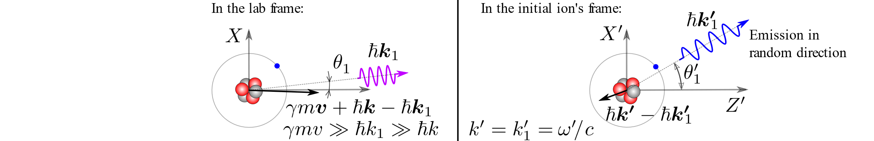
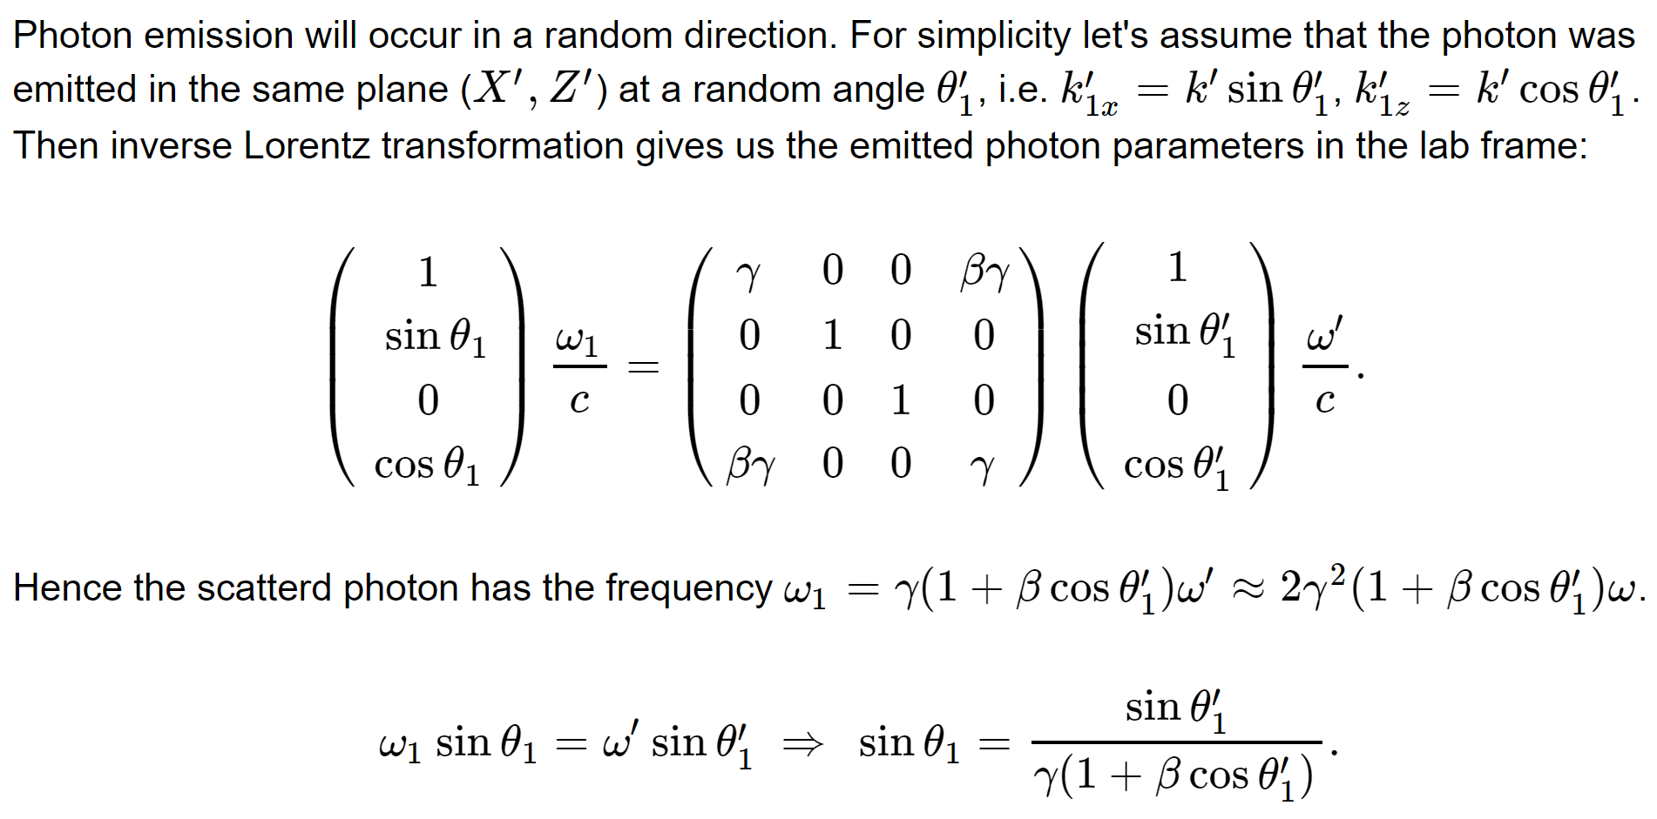
Photon emission

