Slide 1


QUANTUM-MECHANICAL CALCULATIONS
SZYMON PUSTELNY
CERN, 26 OCTOBER 2021

Slide 2
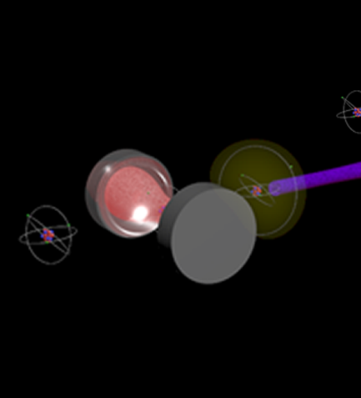
OUTLINE
LIGHT (LIGHT PULSE)
ATOM (HIGHLY-CHARGED ION)
INTERACTION

Slide 3
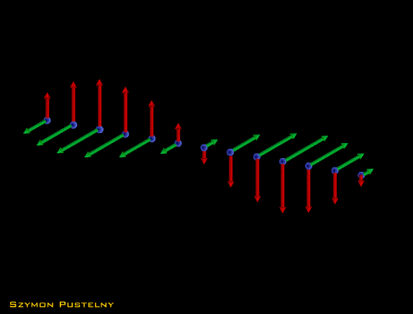




LIGHT
Light treated classically
Monochromatic electromagnetic wave
$$E\left(t,r\right)=e_{ε}{E_{0}}^{ie\left(ωt−k⋅r\right)}$$
$$E_{0}$$
$$ω$$
amplitude
frequency
$$k$$
$$e_{ε}$$
wavevector
polarization

Slide 4
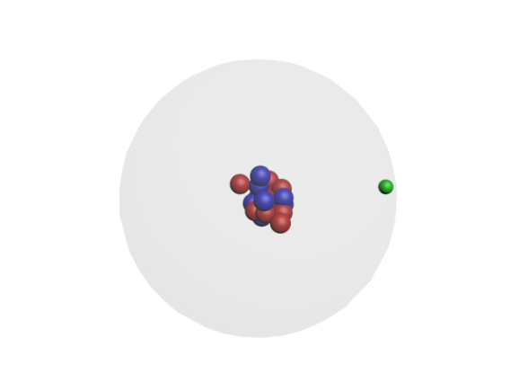
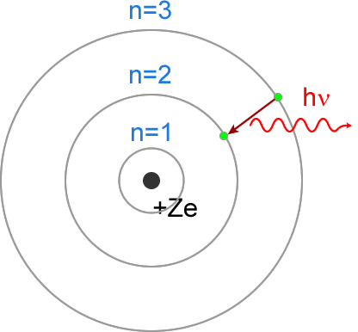
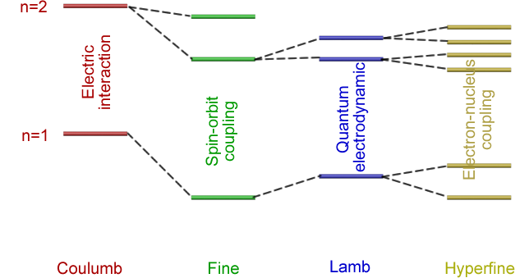
INTRAATOMIC AND VACUUM INTERACTIONS
Bohr model is the zeroth approximation of the atom
Spin-orbit coupling
Coupling of electrons’ angular momentum with electrons’ spins
QED correction
Interaction of atom’s electrons with quantum-vacuum electrons
Electron-nucleus coupling
Interaction of electron total angular momentum (spin+orbital) with orbital angular momentum

Slide 5









LEVELS, LEVELS, LEVELS…
CONVENTIONAL NOMENCLATURE OF STATES (TERMS)
$${n^{2s+1}L}_{j}$$
$$n$$
principle quantum number
$$j$$
total electron angular momentum
$$s$$
spin quantum number
HYPERFINE LEVELS
$$F$$
total atomic angular momentum
Nonzero nuclear spins
SPLITTING OF THE LEVELS
$$F=\left|F−I\right|,…,F+I$$
$$I$$
nuclear spin
MAGNETIC STRUCTURE
Nonzero angular momentum
MAGNETIC SUBLEVELS
$$m_{F}=−F,…,F$$
$$m_{F}$$
magnetic quantum number
THERE MAY BE TENS OF LEVELS
Even in the ground state

Slide 6







LIGHT-ATOM INTERACTION – SELECTION RULES
INTERACTION CONSIDERED WITHIN THE DIPOLE APPROXIMATION
$$V=−E⋅d$$
$$d$$
electric dipole moment
SELECTION RULES
$$ΔL=±1$$
and
$$(ΔJ=0,±1$$
or
$$ΔF=0,±1)$$
EXAMPLES
$$12S_{1/2} F=0→2^{2}P_{1/2}F=1$$
$$12S_{1/2} F=0→3^{2}D_{3/2} F=1$$
Allowed
Forbidden

Slide 7
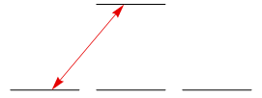
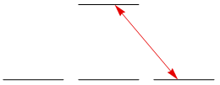
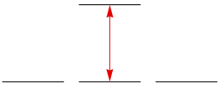

















LIGHT-ATOM INTERACTION – SELECTION RULES
ANGULAR MOMENTUM CONSERVATION
SELECTION RULES FOR POLARIZED LIGHT
$$m_{F′}=0$$
$$m_{F′}=0$$
$$m_{F}=−1$$
$$m_{F}=0$$
$$m_{F}=1$$
$$m_{F}=−1$$
$$m_{F}=0$$
$$m_{F}=1$$
$$m_{F}=−1$$
$$m_{F}=0$$
$$m_{F}=1$$
$$Δm=1$$
$$Δm=−1$$
$$Δm=0$$
right-handed ($σ^{+}$) polarized light
left-handed ($σ^{−}$) polarized light
linearly polarized light ($π$)
ATOMS CAN BE TRAPPED IN DARK STATE

Slide 8
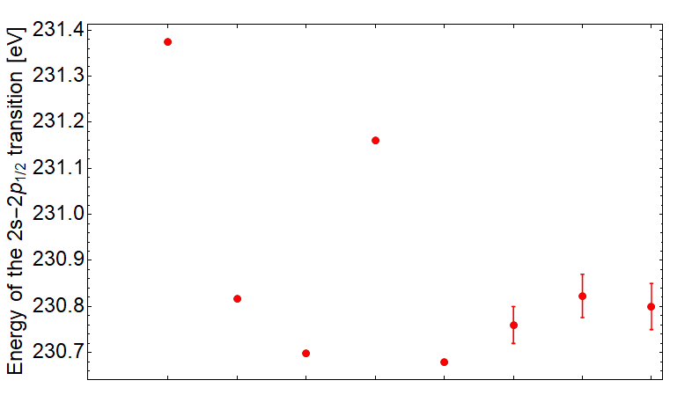
WHERE ARE THE LEVELS?
CALCULATIONS OF TRANSITION ENERGIES
RESULTS OF CALCULATION FOR Pb⁷⁹⁺
Different calculation contributions:
electrostatic interaction,
spin-orbit interaction
hyperfine coupling
quantum electrodynamics (QED)
two-loop QED
relativistic contribution
….
NECESSITY OF TUNING THE LASER

Slide 9

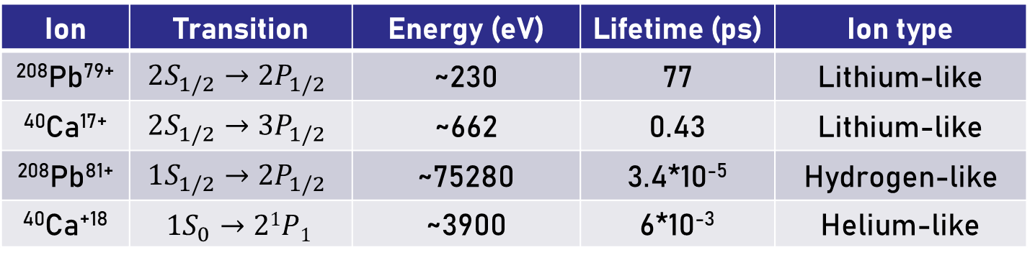
REPRESENTATIVE CASES
PARAMETERS OF SPECIFIC TRANSITIONS
Ion | Transition | Energy (eV) | Lifetime (ps) | Ion type
²⁰⁸Pb⁷⁹⁺ | $$2S_{1/2}→2P_{1/2}$$ | ~230 | 77 | Lithium-like
⁴⁰Ca¹⁷⁺ | $$2S_{1/2}→3P_{1/2}$$ | ~662 | 0.43 | Lithium-like
²⁰⁸Pb⁸¹⁺ | $$1S_{1/2}→2P_{1/2}$$ | ~75280 | 3.4*10⁻⁵ | Hydrogen-like
⁴⁰Ca⁺¹⁸ | $${1S}_{0}→21P1$$ | ~3900 | 6*10⁻³ | Helium-like
Zero nuclear spins
NO DARK HYPERFINE STATE
JACEK BIEROŃ

Slide 10
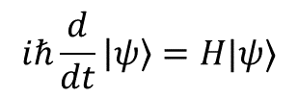
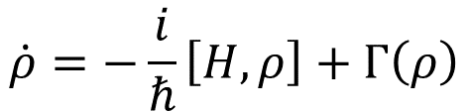



SYSTEM QUANTUM-MECHANICAL DESCRIPTION
STATE DESCRIPTION
STATE VECTOR
DENSITY MATRIX
$$|ψ〉=\sum_{i}{a_{i}}|i〉$$
EVOLUTION DESCRIPTION
$$iℏ\frac{d}{dt}|ψ〉=H|ψ〉$$
$$\dot{ρ}=−\frac{i}{ℏ}\left[H,ρ\right]+Γ\left(ρ\right)$$
$$H$$
interaction Hamiltonian
$$Γ\left(ρ\right)$$
relaxation operators
DENSITY MATRIX INCORPORATES RELAXATION PROCESSES

Slide 11
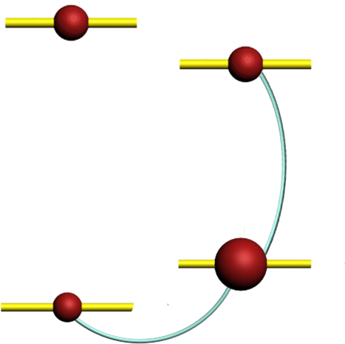






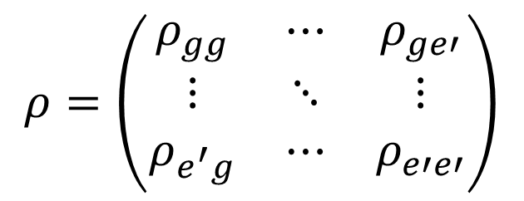

SYSTEM QUANTUM-MECHANICAL DESCRIPTION
$$ρ_{ee}$$
DENSITY MATRIX
$$ρ=\left(\begin{matrix}ρ_{gg} & ⋯ & ρ_{ge′} \\ ⋮ & ⋱ & ⋮ \\ ρ_{e^{′}g} & ⋯ & ρ_{e′e′}\end{matrix}\right)$$
$$ρ_{ge}$$
$$ρ_{gg}$$
$$ρ_{gg′}$$
$$ρ_{gg}$$
population of state g (probability of finding atom in the state g)
$$ρ_{gg′}$$
Zeeman coherence between the magnetic sublevels of the same state g
$$ρ_{ge}$$
optical coherence between the states g and e

Slide 12
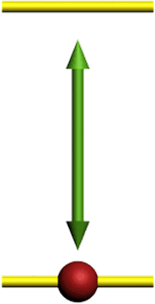
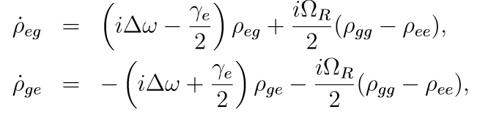

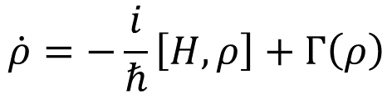
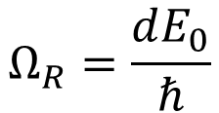

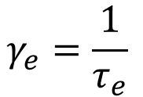

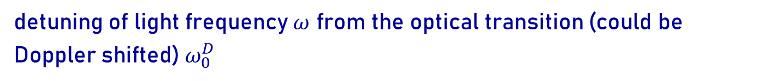

LIGHT-ATOM INTERACTION – TWO-LEVEL ATOM
$$|e〉$$
$$\dot{ρ}=−\frac{i}{ℏ}\left[H,ρ\right]+Γ\left(ρ\right)$$
$$|g〉$$
$$Ω_{R}=\frac{dE_{0}}{ℏ}$$
Rabi frequency (coupling strength)
$$γ_{e}=\frac{1}{τ_{e}}$$
excited-state relaxation constant (natural width of the excited state)
$$Δω=ω−ω_{0}^{D}$$
detuning of light frequency $ω$ from the optical transition (could be Doppler shifted) $ω_{0}^{D}$

Slide 13

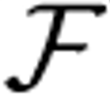
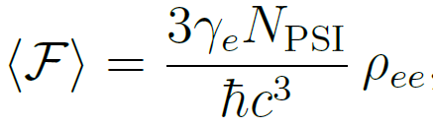
LIGHT-ATOM INTERACTION – FLUORESCENCE
FLUORESCENCE INTENSITY (quantum-mechanical definition)
fluorescence operator
Two-level system
FLUORESCENCE PROPORTIONAL TO THE NUMBER OF ATOMS IN EXCITED STATE

Slide 14
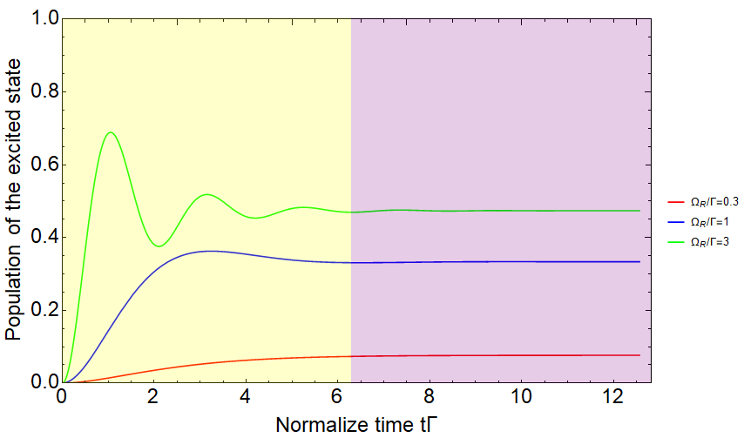
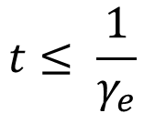

LIGHT-ATOM INTERACTION – DIFFERENT TIME REGIMES
DYNAMICS OF EVOLUTION
(after switching on CW light)
REGIMES
DYNAMIC REGIME
$$t≤ \frac{1}{γ_{e}}$$
Damped oscillations
STEADY-STATE REGIME
$$t≫ \frac{1}{γ_{e}}$$
Constant value
INTERACTION REGIME DETRMINED BY THE RELATION BETWEEN PULSE LENGTH AND RELAXATION TIME

Slide 15
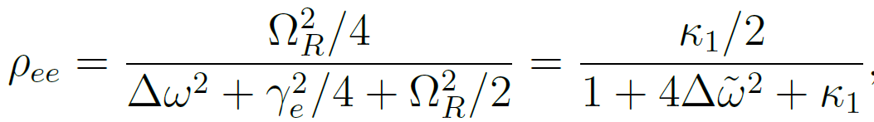
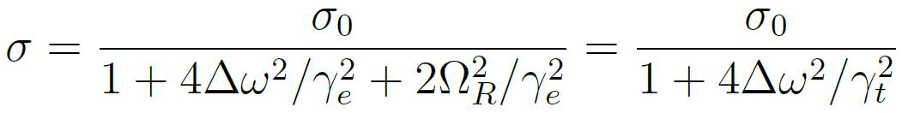
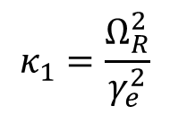



LIGHT-ATOM INTERACTION – STEADY-STATE REGIME
STEADY-STATE = NO EVOLUTION OF THE DENISTY MATRIX
$$\dot{ρ}=0$$
$$κ_{1}=\frac{Ω_{R}^{2}}{γ_{e}^{2}}$$
saturation parameter
Form similar of that of the absorption cross section
$$t≫\frac{1}{γ_{e}}$$
CLASSICAL CROSS-SECTION APPROACH WORKS FOR
POPULATION/FLUORESCENCE SATURATES AT
$$κ_{1}≈1$$

Slide 16
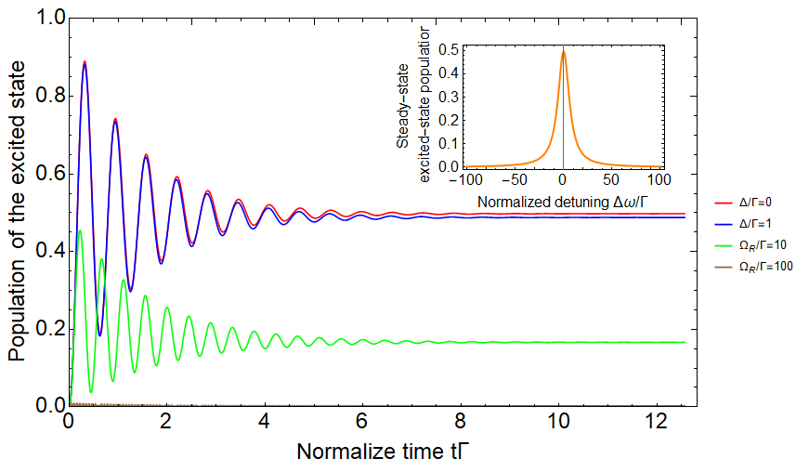

LIGHT-ATOM INTERACTION – DETUNING DEPENDENCE
POPULATION AT DIFFERENT DETUNINGS
It is difficult to saturate with detuned light
Oscillation frequency increases with detuning
Oscillation amplitude drops with detuning
MUCH HARDER TO SATURATE DETUNED TRANSITION
$$κ_{Δ}∝\frac{{Δω}^{2}}{{γ_{e}}^{2}}κ_{1}$$

Slide 17
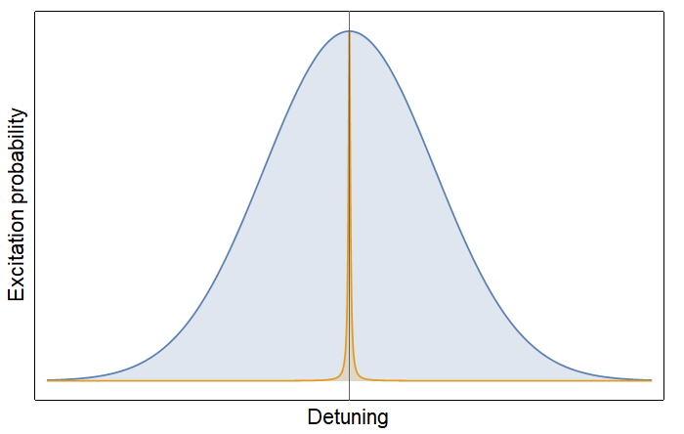


LIGHT-ATOM INTERACTION – DOPPLER EFFECT
Ions in the bunch have momentum dispersion
Doppler broadening on the transition
$$\frac{Δp}{p}≈{2×10}^{−4}$$
Doppler width
Doppler width much larger than the transition width
Natural width
Extremely difficult to saturate the transition
Pb⁷⁹⁺:
$$I≈5\frac{GW}{cm^{2}}$$

Slide 18
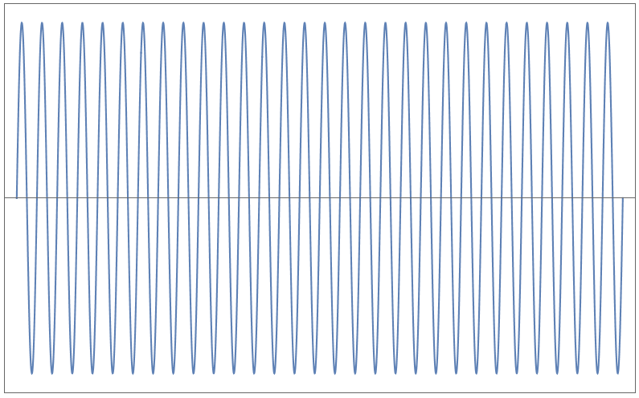
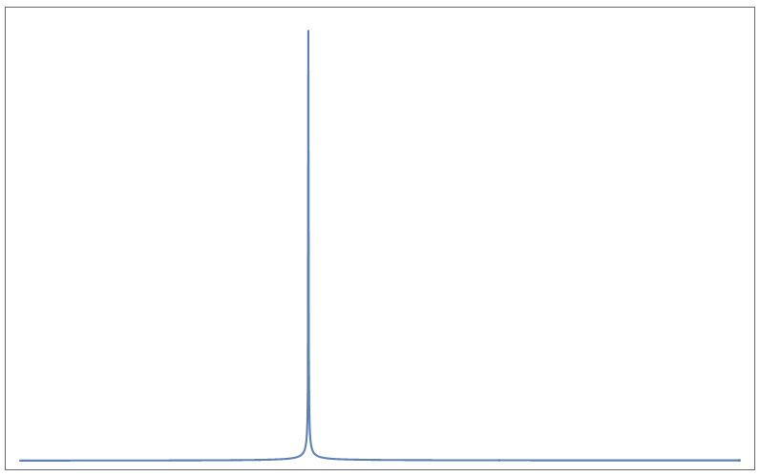
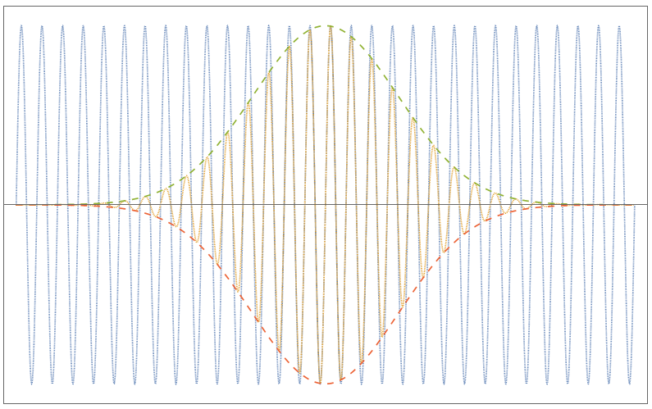
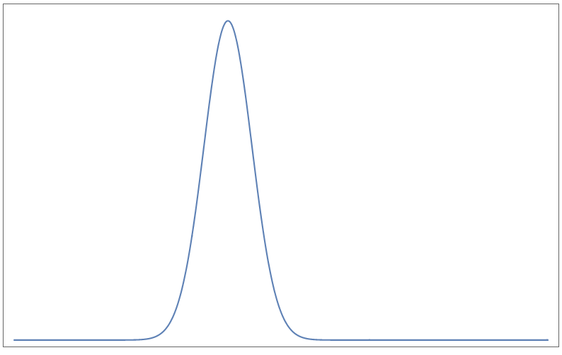
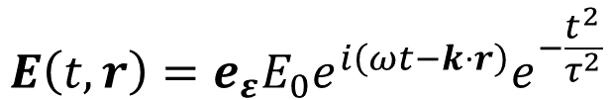
LIGHT-ATOM INTERACTION – DOPPLER EFFECT
POPULATION AT DIFFERENT DETUNINGS
TIME DEPENDENCE
SPECTRUM
Finite interaction time broadens spectrum of light
MONOCHROMATIC
$$E\left(t,r\right)=e_{ε}{E_{0}e}^{i\left(ωt−k⋅r\right)}e^{−\frac{t^{2}}{τ^{2}}}$$
PULSE

Slide 19
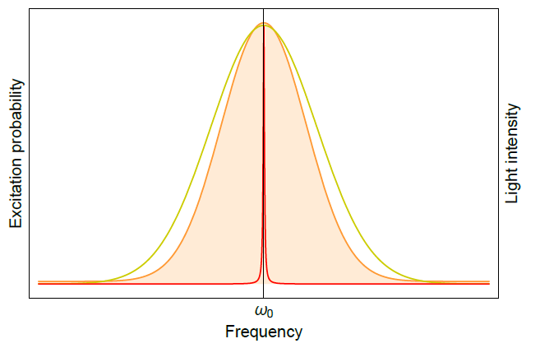
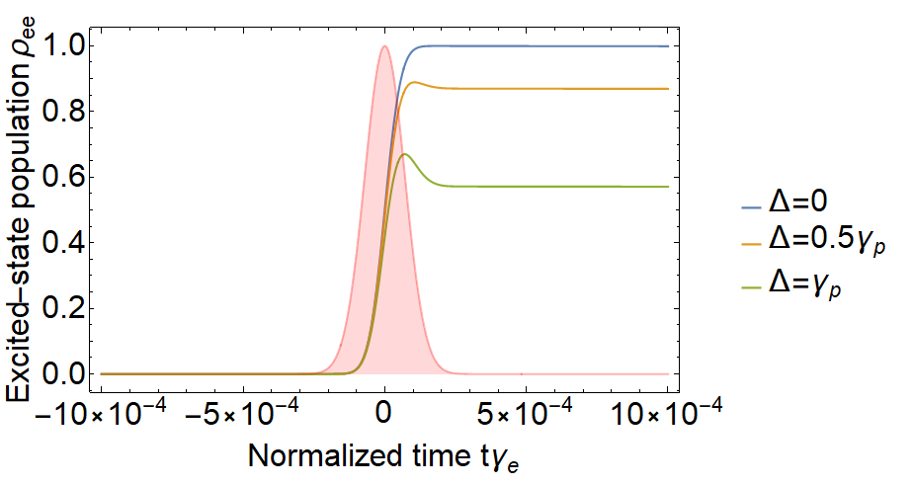
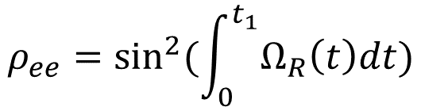
LIGHT-ATOM INTERACTION – PULSE EXCITATION
Using spectrally broad light (pulse)
Population for different detunings
FINAL POPULATION DETERMINED A CUMULATED RABI PHASE
$$ρ_{ee}=\sin^{2}{(\int_{0}^{t_{1}}{Ω_{R}\left(t\right)dt})}$$

Slide 20
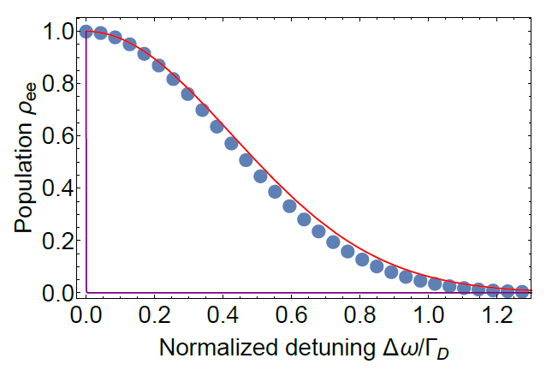

LIGHT-ATOM INTERACTION – PULSE EXCITATION
$$γ_{p}=Γ_{D}$$
EFFICIENT EXCITATION OF ATOMS

Slide 21




















RESULTS OF THEORETICAL SIMULATIONS
Li-like Pb⁺⁷⁹
H-like Pb⁺⁸¹
Transition
$$2s→2p_{1/2}$$
$$1s→2p_{1/2}$$
Transition energy
$$230 eV$$
$$75280 eV$$
Transition width
$$1.3 {10}^{10} 1/s$$
$$3.0 {10}^{16} 1/s$$
Doppler width
$$1.6 {10}^{14} 1/s$$
$$5.4 {10}^{16} 1/s$$
Dynamics regime
Steady-state regime
Lorentz factor
$$96$$
$$2989$$
Number of ions per bunch
$$≈9 {10}^{7}$$
$$≈9 {10}^{7}$$
Laser wavelength
$$1030 nm$$
$$≈100 nm$$
Pulse energy
$$0.55 mJ$$
$$5 mJ$$
Pulse length
$$2.8 ps$$
$$500 ps$$
Ti:Sapphire laser
FEL
EFFICIENCY OF PUMPING
$$≈60\%$$
$$≈660\%$$
Multiply excitation

Slide 22
CHALLANGES
INCORPORATE VELOCITY, INTENSITY, AND DENSITY SPREAD
MAKE ANALYTICAL AND MONTE-CARLO CALCULATIONS IN AGREEMENT
INVESTIGATE SCENARIOS WITH LESS SENSITIVITY TO LIGHT PARAMETERS
???

Slide 23





ACKNOWLEDGEMENTS
COLLABORATORS
IN SPE
WITEK
WIESIEK
JACEK BIEROŃ
SIMON
DISCUSSIONS
KRZYSZTOF DZIERŻĘGA
DIMA

