Slide 1
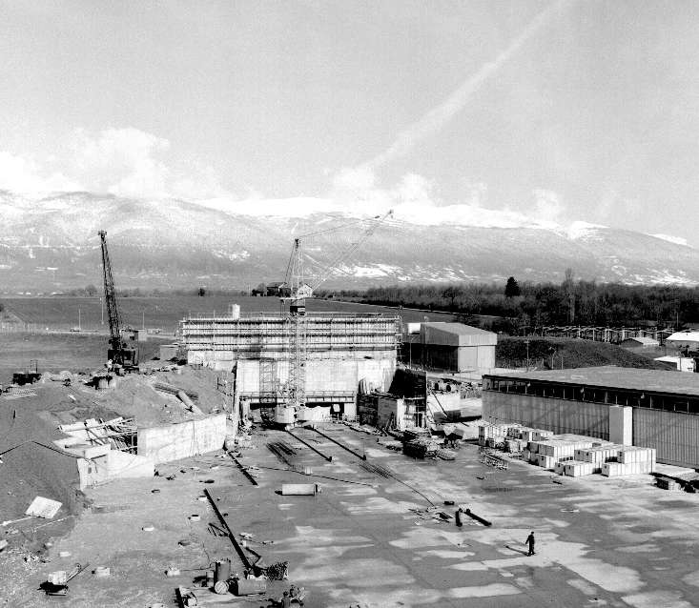
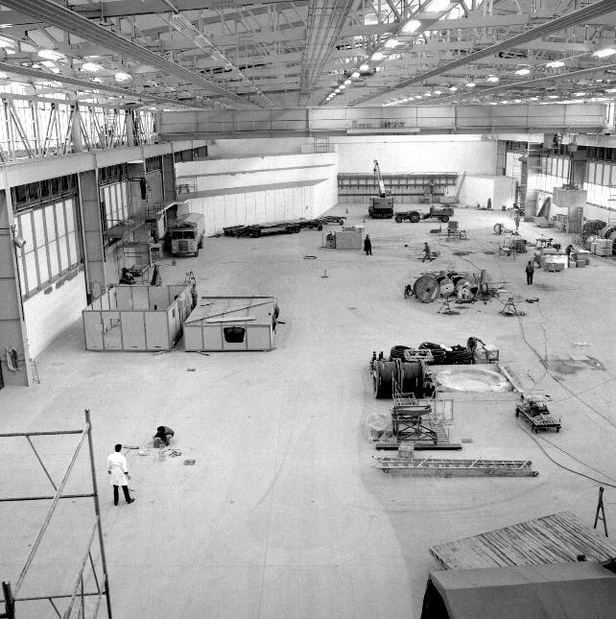
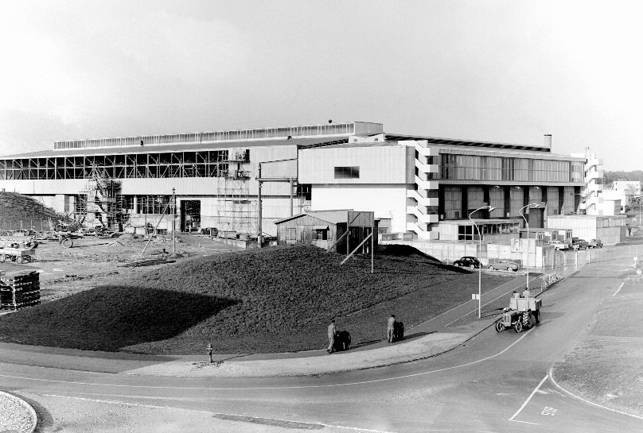




IST status and safety documentation approval
East Hall under construction - 1962
Filipa Carvalho (BE-EA)
East Area Renovation

Slide 2
Commissioning Progress
  Most of the equipment has been installed and commissioned
  DSO test of the primary area completed
  Beam/shielding commissioning started in August 23rd
    Successfully finished the commissioning of the primary area shielding
  DSO test of T09-10, T09 and T10 completed
  Currently installing beam monitors in T09 and T10
  Some delays with XCET

Slide 3
Next Steps
  Some electrical inspections still to be done
    In particular to the control rooms
  Inspection of the Gas Barracks to be done
  Finish the shielding commissioning
  General inspection with HSE to have the final Safety Clearance for operation

Slide 4
Safety File
The Safety File is ready for approval by ATS director (all documents went through Eng. Check and have been updated accordingly).
  Next step is to upload the newest versions of the safety files in EDMS and the PS-CSAP chairman will then recommend the documents for approval to the ATS director.
Descriptive Part: EDMS 1273737
Demonstrative Part: EDMS 1273738
Operational Part: EDMS 1273739

Slide 5
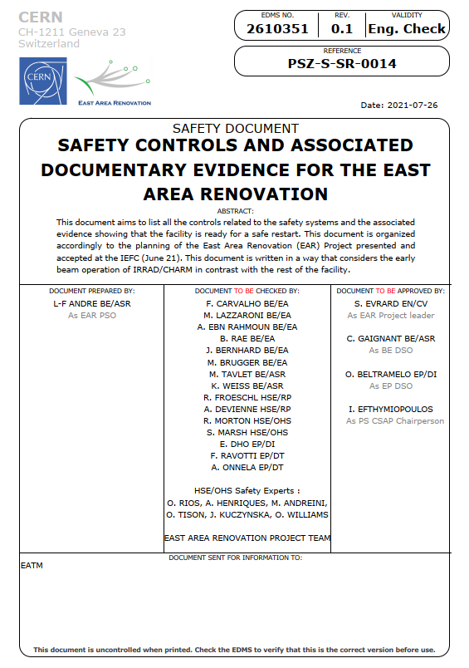
Safety File Compliance Before Operation
EDMS 2610351
This document allows to get a global view on all the tests and safety inspections already carried out in the facility
Being circulated in Engineering check in EDMS
Signed Beam permits
EA1 (Zone Primaire) :
https://edms.cern.ch/document/1134049/2021.1
EA2 (IRRAD/CHARM) : https://edms.cern.ch/document/1609962/2020
T9: https://edms.cern.ch/document/1701960/2021.1
T10: https://edms.cern.ch/document/1701964/2021.1
Beam permit to be signed later on
T11: https://edms.cern.ch/document/1701965/2021.1

Slide 6
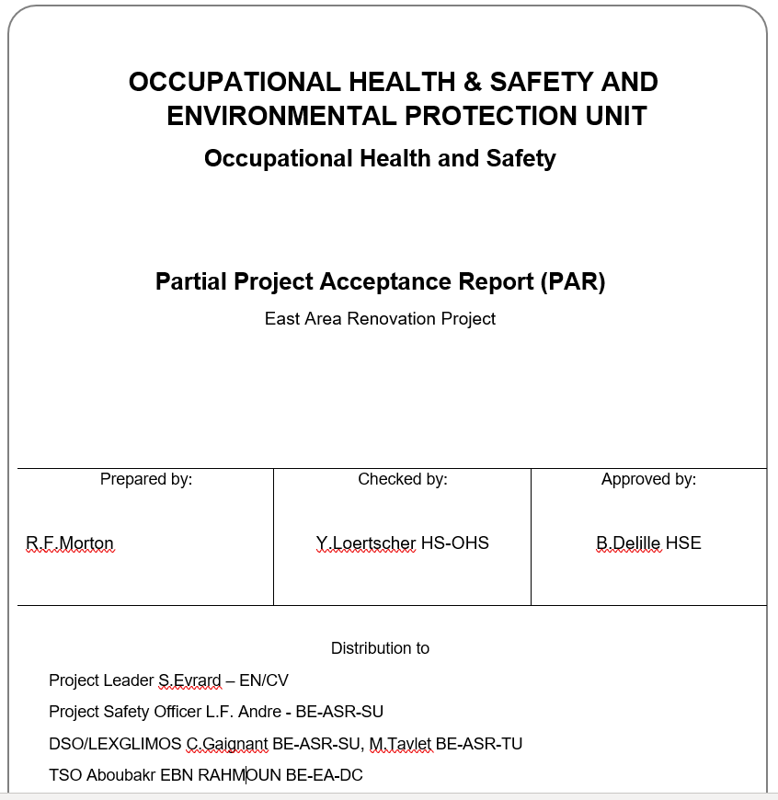
HSE Safety Clearance
EDMS 2616861
Partial project acceptance report (concerning T08 beamline) resulting from a general HSE inspection that took place in August
Full project clearance to come after the final inspection in early October

Slide 7
East Area Renovation
Thank you!

