Slide 1
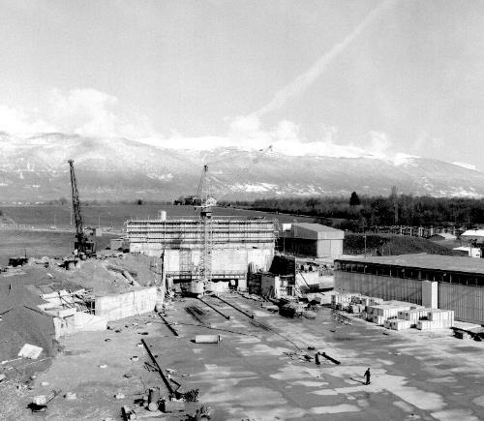
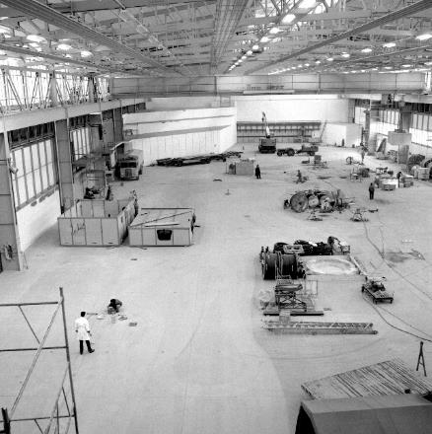
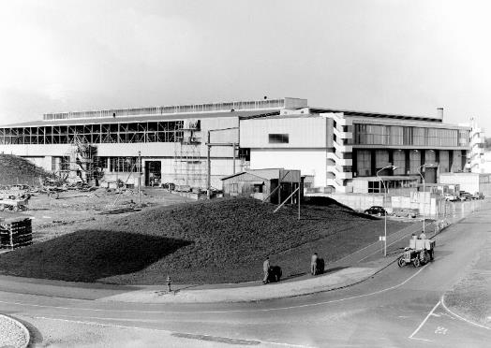

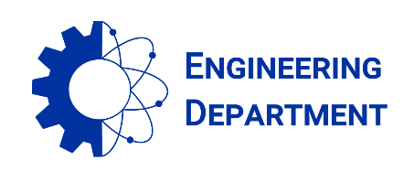
East Area Renovation - News
Project Team #47 on 17.09.2021
East Hall under construction - 1962
S. EVRARD (EN-CV), on behalf of the project team

Slide 2
Agenda
Budget situation on September 1st
Main milestones
TS activities feedbacks
Project safety approval
Miscellaneous

Slide 3
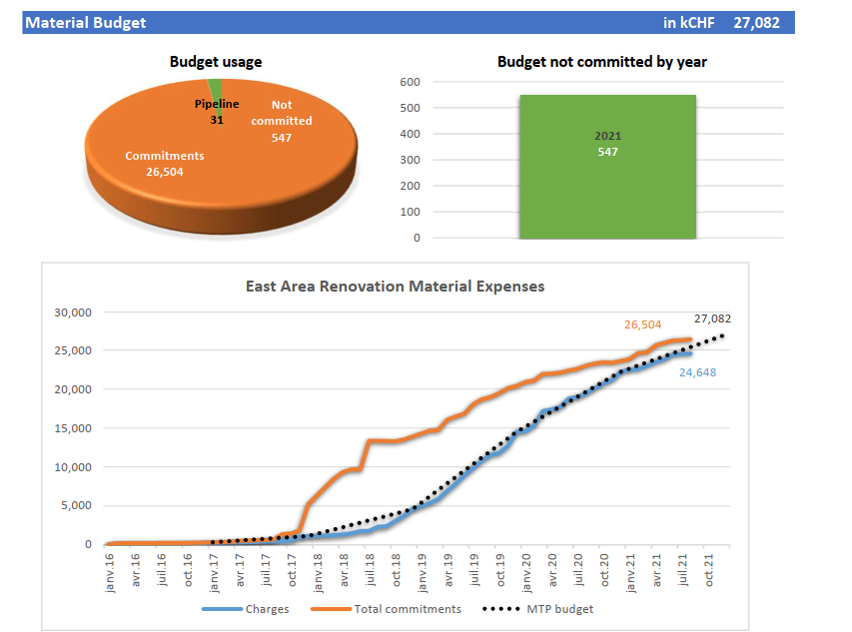
Budget situation on September 1st
Overall material budget: 27.1 MCHF
On September 1st: 98 % committed and 91 % charged
Still 547 kCHF to commit in 2021
Budget review with all WPs to get ready for Project bookkeeping closure

Slide 4
Main milestones
Start of the Primary Beam commissioning: August 23rd: done !
Start of the Secondary Beam commissioning: Today
Start of IRRAD-CHARM Physics: September 20th : D – 2
Start of the whole facility: October 18th: D - 30

Slide 5
TS activities feedbacks
1 day technical stop on Wednesday September 15th
2 activities planned and fully completed:
  Laser scan of the primary and mixed areas (T08 A&B + target area)
  Measurement of the survey points in GT817 + B.157 surface

Slide 6
Project safety approval
Presentation in PS CSAP yesterday: https://indico.cern.ch/event/1075506/contributions/4522884/attachments/2310528/3931791/East_Area_Renovation_Safety_PS_CSAP64_16.09.21.pptx
Well received and support got from PS-CSAP to request the formal safety approval from the complex manager and the Safety clearance from HSE.
PAR (Partial Project Acceptance Report) being approved by HSE
Next steps:
  Final HSE inspection of experimental areas and counting rooms (General + electrical)
  Complex manager approval
  Safety clearance from HSE
→ see Filipa’s talk

Slide 7
Miscellaneous
CHARM BTV and target misalignment
  T8.BTV96 and all other elements downstream, including the target location are offset by 16.5 mm upward with respect to the upstream beam line
  Those devices have been aligned yesterday: big thank you to the survey team !
Unexpected opening of the skydomes in rainy weather
  Short ESD powercut on August 23rd + check T9-T10 magnets
  Alarm level 3 to be installed asap
Counting room electrical non-conformities
  IPT and LS put the contractor on formal notice
  Repair to take place on early October and completed before October 18th

Slide 8

Thanks for your attention !

