Slide 1
3rd Forward Physics Facility (FPF) Meeting, 25-26 October 2021
Civil Engineering Study Update
Kincső Balázs, John Osborne SCE-DOD-FS
Date: 25/10/2021

Slide 2
Introduction
Experimental Requirements and CE considerations
Option 1: Alcoves in the UJ 12
Option 2: Purpose built facility
Next Steps

Slide 3
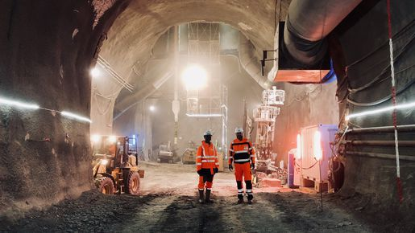
Experimental requirements and CE consideration
Requirements:
Experimental area approx. 500-600 m away from LHC P1 or P5 on the Line of sight (LoS)
Space for experiments
Access needed for construction, installation and maintenance
CE considerations:
Existing infrastructure
Access for construction
Disruption to LHC machine
Geology
Cost

Slide 4
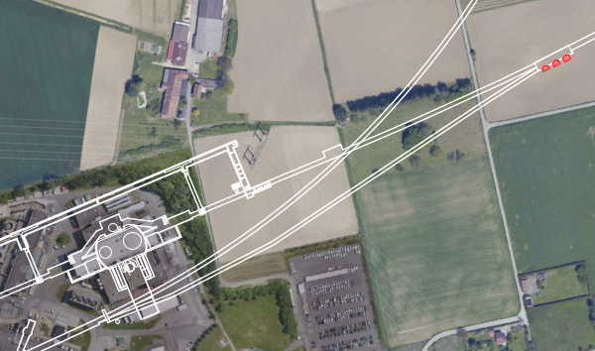
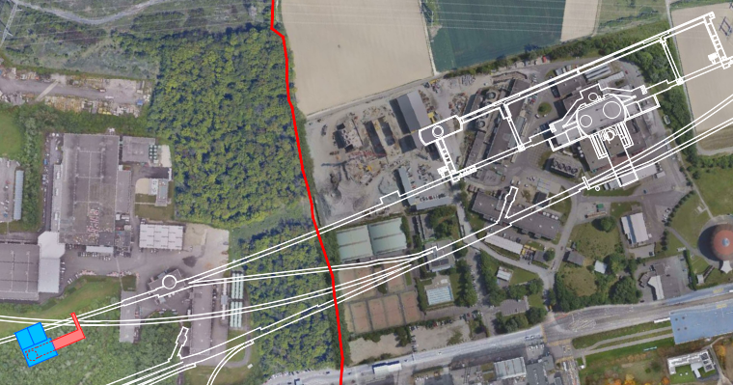
CE Study Update- Considered options
  Option 1 – UJ12 Alcoves
  Option 2 – Purpose built facility
UJ12
SPS
IP1 ATLAS
LHC
IP1 ATLAS
LHC
New proposed facility
PGC3
4

Slide 5
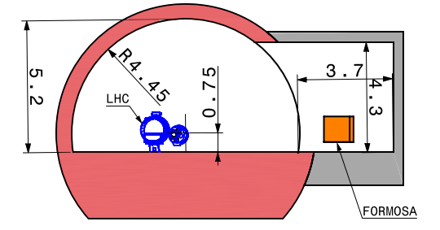
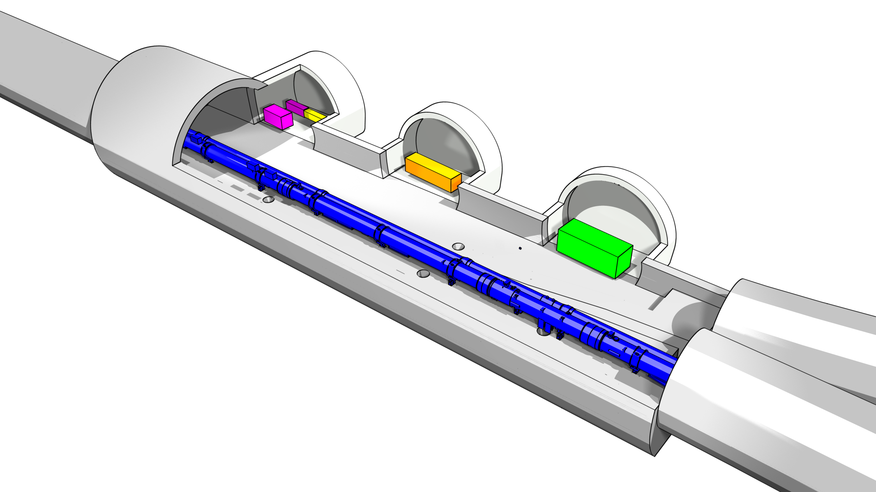
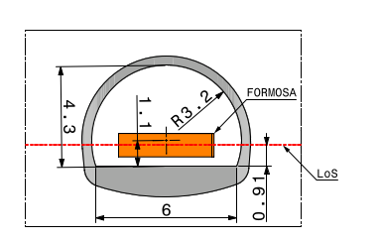
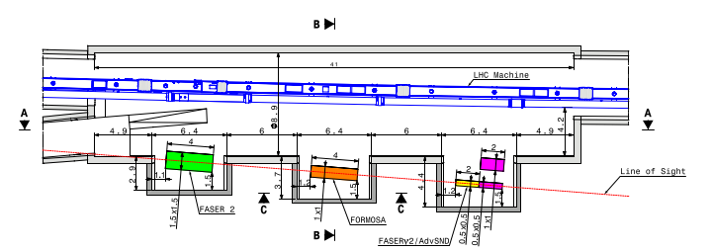
Option 1 – Alcoves in UJ12
Advantages
  Lowest cost and disruption
Disadvantages
  Experiments need to be designed around what is possible
  Likely only 2-3 alcoves possible around 3mØ
  Stability of existing cavern
  All existing services in UJ12 need to be removed (This would include 4 LHC dipole magnets + 1 quadrupole magnet and 40-60m of the QRL cry-line )
Alcove Cross Section at B-B
3D view
Typical Alcove Cross Section C-C
Plan view showing widening and alcoves
5

Slide 6
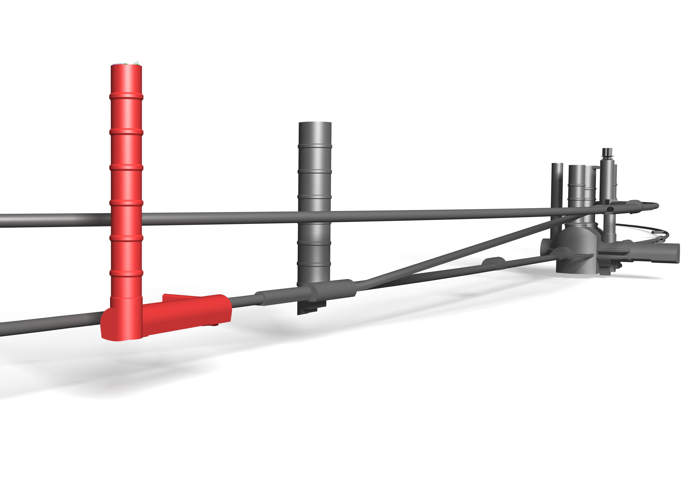
Option 2 – Purpose built facility
Advantages
  Designed around needs of experiments
  Size/ length not constrained
  Construction access far easier
Disadvantages
  More expensive
  Construction still need to be coordinated with LHC shutdowns
SHAFT
PM18
SPS
SAFETY GALLERY
TI18
UJ18
CAVERN
existing
proposed
6

Slide 7
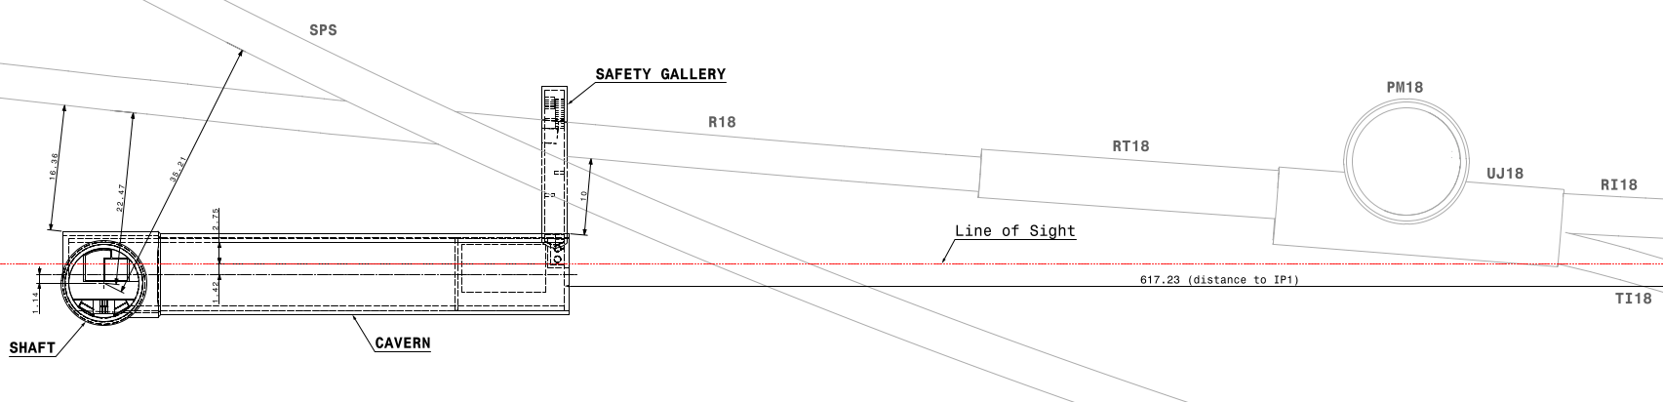
Option 2 – Purpose built facility
Proposed Layout
65 m long Experimental Cavern located on the LoS, approx. 612 m from IP1
9.1 m access shaft located on the top of the cavern
Safety gallery connecting the cavern to the LHC to avoid dead-end
LHC tunnel
Line of sight (red)
FPF
SPS tunnel
Plan view

Slide 8
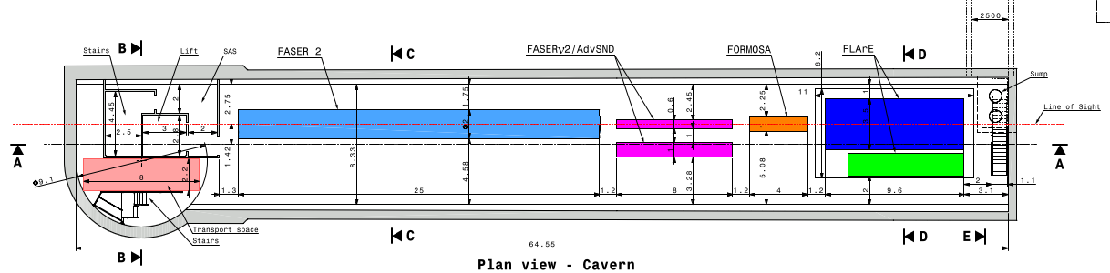
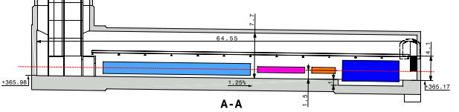
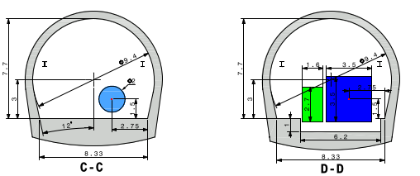
Option 2 – Underground structures
9.7 m wide cavern to allow access for transport and siting of some services
Experiments centralised on the line of sight, 1.5m above the floor
Floor parallel to the LoS, 1.25%fall
Trench under the LAr detector to catch any escaped cold gas
Concept based on overhead crane serving experiments along cavern length

Slide 9
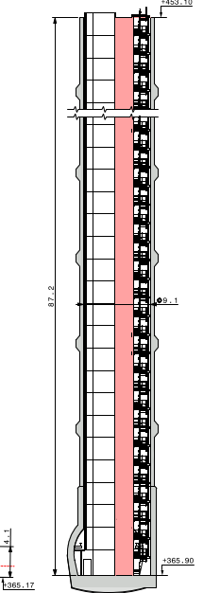
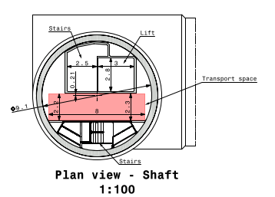
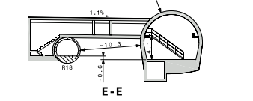
Option 2 – Underground structures
88m deep shaft includes lift and stairs for access and space reserved for transport
Safety gallery connected to the LHC as per Safety requirements
Ongoing RP study regarding the accessibility of the cavern during LHC operations and feasibility of the connecting gallery (See next talk by A. Infantino)
Plan view shaft
Section through the new cavern and the safety gallery
Cross section through the shaft

Slide 10
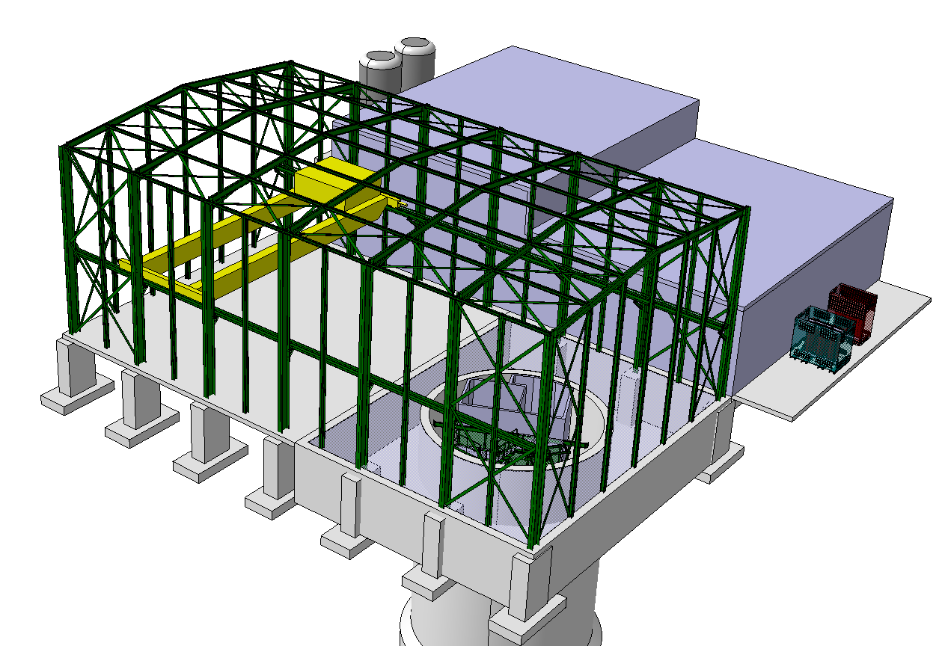
Option 2 – Surface buildings
Access building
Similar in size to SD1 and SD17
Steel portal frame structure with concrete ground bearing floor
2.5 m deep false floor surrounding the shaft
25t overhead crane to lower the experiments to the floor level of the cavern
CV building
Electrical building
Access Building
25t overhead crane
Transformer base
False floor

Slide 11
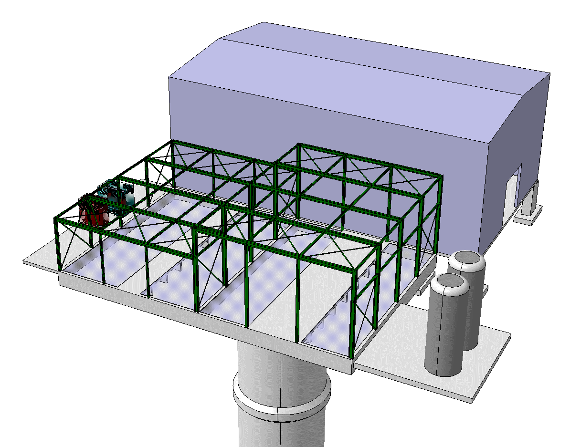
Option 2 – Surface buildings
Service Buildings
Electrical, cooling and ventilation building adjacent to the access building
Electrical building designed as a steel frame structure
Similar size to HL-LHC point 1
1.2m deep false floor to allow the services to be distributed into the shaft with a concrete access platform for vehicles to enter the buildings
Access building
Electrical building
CV building
Transformer base
False floor
Tank base
Vehicle access platform

Slide 12
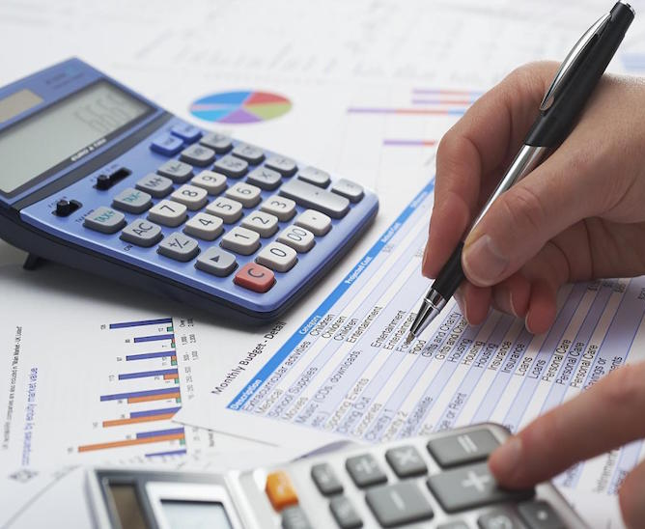
Preliminary Cost Estimate
Very preliminary cost estimate prepared for both options
Cost estimate Class 4 – total could be 50% higher and 30% lower than the given estimate
Conclusion: purpose-built facility including the needed services would cost about 40M CHF, whereas the UJ12 option would cost about 15MCHF

Slide 13
Next Steps
Conclude the RP study
Further input from Integration, Transport, CV, Cryogenic, Radiation Protection and Heath and Safety teams
Include updated requirements from experiments in a more refined design of the facility
Choose the preferred option
Progress with cost estimate and schedule

Slide 14
Thank you!

