Slide 1

Automated Crack Detection for Large-scale Tunnel Structure Using
Deep Learning
Darragh O’ Brien

Slide 2
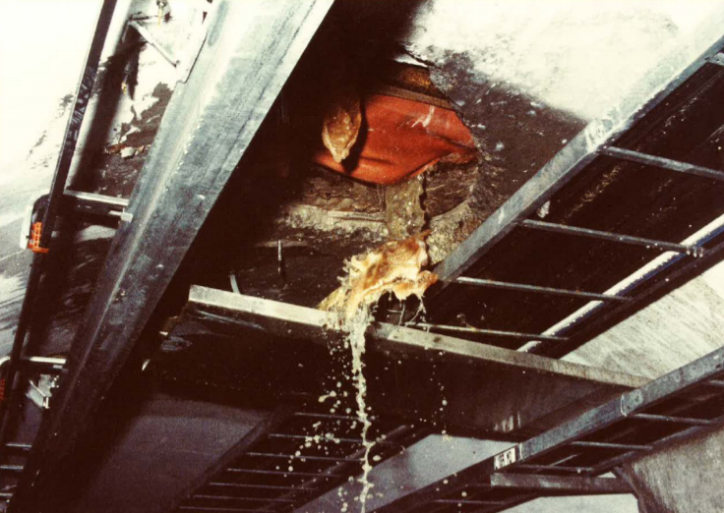
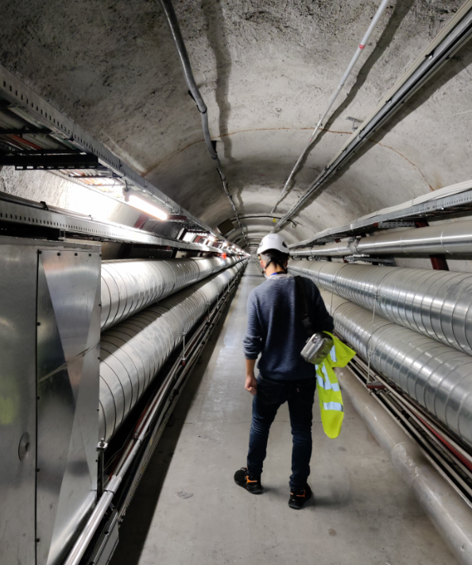
Why Are We Here?
Automate underground inspections as much as possible
Reduce overall inspection time
Objective inspection, to reduce report subjectivity
Collaboration with University College Cork for R&D tunnel monitoring- how can we (SCE & BE) work better together?
Implement R&D into future projects such as FCC
Agenda
Darragh O’Brien (UCC Student) to present summary of research and future of the studies
General discussion
EDMS Nr: 970183

Slide 3

Outline
Motivation
Algorithm development
Algorithm testing
Crack Classification
Algorithm deployment
Drone inspection
Future R&D

Slide 4
Outline
Motivation
Algorithm development
Algorithm testing
Crack Classification
Algorithm deployment
Drone inspection
Future R&D

Slide 5
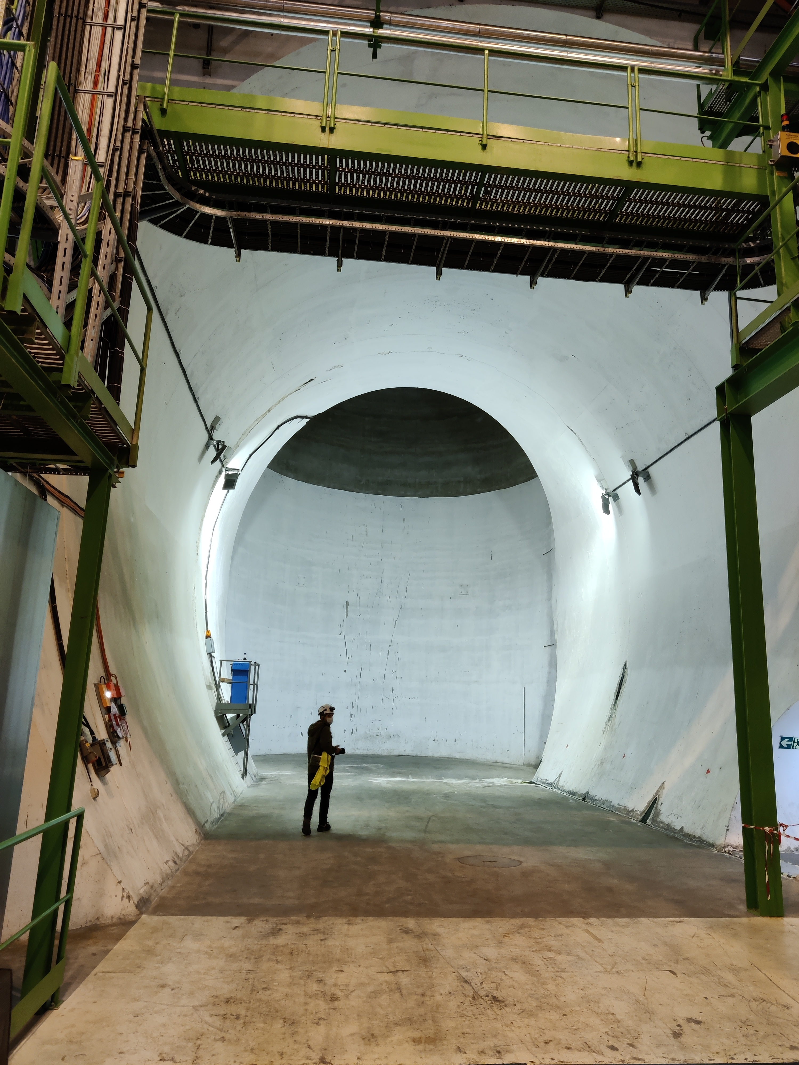
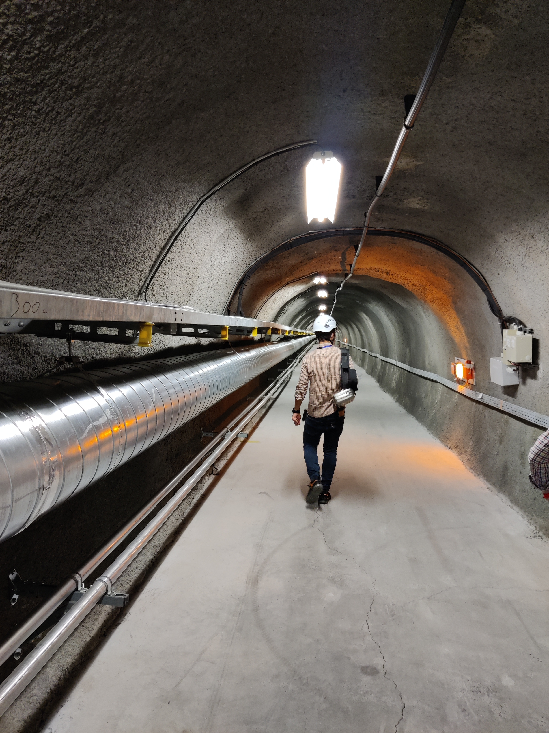
Motivation
At CERN there is over 50km of tunnel infrastructure that must be examined by the SCE department during a Shutdown. The main objective of this photogrammetry research is to automatically detect and subsequently classify cracks in tunnel lining images using a Convolution Neural Network (CNN).
Potential Benefits of this research
Reduce inspection time
Increase objectivity of inspection
Reduce personnel presence in tunnels by permitting focused area inspections in future shutdowns.
Automated Crack Detection for Large-scale Tunnel Structure Using
Deep Learning

Slide 6
Outline
Motivation
Algorithm development
Algorithm testing
Crack Classification
Algorithm deployment
Drone inspection
Future R&D
Automated Crack Detection for Large-scale Tunnel Structure Using
Deep Learning

Slide 7
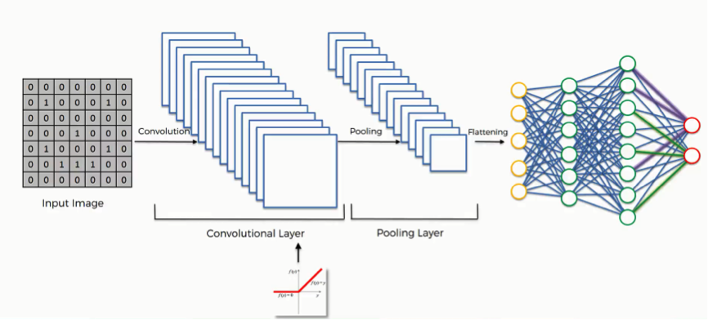
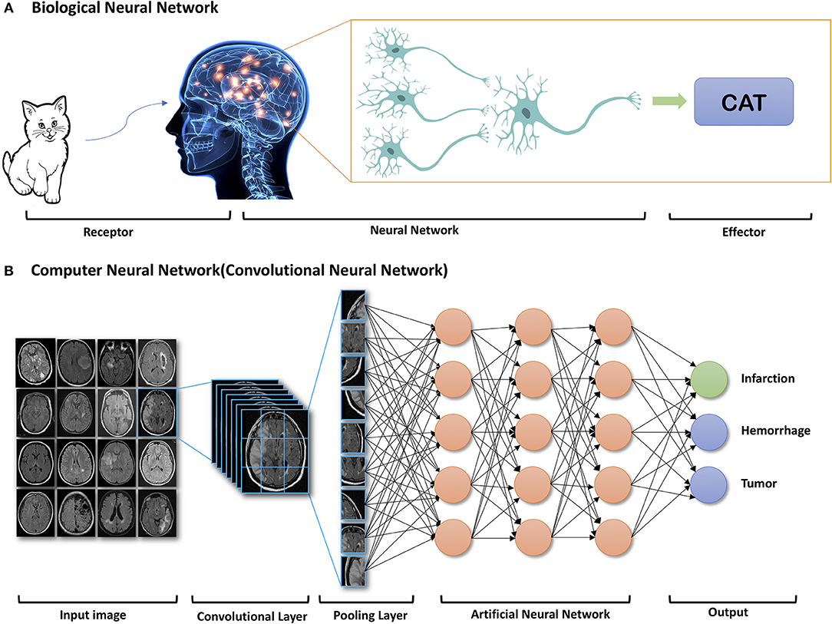
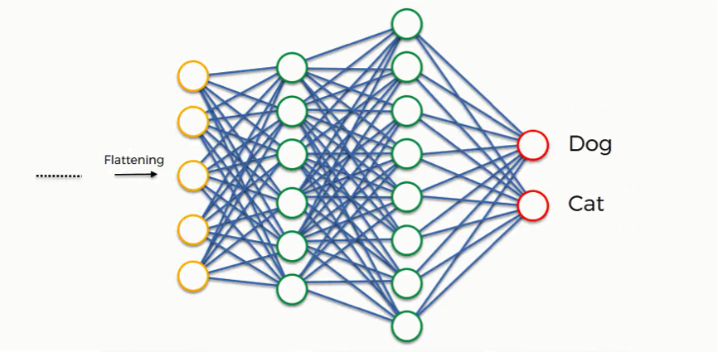
Convolution Neural Network (CNN)
What is a CNN?
A CNN is a stack of layers performing operations to extract information from an image to make a classification prediction
CNN’s and be equated to a computational equivalent of the visual cortex area of the brain.

Slide 8
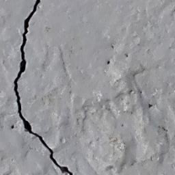
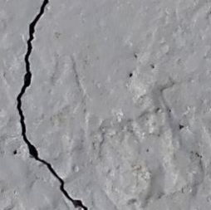
Algorithm development
1. Data Preparation
2. Image processing
3&4.Define the Model structure and Commence training
Perform another epoch.
Start
Create Database
Training
Data
Model Training
Is the model optimally trained?
No
Fully Training Model
Image augmentation
Yes
Split Data
Data input into model for Hyper parameter training
Validation Data input to calculate Validation loss and accuracy values
Training
Data increased
Validation
Data
Original Image
Horizontal Flip
Vertical Flip
Rotated 90⁰
Automated Crack Detection for Large-scale Tunnel Structure Using
Deep Learning

Slide 9
Crack Detection Algorithm Development
To create this CNN 330 images of cracks from tunnels in LHC , SPS and ATLAS were segmented and classified to contain a crack or not. This left a database of 6’600 smaller images of crack with the equivalent number of non cracks chosen to create a even database .
To aid in increase the model accuracy the technology of transfer learning was use developed to detect cracks in input images.
The CNN achieved accuracy in the training of 98.6 % concerning training and validation and out of sample test accuracy of 98.1%.
Automated Crack Detection for Large-scale Tunnel Structure Using
Deep Learning

Slide 10
Outline
Motivation
Algorithm development
Algorithm testing
Crack Classification
Algorithm deployment
Drone inspection
Future R&D
Automated Crack Detection for Large-scale Tunnel Structure Using
Deep Learning

Slide 11
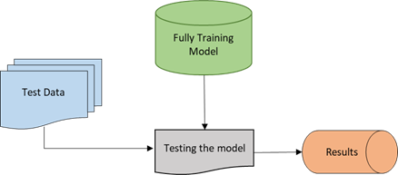
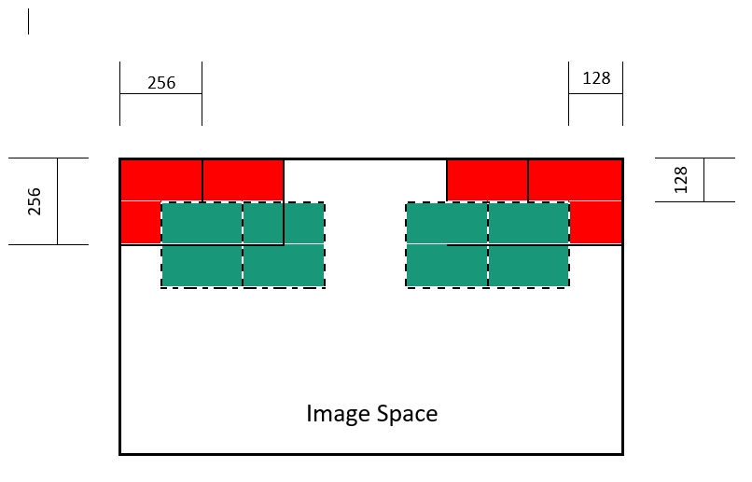
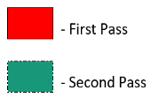
Algorithm testing
To test the CNN algorithm objectively the model is exposed to data that it previously has not seen. The separation of this data from the training process allows for true testing as the model has not learned any information specific to these images.
The testing used 30 large images of 3072 x 4096-pixel resolution which when the two scan method is used ultimately tests the model on 10’710 256 x 256 pixel resolution images .
The images used were taken from different areas of the tunnel infrastructure at CERN displaying varying luminosity/obstructions. This diversity of image conditions enabled to extensively test the accuracy and potential for implementation.

Slide 12
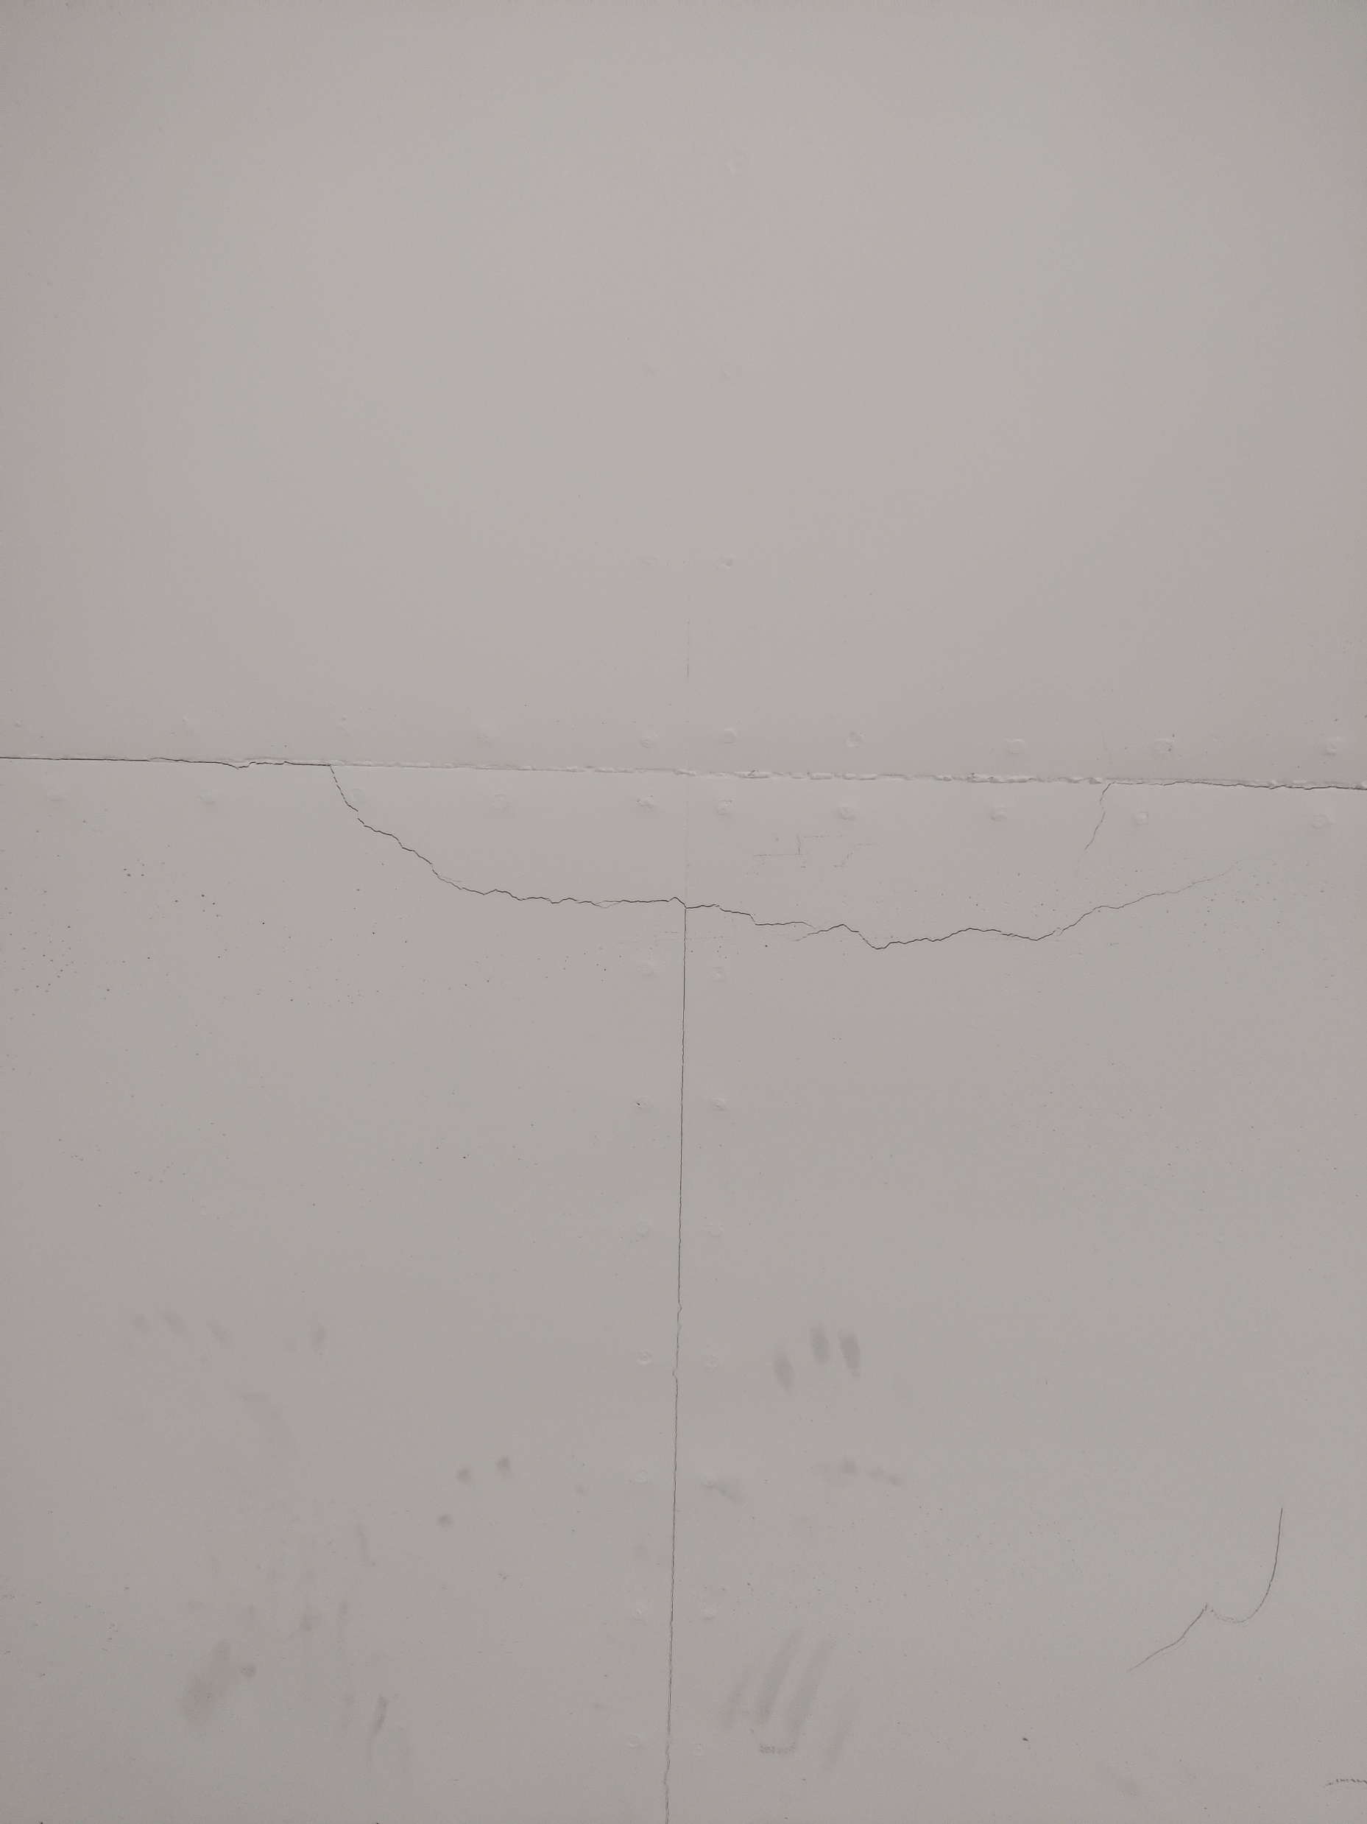
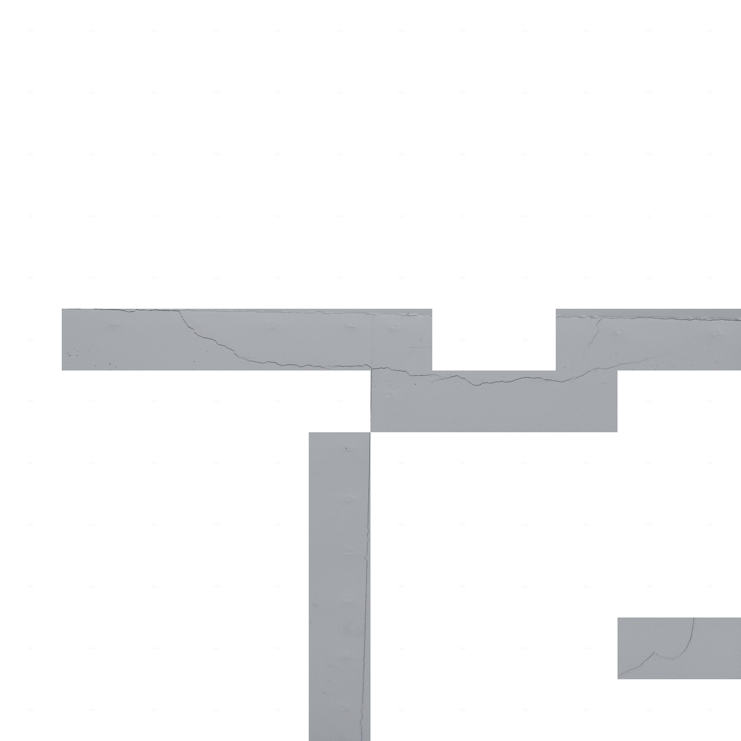
Original Image
Sliding window Pass 1
1 | 2 | 3 | 4 | 5 | 6 | 7 | 8 | 9 | 10 | 11 | 12
2
3
4
5
6
7
8
9
10
11
12
Automated Crack Detection for Large-scale Tunnel Structure Using
Deep Learning

Slide 13
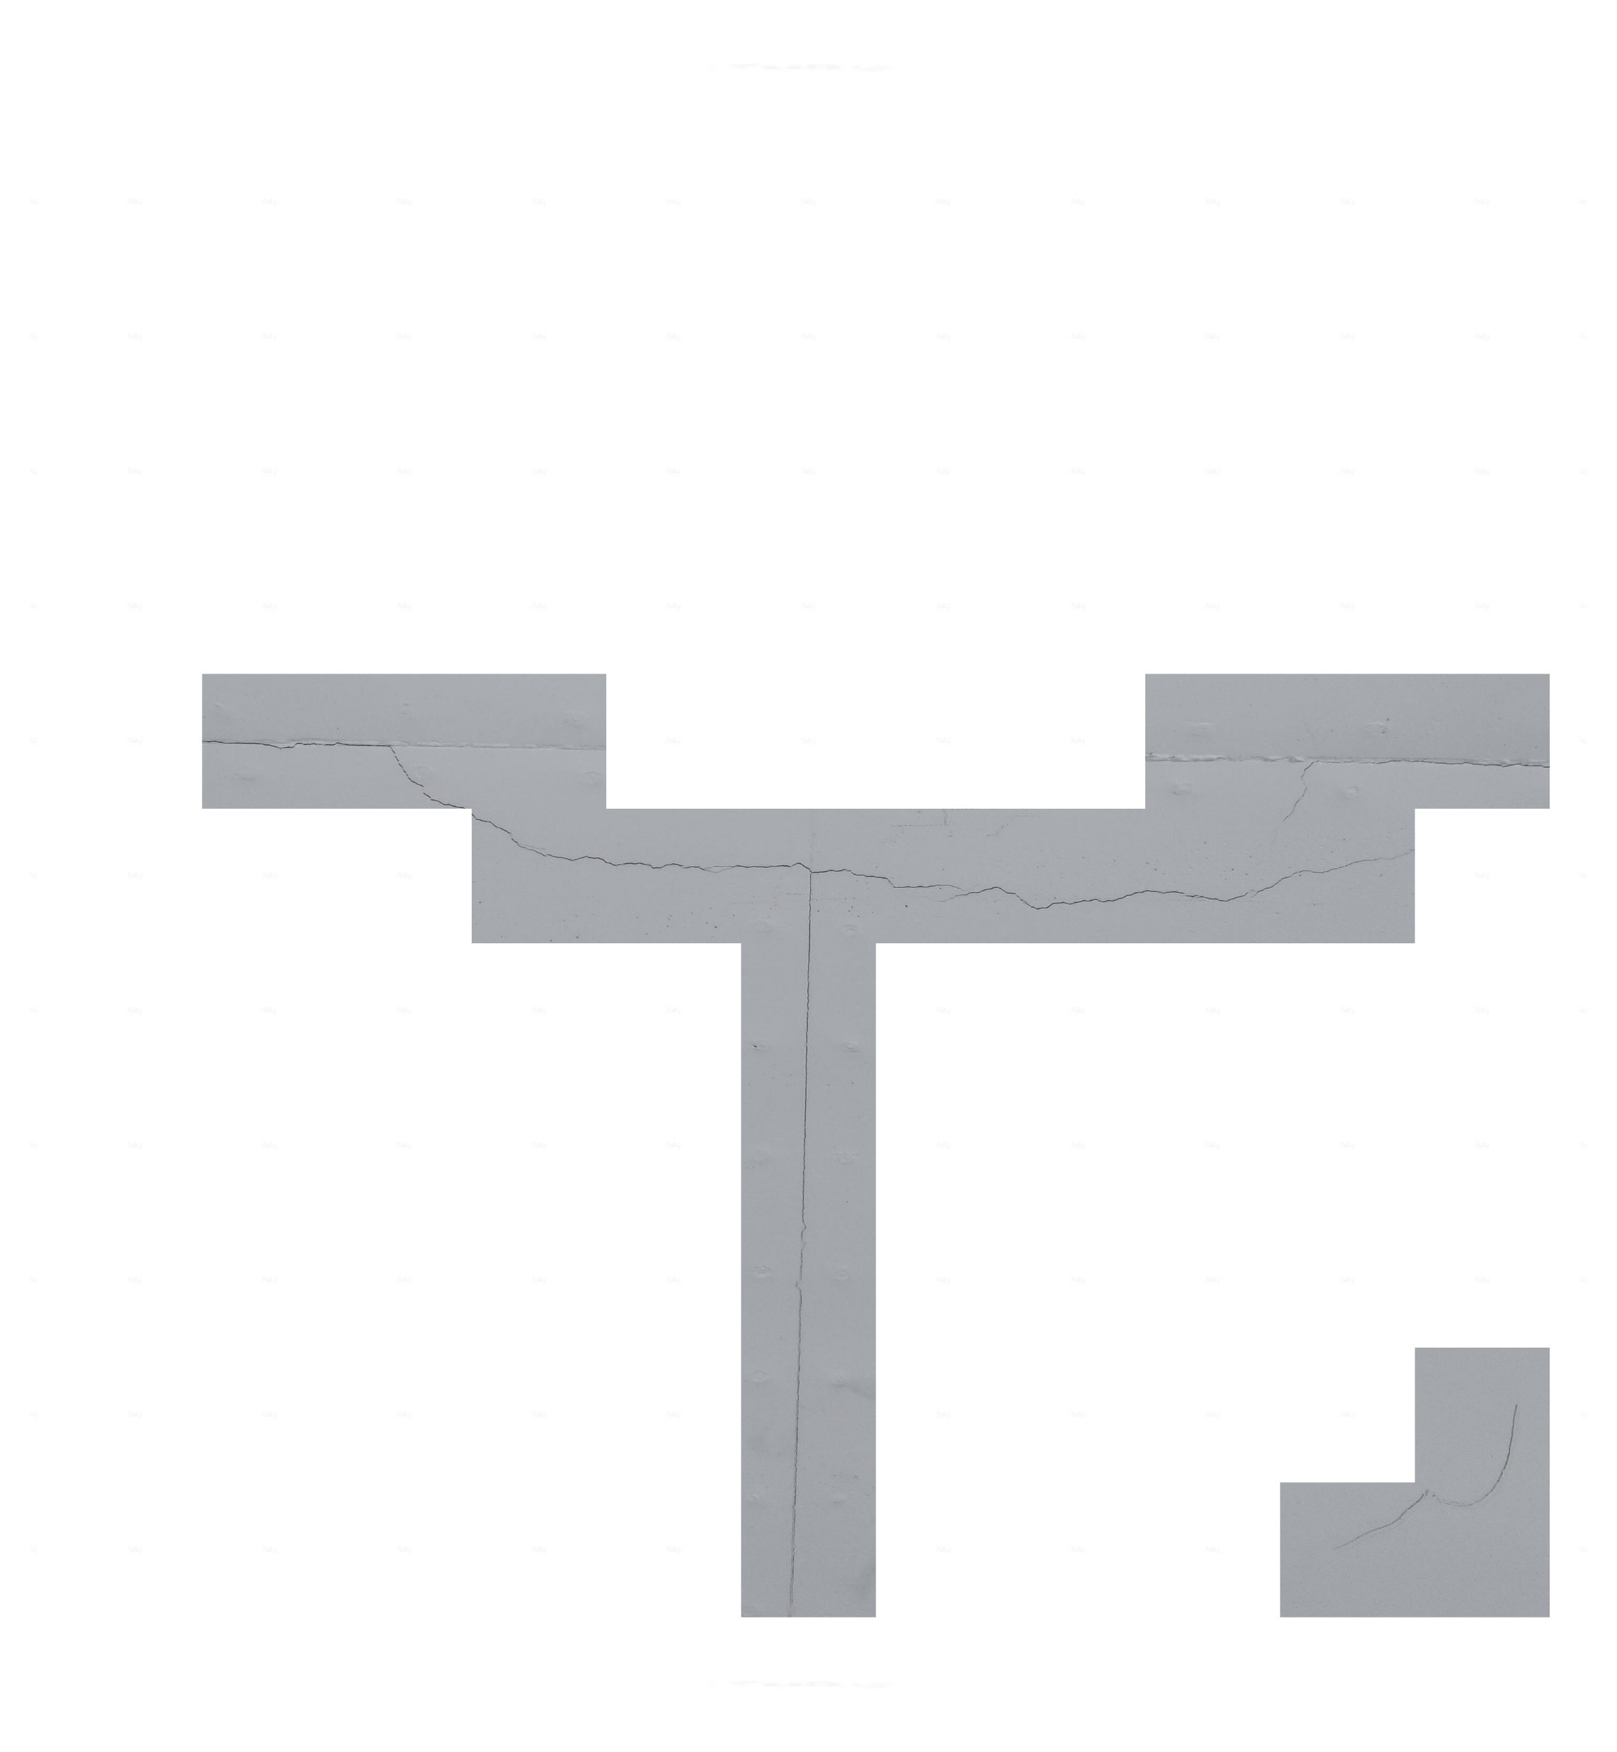
Original Image
Sliding window Pass 2
1 | 2 | 3 | 4 | 5 | 6 | 7 | 8 | 9 | 10 | 11
2
3
4
5
6
7
8
9
10
11
Automated Crack Detection for Large-scale Tunnel Structure Using
Deep Learning

Slide 14
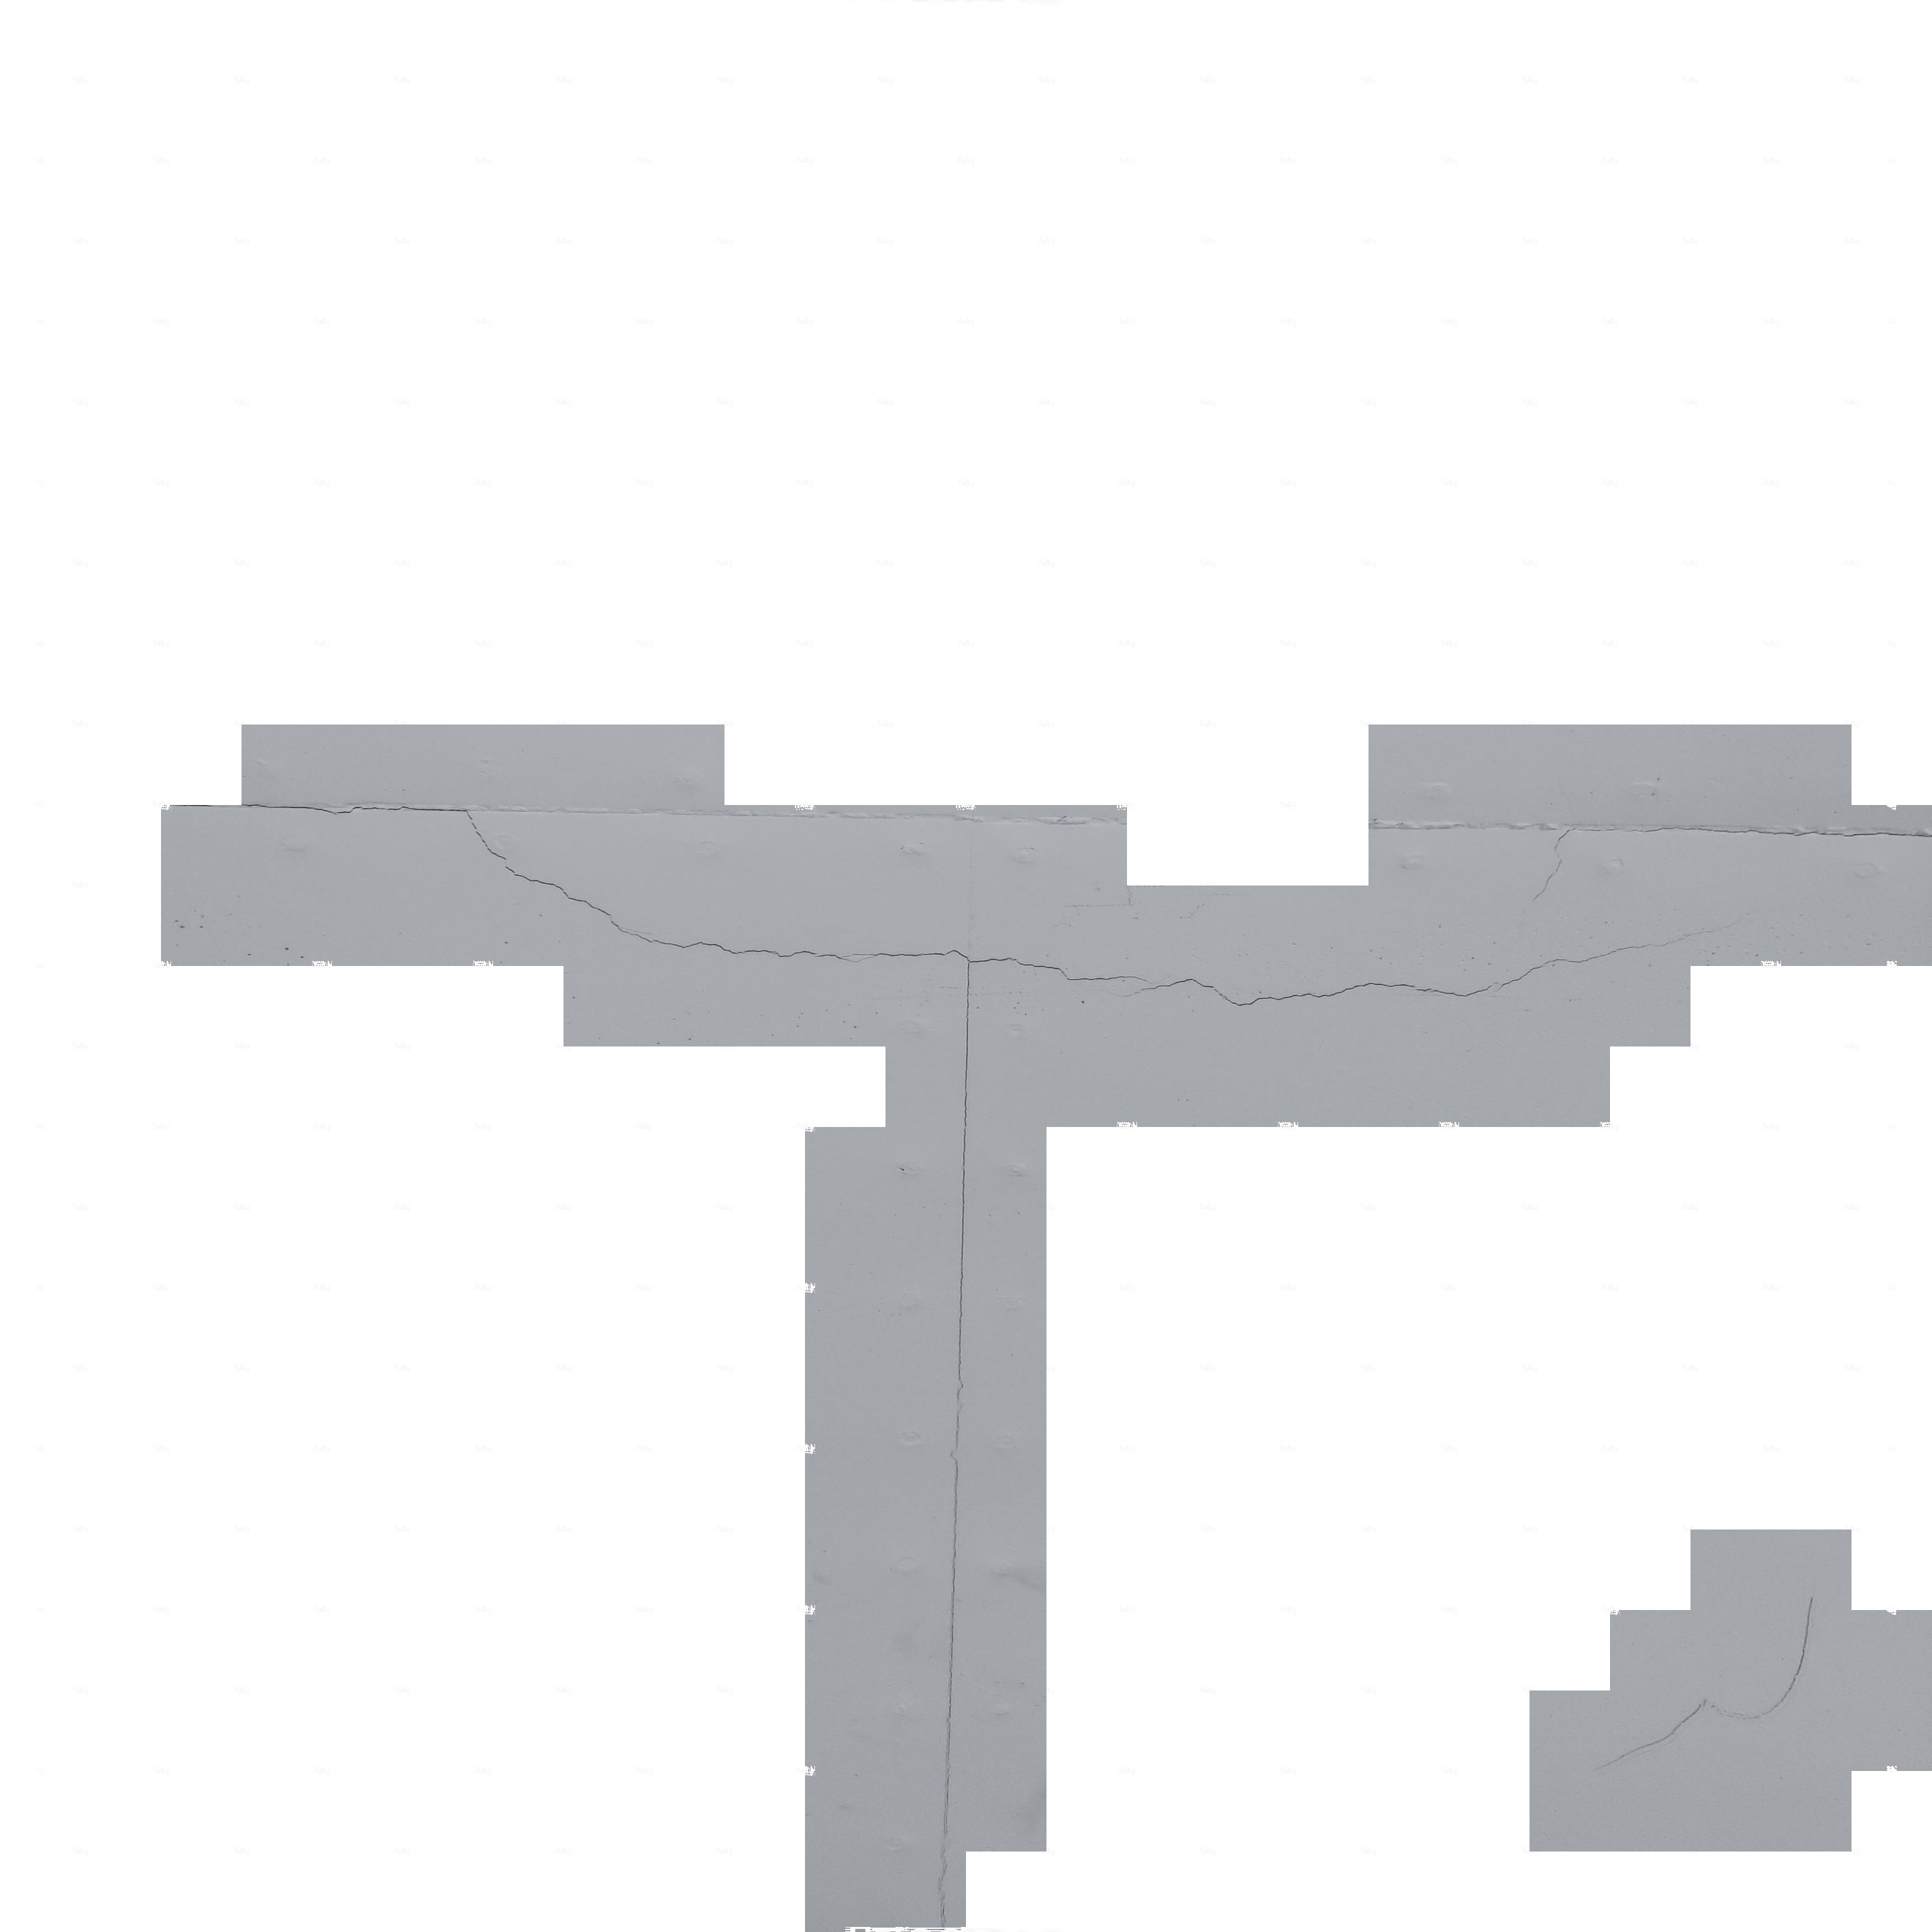
Original Image
Prediction Made
Automated Crack Detection for Large-scale Tunnel Structure Using
Deep Learning

Slide 15
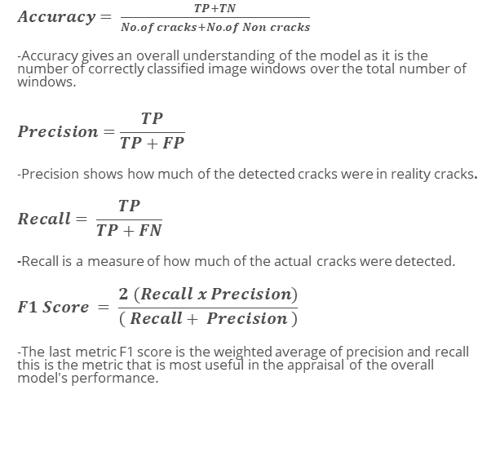
Testing Results
$Accuracy= \frac{TP+TN}{No. of cracks+No. of Non cracks}$
-Accuracy gives an overall understanding of the model as it is the number of correctly classified image windows over the total number of windows.
$$Precision=\frac{TP}{TP+FP}$$
-Precision shows how much of the detected cracks were in reality cracks.
$$Recall= \frac{TP}{TP+FN}$$
-Recall is a measure of how much of the actual cracks were detected.
$$F1 Score = \frac{2 (Recall x Precision)}{\left( Recall+ Precision \right)}$$
-The last metric F1 score is the weighted average of precision and recall this is the metric that is most useful in the appraisal of the overall model's performance.
Automated Crack Detection for Large-scale Tunnel Structure Using
Deep Learning

Slide 16
Outline
Motivation
Algorithm development
Algorithm testing
Crack Classification
Algorithm deployment
Drone inspection
Future R&D
Automated Crack Detection for Large-scale Tunnel Structure Using
Deep Learning

Slide 17
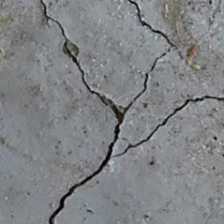
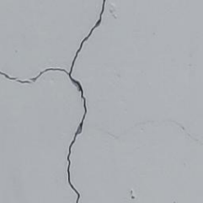
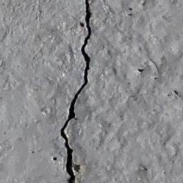
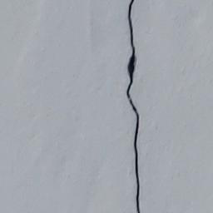

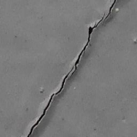
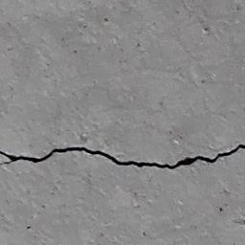
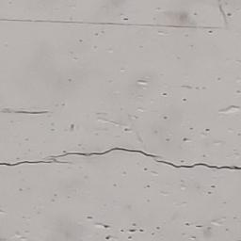
Crack Classification
Crack detection CNN
Crack
No crack
When approaching the dilemma of objective crack clarification, the two prominent crack attributes that can be considered are Dimension and Direction.
Dimensional analysis - all the cracks are classified concerning their size. This approach allows a threshold to be set up to elevate all the cracks under a given size in essence only keeping cracks of significance
Directional analysis – classifies evaluates detected cracks concerning set directional boundary's this is not as accurate as the dimensional approach but still provides a useful insight as a crack orientation indicates behaviors in the tunnel.
Crack Classification CNN
Complex
Vertical
Horizontal
Diagonal
Complex
Vertical
Diagonal
Horizontal
Automated Crack Detection for Large-scale Tunnel Structure Using
Deep Learning

Slide 18
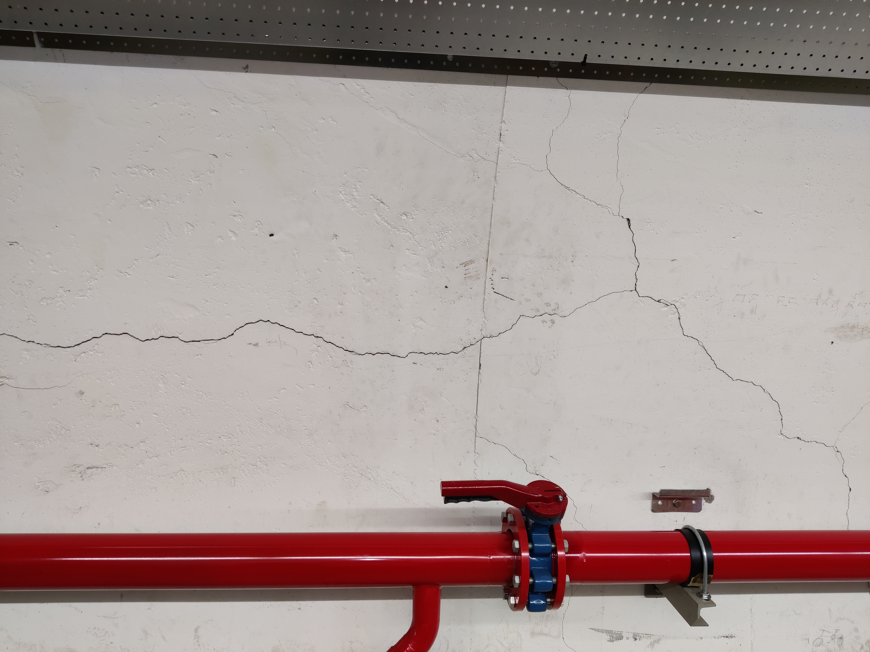
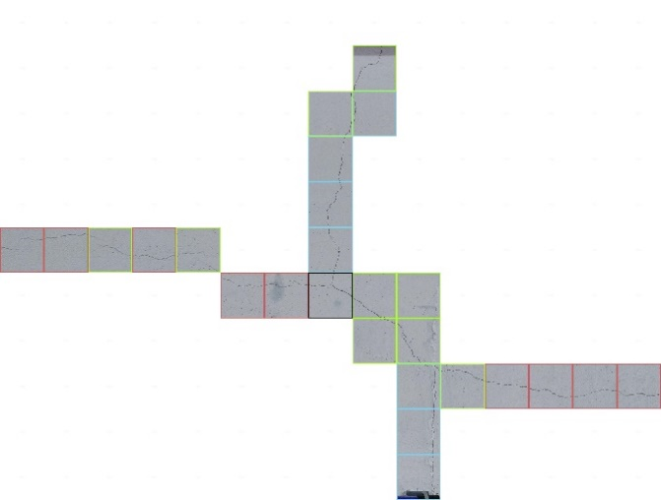
Crack Classification
Crack detection CNN
Crack
No crack
Crack Classification CNN
Complex
Vertical
Horizontal
Diagonal
Automated Crack Detection for Large-scale Tunnel Structure Using
Deep Learning

Slide 19
Crack Classification Test results
Automated Crack Detection for Large-scale Tunnel Structure Using
Deep Learning

Slide 20
Outline
Motivation
Algorithm development
Algorithm testing
Crack Classification
Algorithm deployment
Drone inspection
Future R&D
Automated Crack Detection for Large-scale Tunnel Structure Using
Deep Learning

Slide 21
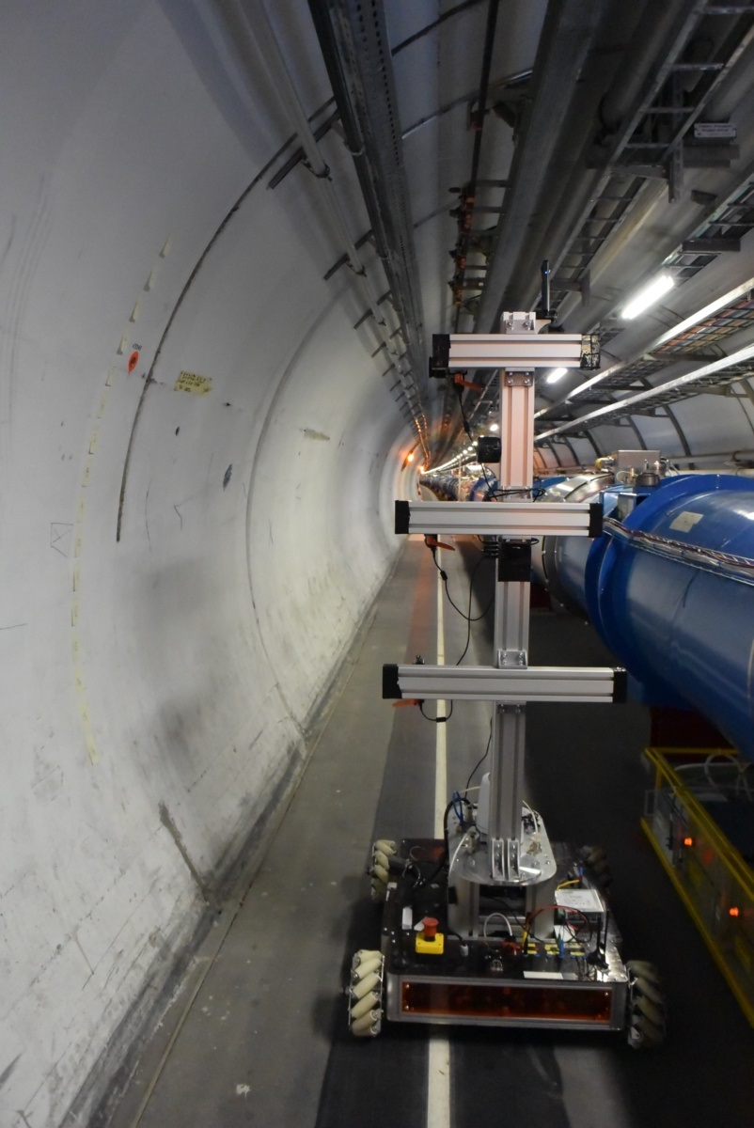
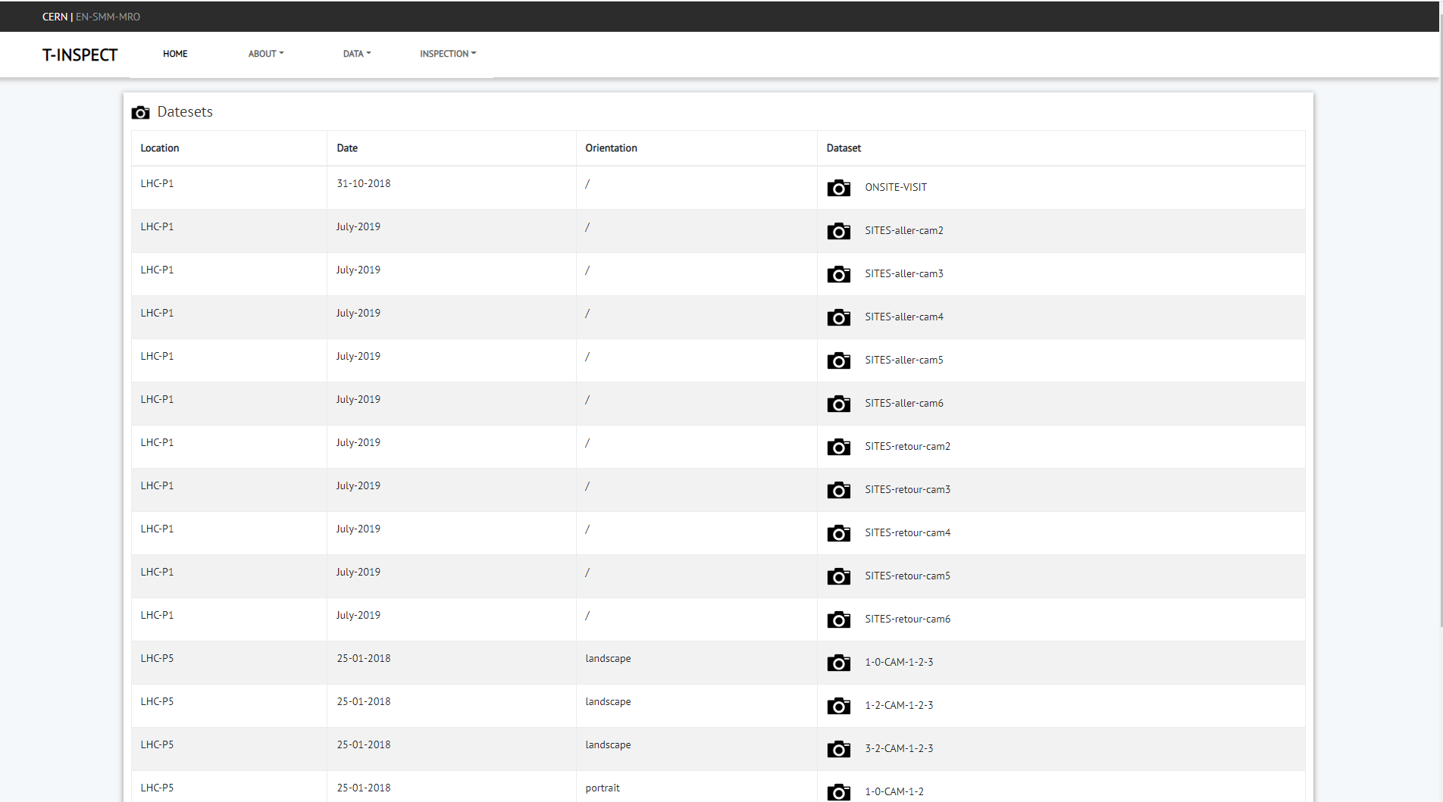
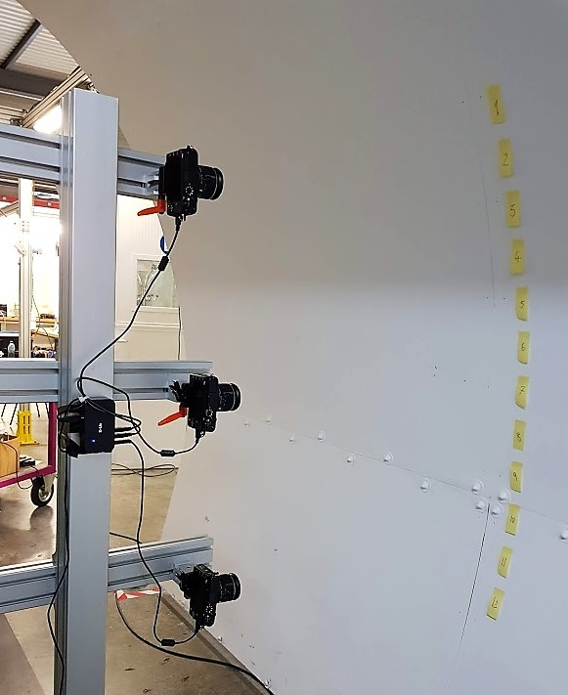
Algorithm deployment
As a proof of concept test regarding the feasibility of future implementation as a inspection methodology the algorithm was deployed to examine 3 separate sections of tunnels.
The 3 separate sections of varying lengths 80, 50 and 20 meters of tunnels linings to be examined were created using data collected and provided by BE/CEM department . This data consisted of high-definition pictures in LHC point 5, TT1 and was collected in 2018/2019 using multiple cameras on an adjustable vertical metal structure fixed referred to as the CERNbot
Data webpage : http://test-tinspect.web.cern.ch/
Results produced
Overall crack % and corresponding crack type %.
A numerical breakdown of the results into the chainage
CERNbot
Automated Crack Detection for Large-scale Tunnel Structure Using
Deep Learning

Slide 22
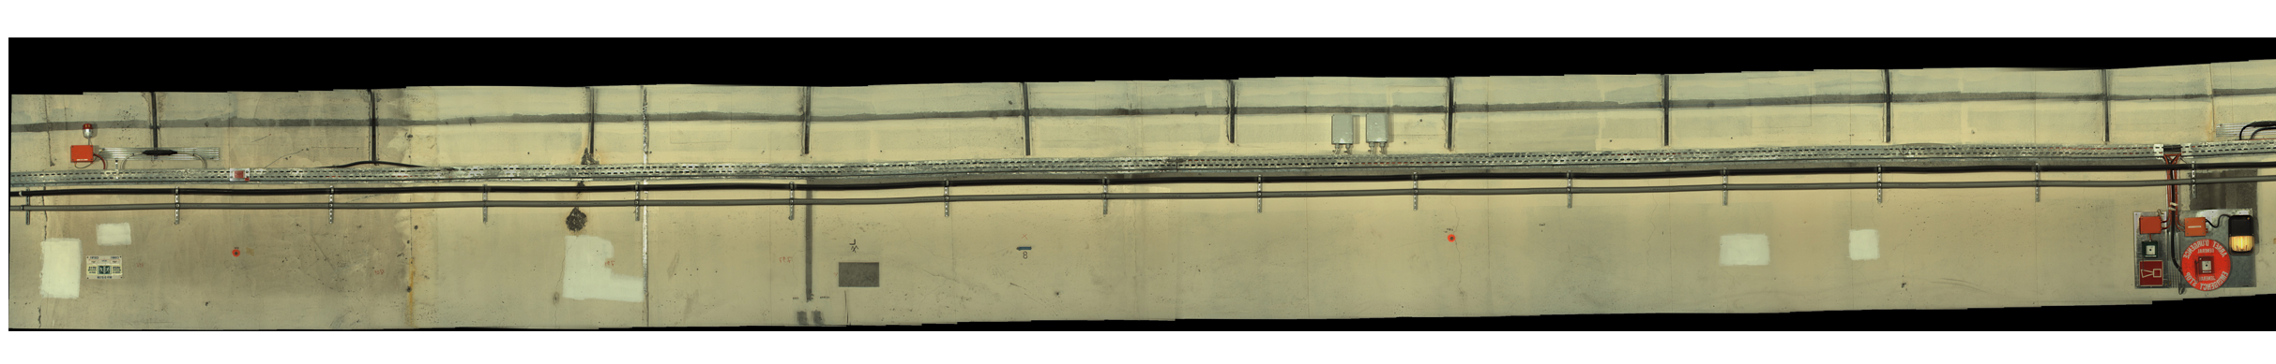

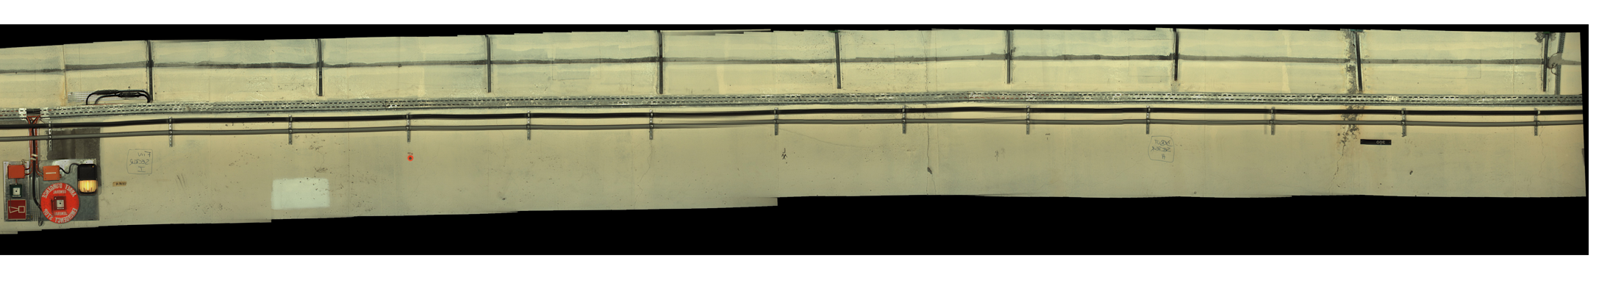
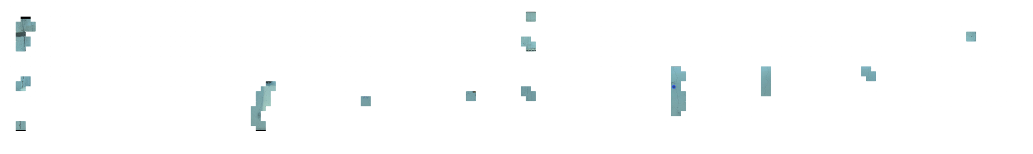
LHC point 5

Slide 23
Results TT1
% of complex | 0 | 0
% of diagonal | 2.6 | 3.20056899
% of horizontal | 0 | 0
% of vertical | 0 | 0
% of non crack | 97.26666667 | 96.51493599
total% of crack per pass | 2.733333333 | 3.485064011
total % windows with cracks | 3.109198672
 | first pass | second pass
complex | 0 | 0
diagonal | 39 | 45
horizontal | 2 | 4
vertical | 0 | 0
non crack | 1459 | 1357

Slide 24
Sectional Breakdown

Slide 25
Outline
Motivation
Algorithm development
Algorithm testing
Crack Classification
Algorithm deployment
Drone inspection
Future R&D
Automated Crack Detection for Large-scale Tunnel Structure Using
Deep Learning

Slide 26
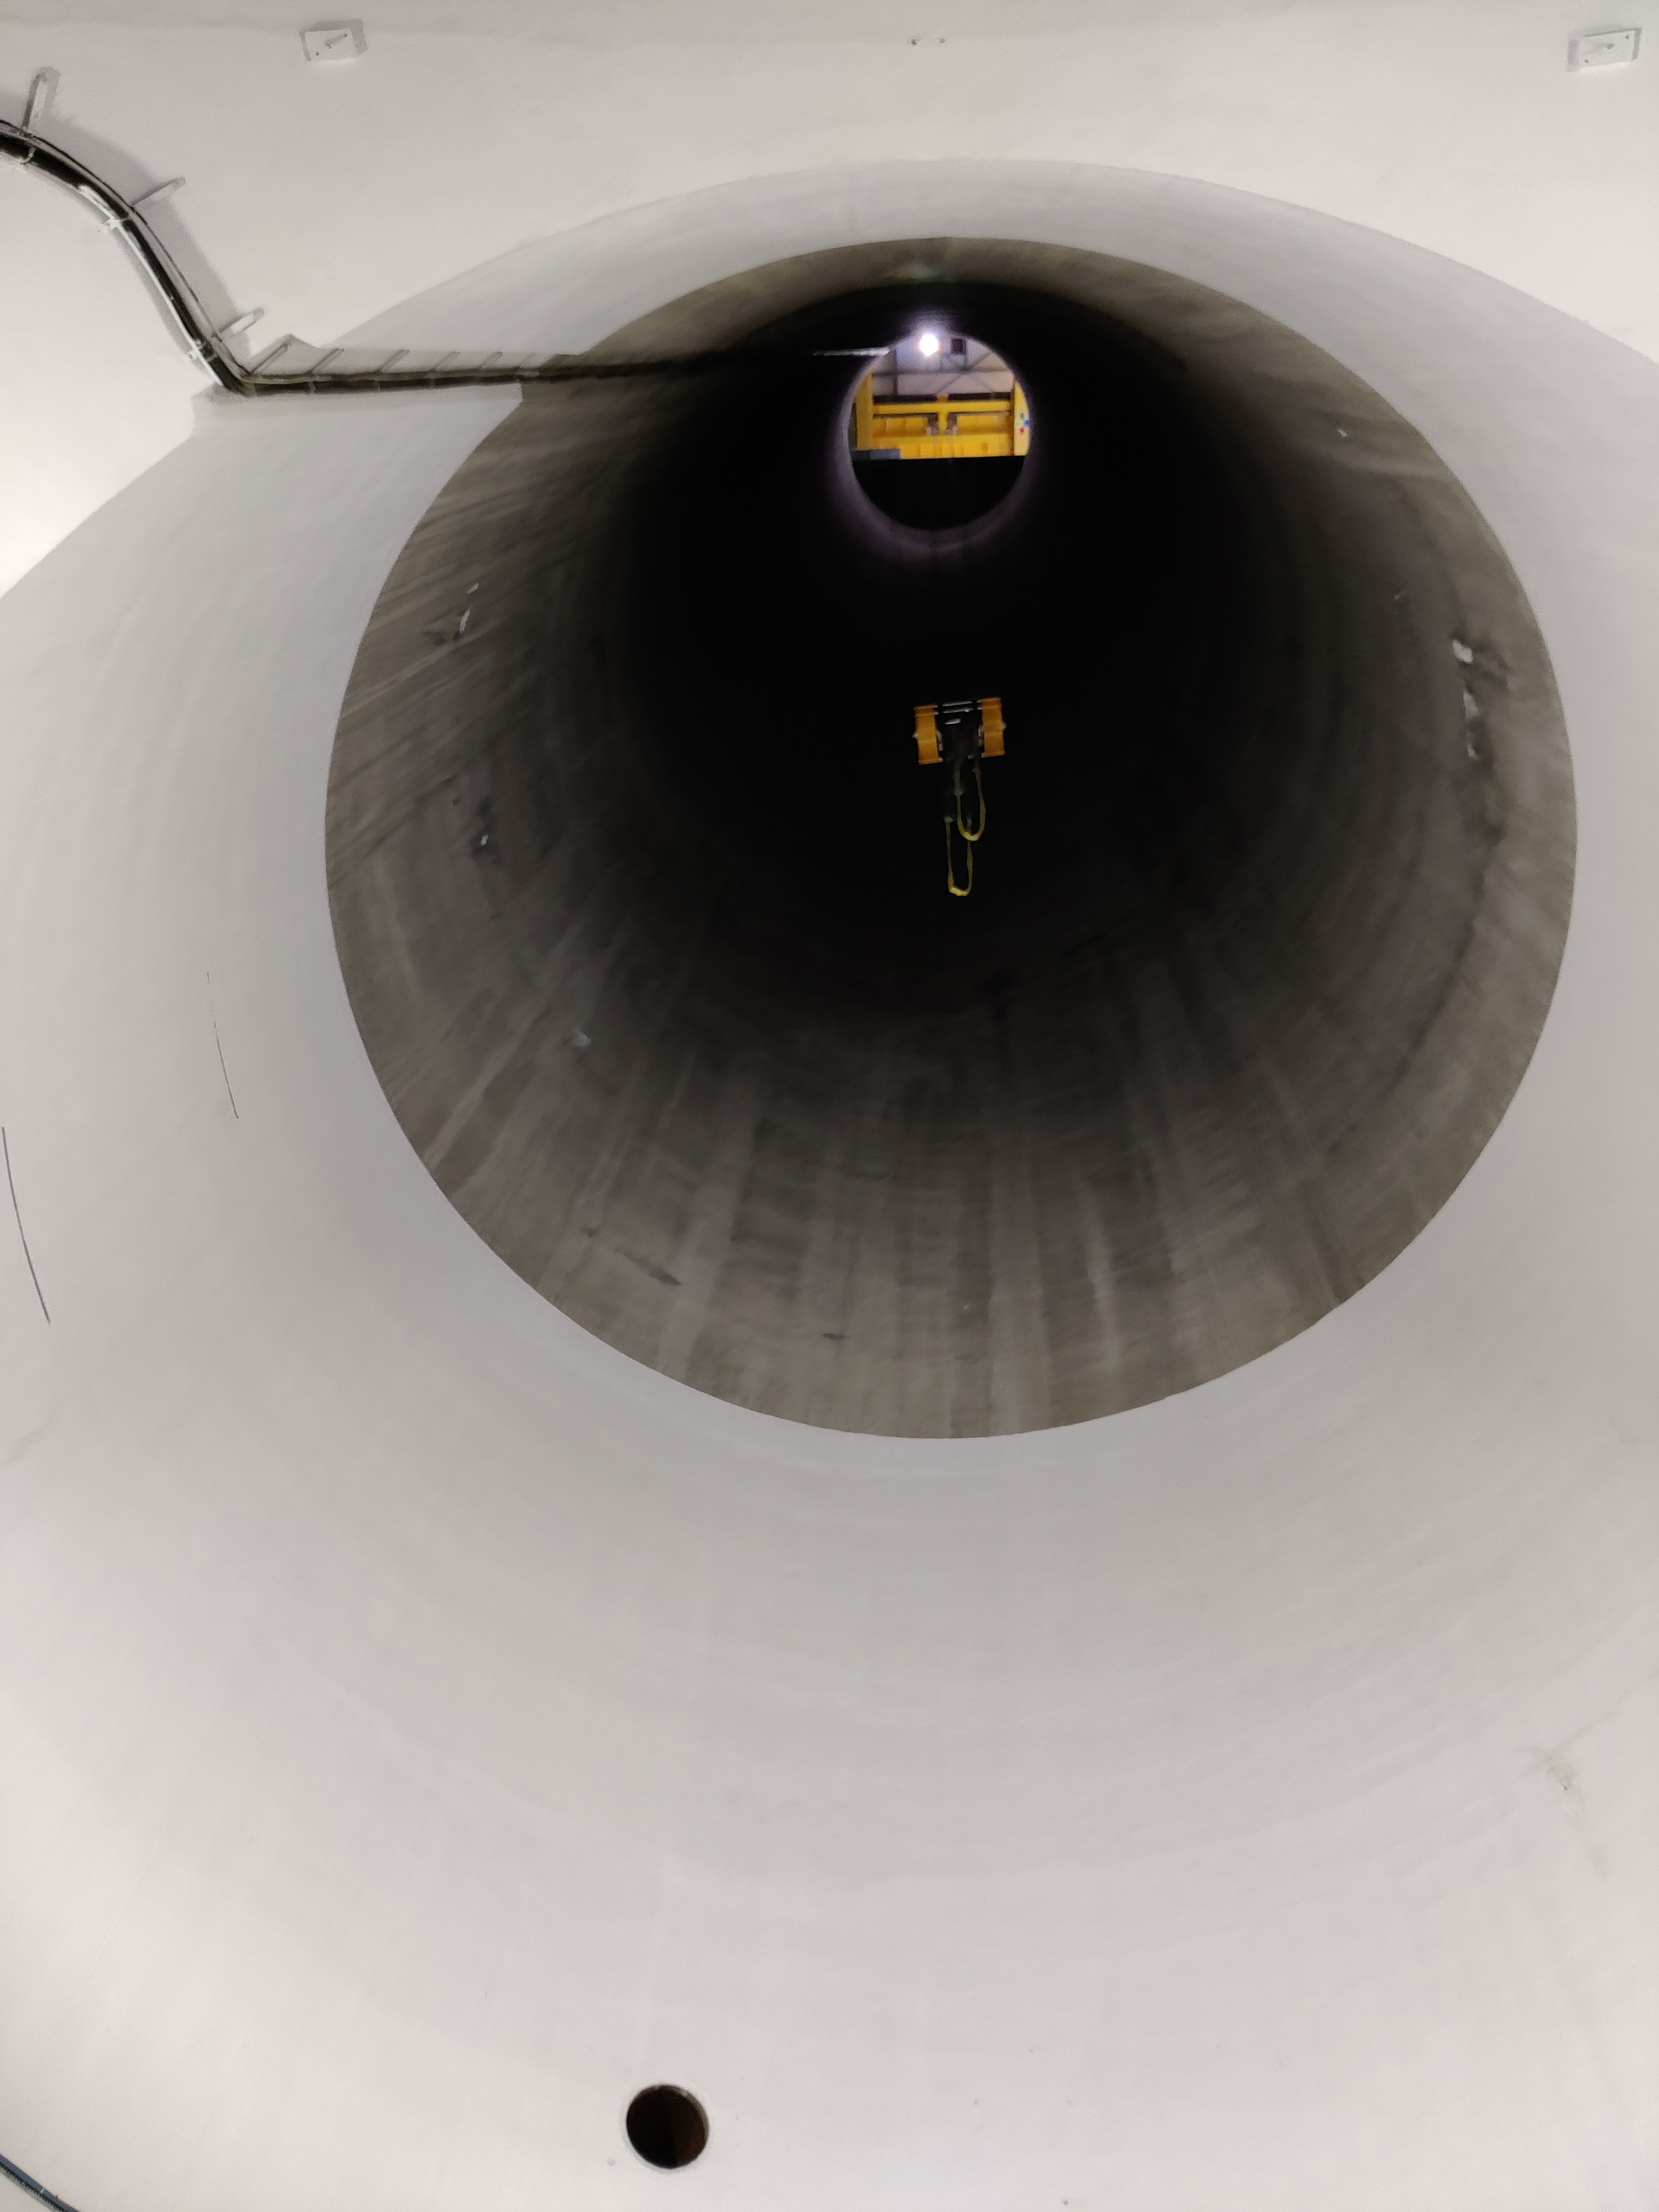
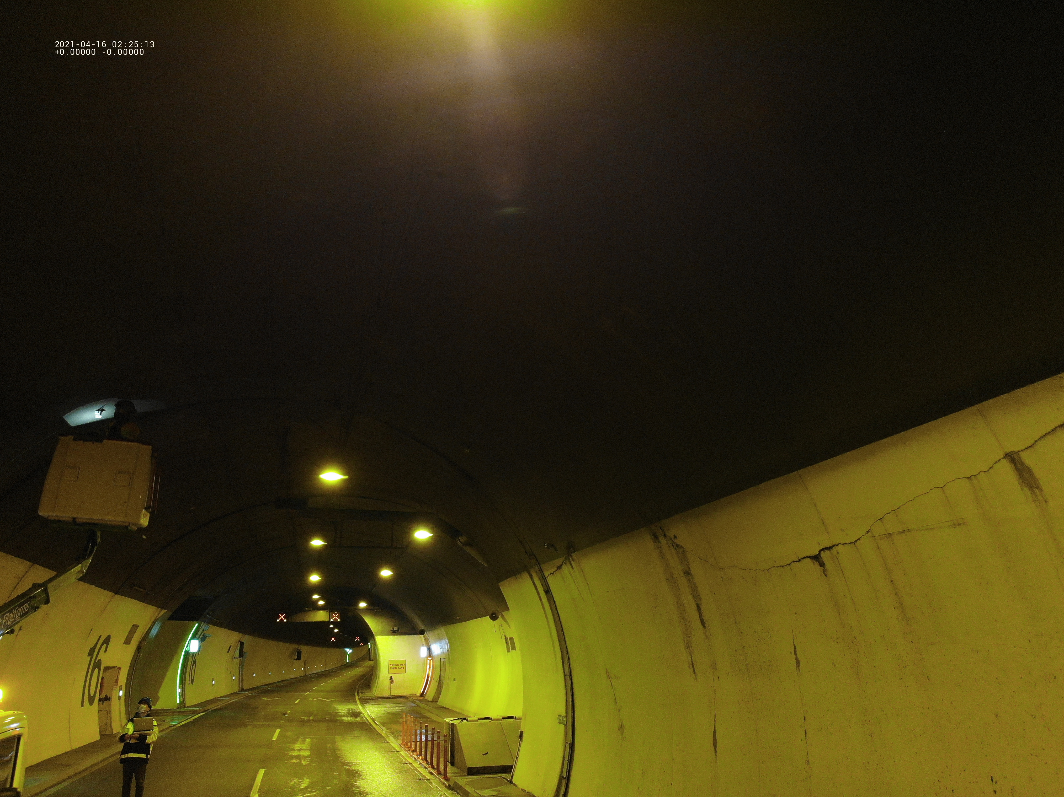
Shaft inspections
The inspection of tunnel infrastructure is a very time consuming and slow process. The shaft elements of the tunnel infrastructure cause particular problem for inspection. As shown in the images not all shafts @ CERN are constructed in a manner to permit for full detailed inspection causing a estimation of structural health to be created .
As a means to counter the inaccessible zones a drone in combination with the Crack detection/ classification algorithm was experimented as a alternative inspection method.
This means of inspection was also trialed in the Dublin port tunnel by a fellow UCC student

Slide 27
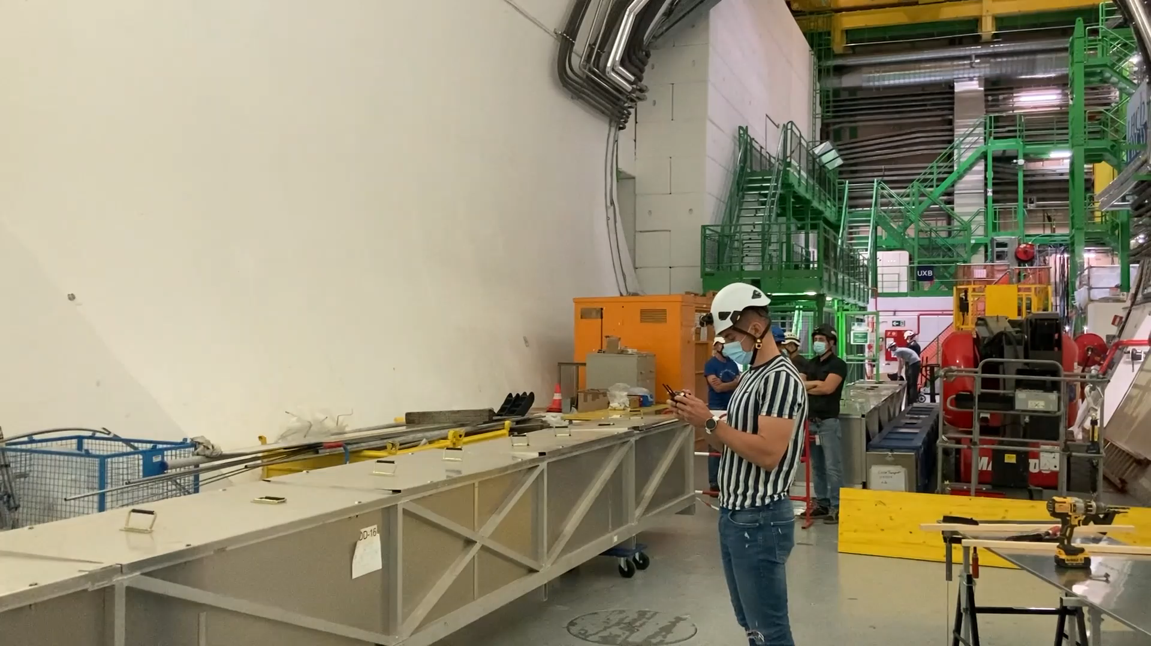
Drone experimentation (PX84)

Slide 28
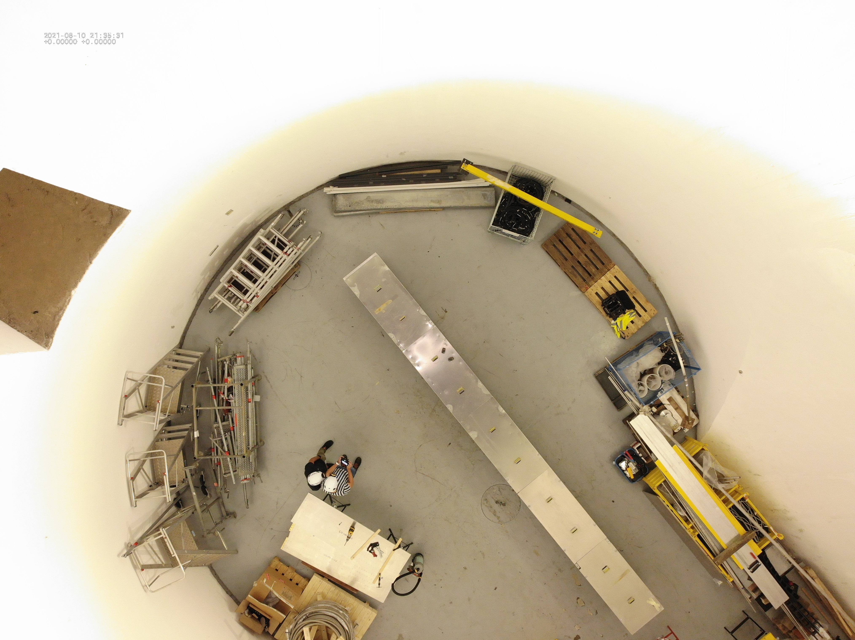
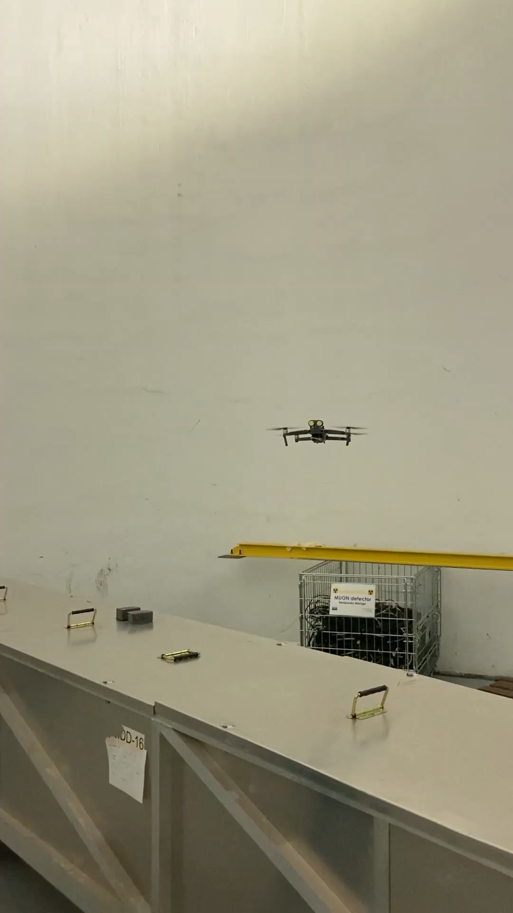
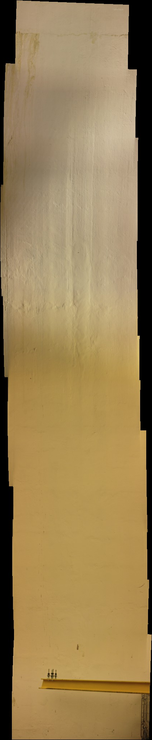
Drone experimentation (PX84)

Slide 29
Outline
Motivation
Algorithm development
Algorithm testing
Crack Classification
Algorithm deployment
Drone inspection
Future R&D
Automated Crack Detection for Large-scale Tunnel Structure Using
Deep Learning

Slide 30

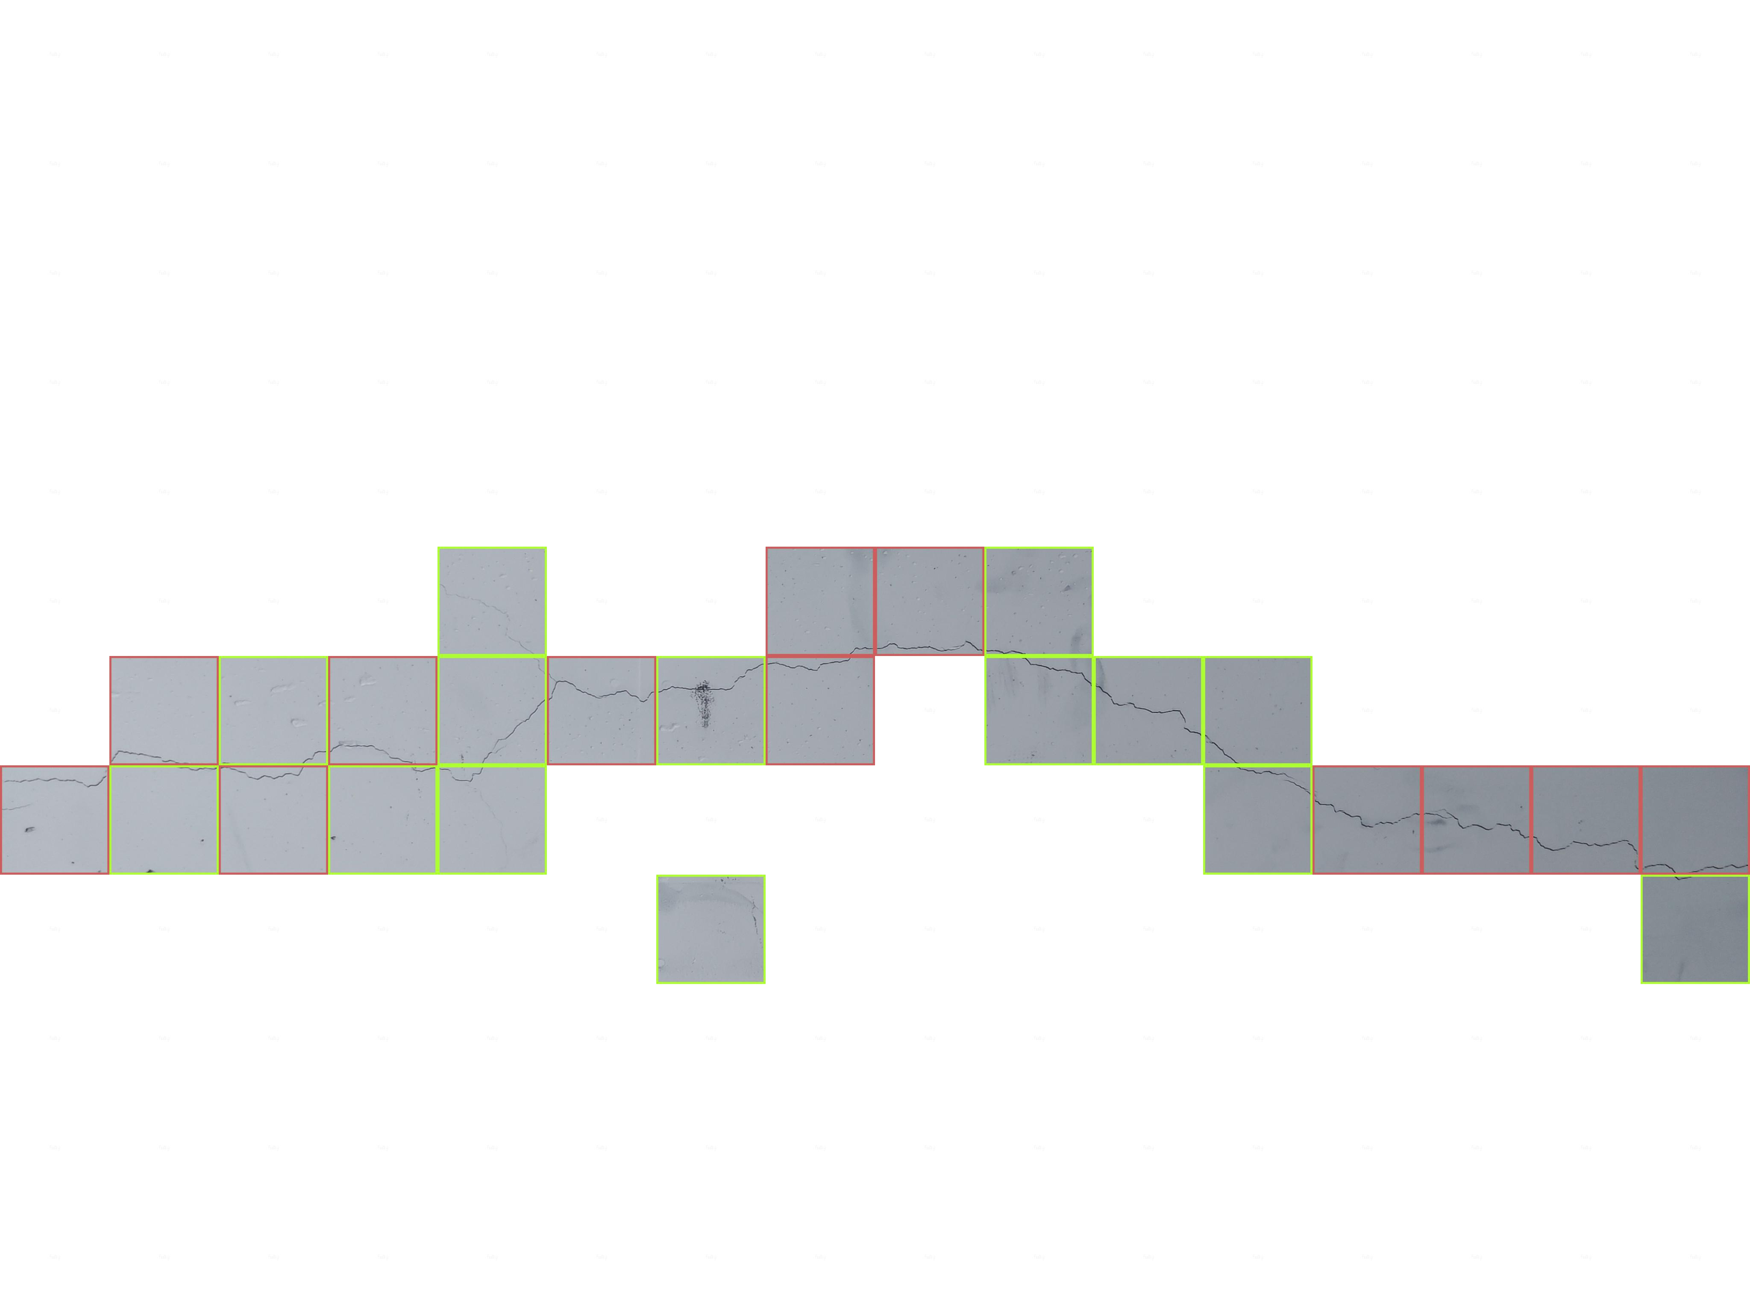
Future R&D
Who will continue to develop the research?
Under the supervision of Dr Zili Li in University of Cork PhD a student (PJAS) has started this September (Aohui Ouyang)
Academic years 1 & 4 in Cork and years 2 & 3 at CERN
Areas of study to be shared between photogrammetry and distributed fibre optic sensing
Future research goals
Crack classification can be further developed by adding a dimensional aspect. This is currently not possible due to an absence of a dimensional aspect within images to reference. The addition of a frame within the collection of future data of would allow crack dimensions to be determined automatically.
Further contextualise the results output from the algorithm to create thresholds of crack % to correspond with the 5 class severity section used at CERN.
Relating observed tunnel defects to in-situ geotechnical conditions and tunnel structural features (e.g. tunnel junction). Which will enable lessons to be learn for future infrastructure.
Expand the classification to include more defects of significance (spalling and water ingress)
Development of drone inspection procedure to counter the shortcomings found during initial testing.
The ultimate goal is to develop the technology for future inspection and early implementation into new infrastructure like FCC.
Automated Crack Detection for Large-scale Tunnel Structure Using
Deep Learning

Slide 31
Publications
{Published}
-Automated Crack detection for Underground Tunnel Infrastructure Using Deep , 2020 conference for Civil Engineering Research Association of Ireland
{Under review}
-Automated Crack Classification for Underground Tunnel Infrastructure Using Deep , Tunnelling and Underground Space Technology journal
-The 13th International Conference on Structural Safety and Reliability (ICOSSAR2021-2022)
{future papers}
-International Scientific Committee of the 10th European Workshop on Structural Health Monitoring (EWSHM2022)
Automated Crack Detection for Large-scale Tunnel Structure Using
Deep Learning

Slide 32
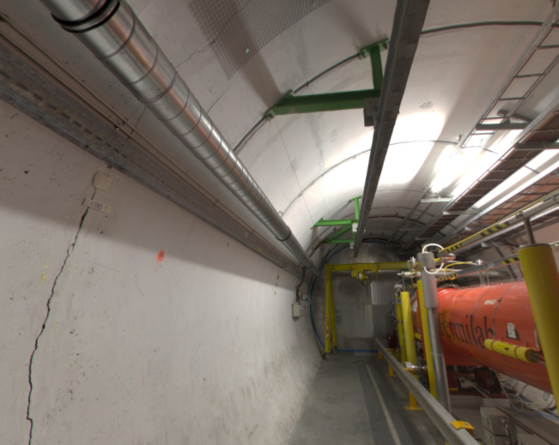
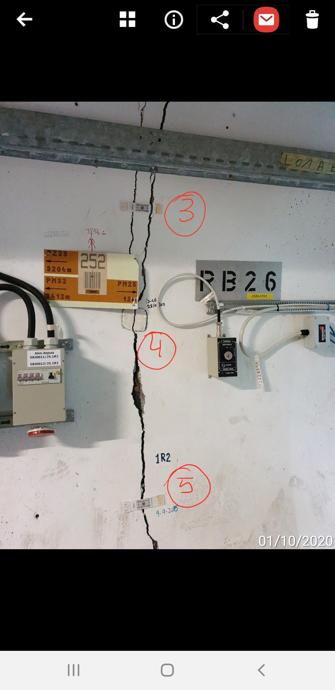
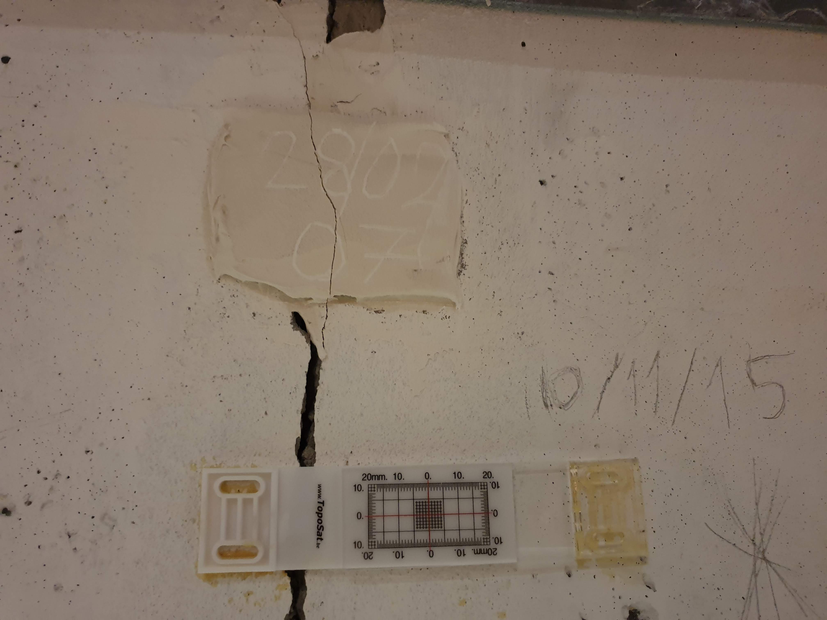
Future BE-CEM collaboration
Use of robotics to remotely inspect monitoring equipment when access is prohibited
  RB26 test week 39/40 2021
Assembly and programming of hardware required for inspections
  Hi-res camera
  TIM
  CERNbot
Addition of dimensional acquisitioning to algorithm and camera
Further development of change detection work
Proof of concept during upcoming technical stops
Automated Crack Detection for Large-scale Tunnel Structure Using
Deep Learning

Slide 33
Automated Crack Detection for Large-scale Tunnel Structure Using
Deep Learning

