Slide 1
Technical update on the UAP design and ongoing technical developments on the FRAS
Mateusz Sosin on behalf of WP15.4
WP5.2 Technical Meeting 2021-10-18

Slide 2
Outline
Update on the switches integration (possible solutions being investigated)
Update on sensors quantities to be implemented
Update on the arguments for the UAP levelling and discussions on what to do for the two prototyes

Slide 3
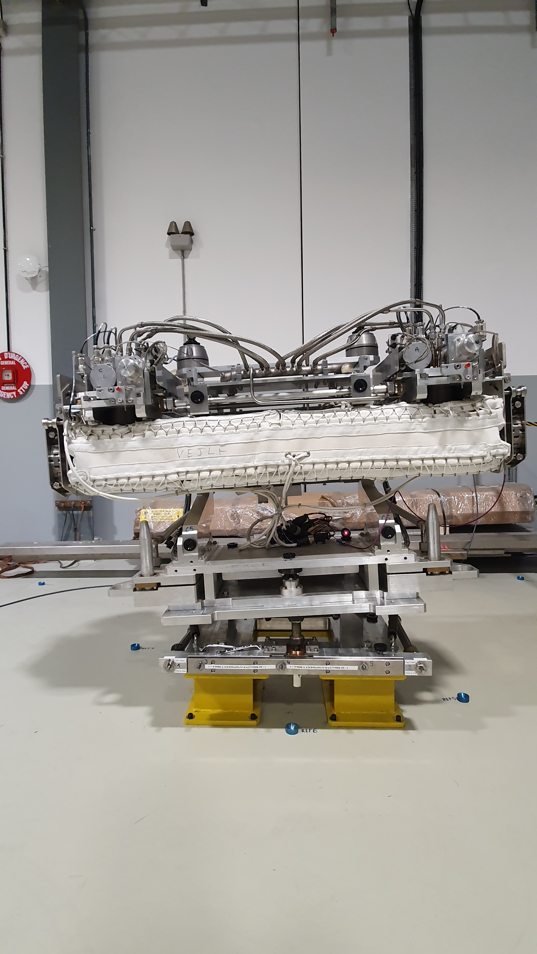
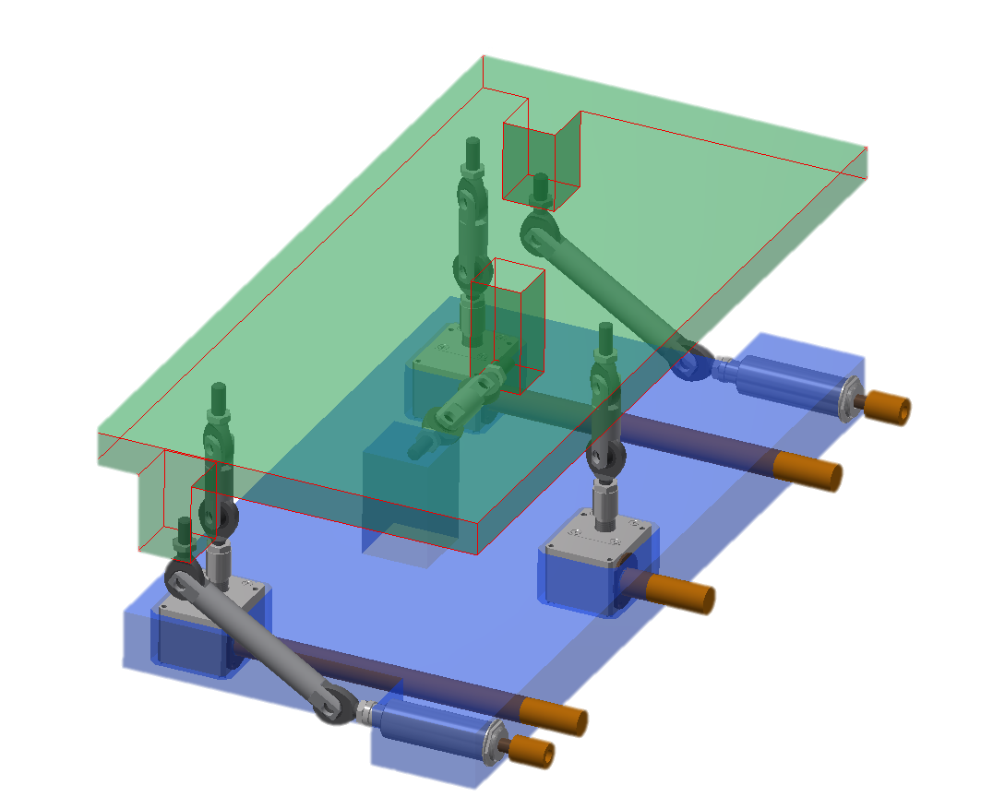
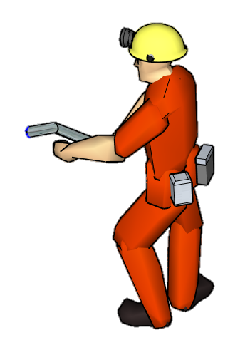
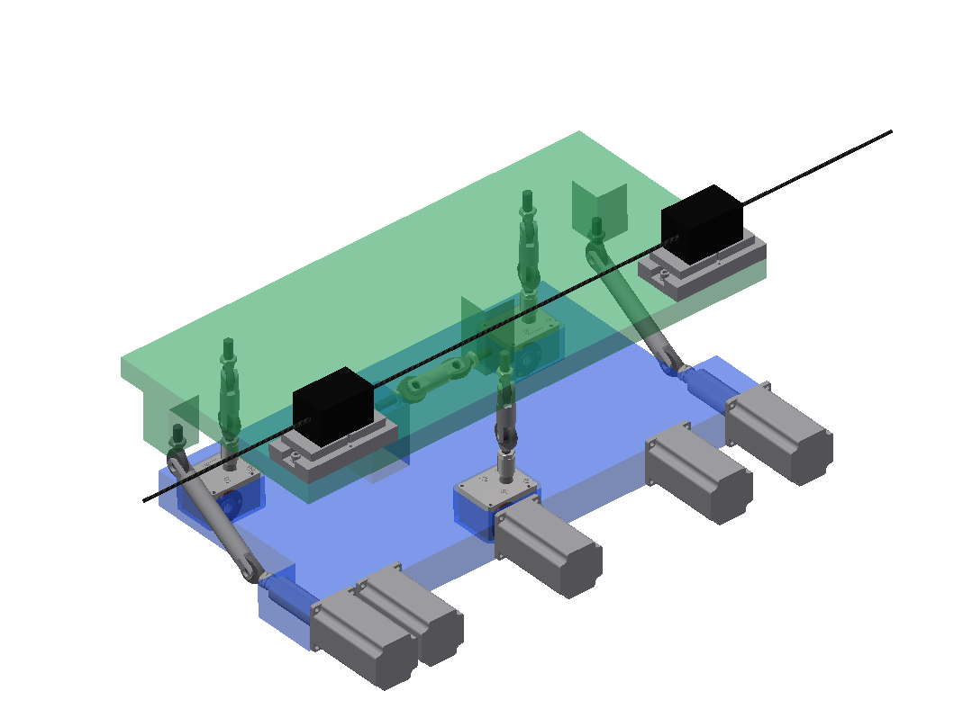
UAP - Limit switches integration
Universal adjustment solution - permanent motors version concept. Platform equipped with WPS sensors
Universal adjustment platform – manual operation concept
TCLPX, TCTPXH,
TCTPXV, TCLMB support case
For now manual UAP configuratuion tested
  Internal review on UAP for Collimators and Masks
  (https://indico.cern.ch/event/1015011/) 2021-03-11
Design of motorized UAP version (including imit switches integration) – starting Nov 21’
FRAS control system – limit switches required on each motorized axis
Used to detect the presence of actuator reaching its limit position
  Full Remote Alignment System software - Functional Specification LHC-_-ES-0047
  (EDMS 2589302)
  Final limit switches configuration under discussion in frames of FRAS risk assesment
  (EDMS 2592013)
One of main feature, to provide safety of operators and machinery

Slide 4
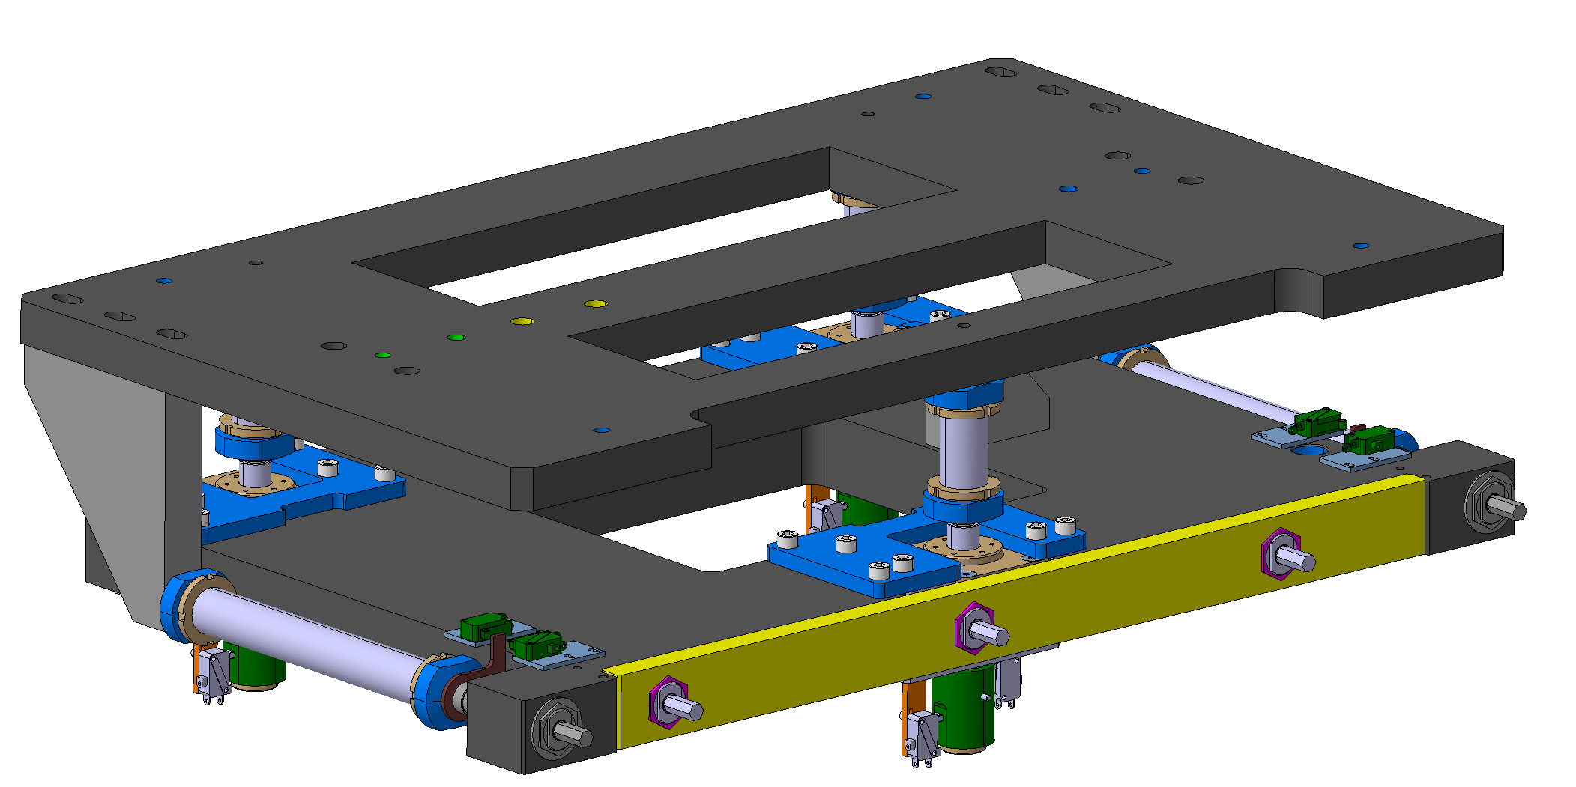
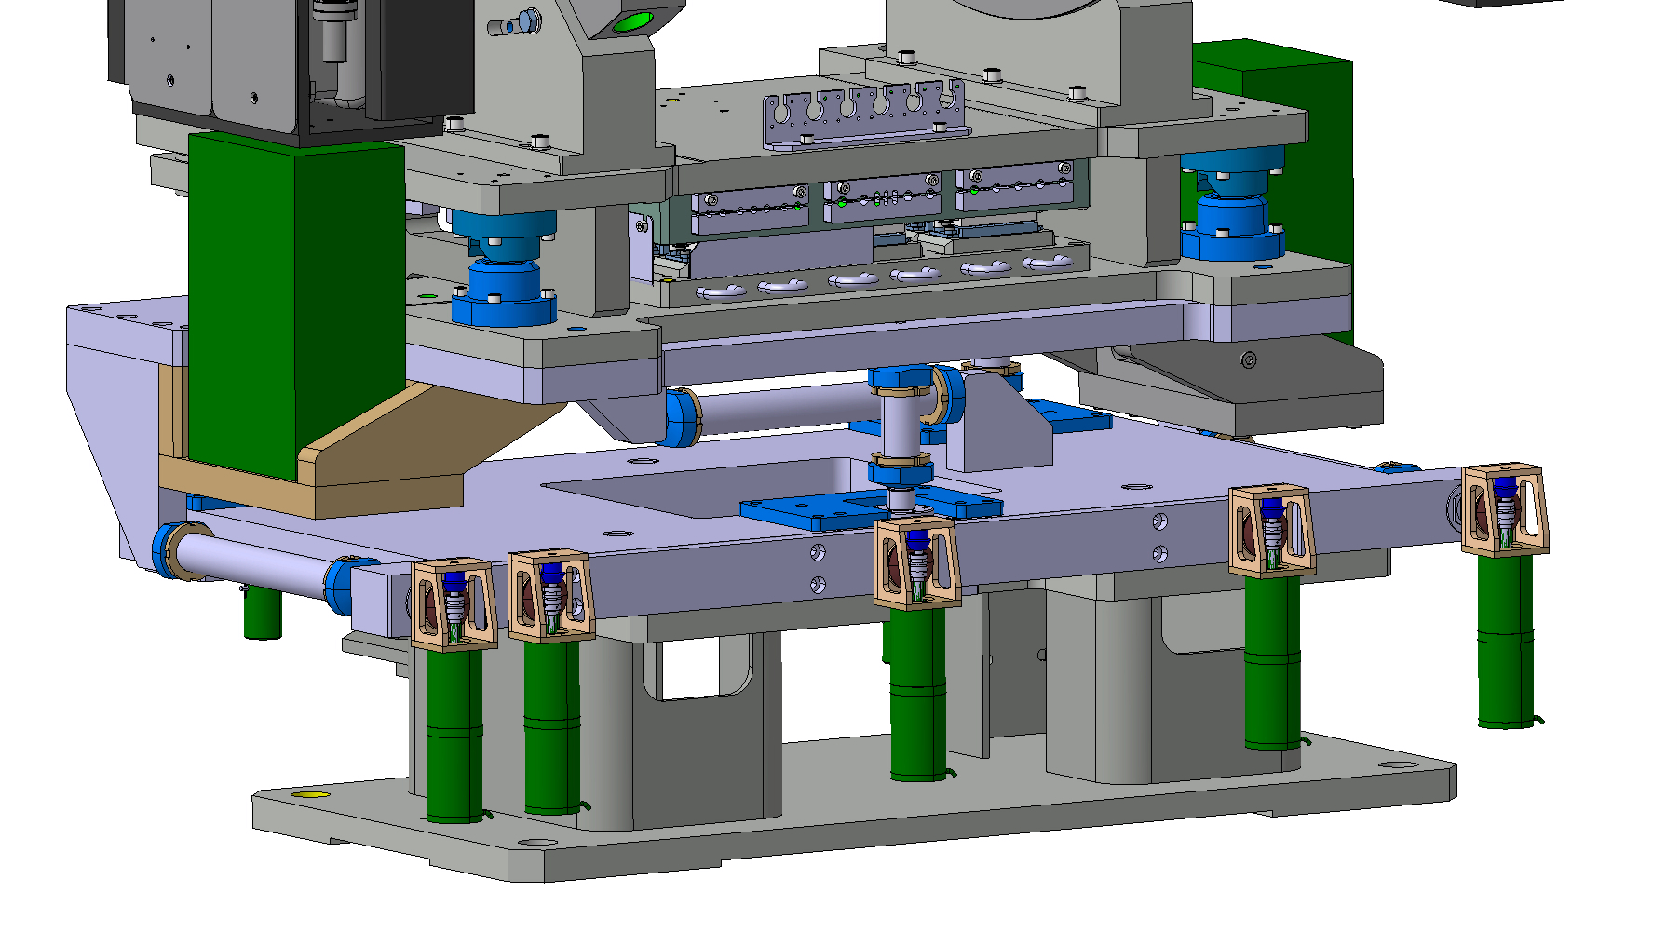
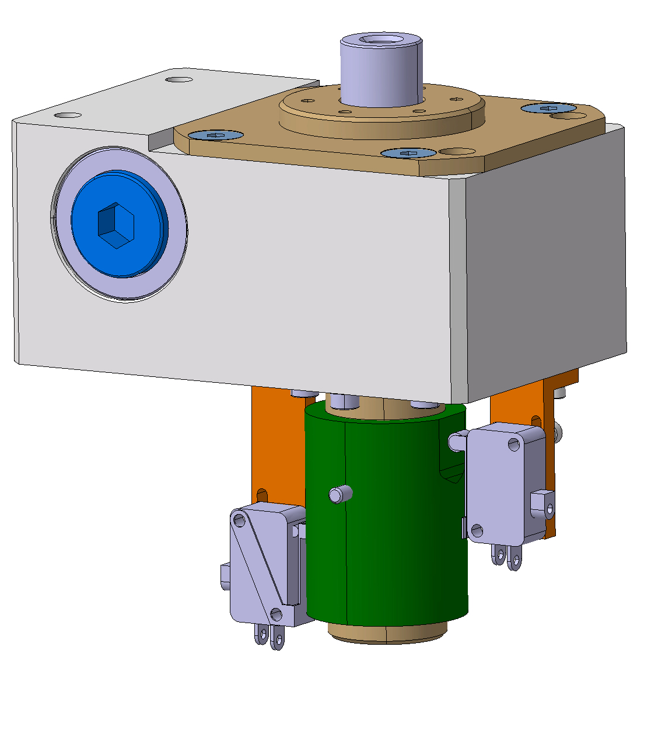
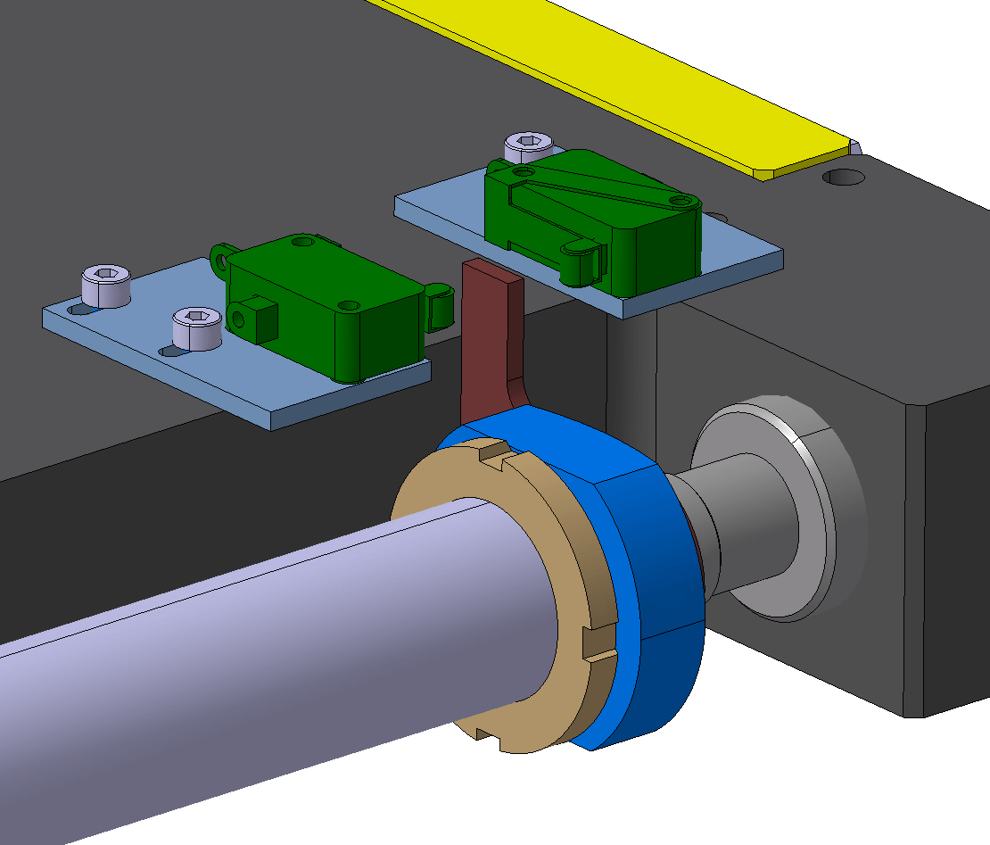
UAP - Limit switches integration
  Limit switches are funtional part of FRAS systems → design under responsibility of WP15.2
  Two options considerd for limit switches integration
    UAP Bottom plate, jigs (preliminarily studied) – this option will require help of WP5.2 to integrate required limit switches interfaces on the platform Bottom Plate (as equipment owner)
    Limit switches integrated within motorized adapters (design and integration by WP15.4)
  Final decision depends on FRAS limit switches configuration, under discussion by CEM-GEM-ICS. Main issue is integration volume vs. available space

Slide 5
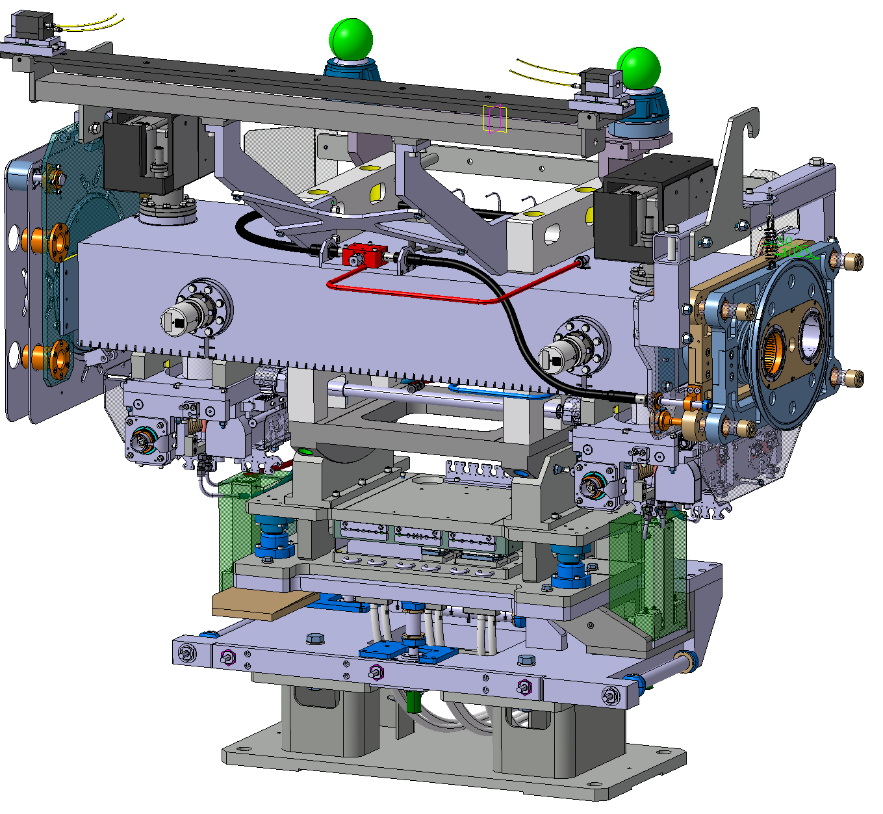
Update on sendor quantities to be implemented on collimators TCLM masks
Reliability improvement in the position determination of HL-LHC components, V. Rude, A. Herty, Working Group on Alignment, 2021-09-29 (https://edms.cern.ch/file/2617042/1/2021-09-29_WGA_VR.pptx)
  Summary of the studies, undertaken to identify the means to improve alignment accuracy and redundancy of the FRAS
Recommendations of the reviewers – Review HL-LHC Alignment and Internal Metrology (WP15.4)
26-28 August 2019
  Recommendation n°6 : “Extra care should be taken to validate the systems before, during and even after installation, built in as many tests and redundancies as reasonable”
WPS sensors
  From Baseline (2019):
  2 WPS + 1 inclinometer
  Simulation 4 – redundancy upgrade (WGA 29-Sep 21’)
  Add 1 WPS → 3 WPS
  Add 1 inclinometer → 2 Inclinometers
Inclinometer reservetion space (booked already on 2 sides of UAP)
Centre WPS sensor – to be added

Slide 6
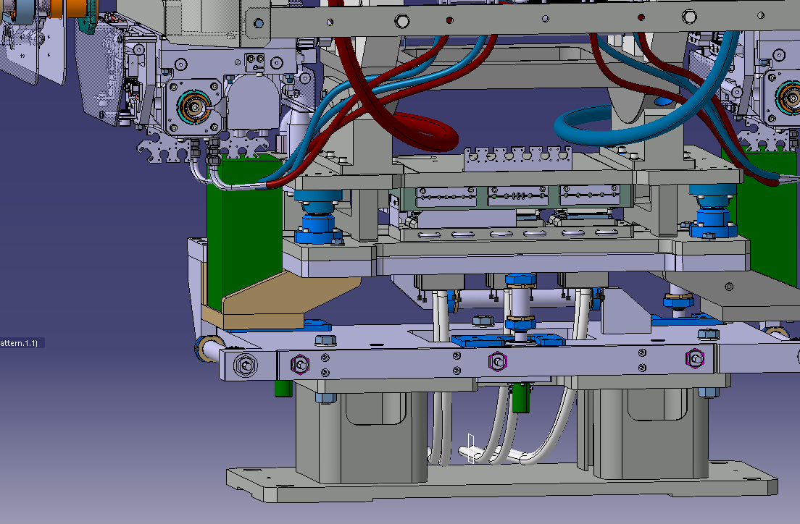


UAP levelling vs. Inclined floor
  LHC tunnell floor is inclined
  P5
  P1
  Slope and (SU:roll) tilt are invisible in
  integration models
  Equipment owner have to consider floor
  inclination in design and installation
  procedure to avoid tilt/slope-derivative
  offsets
Tanα = 1.24/100 → α=~0.71deg

Slide 7
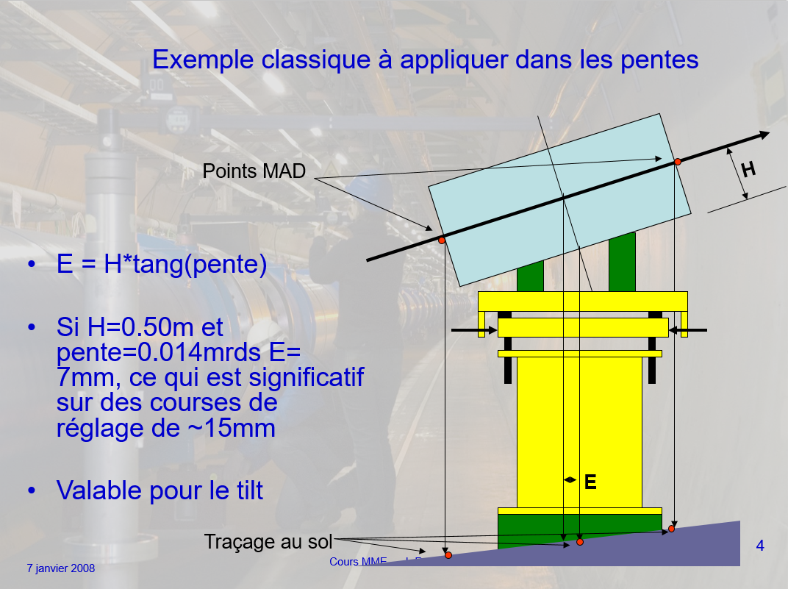
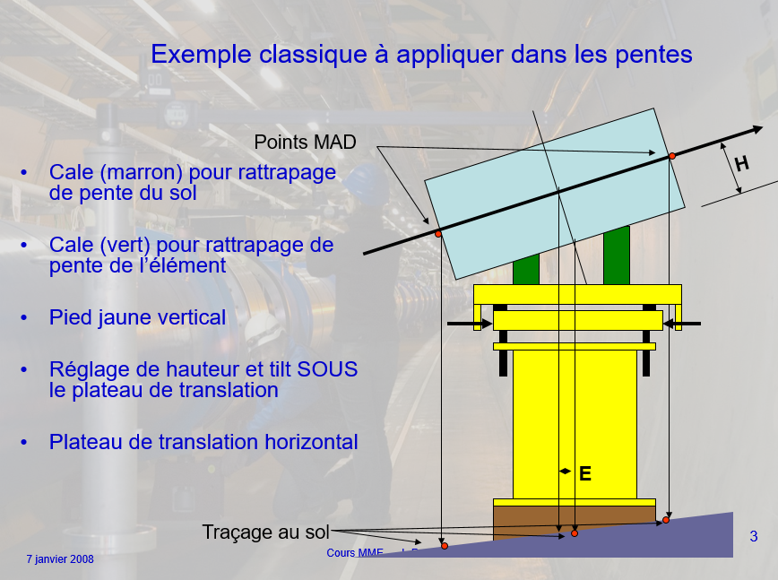
Inclined floor - supporting systems integration guideliness
Supporting and alignment structures need to be verticalized
Anticipation of component centre-of-mass shifts
Anticipation of MAD points marking offsets → Anticipation of longitudinal/lateral shifts of components
Anticipation of adjustment tables range lost
Keep adjustement kinematics standardized and compatilbe with SU procedures
J.C. Quesnel, https://edms.cern.ch/document/886573/1
J.C. Quesnel, https://edms.cern.ch/document/886573/1

Slide 8
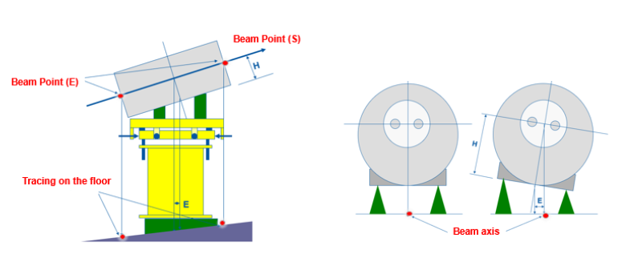
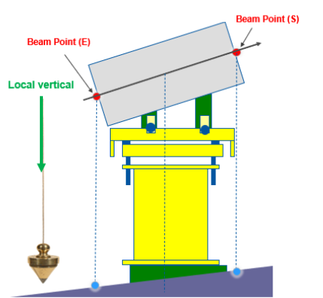
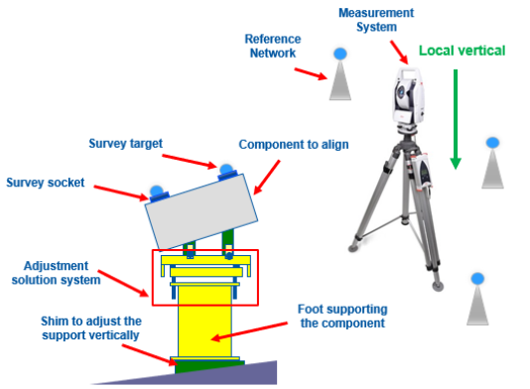
Inclined floor - supporting systems integration guideliness
Why it is so important for SURVEY?
Measurements performed using loacal vertical direction (all instruments measurements prior to levelling)
  All marking is done w.r.t. gravity direction
  All adjustments shall compatible with instruments coordinate systems → adjustment tables kinematics shall be ‚levelled’
  SURVEY teams (usually contractors) follow-up standardized procedures of alignment → no rotations/translations recalculation while alignment of various components

Slide 9
Inclined floor - supporting systems integration guideliness
General needs for design of supporting structures and alignment tables can be found in:
Rules applied since many years in CERN → JP Quesnel training from 2008 https://edms.cern.ch/document/975680/3)
Alignement des composants des accélérateurs : Généralités et besoins mécaniques https://indico.cern.ch/event/998389/ (https://edms.cern.ch/document/2450861/1 - tilted floor issue is described in part3.pptx)
Non-conformity cases detected for components:
Examples: TANB, TDIS, TI2/TI8 collimators, multiple collimators reached maximum longitudinal adjustment stroke
, all caused by errors in integration of the MAD points marking offsets
Currently BE-GM working on CERN Standard: Guidelines and requirements for an alignment of a new component on a beam line at CERN, by J.-F. Fuchs, which introduces requirement of supports verticalization
To standardize the components alignment supports installed in a way compatible with Survey measurement/alignment way of work (vertical/horizontal measurements, coordinate systems);
To avoid offset related errors (impacting further alignment actions) while installation of components
Objective is to keep standardized way of adjustment supports design for all accelerator components

Slide 10
Collimator, TCLM case – parallel installation – current integration for HL-LHC (and LHC collimators case)
Alignment issues –
straight design of all support:
Slope ~1.25%
Needed longitudinal/lateral shift offsets when installing supporting tables (error prone during installation)
Kinematics introduces additional complexity – difficult for manual adjustment (need on-site translation/rotation corrections by SU contractor teams)
Adjustable (levelling) FRAS inclinometer support required
Pros:
No UAP stroke lost
Simplest design
~1m
β=~0.45deg = 8 mrad
α=~0.71deg = 12.3 mrad
Δ~4 mm
Δ~12.3mm

Slide 11
Single shimming – only supporting table verticalized
(example of adjustment platforms stroke lost)
Radial:
β=~0.45deg = 8 mrad
y=385 mm -> Stroke lost -> ~3mm
Alignment issues –
straight design of all support:
Slope ~ 1.25%
~4.9 mm longitudinal shift caused by UAP
vs. beam height distance tilted
Kinematics introduces additional
complexity
Adjustable (levelling) FRAS inclinometer
support required
Pros:
Supporting table easy to level,
using shims and standard level
tools
h=400mm
Longit:
Stroke lost ->
~8.1mm
x=660mm
~1m
α=~0.71deg = 12.3 mrad
Δ~4.9 mm

Slide 12
Supporting table and adj. platform levelled
Alignment issues –
straight design of all support:
Slope ~1.25%
Smallest longitudinal shift caused by UAP vs. beam height distance tilted
Additional shims required
Pros:
No UAP stroke lost
No need for inclinometers angled supports
Minimized risk of assembly offset
errors
Intuitive kinematics for SU teams during manual alignment
~1m
α=~0.71deg = 12.3 mrad

Slide 13
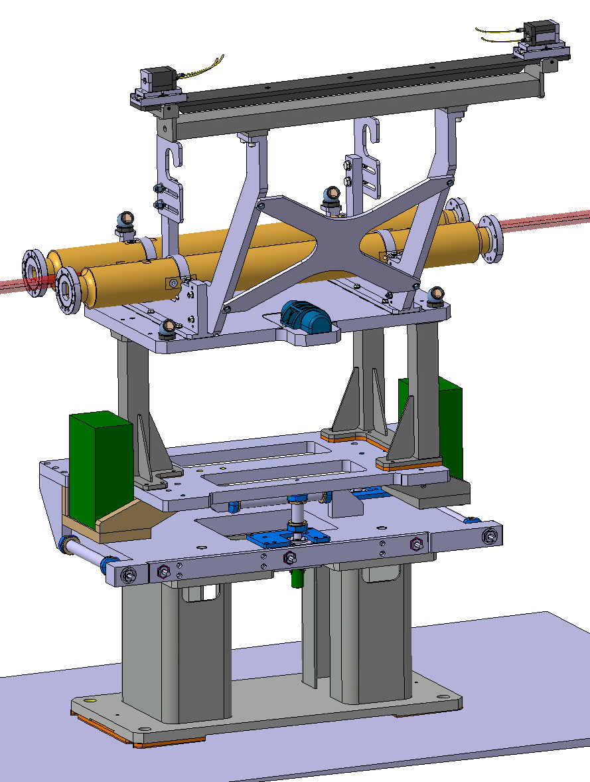
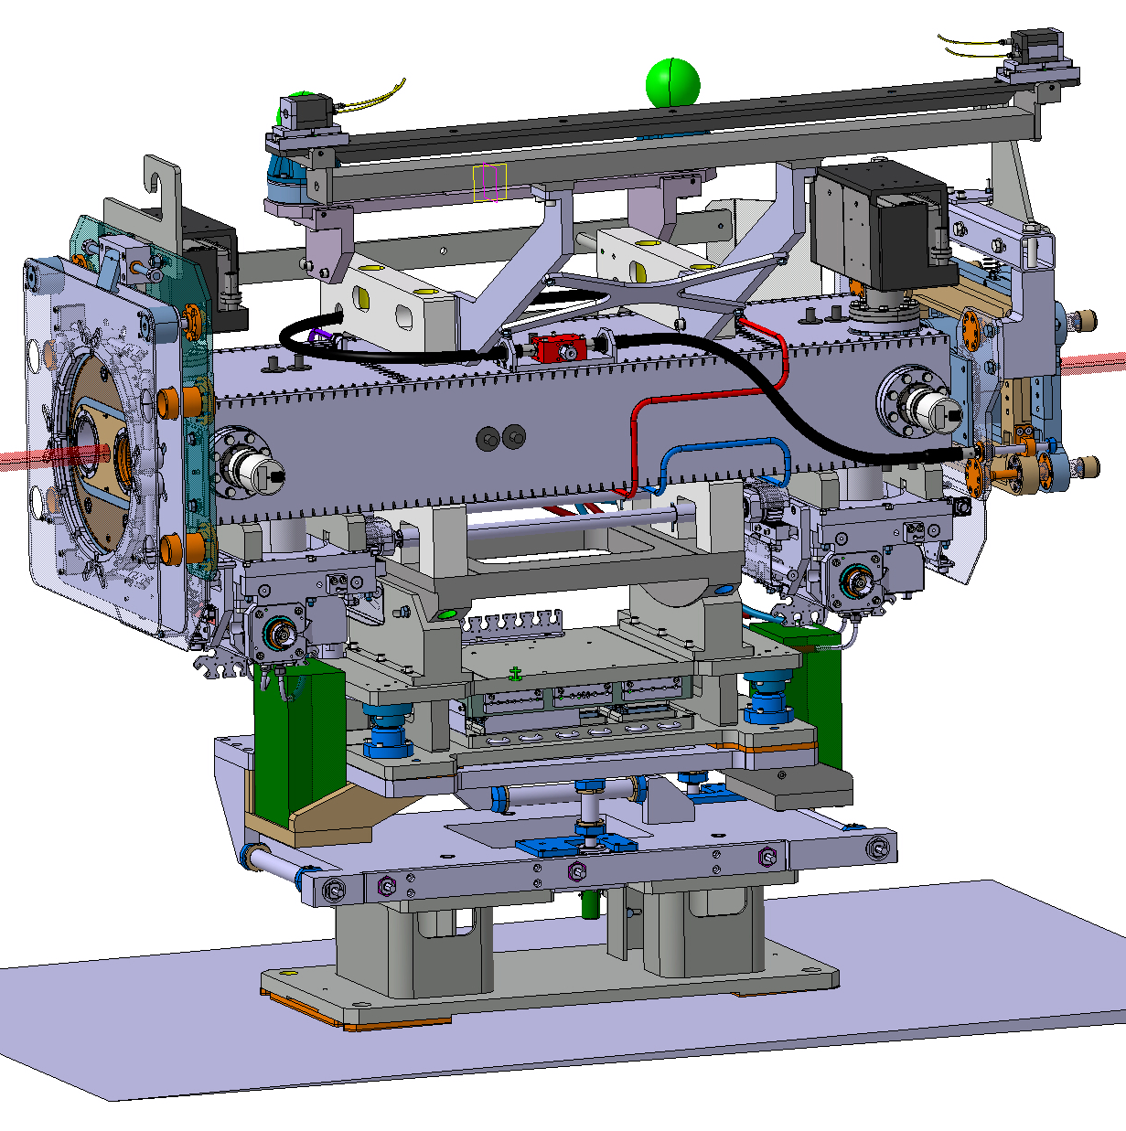
Solution option - shims integration?
Pin-mounted
– issue with pins fitting
+ screws + concave convex
washer
Screws + concave convex washer
mounted

Slide 14
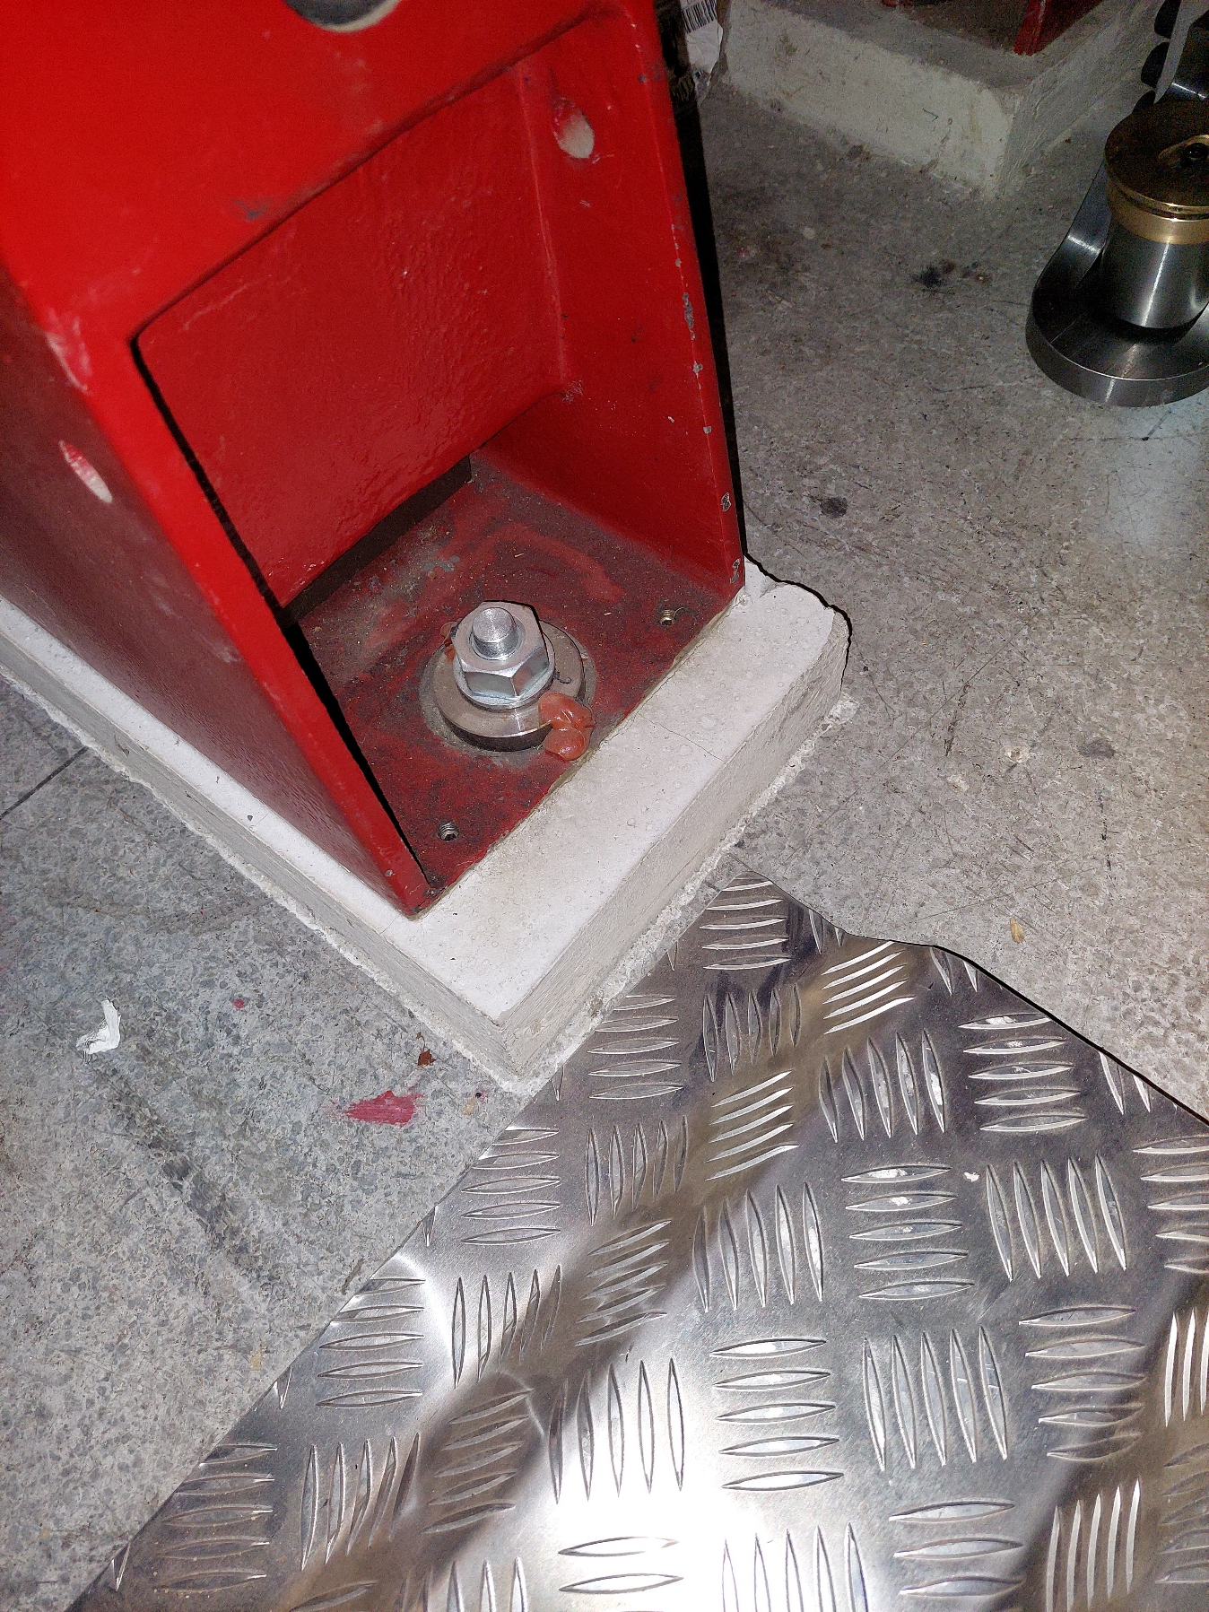
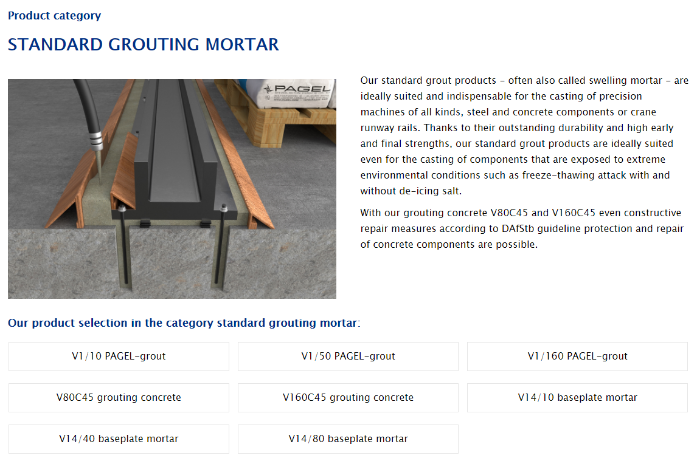
Other alternatives – grouting?
Jack levelling

Slide 15
Spare slides

Slide 16
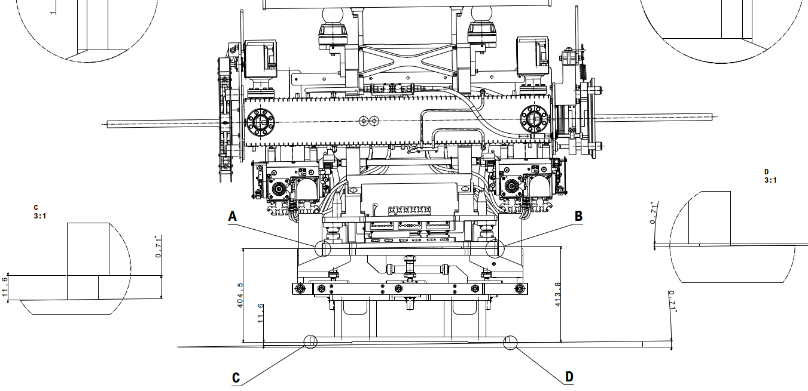
Collimator shims – example of integration

Slide 17
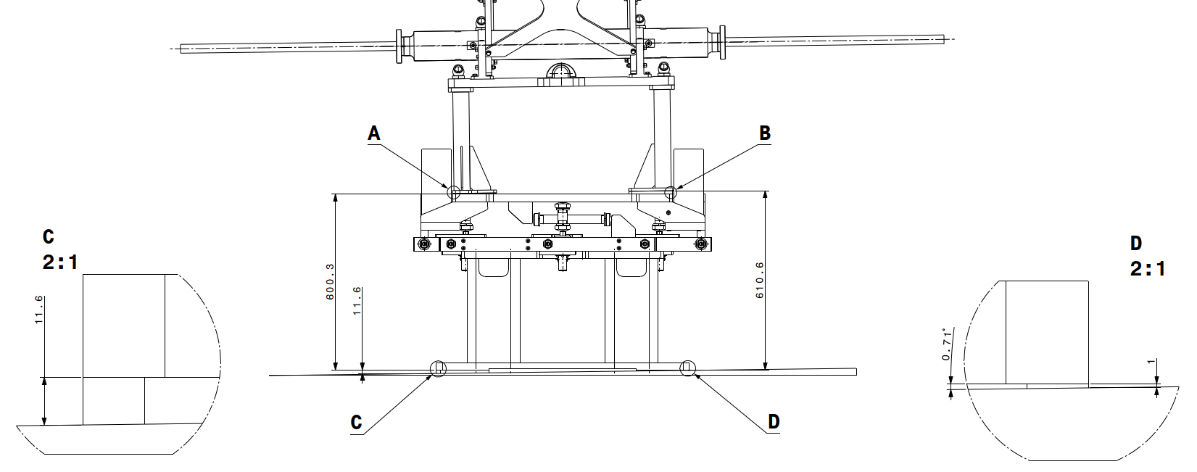
TCLMB shims – example of integration

Slide 18
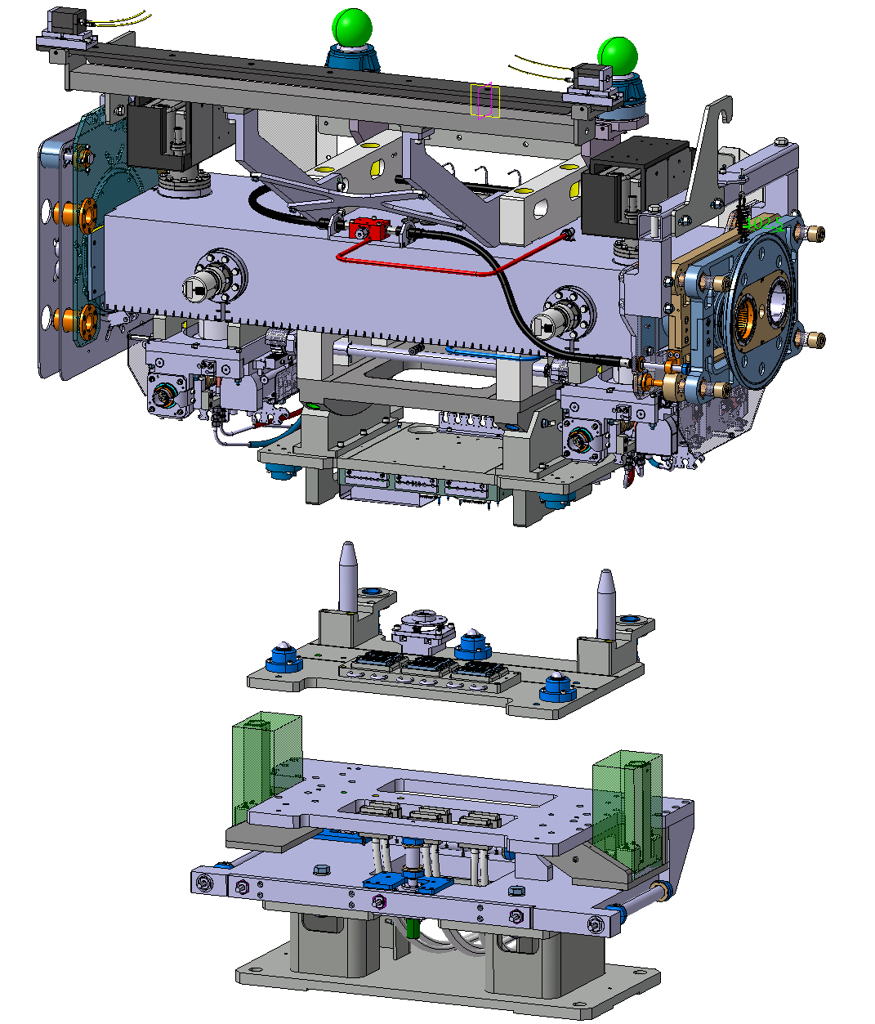
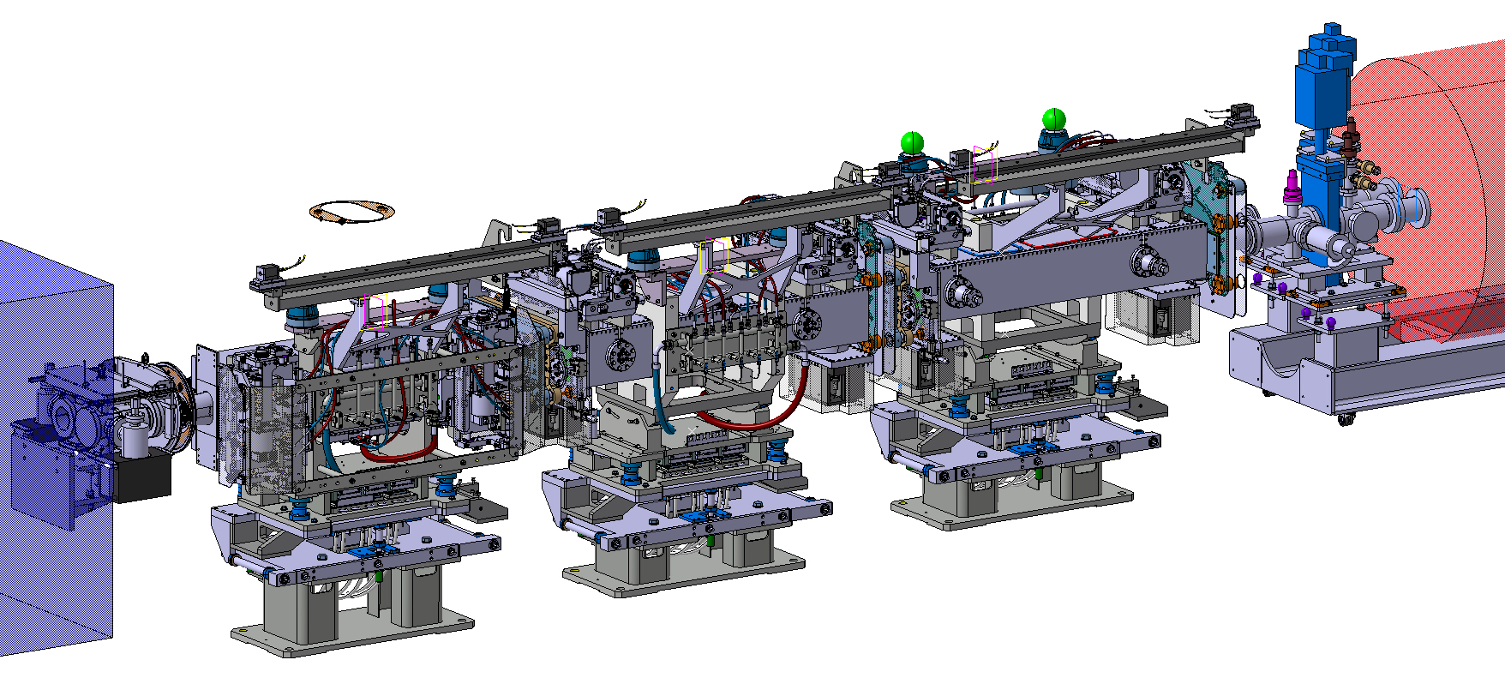

Universal Alignment Platform integration
Collimator
equipped
Collimator 3-ball interface plate
Universal Alignment Platform (UAP)
Collimator installed on the Universal
Alignment Platform (UAP)
ST1164052_01 (L. Gentini, E. Urrutia)
IP5 Collimators layout

