Slide 1
Update on LS3 collimator materials
WP5.2 Technical Meeting – C. Accettura, F. Carra – EN/MME
2021-10-28
WP5.2 Technical meeting (1 November 2021) · Indico (cern.ch)

Slide 2
Outline
Material robustness under impact design scenarios
  Design cases
  Thresholds of damage
  Molybdenum-Graphite & Graphite
  Inermet180 & Copper-Diamond
Material procurement and acceptance for prototypes
  Molybdenum-Graphite TCLPX taperings
  Inermet180 TCPLX blocks
  Copper-Diamond TCTPXH blocks
For a future meeting (ColUSM / WP5.2 / …) → would be interesting to have a summary of past and ongoing studies of long-term radiation resistance under ions and protons!

Slide 3
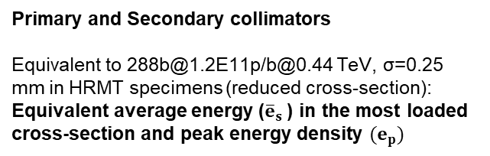
Beam Impact Design Cases
Primary and Secondary collimators
Equivalent to 288b@1.2E11p/b@0.44 TeV, σ=0.25 mm in HRMT specimens (reduced cross-section):
Equivalent average energy (${\overline{e}}_{s}$) in the most loaded cross-section and peak energy density ${(e}_{p})$
Failure Scenario | Beam Type | Beam Energy [TeV] | Intensity Deposit. [p+] | Beam Emittance [μm] | RMS beam size [mm]
Injection Error | LHC Ultimate | 0.45 | 4.9e13 | 3.5 | 1
Injection Error | Run 2 BCMS | 0.45 | 3.7e13 | 1.3 | 0.61
Injection Error | HL-LHC | 0.45 | 6.6e13 | 2.1 | 0.77
Injection Error | LIU BCMS | 0.45 | 5.8e13 | 1.3 | 0.61
Asynchronous Beam Dump | BCMS Run 2 | 7 | 1.3e11 | 1.3 | ~0.5
Asynchronous Beam Dump | HL-LHC | 7 | 2.3e11 | 2.1 | ~0.6
Tertiary and IR collimators
→ 24b@1.2E11p/b@0.44 TeV
→ 48b@1.2E11p/b@0.44 TeV
σ=0.5 mm in HRMT specimens:
Equivalent damage on Inermet180
See also “International Review of the HL-LHC Collimation System”, 11-12 Feb 2019 (in particularly, summary given by A. Bertarelli)

Slide 4
Thresholds of Damage
Three damage thresholds defined for collimator materials.
  Introduced for metallic (ductile) materials (MPP Workshop 2013). Extended to graphitic materials in the MPP Workshop 2019.
  Defined as a function of the effect on the collimator behaviour.
Threshold 1: onset of damage, with no need to activate the 5th axis.
  Ductile materials: onset of plasticity.
  Graphitic materials: crack initiation, local material ablation.
Threshold 2: damage to the surface requiring correction with the 5th axis.
  Ductile materials: it usually involves heavy plastic deformation and/or ejecta generation.
  Graphitic materials: pseudo-plastic deformation, internal delamination, important material ablation, …
Threshold 3: damage cannot be corrected with 5th axis anymore.
  Ductile materials: significant material erosion and plastic deformation in the jaw, no more flat surface close to the impact.
  Graphitic materials: fracture of the blocks jeopardizing the structural integrity, complete block face delamination with loss of the flatness.

Slide 5
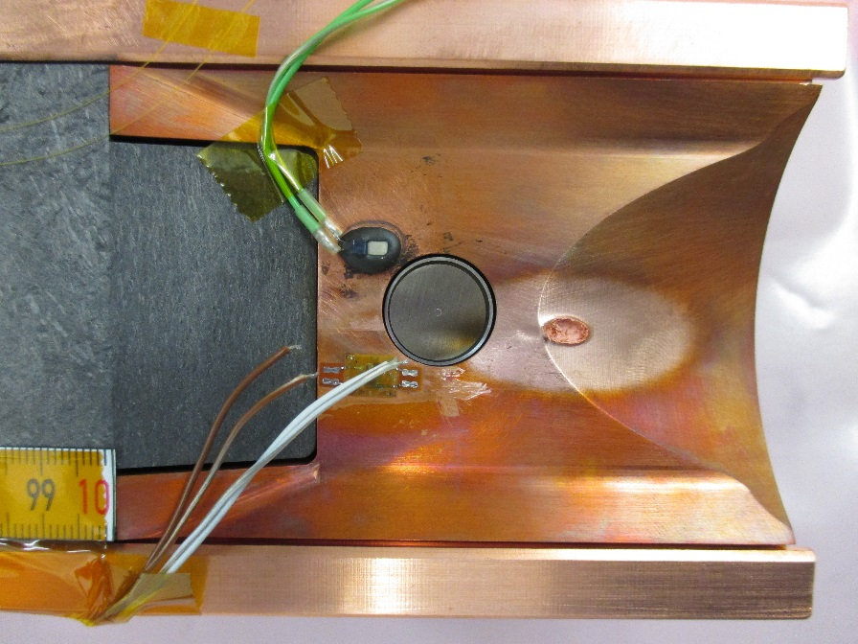
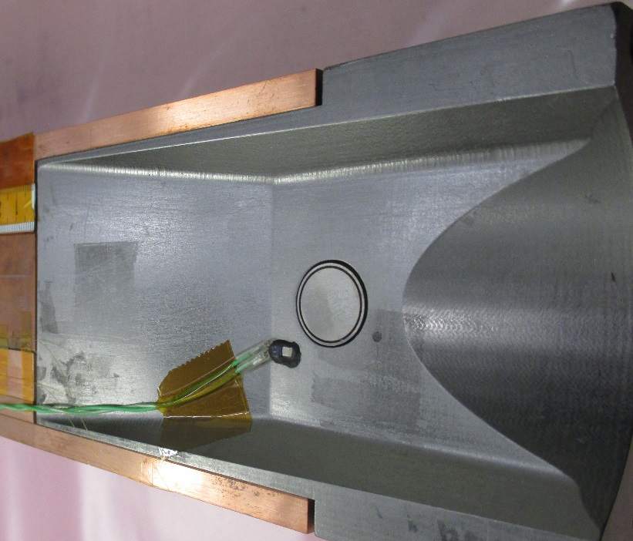
Molybdenum-Graphite & Graphite
Where are they used?
  TCSPM blocks, with 5um Mo coating
  TCTPXH & TCTPM taperings (MoGr, only in case CuCD is selected over Inermet180, otherwise CuCrZr)
  TCPPM (MoGr, none still to produce/install)
Plan A: MoGr
Plan B: FS140 CFC
Plan C: isotropic graphite (7550)
Robustness of MoGr and coatings discussed / validated at several technical meetings and reviews:
  1st Special ColUSM: Material and design readiness for LS2 productions, 2 May 2017
  2nd Special ColUSM on Materials, 8 November 2017
  International Review of the HL-LHC Collimation System, 11-12 February 2019
  MPP Workshop 2019, 7-8 May 2019
  With results presented at many other meetings (LMC, HiColDEM, etc.)
  +Article dedicated to Multimat: Dynamic Response of Advanced Materials Impacted by Particle Beams: The MultiMat Experiment, Journal of Dynamic Behavior of Materials volume 5, pages 266–295 (2019)

Slide 6
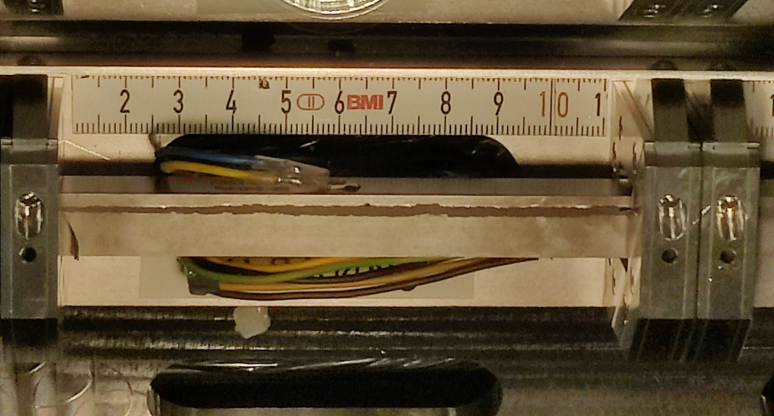
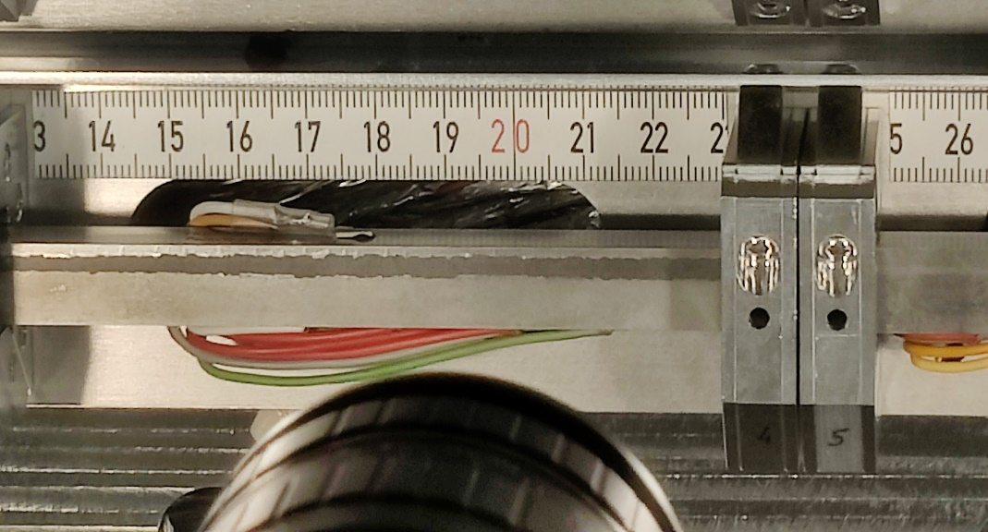
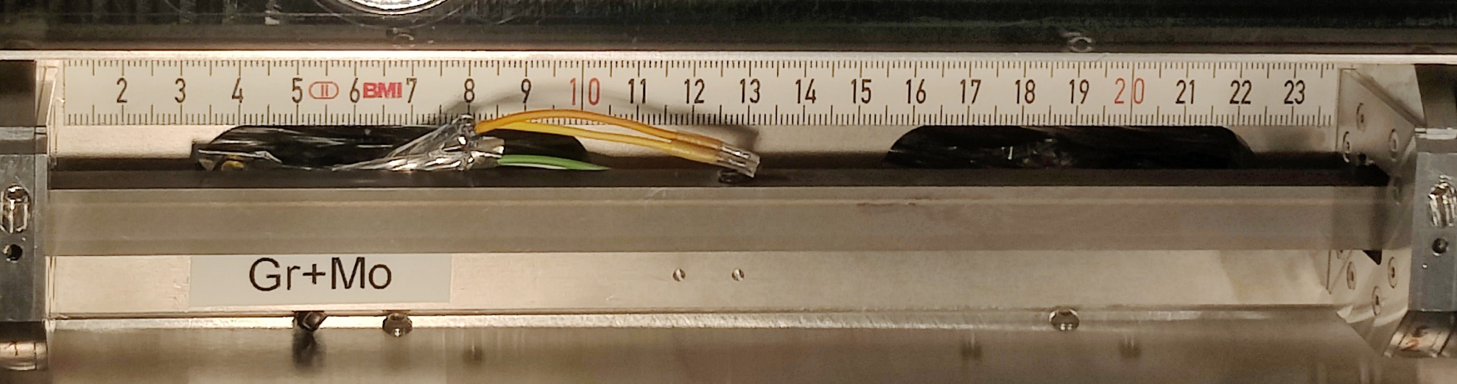
Molybdenum-Graphite & Graphite
In a nutshell
  Beam impact scenario on bulk and coating → Threshold 1 bulk, Threshold 2 (1?) coating
  Before Multimat-2: “prototype” compositions only tested (bulk MoGr from Brevetti Bizz, coating done at CERN by DCMS)
  Multimat-2 needed to test Nanoker MoGr (installed in LS2) and DTI coating (HiPIMS → much better conductivity!)
  DTI coating both tested on MoGr and Gr
Multimat-2 → Jorge’s talk at the 11th HL-LHC annual meeting
No visible fracture of samples
Coating ablation
  Up to ~3mm on MoGr
  Up to ~1.5mm on Gr
  Both in the range of 5th axis movement
288b,σ=0.25 mm grazing shot at depth=0 mm on coated NB-8404Ng:
288b,σ=0.25 mm grazing shot at depth=0 mm on coated graphite:

Slide 7
Molybdenum-Graphite & Graphite
What’s next?
  Calculation of energy density peak during impacts (to confirm that we match / exceed the design case) → FLUKA / ANSYS
  PIE
    On bulks (microscopy, µ-tomography)
    On coated surfaces (topography, adhesion)
  Do we want to go back to HRMT in 2022? to see effects of intermediate intensities on coating (e.g. asy. Beam dump on TCSPM – 8 HL-LHC bunches) / test NB8304Ng / etc.

Slide 8
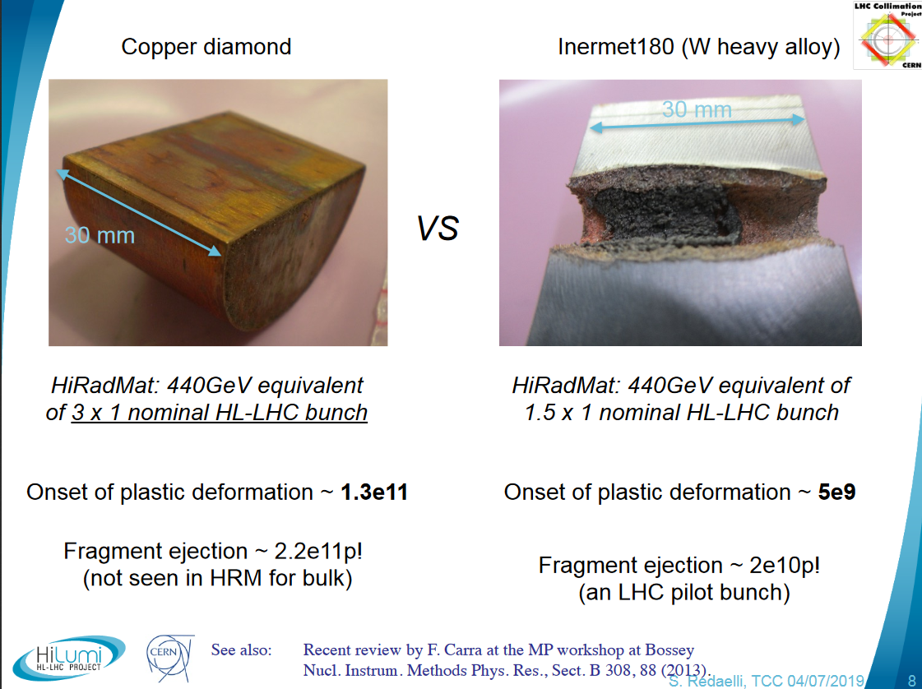
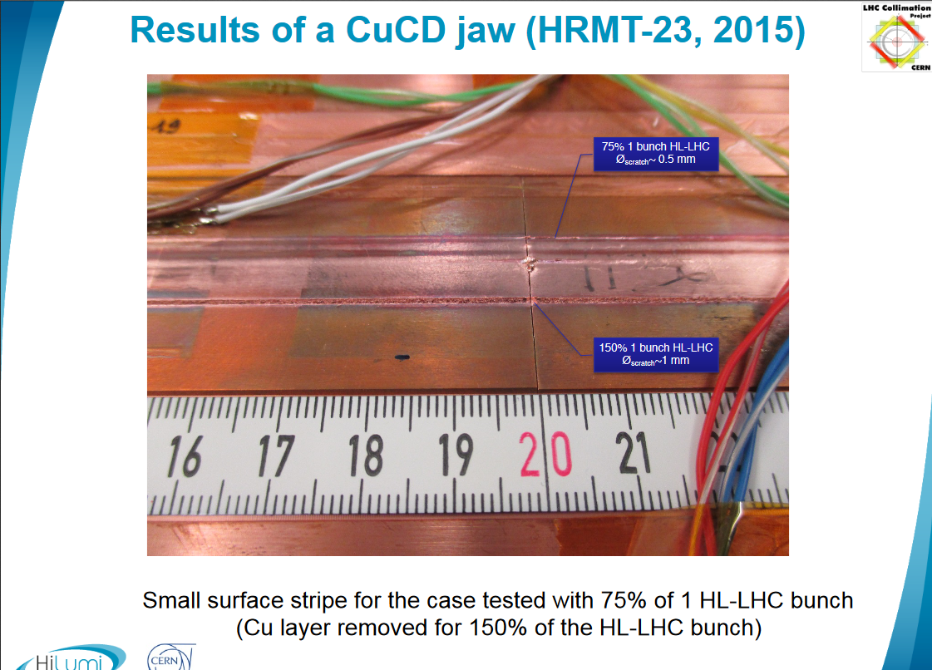
Inermet180 & CuCD
Where are they used?
  TCLPX, TCTPXV, TCLP blocks (Inermet180)
  TCTPXH & TCTPM blocks (Inermet180baseline, with CuCD alternative)
  TCLM4 → (Inermet180, not in the scope of this talk)
Comparison
  Inermet180: high stopping power, low robustness, cheaper
  CuCD: medium stopping power, high robustness, more expensive
Overview on IT180/CuCD robustness
  International Review of the HL-LHC Collimation System, 11-12 February 2019
  MPP Workshop 2019, 7-8 May 2019
  78th HL-LHC TCC, 4 July 2019
  +Several publications, most recent ones:

Slide 9
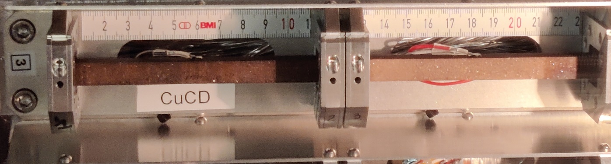
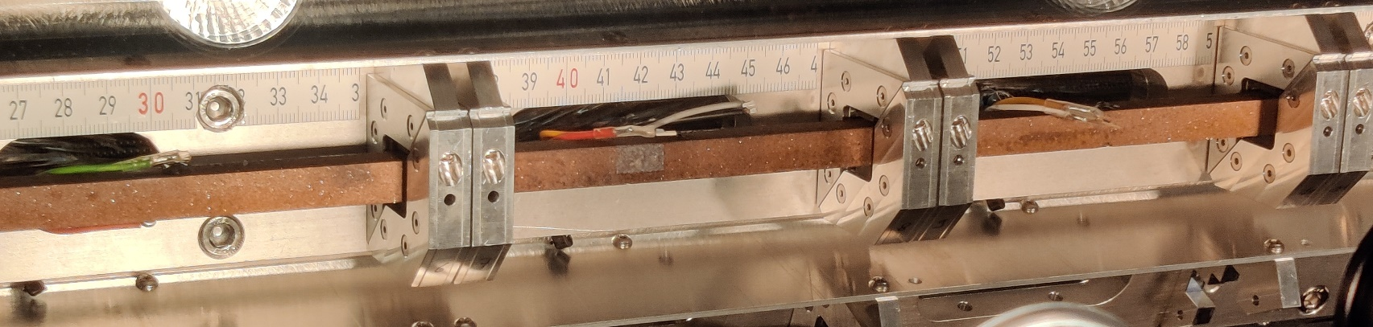
Inermet180 & CuCD
Conclusions from the reviews / discussions:
  CuCD interesting as more robust solution to Inermet180, but:
    Difference in cost for the series production must be precisely estimated and compared with the cost of replacing an IT180 collimator in case of accident (also estimate probability of this)
    Cu-cladding on CuCD (useful to control manufacturing tolerances) weaker than bulk → can we avoid/minimize it?
Actions taken / proposed
  Uncladded CuCD from different suppliers tested in HiRadMat:
    Multimat-1: RHP, IFAM → LHC asynchronous beam dump
    Multimat-2: Nanoker (preseries TCTPXH) → up to HL-LHC asynchronous beam dump
  Multimat-2 PIE
    No visible damage during preliminary out of tank inspection
    Microscopy, µ-tomography once opening
  Nanoker going for uncladded configuration for TCTPXH preseries blocks (and, if successful, the series ones) → dimensional tolerances to be checked once here!
  Launch a Price Enquiry for CuCD (and Inermet180?) for the LS3 production units
    Reminder of cost per single collimator unit: CuCD TCTPXH 73 kCHF; Inermet180 TCLPX 20 kCHF

Slide 10
Multimat-2 possible timeline
1st possibility: opening Multimat-2 asap and testing
  Before end of 2021: setup brought to b. 954 for further cooldown
  March 2022? Tank opening
  April – September 2022: testing
  In line with decision on LS3 materials by end of 2022
2nd possibility: keeping Multimat-2 closed and completing experimental campaign in 2022
  Possible reasons: asy. Beam dump on coating, completion of testing on NB 8304Ng
  May 2022? Beam time
  November 2022? Tank opening
  Hardly compatible with deadline on LS3 material choice by end of 2022
3rd possibility: opening the tank, extracting tested samples, closing again and completing experimental campaign → I see it hardly compatible with the activation levels and timelines (it could be further investigated if needed)

Slide 11
Procurement of materials for TCPLX and TCTPXH prototypes
Overview of absorber materials
Material | Part | Ref. Drawing | Proto | #unit installed | #spares | Unit cost [CHF] | DAI
MoGr | Tapering | LHCTCTPXH_0022 | TCTPXH | 4 | - | ~3k | 8676513
CuCD | Blocks | LHCTCTPM0001 | TCTPXH | 16 | 2 | ~3k (5k for pre-series) | 8676754
Inermet180 | Central blocks | LHCTCLPX__0018 | TCPLX | 6 | 1 | ~1.6k | 8850132
Inermet180 | Extremity Blocks | LHCTCLPX__0017 | TCPLX | 4 | 1 | ~1.5k | 8850132

Slide 12
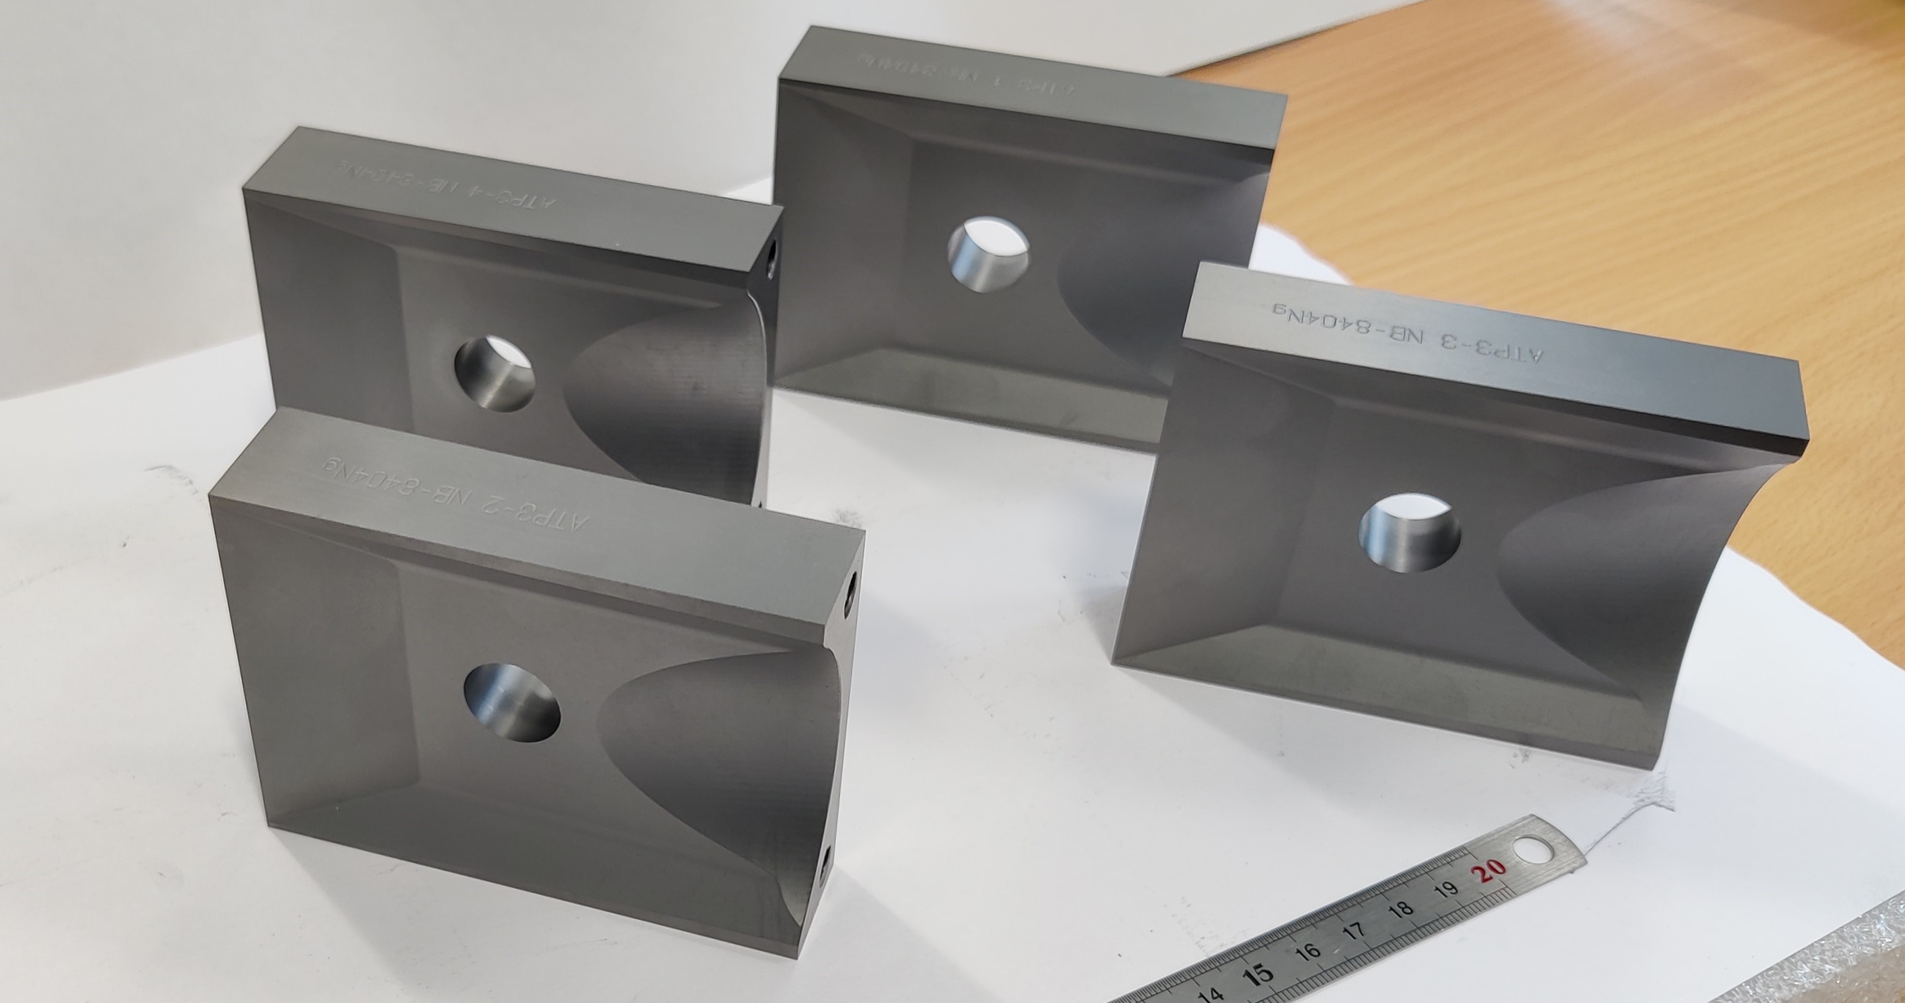
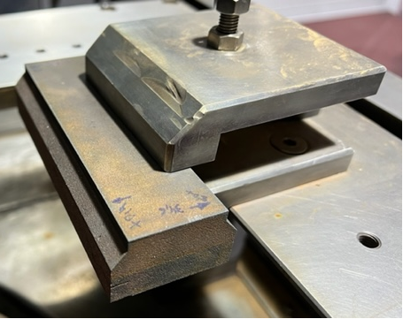
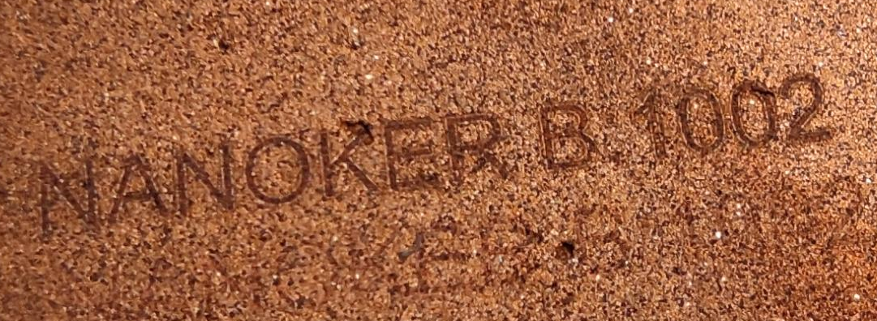
Procurement of materials for TCPLX and TCTPXH prototypes
Procurement and validation status:
  CuCD (tested in MultiMAT2)
  2 pre-series blocks expected shipping at CERN
  w. 44
  First jaw end of 2021
  Second jaw end of Jan. 2022
  MoGr tapering (Nb8404Ng)
  Metrology ☑
  Electrical conductivity ☑
  Vacuum test ☑
  INERMET (IT180)
  Expected at CERN end 2021
INERMET and CuCD samples requested by VSC for SEY, TDS, EDS tests→ procurement ongoing

Slide 13
Procurement of materials for TCPLX and TCTPXH prototypes
UHV (as received)
Greenlight for series to Nanoker
Metrology
Procurement and validation status:
Thermo-physical and mechanical characterization almost completed (record strength!)
UHV test first block foreseen this week at CERN

Slide 16
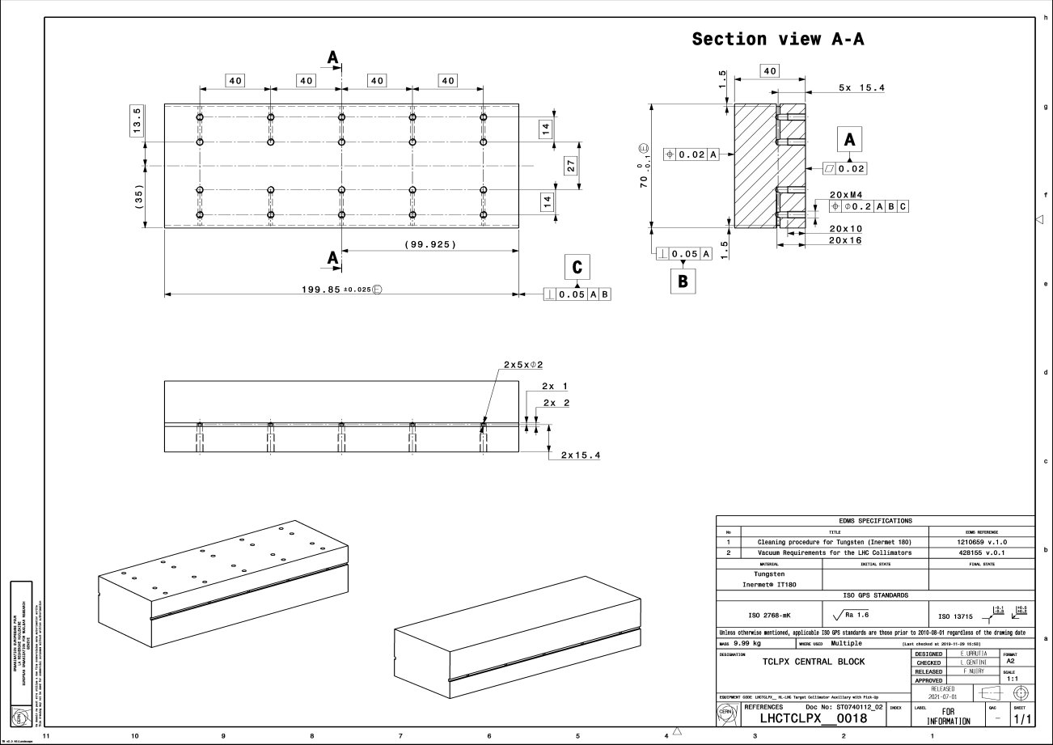
Drawing
Inermet 180-central

Slide 17
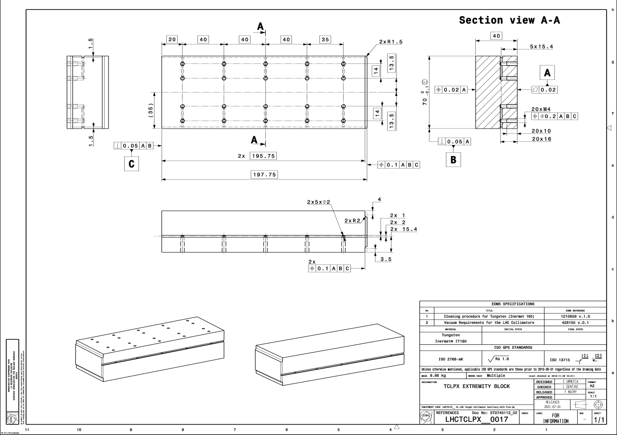
Drawing
Inermet 180-extremity

Slide 18
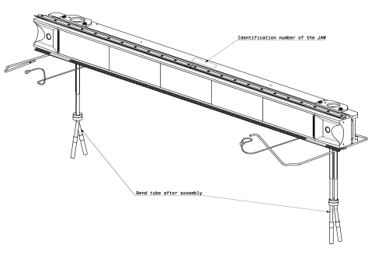
Drawing
Jaw assembly TCLPX-LHCTCLPX__0004

Slide 19
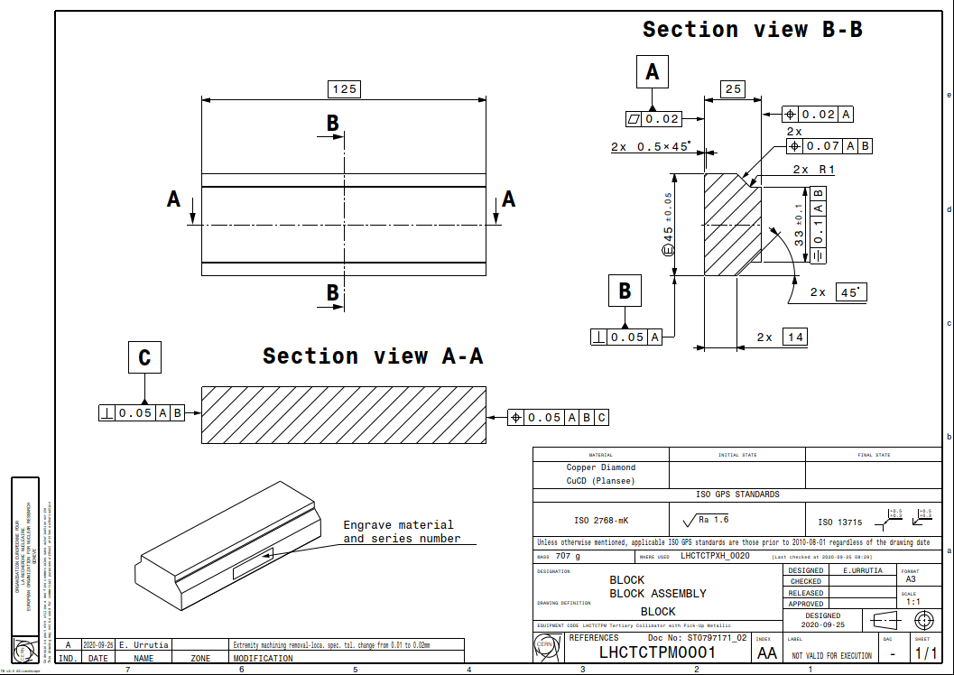
Drawing
CuCD blocks

Slide 20
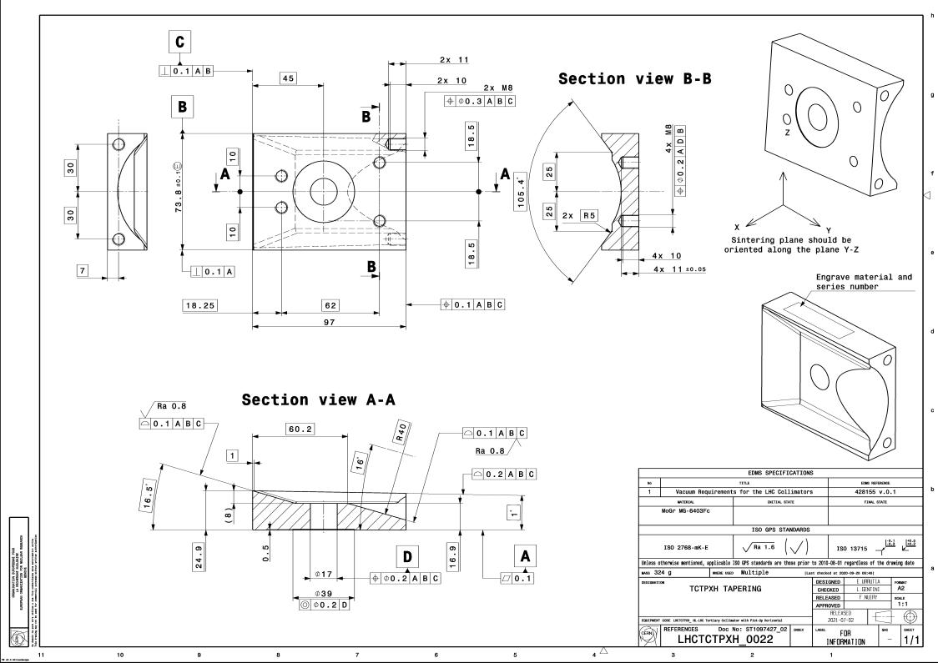
Drawing
MoGr tapering

