Slide 1

TCLPX – TCTPXH tooling
WP5.2 Technical meeting
L. Gentini

Slide 2
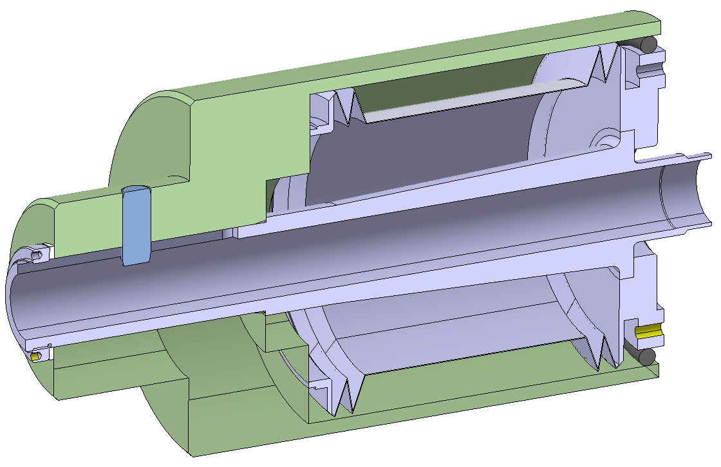
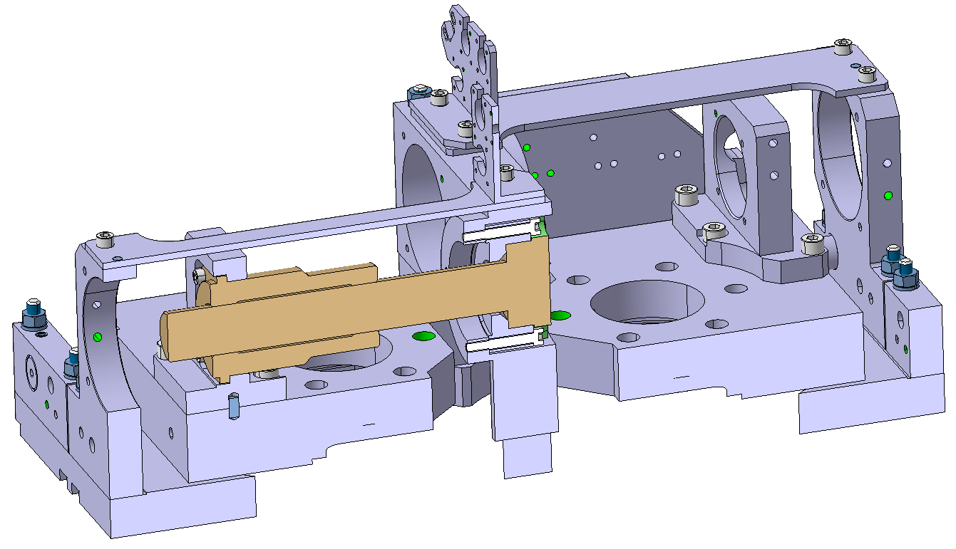
TOOLINGS FOR IR COLLIMATOR
LHCTC__X_T0001
BELLOW SURFACING FLANGE TOOLING
LHCTC__X_T0014
IR MECHANICAL TABLE ALIGNEMENT TOOL

Slide 3
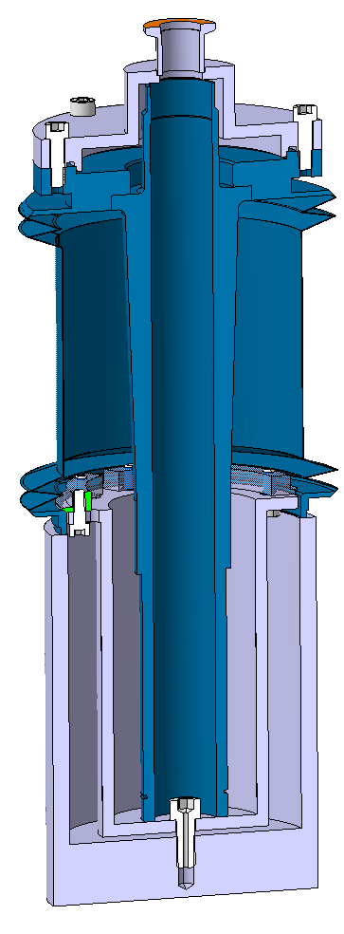
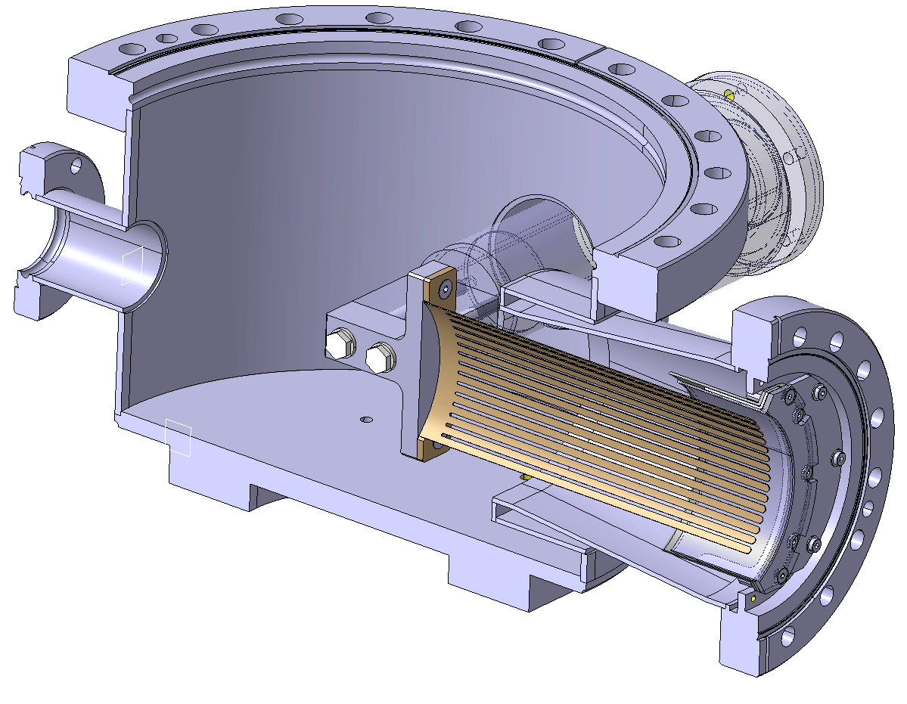
TOOLINGS FOR IR COLLIMATOR
LHCTCLPX_T0022
TCLPX RF FINGERS TEST STAND
LHCTCLPX_T0032
TCLPX BELLOW/SHAFT VACUUM TEST - ASSEMBLY

Slide 4
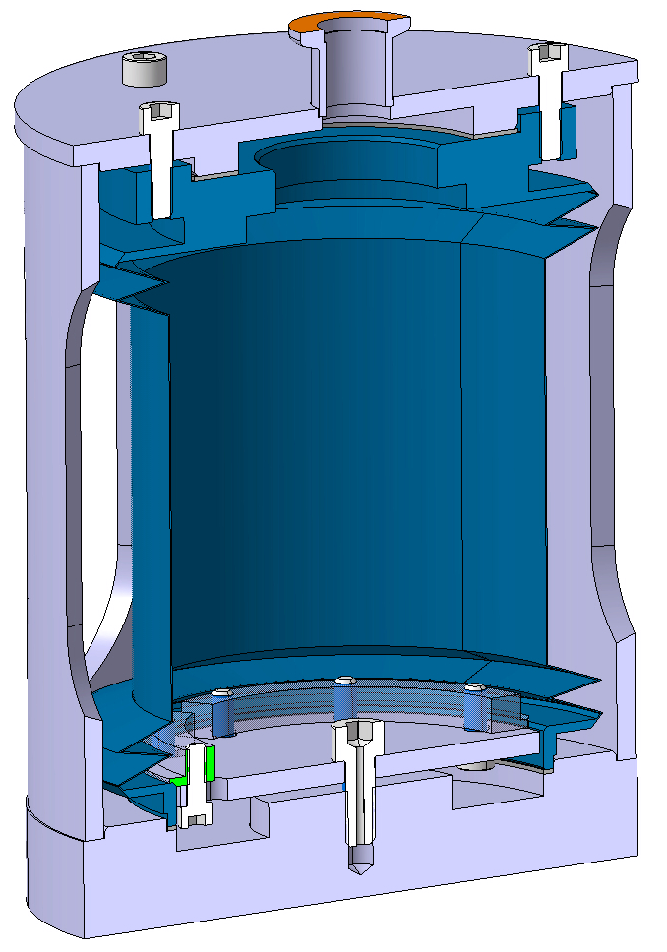
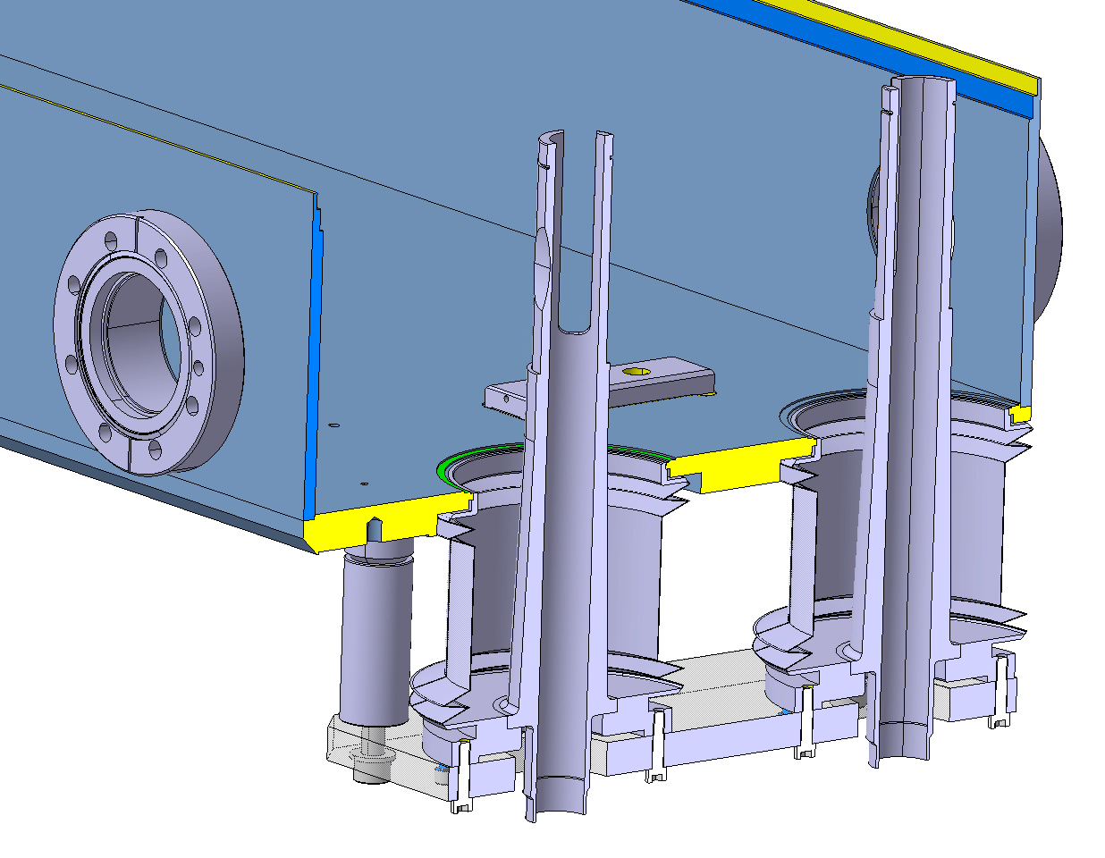
TOOLINGS FOR IR COLLIMATOR
LHCTCLPX_T0037
IR COLLIMATOR BELLOW LEAK TEST - ASSEMBLY
LHCTCLPX_T0042
TCLPX SHAFT/TANK WELDING TOOL ASSEMBLY

Slide 5
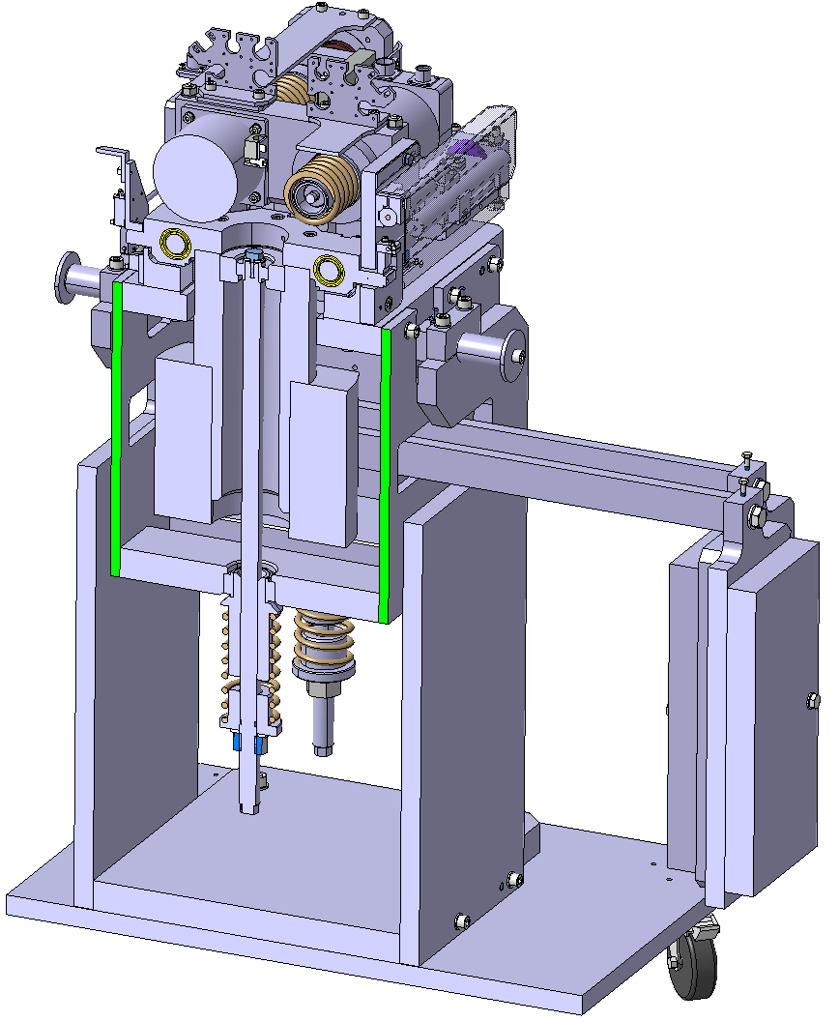
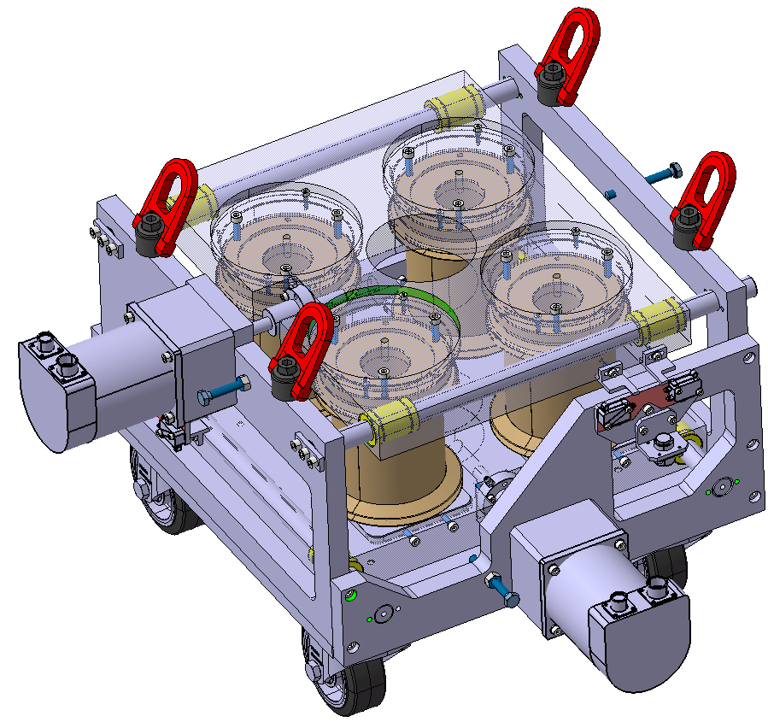
TOOLINGS FOR IR COLLIMATOR
LHCTCLPX_T0060
TCLPX CYCLING TEST BENCH OF MECHANICAL TABLE
LHCTCLPX_T0071
TCLPX BELLOW CYLING TOOL ASSEMLBY
Jaw load
~4.2 kN
Jaw load
Vacuum load
~785 N

Slide 6
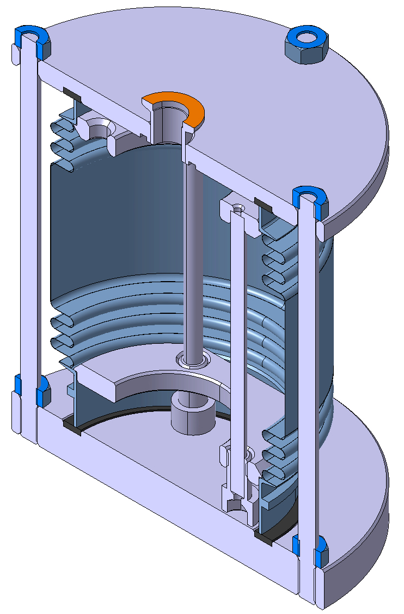
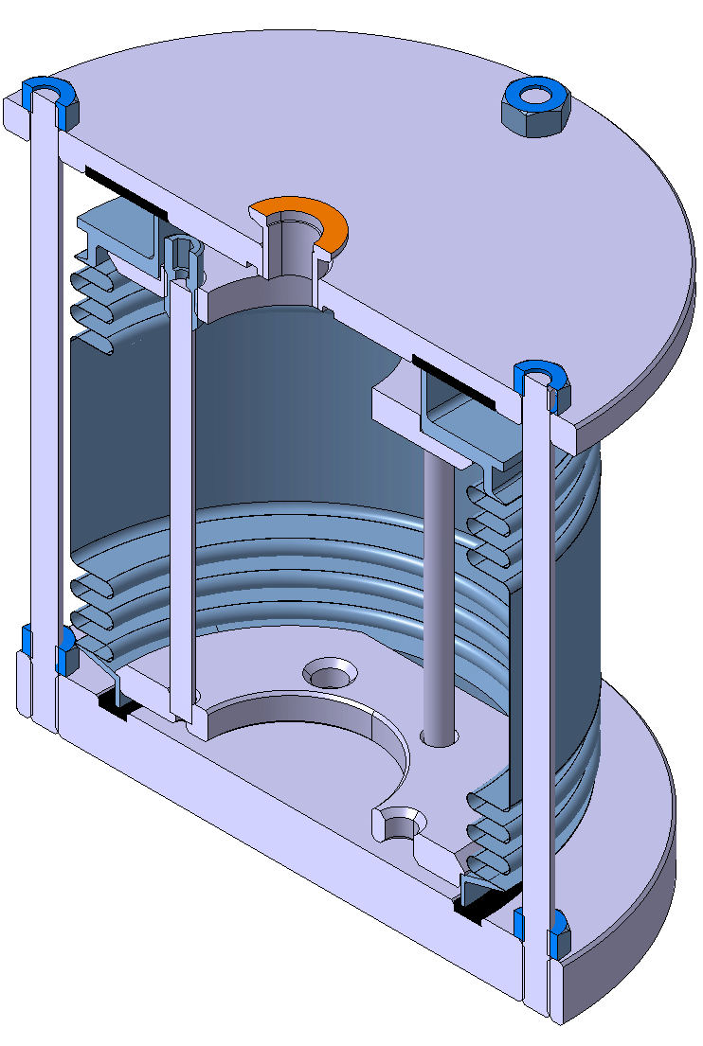
TOOLINGS FOR IR COLLIMATOR
LHCTCLPX_T0078
TANK BELLOW LEAK TEST HBLT ID105 Assembly
LHCTCLPX_T0077
TANK BELLOW LEAK TEST HBLT ID125 Assembly

Slide 7
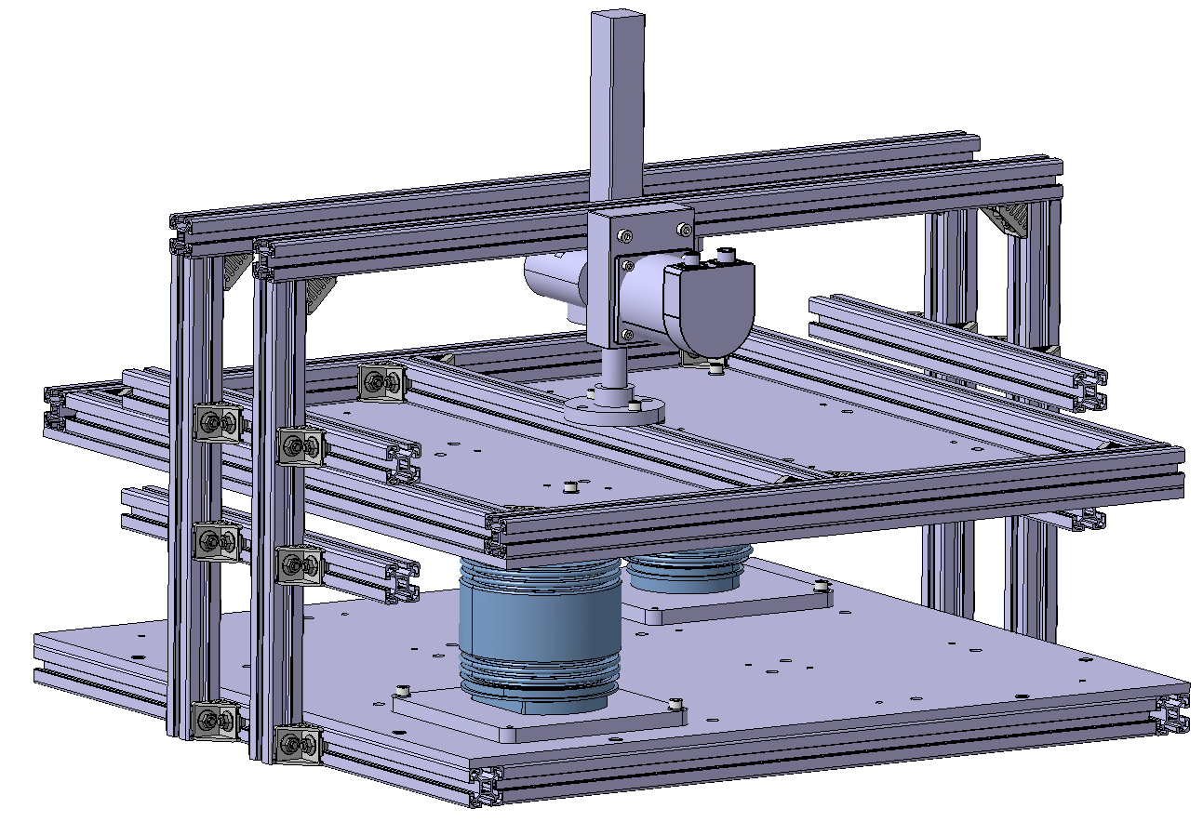
TOOLINGS FOR IR COLLIMATOR
LHCTCLPX_T0095
Hydroformed Bellow Cycling Tool

Slide 8
Summary table
Definition | CDD number | Designed by | Design Status | Used by | Manufact. Resp. | Manufact. Status
BELLOW SURFACING FLANGE TOOLING | LHCTC__X_T0001 | MME | Released | MME | MME | On-going
BELLOW-SHAFT WELDING TOOLING ASS. | LHCTC__X_T0002 | MME | Released | MME | MME | On-going
IR MECHANICAL TABLE ALIGNEMENT TOOL | LHCTC__X_T0014 | MME | Under check | STI | STI | On-going
TCLPX RF FINGERS TEST STAND | LHCTCLPX_T0022 | MME | Released | STI | STI / MME | On-going
TCLPX BELLOW/SHAFT VACUUM TEST - ASSEMBLY | LHCTCLPX_T0032 | MME | Released | MME | MME | On-going
IR COLLIMATOR BELLOW LEAK TEST - ASSEMBLY | LHCTCLPX_T0037 | MME | Released | STI | STI | On-going
TCLPX SHAFT/TANK WELDING TOOL ASSEMBLY | LHCTCLPX_T0042 | MME | Released | MME | MME | On-going
TCLPX CYCLING TEST BENCH OF MECHANICAL TABLE | LHCTCLPX_T0060 | MME | Released | STI | STI | On-going
TCLPX BELLOW CYLING TOOL ASSEMLBY | LHCTCLPX_T0071 | MME | Released | STI | STI | On-going
TANK BELLOW LEAK TEST HBLT ID125 Assembly | LHCTCLPX_T0077 | STI | Released | STI | STI | On-going
TANK BELLOW LEAK TEST HBLT ID105 Assembly | LHCTCLPX_T0078 | STI | Released | STI | STI | On-going
Hydroformed Bellow Cycling Tool | LHCTCLPX_T0095 | STI | Released | STI | STI | On-going
TCTPXH SHAFT/TANK WELDING TOOL ASSEMBLY | LHCTCTPX_T0010 | MME | Released | MME | MME | On-going
BPM CABLE BENDING TOOLS
BPM ANTENNA TOOL

Slide 9
Thank you for your attention

