Slide 1

TCLPX – TCTPXH – TCSPM
Bake out systems
WP5.2 Technical meeting
L. Gentini

Slide 2
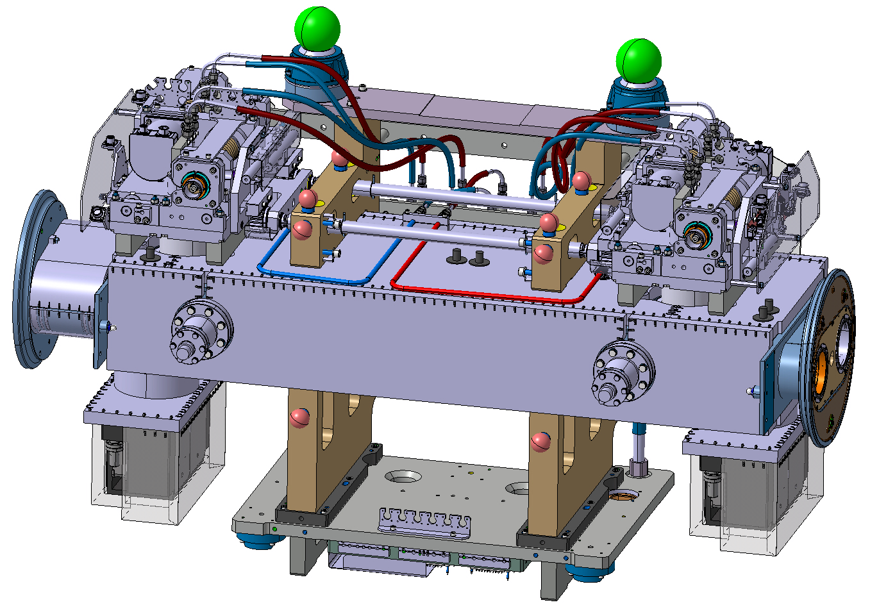
TCLPX heating JACKETS
Body jackets
Pump jackets
The jackets must be installed on the collimator before to put the collimator on its support.
7 electrical lines are used on the hypertac.
Bellow jackets

Slide 3
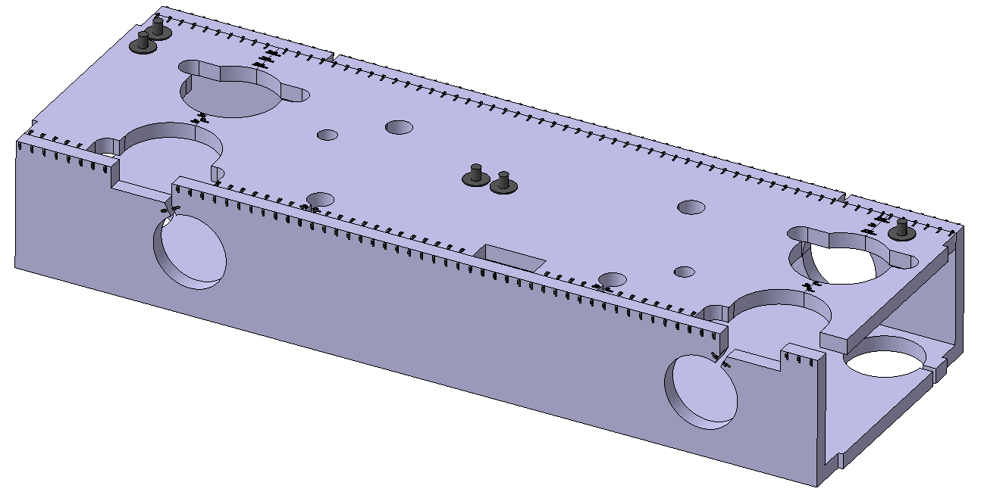
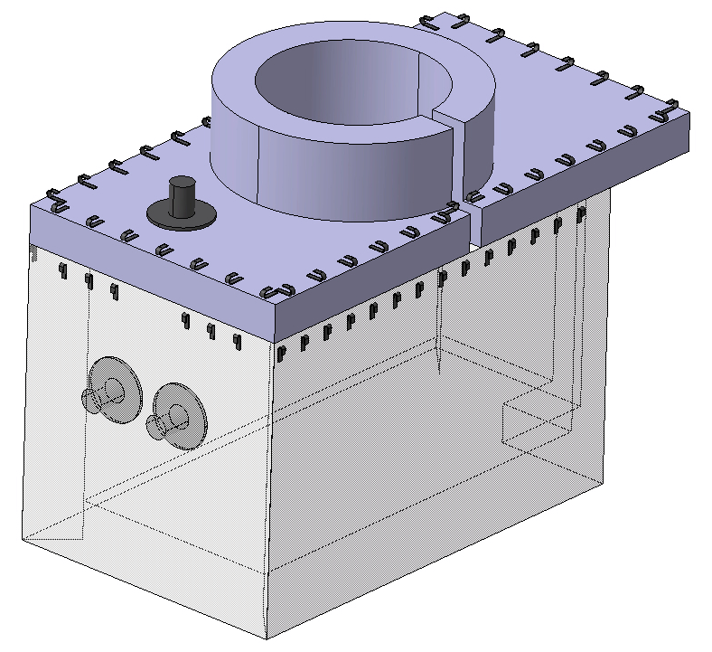
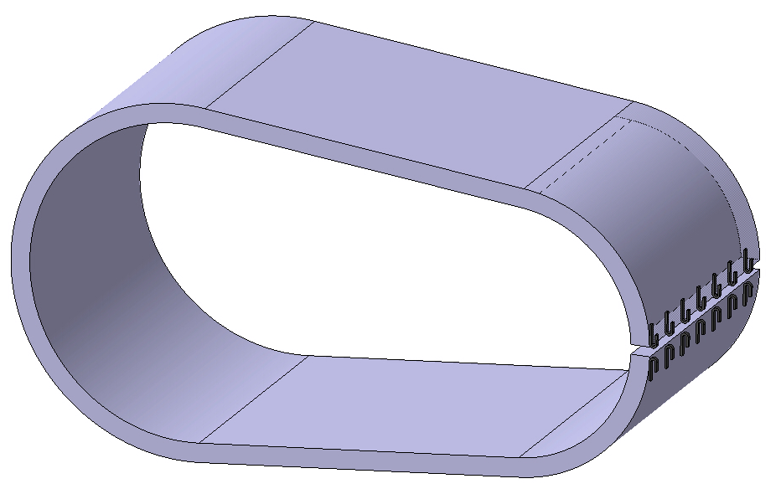
TCLPX heating JACKETS
BODY JACKETS ASSEMBLY - LHCTCLPX_T0001
25 mm thickness.
Just one single jacket for the bottom side and the two lateral sides.
For space matters on jacket has just one electrical connector.
ION PUPM JACKETS - LHCVEJEC0006
25 mm thickness.
The two jackets of the ion pumps are connected in series to reduce the number of electrical connections on the hypertac.
BELLOW JACKETS - LHCTCLPX_T0019
10 mm thickness.

Slide 4
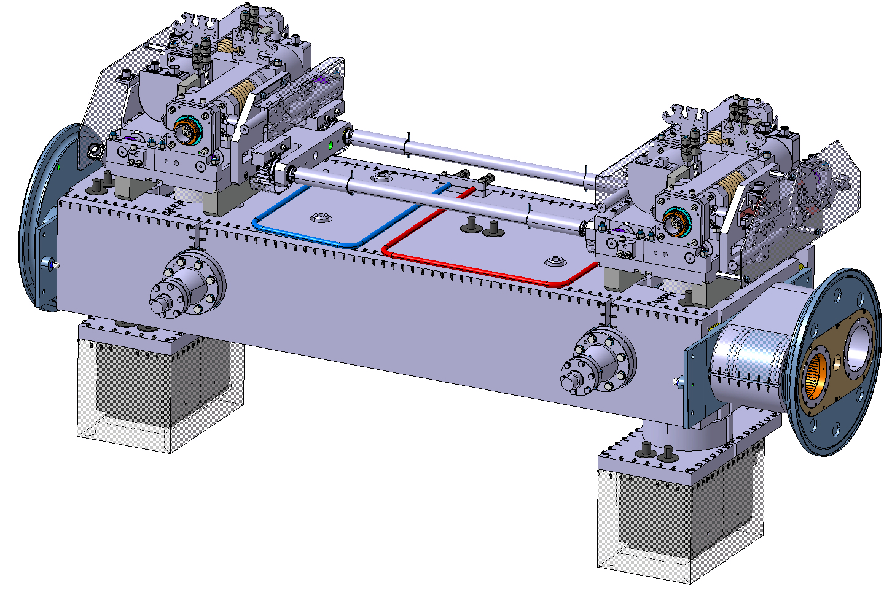
TCTPXH heating JACKETS
Body jackets
Pump jackets
The jackets must be installed on the collimator before put the collimator on its support.
7 electrical lines are used on the hypertac.
Bellow jackets

Slide 5
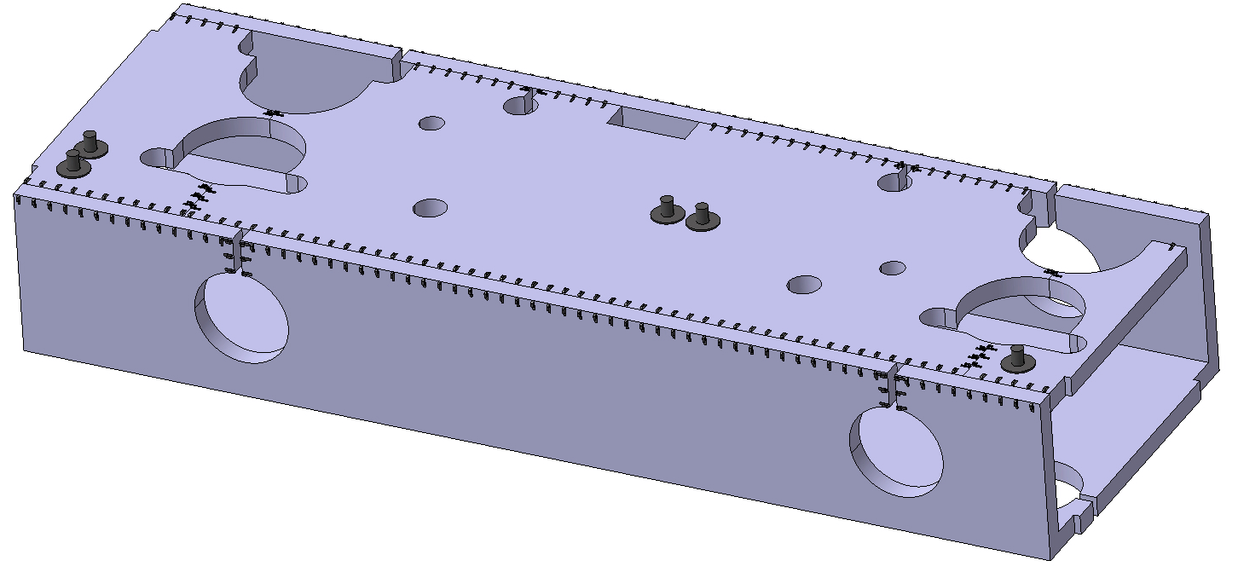
TCTPXH heating JACKETS
BODY JACKETS ASSEMBLY - LHCTCLPX_T0011
25 mm thickness.
Just one single jacket for the bottom side and the two lateral sides.
For space matters on jacket has just one electrical connector.
ION PUPM JACKETS - LHCVEJEC0006
25 mm thickness.
The two jackets of the ion pumps are connected in series to reduce the number of electrical connections on the hypertac. (Same of TCLPX)
BELLOW JACKETS - LHCTCLPX_T0019
10 mm thickness.
Same design of TCLPX

Slide 6
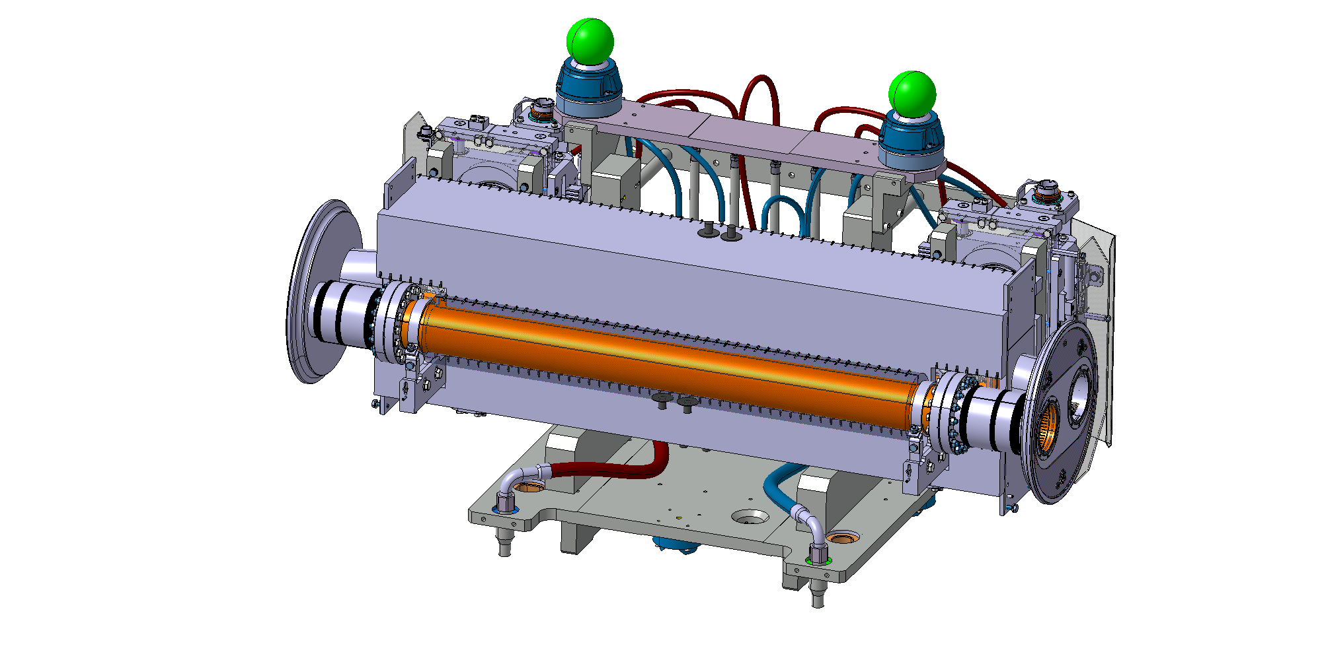
TCTPXV heating JACKETS
Body jackets
2nd beam jackets
The jackets must be installed on the collimator before put the collimator on its support.
6 electrical lines are used on the hypertac.

Slide 7
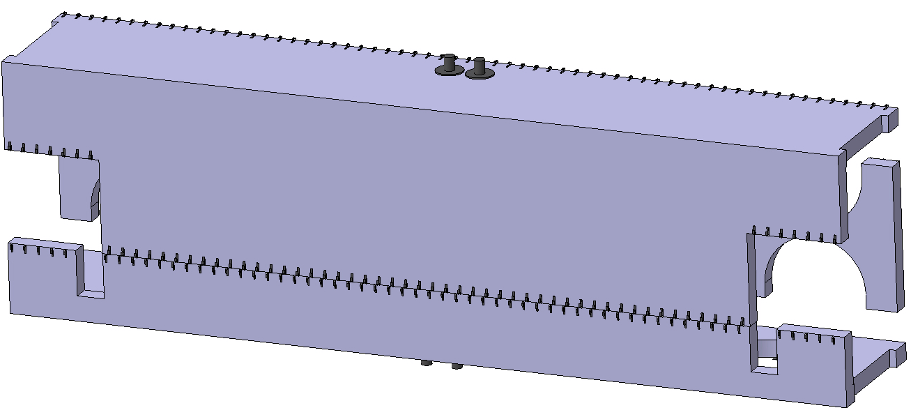
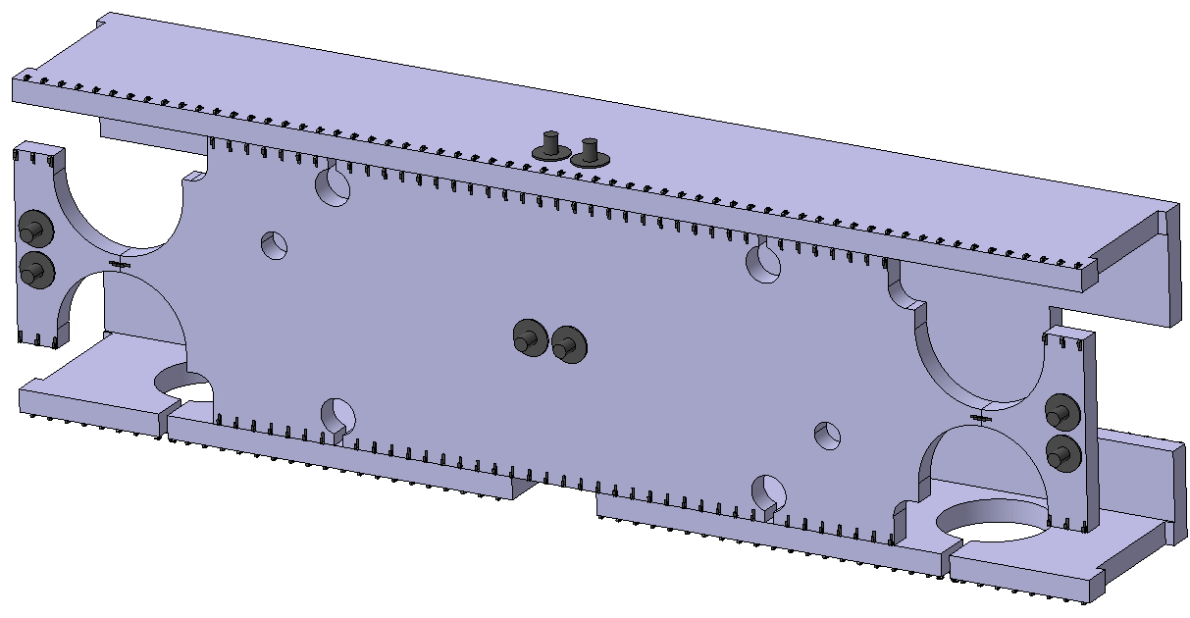
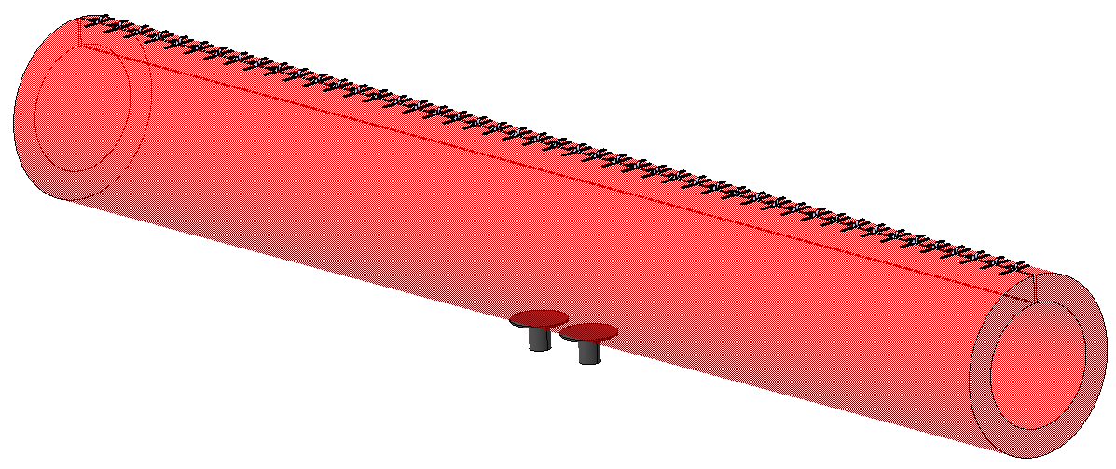
TCTPXV heating JACKETS
BODY JACKETS ASSEMBLY - LHCTCTPX_T0001
25 mm thickness.
Two jackets for the bottom side and the two lateral sides.
2nd BEAM JACKETS – LHCTCTPXV_0104
20 mm thickness.
EXTREMITY JACKET NECESSARY ?

Slide 8
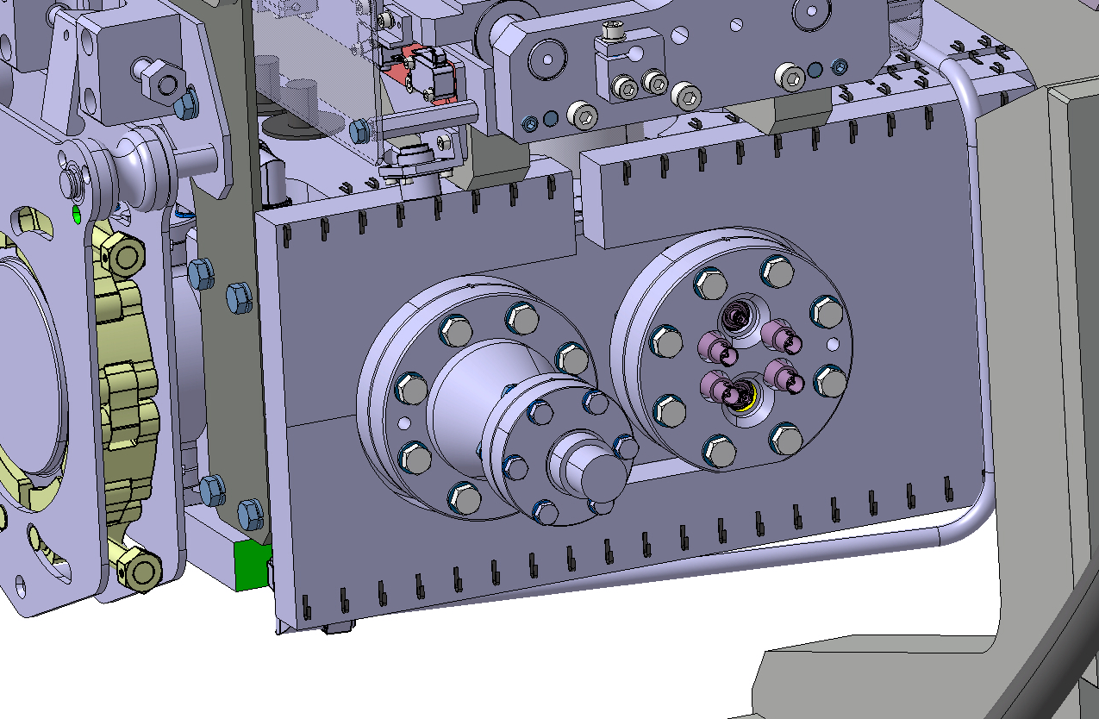
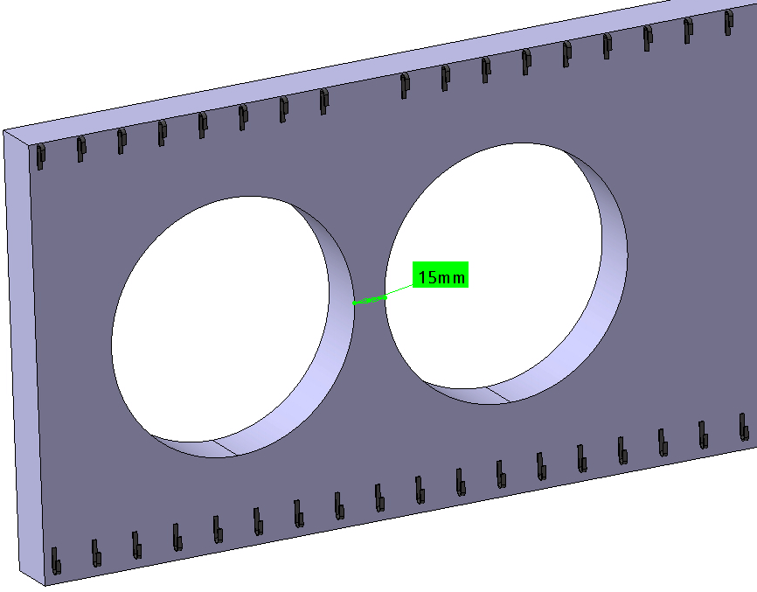
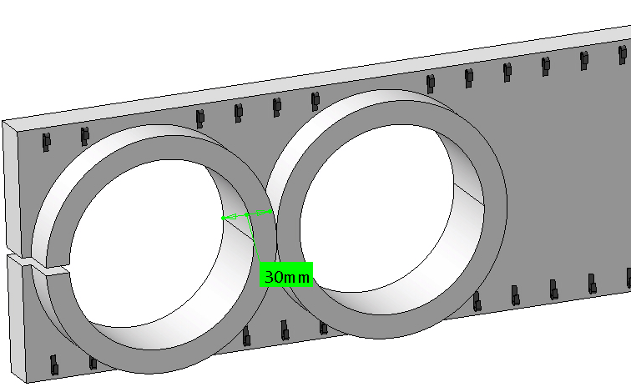

TCSPM bake out system improvement 1
BODY JACKETS ASSEMBLY – LHCTCSPM0105
6 electrical lines are used on the hypertac.
DESIGN IMPROVEMENT
A lot of eating is lost in the pick-up area:
There is not heating on the tank between the pick-up
There is not heating on the pick-up flanges.
SOLUTION 1
Remove the aperture between the pick-up.
Close the gap between the pick-up (20 mm of jacket).
This solution does not change the design
SOLUTION 2
Remove the aperture between the pick-up.
Put a collar on the lateral jacket to heat also the pick-up flanges.
For this solution, the pick-up of the cartridge must be moved by 10 mm.
SOLUTION 1
SOLUTION 2

Slide 9
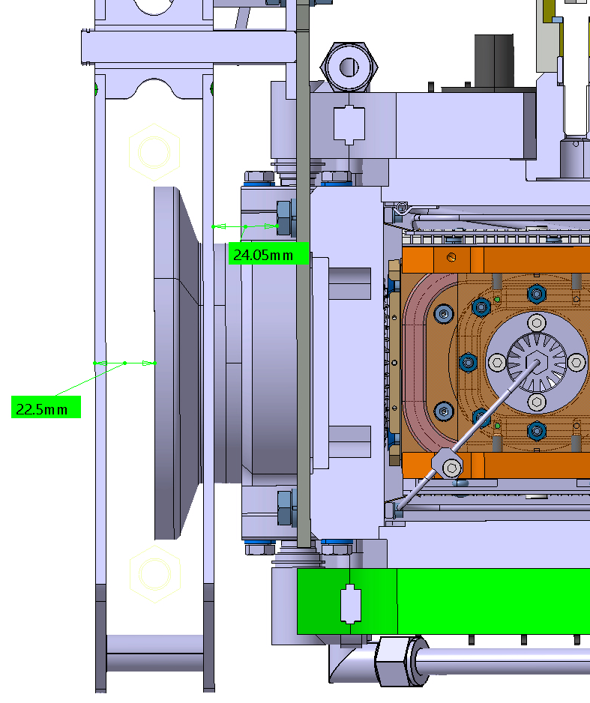
TCSPM bake out system improvement 2
MKT CHAIN SYSTEM
By conduction, the extremities of the tanks are cooled down.
A solution could be to add tow thermal insulating plates between the MKT system and the tank (2 or 3 mm) as we have done on the IR collimators.
To do not decrease the stroke of the MKT, the space must be obtained on the thickness of the MKT plate. The MKT system must be slightly modified.

Slide 10
Thank you for your attention

Slide 11
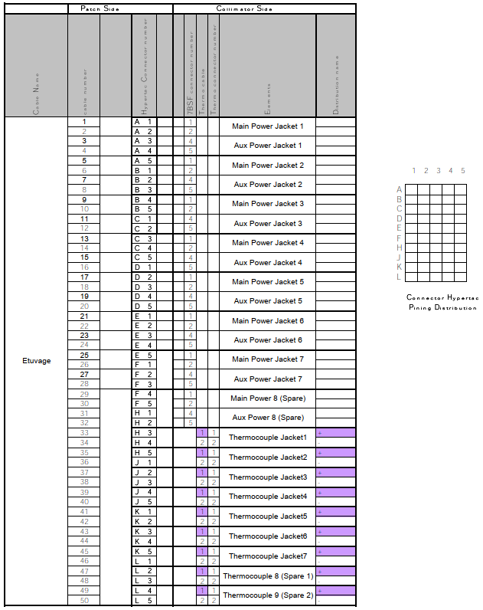
Hypertac – bake out connector

