Slide 1
ELENA SEM-Grid Areas Needing Consolidation
15th September 2021

Slide 2
Overview
ELENA SEM-Grid Profile Monitors provided as an “In-kind” contribution by Japan.
Approx 46 monitors are planned, of which 39 are already installed and working. Some have missing wires or connections in their grids.
Note that the ELENA SEM-Grids are more sensitive than the Emittance SEM-Grids. The ELENA bunches are approx 10⁷ particles, compared to 10¹¹, but SEY is 10² lower so the signal is only 100 times smaller in ELENA.
The ELENA SEM-Grids have to be compatible with the ELENA vacuum which means they must be baked at 180 ͦC.
The discussion can be conveniently broken into three parts:
  Electronics
  Mechanics
  Sensor grids

Slide 3
Summary of parts needed to complete installation
 | Fixed (PUMA, Base-STEP) | Moveable (PUMA x 2, ASACUSA) | Bad grids (BSGWA-0533, BSGWA-0611) | Bellows test (Will test to destruction) | Stock
Bellows assemblies | 0 | 3 | 0 | 1 | 7
Grids | 2 | 3 | 2 | 0 | 0
Need in-house supply of Bellows Assemblies and Grids

Slide 4
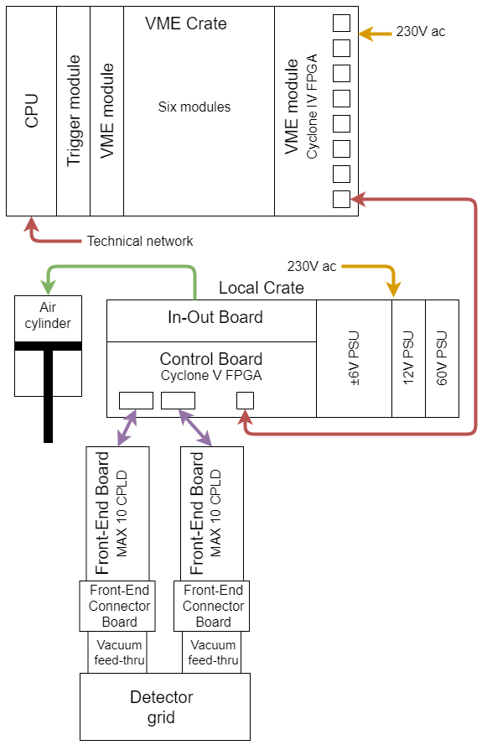
Electronics
Basically nothing to do. All parts have been, or can be, manufactured at CERN and we have all the necessary documentation.
The ASIC used (which is still in production, and of which we have spares), is extremely sensitive with a noise floor of 0.06 fC and a full scale range of 200 fC. We expect that this precludes using the ELENA SEM-Grid electronics in other SEM-Grids, or vice-versa.

Slide 5
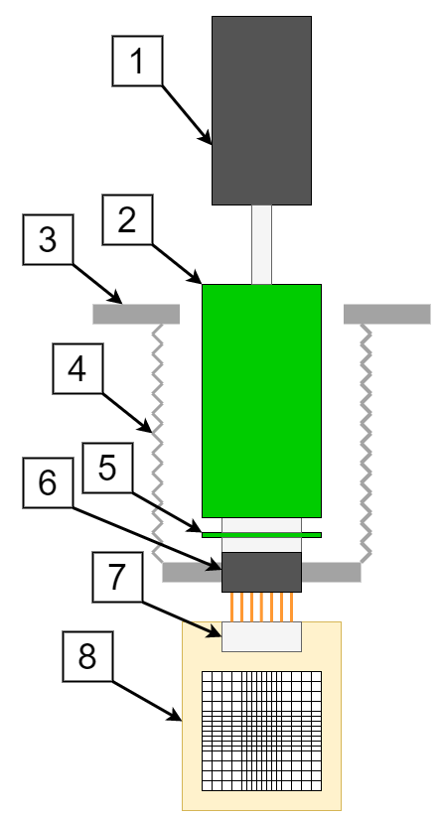
Mechanics
We have already done a lot of work to improve the design.
We have 3D Sketch using an European bellows unit, and eventually a bellow guide outside the vacuum.
The flange and the grid connection is un-changed.
We have the part numbers of all the major bought-in items (pneumatic cylinder, vacuum feed-through, etc)
So we could make the mechanical assemblies ourselves.
We have no spare “installable” tanks, but we do have two spare tanks for vacuum testing.
The cost of buying a complete assembly from Japan is around 5kCHF, but long term we should make them at CERN to ensure availability.

Slide 6
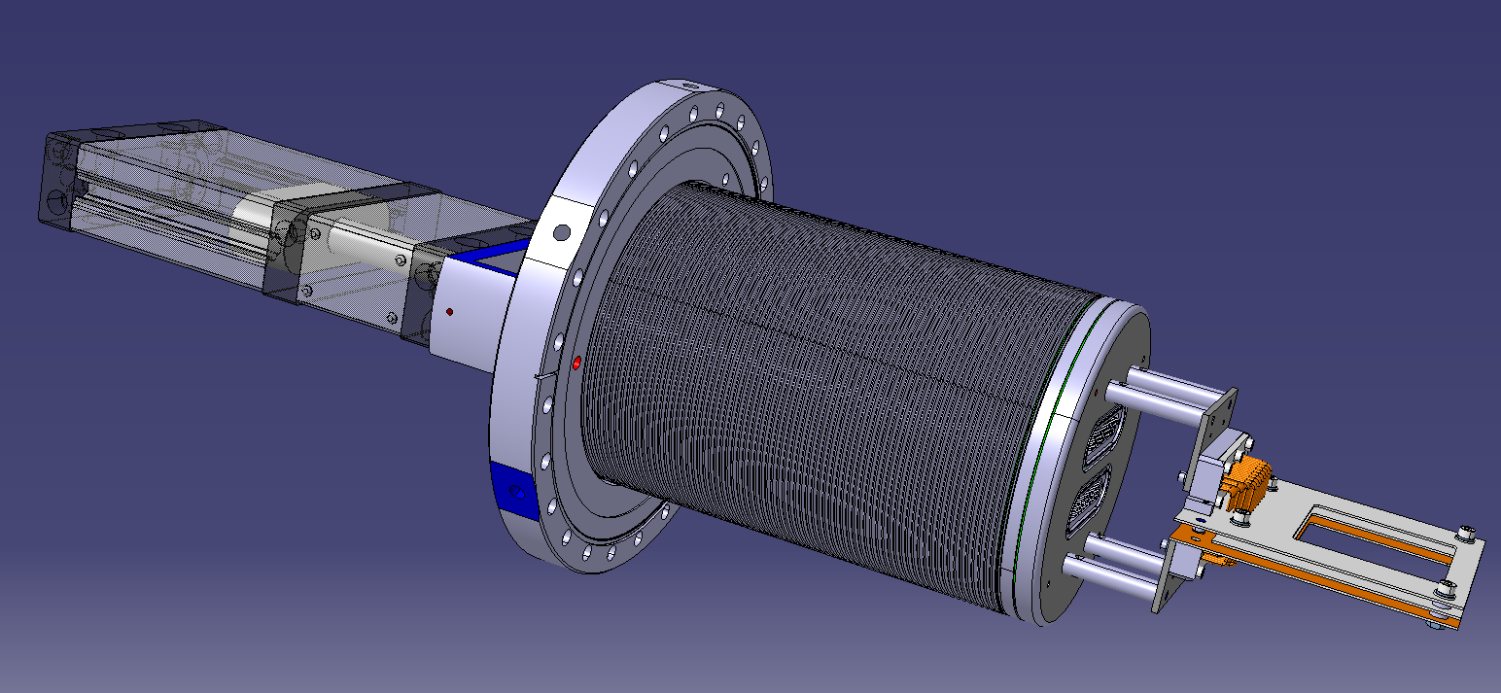
Proposed new assembly design, compatible with existing flange and grid
New Double Bellow Assembly standard
Size 150/120 > 157/127mm
Triple new ceramique
2 > 1 mm thickness
From CERN
New Sub-D50 plate Ø157
with Allectra feedtrough

Slide 7
Feed-through issues
The first vacuum feed-through used by the Japanese was manufactured by Solid Sealing, approximately 30% leaked during the Vacuum Acceptance Test.
So the production was changed to Allectra, only one or two have failed so far.
But 40% of the installed monitors are still Solid Sealing, and we can expect failures when the transfer lines are baked.
To replace a feed-through at the CERN workshop costs about 5kCHF, so it is cheaper to make a new Bellows Assembly.

Slide 8
Mechanics consolidation reqd
We have seven complete assemblies (without grids) and we four for the installation and test rig.
We would like to make five spares to Jean’s design.
Rough cost estimation is 20kCHF each.

Slide 9
Sensor grids
These are the parts which have caused the most trouble.
They take a long time to make and are fragile. They sometimes fail during bakeout.
We have no spares and the supply of these parts is the “rate limiting step” in our installation programme.
There is a project ongoing with the EP department to produce grids here at CERN. They plan to use conductive glue, which the vacuum group is not comfortable with.
The ELENA SEM-Grids contain three anode grids in addition to the X and Y sensor grids, so they are quite different to the Emittance SEM-Grids.

Slide 10
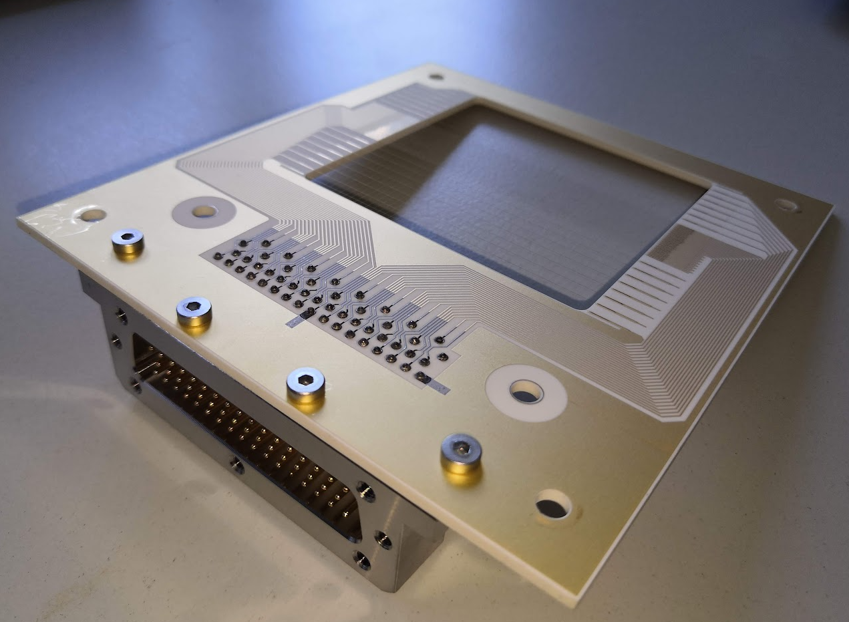
Sensor grids detail
There are two areas of the sensor grids which are difficult:
  Attaching the wires
  “Soldering” the pins of the D connector

Slide 11
Attaching the wires
The Japanese use a resistance welding technique to attach the wires to the pads. We believe this took some development to get right, but the Japanese are willing to share their knowledge with us. Broken wires are very rarely a problem.
The EP Department propose to use a conductive glue. Tests are underway by the Vacuum Group to determine if this is acceptable.

Slide 12
“Soldering” the connector pins
The Japanese use vacuum brazing with a 5% tin, 95% lead solder. This melts around 300 ͦC, so it should not be affected by the bakeout. However the solder does not seem to wet the materials well, probably because there is no flux and it is impossible to completely exclude oxygen. Sometimes the joints are bad when we receive the grids, and sometimes they fail during bakeout.
The EP Department propose to use the same glue as proposed for the wires.
We have done some research and think that a predominately gold solder should work, if we use PCBs made with gold plated tracks. However we do need to test this idea.

Slide 13
Proposal for grid without glue
The company who makes the Emittance SEM-Grids could make a ceramic PCB for us with titanium-copper-gold tracks and plated -through holes.
We believe that the connector pins could be vacuum brazed with fluxless mostly gold solder.
The wires would then be resistance welded as they are now.
This will require some R&D.

Slide 14
Conclusion
We would like to produce 5 mechanical assemblies at 20kCHF each. Some technical design work is also needed.
We would like to make ten complete grids. The price from the EP department is 4kCHF per set. The price for a glue-less solution is hard to estimate because there will be R&D required. The labour and material costs of the glue-less solution is also likely to be higher.

