Slide 1







Example : machine learning for adverse drug events prevention

Slide 2
Adverse drug events
ADEs = Adverse Drug Events
Several definitions. Institute of Medicine (2007):
  “An injury resulting from the use of a drug”
  “An injury due to medication management
  rather than the underlying condition of the patient”
Epidemiological data:
  98,000 deaths per year in the US
  An ADE would occur in 5-9% of inpatient stays

Slide 3


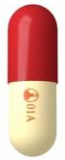


Prospective prevention of ADEs
Change of the drug prescription
Alert generation, before the ADE occurs, in order to prevent it.
Alert method
Prescription
Prescription
Inpatient stay
Hospital information system

Slide 4
Adverse drug events prevention by rule-based AI: CDSS

Slide 5
ADE prevention using rule-based CDSS
CPOE:
  computerized physician order entry
  process of electronic entry of medical practitioner instructions for the treatment of (hospitalized) patients
CDSS:
  Clinical decision support system
  Health information technology system that is designed to provide physicians and other health professionals with clinical decision support
  Often based on level 1 artificial intelligence (rules)
CPOE + CDSS = the “obvious” solution for adverse drug events prevention?

Slide 6
CDSS & CPOE: Over-alerting, alerte-fatigue
=> poor clinical efficiency!
Over-alerting: too numerous and inappropriate alerts
Alerts interrupt the clinicians’ workflow and induce alert-fatigue
  Too many alerts
  => time and mental energy consumption
  => a mental state whereby users start ignoring critical alerts along with those that may be clinically insignificant
May prevent CDSS from improving patient safety
Alert override:
  up to 96% of alerts are overridden by prescribers
  But alert override is often inappropriate, and is sometimes followed by actual ADEs

Slide 7



Machine learning for ADE prevention
Idea driven by
Pr Regis Beuscart, head of the PSIP Project
Funded by the European Research Council, 7th framework program
(agreement N°216130)

Slide 8
Administrative data
Drugs
88 years old woman
Acetaminophen
VKA
Vitamin K
Statine
Red blood cells
Diagnoses
I10 Arterial hypertension
Z8671 Personal history of myocardial ischemia
I620 Non-traumatic subdural hemorrhage
Medical procedures
Laboratory results
ABJA002 Drainage of an acute subdural hemorrhage, by craniotomy
FELF001 Transfusion
INR
Free-text reports
Hemo-globin
Discharge letter
Surgical report

Slide 9
Available data: ~175,000 inpatient stays from 6 hospitals (F, Dk, Bu)
Data management,
Data mining,
Expert filtering
ADE detection rules

Slide 10
Artificial intelligence
Example of decision tree
VKA= vitamin K antagonists (anticoagulant)
INR= international normalized ratio. Evaluates VKA activity
INR>5 => risk of hemorrhage
The tree attempts to explain INR>5
VKA
no
f=0.1
yes
Butyrophenone discontinuation
f=0
no
yes
f=0.25
Hypoalbuminemia
no
yes
f=0.2
f=0.4
f=0.05
f=0.5

Slide 11
Artificial intelligence
Example of decision tree
Rule #1 (4th leaf):
VKA
& butyrophenone discontinuation
→ P=0.4
VKA
no
f=0.1
yes
Butyrophenone discontinuation
no
yes
f=0.4

Slide 12
Artificial intelligence
Example of decision tree
Rule #2 (3rd leaf):
VKA
& no butyrophenone discontinuation
& hypoalbuminemia
→ P=0.5
VKA
f=0.1
yes
Butyrophenone discontinuation
no
Hypoalbuminemia
yes
f=0.5

Slide 13
Artificial intelligence
Expert validation of rules
Albumine = plasmatic protein to which VKA bind. Only the non-bound part is biologically active.
Serum albumin
VKA
Normal state:
99% of the VKA bind to albumin.
Only 1% of VKA are biologically active. The intake is based on it.
Hypoalbuminemia:
decrease of the bound fraction,
increase of the non-bound fraction
=> too high INR (with constant intake)
=> Need for validation, explanations, reorganization!

Slide 14
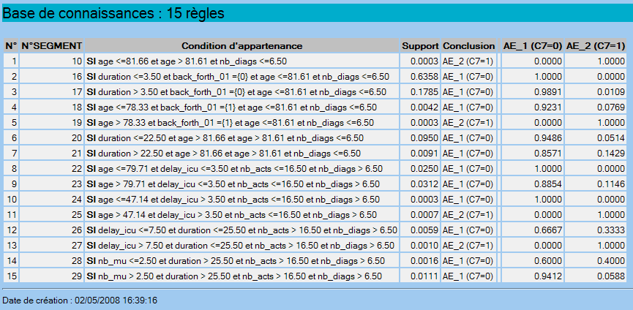
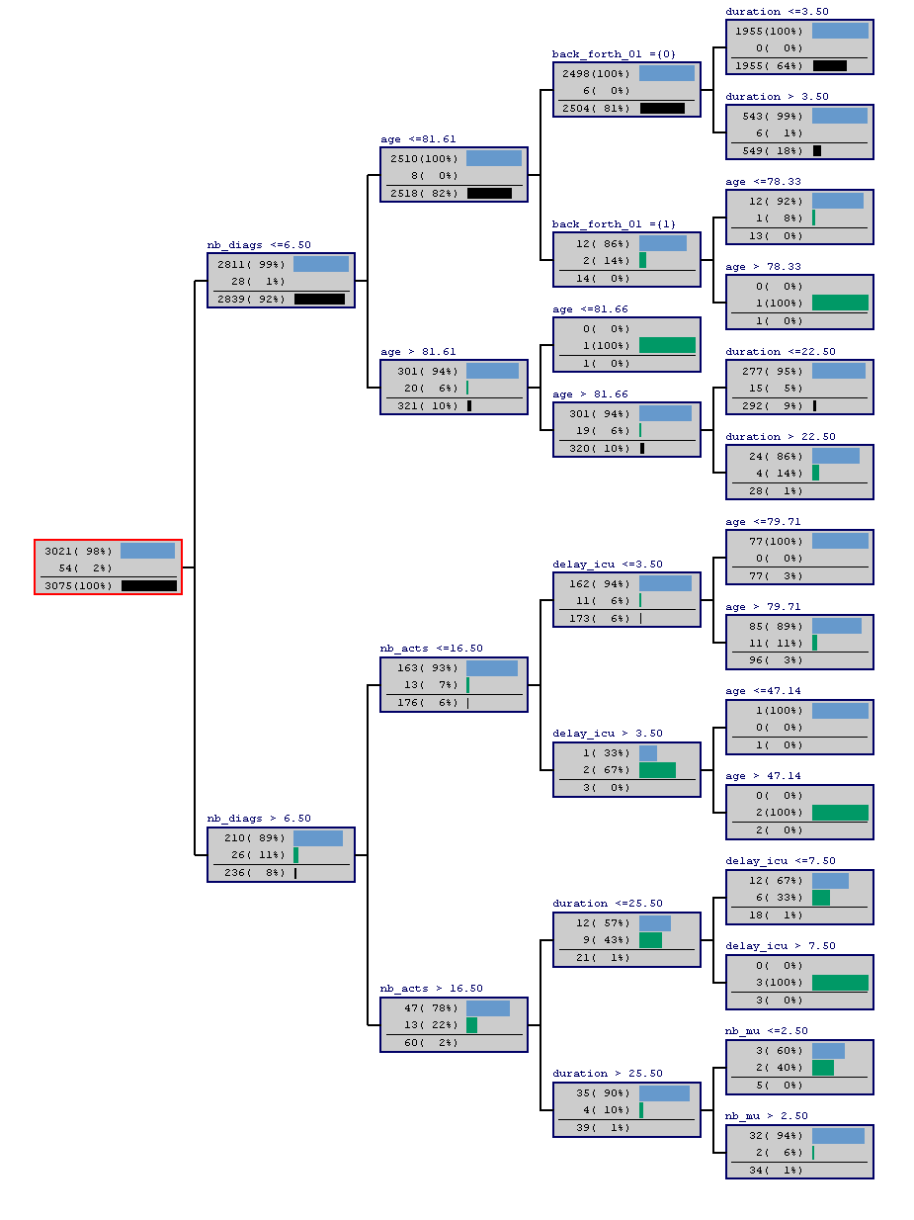
Actual result: risk of death
Explanatory variables: ~20 administrative variables, ~500 laboratory results, ~500 drugs. Result: old people die more than young people…

Slide 15
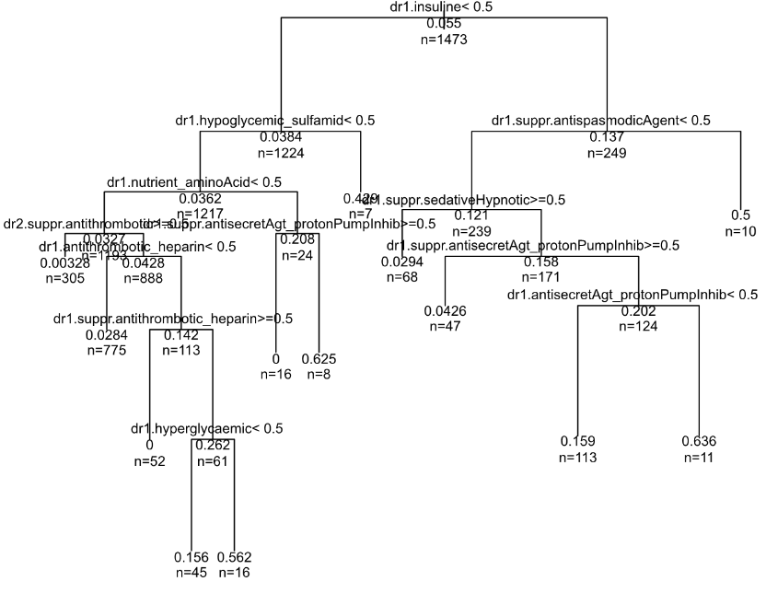
Actual results: risk factors of hyperglycemia…

Slide 16
The failure of fully-automated machine learning
Supervised data mining:
  Good predictive power
  Enables to filter, reorganize and explain knowledge
“Black boxes”, such as deep learning
  Better predictive power
  Does not enable to manage knowledge!
However, some other steps are from far more crucial: feature extraction

Slide 17
Feature extraction

Slide 18
Structured data reuse process in healthcare
Routine patient care
Phase 2: Feature extraction
Phase 3: Statistical and graphical mining
Phase 4: Expert filtering and reorganization
Phase 1: Data pre-processing
Phase 5: Decision making
Individual information: questionnaire-like data
Transactional
databases, e.g. electronic health records
Datawarehouse
Statistical/graphical metrics/associations/models
Knowledge
Traditional health research (questionnaire data)
Health research based on data reuse

Slide 19
The objectives of feature extraction
To reduce
data
complexity
To introduce
domain specific
thresholds
for quantitative
variables
Features
extraction
To reduce
data
imbalance
To handle
heterogeneous
data as generic
time-dependent
events
To make
results more
acceptable
for experts

Slide 20
Feature extraction, example 1: laboratory results
Features
extraction
Example of missing data handling
Formally:
  Example of 2 patients, 2 parameters measured 5 times
  Before: 1 table with 2 lines + 1 table with 10 lines
  After: 1 table with 2 lines

Slide 21
Feature extraction, example 2: administered drugs
Features
extraction
Formally:
  Example of 1 patient, 2 administered drugs
  Before: 1 table with 1 line + 1 table with 2 lines
  After: 1 table with 1 line

Slide 22

Book music
Street organ (Credit: Roman Bonnefoy - Creative Commons Attribution-Share Alike 3.0)

Slide 23
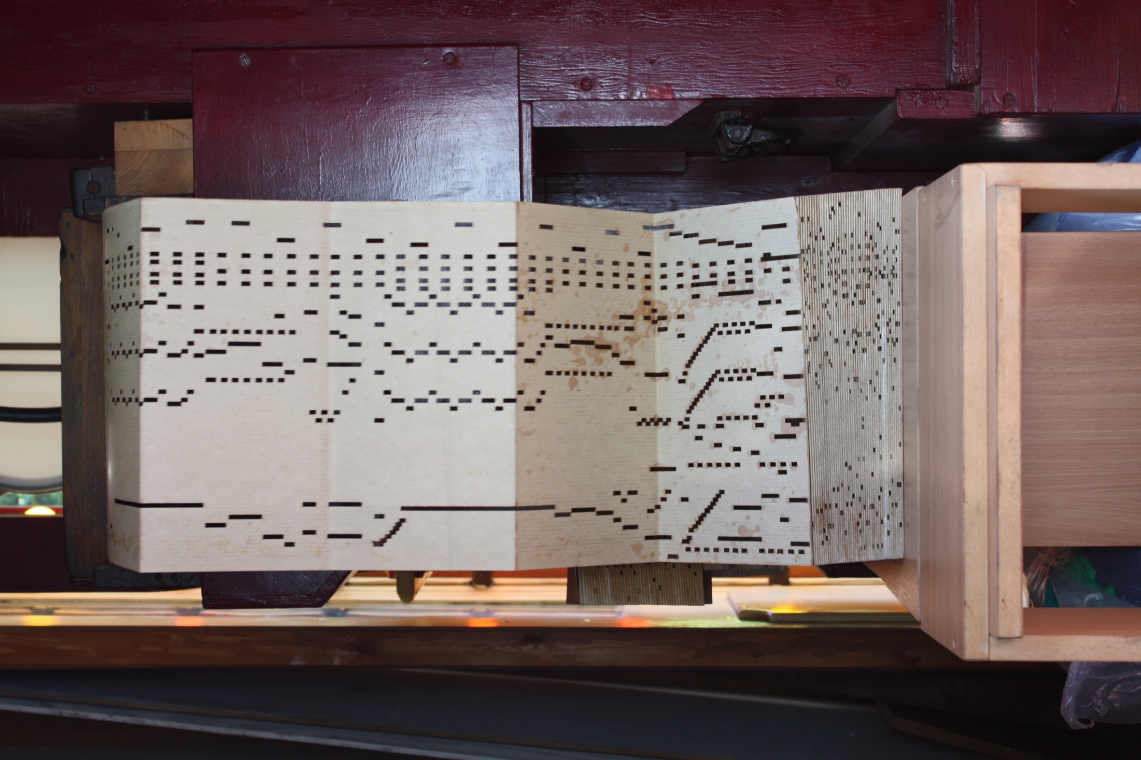
Book music
Time axis
Note (binary: hole=on, no hole=off)
All notes are synchronized
Book music (resized picture - Credit: Richard Ash - Creative Commons Attribution-Share Alike 2.0)

Slide 24
e.g. representation of patient’s flow

Slide 25
e.g. representation of laboratory results

Slide 26
e.g. tabular representation
Book music (expanded view)
Example of tabular representation
id | Variable | From | To
1 | female | 1960-06-30 | +inf
1 | age0_60 | 1960-06-30 | 2020-06-29
1 | Age60_70 | 2020-06-30 | 2030-06-29
… | … | … | …
1 | transfer | 2020-06-30 | 2020-06-30
1 | transfer | 2020-07-03 | 2020-07-03
1 | inhospital | 2020-06-29 | 2020-07-10
… | … | … | …
1 | hyperk+ | 2020-06-29 | 2020-06-30
1 | k+measure | 2020-06-29 | 2020-06-29
1 | k+measure | 2020-06-29 | 2020-06-29
… | … | … | …
Book music (condensed view)
time
V1
V2
V3
V4
V5
V6
V7
V8
V9
V10
V11
V12
…

Slide 27
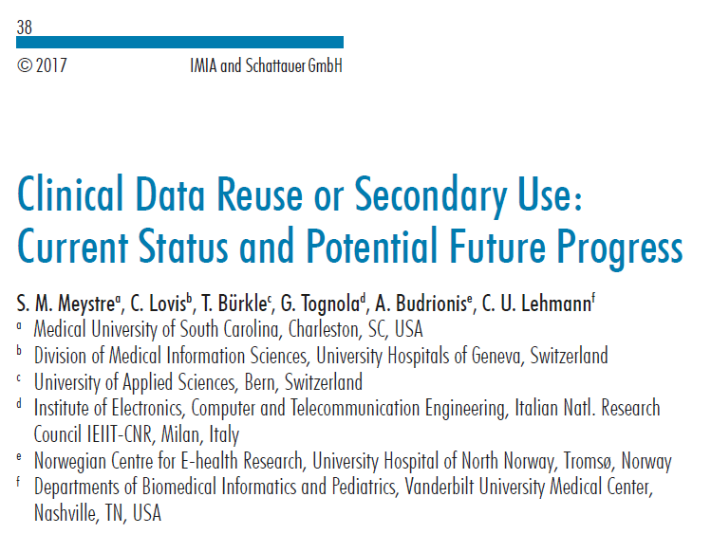
The place of domain-specific knowledge
Literature review published par Meystre et al. in 2017
Classifications performed by Arnaud Dezetrée & Adrien Lecoeuvre

Slide 28
The place of domain-specific knowledge

Slide 29
Needs / wishes
Defining methodological framework or methods for feature extraction
Methods for statistical mining of time-dependent data

