Slide 1
Tips and Tricks
Good asset management practices
Reasons for bringing this up
Work-order types
Closing codes
  Problem, Failure, Cause, Action

Slide 2
Background
Predictive maintenance:
  We started during 2021 to look closer at predictive maintenance for equipment in infor EAM (collaboration with the Infor company)
  First attempt based purely on work-order history (for lifts and compressors) takes into account
    “P” type work-orders = preventive
    “C” type work-orders = corrective/failure
    We realised that
      Very few ‘C’ type work-order corresponded to ‘real’ failures requiring repair
      No (consistent) closing codes were found allowing to filter
        Forced to implement additional screening of work-orders (equipment specific algorithms)
EN maintenance cost working-group (S. Deleval)
  Pin-point area where a lot of effort (and money) is spent

Slide 3
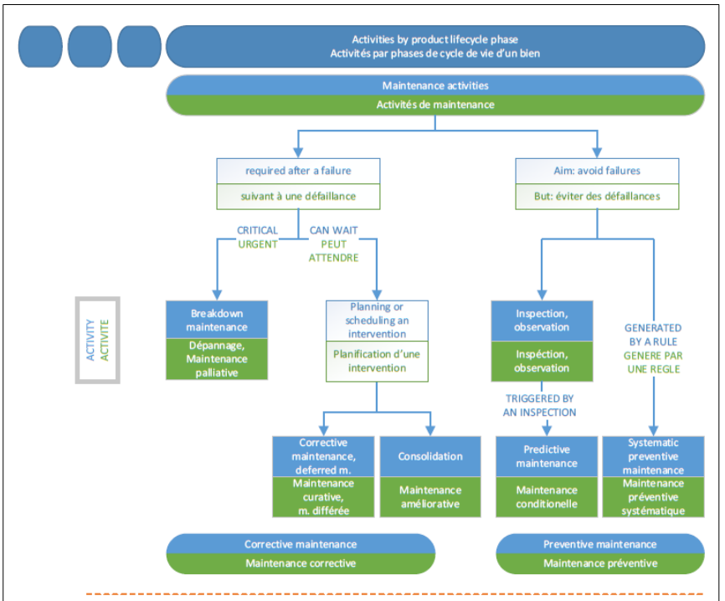
Work-order types (P and C)
P<X> = Preventive
    PM = preventive maintenance
    PS = preventive systematic
C<X> = Corrective (fault / error)
    CD = Corrective Depannage (repair)
    CA = Corrective Amelioration (improvement)
System WO types:
  MTF
  INSP
  EX
  ..

Slide 4
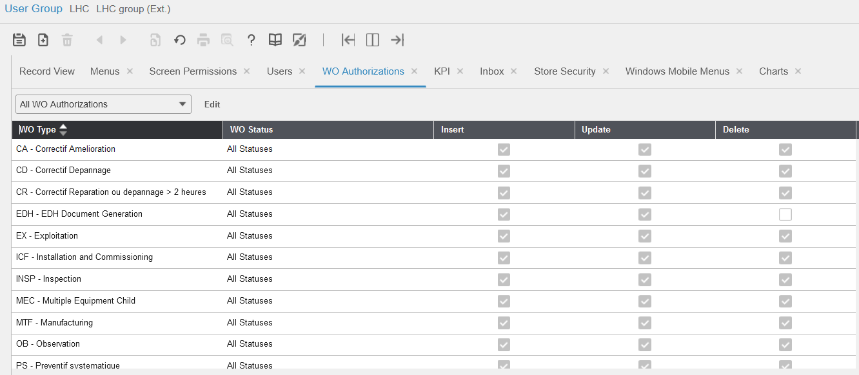
Work-order authorisations (per user-group)

Slide 5
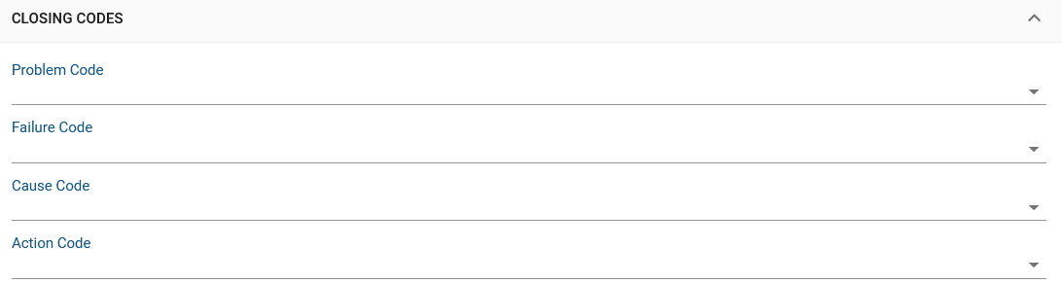
Closing codes
Documentation:
https://edms.cern.ch/ui/file/1309527/11.3/Infor_EAM_Closing_Codes.pdf
https://edms.cern.ch/ui/file/1151891/3.1/Guideline_Closing_Codes_Infor_EAM_20180308_v31_docx_cpdf.pdf
Code | Explanation | Examples
Problem code | What is observed (top level) | Computer not working
Failure code | Technical reason (person intervening) | No power on socket
Cause code | Root cause | Excessive vibration
Action code | What was done | Fuse replaced
Closing code panel in EAM Light (work-order):

Slide 6
Final comments
Get in touch with us if you
  Have any questions about WO types or closing codes
  Have candidates for predictive maintenance
cmms.support@cern.ch

