Slide 1
Fast ramping magnet’s powering for the Muon Collider
F. Boattini, D. Aguglia and G. Brauchli
Electrical Power Converters (SY/EPC) group
20/09/2021

Slide 2
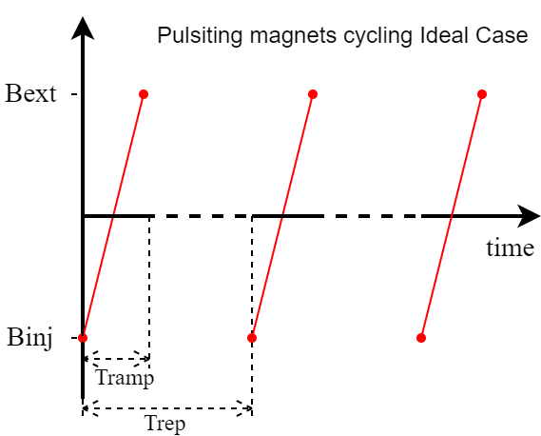
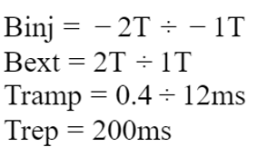

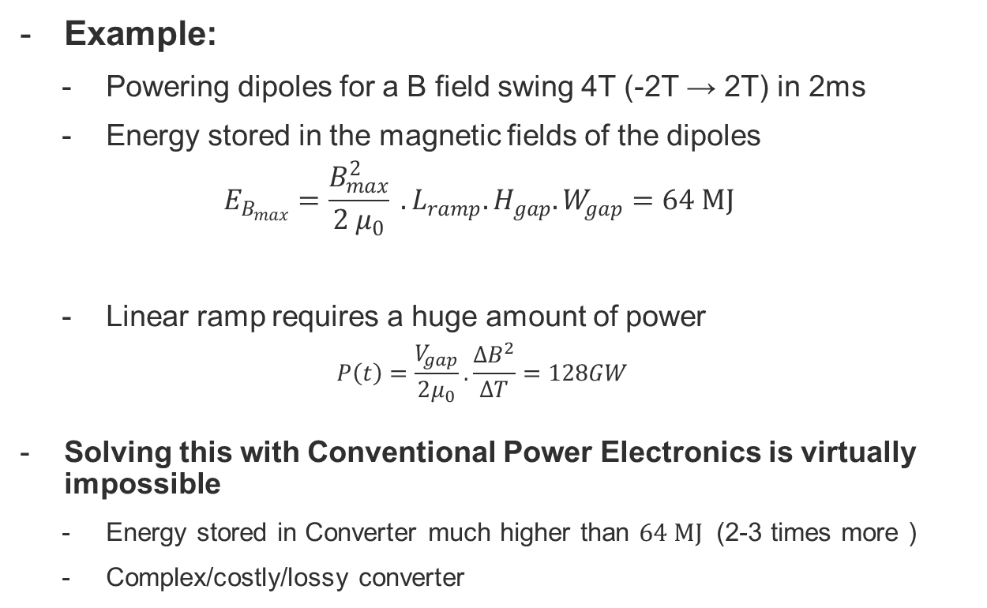
Introduction: Problem Statement
Powering dipole magnets with fast rising magnetic field with repetition frequency of 5Hz
Example:
  Powering dipoles for a B field swing 4T (-2T → 2T) in 2ms
  Energy stored in the magnetic fields of the dipoles
  $$E_{B_{max}}=\frac{B_{max}^{2}}{2 μ_{0}} . L_{ramp}.H_{gap}.W_{gap}=64 MJ$$
  Linear ramp requires a huge amount of power
  $$P_{ }\left(t\right)=\frac{V_{gap}}{2μ_{0}}.\frac{ΔB^{2}}{ΔT}=128GW$$
Solving this with Conventional Power Electronics is virtually impossible
  Energy stored in Converter much higher than $64 MJ$ (2-3 times more )
  Complex/costly/lossy converter
$$V_{gap}$$

Slide 3
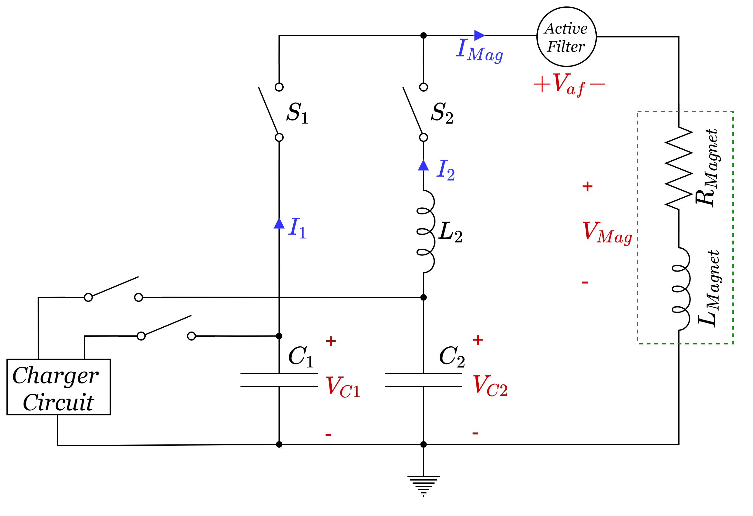
An alternative strategy: resonant converter
Natural resonant discharge
  The energy initially stored in the capacitors is transfer to the magnets
  Lineal ramp approximated by resonance of two harmonics
Active Filter (AF)
  Built with modern power electronics.
  Corrects current through magnet (α B-Field) to make it linear
Advantages
  Less power handle by Power Electronics
  Minimum energy storage configuration

Slide 4
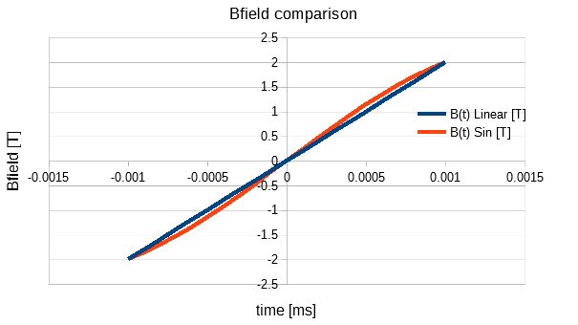
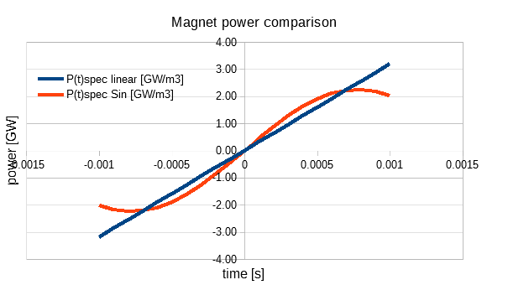
Optimization of the B Field Reference
A further improvement in the design can be achieved if some compromise can be accepted with respect to the linear ramping up of the Bref
B-Field: Linear vs. Sine portion
Peak Power: Linear Vs Sine portion
A portion of sinus slightly deviate from a linear acceleration, but the peak power is greatly reduced (30%)

Slide 5
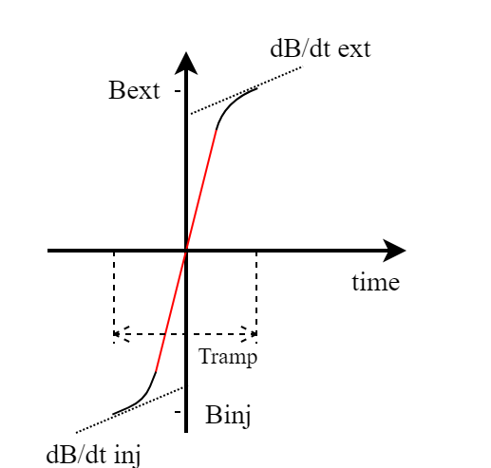
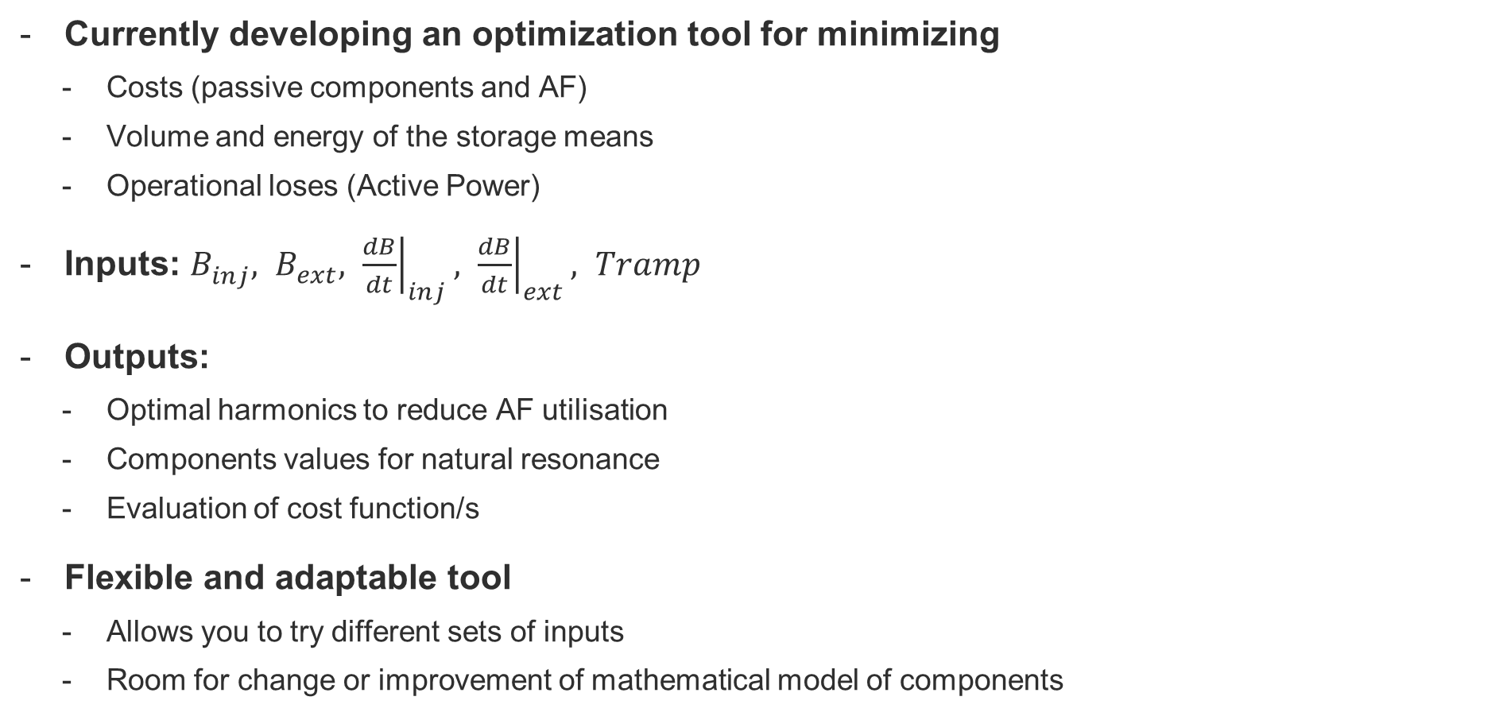
Optimization of the B Field Reference
Currently developing an optimization tool for minimizing
  Costs (passive components and AF)
  Volume and energy of the storage means
  Operational loses (Active Power)
Inputs: $B_{inj}^{ }, B_{ext}^{ }, {\left.\frac{dB}{dt}\right|}_{inj}, {\left.\frac{dB}{dt}\right|}_{ext}, Tramp$
Outputs:
  Optimal harmonics to reduce AF utilisation
  Components values for natural resonance
  Evaluation of cost function/s
Flexible and adaptable tool
  Allows you to try different sets of inputs
  Room for change or improvement of mathematical model of components

Slide 6
Optimization of the B Field Reference
Ramping up:
  Sin. + Linear + Sin.
Inj. and ext. during the sinusoidal portion greatly relaxes the demand on the AF

Slide 7
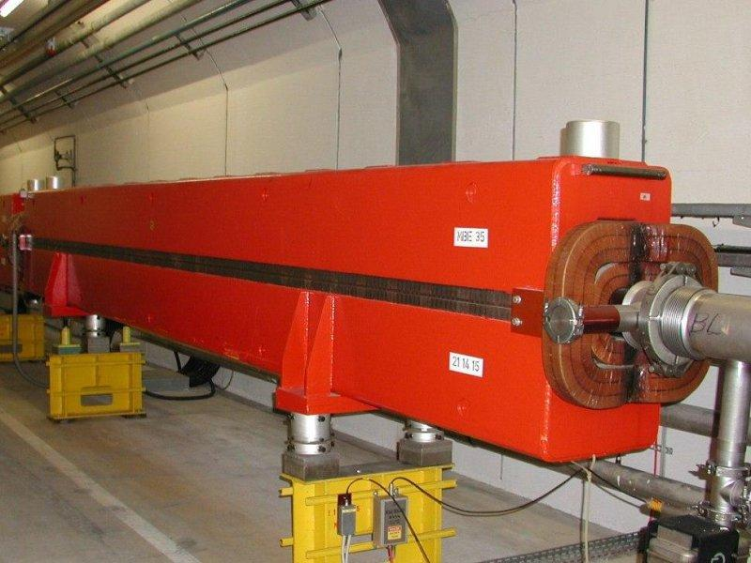
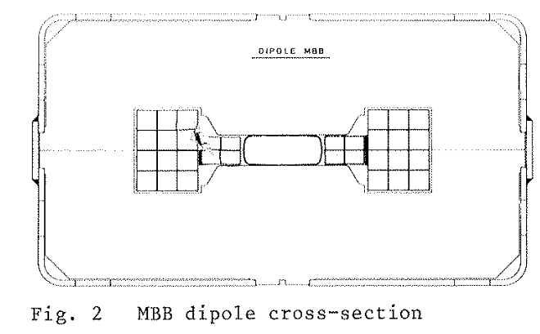
Ramping up magnets (Warm type)
Magnet characteristics are mandatory for an evaluation of the powering system
The SPS magnet type MBE are our baseline for the moment (also 1.8T - 2T range)
It is very important to correctly evaluate the Energy integral over the total volume of the air gap and not only the vacuum chamber
In MBE magnets the total energy is 2.5 times the value calculated only considering the vacuum chamber volume
The input of magnet experts is strongly required!

Slide 8
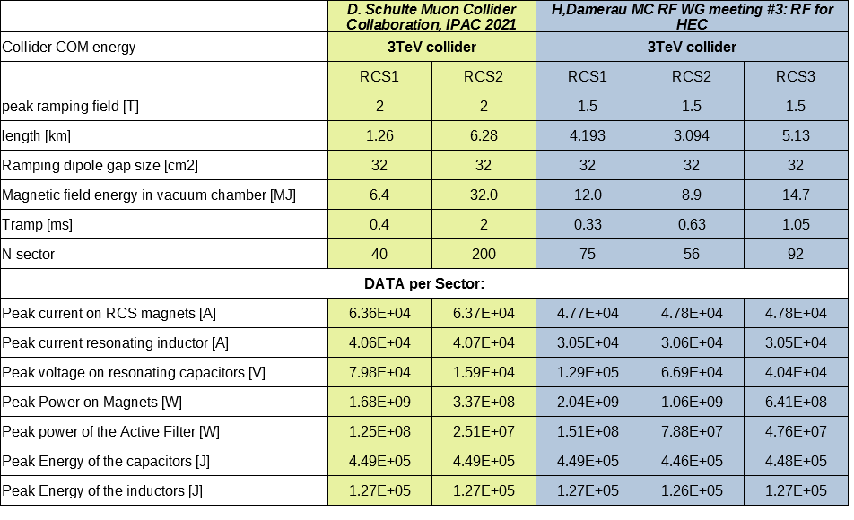
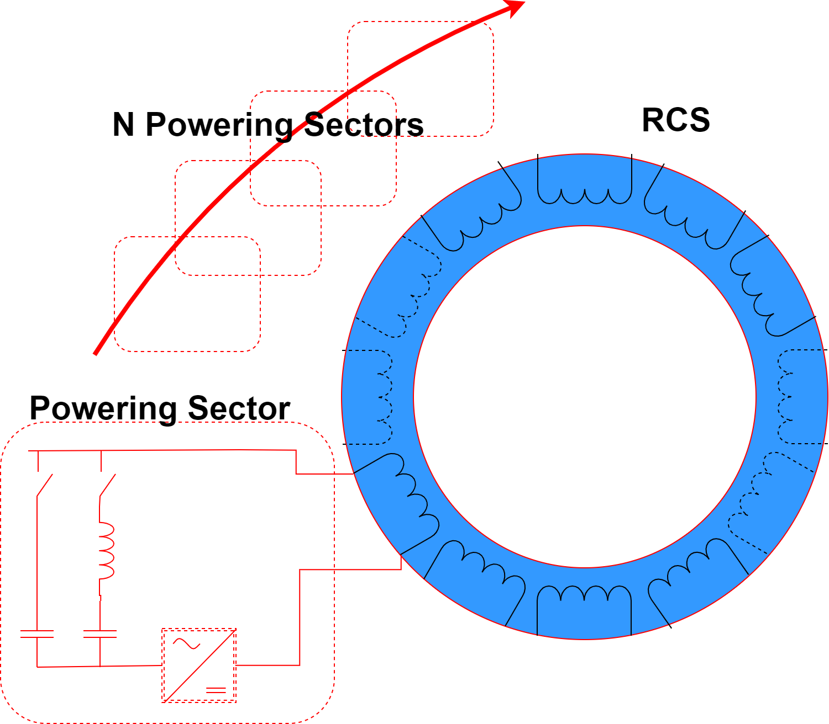
Preliminary results (3TeV collider):
Low inductance magnet (# of turns = 1) 200 Powering Sector
Pulsed operation @5Hz
Acceleration in 2 steps (per sector)
Current on magnets → 60kA
NRG capacitors (total) → 0.9MJ
NRG on inductors → 0.25 MJ
Power of Active Filter (peak) →150MW
Acceleration in 3 steps (per sector)
Current on magnets → 40kA
NRG capacitors (total) → 1.3MJ
NRG on inductors → 0.38 MJ
Power of Active Filter (peak) →280MW

Slide 9
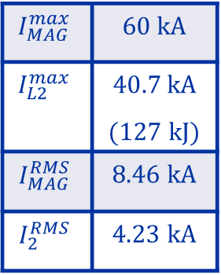
Preliminary results: RCS2 Waveforms
$$I_{MAG}^{max}$$ | 60 kA
$$I_{L2}^{max}$$ | $$40.7 kA$$ (127 kJ)
$$I_{MAG}^{RMS}$$ | 8.46 kA
$$I_{2}^{RMS}$$ | 4.23 kA

Slide 10
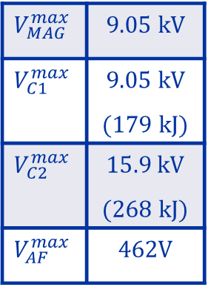
Preliminary results: RCS2 Waveforms
$$V_{MAG}^{max}$$ | 9.05 kV
$$V_{C1}^{max}$$ | 9.05 kV (179 kJ)
$$V_{C2}^{max}$$ | $$15.9 kV$$ (268 kJ)
$$V_{AF}^{max}$$ | 462V

Slide 11
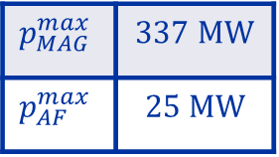
Preliminary results: RCS2 Waveforms
$$p_{MAG}^{max}$$ | 337 MW
$$p_{AF}^{max}$$ | 25 MW

Slide 12
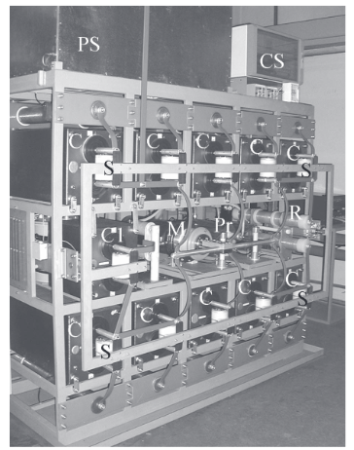
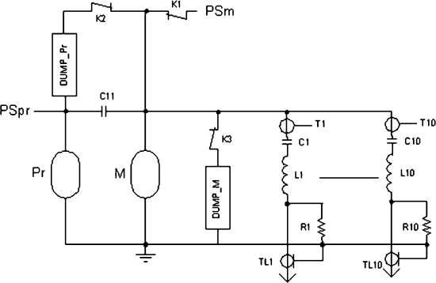
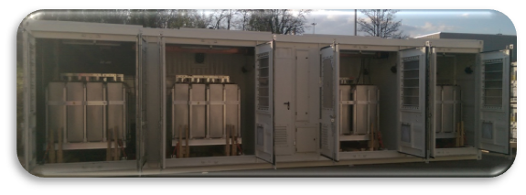
Cost Estimation: example of Capacitors
Muon Collider N of pulses → 10⁹ pulses in 10 years with current peak of 60kA and a repetition period of 200ms
There is no existent application with very high current pulses and fast repetition rate.
Laser Mega Joule (France)
480xCapacitorBankModule ≈ 400MJ
One CBM: 860kJ @ 24kV; 360us wide 240kA current pulse; 1 pulse every 25min; 2500 kg; estimated price 70kCHF
total lifetime → 200’000 pulses (12h of the MC)
Cost ≈ 0.09 CHF/Joule
POPS (CERN)
6xCapacitorContainers ≈ 20MJ
One CC: 3.2MJ @ 5kV; 2ms wide 2kA current pulse; 1 pulse every 1.2; 25000 kg; estimated price 500kCHF
total lifetime → 120’000’000 pulses (1 year of the MC)
Cost ≈ 0.15 CHF/Joule

Slide 13
Cost Estimation: example of Capacitors
Muon Collider N of pulses → 10⁹ pulses in 10years with current peak of 60kA and a repetition period of 200us
There is no existent application with very high current pulses and fast repetition rate.
POPS (CERN)
6xCapacitorContainers ≈ 20MJ
One CC: 3.2MJ @ 5kV; 2ms wide 2kA current pulse; 1 pulse every 1.2; 25000 kg; estimated price 500kCHF
total lifetime → 120’000’000 pulses (1 year of the MC)
Cost ≈ 0.15 CHF/Joule
Attempt for order of magnitude
Cost ≈ 1.5 CHF/Joule
Applying POPS to the MC, we need to reduce the Efield in the capacitor by a factor of 2-3, therefore the energy density by a factor 4-9
Is that enough? Too much?
With the same large approximation
Only Material, no Civil Engineer no installation:
Cost Capacitor ≈ 1.5 CHF/Joule
Cost Inductance ≈ 0.8 CHF/Joule
Cost Active Filter ≈ 0.2 CHF/Wpk
Acceleration for 3TeV collider in 2 stages → 2.2BCHF
Acceleration for 3TeV collider in 3 stages → 4.2BCHF

Slide 14
Next Steps and Conclusions
Define a R&D Road Map
  Power electronics for Active Filter and Switches
  High voltage storage capacitor with fast pulse discharge and high repetition rate
  Inductor design
  Samples testing is required to determine limits of NRG storage elements in MC application conditions
Necessary cooperation with magnet’s expert for a combined optimisation
  NRG of the airgap versus vacuum chamber (how can we minimize it?)
  Magnets’ design should aim at reducing the total inductance due to pulsed operation (voltage levels)
  Can we increase the peak current above that required for injection-extraction? (beneficial for the powering system)

Slide 15
Conclusion
- Power scheme not addressable with standard power converters
  Resonant circuit relieves power demands on the electronics
Reach a compromise in the waveform of B-Field
  To reduce linear portion as much as possible
Need for input from magnet’s expert in the near future
High number of power sectors/converters (>200)
  To prevent large voltage levels and isolation issues.
  Power of individual sector still challenging
R&D greatly required in many fields (storage means, power switching, …)
  To determine the feasibility of the powering and estimate costs

