Slide 1
Banff Challenge 2a Results
Tom Junk
Fermilab
PHYSTAT2011
CERN
18 January 2011
The Challenge: Signal Significance
Designing the Problems
Figures of Merit
Submissions Received and Performance

Slide 2
A Little History
Banff Challenge 1: Upper limits on a signal in a Poisson counting experiment with
a background predicted with the help of another Poisson counting experiment
From the Banff 2006 workshop. Files and results are available at
http://newton.hep.upenn.edu/~heinrich/birs/
http://doc.cern.ch/yellowrep/2008/2008-001/p125.pdf
The idea: A open forum to test coverage and power using data samples
with and without signal present
Blind: signal “answers” hidden from the participants.
Many different strategies used: Frequentist, Bayesian, mixtures....
Quite a success! But...
We’d also like to make discoveries. Only of particles/phenomena that
are truly there of course.
Additional issues must be addressed in discovery that aren’t relevant for limits.

Slide 3
Original Banff Challenge 2
Discovery significance with a realistic set of problems
  Distributions (histograms, or unbinned data) that look like modern
  multivariate analysis outputs
  A distribution that has a bump in it (or not)
  Rate and Shape uncertainties in distributions – some quite large
All of these features are present in most modern searches at hadron colliders.
Often the signal yield is smaller than the uncertainty on the background
(as determined from theory or control samples)
Not very many solutions attempted by the time of the workshop (Summer 2010)
Topics discussed at the workshop needed to be addressed in the challenge.
The challenge needed to be advertised to a larger audience

Slide 4
Discovery Issues Addressed by Banff Challenge 2a
The “Look Elsewhere Effect”, which also goes by these names
  Trials Factor
  Multiple Testing / Multiple Comparisons
Note: setting limits doesn’t really have a LEE although there is a
multiple testing effect that makes mass limits weaker
Dealing with nuisance parameters which are poorly constrained by
auxiliary experiments (or theory)
Large vs. small numbers of events of signal and background – in the
same distribution!
Finite Monte Carlo parameterizations of the expected
signal and background predictions
Measurements – cross sections and masses (“point estimation”
in statistics jargon) along with hypothesis testing
Estimations of power of the test by the analyzer

Slide 5
Discovery Issues Not Addressed by Banff Challenge 2a
3σ “evidence” and 5σ “discovery” levels. To keep the computation and storage
requirements under control, we asked for a Type-I error rate (= false discovery
rate) of no more than 0.01. Far fewer simulated data sets are needed to measure
this rate than 3σ and 5σ significances
Multiple channels – a feature of Banff Challenge 2 but not 2a.
Shape uncertainties – also a feature of BC2 but not 2a.
Many components of signal and background – BC2a problem 2 has two kinds
of background, while a “real” search can have 10 or more
Many nuisance parameters
For example, a search for a new particle that decays to W+jets has as backgrounds:
Wbb, Wcc, Wc, W+LF, Z+jets (bb, cc, LF), WW, WZ, ZZ, ttbar, single top (s, t, tW), non W
and these often can be broken into subcategories.
These last four are judgment and bookkeeping exercises – defining an appropriate set of
nuisance parameters and applying them properly to all predictions is part of the daily
business of a HEP experimentalist. Discoveries often hinge on them.

Slide 6
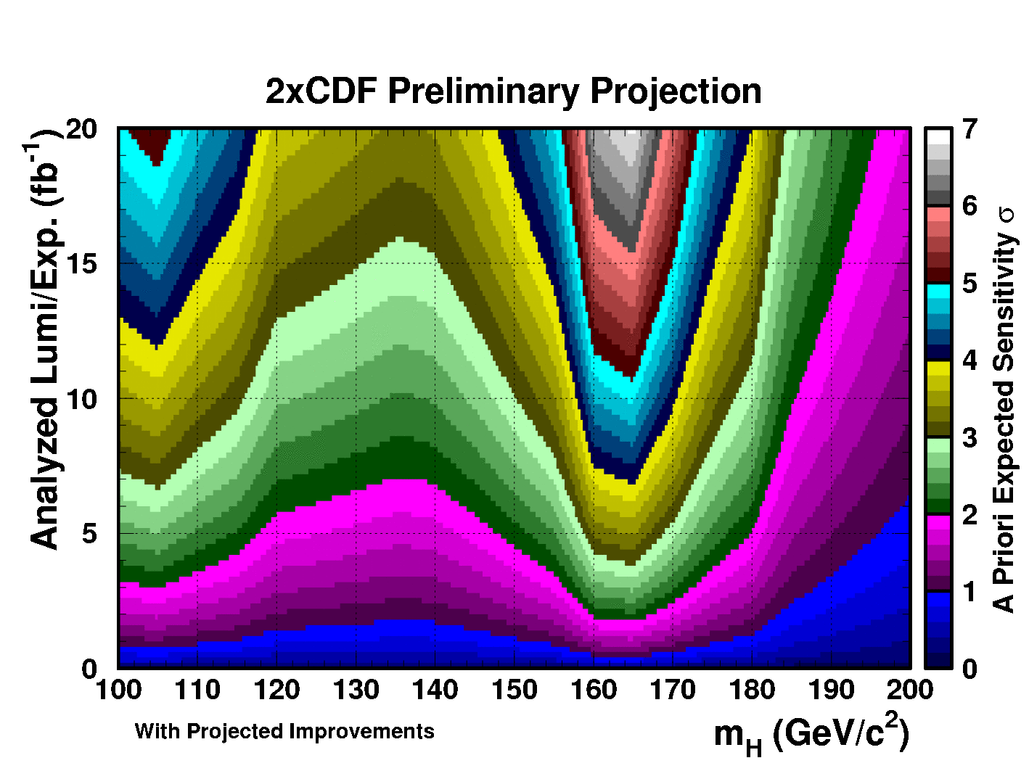
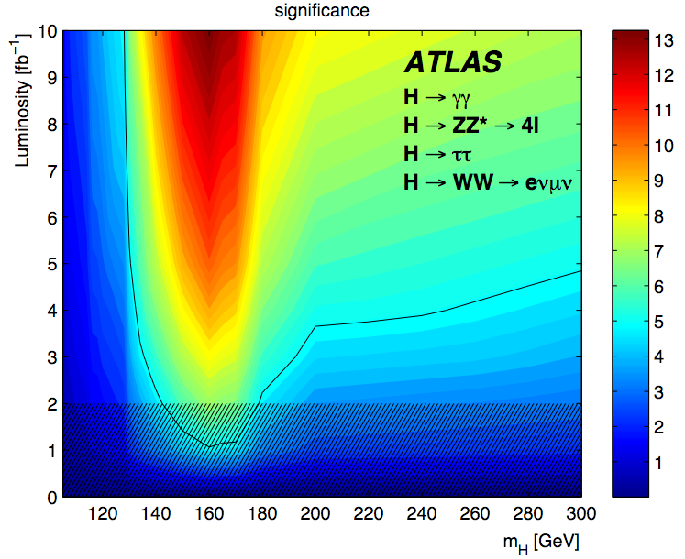
Importance of Power Estimations
Example: Higgs Sensitivity vs. Integrated Lumi
CERN-OPEN-2008-020, “Expected Performance of the ATLAS
Experiment”: arXiv:0901.0512v3 [hep-ex]
Plots like these are inputs to decision-making processes!
It is important not to overstate or understate sensitivity (overstating it is worse).

Slide 7
Figures of Merit – how to Pick a Method
I don’t speak for everyone, but this is my preference:
1) Method should have coverage at the stated level (Type-I error rate ≤ 1% when we
use that as a target. 3σ and 5σ are more customary and coverage should hold for those
thresholds as well) A “yes-no” issue.
2) The quoted sensitivity should not be an overestimate. A “yes-no” issue.
3) The most powerful quoted sensitivity then helps us select a method.
4) We may use different methods for measuring peak positions and cross sections
that have little to do with the method used to make the hypothesis test.
-- Coverage first, then estimated power.
Usual: “check the pulls” and work at it until you get it right. Feldman-Cousins provides
a way of calibrating all measurements so coverage is okay – you can always add that as
a last step.

Slide 8
Documentation, Challenge Datasets, and Submission Descriptions
The problem specifications and data files with challenge
datasets and Monte Carlo signal and background templates:
http://www-cdf.fnal.gov/~trj/
Summary note, submitted entry descriptions, the “answer keys”
and the programs used to generate the challenge datasets:
http://www-cdf.fnal.gov/~trj/bc2sub/bc2sub.html

Slide 9
A Big Thanks to All of the Participants
Participant | Problem 1 | Problem 2
Tom Junk | LLR+MINUIT+MC | LLR+MCLIMIT binned
Wolfgang Rolke | LLR+MINUIT+MC | LLR+MINUIT parameterized marks
Valentin Niess | Windowed event counting | KS Test + MC parameterized marks
Stefan Schmitt | Fractional Event Counting aux MC to correct p values for LEE | Fractional Event Counting binned marks
Stanford Challenge Team B. Efron, T. Hastie, O. Muralidharan, B. Narasimhan, J. Scargle, Robert Tibshirani, Ryan Tibshirani | LLR+MC “Lindesy’s method” Binned Poisson | LLR+MC Parameterized marks
“LLR” =
log likelihood
ratio
“-2lnQ”
“Δlogλ”
More
complete
descriptions
are available
from the
participants
notes
Continued
on next page

Slide 10
A Big Thanks to All of the Participants
Participant | Problem 1 | Problem 2
Ofer Vitells and Eilam Gross | LLR + explicit LEE-corrected p-values from a χ² distrib LEE corr calibrated with MC | LLR + χ² distrib p values binned marks
BAT Team: F. Beaujean, A. Caldwell, S. Pashapour | Bayesian LEE accounted for in prior p-value first, then further Bayesian selection
Georgios Choudalakis | BumpHunter
Mark Allen | LLR+MC – repeated fit with different initial params
Matt Bellis and Doug Applegate |  | Bootstrapped nearest- neighbor + MC
Stefano Andreon | Bayesian – arb threshold

Slide 11
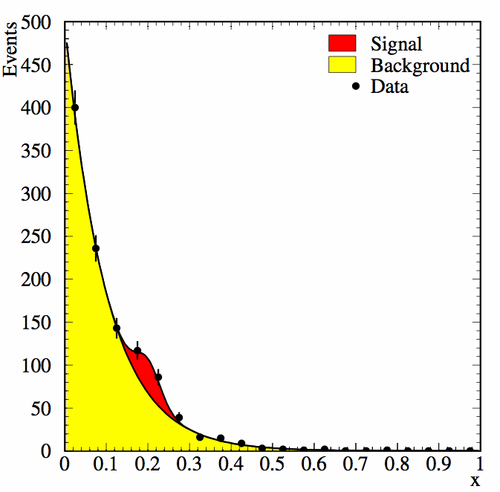
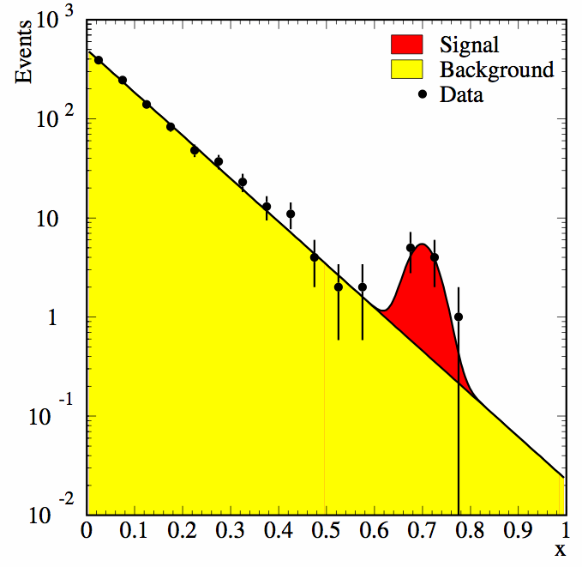
Challenge Parameters – Problem 1
Would like to measure Type-I error rates of 0.01 ± 0.001 → O(10000)
repetitions are needed. We picked 20K total samples, including those with signal.
Would like a LEE of at least 10 – Signal peak width of 0.03 on a histogram
of marks from 0 to 1.
(statistics jargon: A “mark” is a reconstructed quantity, like a measured mass
or a neural network output. We have a “marked Poisson process”.)
Discoveries often
look like these.
O(1000) events per
simulated experiment
to make “high statistics”
and “low statistics”
outcomes possible (see
plots)

Slide 12
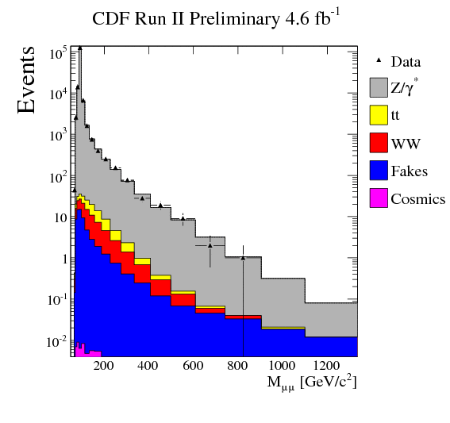
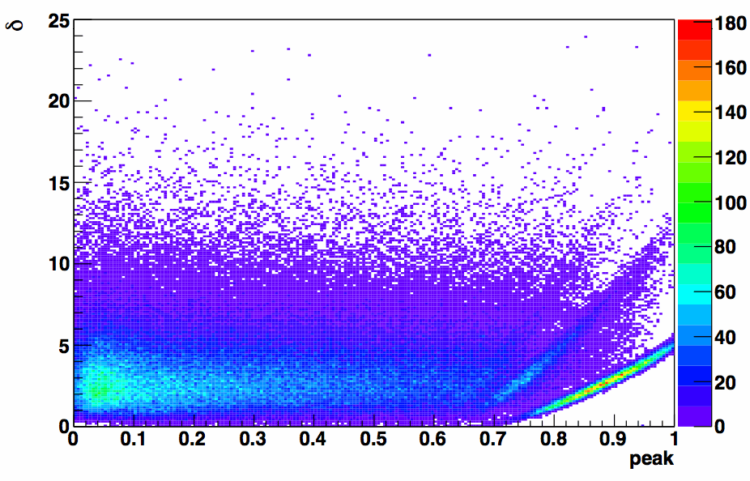
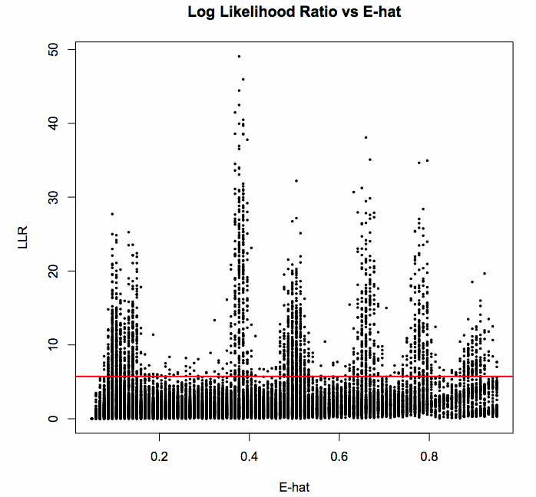
Problem 1 Has High-Statistics and Low-Statistics Extremes
We have to deal with this all the time.
Example: CDF’s Z’ search in the μ⁺μ⁻ channel:
A real search has elements of both Problem 1 and
Problem 2
Mark Allen
Stanford Challenge
Team (B. Efron et al)

Slide 13
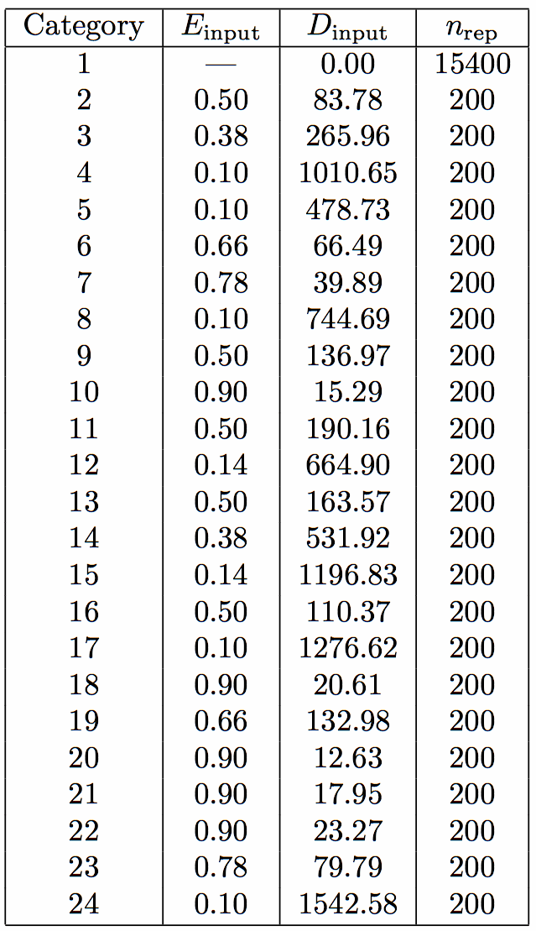
Challenge Parameters – Problem 1
Background:
Signal:
A=10000 ± 1000
C = 10 ± 0
σ = 0.03 ± 0
D, E, unknown, but
D ≥ 0
0 ≤ E ≤ 1

Slide 14
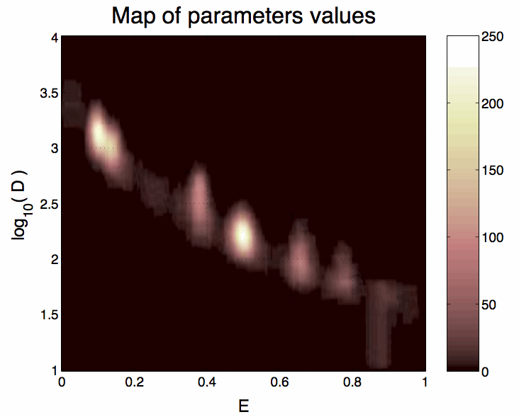
Bump Locations and Rates – Problem 1
Wanted to test the entire range
(but didn’t generate signals right
at the edges of the physical region)
Wanted true discovery rates not
to be all 0% or 100% -- need
rates that are measurable with
the remaining datasets –
200 per signal point.
Three signal models at which
to quote sensitivity
E=0.1, D=1010
E=0.5, D=137
E=0.9, D=18 (the hardest one)
Valentin Niess

Slide 15
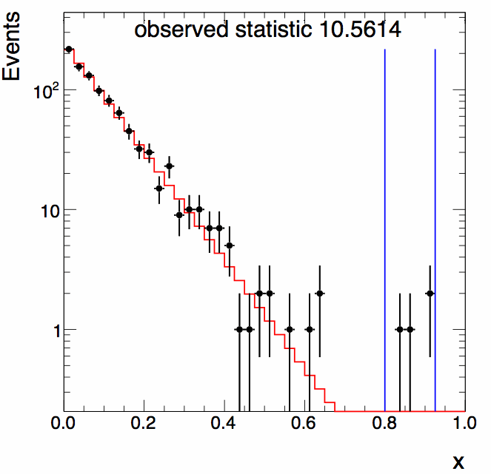
Some of the Signals are Small and Way Out on the Tails
We did say that the background
distribution was exponential, so
the few events out on the end
of this histogram are evidence of
a signal.
But in a real experiment, we’d have a
tough time convincing our collaborators
it’s real. Tails of distributions are
notoriously hard to model reliably.
Importance of assigning proper
systematic uncertainties, which may
be fractionally large on a tail of a
distribution
G. Choudalakis

Slide 16
Handling the Nuisance Parameter
D and E are the “parameters of interest” – we ask for intervals on both,
and want to test H₀: D=0
The background normalization is uncertain at the 10% level however. Fitting the
data gives a fractional uncertainty of
so the a priori (or auxiliary) prediction of A=10000±1000 carries little extra information.
Contributors who fit for A (and all did) thus were immune to the broad distribution of A
chosen in the simulated data.
In the early phases of an experiment, or for selections resulting in too few data,
the auxiliary predictions can be more powerful than the sideband fits. With more
running time, the sidebands overpower the predictions.
The most complicated stage is the crossover – theoretical predictions and sideband
measurements have similar uncertainty.
A real problem may have a mixture of these – some backgrounds are better determined
with MC, others with the data.

Slide 17
Constructing the Datasets
Randomly choose an A from a Gaussian distribution centered on 10000 with
width 1000 (do not let A be negative)
Generate a Poisson number from a distribution with mean A*(0.9999955):
these will be “background” events n_{b}
Generate a number signal events n_{s} from a Poisson distribution of mean
Generate n_{b} marks x for the background events from the exponential distribuiton
Generate n_{s} marks x for the signal events from the Gaussian signal
Shuffle the marks and write to the challenge file.
Save the injected values of A, D, E, n_{b} and n_{s} in an “answer key”
The signal models were chosen from the list of 23 models.
The simulated dataset order was shuffled.

Slide 18
The Prior-Predictive Ensemble
A usual, but not unique choice for handling nuisance parameters in HEP
Fluctuate all nuisance parameters within their priors for each simulated dataset
used to compute p values (and thus coverage)
Has benefits of consistency of treatment
  Setting limits or making discovery – a +2σ excess shows up as a +2σ excess
  in all plots: -2lnQ, cross section limit, cross section measurement,
  p values for H₀ and H_{test}.
  Alternative: supremum p value – the limit plot could show an excess of data
  wrt the background while the discovery plot could show an excess, just because
  we picked the most conservative choice of background for the two
  interpretations.
  Supremum p values don’t line up with the cross section measurement – we don’t
  want always the largest cross section or the smallest, but the best with its
  uncertainty
Behaves in an intuitive way when systematic uncertainties dominiate. E.g., large
data counts, counting experiment. Significance of observation depends on where the
data fall in the tail of the prior for the background prediction.

Slide 19
Quoting Error Rates
We use the prior predictive ensemble – drawing A from its prior, D and E are fixed
for each model tested.
The Type-I error rate is just the fraction of D=0 simulated datasets on which
an analyzer makes a discovery decision
We want this rate to be ≤ 1% to mimic the procedure used to make a discovery at
higher significance levels.
Analyzers fit for A anyhow. Had the prior information on A been dominant over
the fits, we would be discussing how to define the multi-σ tails on the priors
for A.
Similarly for the discovery rates – these are quoted as the fraction of true discoveries
in each of the signal categories.

Slide 20
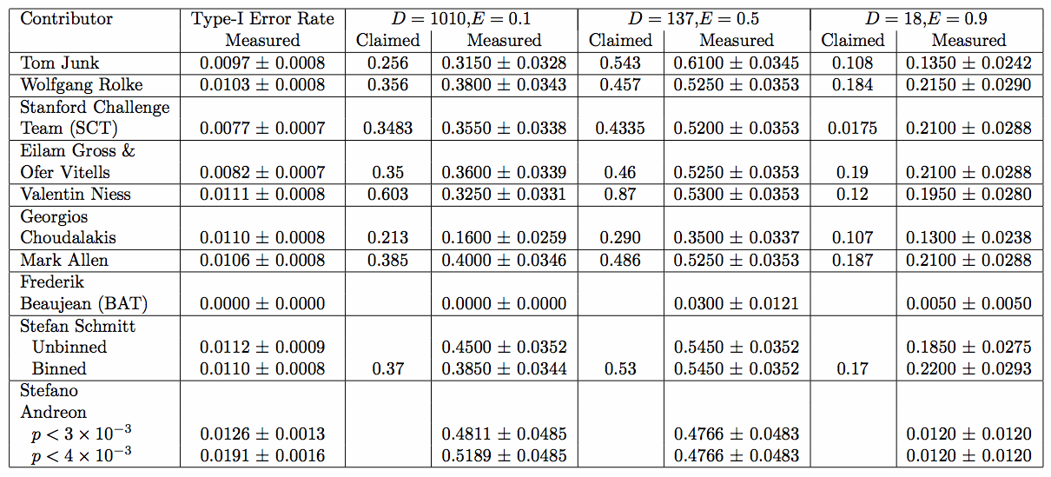
Performance – Problem 1 – Discovery Error Rates
Update from V. Niess: powers of 0.34, 0.46, 0.17 quoted after answers released.
(technical issue resolved not related to the answer key)

Slide 21
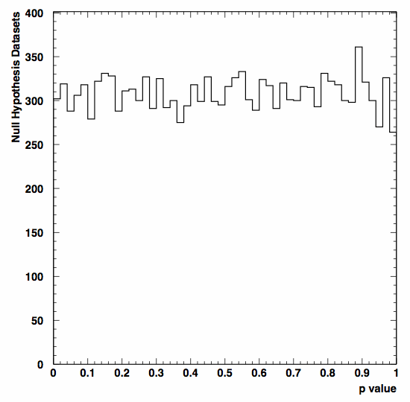
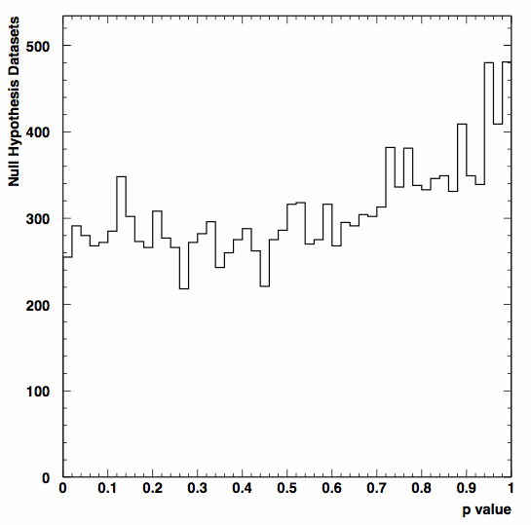
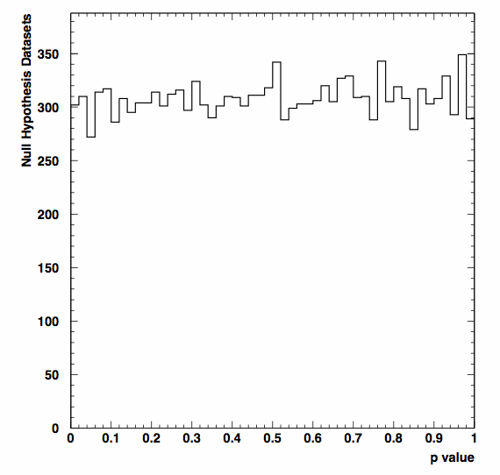
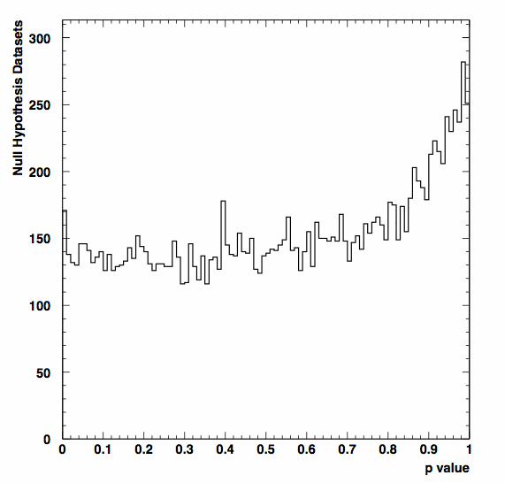
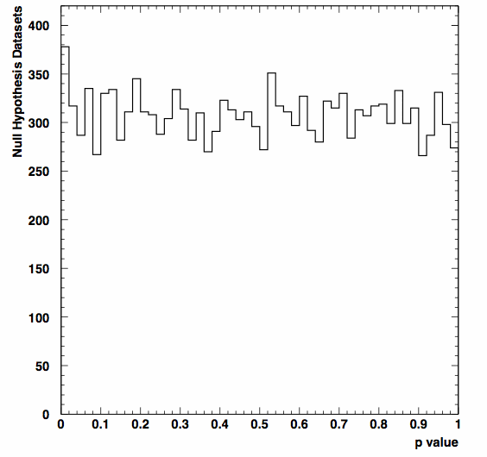
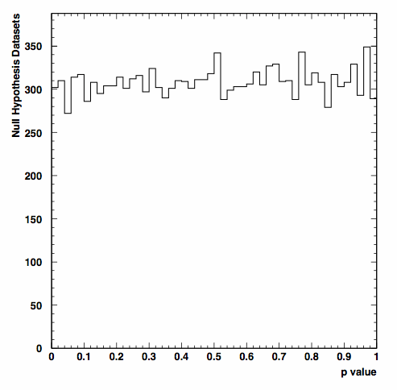
p Value Distributions – Should be uniform on [0,1]
Problem 1
Mark Allen
Tom Junk
LLR, Minuit
Wolfgang Rolke,
LLR, Minuit
Stanford Challenge
Team (B. Efron et al)
Valentin Niess
BAT team
(Frederik
Beaujean et al)
Tom Junk

Slide 22
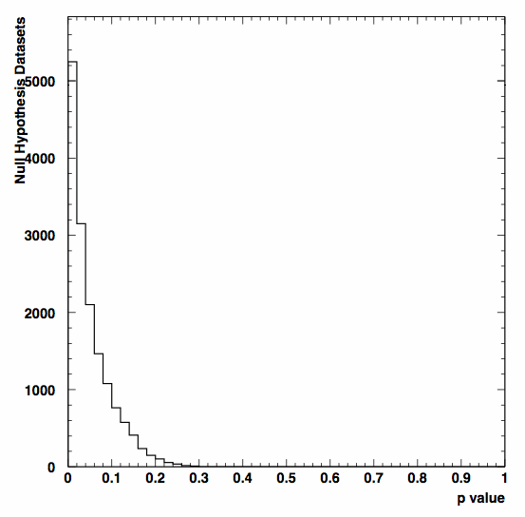
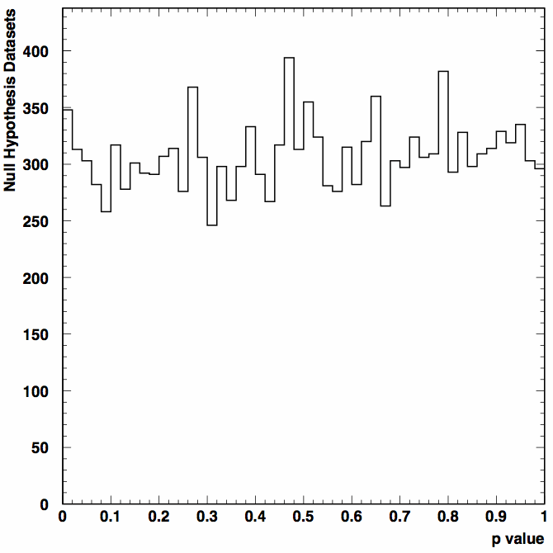
Stefan’s p Values – Correcting for Look-Elsewhere
LEE Correction done with Background-Only Monte Carlo simulation
Stefan
Schmitt
(unbinned)
Uncorrected for LEE
Corrected for LEE
Stefan’s Type-I error
rate is okay, though.

Slide 23
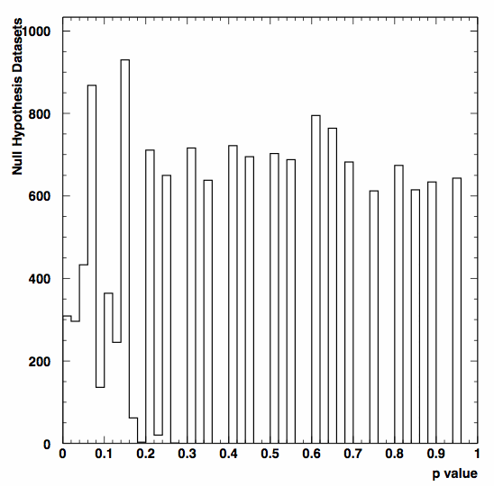
p Value Distributions – Some of the More Interesting Cases
for Problem 1
Georgios
Choudalakis
simulation stopped
when very sure p>0.01
Not a problem for discovery

Slide 24
p Value Distributions – Some of the More Interesting Cases
for Problem 1
Eilam Gross &
Ofer Vitells
LEE-corrected
(max value=3.5)
Large maximum p value
comes from the LEE
correction – See Ofer’s talk
tomorrow.
Not a problem for
discovery. May want to use
this distribution as a test
statistic in case there’s
a 1σ deficit...

Slide 25
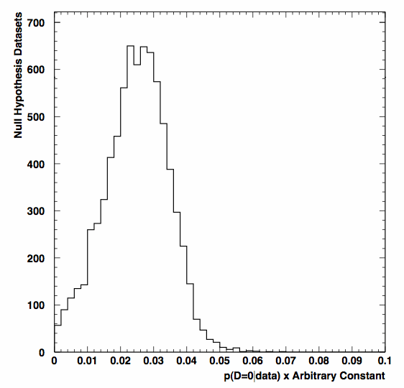
And One Test Statistic Instead of a p Value
Stefano
Andreon
(not a p value
but a posterior credibility
of D=0)
P(D=0|data) – a Bayesian
posterior
This is okay too – but
what’s the critical value?
Stefano chooses 3x10⁻⁴ and
4x10⁻⁴ as possibilities

Slide 26
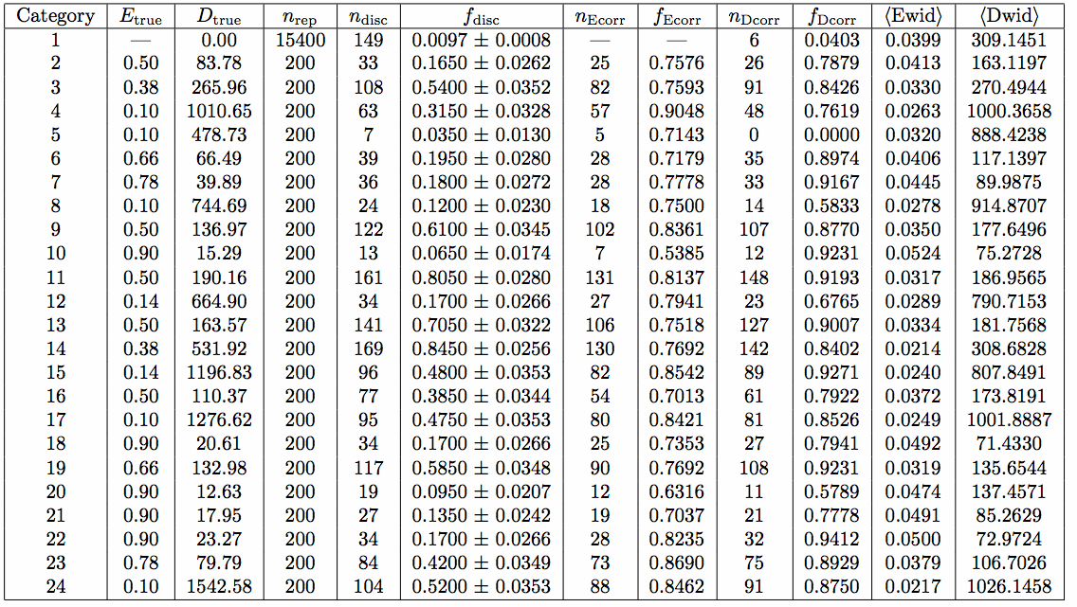
A Typical Error Rate Summary Table
From Tom Junk

Slide 27
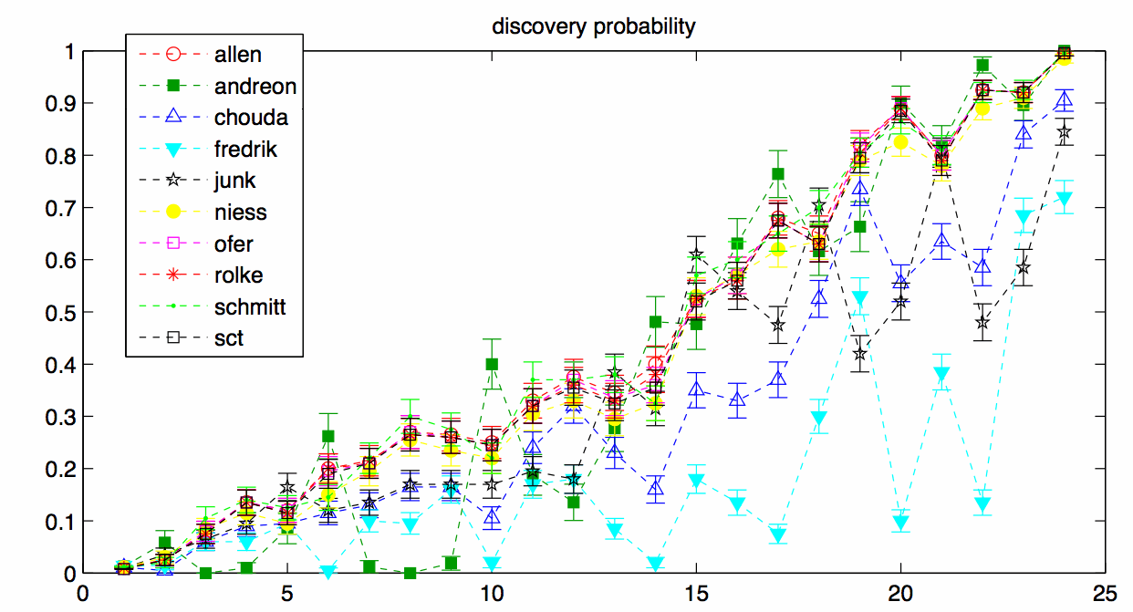
A summary of the Discovery Probabilities
Thanks to Ofer Vitells who
made the plot!
Dataset category sorted by average discovery probability

Slide 28
Making Measurements of D and E
signal
rate
peak
position
Requested 68% intervals for D and E in the case a decision was made to claim
a discovery.
I regret a little bit not asking for these in case a discovery is not claimed.
Reporting only the discovery cases biases the measurements of D upwards.
HEP experiments rarely report measurements of parameters like D and E unless
evidence is claimed.

Slide 29
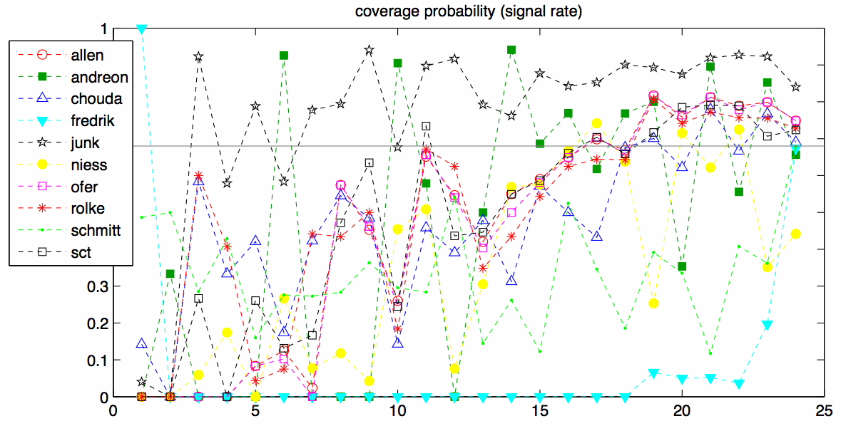
A summary of the Coverage of D Measurements
Thanks to Ofer Vitells who
made the plot!
Dataset category sorted by average discovery probability

Slide 30
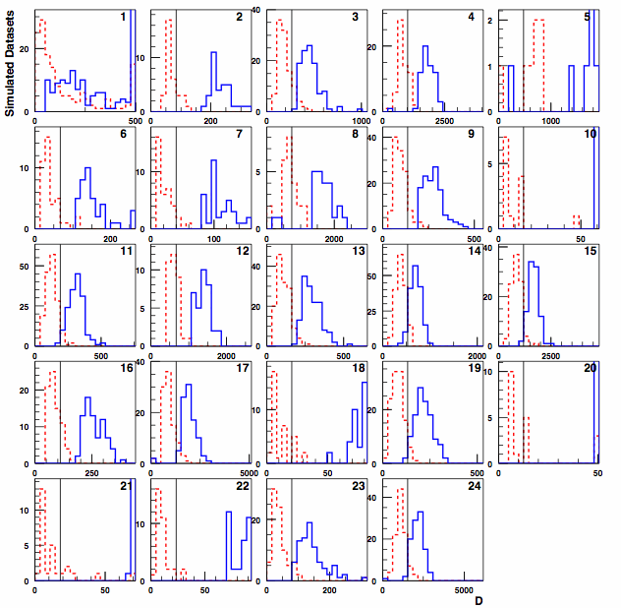
Upper and Lower Interval Edges for D for Each Signal Category
H₀
Large signals
OK, small
signals
biased
upwards
Sum of
fractional
areas of
red > black
and
blue < black
should be < 32%
T. Junk’s
Submission
Tom:
Call mnseek
MINIMIZE
IMPROVE & quote resulting uncertainties on D and E
Lower Interval edges
Upper Interval edges

Slide 31
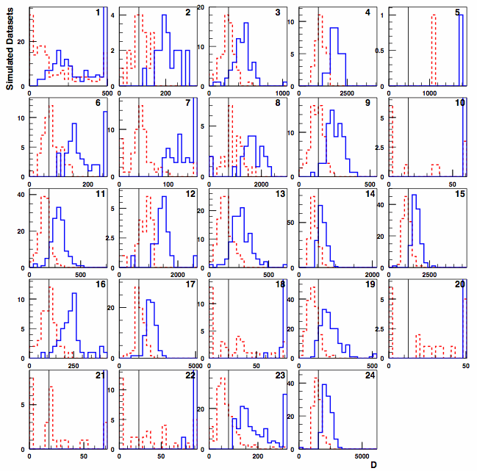
Differences in Participants’ Intervals – This set tends to give too large D
G. Choudalakis
Lower Interval edges
Upper Interval edges

Slide 32
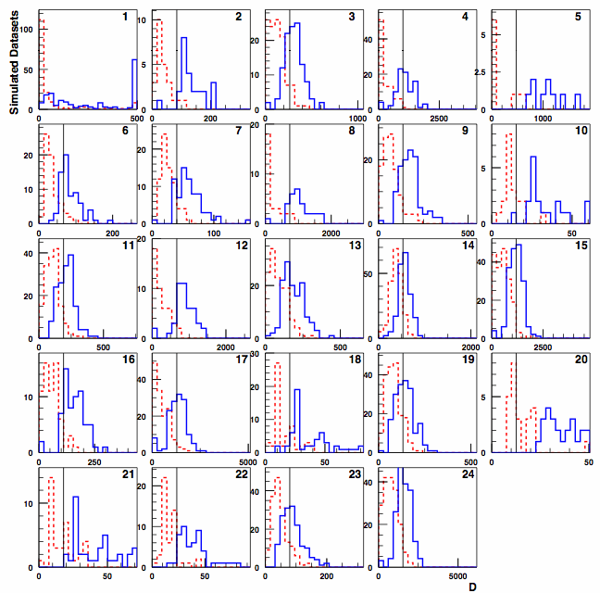
This set tends to give smaller D
More blue
to the left
of the
black
lines.
S. Schmitt,
Unbinned
Lower Interval edges
Upper Interval edges

Slide 33
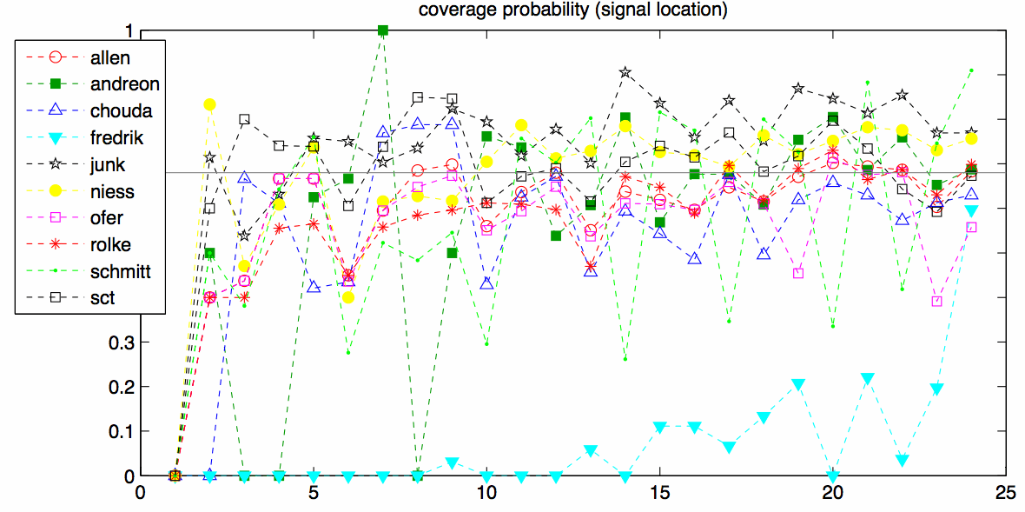
A summary of the Coverage of E Measurements
Thanks to Ofer Vitells who
made the plot!
Dataset category sorted by average discovery probability

Slide 34
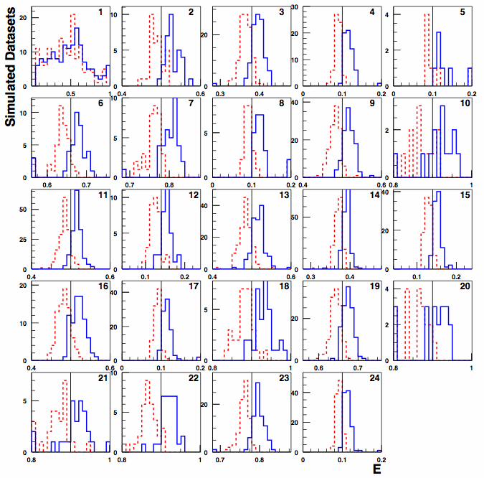
Fraction of Correct Intervals for E
T. Junk’s
Submission
Lower Interval edges
Upper Interval edges

Slide 35
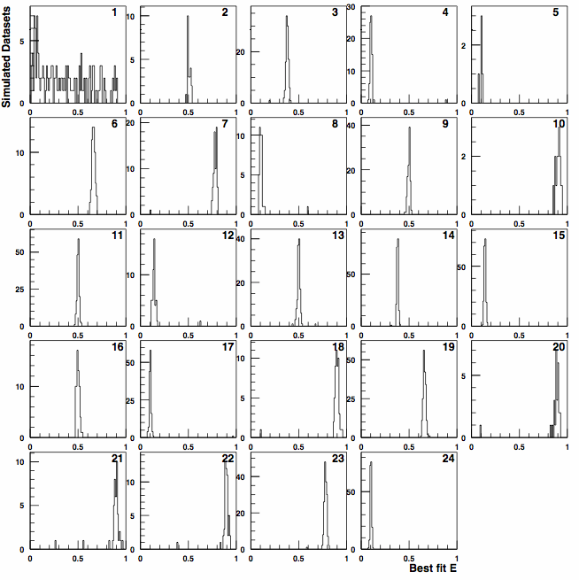
Even Intervals that don’t contain the true value quite often enough tend to still
get the right answer. Intervals just a bit too short.
H₀
W. Rolke
No long tails
Avg. interval
length much
shorter than
Tom’s for
example.

Slide 36
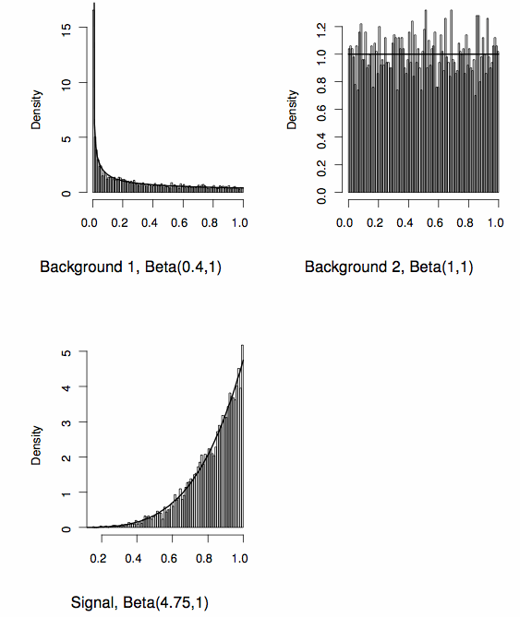
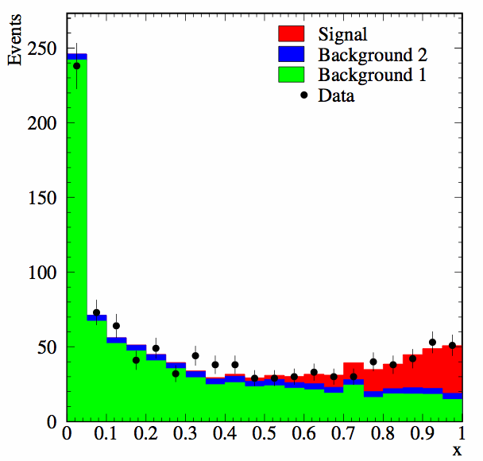
Problem 2 – A Monte-Carlo Parameterized Example
Three processes contribute – Two Backgrounds and one Signal process.
Monte Carlo simulations of each process provided with 5000 events (“marks”)
apiece.
Just one signal model.
-- No LEE!
W. Rolke

Slide 37
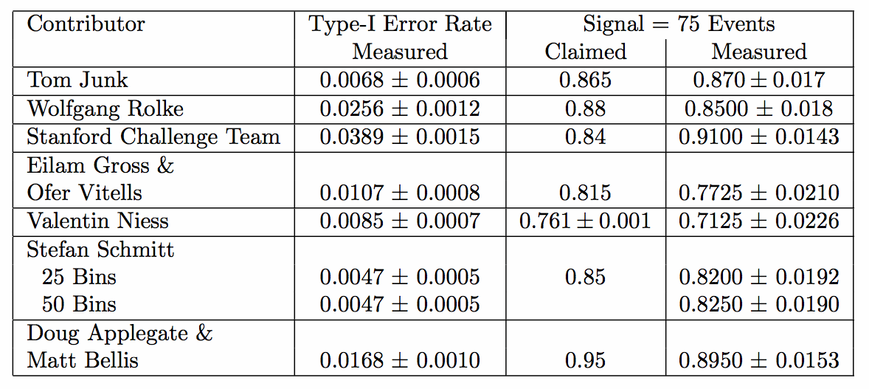
Problem 2 Error Rate Summary

Slide 38
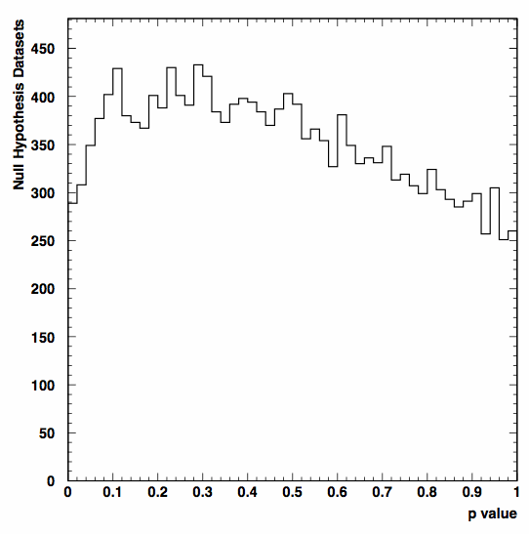
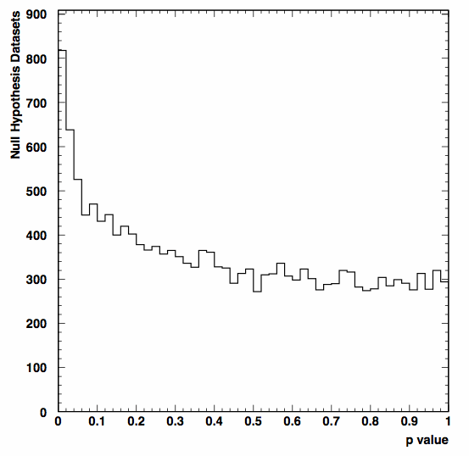
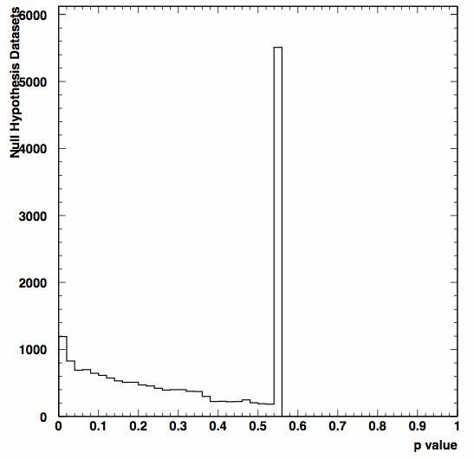
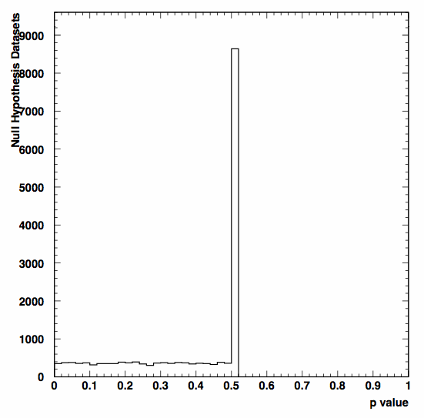
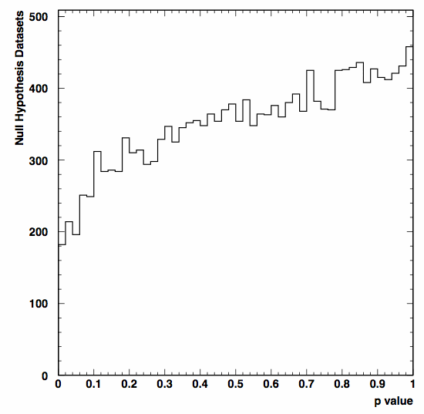
Distributions of the p Value for Problem 2
Should be flat..
W. Rolke
Stanford
Challenge
Team
T. Junk
O.Vitells &
E. Gross
S. Schmitt
(50 bins)

Slide 39
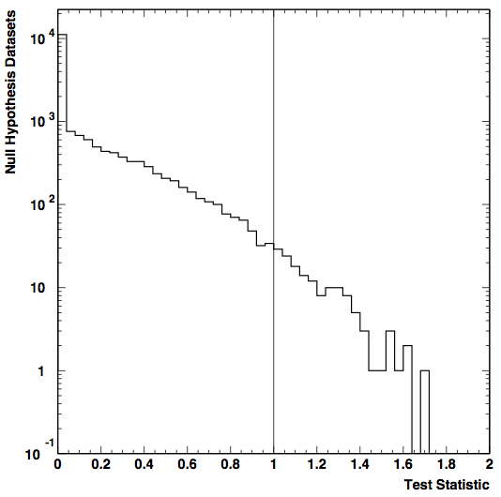
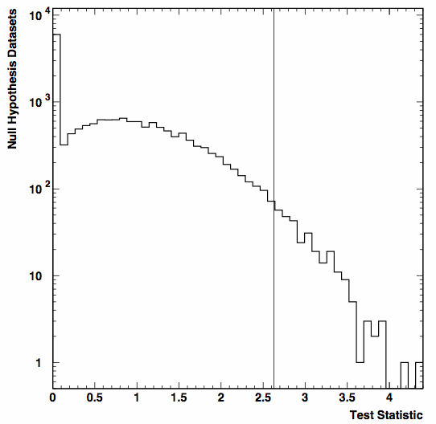
And Some Test Statistics Instead for Problem 2
V. Niess
KS Test Statistic
Matt Bellis and
Doug Applegate

Slide 40
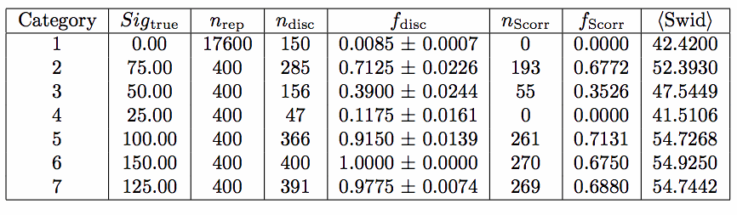
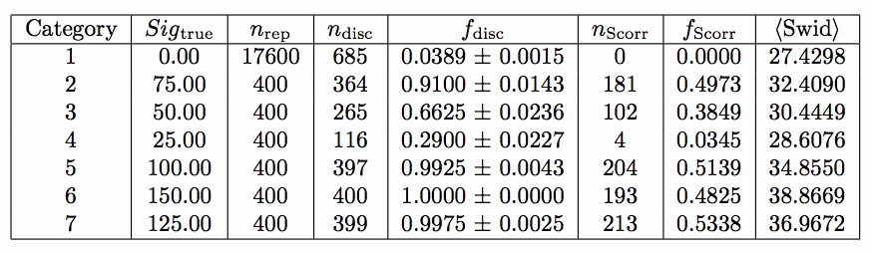
Measuring the Signal Rate in Problem 2
V. Niess
-- coverage
is fine for
most categories.
For categories
1, 3, and 4, we get the usual bias from small signal rates – quote measurements only for
discoveries biases the rates upwards.
Stanford Challenge
Team: Smaller
intervals, less
coverage

Slide 41
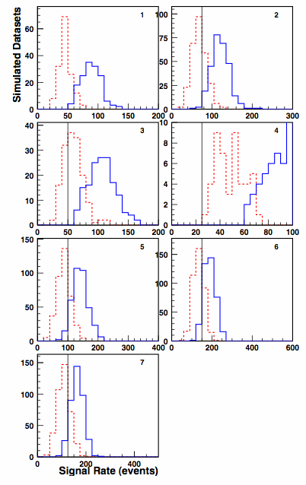
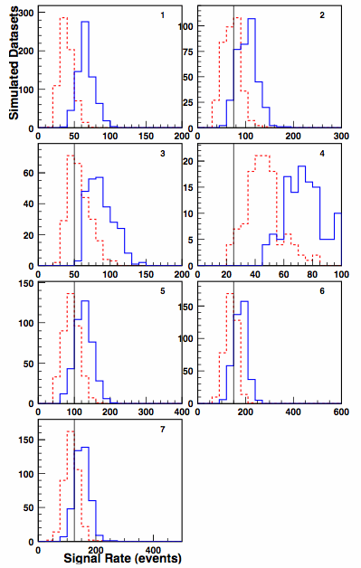
Signal Rate Intervals for Problem 2
V. Niess
Stanford Challenge Team
H₀
H₀
Small
Signal
Small
Signal
Lower Interval edges
Upper Interval edges
Lower Interval edges
Upper Interval edges

Slide 42

Summary
Wow! What a lot of good work went into Banff Challenge 2a.
I am very pleased with the variety and quality of the solutions.
Congratulations to all the participants!
People must be excited about making discoveries. And have time to solve challenges.
Some methods perform better than others. Even methods that are nominally
identical but differ in the details.
Good to do this with a blind test like BC2a.
No one was tripped up by the Look-Elsewhere Effect in Problem 1
Any method used to make a discovery within a collaboration must be characterized
and approved by the collaboration. Good performance on the challenge problems
is not a seal of approval! Participants’ solutions are not to be considered
endorsed by any HEP collaboration.
Some technical issues uncovered here are highly problem-specific. A difficulty
encountered in Problem 2 may not affect a technique’s performance on Problem 1,
for example. It’s a learning exercise to tune up methods on tractable, fairly
realistic problems.

Slide 43
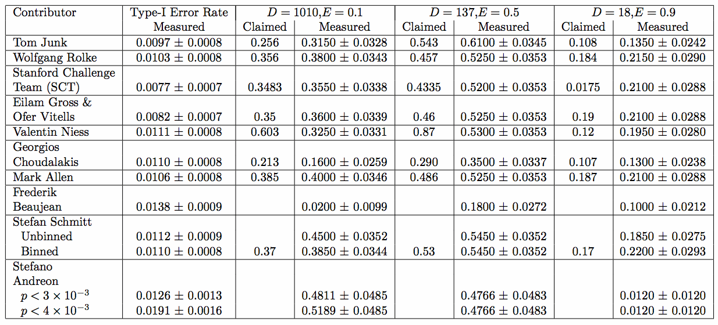
“Winners” – Problem 1
Based on my criteria – coverage first, then estimated power as long as it is not
overestimated, I put these four in the top teams for Problem 1:
Mark Allen
Stefan Schmitt
Wolfgang Rolke
Eilam Gross and Ofer Vitells
Stanford Challenge Team (modulo a typo in the sensitivity in case 3)
Difficult to rank them because no one “won” all three operating points.
All winners have to work on the
point estimation of D and E though!

Slide 44
“Winners” – Problem 2
According to the criteria, these solutions were the best:
Tom Junk (but I don’t count – I knew the answers!)
Stefan Schmitt
Eilam Gross & Ofer Vitells
Problem 2’s priors/aux
experiments have more
ambiguity. What does
±100% mean on bg2?

