Slide 1
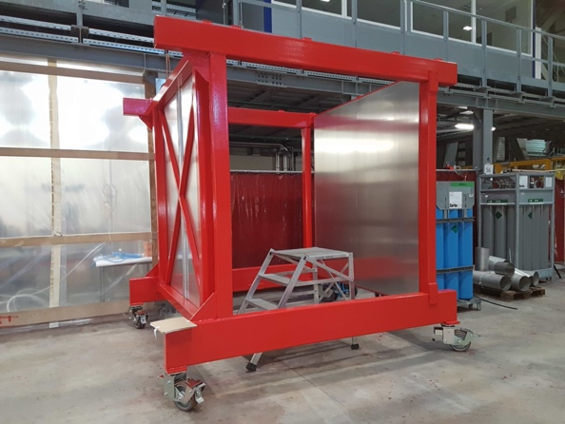
ND280 sFGD Assembly tool
A few ideas to be discussed
(related to BabyBASKET current design)

Slide 2
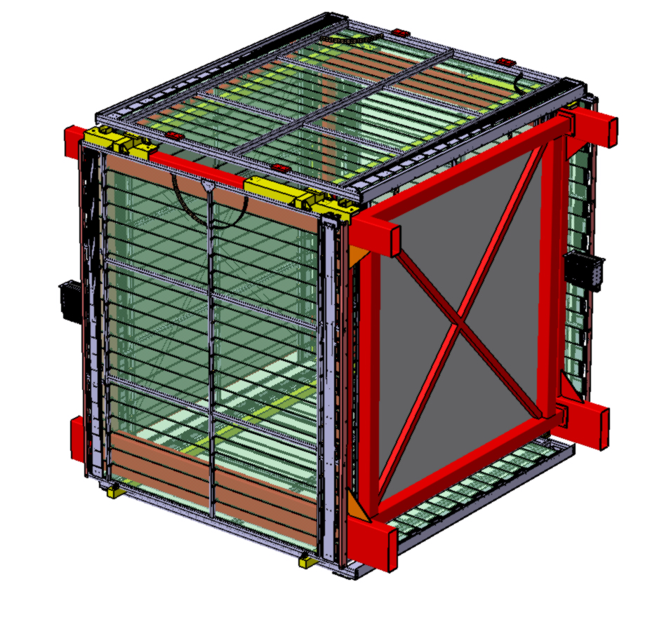
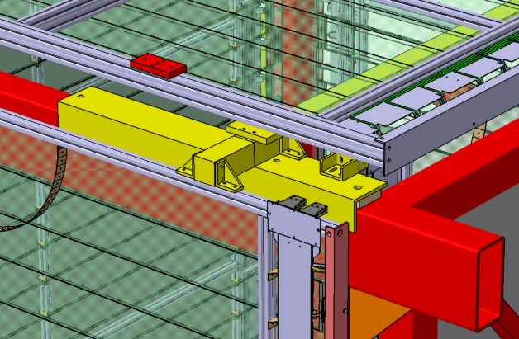
ND280 sFGD Assembly tool
Currently planned for TOF integration (dry assembly for calibration at EHN1)
Starting early next week
Simplified TOF connections (time saving)

Slide 3
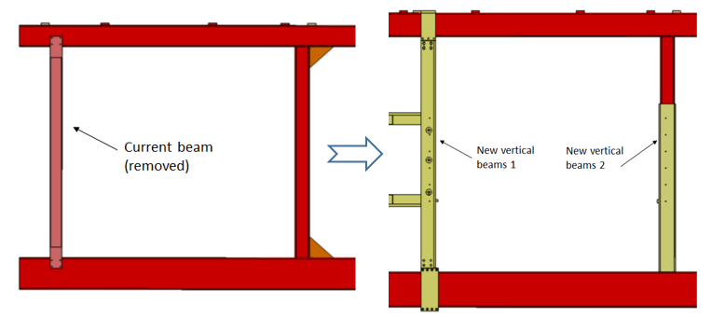
ND280 sFGD Assembly tool
Later some adaptations and modif to be done on BabyBASKET
New vertical beam to accommodate with HA-TPC and sFGD integrations (final boundary conditions)

Slide 4
ND280 sFGD Assembly tool
sFGD in its nominal position
Possibility to add the CRATES for commissioning and preparations

Slide 5
ND280 sFGD Assembly tool
sFGD bracket fixations
Complete rehearsal of the final integration
Clamps for HA-TPC

Slide 6
ND280 sFGD Assembly tool
1240mm high (SFGD mid plane)
BUT without the wheels (about 30cm more / floor)
Better to ADAPT to the sFGD assembly process
A second stand to be built in Japan?
I could help in the design since this is closely linked to the bracket system…
Need also some SPEC document (height, accesses, platform…

