Slide 1

Coherent Instabilities
Xavier Buffat and Nicolas Mounet, CERN/BE-ABP-CEI
Acknowledgements: D. Amorim, S. A. Antipov, N. Biancacci, R. Bruce, E. Carideo, L. R. Carver, S. Fartoukh, S. V. Furuseth, G. Iadarola, A. Mereghetti, L. Mether, E. Métral, A. Oeftiger, Y. Papaphilippou, A. Ribes Metidieri, A. Romano, G. Rumolo, L. Sabato, B. Salvant, M. Soderen, R. Tomás, D. Valuch, J. Wenninger.

Slide 2
Introduction
Beam stability in the LHC is related essentially to impedance and electron-cloud effects (see also talk by L. Mether).
During operation, such coherent instabilities sometimes lead to beam dumps (mainly during Run 1) or beam blow-up, and are still one of the sources of brightness limitation in the LHC.
Main evolutions since Run 2 affecting impedance-related stability:
  low-impedance collimator upgrade (jaws of 2 TCPs and 4 TCSs in IR7 replaced by Mo-graphite ones, Mo-coated for the TCSs),
  increased brightness from the injectors (post-LIU beams),
  energy increase (6.5 ⟶ 6.8 TeV),
  transverse feedback (ADT) improvements (in particular in terms of noise from the pickups).
Main modifications since Run 2 affecting e-cloud effects:
  intensity increase (see later),
  deconditioning (should disappear after scrubbing).

Slide 3
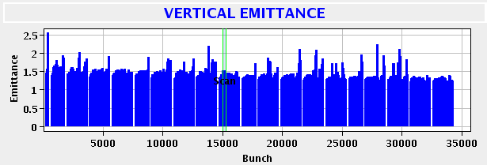
Injection - Lessons learned from Run 2
Possible stability issues are related to electron-cloud.
After scrubbing, instabilities at injection were well contained with a high chromaticity (15-20) and octupole current (~50 A)
    Weak single bunch instabilities remained, with a marginal impact on the beam quality at flat top

Slide 4
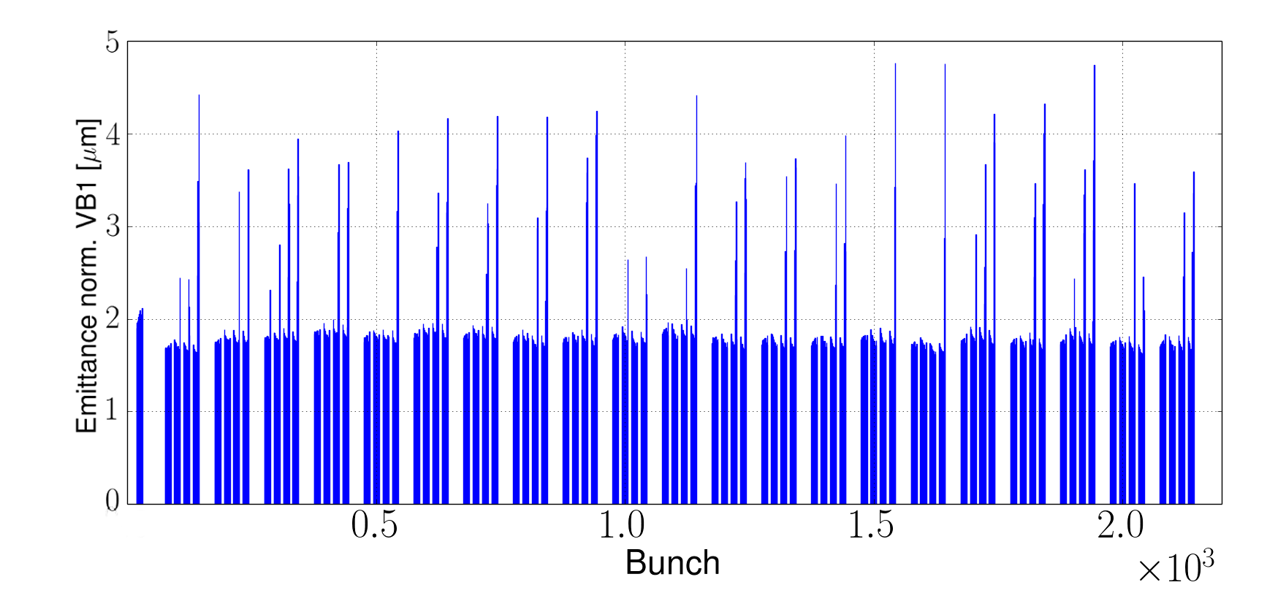
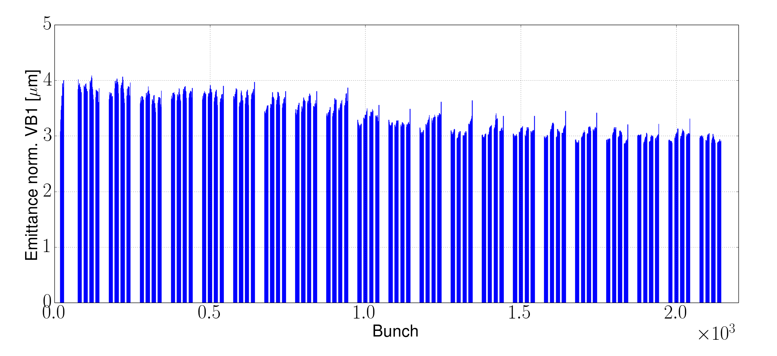
Injection - Recommendation
Improvements are expected with higher bunch intensities, allowing for a reduction of the octupole current:
    ⟹ 50 A and Q’~15-20 (for 1.8 μm emittance) is a very safe starting point.
    ⟹ Possibility to relax these can be determined empirically.
The octupole current should be scaled inversely proportional to the transverse emittance.
0.7e11 p+/b, 56 A in octupoles (12b-trains)
1.8e11 p+/b, 0 A in octupoles (12b-trains)
Some unstable bunches
Fully stable
A. Romano et al., Phys. Rev. Accel. Beams 21, 061002 (2018)
G. Iadarola,et al., Chamonix 2018
L. Sabato et al., CERN-ACC-NOTE-2020-0050

Slide 5
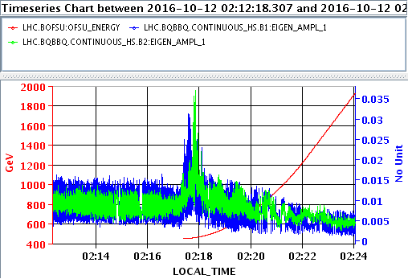
Ramp - Lessons learned and recommendations
Weak single bunch instabilities were observed at the beginning of the ramp, similarly to those of injection (e-cloud).
  Still well-contained if octupole and chromaticity starts at injection values (marginal impact on the beam quality at flat top).
  ⟹ Incorporate injection settings into the ramp – in particular octupoles & chromaticity. ADT gain can be reduced (50 turns).

Slide 6
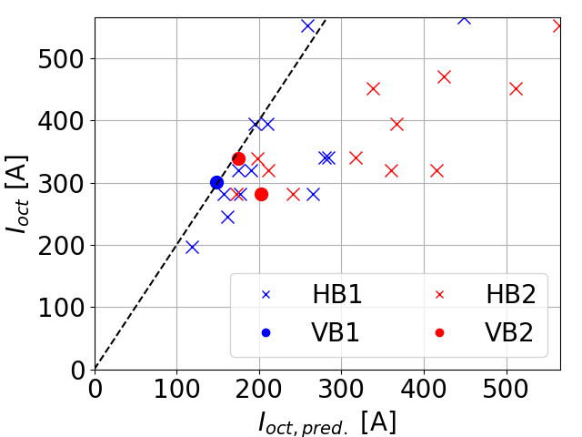
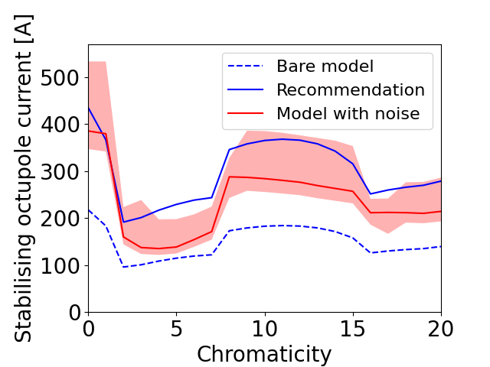
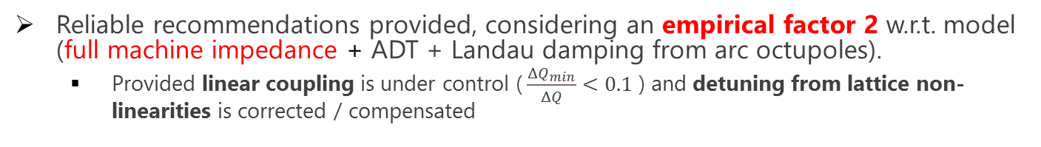
Flat top - Lessons learned from Run 2
Reliable recommendations provided, considering an empirical factor 2 w.r.t. model (full machine impedance + ADT + Landau damping from arc octupoles).
    Provided linear coupling is under control ($\frac{ΔQ_{min}}{ΔQ}<0.1$ ) and detuning from lattice non-linearities is corrected / compensated
No unstable cases above this line
Empirical factor 2 can be understood knowing the impact of noise on Landau damping, within uncertainties (noise amplitude, impedance, residual coupling, emittance measurement).
    noise reduction in the ADT pickups beneficial (upgrade in LS2 – see talk by M. Soderen),
    … but impact on stability at flat top remains marginal (residual noise in the machine).
Currently the chromaticity is kept high (15) to avoid small (or even negative) values.
L. R. Carver et al., Phys. Rev. Accel. Beams 21, 044401 (2018)
X. Buffat et al., in proceedings of Evian 2019
S.V. Furuseth and X. Buffat, Phys. Rev. Accel. Beams 23, 11440 (2020)

Slide 7
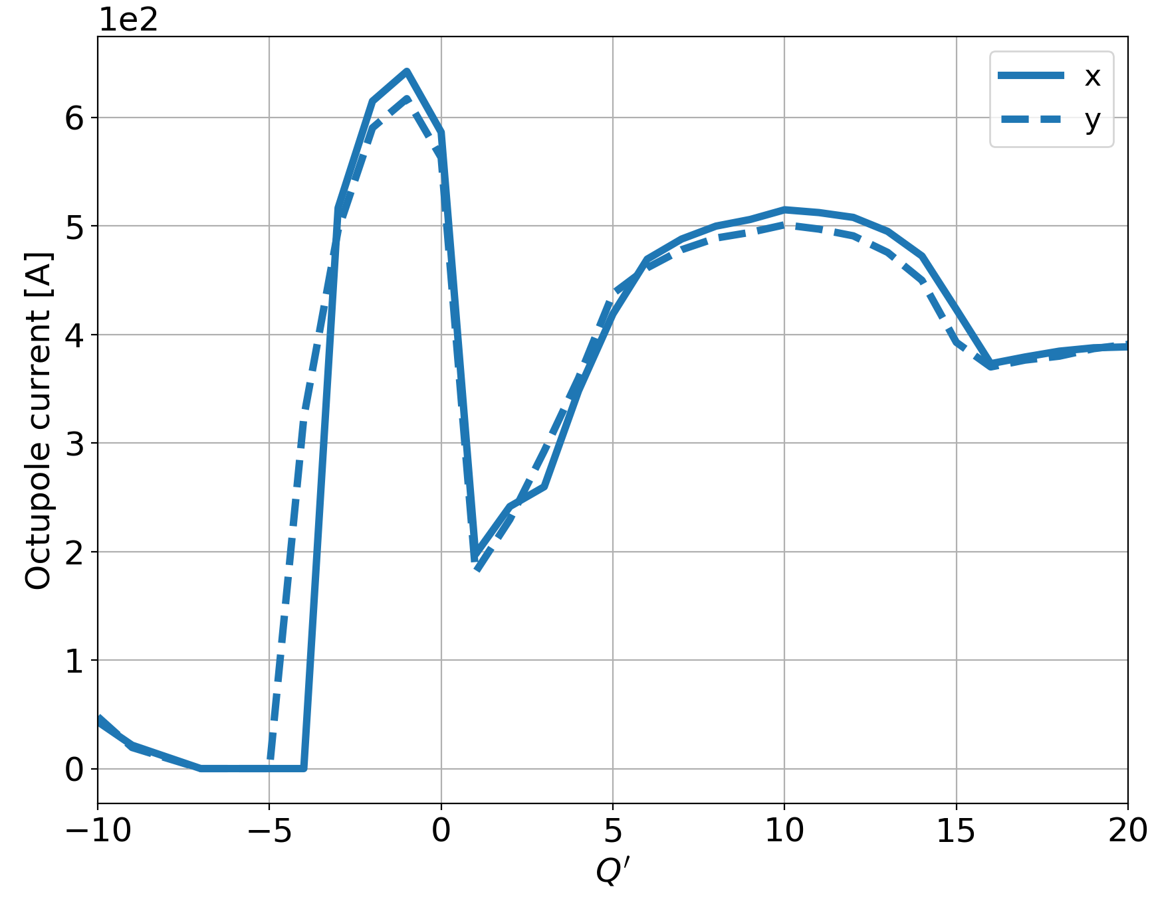
Flat top prediction – octupole vs. Q’
Regarding impedance-related instabilities, flat top is the most critical part of the cycle:
  collimators (main impedance contributors) at the tightest settings,
  we get only later the large, stabilizing effect from head-on tunespread (in stable beam, when collisions are established).
The most critical stability threshold is in single-beam (long-range interactions have a beneficial effect with positive octupole polarity, but vary from bunch to bunch ⟶ we do not include them here).
This is the « plateau » we usually consider « safe » (chromaticity uncertainty)
Octupole threshold vs. chromaticity (N=1.8e11 p+/b, 𝜀=1.8𝜇m, 25 ns, 6.8 TeV, single beam, 50 turns damper, factor 2 included, oct. > 0)

Slide 8
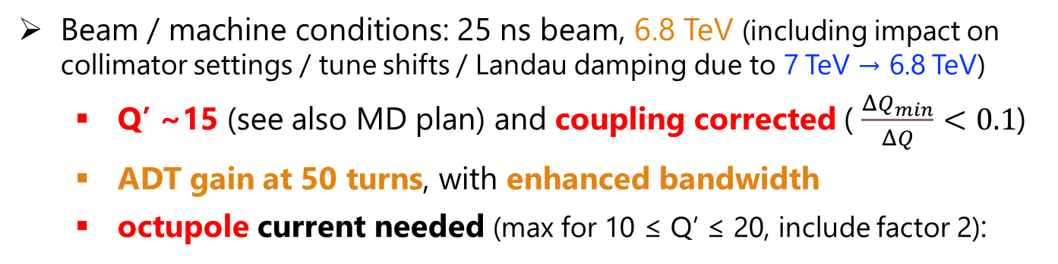
Flat top – recommendations
Beam / machine conditions: 25 ns beam, 6.8 TeV (including impact on collimator settings / tune shifts / Landau damping due to 7 TeV → 6.8 TeV)
  Q’ ~15 (see also MD plan) and coupling corrected ( $\frac{ΔQ_{min}}{ΔQ}<0.1$)
  ADT gain at 50 turns, with enhanced bandwidth
  octupole current needed (max for 10 ≤ Q’ ≤ 20, include factor 2):
Brightness [10¹¹ p+/𝜇m] | Oct. Threshold [A] 1.2 ns TeleIndex=1 | Oct. Threshold [A] 1.2 ns TeleIndex=0.5 | Oct. threshold [A] 1.4 ns TeleIndex=1
0.7 | 361 | 281 | 320
0.8 | 413 | 321 | 367
0.9 | 464 | 361 | 412
1.0 | 516 | 401 | 458
1.1 | 568 | 441 | 504
2022
(1.4e11 in
1.8 𝜇m)
2023/2024
(1.8e11 in
1.8 𝜇m)

Slide 9
Collision – lessons learned and recommendations
Bunches colliding with an offset (1-2σ) can lose Landau damping
  Keep one of the main IPs colliding during emittance / lumi scans
  Avoid bunches colliding only at levelled IPs in the filling schemes
  Design the VdM configurations with the instability team
Enhanced ADT bandwidth (optimal for beam stability), should be maintained from injection to start of collision
  Once in collision the standard ADT bandwidth reduces the emittance growth, and is enough since head-on tunespread stabilizes the beam.
X. Buffat et al., CERN-ACC-NOTE-2020-0059
S.V. Furuseth et al., Phys. Rev. Accel. Beams 24, 011003 (2021)
A. Ribes Metidieri and X. Buffat, CERN-ACC-NOTE-2019-0037
J. Wenninger et al, CERN-ACC-NOTE-2018-0026

Slide 10
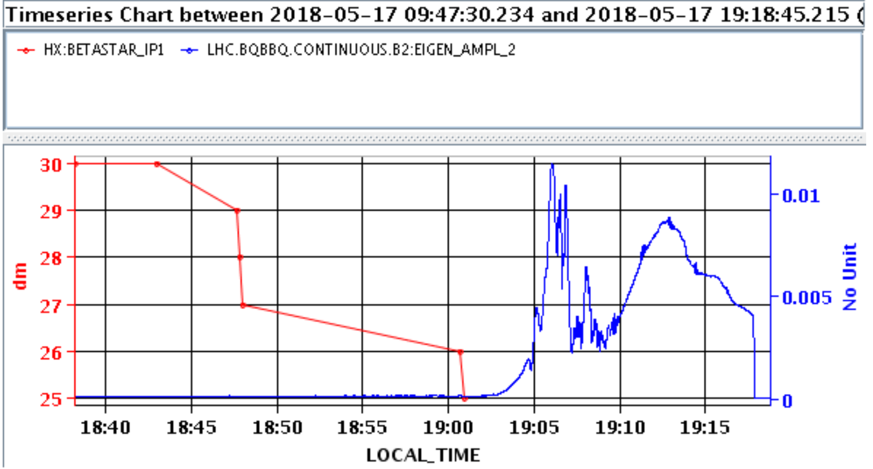
Collision – lessons learned and recommendations
Non-colliding bunches:
    Perform coupling correction based with ADT-AC dipole on non-colliding bunches (bunch-dependent coupling).
    Correct lattice non-linearities.
    Reduce oct. in stable beams ONLY if brightness of non-colliding is reduced (HiLumi strategy).
Check for possible “pop-corn” instabilities (related to increased e-cloud effects with intensity decrease from burn-off)
⟶ high Q’ needed when machine not yet well conditioned.
Instability during leveling
X. Buffat et al., CERN-ACC-NOTE-2020-0059
S.V. Furuseth et al., Phys. Rev. Accel. Beams 24, 011003 (2021)
A. Ribes Metidieri and X. Buffat, CERN-ACC-NOTE-2019-0037
J. Wenninger et al. CERN-ACC-NOTE-2018-0026

Slide 11
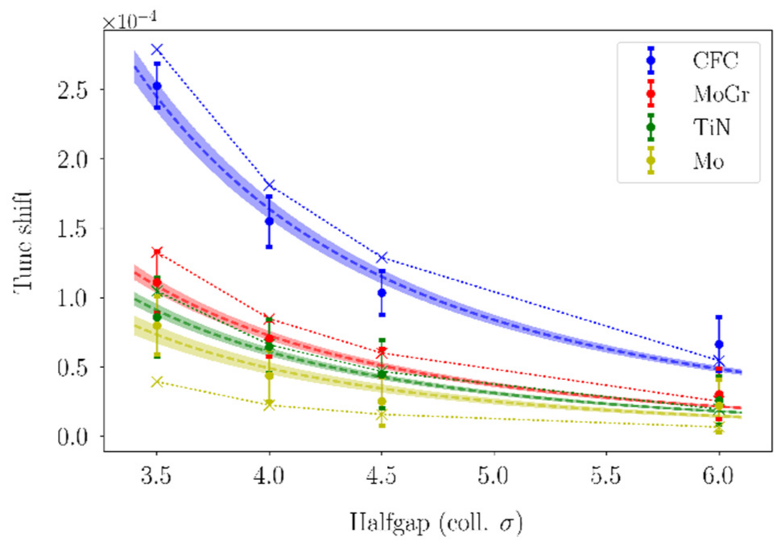
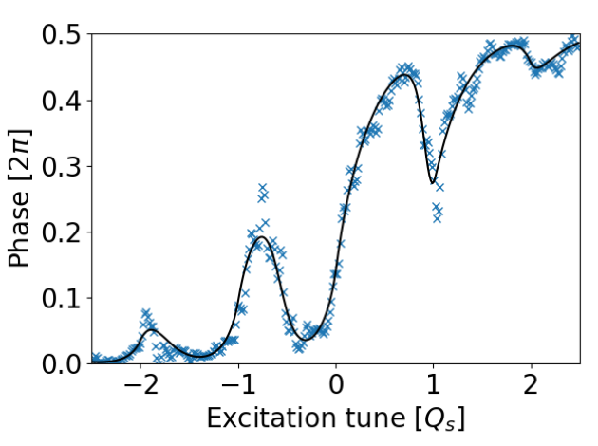
MD plan
Characterization of the machine and individual collimators’ impedances with emphasis through tune shift measurements
  Identification of non-conformities
  Monitoring of the impact of radiation
  Input for HL-LHC predictions (upgraded collimators)
  Growth rates / octupole thresholds.
Online chromaticity measurement based on Beam Transfer Function (BTF)
  Accuracy demonstrated in simulations with non-linear fit / neural network
  Test new BTF method based on noise injection with the ADT (single bunch kick) → could be used at every fill.
Probe the accuracy of the stability model including noise
  Validate the existence of a ‘sweet spot’ at lower chromaticity that would relax operational constraints (octupole current, coupling correction, NL correction)
S. A Antipov et al., IPAC’18, THPAF035
X. Buffat et al., in proceedings of HB2021

Slide 12
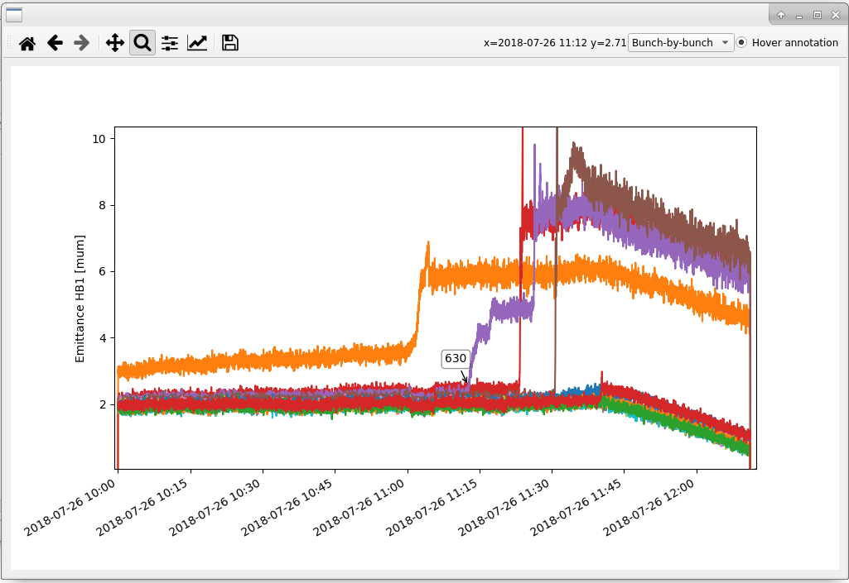
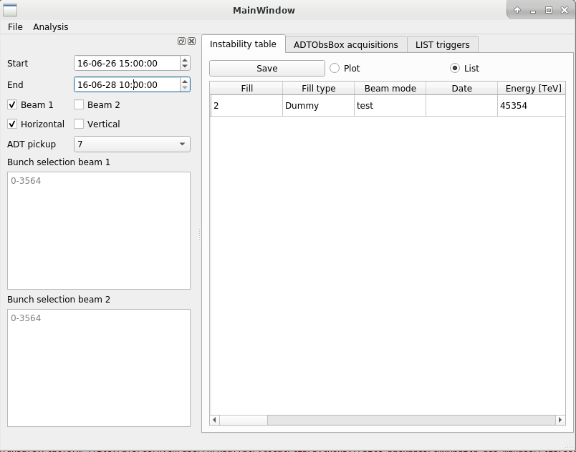
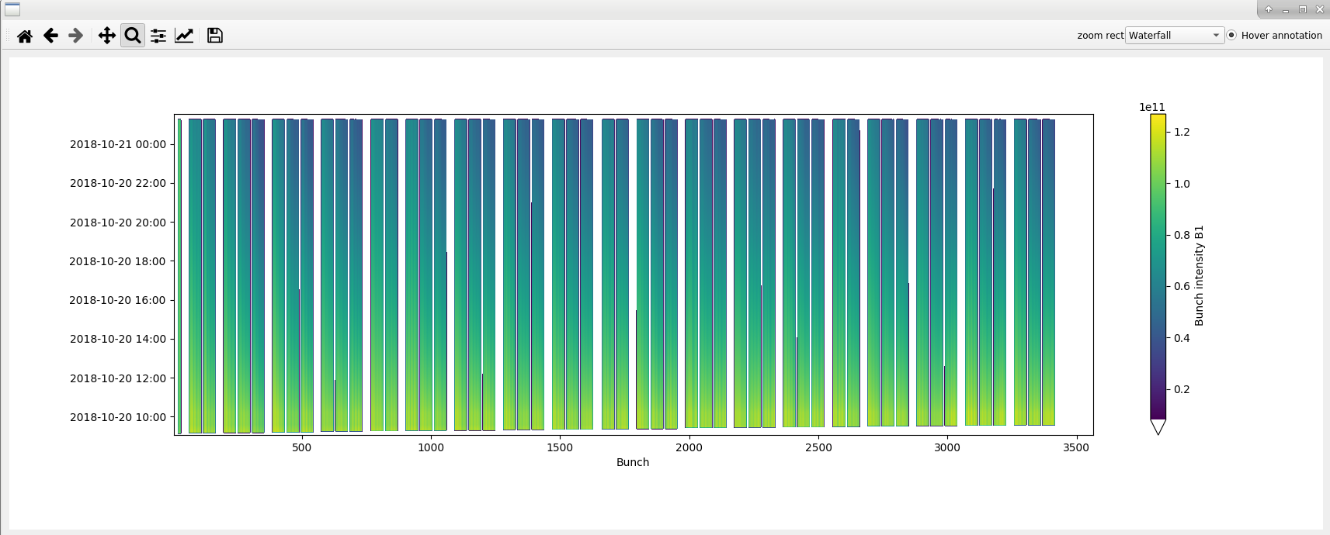
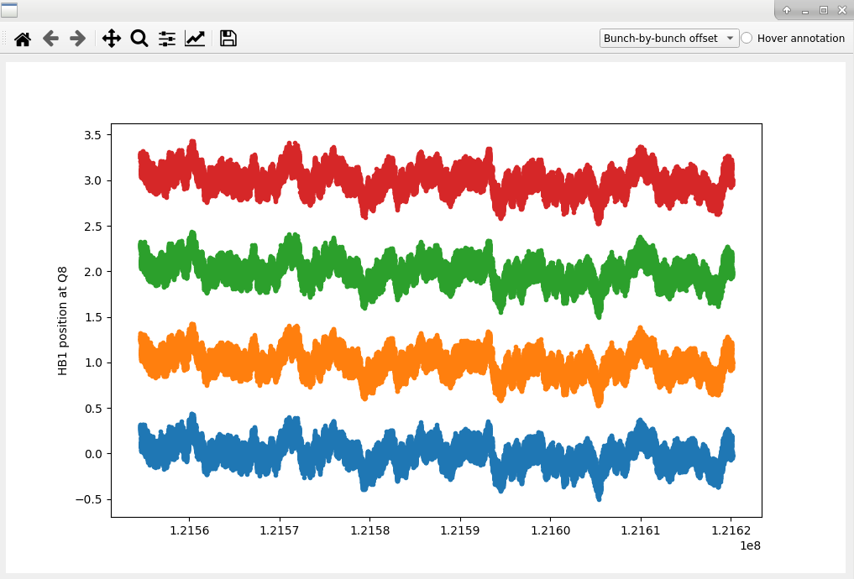
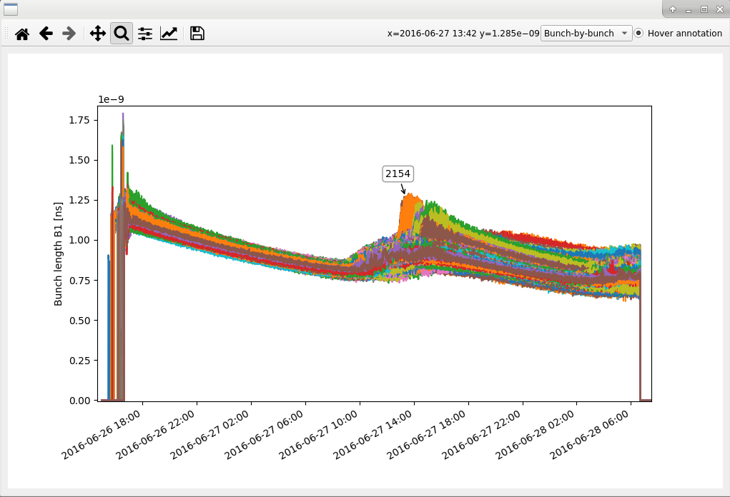
Operational tools and monitoring
New instability panel based on acc-py (pyQt, pytimber, pyjapc)
  Bunch-by-bunch NXCALS data visualization and analysis
ADTObsBox data visualization and analysis (24h rolling buffer and LIST)
LHC pilot beam test 2021
Online tools for Scrubbing and MDs
ML based anomaly detection (L. Coyle)
Up-to-date recommendation and communications (for OP and MDs):
  https://cern.ch/lhcinstability

Slide 13
Summary of recommendations
In general: high chromaticity, correct linear coupling, use enhanced ADT bandwidth from injection until end of flat top.
Injection: start with Run 2 settings (Q’~15-20, oct. ~50 A for 1.8 μm emit.), possibly relax step-by-step after scrubbing (when bunch intensities > Run 2).
Ramp: start with injection settings in terms of Q’ / octupoles.
Flat top:
  worst situation for impedance-related stability,
  teleIndex=1, positive octupole polarity, brightness of 1.10¹¹ p+/𝜇m: oct. ~516 A,
  teleIndex=0.5, positive octupole polarity, brightness of 1.10¹¹ p+/𝜇m: oct. ~401 A,
  depending on new procedure to measure Q’, decrease Q’ from 15 to ~5.
Collisions:
  ADT settings to standard bandwidth,
  Non-colliding bunches define the required octupole current, coupling correction and non-linear correction ⟶ reducing their brightness would relax these constraints.
  “Pop-corn” (e-cloud) instabilities to consider carefully ⟶ start the run with high Q’.

Slide 14
Backup slides
DISCLAIMER: values are not necessarily up-to-date (in particular, 7 TeV is always considered, instead of 6.8 TeV)

Slide 15
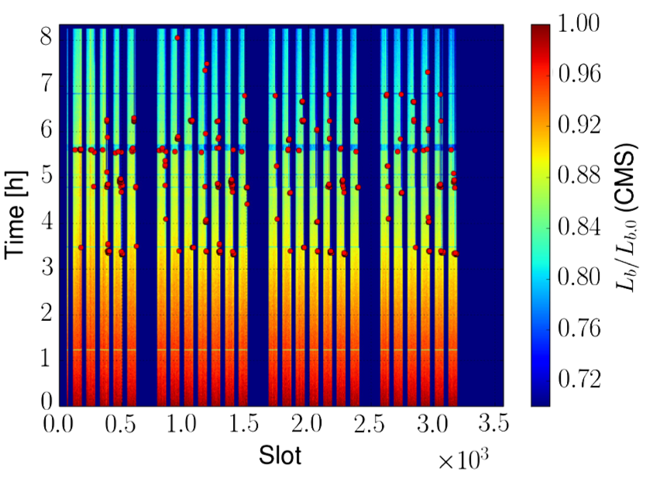
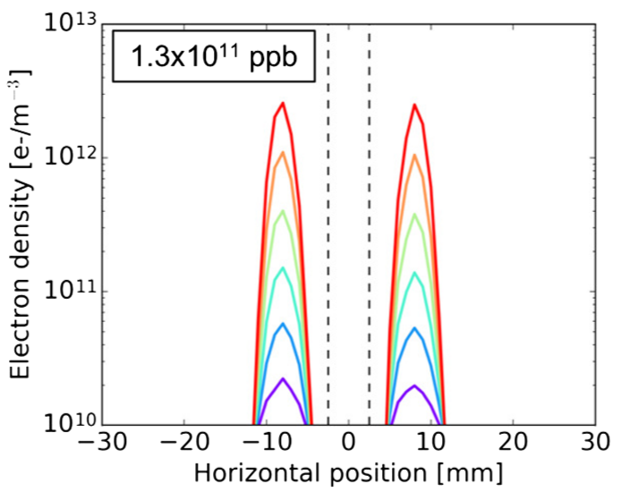
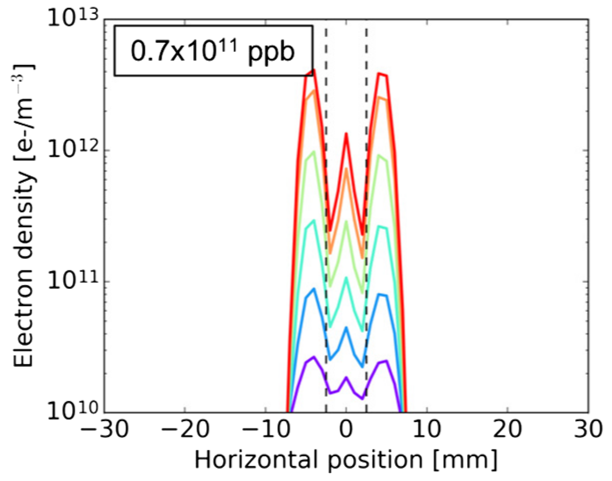
Collision – lessons learned and recommendations
E-cloud stripes
Beam
Beam
after burn-off
Popcorn instabilities during STABLE BEAM are caused by the increased central density of the electron cloud in the dipoles with low bunch intensity
  They could re-appear due to deconditioning of the dipoles
Proposed strategy: Start the run with a high chromaticity in collision (15 units), possibly reduce it in steps after few weeks of high intensity operation to optimize the beam lifetime
A. Romano, et al., Phys. Rev. Accel. Beams 21, 061002 (2018)

Slide 16
Run 3: Stability from impedance
Collimator scenario at top energy (expressed in 𝜎 computed with 𝜀=3.5𝜇m):
 | « Tight » as in LHC Run II
TCP/TCS/TCLA(D) IR7 | 5 / 6.5 / 10 (10)
TCP/TCS/TCLA IR3 | 15 / 18 / 20
TCDQ/TCS IR6 | 7.3
TCT IR1/5 | 7.8
TCL (IR1/5) Q4/Q5/Q6 | 15 / 15 / parking
TCT IR2/8 | 37 / 15
Note: IR2 injection protection collimators are always in parking position.

Slide 17
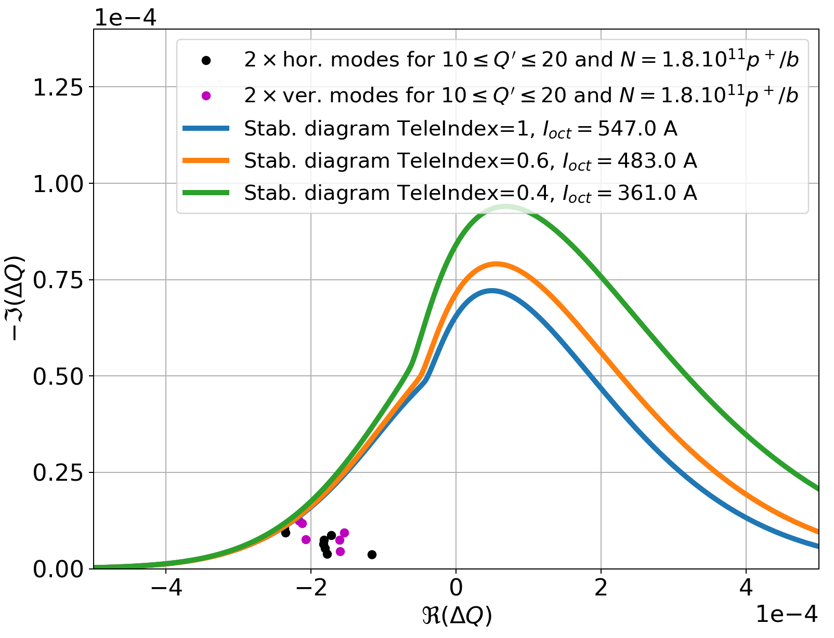
Impact of (anti-)TeleIndex on stability
Octupole threshold depends on TeleIndex ⇒ different stability diagrams
Positive polarity, 𝜀=1.8𝜇m
4 RMS bunch length 1.2ns
Factor 2 on the modes
7 TeV
Oct. current adjusted to stabilize all modes.
1/r=2.5 (End Of Ramp with 𝛽*=1.5m)
1/r=1.67 (End Of Ramp with 𝛽*=1m)
⇒ TeleIndex=1 seems possible, but remaining margin is rather small.
TeleIndex=r=1

Slide 18
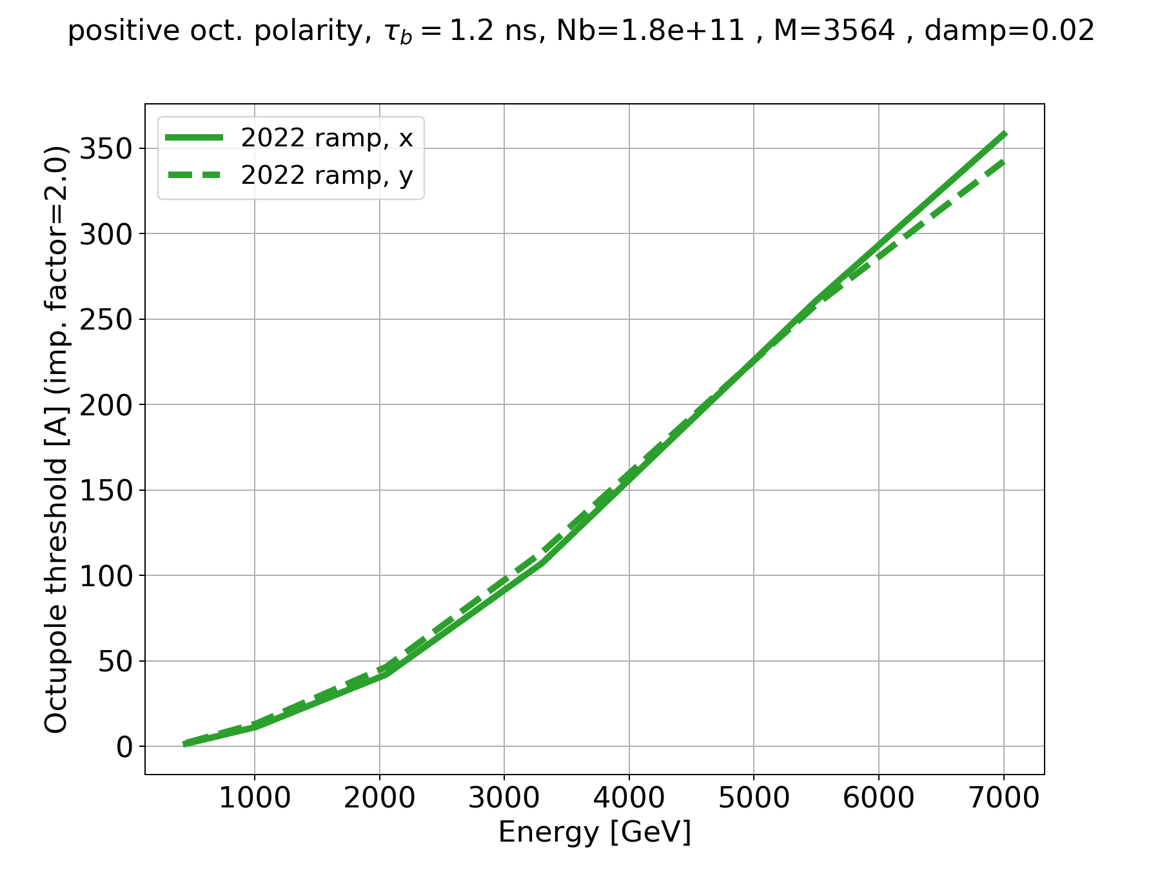
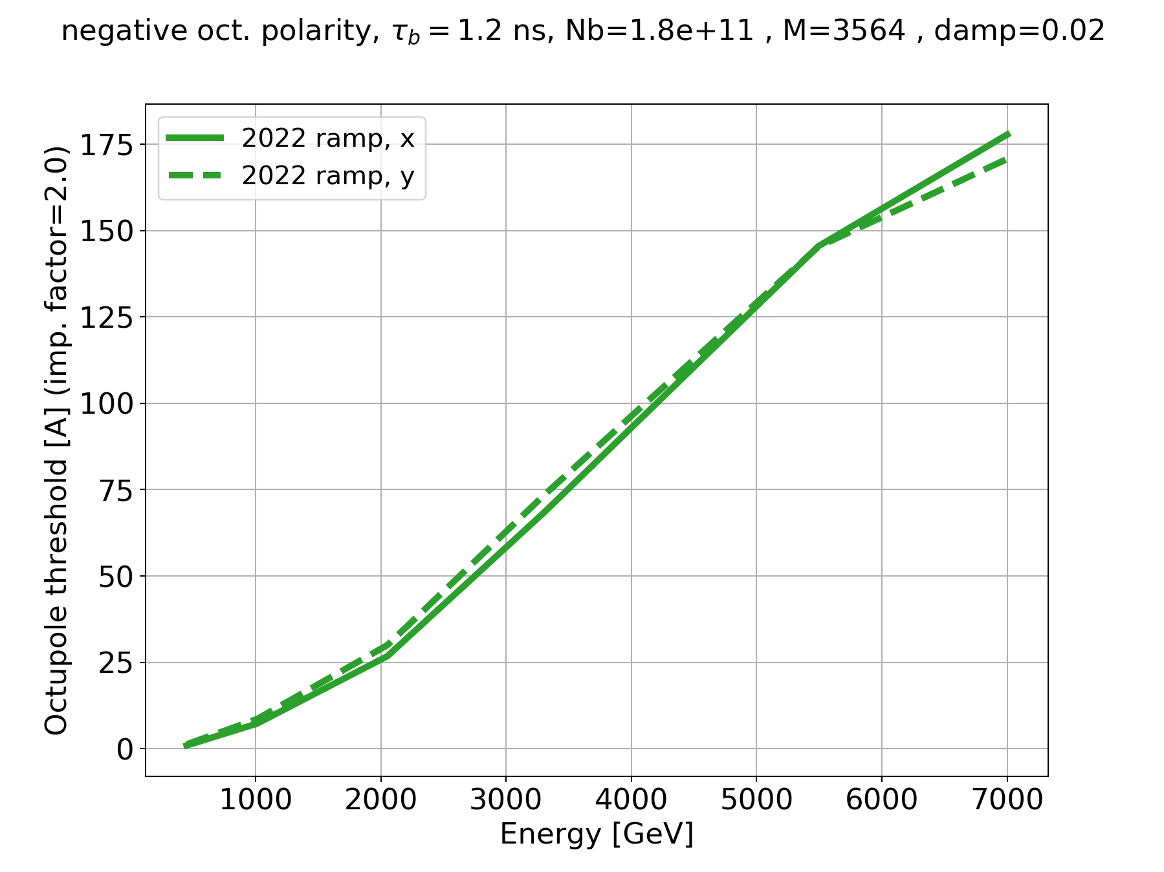
Single-beam stability
Including factor 2, with Gaussian transverse distribution.
Positive polarity
Negative polarity
⟹ Negative polarity is twice more stable as positive one, in single-beam.

Slide 19
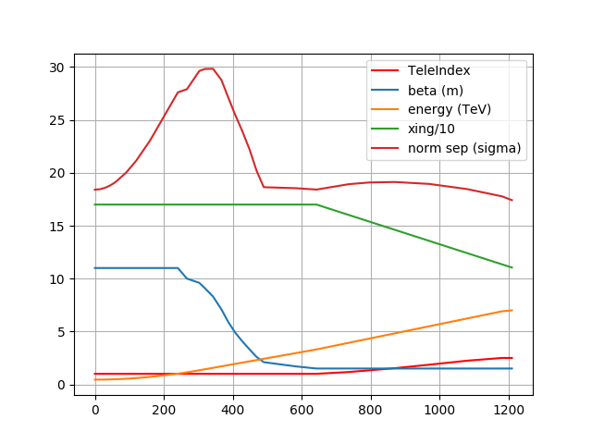
Ramp parameters
Evolution of the parameters relevant to long-range effects, along ramp:
(𝜇rad)
Value
Time along the ramp [s]

Slide 20
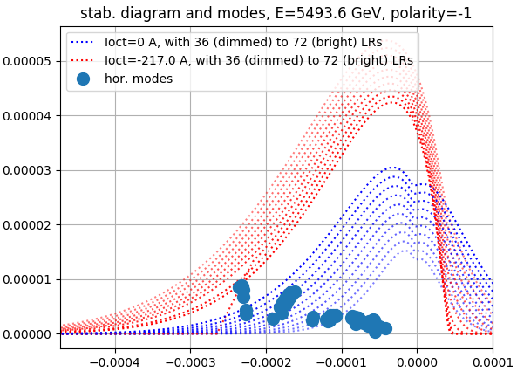
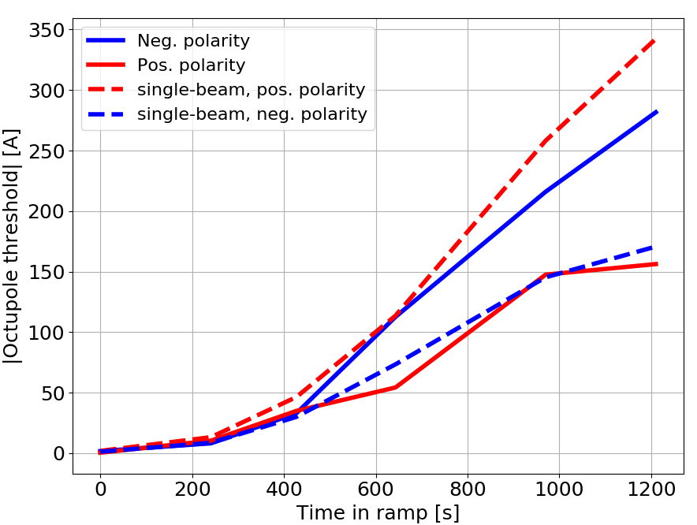
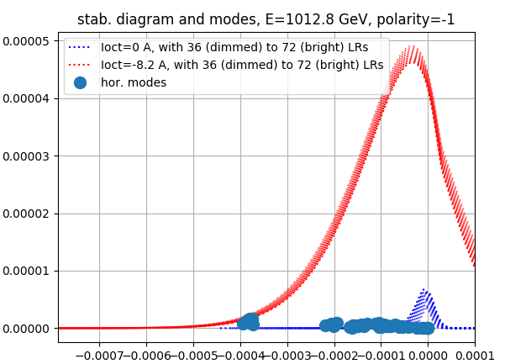
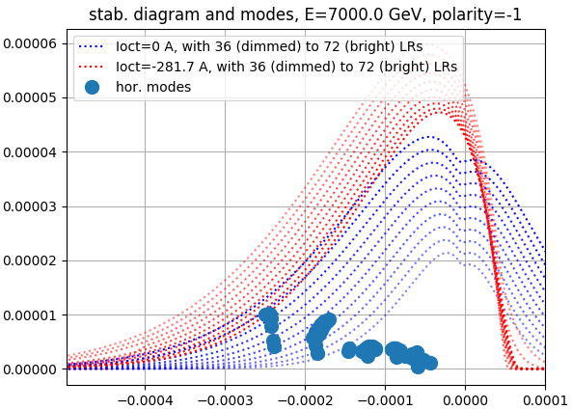
Stability with long-range beam-beam effects
Horizontal only, with factor 2 included:
25 ns beam
N_{b}=1.8e11 p+/b
𝜀=1.8 𝜇m
ADT gain: 50 turns
bunch length (4xRMS)=1.2 ns
Gaussian distribution

Slide 21
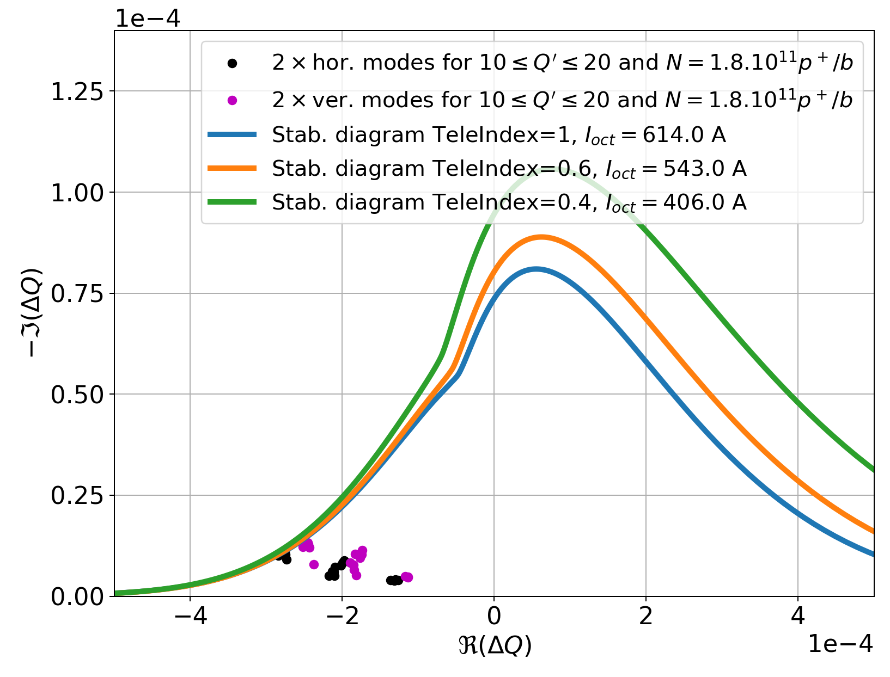
Impact of shorter bunch length on stability diagrams
With bunch length (full, i.e. 4*RMS) = 1ns, positive polarity, 𝜀=1.8𝜇m, 7 TeV

Slide 22
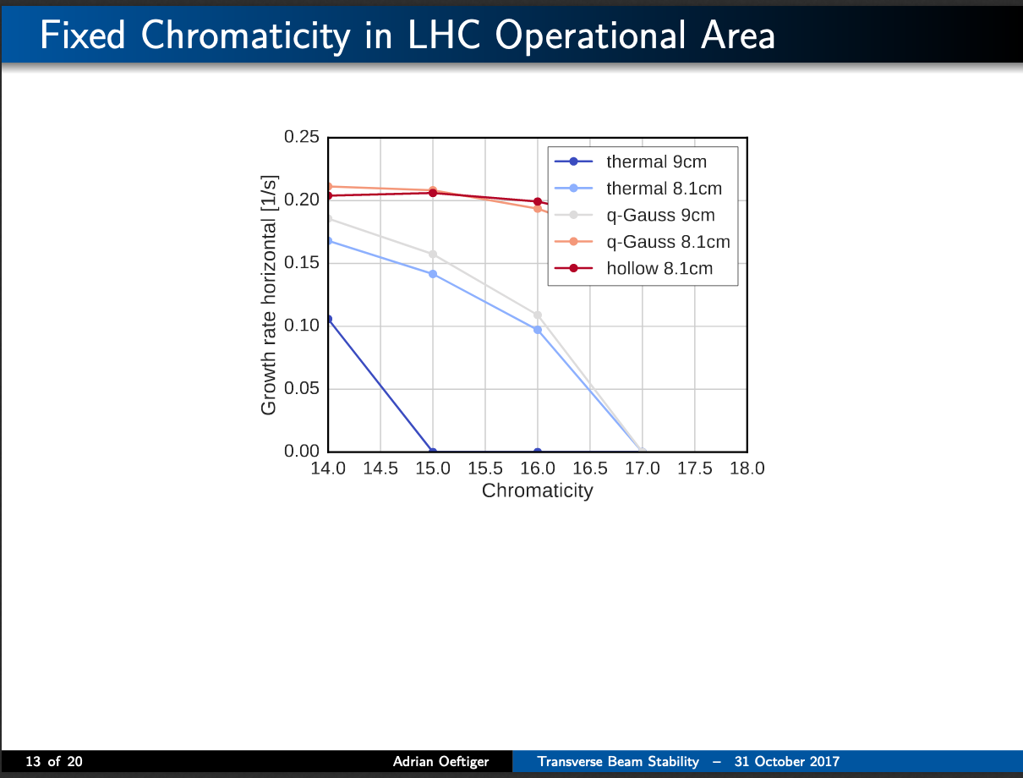
Dependency on longitudinal profile
From Adrian Oeftiger, 109th WP2 meeting (31/10/2017)

Slide 23
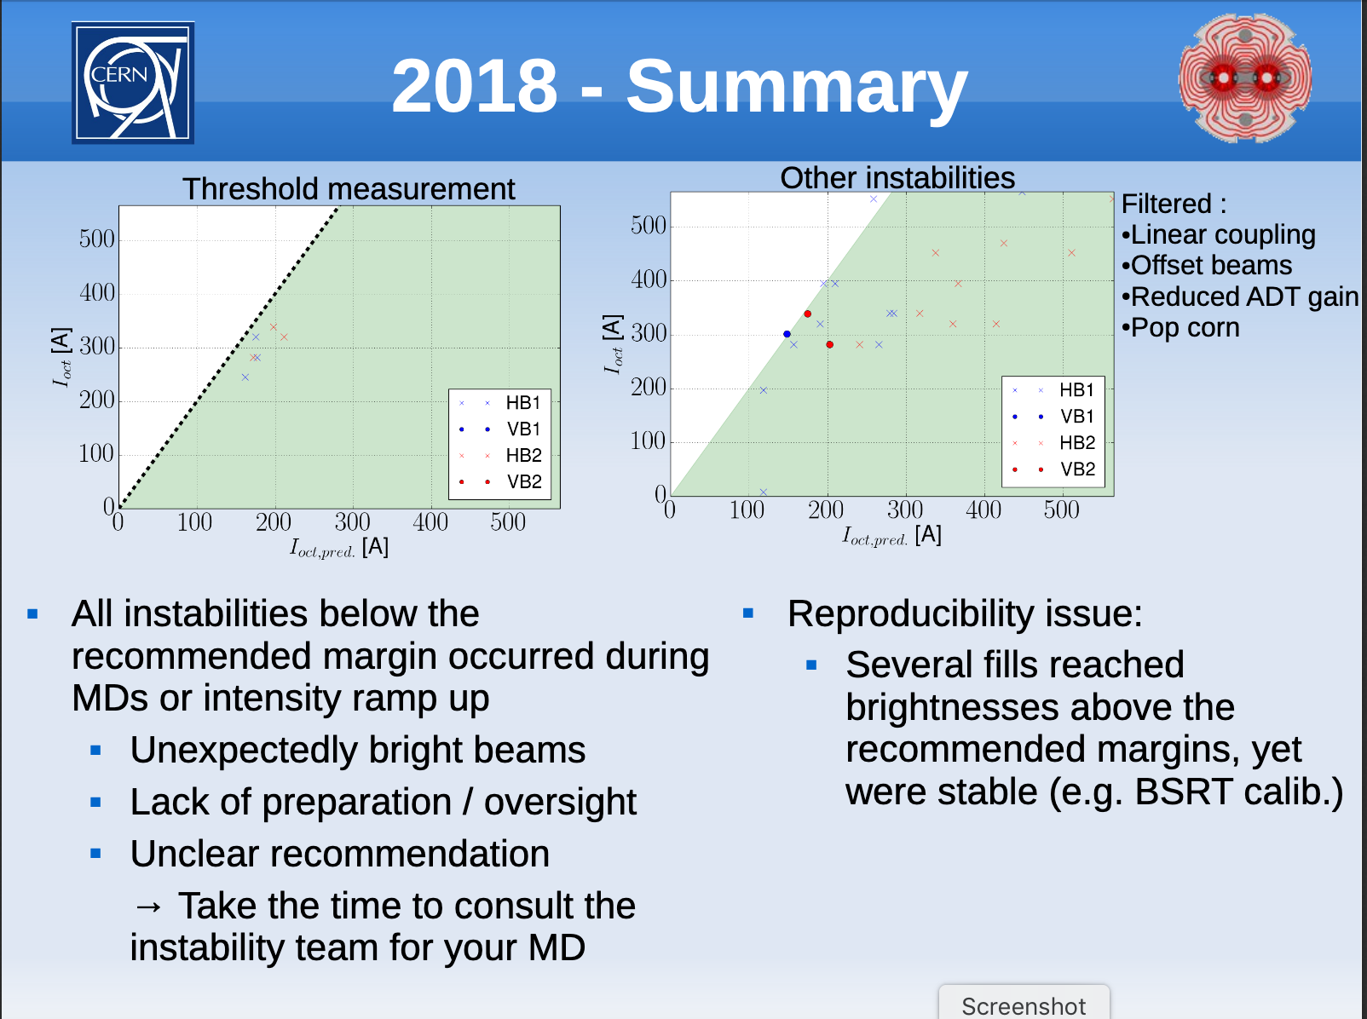
Factor 2 discrepancy
From Xavier Buffat, 9th LHC Operations Evian Workshop (01/02/2019):

Slide 24
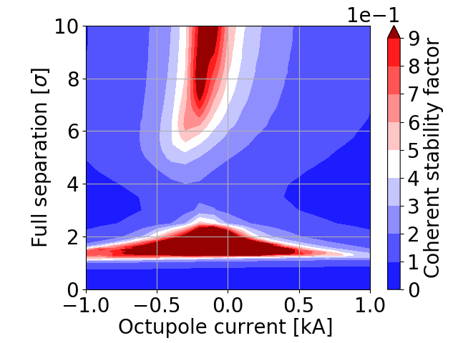
The two options: answers for stability
Option 1: large Piwinsky angle
Question: “Is it OK for impedance for the beam brightness limits of above (1.6E11 within 1.8 micron – i.e. brightness=0.89e11 p+/𝜇m, 1.8E11 within 2.2 micron – i.e. brightness=0.82e11/𝜇m)?”
  Single-beam: limit with 20% margin = 0.88e11 p+/𝜇m ⇒ ~OK
  Two beams: NOT OK ⇒ instability with offset beams
Stability parameter (should be >0.5) vs. separation and octupole current with slightly lower emittance (half crossing angle 220𝜇rad, 𝛽*=0.65m, 7TeV, N_{b}=1.6e11 p+/b, 𝜀=1.6 𝜇m):
Xavier Buffat

Slide 25
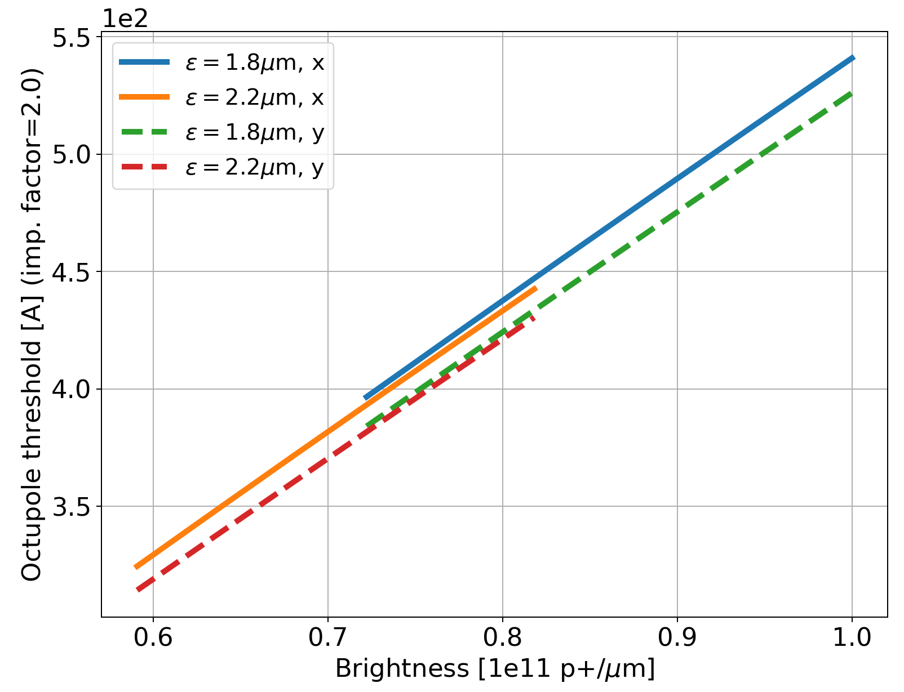
Checking the brightness dependency
We plot the octupole threshold (max. for 10≤Q’≤20) vs. brightness (N_{b}/𝜀) for two different emittances (4𝜎_{RMS} = 1.2ns, positive polarity, TeleIndex=1, with factor 2, ADT gain 0.02).
Very linear dependency, independent on emittance

Slide 26
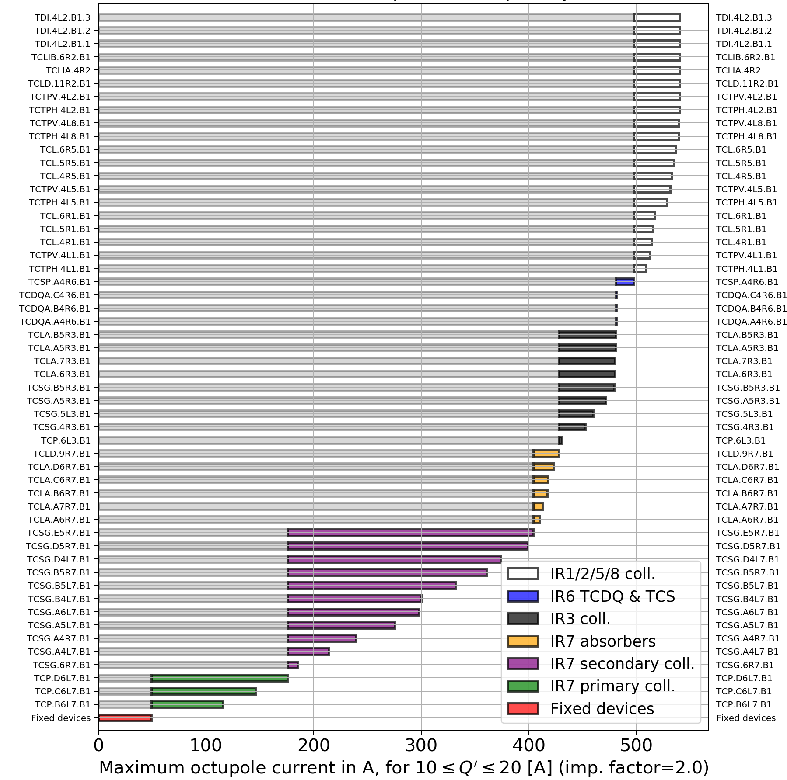
Impedance contributions in Run III
Single-bunch octupole threshold (max. for 10≤Q’≤20), N_{b}=1.8x10¹¹ p+/bunch, bunch length 4𝜎_{RMS}=1.2 ns, 𝜀=1.8 𝜇m, d=0.02, with factor 2:

Slide 27
LHC Run III & HL-LHC collimator settings
At top energy:
Collimators | LHC half-gaps [#𝜎 (3.5𝜇m)] 𝛽*=1.5m | HL-LHC half-gaps [#𝜎 (3.5𝜇m)] 𝛽*=40cm | HL-LHC half-gaps [#𝜎 (2.5𝜇m)] 𝛽*=40cm
TCP/TCS/TCLA(D) IR7 | 5 / 6.5 / 10 (10) | 5.7 / 7.7 / 10.7 (14) | 6.7 / 9.1 / 12.7 (16.6)
TCP/TCS/TCLA IR3 | 15 / 18 / 20 | 15 / 18 / 20 | 17.7 / 21.3 / 23.7
TCDQ/TCS IR6 | 7.3 | 8.5 | 10.1
TCT IR1/5 | 7.8 | 13.9 | 16.4
TCL (IR1/5) Q4/Q5/Q6 | 15 / 15 / parking | 18.9 | 22.4
TCT IR2/8 | 37 / 15 | 30 / 15 | 35.5 / 17.7
Note: injection protection collimators and TCLD in IR2 are always in parking position at top energy.

Slide 28
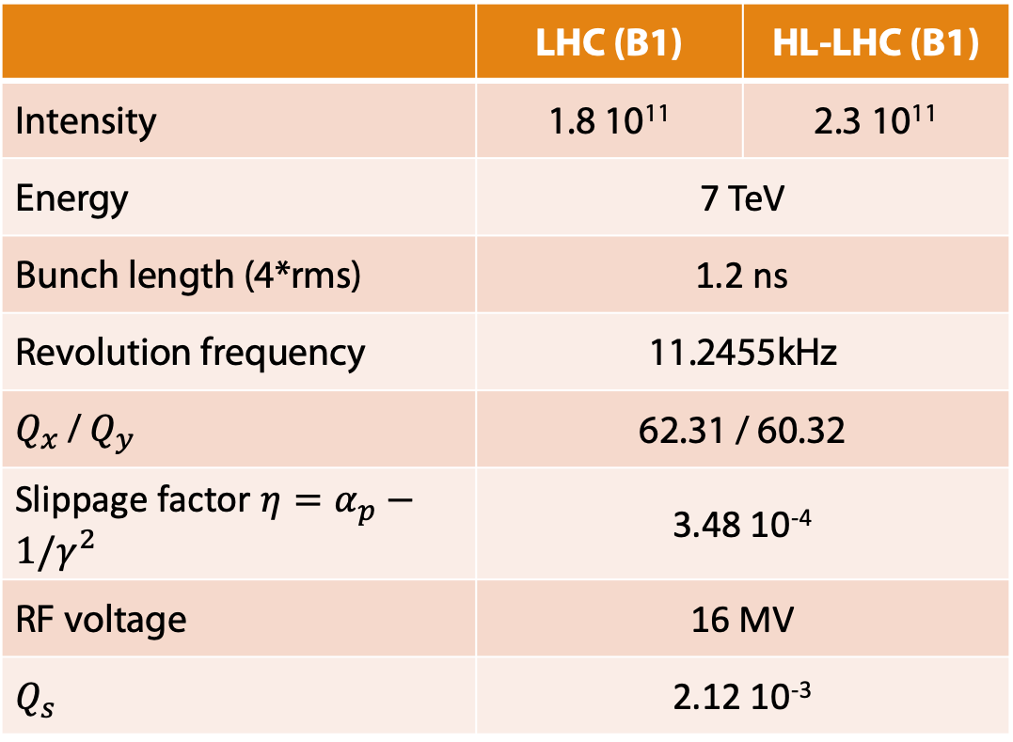
LHC Run III & HL-LHC parameters
At top energy, and unless specified differently, the main parameters used in DELPHI simulations are:
 | LHC (B1) | HL-LHC (B1)
Intensity | 1.8 10¹¹ | 2.3 10¹¹
Energy | 7 TeV
Bunch length (4*rms) | 1.2 ns
Revolution frequency | 11.2455kHz
$Q_{x}$ / $Q_{y}$ | 62.31 / 60.32
Slippage factor $η=α_{p}−1/γ^{2}$ | 3.48 10⁻⁴
RF voltage | 16 MV
$$Q_{s}$$ | 2.12 10⁻³

Slide 29
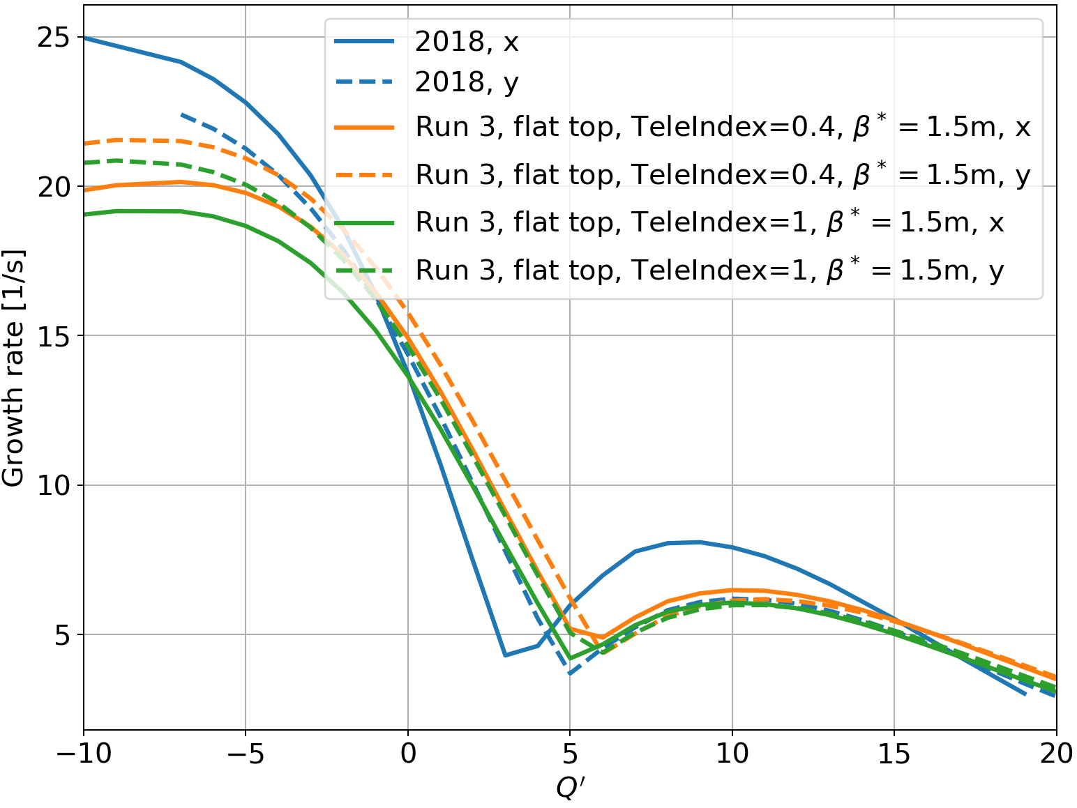
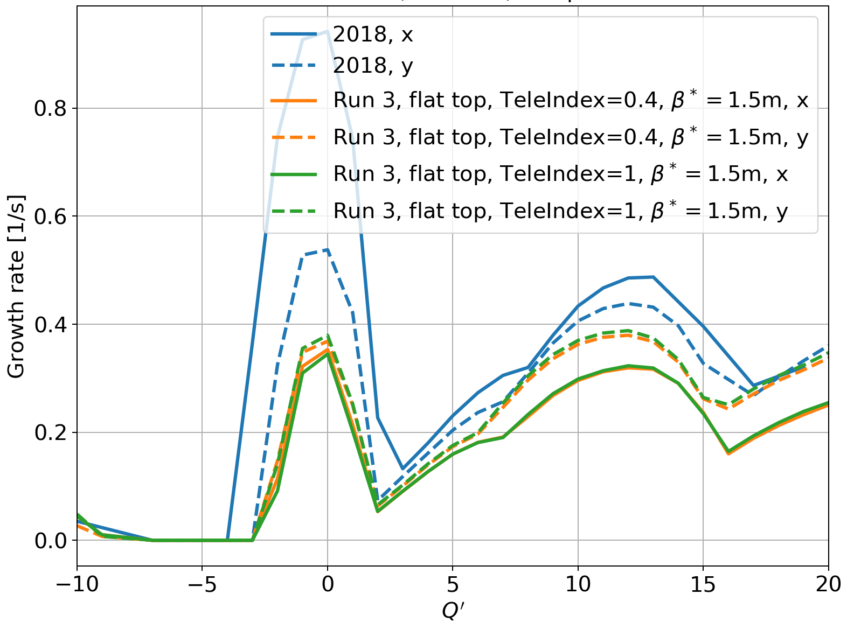
Growth rates vs. chromaticity – checks
Do growth rates depend on the optics (here LHC Run 3, 25ns beam)?
YES (slightly) without damper
NO, with damper (here 100 turns)
Old model
Pre LS2 (2018), for comparison

Slide 30
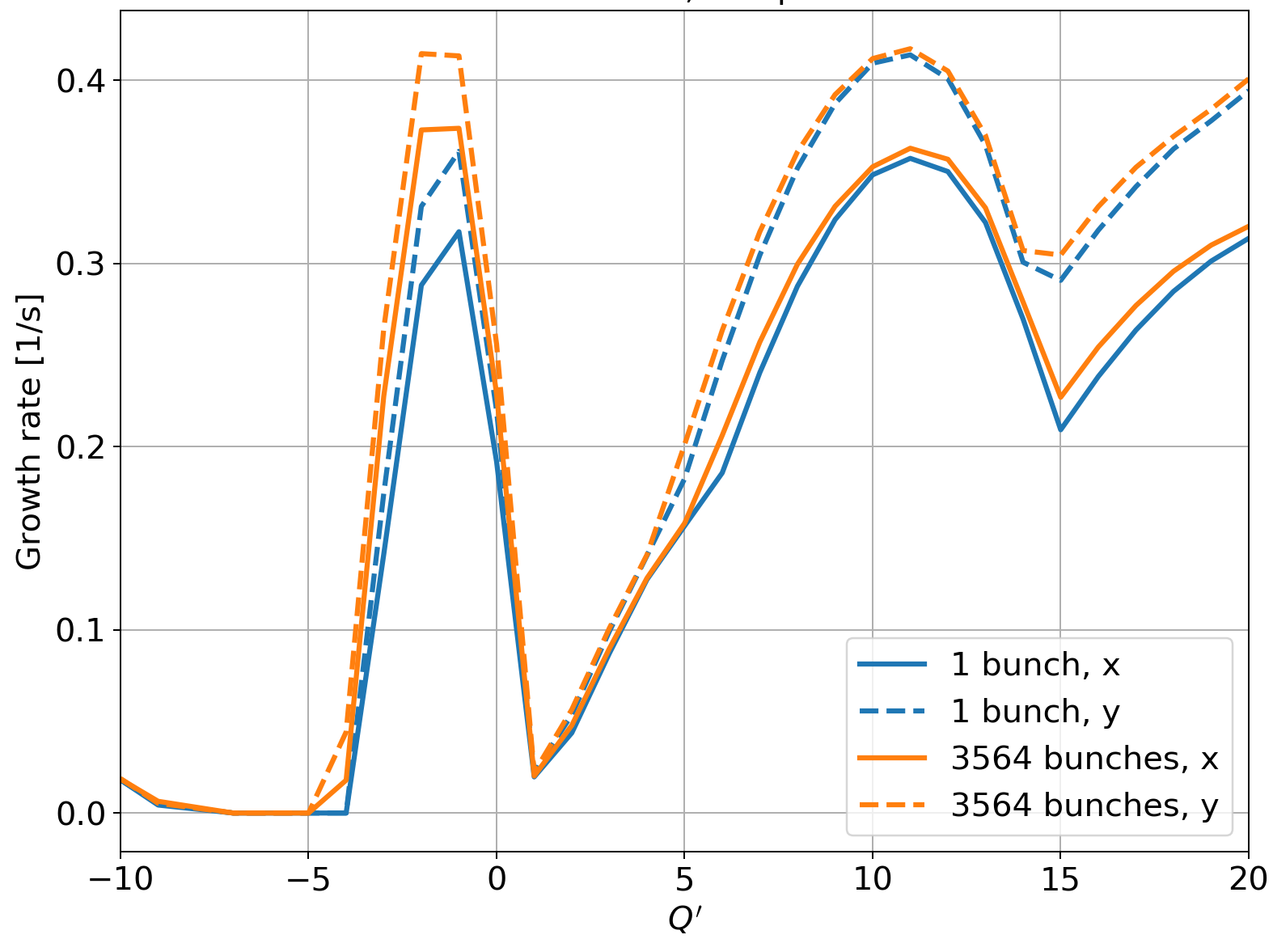
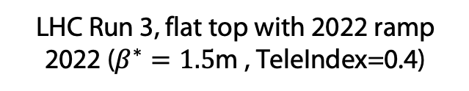
Growth rates vs. chromaticity – checks
Do growth rates with damper on (here 50 turns), depend on number of bunches?
~NO for LHC
LHC Run 3, flat top with 2022 ramp 2022 ($β^{∗}=1.5$m , TeleIndex=0.4)

Slide 31
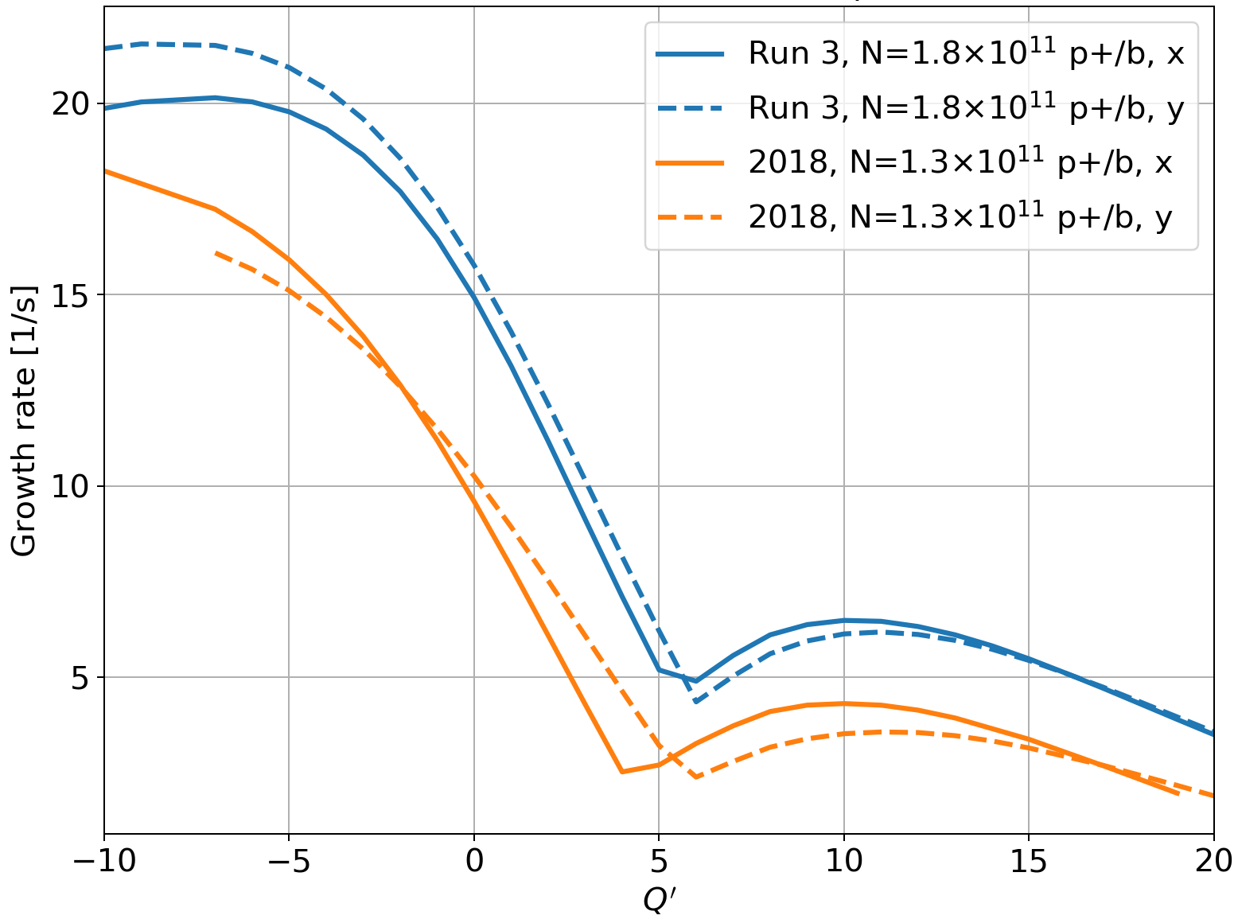
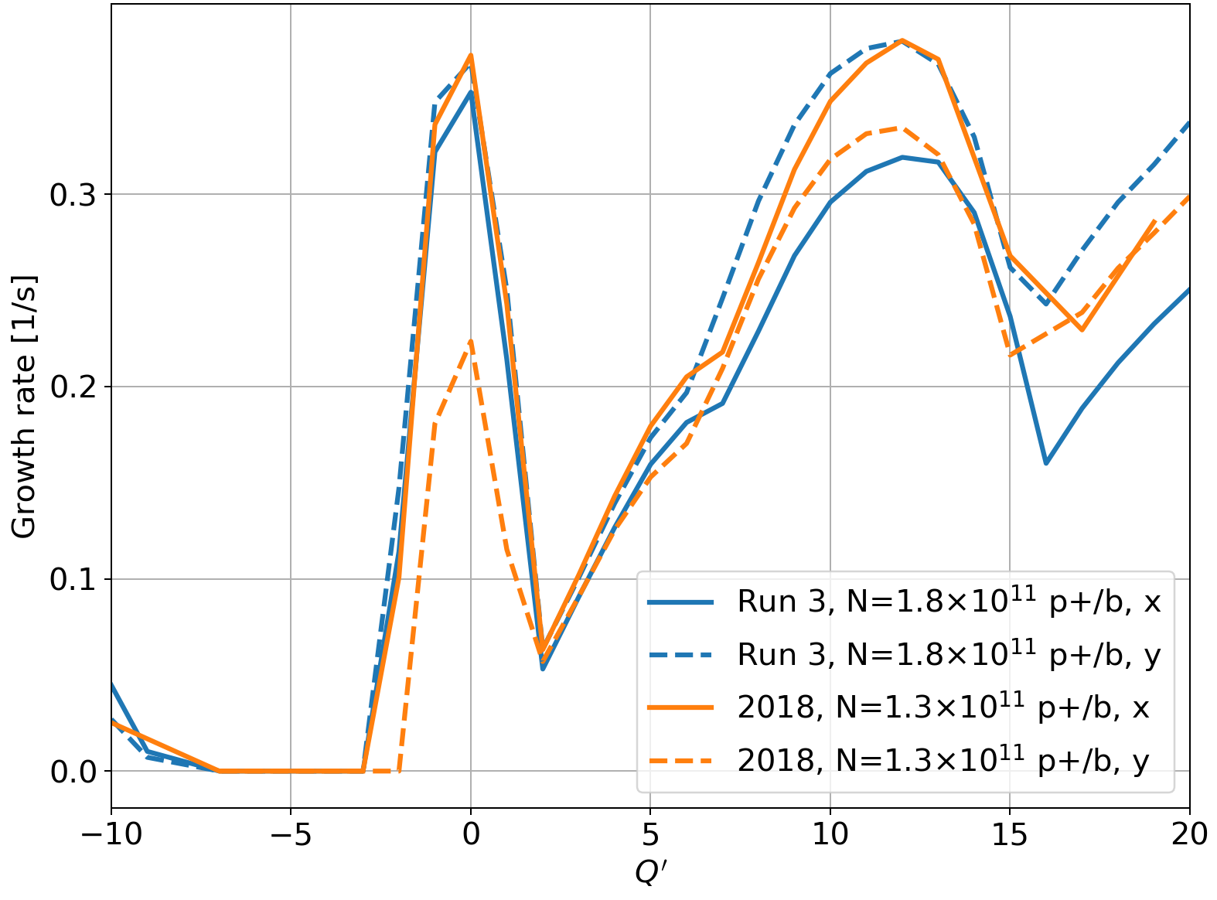
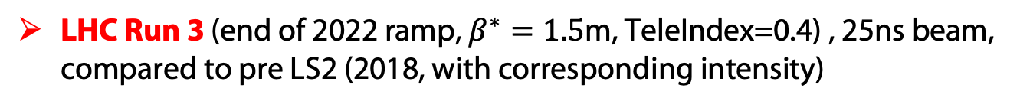
Final growth rates vs. chromaticity: LHC
LHC Run 3 (end of 2022 ramp, $β^{∗}=1.5$m, TeleIndex=0.4) , 25ns beam, compared to pre LS2 (2018, with corresponding intensity)
No damper
Damper 100 turns
Run 3
2018
Higher coupled-bunch growth rates without damper for Run 3 vs 2018, despite the impedance upgrade (from beam screens impedance & higher intensity).

Slide 32
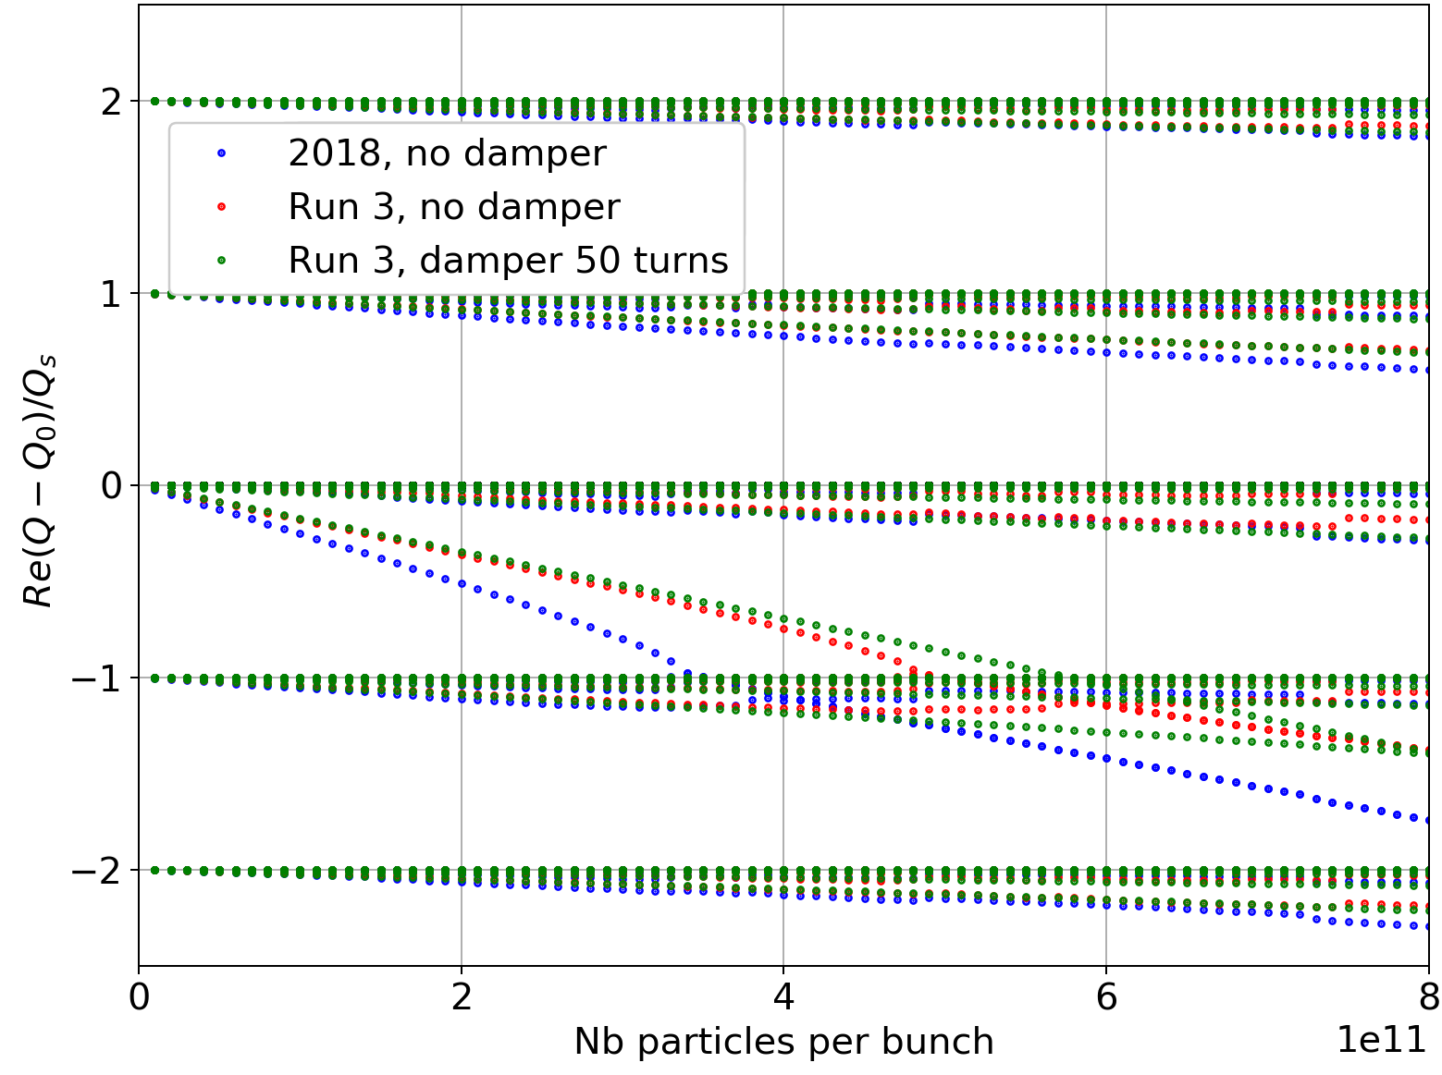
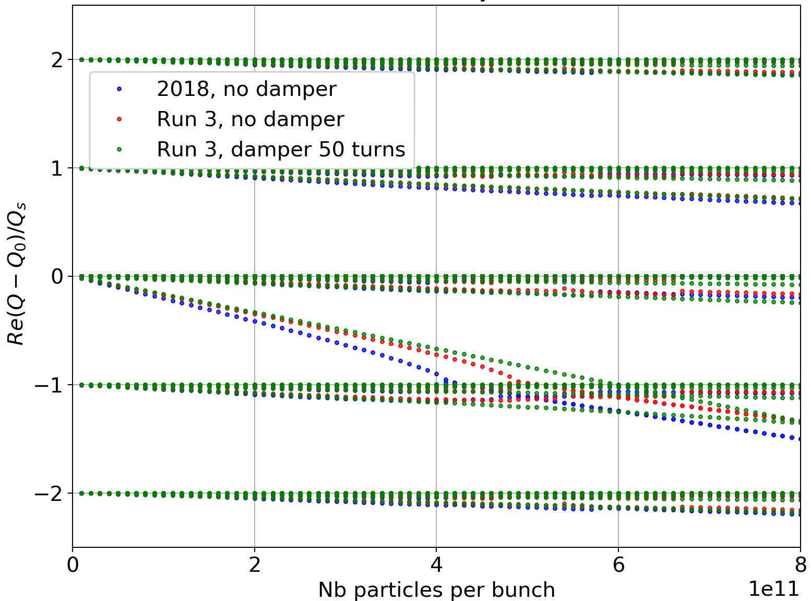
Transverse Mode-Coupling Instability: LHC Run 3
In single-bunch: TMCI threshold ~4.9 10¹¹ p+/bunch (vs. 3.4 10¹¹ in 2018)
Horizontal
Vertical
Independent on optics choice for Run 3.
David Amorim found 5.7 10¹¹ in 2018, for HL-LHC with LS2.2 configuration (HSC meeting, 20/08/2018).

Slide 33
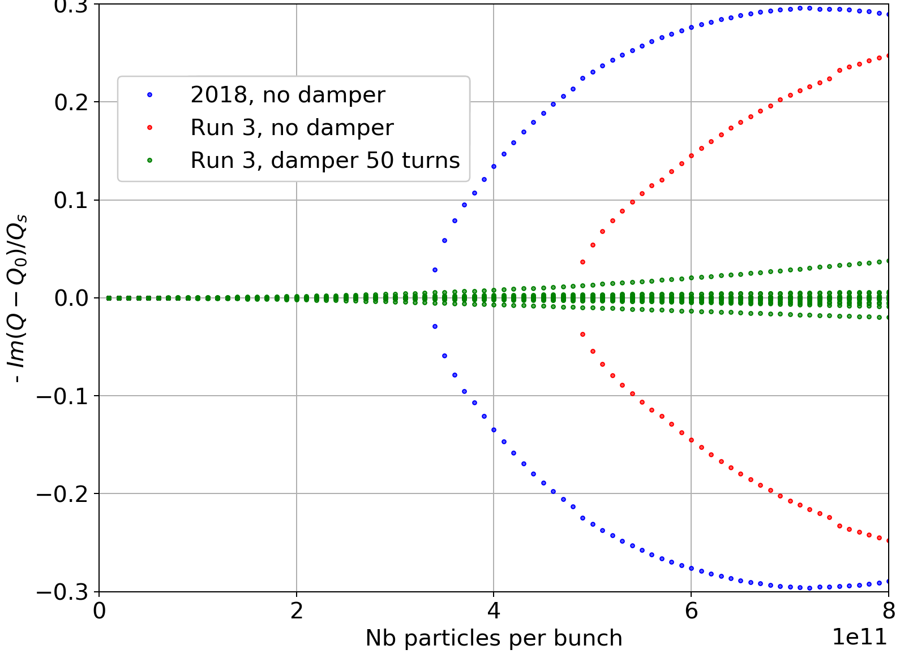
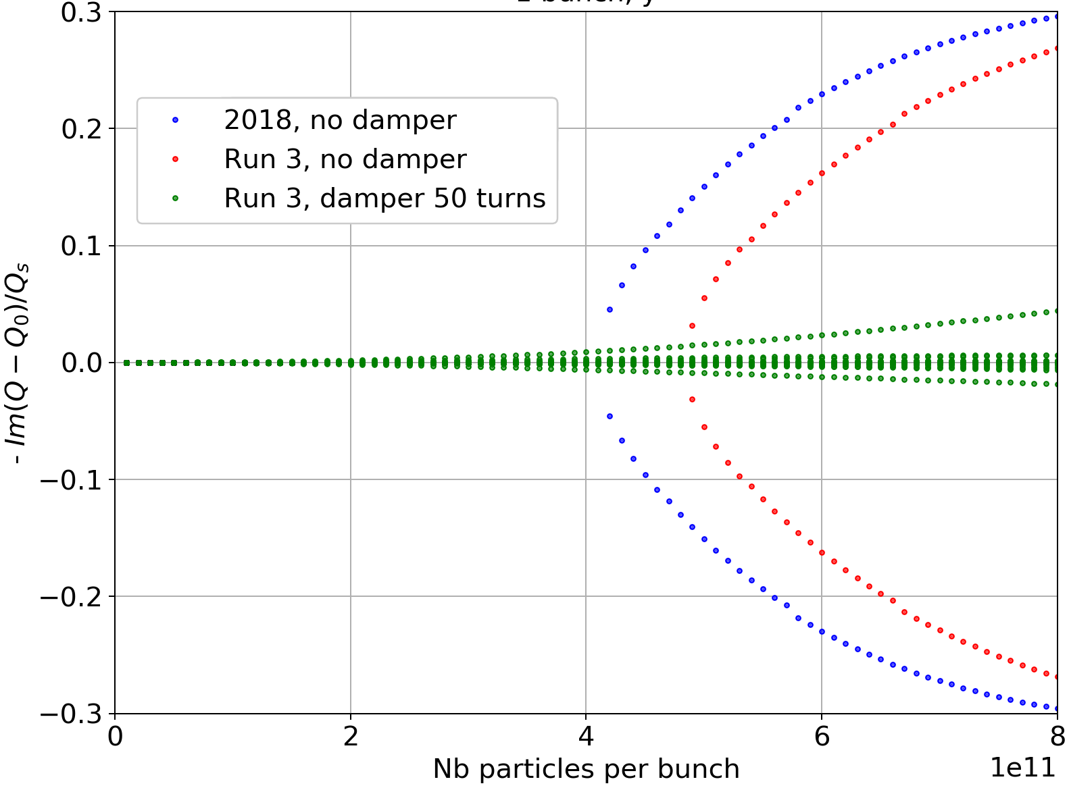
Transverse Mode-Coupling Instability: LHC Run 3
In single-bunch: TMCI threshold ~4.9 10¹¹ p+/bunch (vs. 3.4 10¹¹ in 2018)
Horizontal
Vertical
Destabilizing effect of damper present here as well.

Slide 34
LHC impedance model – Run III
The main LS2 planned modifications that can affect impedance at top energy, are in the model:
  Low-impedance collimator upgrade (jaws of 2 TCPs and 4 TCSs in IR7 replaced by Mo-graphite ones, Mo-coated for the TCSs),
  Updated tapers of collimators (thanks to E. Carideo & S. Antipov),
  Addition of TCLD absorber (tungsten) in IR7,
  Addition of TCLD in IR2 (will stay in parking for the proton run),
  Beta functions in the arcs and triplets (new optics from S. Fartoukh),
  fully updated TDIS – geometric and resistive-wall (thanks to N. Biancacci & B. Salvant),
  New MKI cool (implemented by D. Amorim).

Slide 35
LHC Run 3 impedance model – what’s not there
Planned modifications that are not yet in the model (thanks to B. Salvant):
  experimental chamber upgrades (CMS, ALICE, LHCb),
  VELO and SMOG2 (LHCb),
  in-situ aC-coating in Q5 and Q6 (beam screens of stand-alones),
  new BGC (negligible) and potential new beam instrumentation.

