Slide 1
Options for 2011
Evian 2010
Goal: 1 fb⁻¹
Energy to 4 TeV under consideration
  Not yet given
No limit on beam intensity from collimation
Reduction of beta* to a minimum of 1.5 m
  Collimation, aperture, orbit look OK
  Alice and LHCb (max. lumi 1e32) to be decided
  Between 2.5 to 1.5 m certainly possible
Bunch intensity at least nominal
  1.2e11 with emittance of 2 micron – 75 ns – single batch
beta* Alice and LHCb to be defined
  LHCb: 5 to 3.5 m (semi-dynamic squeeze?)
  Alice 10 m and accepted overhead of commissioning squeeze for ion run?

Slide 2
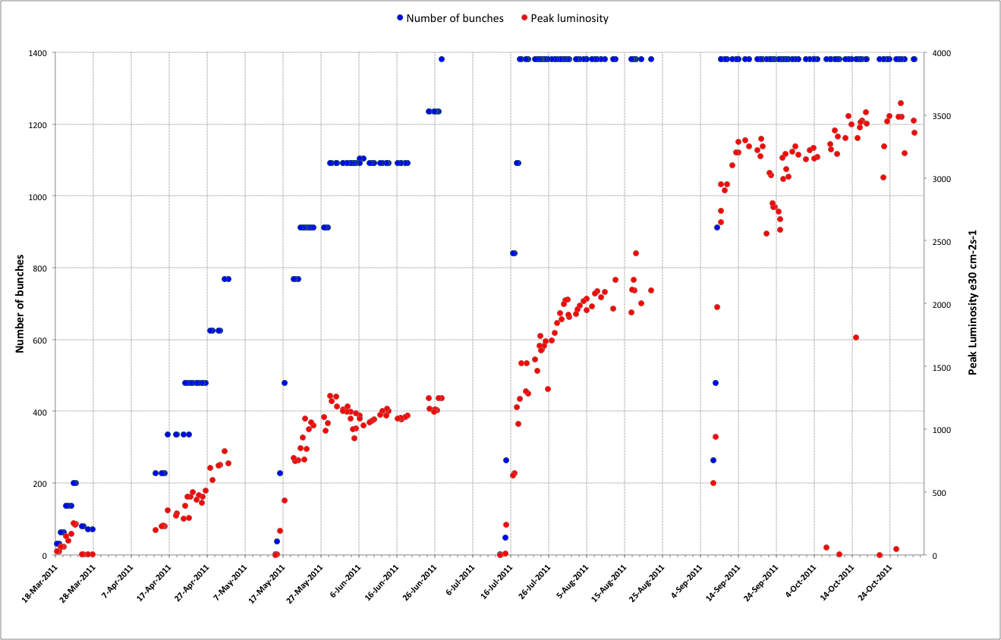
2011 – a brief recap
75 ns
50 ns
3. Squeeze further
1. Increase number of bunches
4. Increase bunch intensity
2. Reduce beam size from injectors

Slide 3
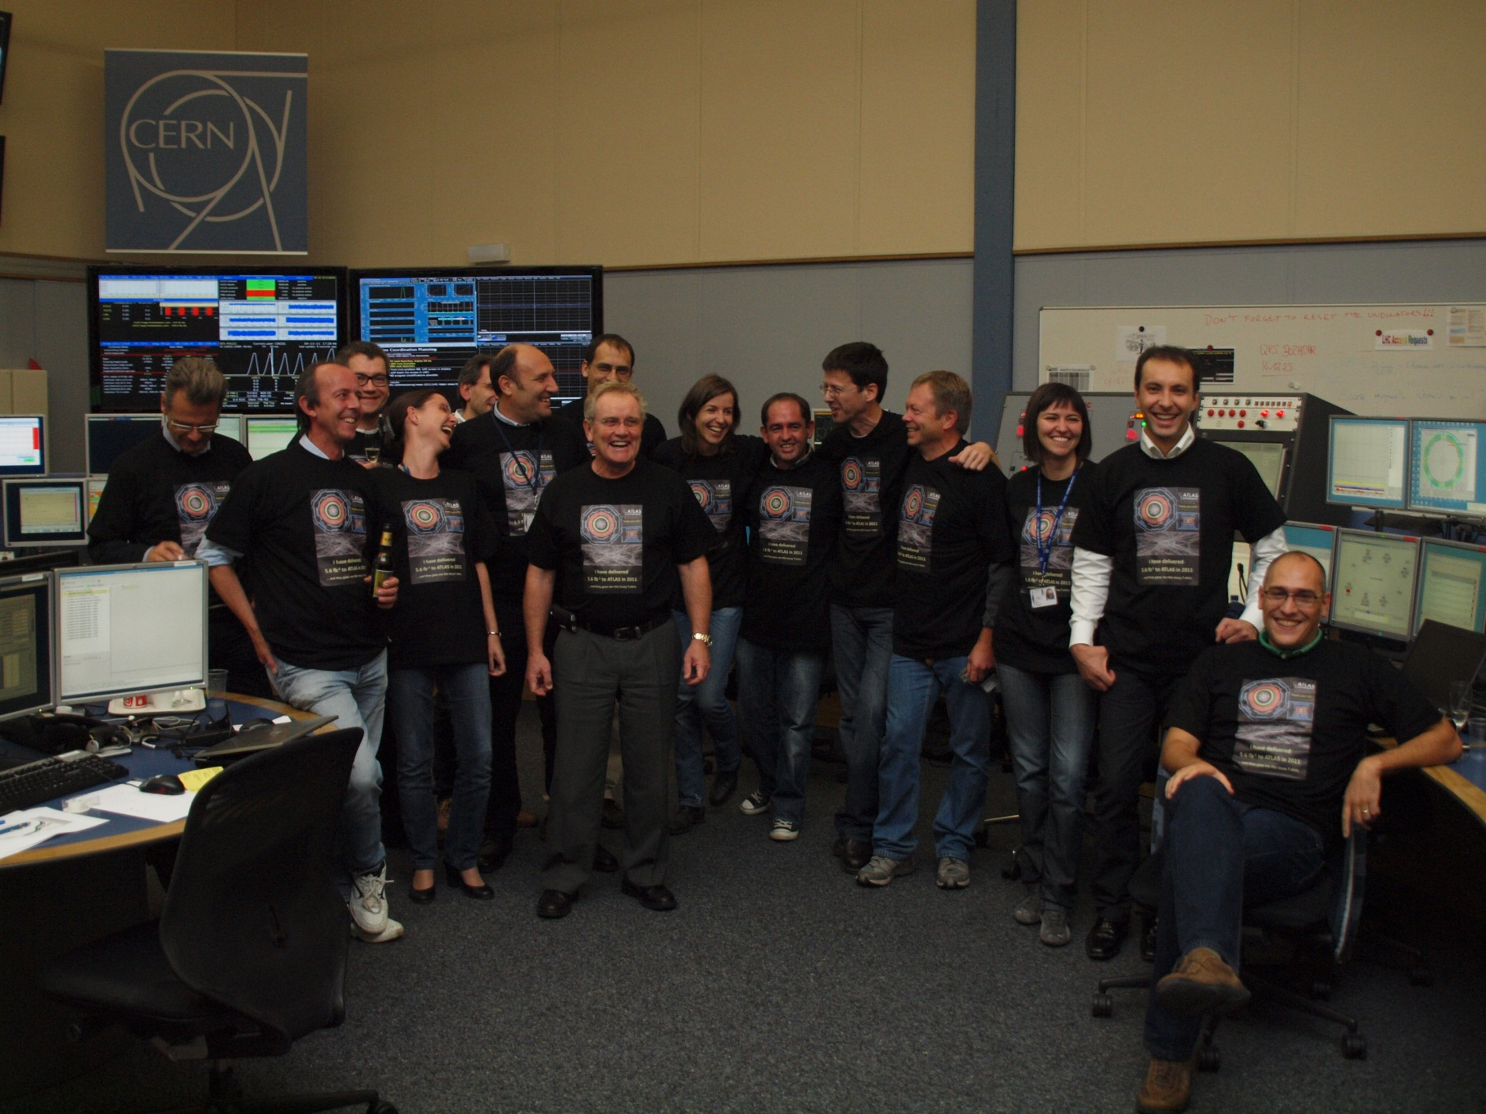
We delivered 5.6 fb⁻¹ to Atlas in 2011 and all we got was a blooming tee shirt

Slide 4
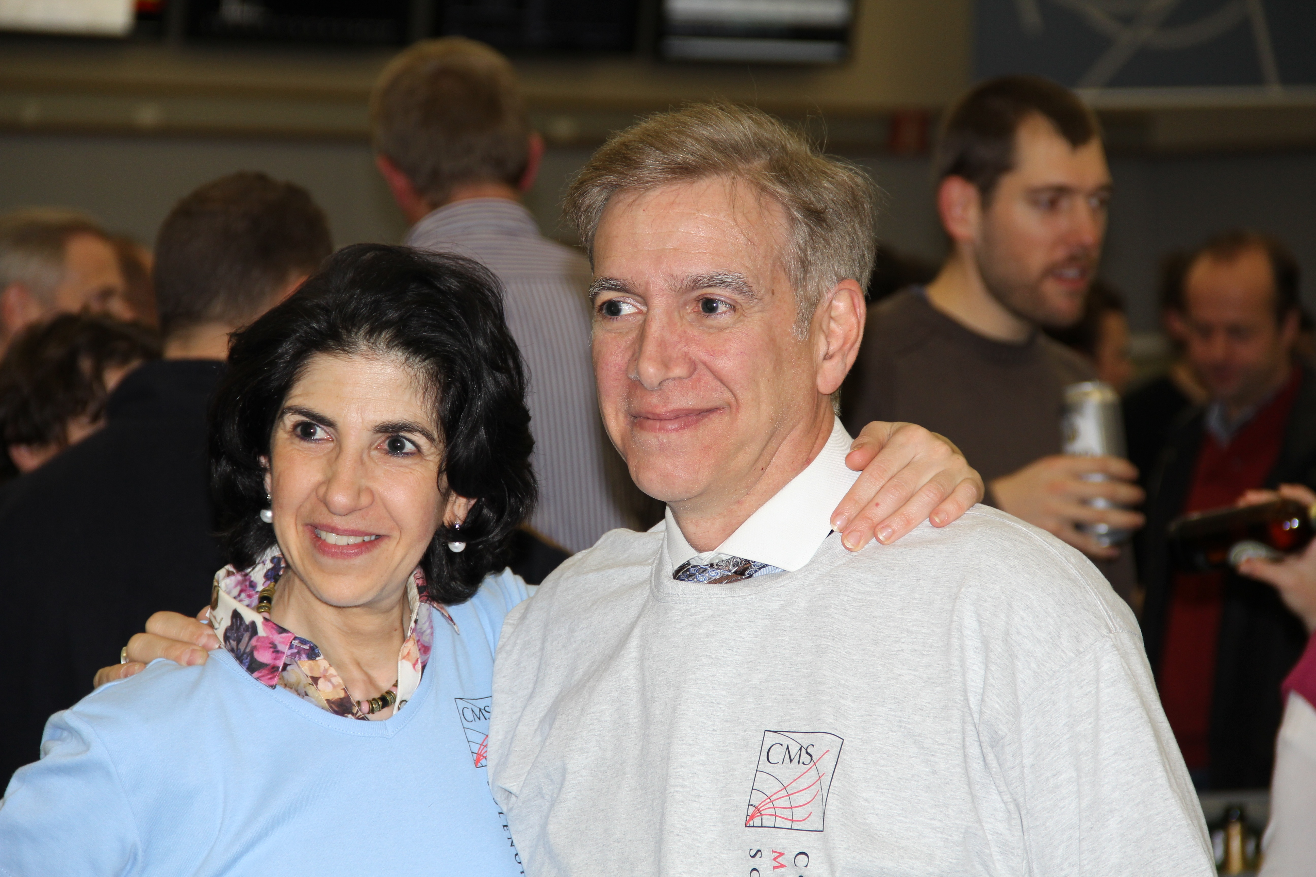
0.5 and 0.25 million dollar babies

Slide 6
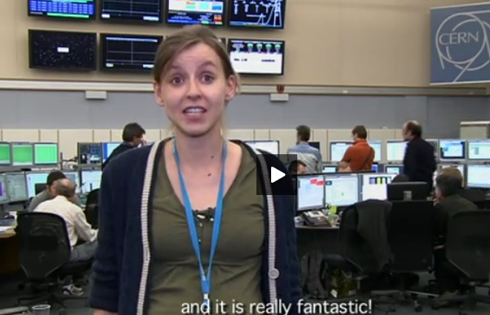

Slide 7
OP - what we want?
End 2012
Analysis of systems issues from an OP perspective
Reliable tune measurement, feedback to stay on
Orbit feedback to stay on through the cycle ( 21 dumps assigned in 2012)
Release management and testing
Better information flow
Interlocked BPMS…
Beam size: operational applications in CCC
Improved instability observation tools
Reduced time steering lines…
Ease the wrestling match with the injection kickers
RF: interlock diagnostics; phase acquisition per batch; faster BQM; phase/amplitude noise for each klystron…
ADT settings management – less dependency on experts
Control System and data management – 3 pages of requirements
Delphine Jacquet

Slide 8
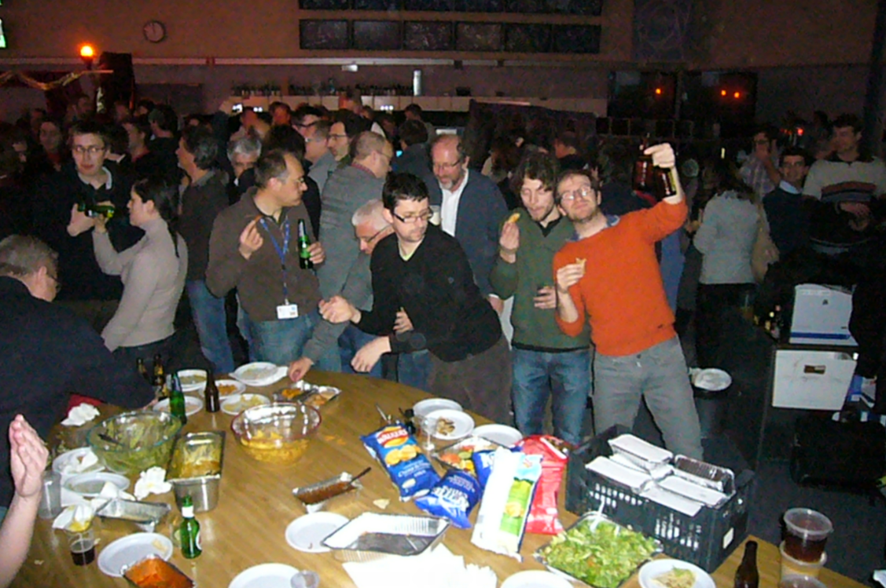
2012

Slide 9
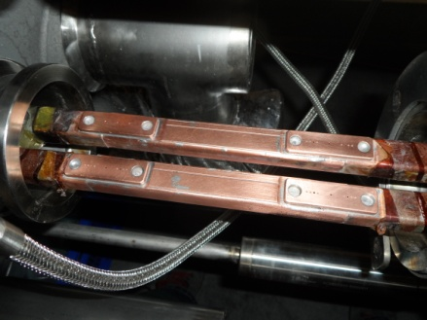
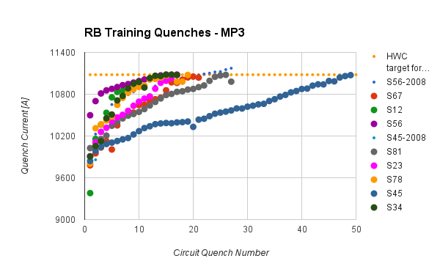
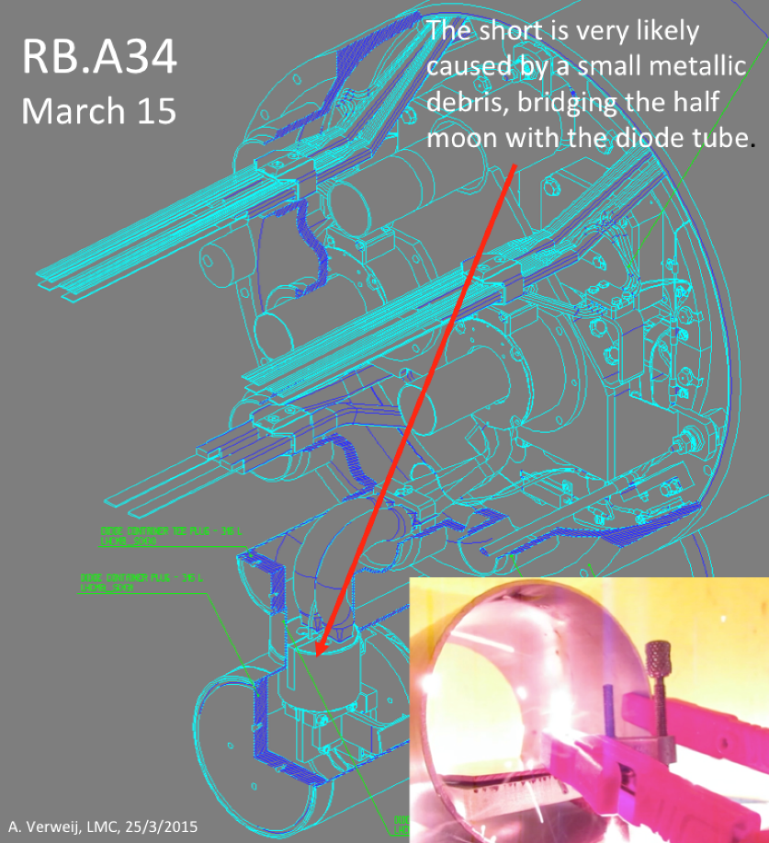
Coming out of LS1
Copper Stabilizer Continuity Measurements (CSCM) using modified Quench Protection System (mQPS)
Dipole training
Earth fault

Slide 10
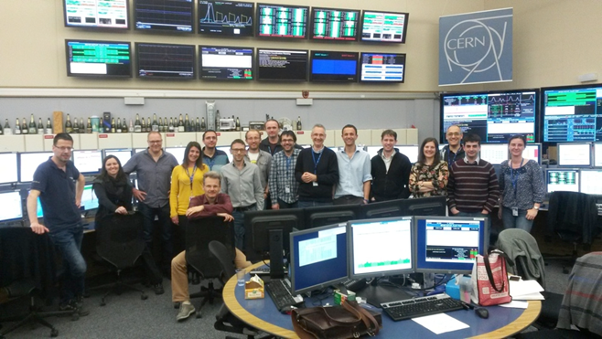
First beam at 6.5 TeV - 1 o’clock in the morning

Slide 11
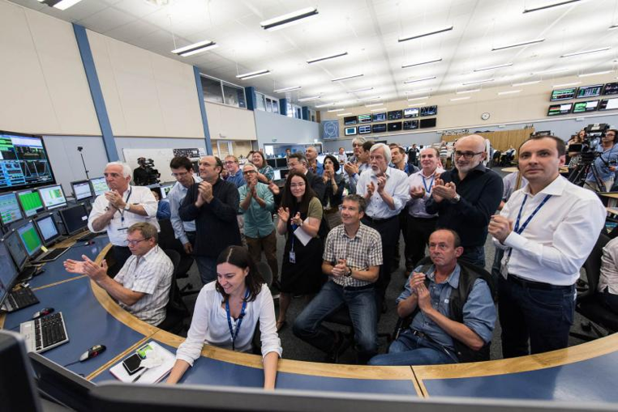
First Stable Beams – office hours

Slide 12
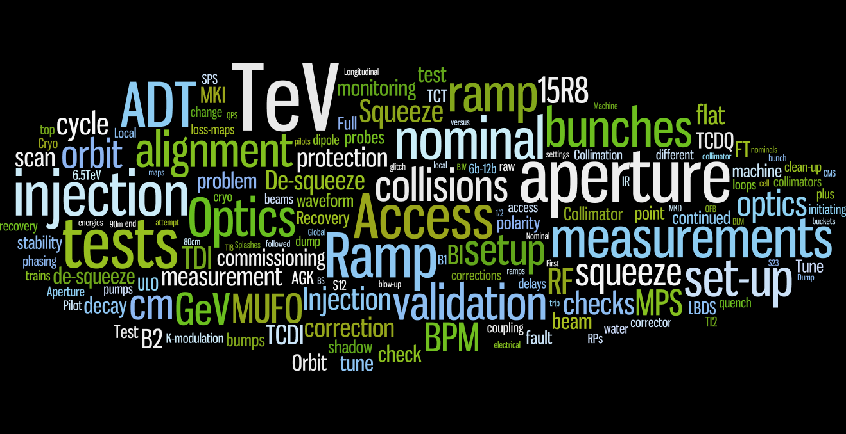
Beam commissioning
59 days - 177 shifts
9 weekends
4 public holidays
133 loss-maps

Slide 13
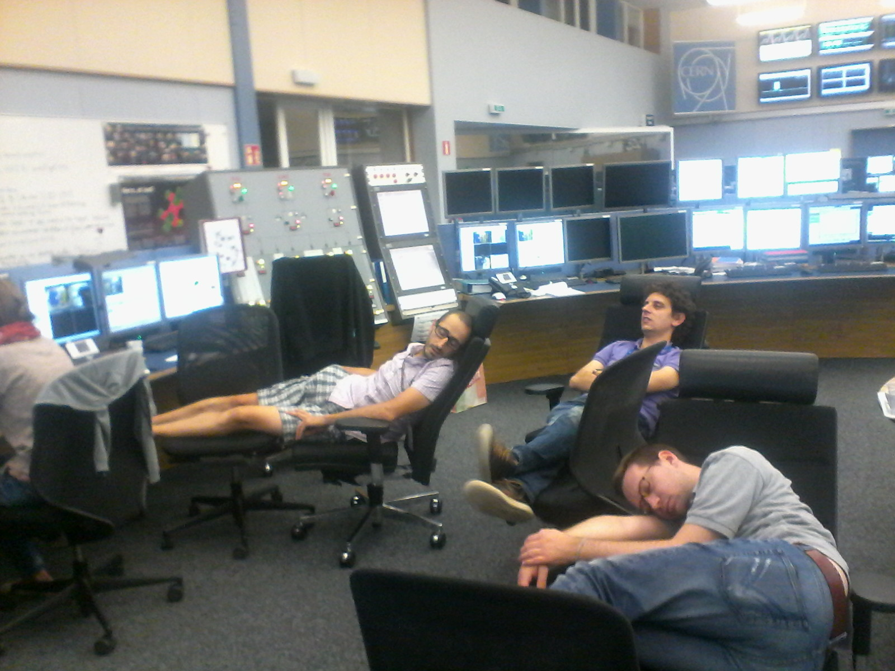
Unidentified lying objects

Slide 14
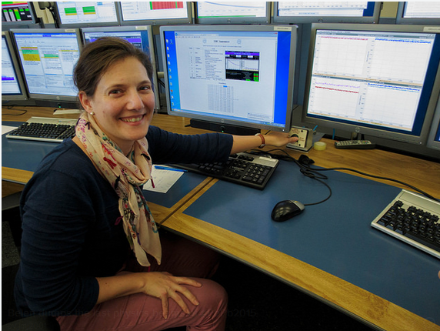
Ion curtains
Belen dumps the last physics beam of #PbPb2015

Slide 16
Experiment perspective

Slide 17
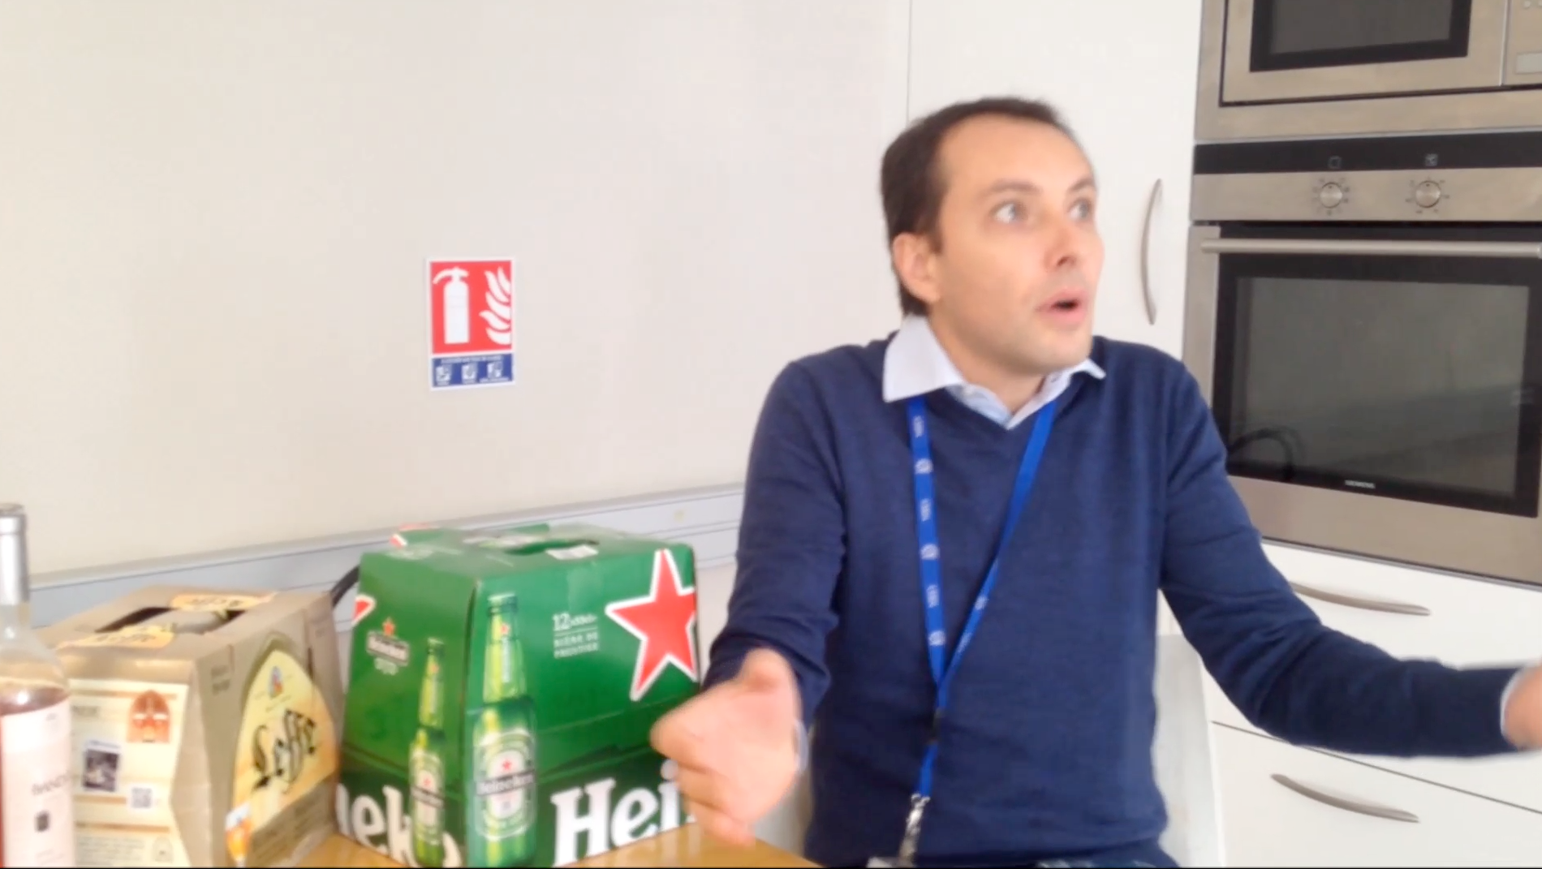
Machine perspective

Slide 18
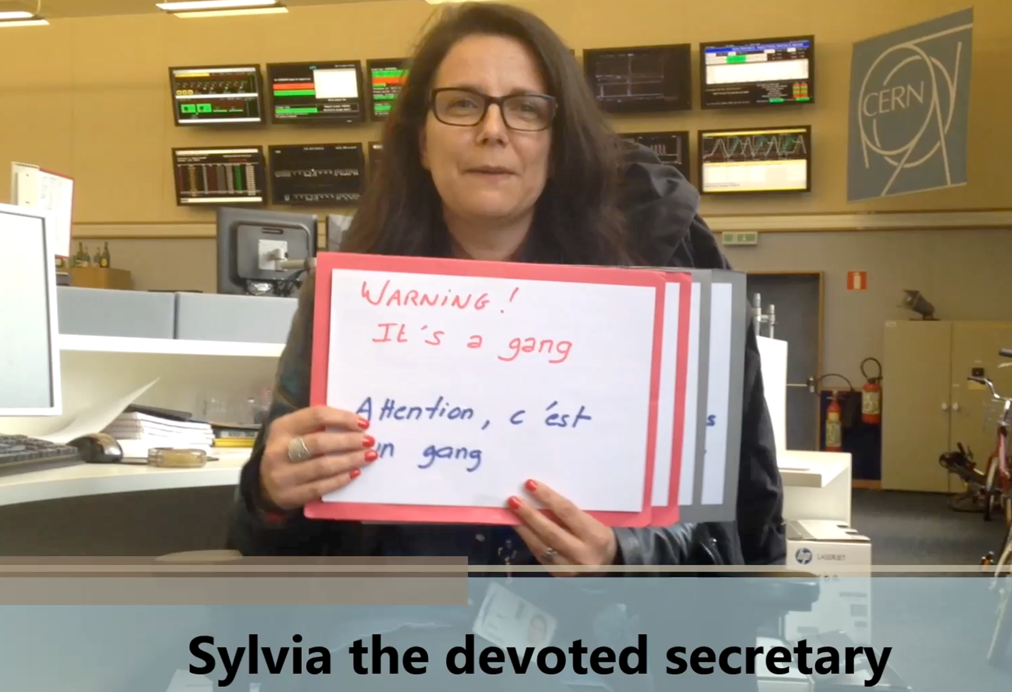
Operations group perspective

Slide 19


Slide 20


Slide 21
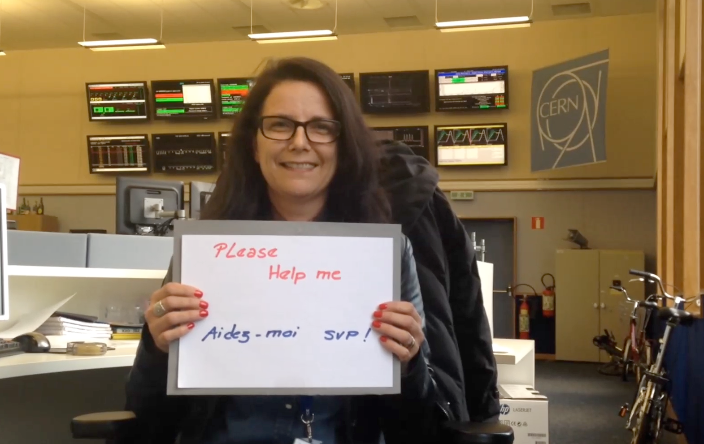

Slide 22
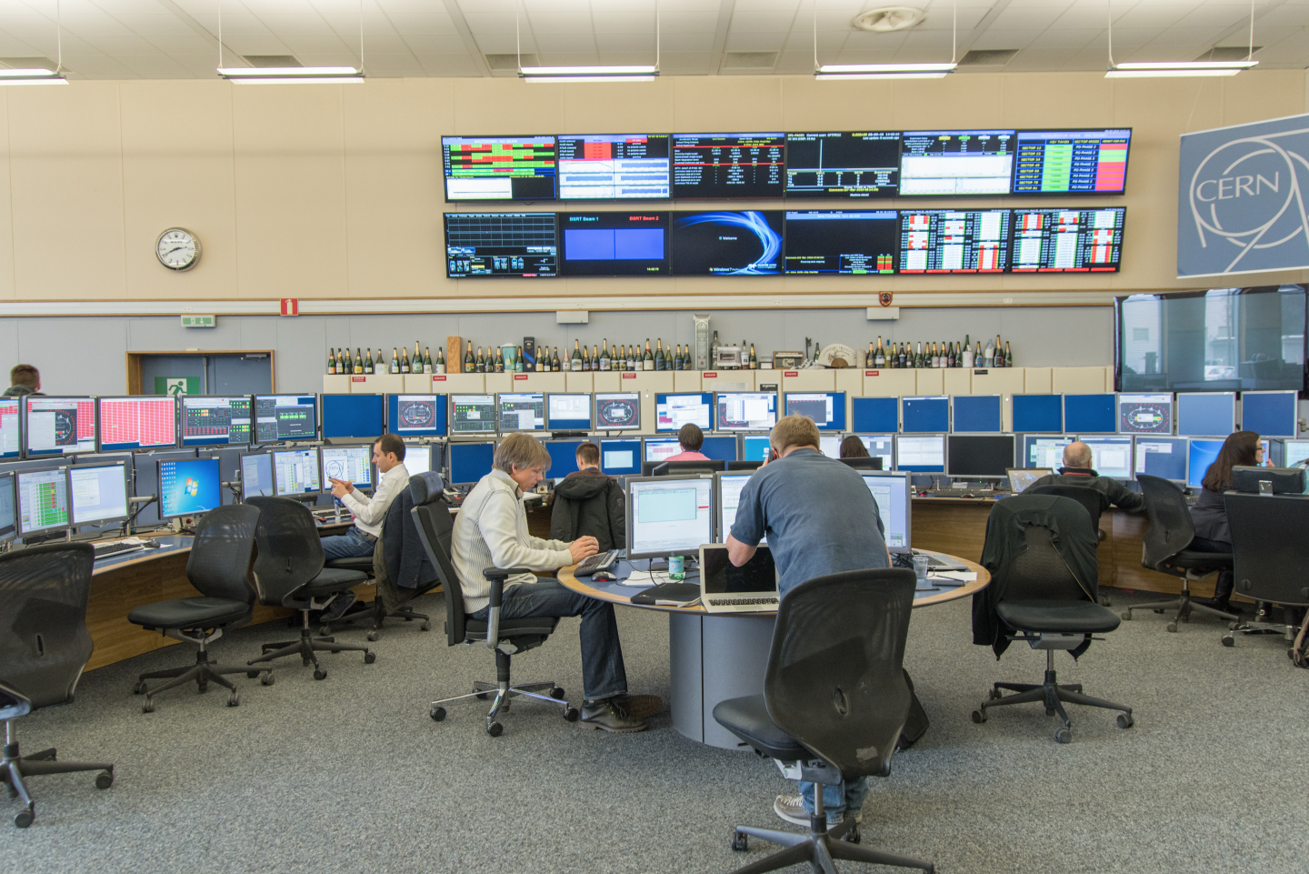
2016
A very calm hardware commissioning

Slide 23
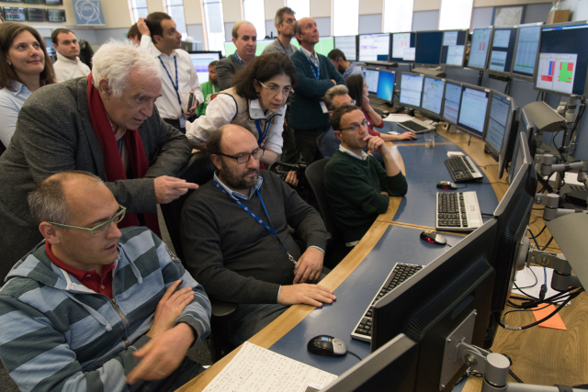
Usual high level of interest for first circulating beams

Slide 24

2 shifts required for commissioning of nonlinear optics

Slide 25
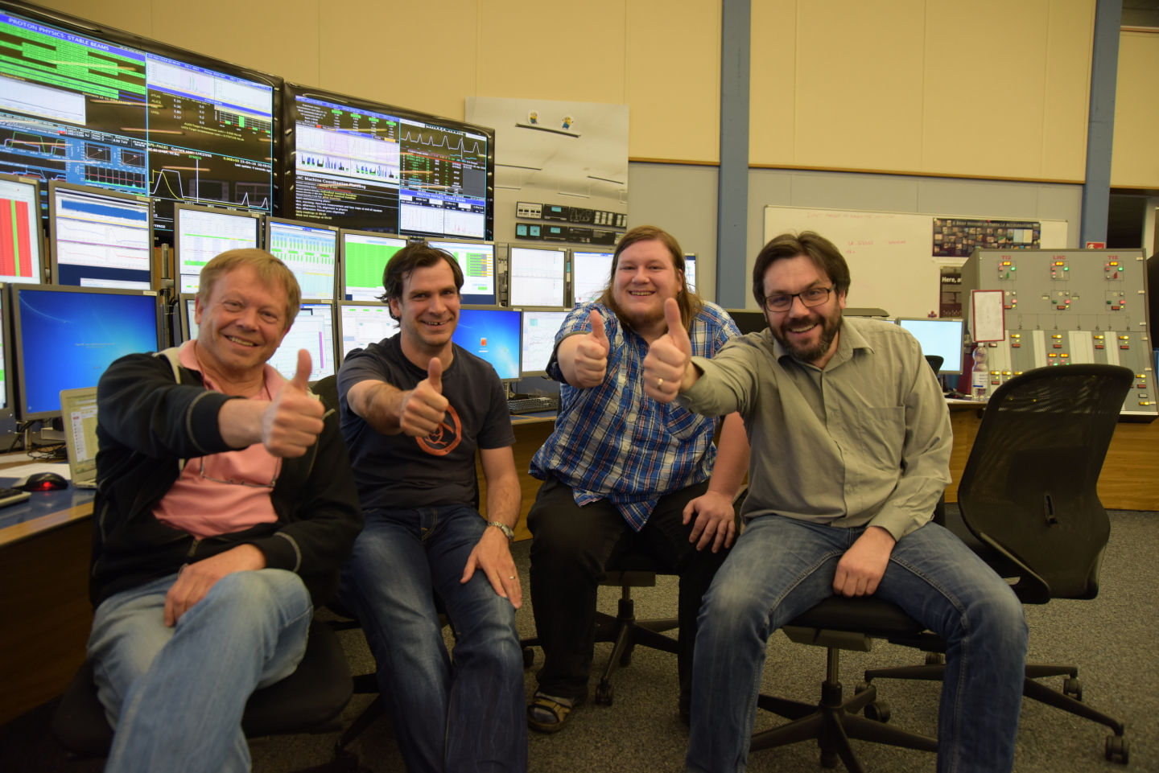
First stable beams 2016 – four hitch hikers

Slide 26
System performance is excellent
Cryo maintain: 98.6%
QPS: MTBF per element : ~4Mh
Average availability for proton run: 99.49%
Evian 2016

Slide 27
System performance is excellent
MKI 1.2 million pulses since 2014 – 3 erratics
Evian 2016

Slide 28
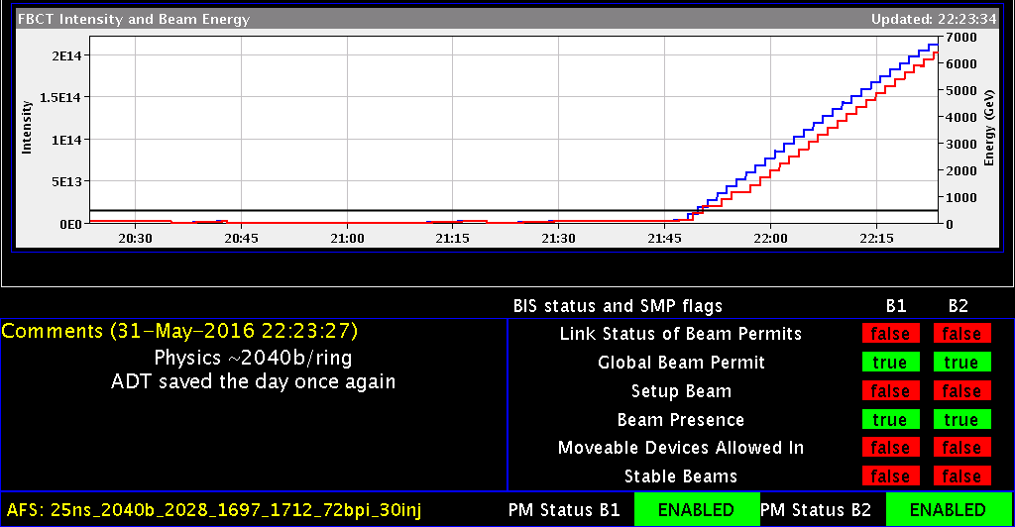

System performance is excellent

Slide 29
It is a safe machine
No asynchronous beam dumps in 2016
LBDS is a part of Machine Protection:
We do not run in degraded mode (we don’t mask faults / adjust thresholds…)
System returns in ‘As Good As New’ state after every fault / intervention
Even if it takes all night

