Slide 1
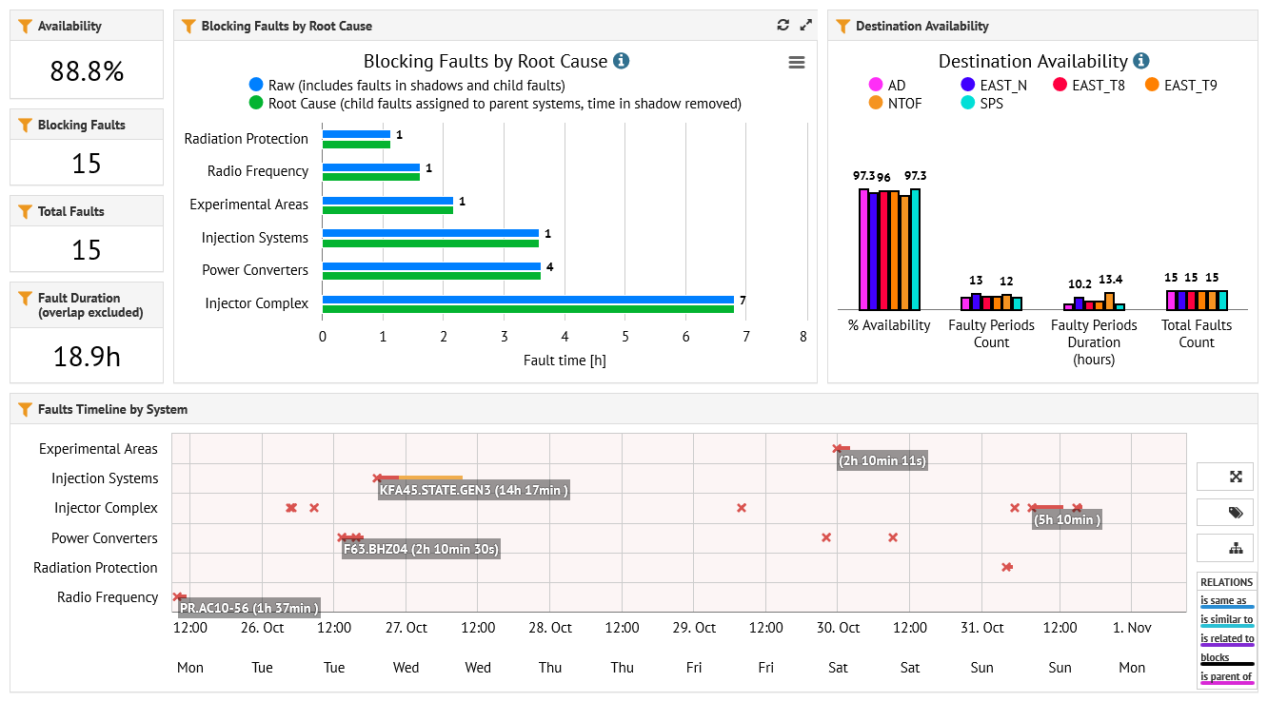
East Area FOM Report – PS AFT
02/11/2021

Slide 2
East Area FOM Report
T8 :
Safety clarifications for the Ion beam permit have taken place. A more thorough study with FLUKA/BDSIM simulations should better clarify the situation in the future. Measurement campaign to connect F61-T8 is being organized in YETS by BE-OP
T9:
LDMX detectors were delayed and they were not able to take the intended beam with the full setup. However, they took data with their trigger system and performed all debugging necessary. They aim to take beam early next year with their full setup.
HERD started their run from Monday, November 1st.
The XCETs are operational now and will be used by HERD the coming week. The operational pressure is limited to 3.5 bars for both XCETs.
T10 :
We found a problem with the BHZ01 power supply in the beginning of the week. This was not visible in the control software and let probably to have a factor 0.77 less beam momentum than originally set. We were lucky that the users were not sensitive to the momentum.
02/11/2021
Courtesy : D. Banerjees, J. Bernhard, N. Charitonidis, B. Rae

Slide 3
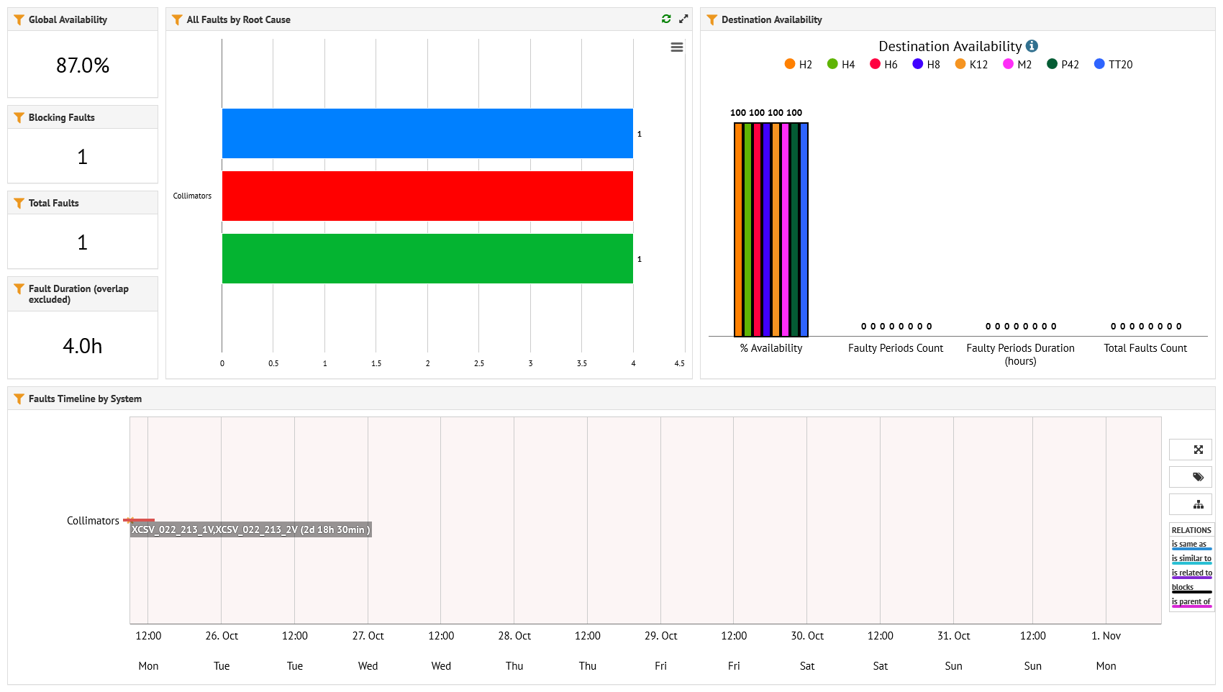
North Area FOM Report

Slide 4
North Area FOM Report
H2 :
NA61 run smoothly, their momentum scan allowed very good beam configurations for HERD & this week for LHCB-cal.
H4 :
Last week we had XCSV.022.213 collimator stuck in-beam. The problem was not clear for the BE-CEM piquet that intervened on Friday night, resulted to degraded beam for RD51 / GIF++ during the weekend. Intervention on Monday resolved the issue. GIF++ pre-dump installed yesterday and accompanied by RP measurements, first results very promising a) decoupling operation from PPE134 b) using a proper dump as a muon dump and not a collimator and c) better rate & spectrum of muons for GIF++.
T4 target:
As the NA62 beam dump run ended the intensity on T4 was reduced on Friday to 80 units as well as the target was changed back to 100 mm.
H6:
Operation is ongoing with the users taking 120 GeV hadron beam with alternating high intensity and low intensity runs.
H6 has been retuned after the target change to have the same conditions.
H8:
Operation continues as in the previous week, with parallel user being TOTEM instead of CMS MTD.
The beam has been retuned after the target change to not trigger the radiation alarms.
M2:
AMBER finished their run on Wednesday. They got the hydrogen gas clearance last Friday and ran in that configuration for the remainder of their beam time.
NA64µ is currently installing in the CEDAR region and MUonE is already installed downstream of COMPASS near the dump region to take parasitic data.
The safety clearance of NA64µ and of MUonE has taken place on Monday
P42/K12
The experiment moved today back from the beam dump mode to standard data taking. The intensity on the targets was adjusted and NA62 will keep taking data until the end of the run. We profited from the beam dump mode to also have NA62 colleagues take some measurements for the muons outside of the beam for benchmarking our simulations.
02/11/2021
Courtesy : D. Banerjees, J. Bernhard, N. Charitonidis, B. Rae

